Slide 1
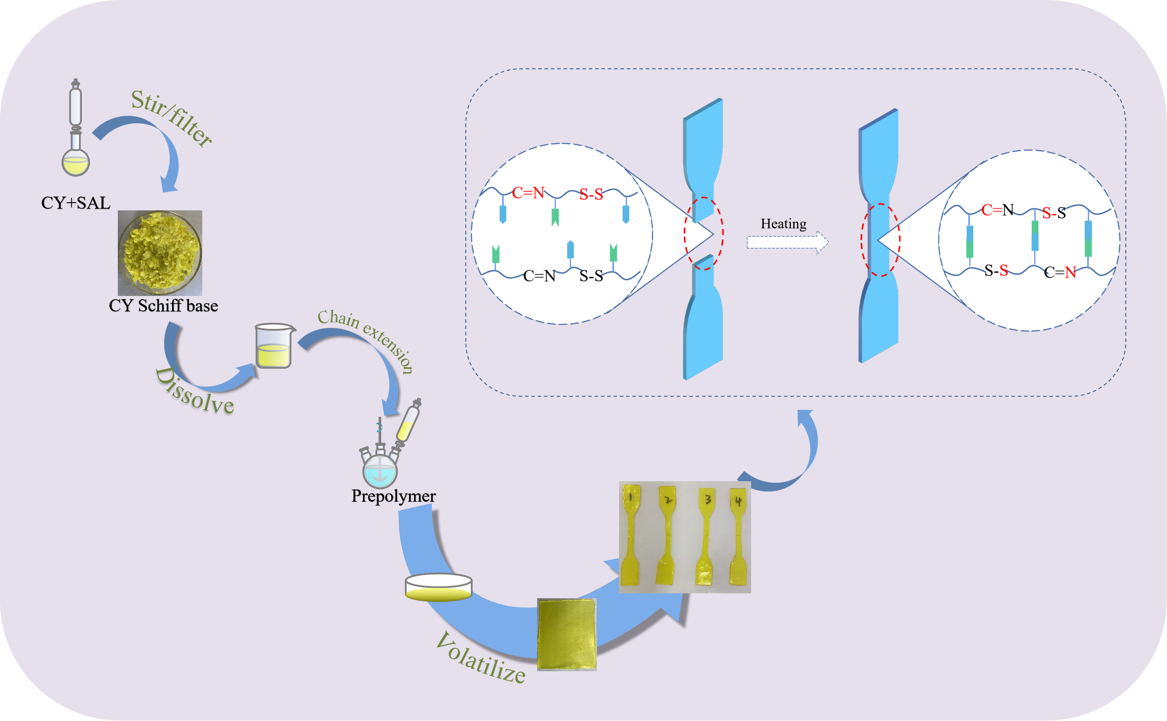

Slide 2
(a) Reaction flow chart of CDE

Slide 3
(b) Reaction flow chart of EDA Schiff base

Slide 4
(c) Reaction flow chart of CY Schiff base

Slide 5
Scheme 2. Flow chart of polyurethane synthesis

Slide 6
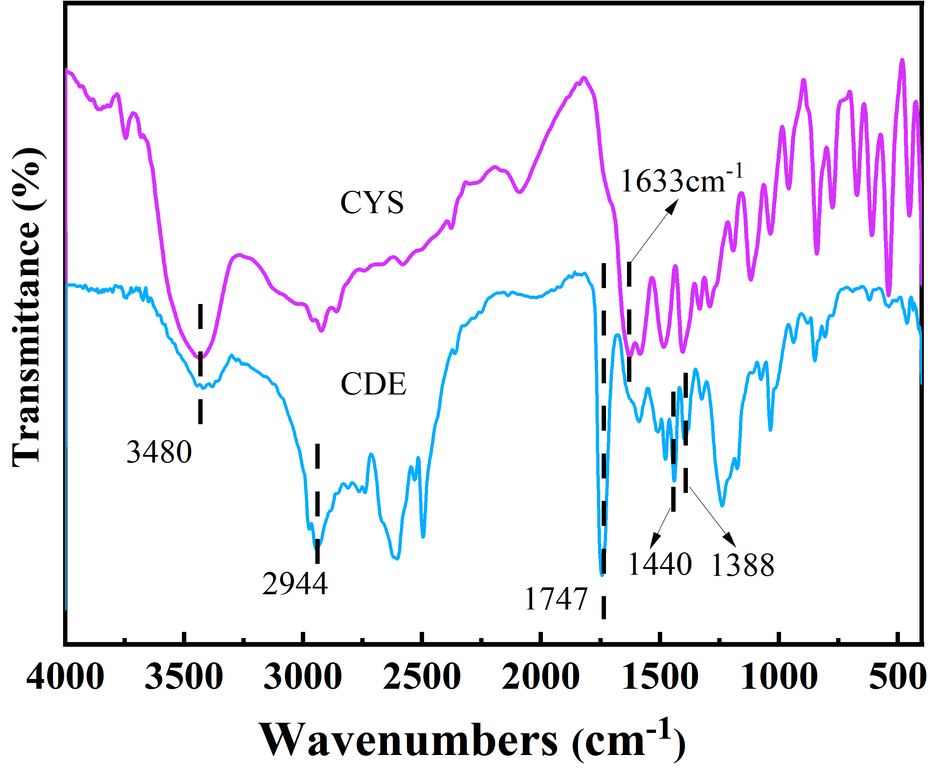
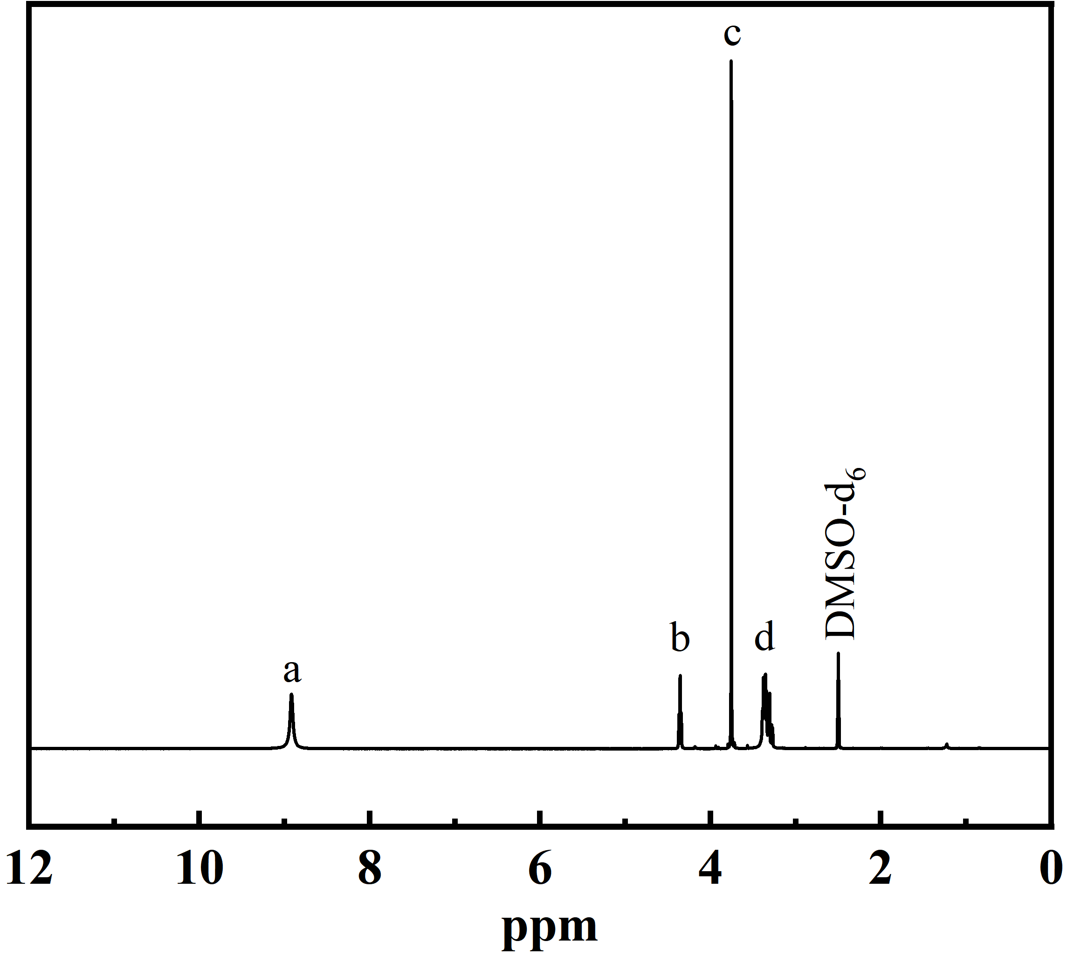
(a)
(b)
Fig.1.(a) FTIR of CYS and CDE, (b) 1H-NMR spectra of CDE

Slide 7
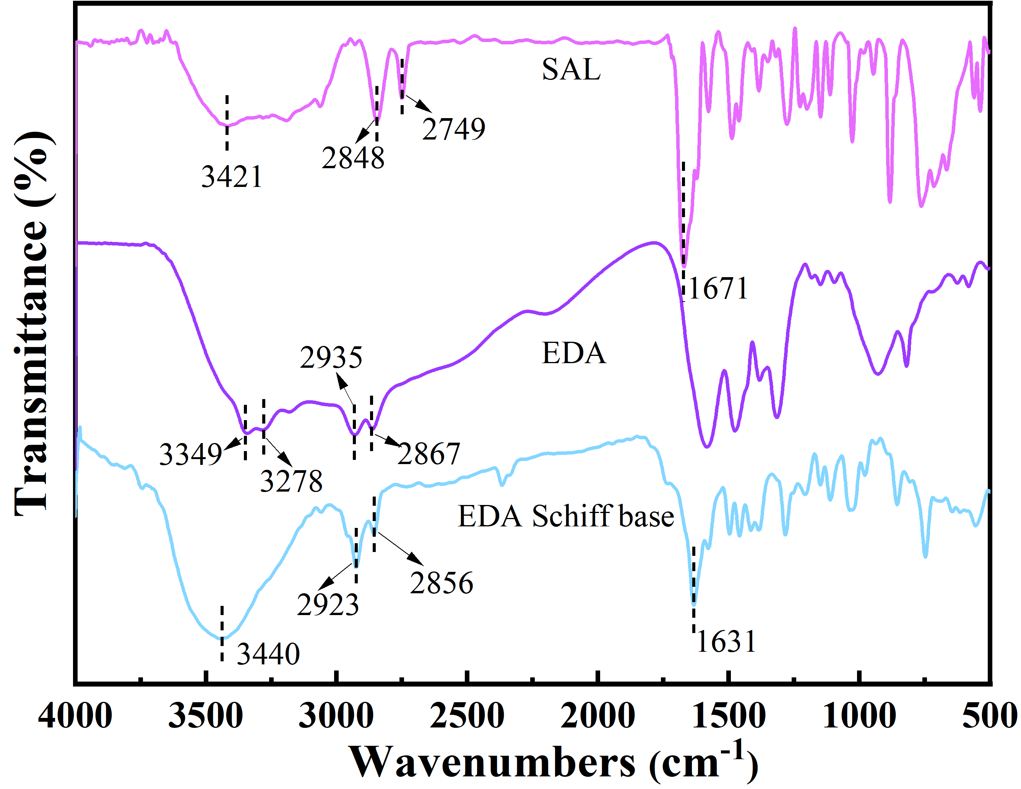
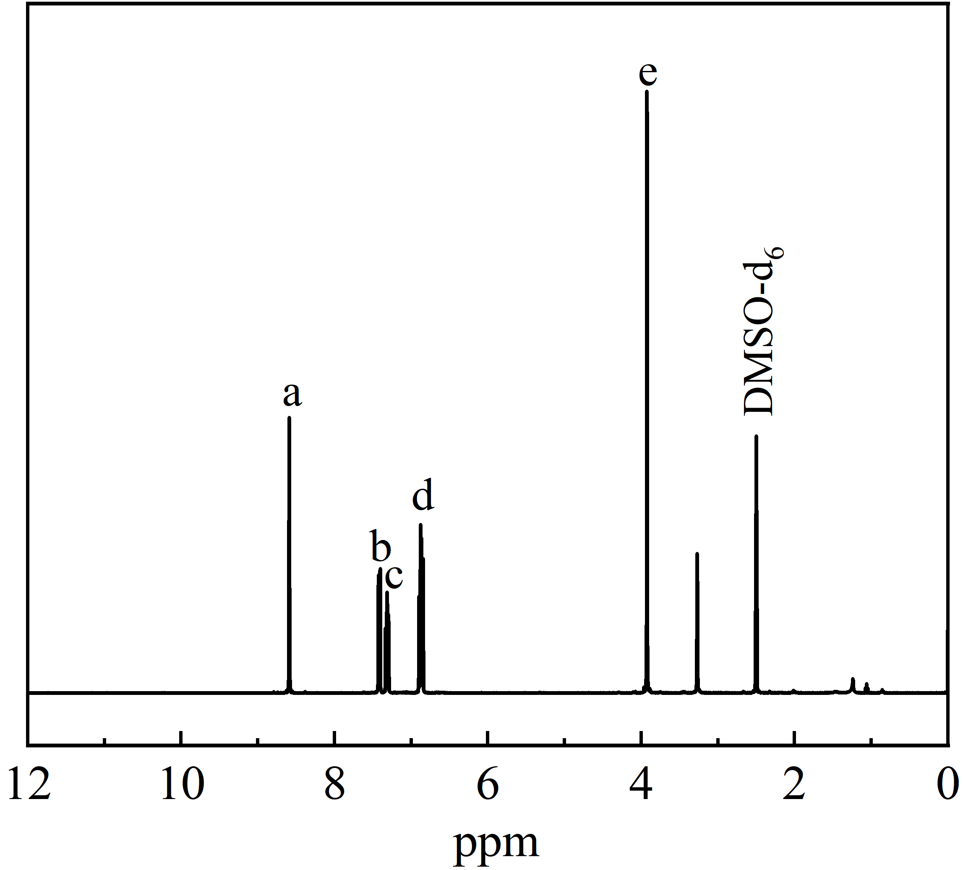
(a)
(b)
Figure 2.(a) FTIR of SAL、EDA and EDA Schiff base, (b) 1H-NMR spectra of EDA Schiff base

Slide 8
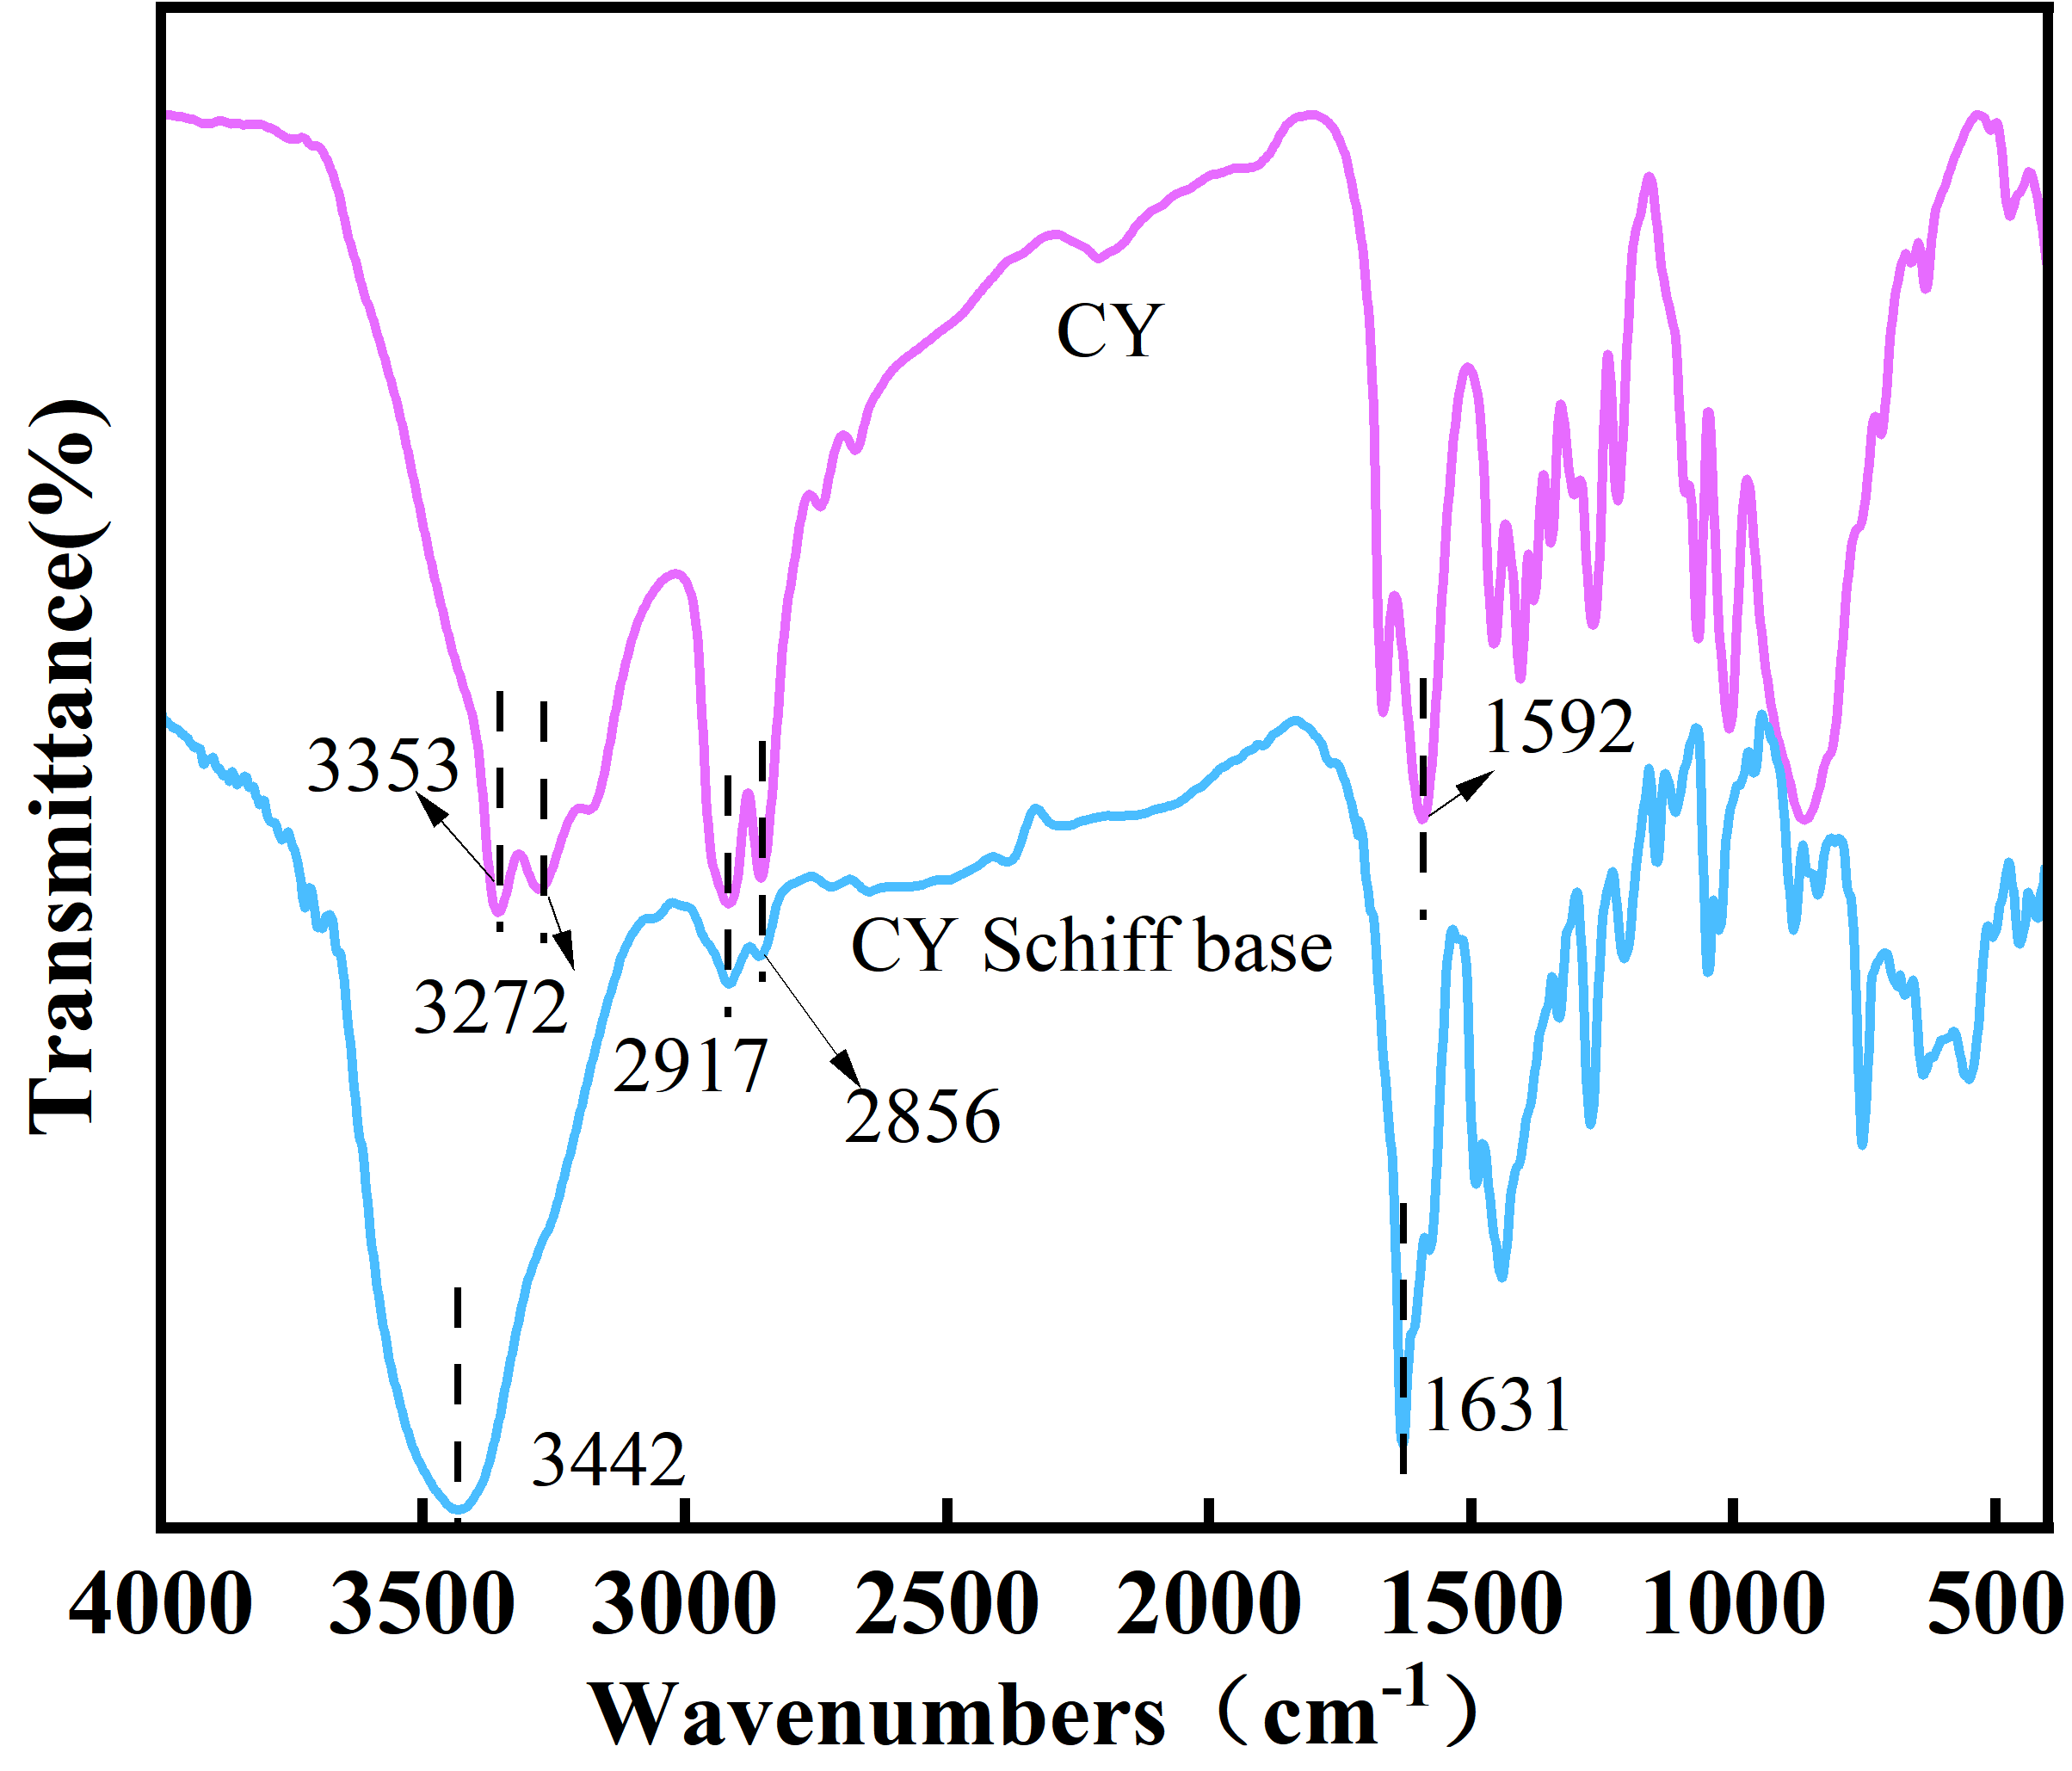
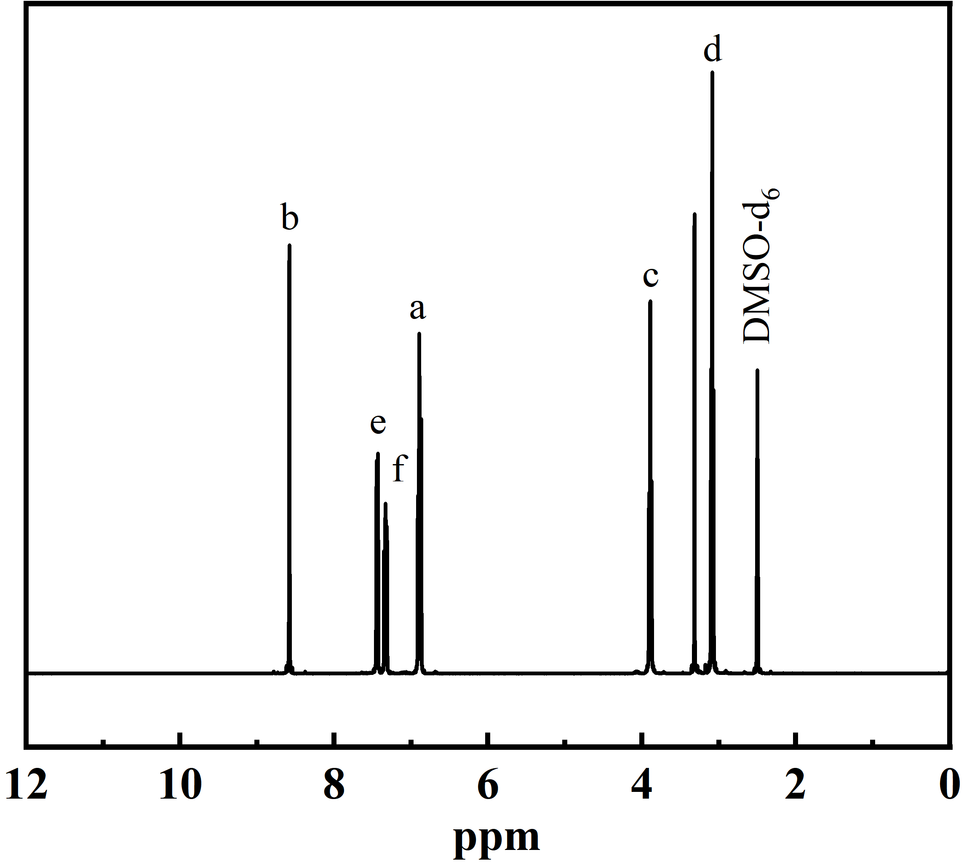
Figure 3.(a) FTIR of CY and CY Schiff base, (b) 1H-NMR spectra of CY Schiff base
(a)
(b)

Slide 9
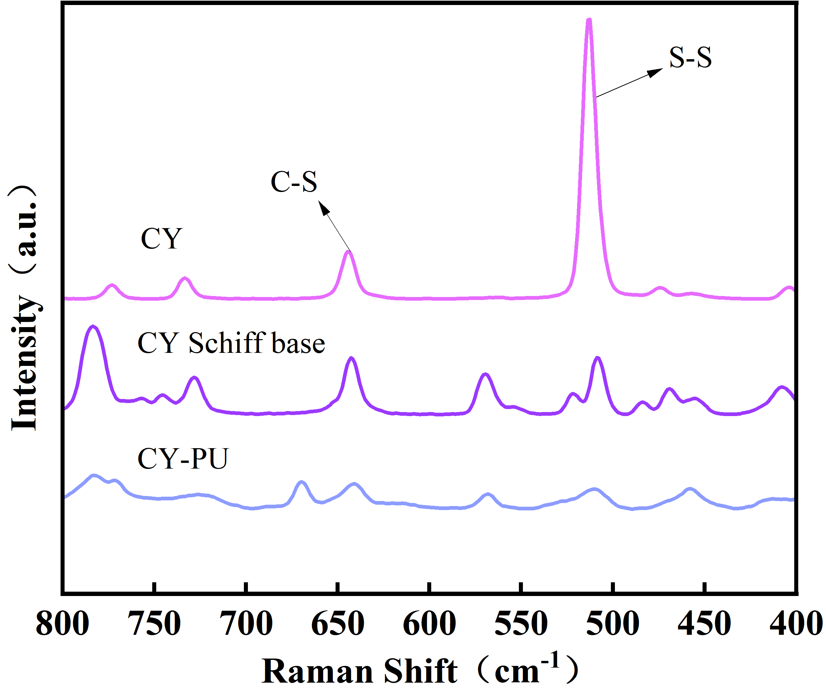
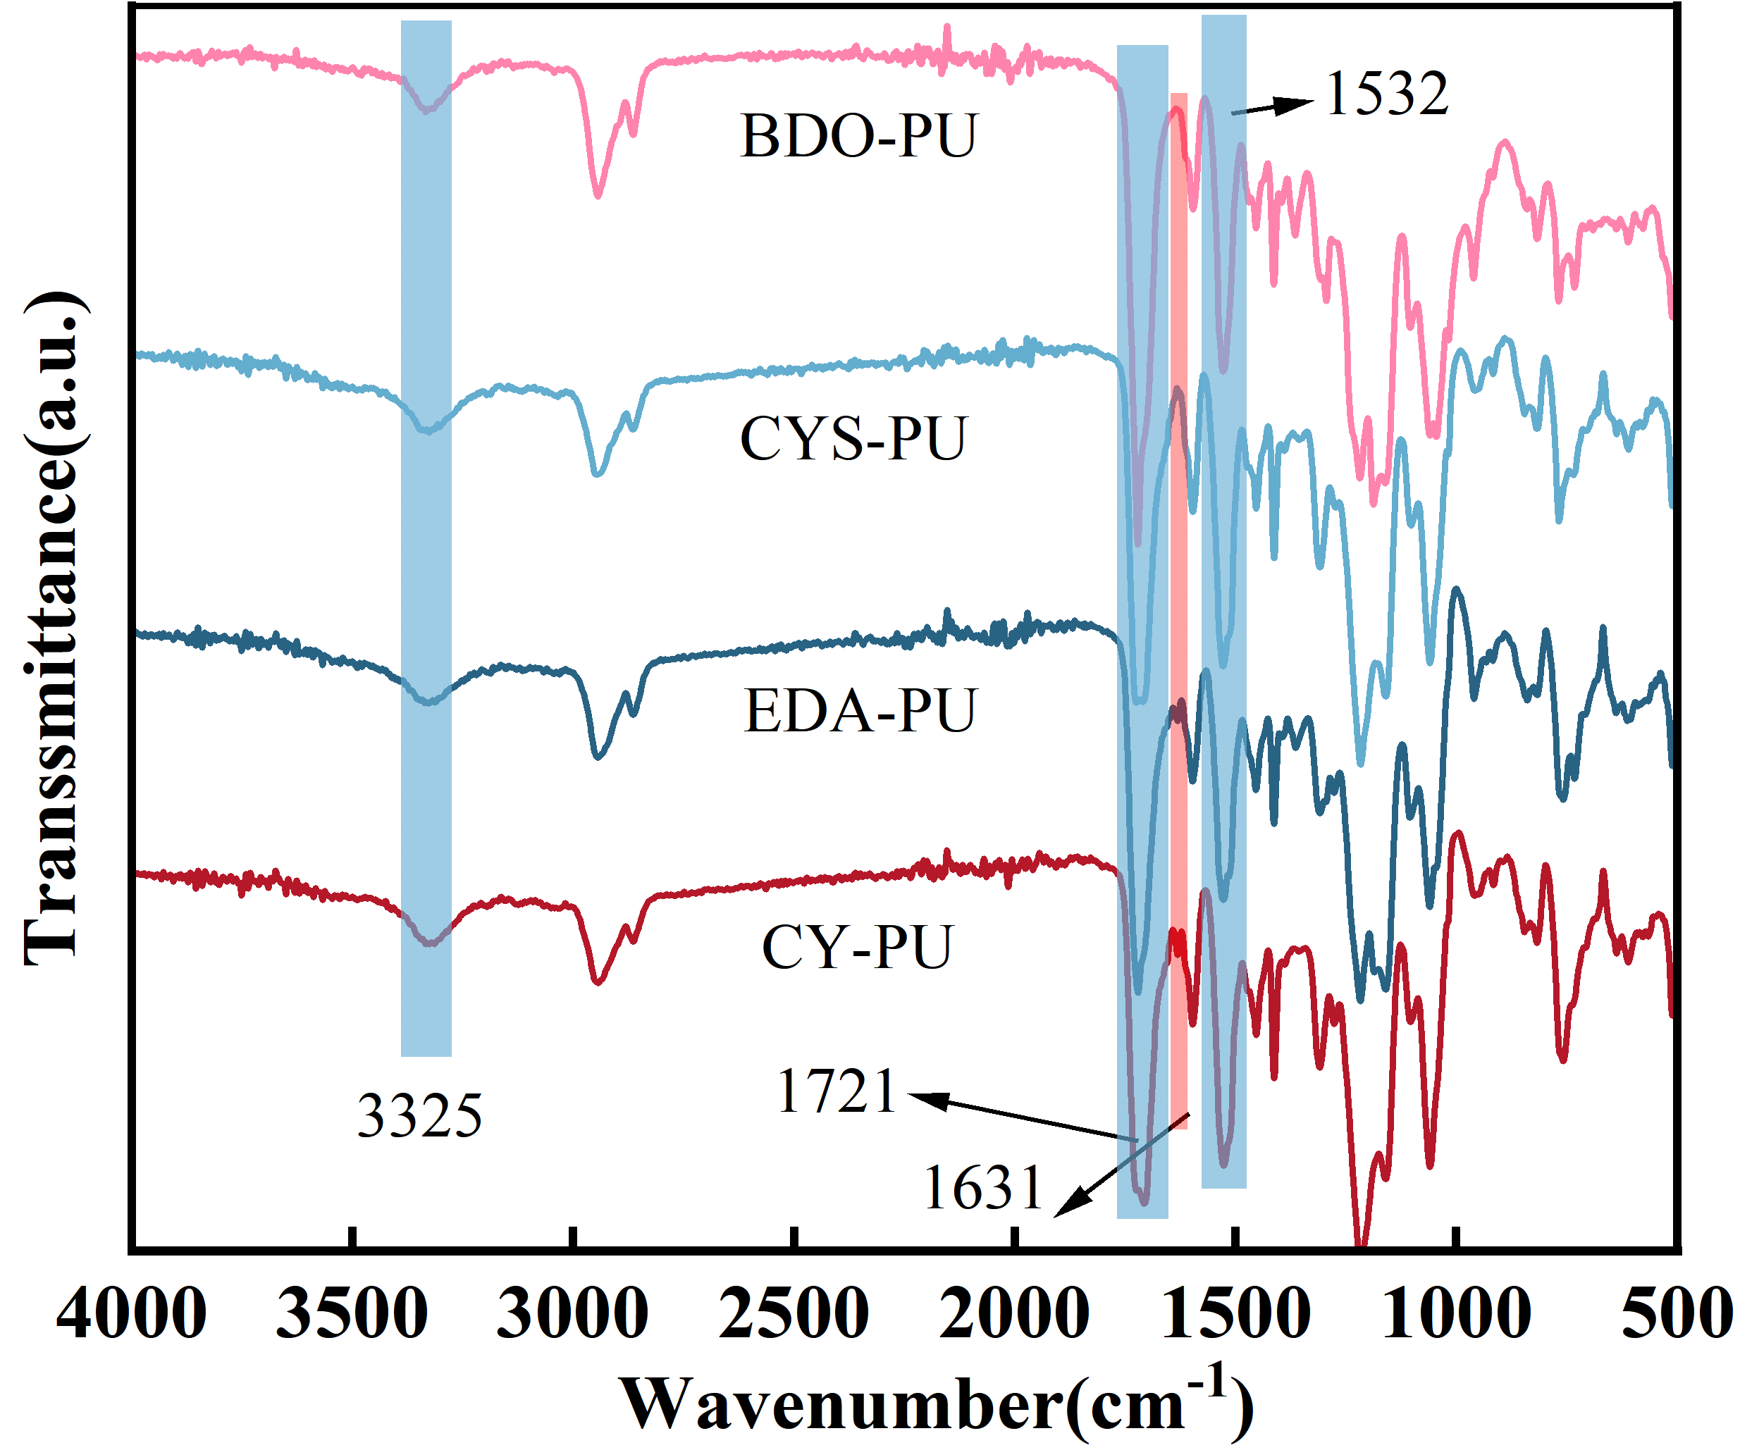
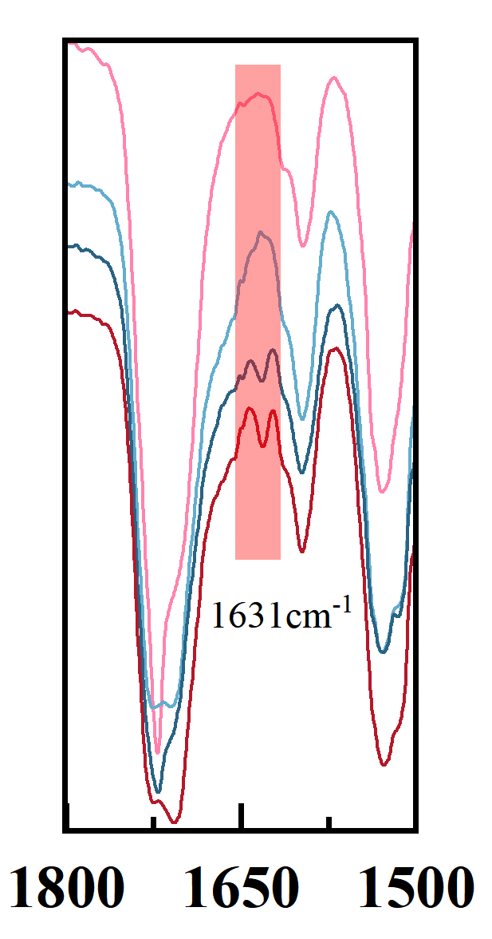
(a)
(b)
Figure 4.(a) Raman spectra of CY, CY Schiff and CY-PU, (b) Total reflection infrared spectra of four polyurethanes BDO-PU, CYS-PU, EDA-PU and CY-PU, as well as a magnified image at the 1500 cm⁻¹-1800 cm⁻¹

Slide 10
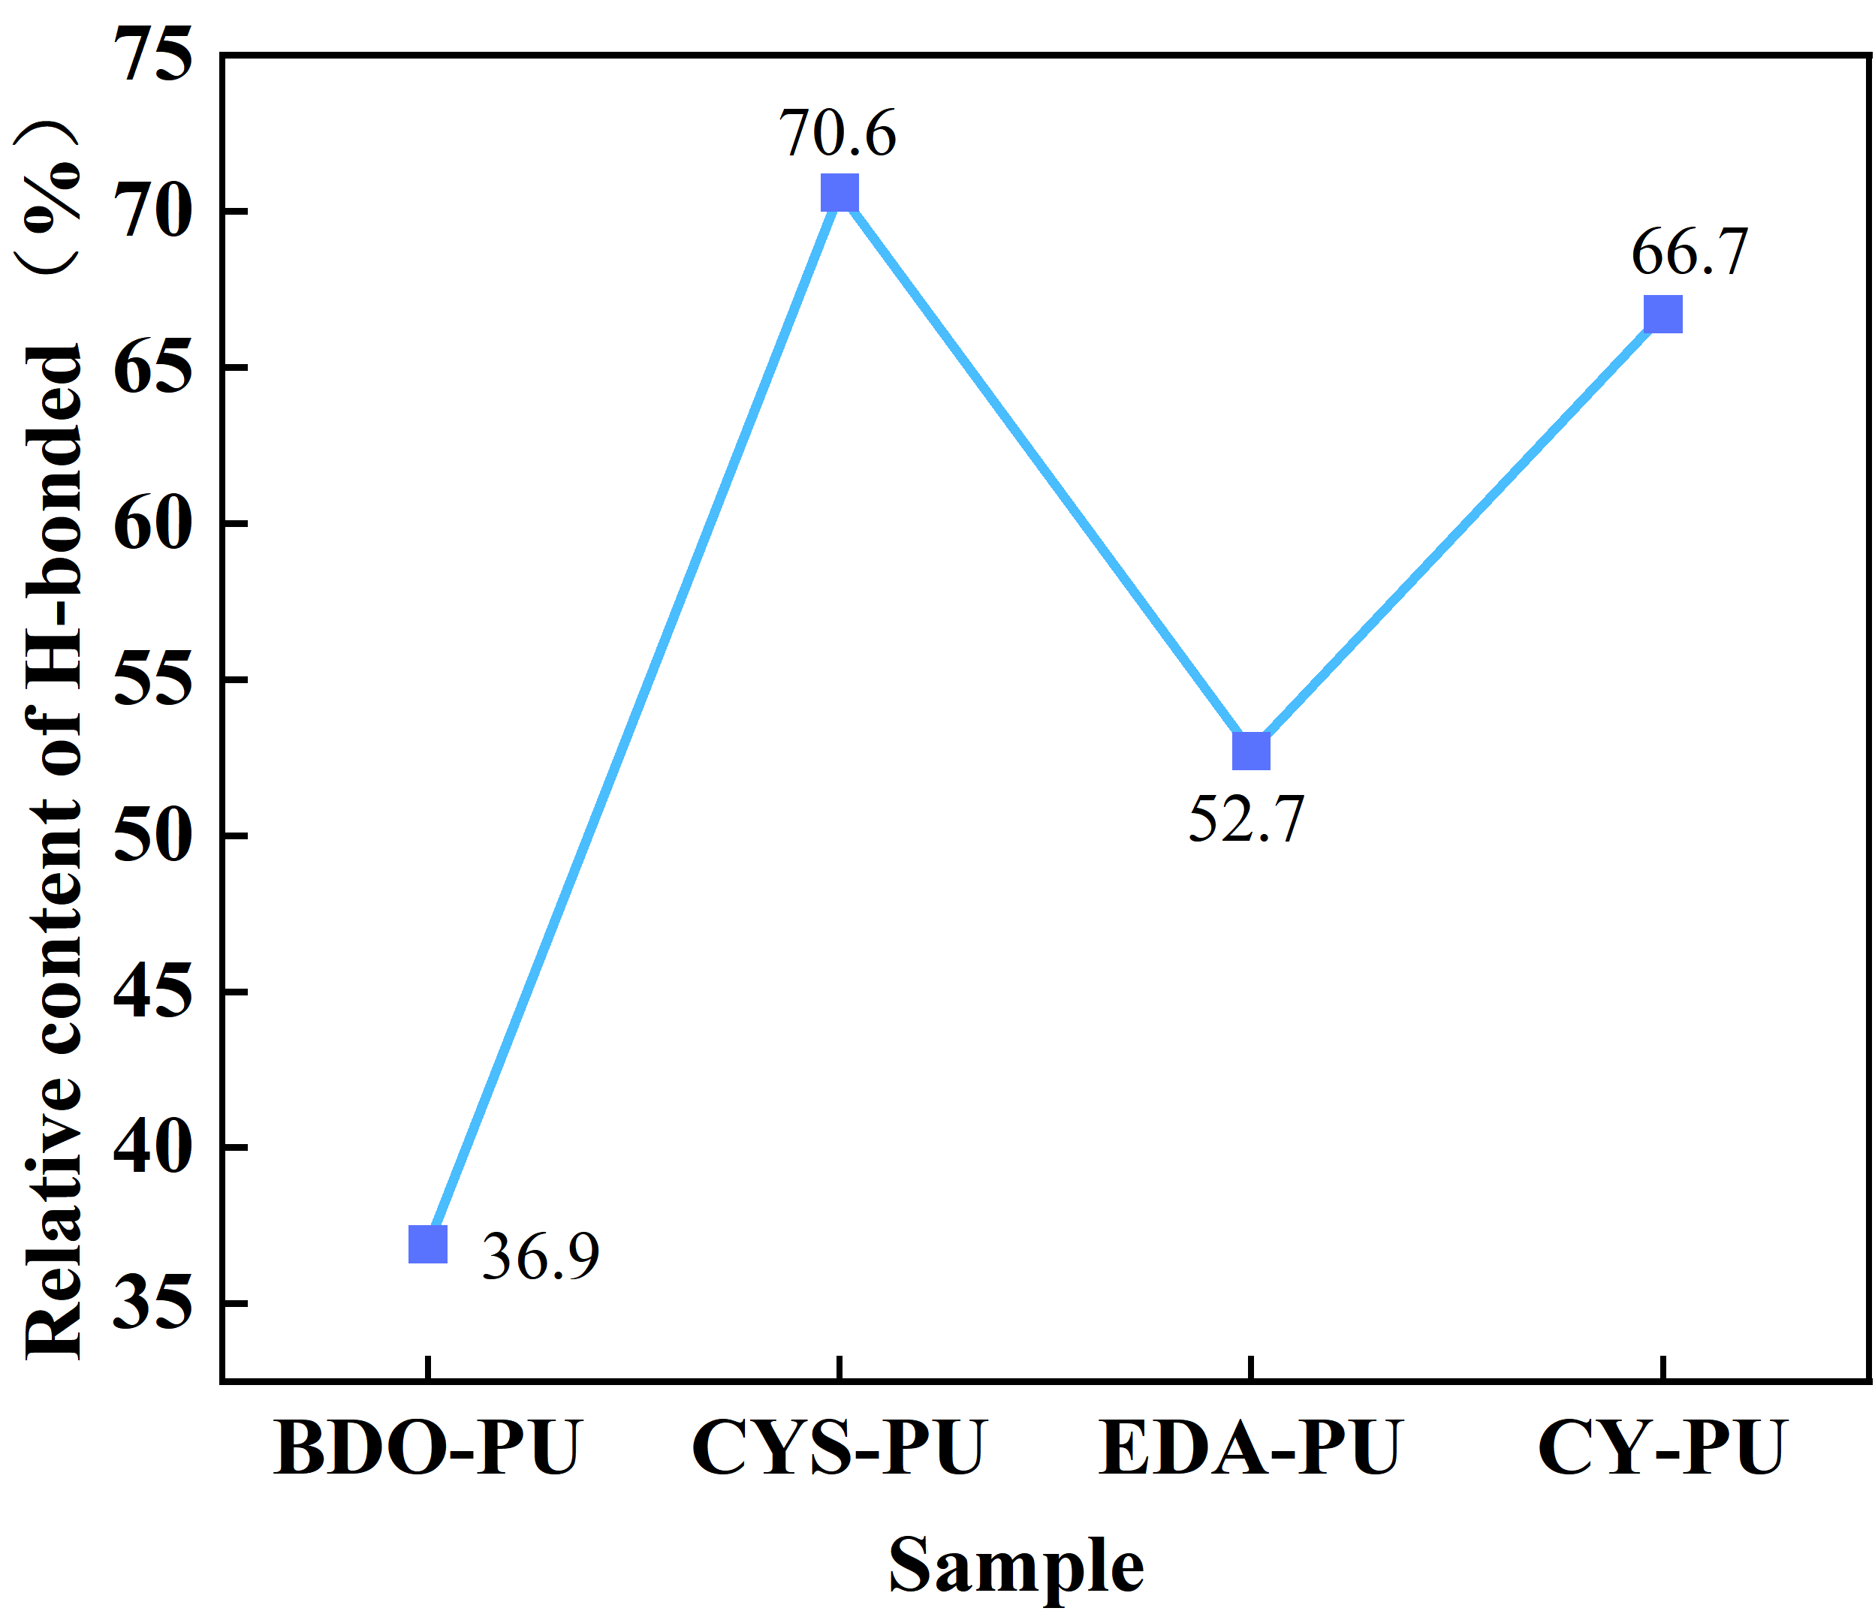
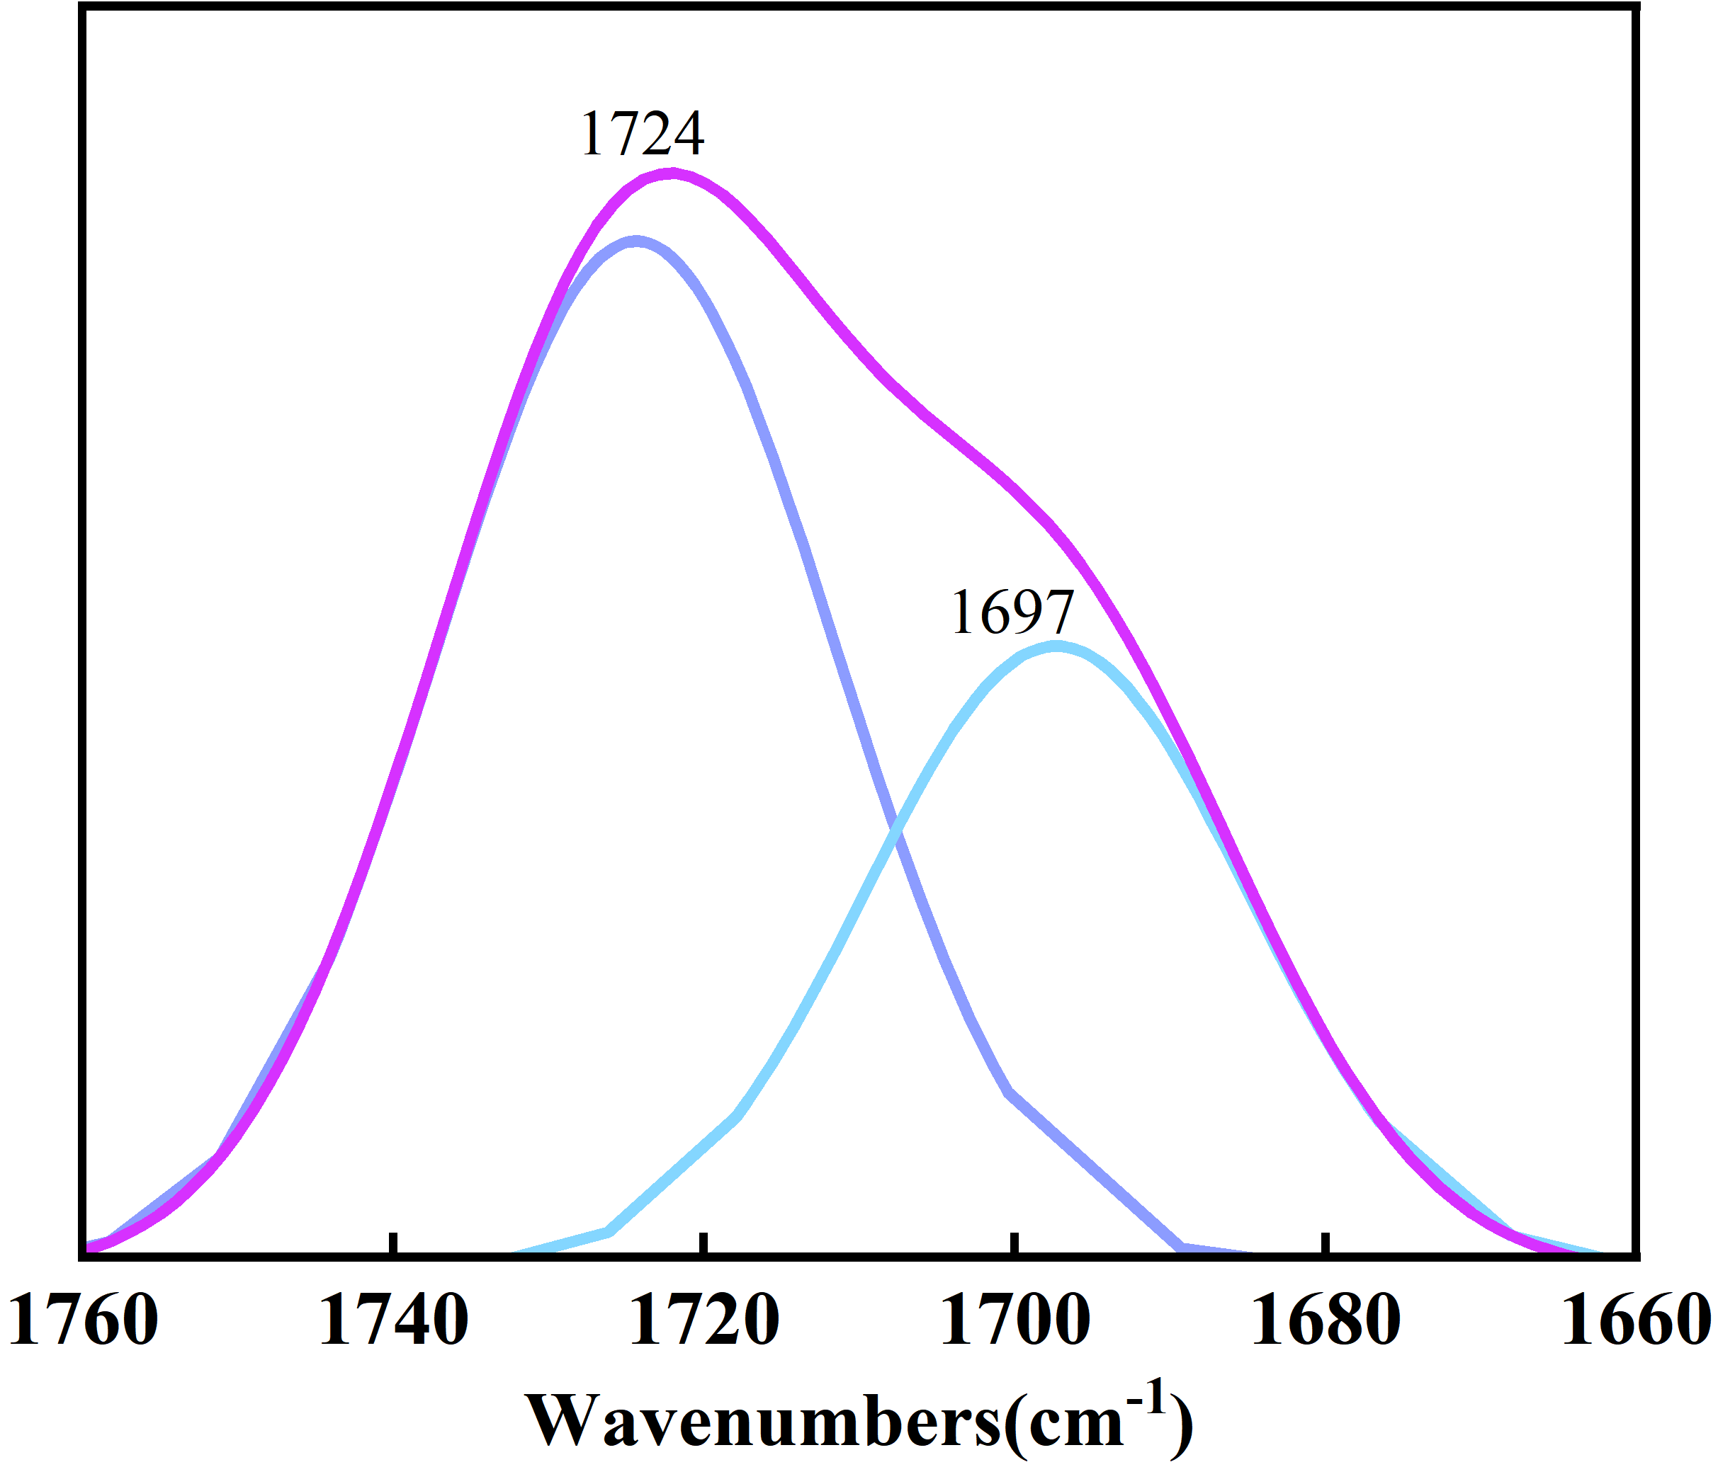
(a)
(b)
Fig.5.(a) The carbonyl peak-fitting profile of the CY-PU, (b) Degree of hydrogen bonding of different polyurethane samples

Slide 11
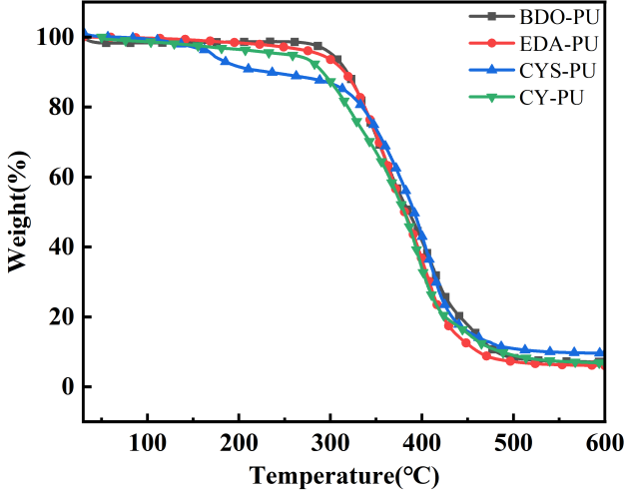
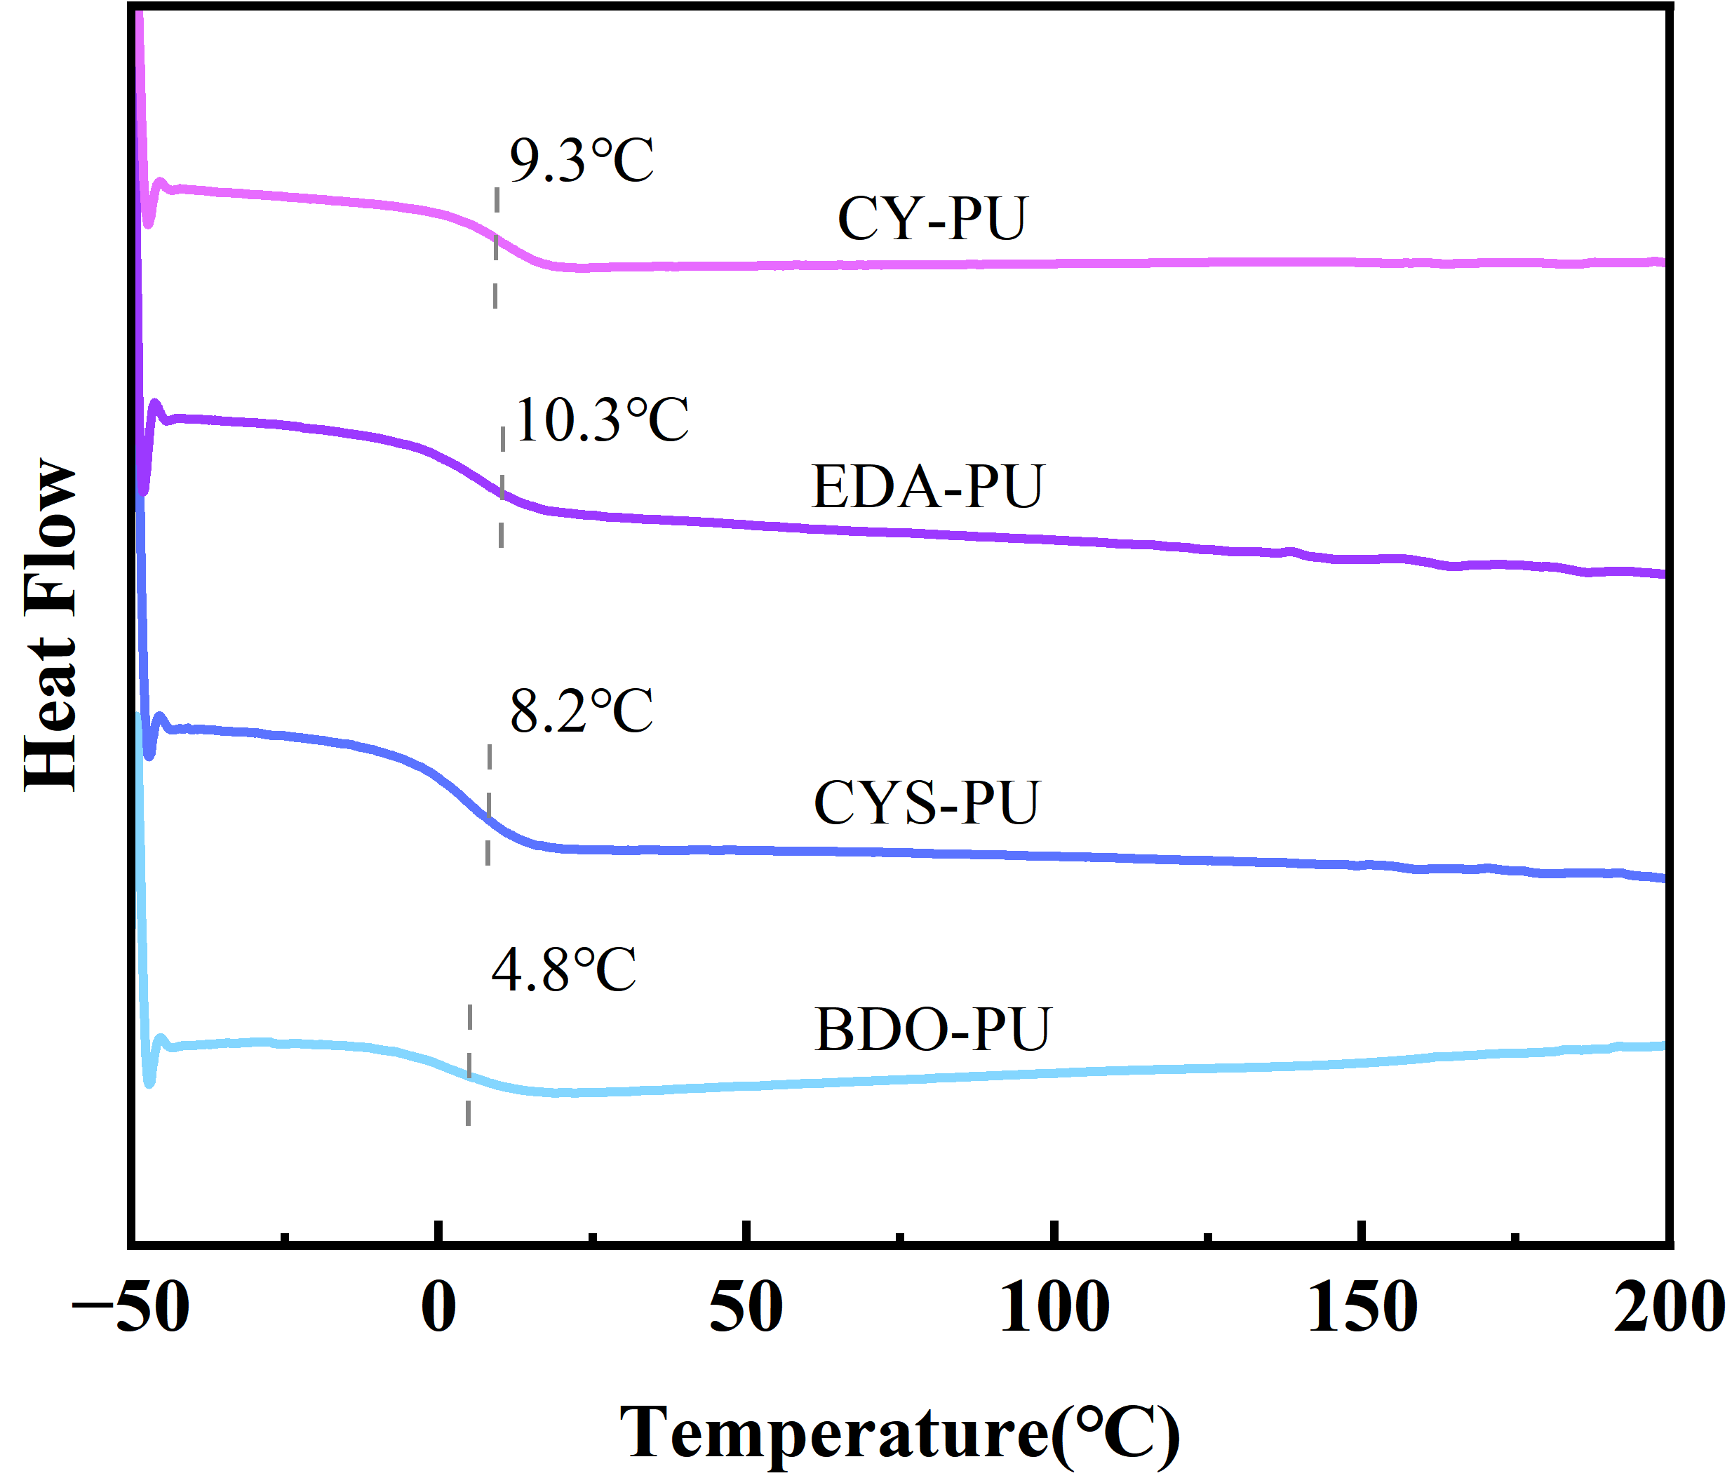
(a)
(b)
Fig.6.TGA (a) and DSC (b) of polyurethanes with different chain extenders

Slide 12
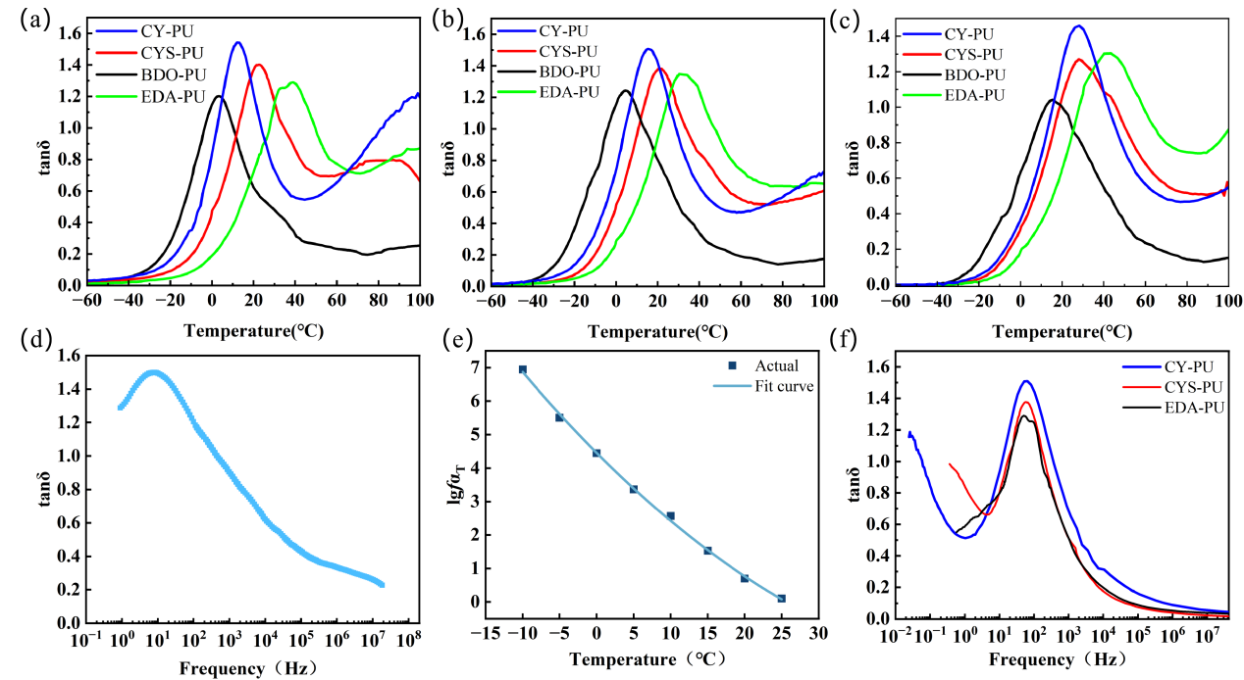
Figure 7. The damping factor curves for four polyurethane samples at 1 Hz (a), 10 Hz (b) and 50 Hz (c), respectively. (d) Master curve of CY-PU. (e) The translation factor of the CY-PU fits the curve. (f) Frequency extrapolation curve of CYS-PU, EDA-PU and CY-PU.

Slide 13
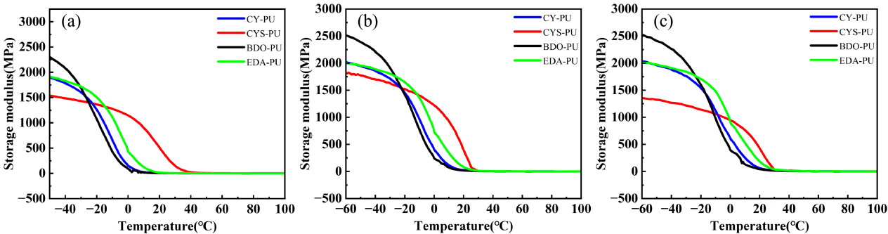
Figure 8. Storage modulus of CY-PU, CYS-PU, BDO-PU and EDA-PU with 1 Hz (a), 10 Hz (b) and 50 Hz (c)

Slide 14
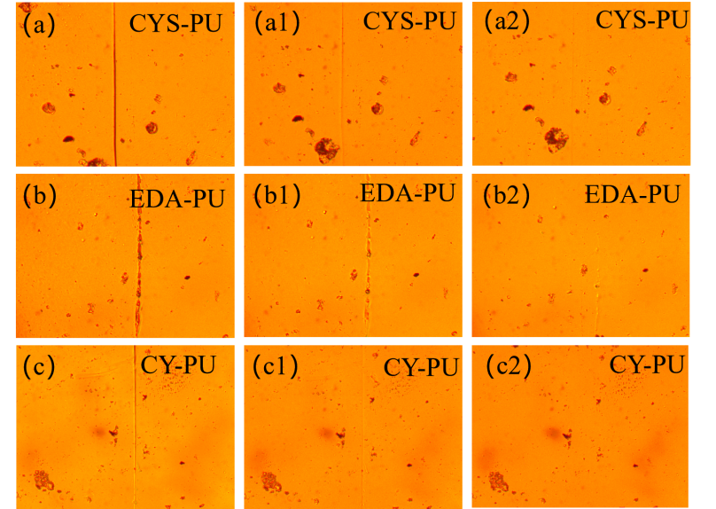
Figure 9. Pictures of the scratch self-healing test of CYS-PU, EDA-PU and CY-PU. (a), (b) and (c) are at room temperature for 1 h. (a1), (b1) and (c1) are at 40 ℃ for 30 min. (a2), (b2) and (c2) are at 40 ℃ for 60 min.

Slide 15
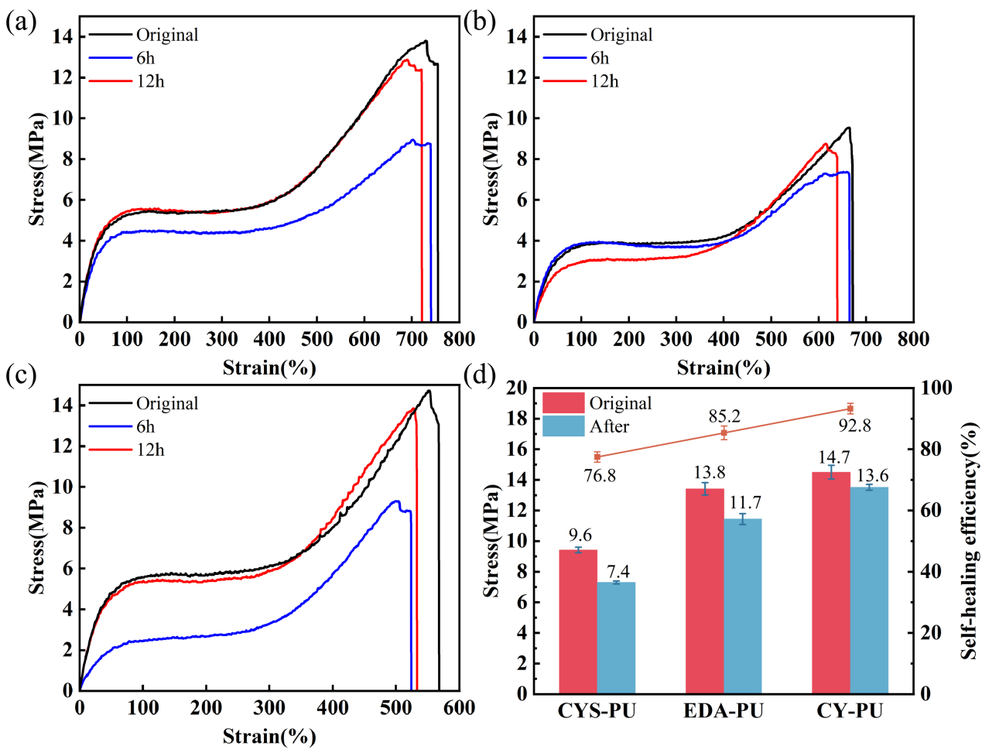
Figure 10.(a), (b) and (c) show the self-healing stress-strain curve of CY-PU, CYS-PU and EDA-PU, respectively. (d) is data on the self-healing properties of CY-PU, CYS-PU and EDA-PU.

Slide 16
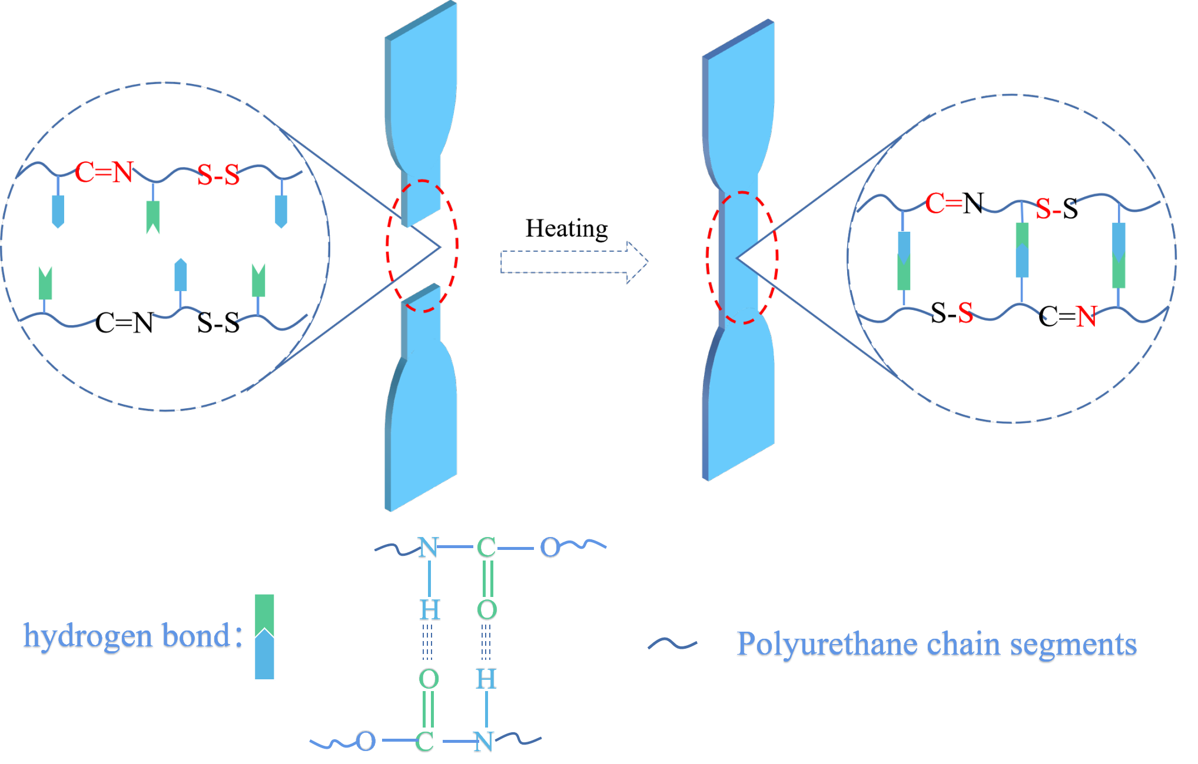
Figure 11. Self-healing mechanism of CY-PU

