Slide 1
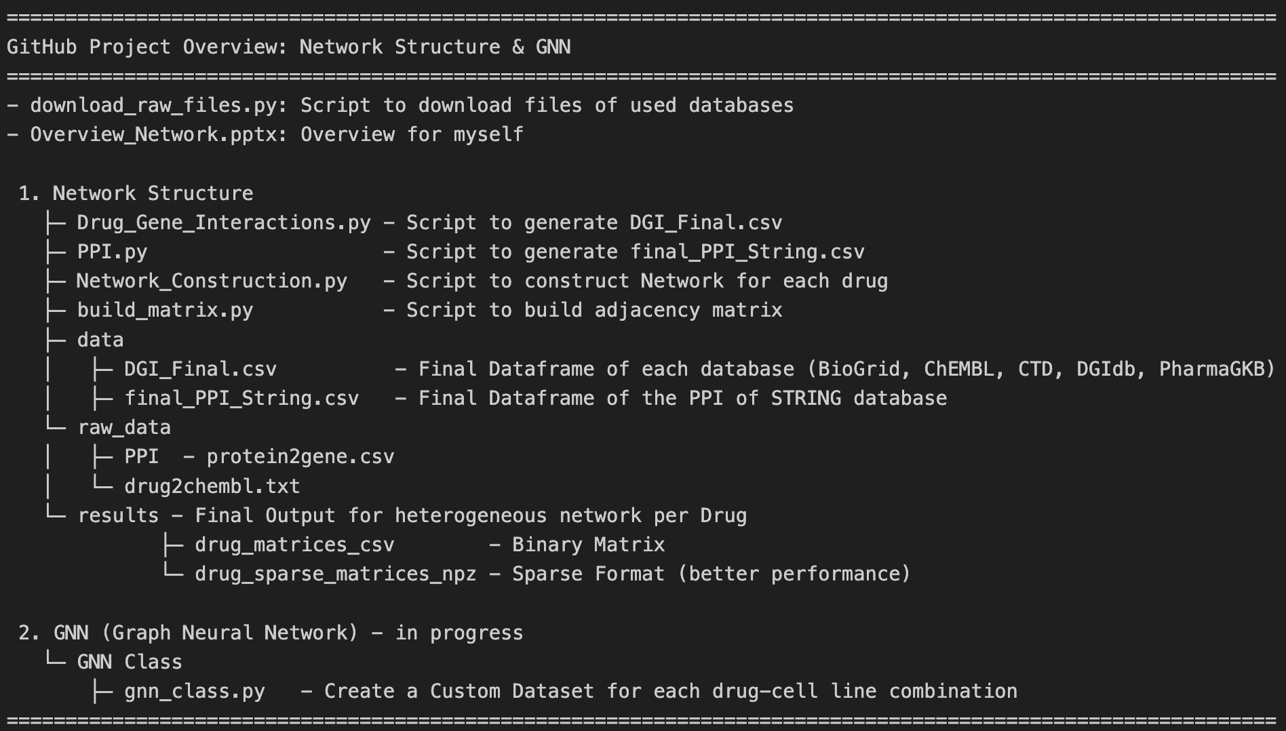
use databases

Slide 2
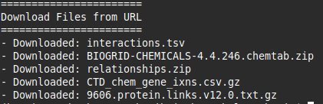
Download_raw_files.py
Step 1: Define URLs for Databases
Step 2: Create local directory
Step 3: Download Files

Slide 3
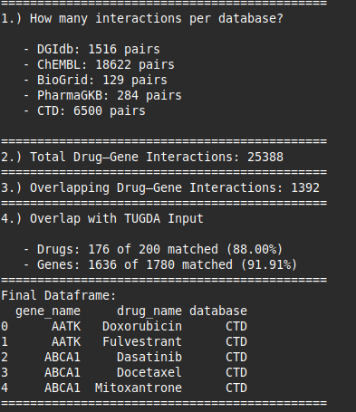
DGI.py
Step 1: Download and Preprocess
Step 2: Get Drug-Gene-Interactions
DGIDB
Step 3: Merge all databases together
ChEMBL (with API)
BioGrid
PharmaGKB
CTD
Step 4: Analysis Step

Slide 4
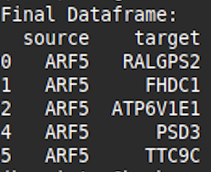
PPI.py
Step 1: Download and Preprocess
Step 2: Mapping and Merge Dataframes
used the `idconverter.py` script from: https://github.com/yafeng/idconverter
python idconverter.py --input unique_ENSP_IDs.csv --output protein2gene.csv --n 1

Slide 5
Network_Construction.py
Nodes = Gene + Pathways
Edges = Gene-Interaction, Pathways
Step 1: Download and Preprocess
Import Final DGI
Import Final PPI-Template
Step 2: Create Edges and Nodes
Level 1 Edges
direct targets: Drug → Target
indirect targets: Target → Partner via PPI
Filtering to keep only edges that also occur in the PPI
e.g. tuple(sorted(['TP53', 'BRCA1'])) → ('BRCA1', 'TP53‘)
Level 2 Edges
Pathways: (Pathway, Gene)
Merge Level 1 and 2 Edges
Step 3: Create binary matrix for each drug
Final Input Dataframe

Slide 6
build_matrix.py
Step 1: Download Files of Network_Construction.py
Import npz Final
Step 2: Create for each drug the binary matrix
save them as csv files

Slide 8
Next Steps
Drug Graph Input: GNN (Drug Encoder)
Cell Line Features: CellLine (Cell Encoder)
↓
TUGDA-MTL (Input: drug_emb + cell_emb)
↓
Prediction IC50 (MSE)
Custom GNN-Dataset
GNN Encoder Klasse (now!)
→ Embeddings
Extension in TUGDA
→ Model multimodal : Table + Graphs
1.) attention-based Fusion or modality gating
2.) Hyperparameters
1 Week
1 Week

Slide 9
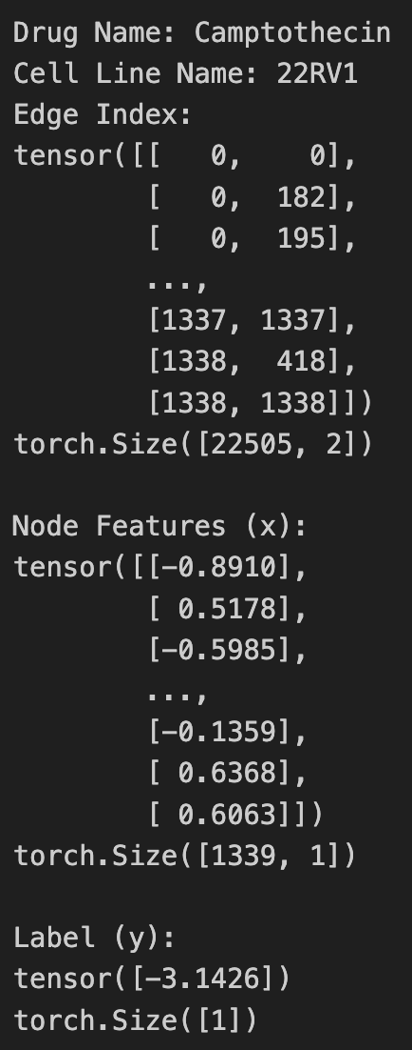
Custom GNN-Dataset
for drug in drug_list
for drug in cell_line
Gene expression value of node x für the drug-cell line combination
Edges in COO-Format
[source_node, target_node]
e.g.: edge of node x to node y (Interaction)
log_IC50 value for a drug-cell line combination

