Slide 1
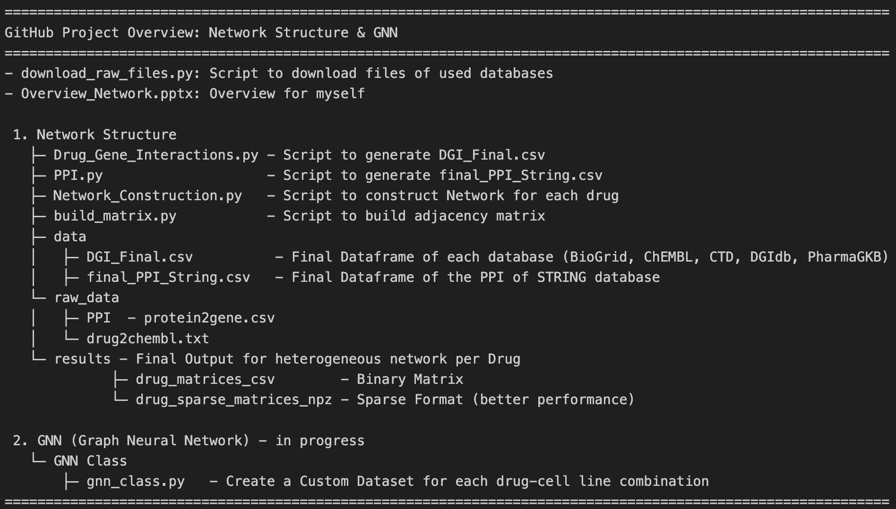
use databases

Slide 2
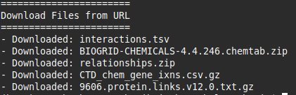
Download_raw_files.py
Step 1: Define URLs for Databases
Step 2: Create local directory
Step 3: Download Files

Slide 3
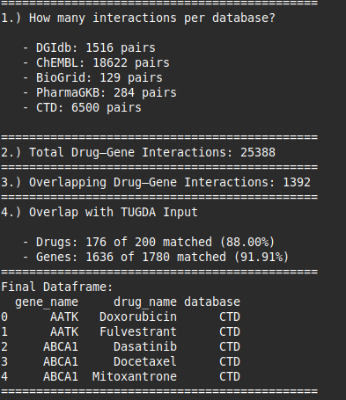
DGI.py
Step 1: Download and Preprocess
Step 2: Get Drug-Gene-Interactions
DGIDB
Step 3: Merge all databases together
ChEMBL (with API)
BioGrid
PharmaGKB
CTD
Step 4: Analysis Step

Slide 4
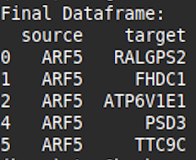
PPI.py
Step 1: Download and Preprocess
Step 2: Mapping and Merge Dataframes
used the `idconverter.py` script from: https://github.com/yafeng/idconverter
python idconverter.py --input unique_ENSP_IDs.csv --output protein2gene.csv --n 1

Slide 5
Network_Construction.py
Nodes = Gene + Pathways
Edges = Gene-Interaction, Pathways
Step 1: Download and Preprocess
Import Final DGI
Import Final PPI-Template
Step 2: Create Edges and Nodes
Level 1 Edges
direct targets: Drug → Target
indirect targets: Target → Partner via PPI (Threshold)
Filtering to keep only edges that also occur in the PPI
e.g. tuple(sorted(['TP53', 'BRCA1'])) → ('BRCA1', 'TP53‘)
Level 2 Edges
Pathways: (Pathway, Gene)
Merge Level 1 and 2 Edges
Step 3: Create binary matrix for each drug
Final Input Dataframe

Slide 6
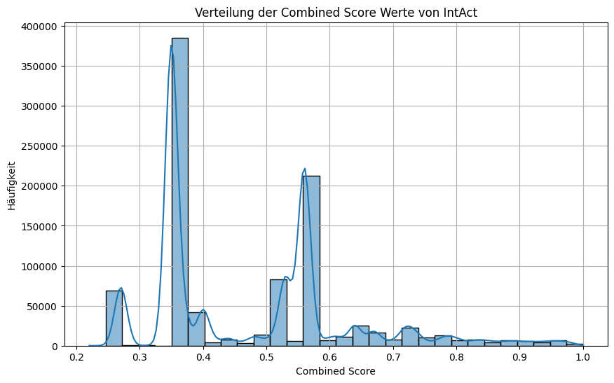
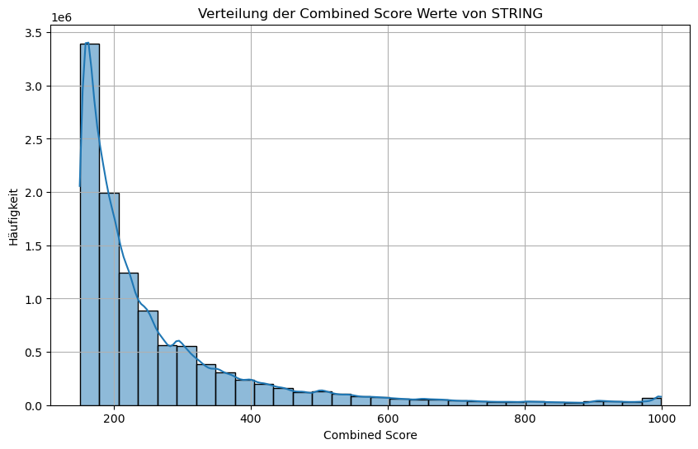
Network_Construction.py
Nodes = Gene + Pathways
Edges = Gene-Interaction, Pathways
IntAct: Median: 0.4, 75% Quantil: 0.56
Experimentell nachgewiesene Interaktionen
STRING: Median: 209, 75% Quantil: 298
experimentell + vorhersagte Interaktionen

Slide 7
Network_Construction.py
Threshold | Common Genes | direct/indirect gene pairs
200 | 1627 | 5,867,623
300 | 1627 | 3,249,014
400 | 1627 | 2,135,701
500 | 1624 | 1,477,686
600 | 1608 | 1,045,730
700 | 1584 | 749,333
Results with STRING
Common Genes | direct targets | gene pairs
1763 | 25318 | 1,500,708
Threshold | Common Genes | direct/indirect gene pairs
0.2 | 1762 | 837,544
0.3 | 1761 | 668,582
0.4 | 1664 | 289,680
0.5 | 1622 | 211,501
0.6 | 1266 | 107,512
0.7 | 934 | 62,442
Results with IntAct

Slide 8
build_matrix.py
Step 1: Download Files of Network_Construction.py
Import npz Final
Step 2: Create for each drug the binary matrix
save them as csv files

Slide 10
Next Steps
Drug Graph Input: GNN (Drug Encoder)
Cell Line Features: CellLine (Cell Encoder)
↓
TUGDA-MTL (Input: drug_emb + cell_emb)
↓
Prediction IC50 (MSE)
Custom GNN-Dataset
GNN Encoder Klasse (now!)
→ Embeddings
Extension in TUGDA
→ Model multimodal : Table + Graphs
1.) attention-based Fusion or modality gating
2.) Hyperparameters
1 Week
1 Week

Slide 11
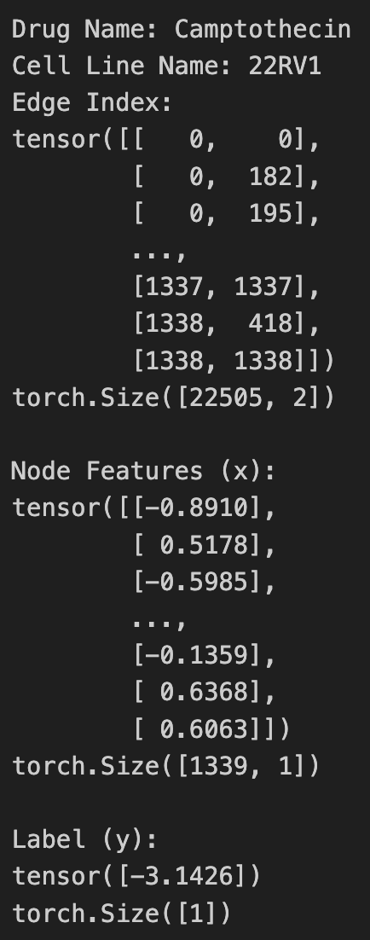
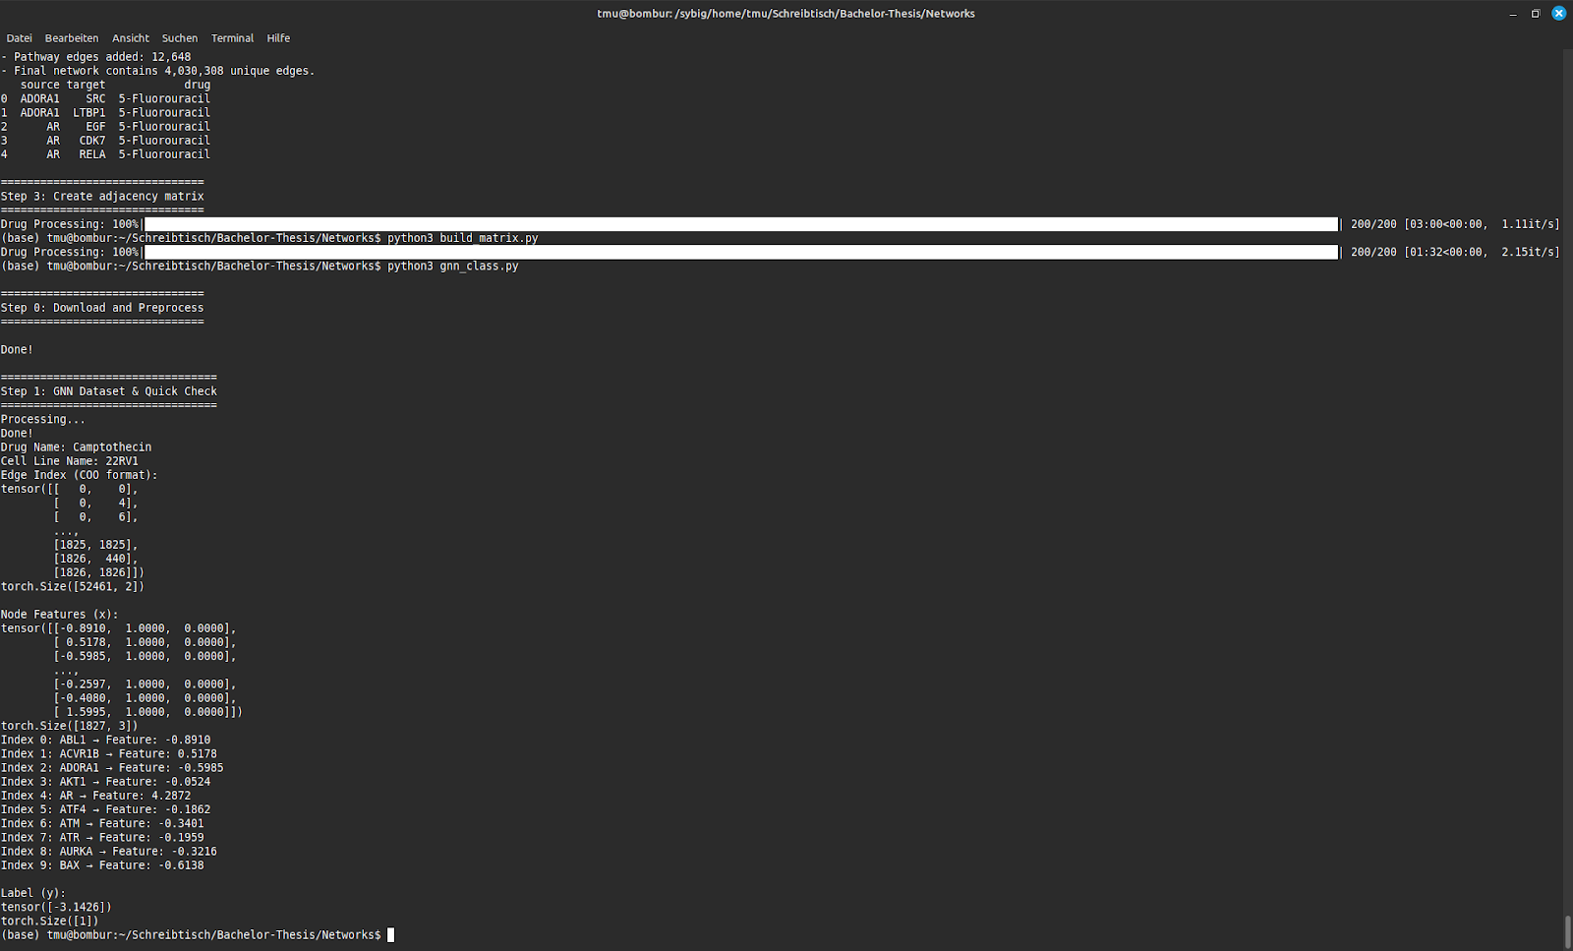
Custom GNN-Dataset
for drug in drug_list
for drug in cell_line
expression
is_gene
is_pathway
Gene expression value of node x für the drug-cell line combination, is_gene, is_pathway
Edges in COO-Format
[source_node, target_node]
e.g.: edge of node x to node y (Interaction)
log_IC50 value for a drug-cell line combination

Slide 12
GNN-Class Encoder
Input: Drug-Cell Combination (one graph) with the node and edge features
GNN
Output: Update node embeddings
→ one single embedding vector instead of one per node
How to get this embedding?
naive pooling
Hierarchcial pooling
Mean
Sum
max

Slide 13
GNN-Class Encoder
How to get this embedding?
naive pooling
Hierarchcial pooling
Mean
Sum
max
How to remove the nodes?
diff-pool-layer
Top-K-Pooling
Super Node
keep
keep
drop
keep
drop
Cluster

Slide 14
Current Architecture
Input
GNN-Encoder
TUGDA (Predictor)
embedding
One Encoder
Two Encoder
Layer
Linear Transformation
Batch Normalization
Layer
Linear Transformation
Batch Normalization
Hyperparameter
Top-K-Pooling
Linear Layers (128 → 64 → 1)
diff-pool-layer
Linear Layers (128 → 64 → 1)

Slide 15
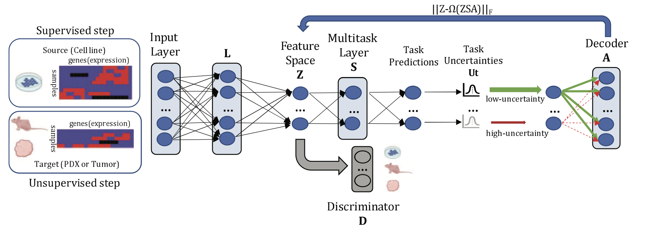
Extension - TUGDA
Input
Aim:
GNN-Class with 3 features
One Encoder
GNN-Class with 2 features
Two Encoders
One Encoder
embedding
Two Encoder

