Slide 1

Technical Approach
Step 4
Homography based
Self-Calibration
Focal length estimation
Non-linear minimization
Principal point correction
Step 5
Metric Reconstruction
Initial extrinsic guess for reference frame
Approximate 3D point coordinates in reference frame (triangulation)
Extrinsic parameters for all frames using PnP
Step 6
Metric
Bundle Adjustment
Minimization of reprojection errors
Refine 3D scene point coordinates
Refine intrinsics and distortion

Slide 2
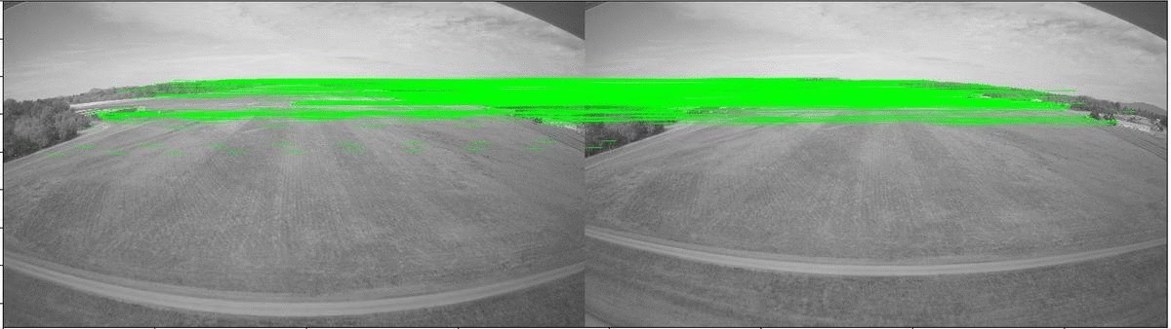
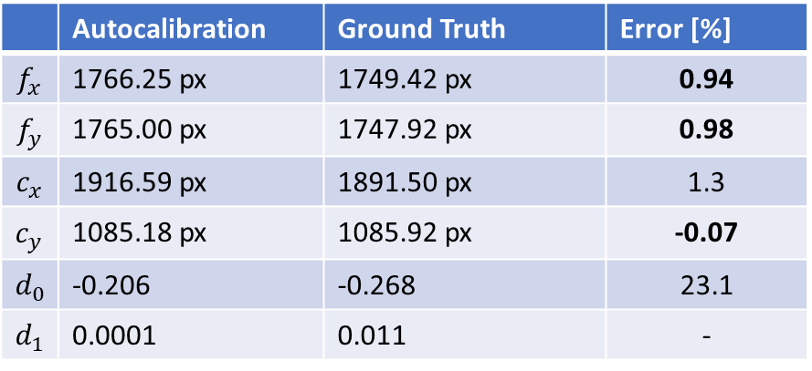
Results on real aerial imagery
 | Autocalibration | Ground Truth | Error [%]
$$f_{x}$$ | 1766.25 px | 1749.42 px | 0.94
$$f_{y}$$ | 1765.00 px | 1747.92 px | 0.98
$$c_{x}$$ | 1916.59 px | 1891.50 px | 1.3
$$c_{y}$$ | 1085.18 px | 1085.92 px | -0.07
$$d_{0}$$ | -0.206 | -0.268 | 23.1
$$d_{1}$$ | 0.0001 | 0.011 | -
Real flight imagery from landing maneuver at Sanderson Field Airport (Washington).
4K resolution images taken with GoPro camera (forward-looking).
Real lenses with radial + tangential distortion.

