Slide 1

Technical Approach
“Forget the checkerboard: practical self-calibration using a planar scene”
Herrera et. Al, WACV 2016
Asm.
Assumptions
Planar scene
Camera
zero-skew
Radial distortion model
Step 1
Feature Extraction
& Matching
SIFT feature extraction
FLANN matching
Filtering
Step 2
Projective
Reconstruction
Homography estimation
RANSAC
Step 3
Projective
Bundle Adjustment
Initial estimation of distortion and Central Point
Refinement of Homographies and world coordinates of scene points

Slide 2
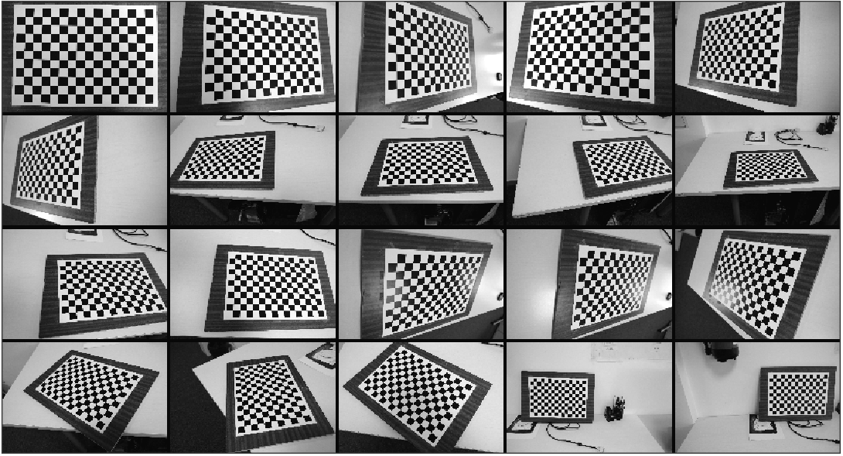
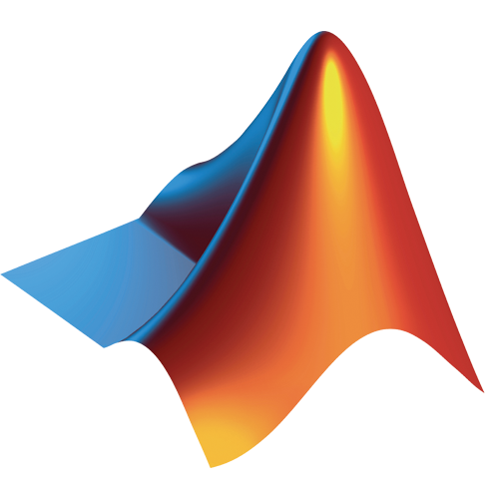
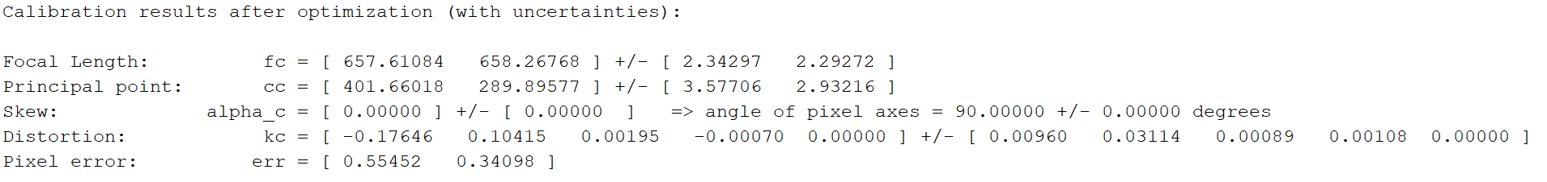
Results – Close Range Imagery (1/3)
Baseline calibration
DSLR + 18mm lenses
Checkerboard pattern
Resized to 800x533 px
Matlab Calibration Toolbox
[18.25, 18.27 ] mm
norm(err) = 0.65

Slide 3
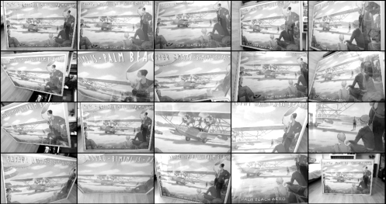

Results – Close Range Imagery (2/3)
Planar Self-Calibration
DSLR + 18mm lenses
Pictures of poster
Resized to 800x533 px
Custom Python implementation
Focal Length | fx | 664.954 (18.45 mm)
 | fy | 666.036 (18.49 mm)
Principal Point | u | 425.684
 | v | 283.173
Distortion | d0 | 3.75E-07
 | d1 | 3.96E-13
Pixel Error |  | 0.5832

Slide 4
Results – Close Range Imagery (3/3)
Results Planar Self-Calibration vs Checkerboard
Focal Length very accurate ~ 1.2%
Less accurate Principal point ~ 2.5 – 6 %
Reprojection error slightly better than Checkerboard
High error in distortion, probably due to different
Distortion models
 |  | Checkerboard Cal. | Planar Self-Cal. | Deviation( %)
Focal Length | fx | 657.611 (18.25 mm) | 664.954 (18.45 mm) | 1.12
 | fy | 658.268 (18.27 mm) | 666.036 (18.49 mm) | 1.18
Principal Point | u | 401.66 | 425.684 | 5.98
 | v | 289.896 | 283.173 | 2.32
Distortion | d0 | -1.76E-01 | 3.75E-07 | 100.00
 | d1 | 1.04E-01 | 3.96E-13 | 100.00
Pixel Error |  | 0.65 | 0.58 | 10.28

