Slide 1
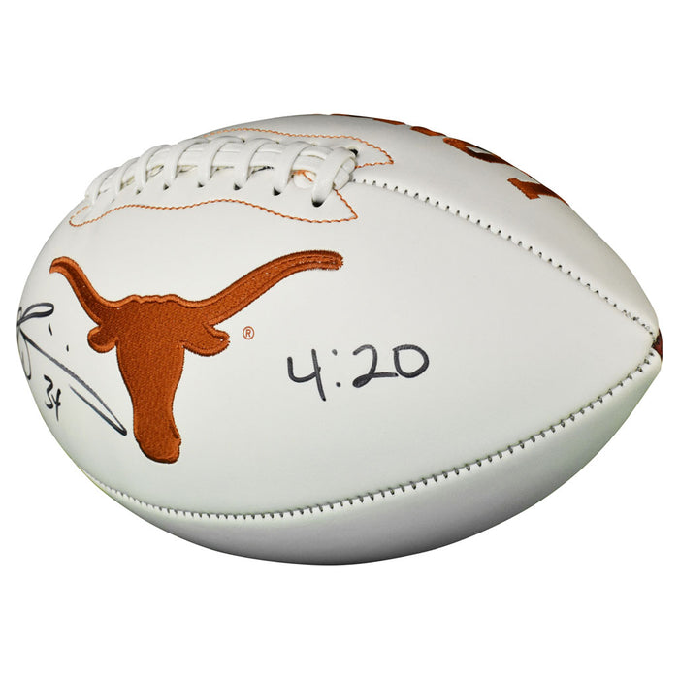
Hackathon Project Final Presentation
March 27th, 2022
NFL
(No Free Lunch)
Javier Guerrero, Petroleum Engineering
Viridiana Salazar, Petroleum Engineering
Shuhan Shen, ORIE
Junyu Yao, Physics
What start here change the world!
Hook’em

Slide 2
Executive Summary
The Problem
Select the location of the next three oil production wells to be drilled in order to maximize the production for the next two years using Machine Learning models.
Our Solution
Integrate expert knowledge, geostatistical methods, and uncertainty modelling into our machine learning workflow to maximize the production of the following three wells to be drilled
Our Learning Outcomes
• Actually, cleaning and preparing the data really takes more than % of the time in a ML project.
• Expertise knowledge is a critical skill in every ML step. (Thanks to all our advisors in this Hackathon for share their knowledge with us!)
• There is a big potential in the Oil and Gas industry , which is a highly productor of big data, to solve problems by using ML techniques
Our Recommendation
• We have made some assumptions due to time constrain. However, in real life, we need to consider things such as the drainage radius of each well, workovers, maintenances of superficial facilities among other things that can affect the forecasting of oil production.

Slide 3
1. Visualize, Cleaning and Prepare the data
Examine for missing and erroneous values
Feature Imputation
Feature Selection
Raw Data
2. Machine Learning Model
3. Use the model to predict
Split the data in training and testing
Train the model
Test the model
Tunning Hyperparameters
Evaluation
Use the final model to predict the production of our following wells

Slide 4
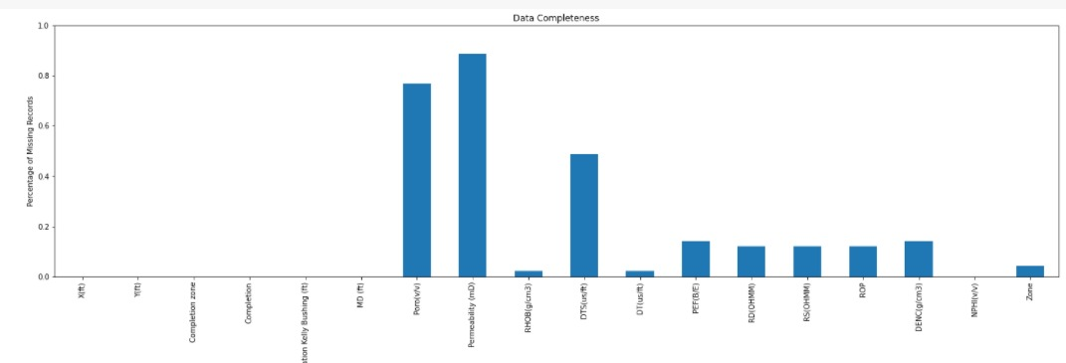
Feature Imputation
1. Density
K-Nearest Neighbors
2. Porosity
Multilinear regression (Density, NPHI)
3. Acoustic Impedance Imputation
Interpolation from the 2D MAP
4. Permeability Imputation
Petrophysics equations (Karman-Kozeny relation)
Data Completeness
Core Porosity
Permeability
Fraction of Missing Data

Slide 5
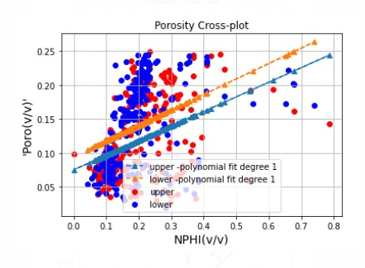
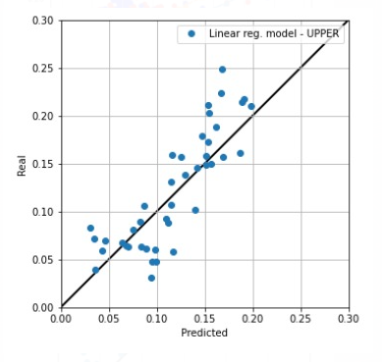
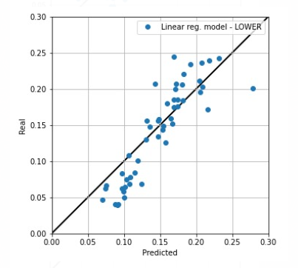
Feature Imputation
Porosity
Linear Regression between NPHI and Core Porosity
Not good
Multivariate Linear Regression to predict porosity as a function of Density and NPHI
Good
UPPER
Lower

Slide 6
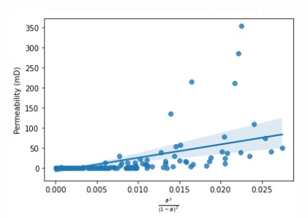
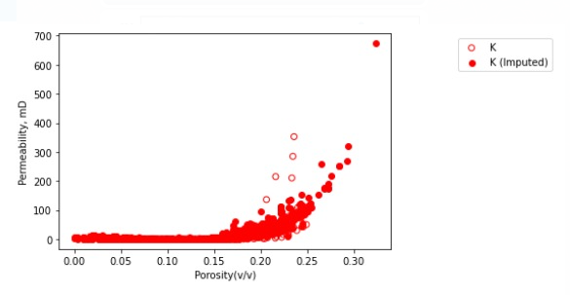
Feature Imputation
Permeability
Permeability (Porosity)

Slide 7
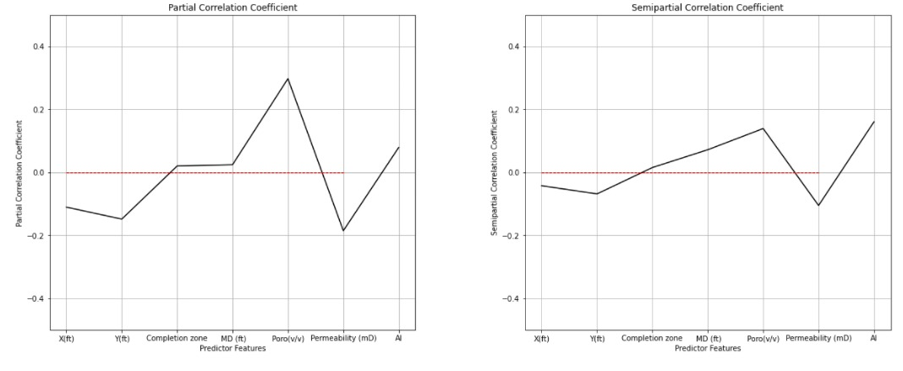
Feature Ranking and Selection

Slide 8
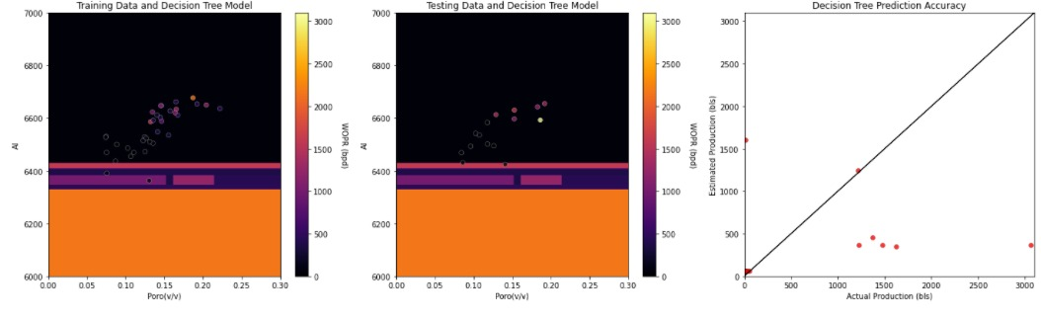
Decision Tree
Training
Testing

Slide 9
Decision Tree
Testing data Prediction Accuracy before hyperparameter tunning

Slide 10
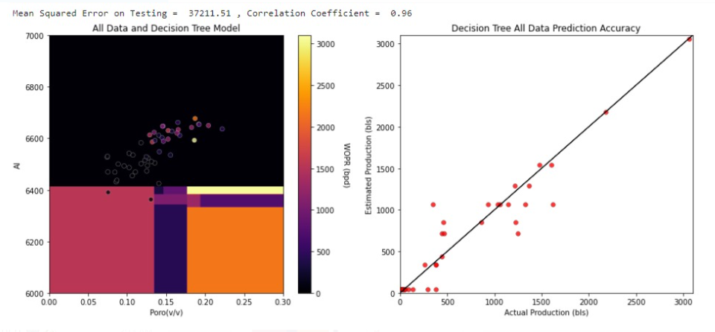
Decision Tree
Final Model after hyperparameter tunning
Nodes=3 MSE= 176144.81 , Correlation Coefficient = 0.795
Nodes=5 MSE= 88694.48 , Correlation Coefficient = 0.910 5
Nodes=10 MSE= 37211.51 , Correlation Coefficient = 0.96

Slide 11
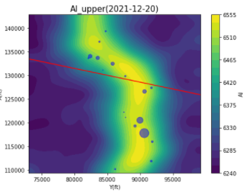
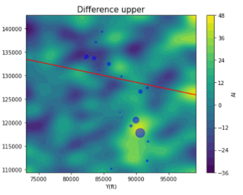
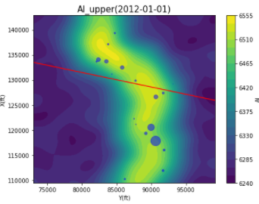
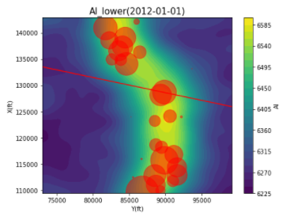
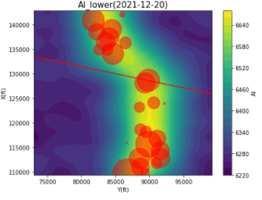
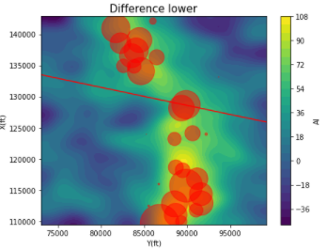
Feature Selection
2021 – 2012=9 years
Rock density is the same
The AI difference along time give us an idea about the change in the fluids inside the porous media
2012
2021
New 3 Wells

Slide 12
Decision Tree
Proposed wells and forecast cumulative production for the next two years
X (ft) | Y (ft) | unit | Np (bls)
88000 | 125500 | Lower | 1077407
88000 | 134000 | Lower | 627435
87500 | 131000 | Lower | 1077407

Slide 13
Feedback
What did your team learn?
Machine Learning is a helpful tool to maximize value in oil and gas projects in which we produce loads of data every day
How important is include expert knowledge in every ML step
"There ain't no such thing as a free lunch“
What did your team like?
The feedback and suggestion of all of the advisors
What could we do to improve next year?
The organization in general was awesome, we just like to suggest maybe one day more to solve the problem

