Slide 1

基于多任务学习的文本表示方法研究
Language Representation with Multi-Task Learning
孙天祥
txsun@stu.xidian.edu.cn
2019年4月

Slide 2

Outline
毕业设计完成情况
课题简介与实验结果
存在问题与解决方案
下一步计划

Slide 3
一、毕业设计完成情况
调研 学习已有工作、翻译外语文献
设计 设计新的多任务学习模型
实现 实现基线模型及新提出的模型
实验 搭建实验环境、对比试验
改进 根据存在的问题和实验结果改进模型
写作 完成毕业论文

Slide 4
二、课题简介
题目 基于多任务学习的文本表示方法研究
Language Representation with Multi-Task Learning
Multi-Task Learning
Natural Language Learning
MTL for NLP
Transformer

Slide 5
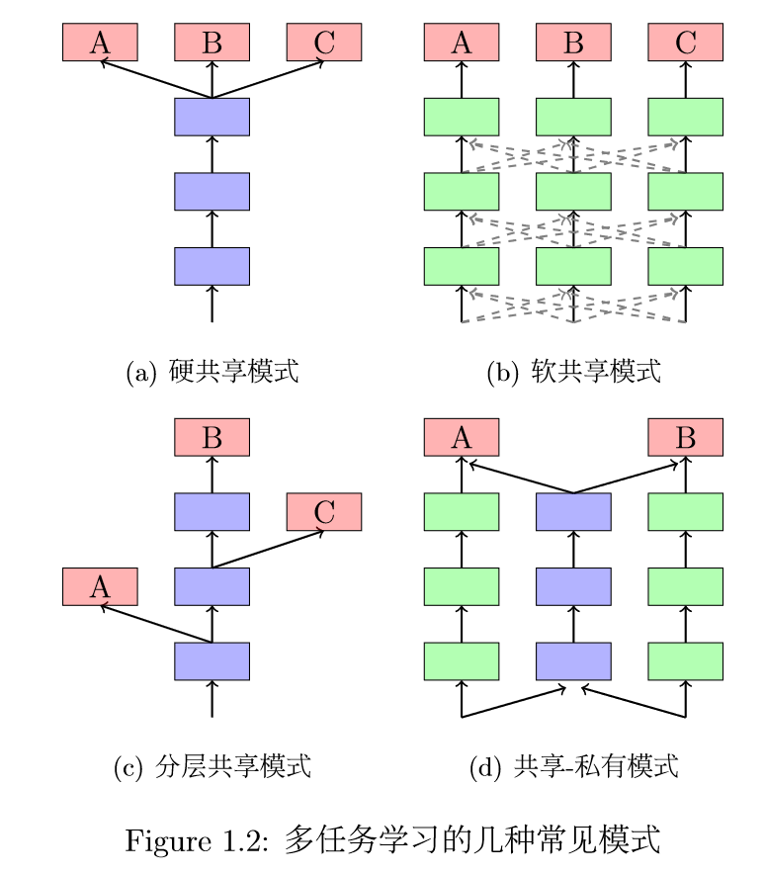
Multi-Task Learning
多任务学习通过利用包含在相关任务训练信号 中的领域特定信息来提升泛化能力^{[1]}。
[1] R. Caruana, “Multitask Learning,” Machine Learning, vol. 28, no. 1, pp. 41–75, 1997.

Slide 6
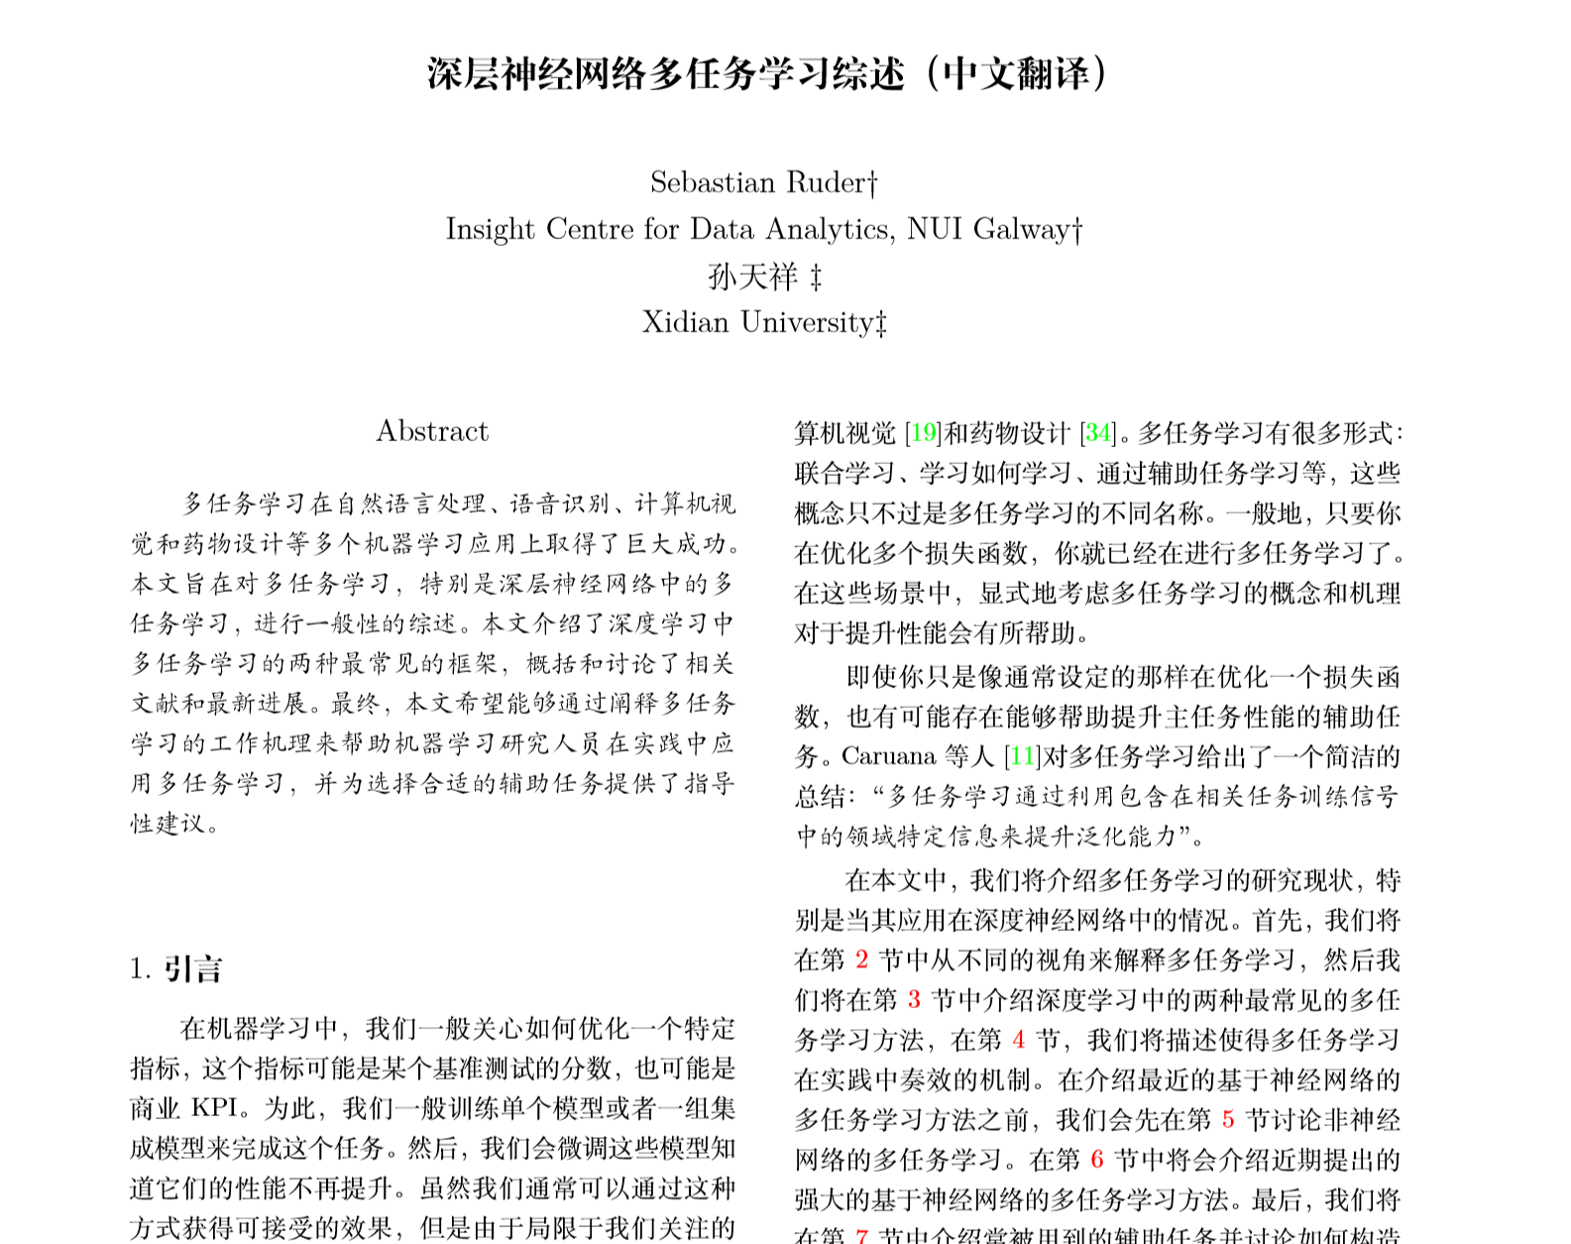
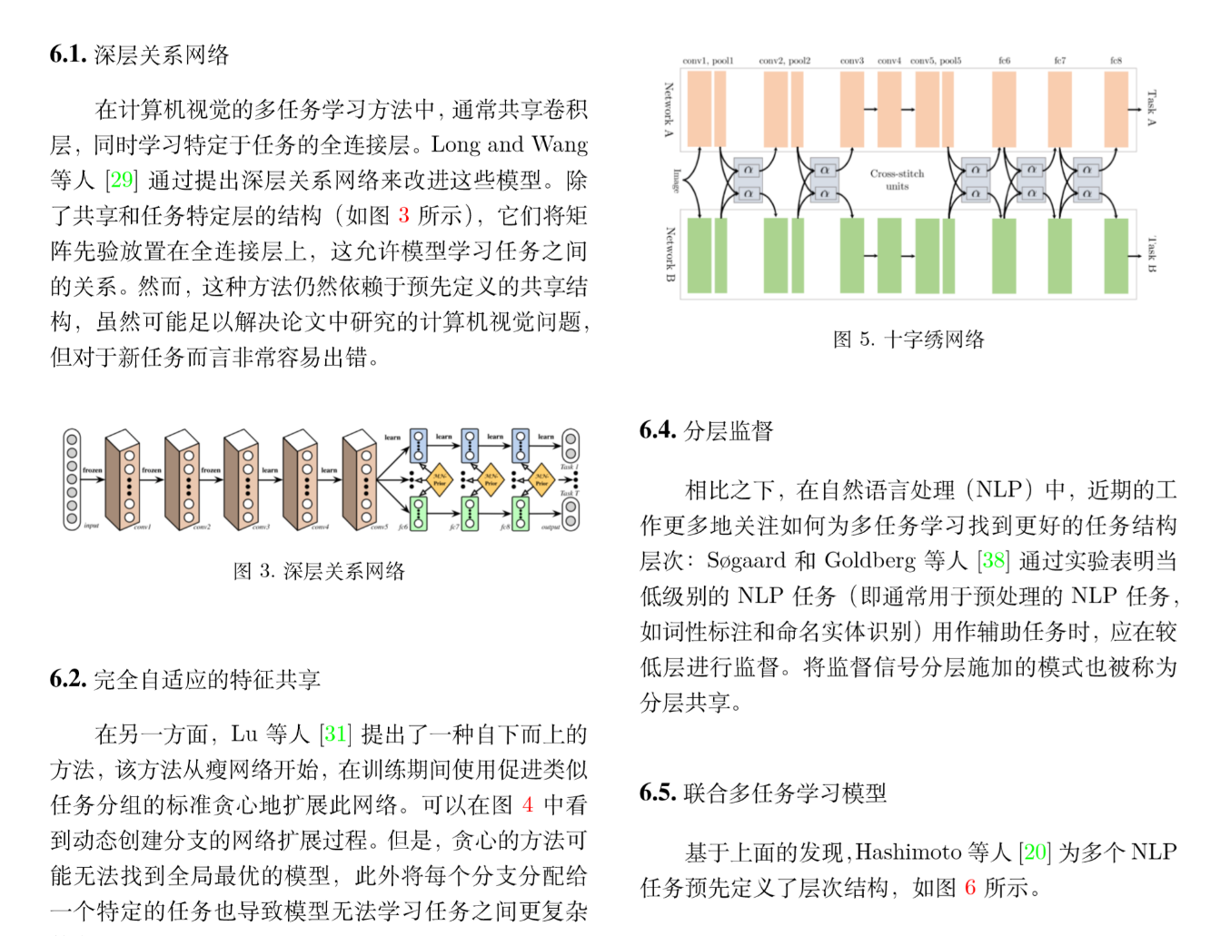
Multi-Task Learning
Ruder, Sebastian. "An overview of multi-task learning in deep neural networks." arXiv preprint arXiv:1706.05098 (2017).

Slide 7
Natural Language Processing
Non-textualized representation
word-level: word2vec, GloVe, etc.
char-level: fastText, etc.
Contextual representation
RNN: ELMo, etc.
Transformer: GPT, BERT, etc.
[ 0.012 , -0.76 , … , 0.005 ]
CNN / RNN / Transformer
I love cats and logs

Slide 8
MTL for NLP
MTL with CNNs
Collobert et al. A Unified Architecture for Natural Language Processing: Deep Neural Networks with Multitask Learning
Misra et al. Cross-stitch Networks for Multi-task Learning
MTL with RNNs
Dong et al. Multi-Task Learning for Multiple Language Translation
Liu et al. Recurrent Neural Network for Text Classification with Multi-Task Learning
Hashimoto et al. A Joint Many-Task Model: Growing a Neural Network for Multiple NLP Tasks
MTL with Transformer
?

Slide 9
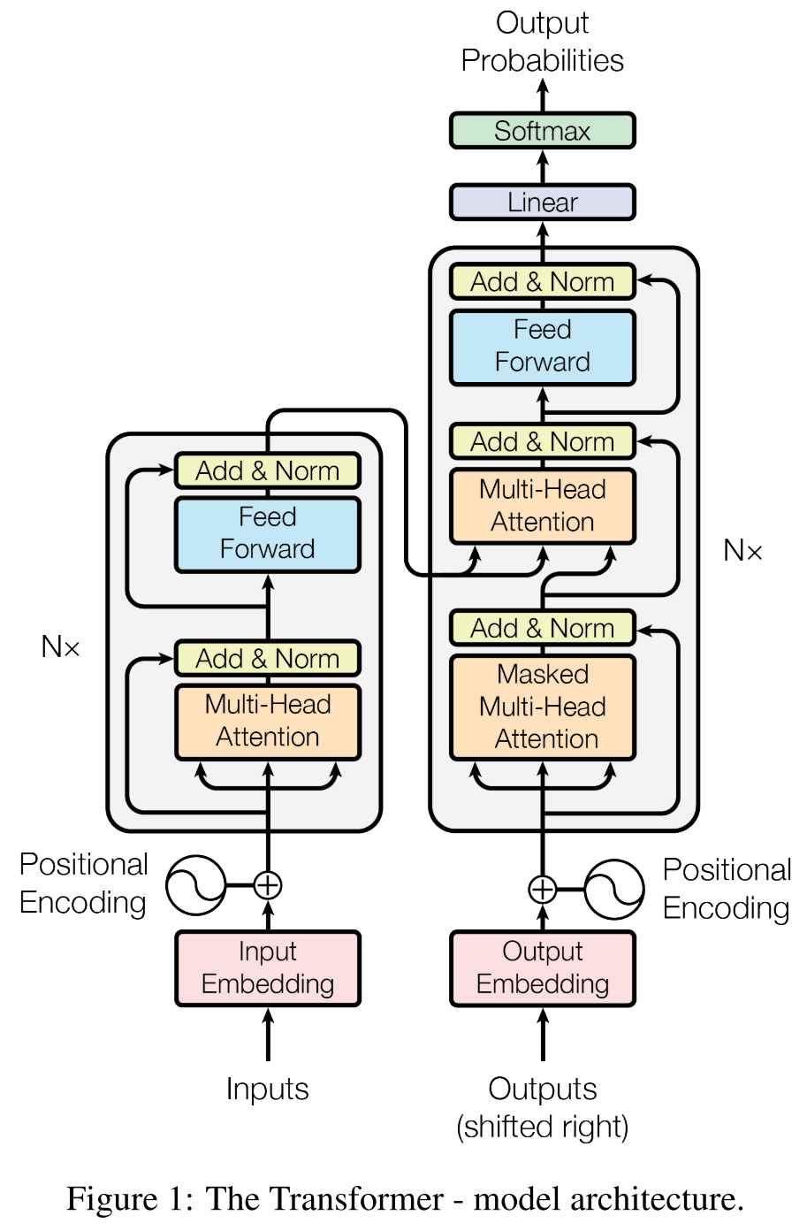
Transformer
Vaswani, Ashish, et al. "Attention is all you need." Advances in neural information processing systems. 2017.

Slide 10
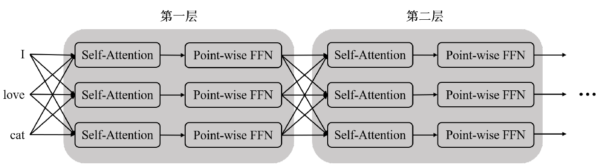
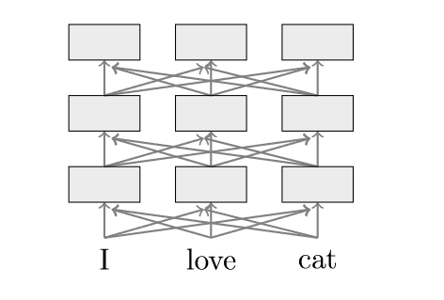
Transformer
Transformer编码过程
一个简化版本
Vaswani, Ashish, et al. "Attention is all you need." Advances in neural information processing systems. 2017.

Slide 11
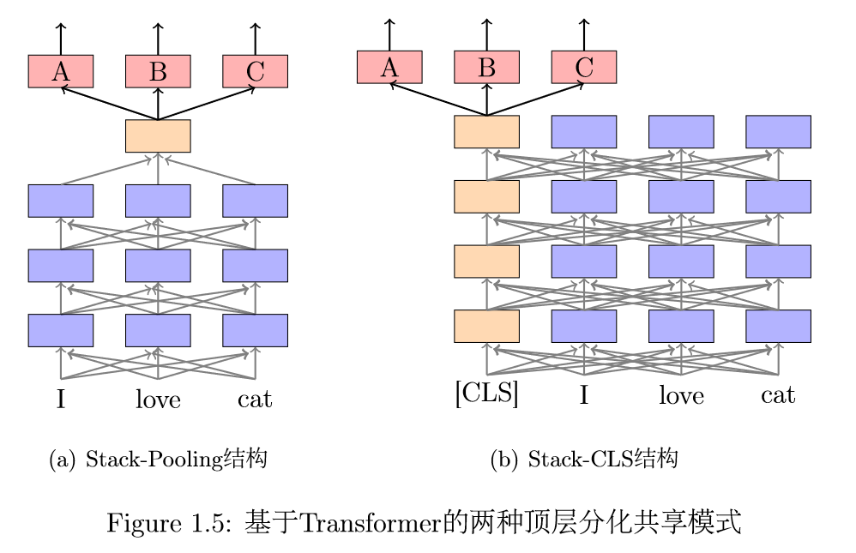
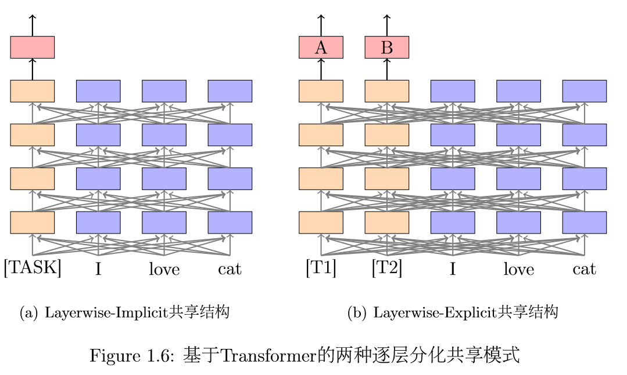
MTL with Transformer

Slide 12
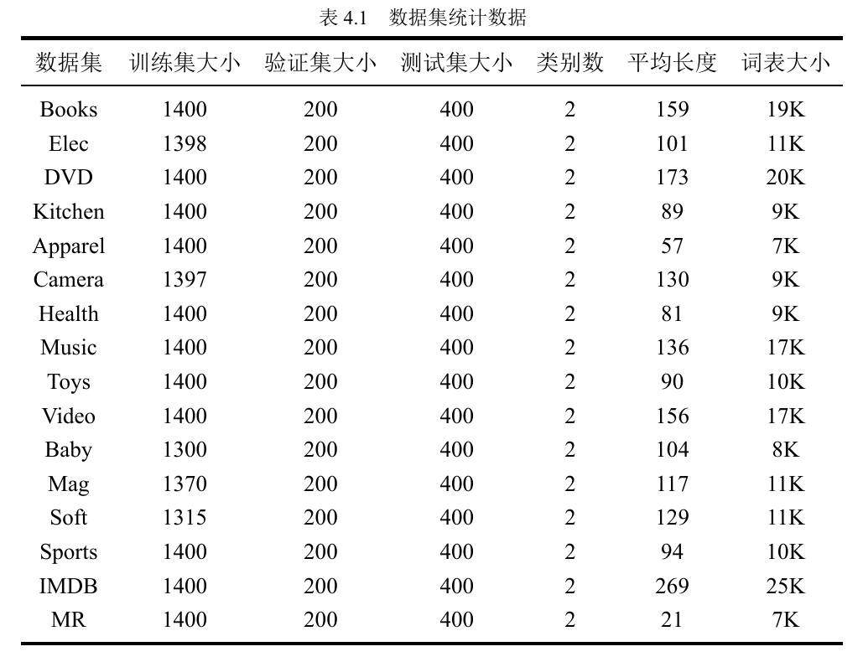
Experiments

Slide 13
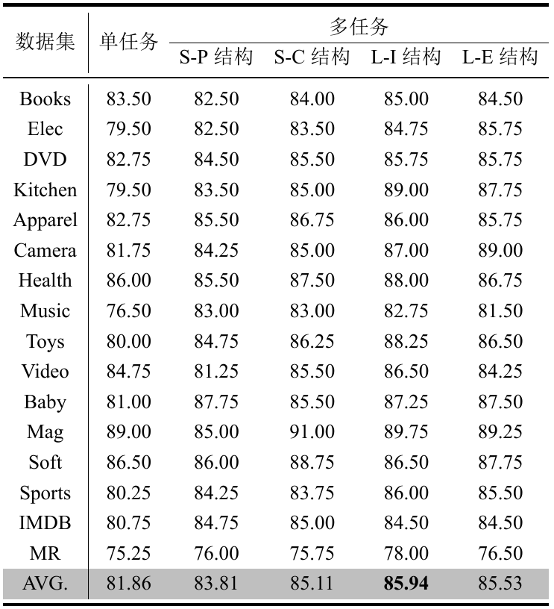
Experiments

Slide 14
三、存在的问题与解决方案
存在的问题
任务跨度不够大
数据集规模单一
未在BERT上验证

Slide 15
四、下一步计划
实验
BERT (a pre-trained transformer)
NLI (MNLI, QNLI, RTE, WNLI)
论文

Slide 16
Q&A

