Slide 1
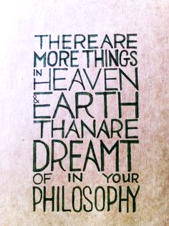
Agentic software? Sure!
All agents LLMs? No!
Tim Menzies, ncstate, usa timm@ieee.org Mar10 2026

Slide 2
We have been here before
The 1988 AI Winter

Slide 3
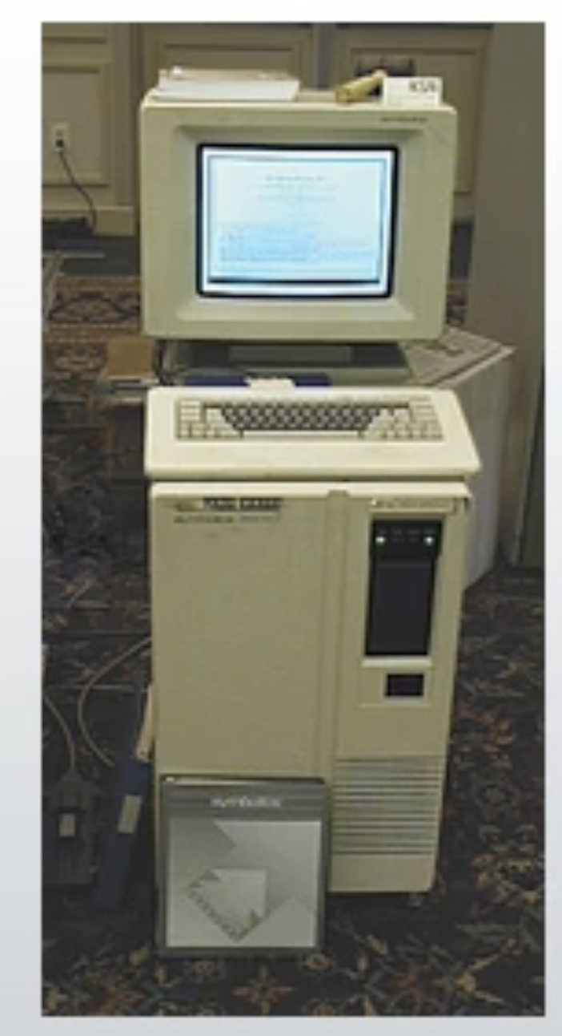
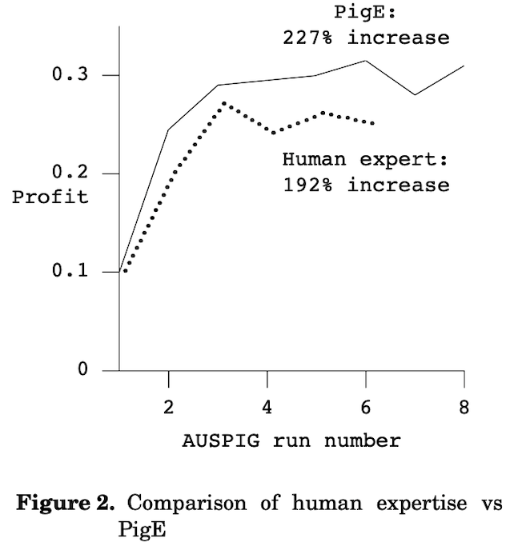
1980s AI winter
Meanwhile…
An expert system for raising pigs, Menzies et al. 1989
“Raising pigs is big business”
Out-performed the humans who wrote its rules

Slide 4
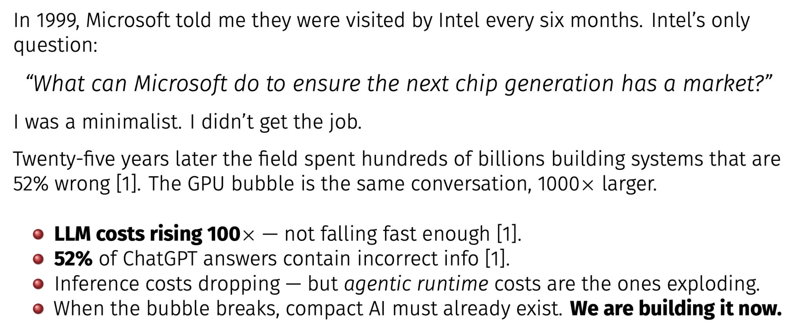

Slide 5
I believe LLMs are cool
Requirements engineering
Optimization

Slide 6
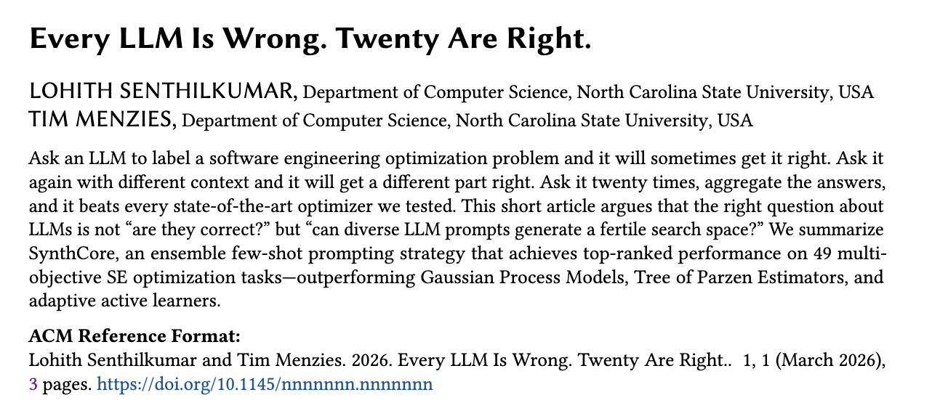
EMSE’26, to appear

Slide 7
SynthCore: diversity beats correctness
prompt 1
ans 1
SE task
prompt 2
ans 2
...
...
Aggregate (vote / weighted)
answer
prompt 19
ans 19
prompt 20
ans 20
each varies context
Each prompt is wrong in a different way. The ensemble covers the fertile region.
Beats GP, TPE, adaptive active learners on 49 MOO tasks (Senthilkumar & Menzies, EMSE'26)

Slide 8
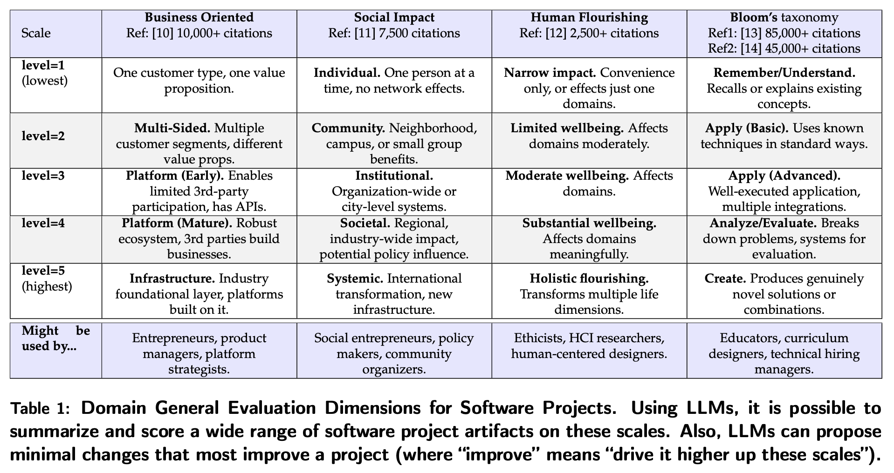
"RE education is at best an afterthought in many university software engineering curricula."
LLM-based ideation for requirements engineering: 1) defined “good”; (2) score projects on “good”; (3) prompt “how to be better”?

Slide 9
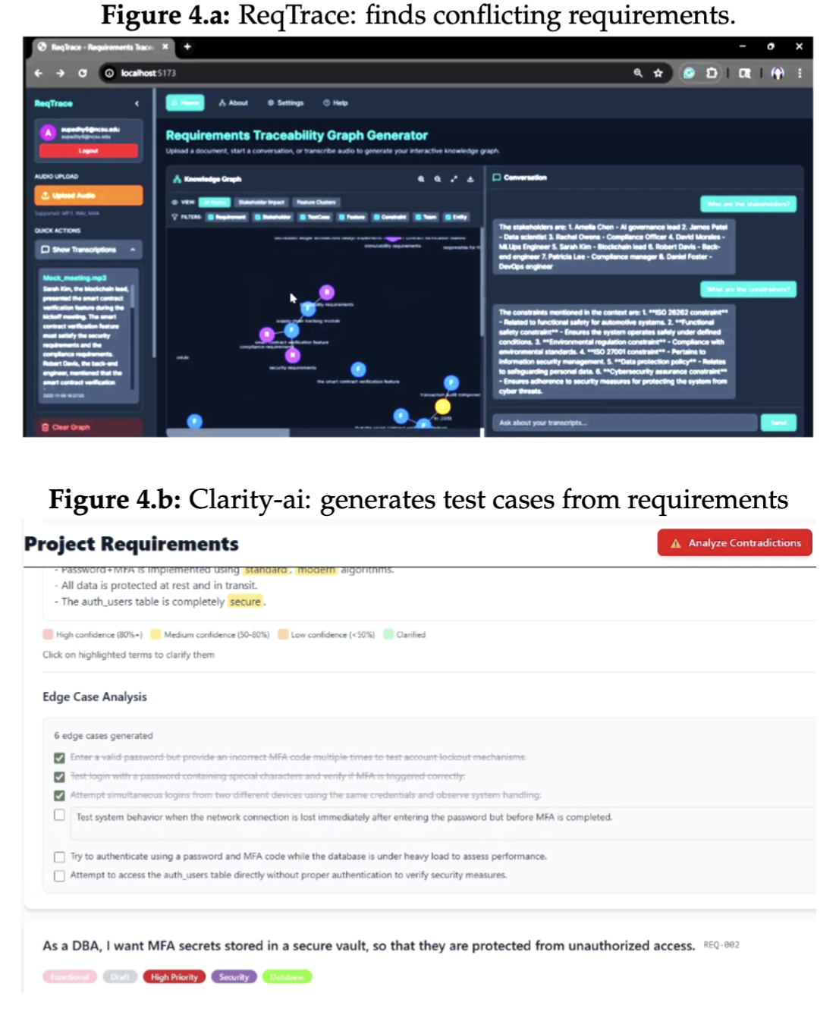
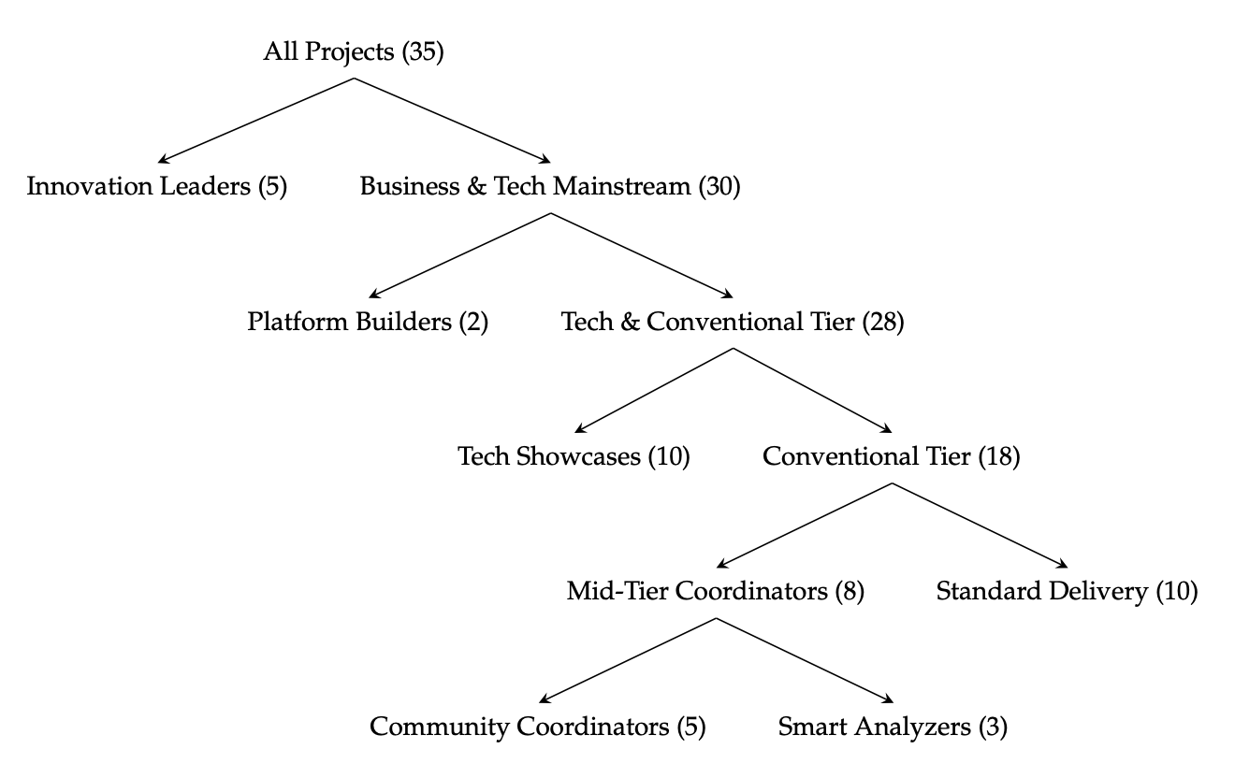
Effects of LLM-based ideation: 35 grad student projects
Also: portofolio-level recommendations for CTOs

Slide 10
Large scale studies of AI in SE
MOOT repository: MSR’26, to appear

Slide 11
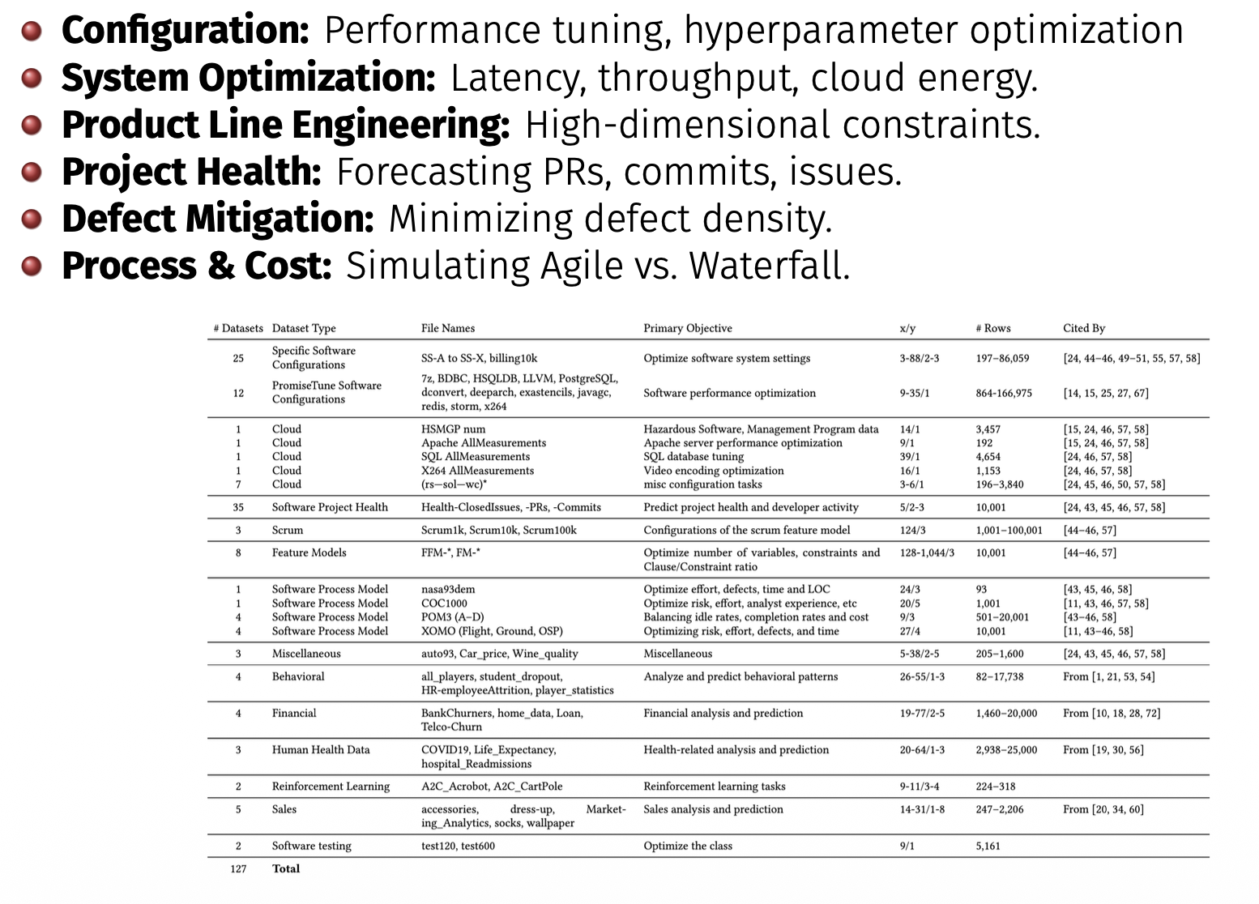
MOOT= 120+ multi-objective optimization tasks http://github.com/timm/moot

Slide 12
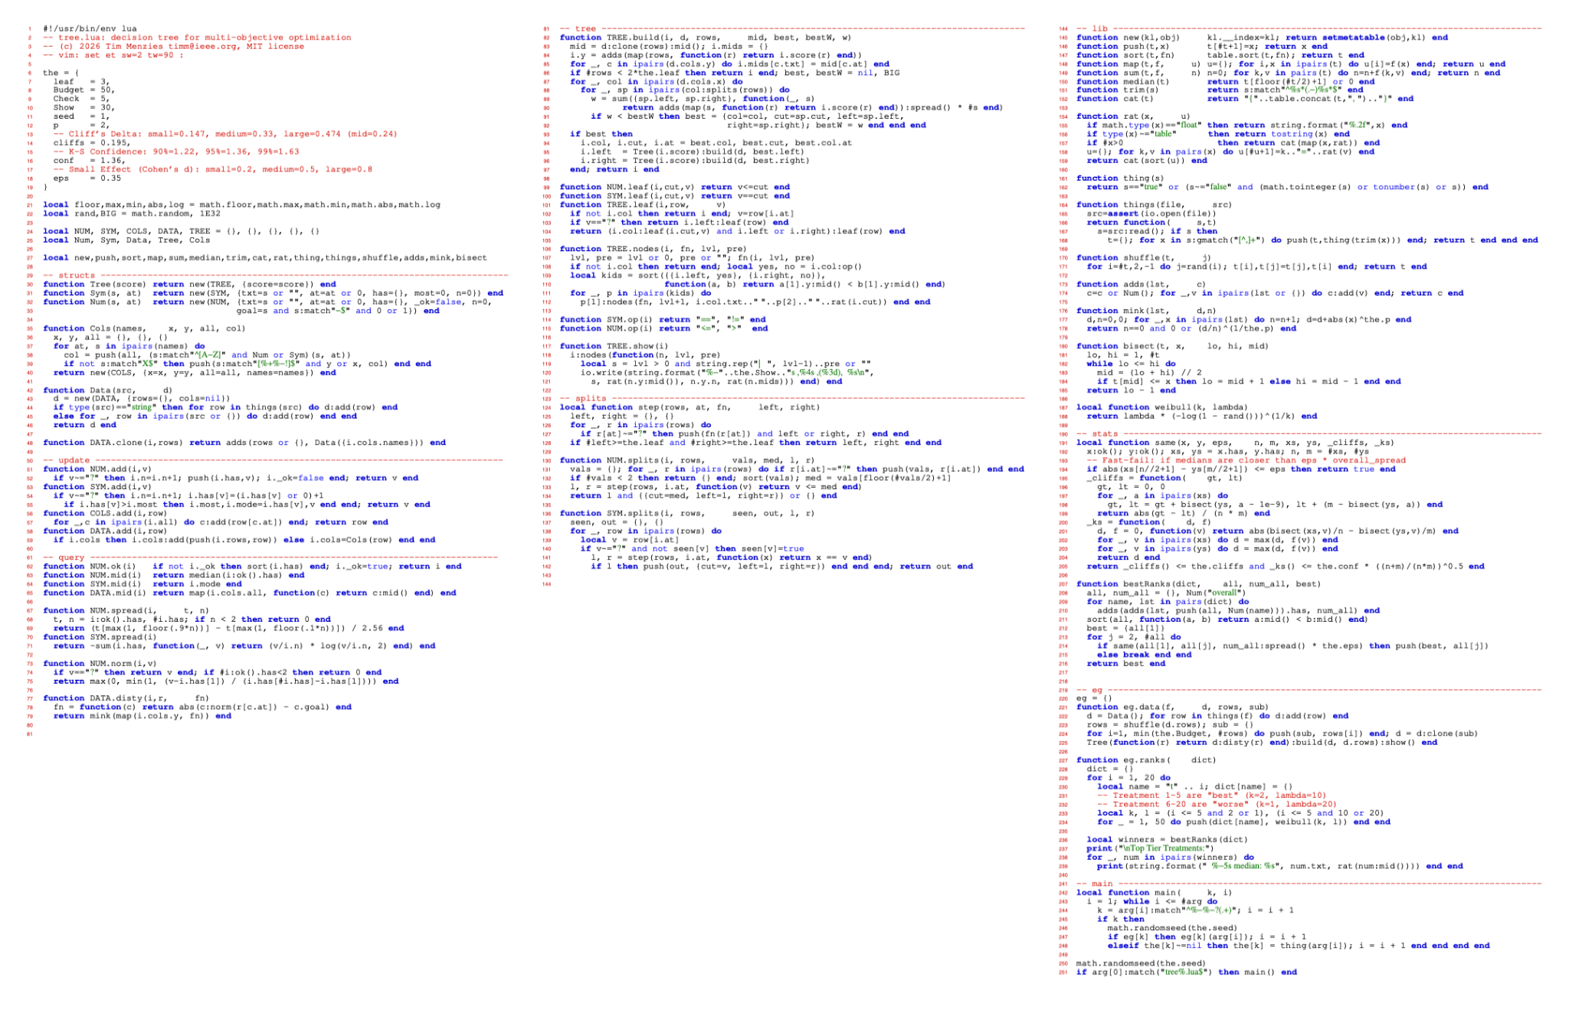
Misc: 43 loc
Non- parametric effect size, significance tests: 24 loc
Tree learner:
40 loc
Unit tests,
CLI: 30 loc
My “Pandas” learner: 50 loc

Slide 13
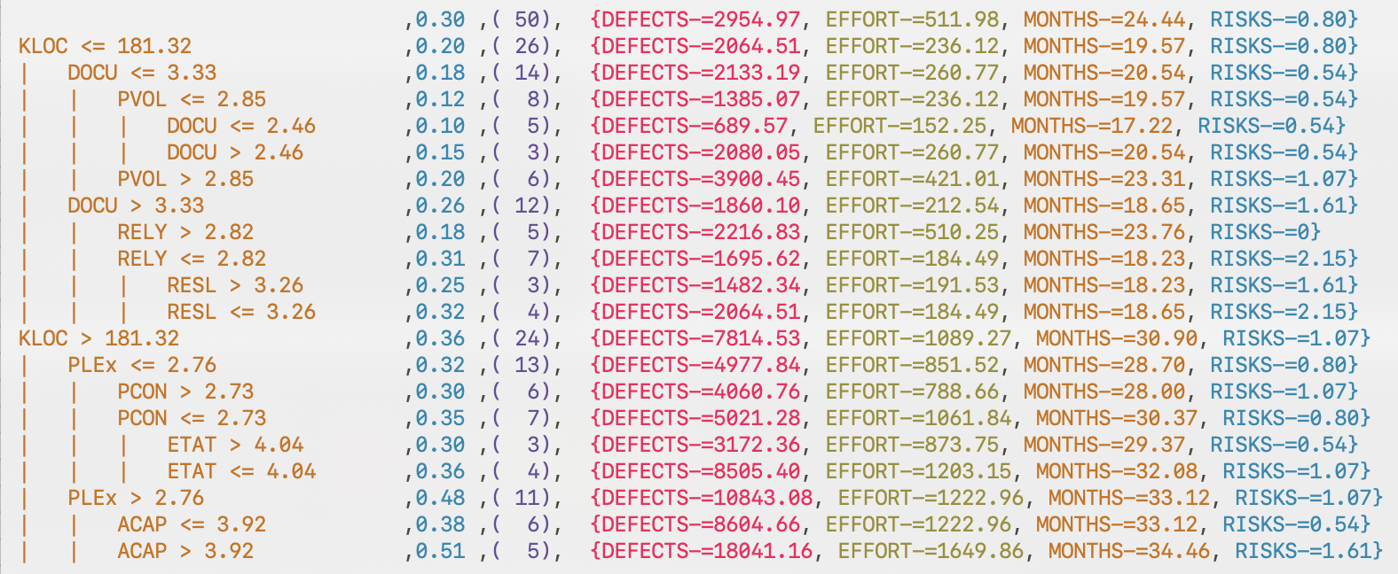
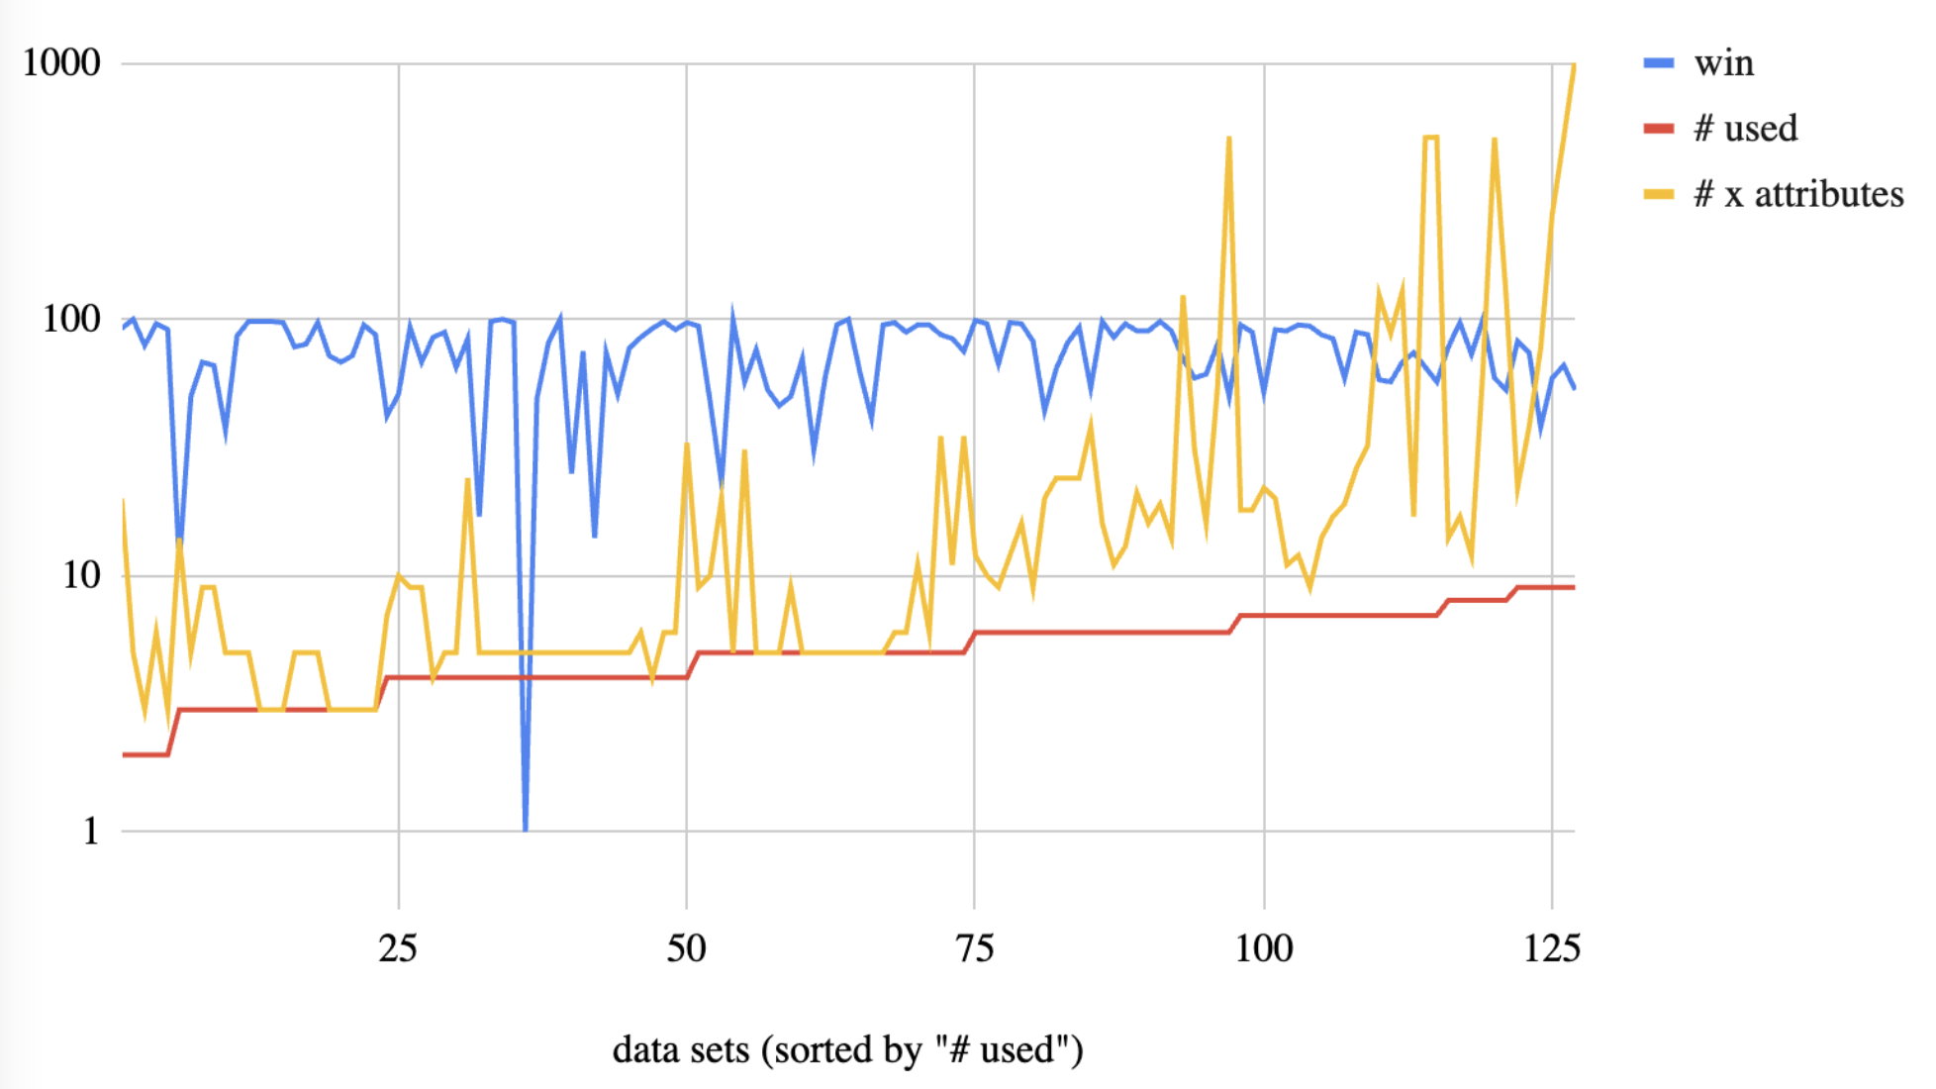
10,000 rows
only labelling 50
24 independent
attributes
Only 3 used in path to best
Only 8 used
In tree
In 126 data sets,
never use > 10
Not what you’d expect in this era of
“big data”

Slide 14
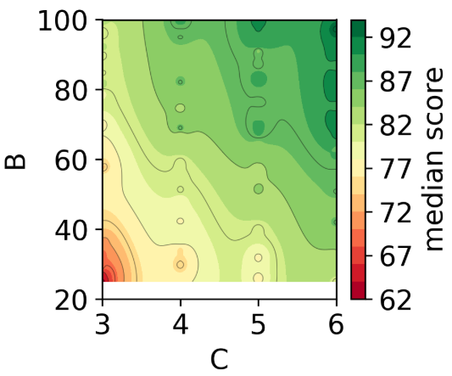
10,000 rows
(only labelling 50)
24 independent
attributes (only using 8 in tree)
Only 3 used in path to best
Repeat 200 times:
Pick a Moot data set at random
Divide data 1:1 train:test
Learn tree from B=50 labelled training egs
1st: sort test by tree predictions
2nd: sort first C=5 test egs by labels
Return first item in 2nd sort.
score ≈ .55 + 0.4*B*C

Slide 15
Why sort twice?
Sort 1: tree predictions on ALL test rows Tree learned from 50 labels. Coarse but cheap ranking. Filters the haystack.
Sort 2: true labels on TOP-5 only 5 more labels, exact rank. Breaks within-leaf ties. Picks the needle.
Why not just argmax(tree)?
At B=50, tree leaves are noisy: many rows share the same predicted rank.
The within-leaf order is random unless you spend a few labels to resolve it.
C=5 labels is usually enough — the leaf is already small.
Total labels used: 50 (train tree) + 5 (tie-break) = 55

Slide 16
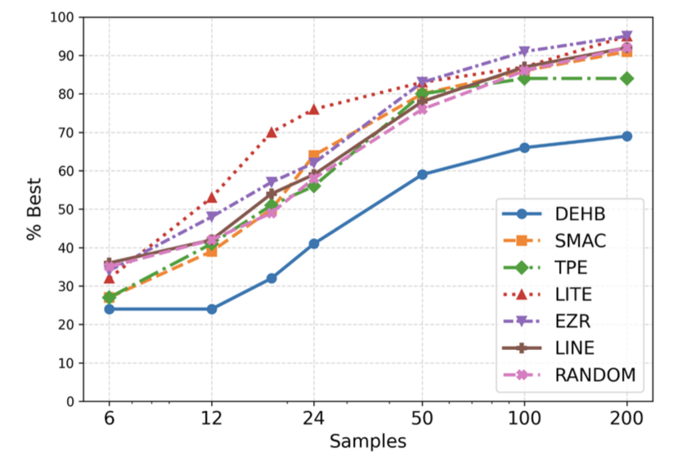
10,000 rows
(only labelling 50)
24 independent
attributes (only using 8 in tree)
Only 3 used in path to best
Repeat 200 times:
Pick a Moot data set at random
Divide data 1:1 train:test
Learn tree from B=50 labelled training egs
1st: sort test by tree predictions
2nd: sort first C=5 test egs by labels
Return first item in 2nd sort.

Slide 17
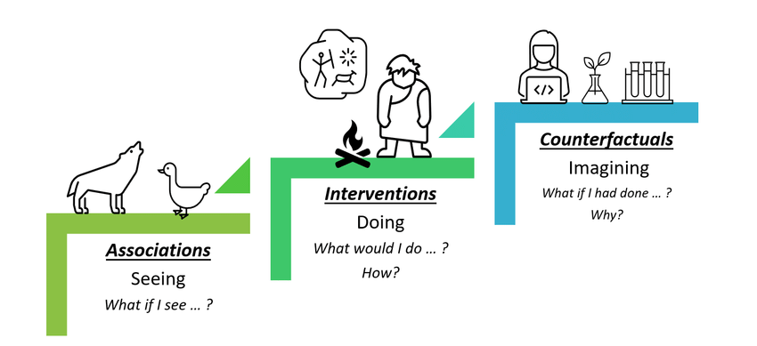
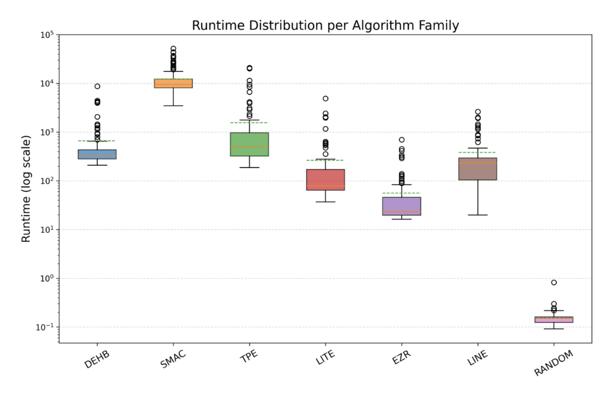
10,000 rows
(only labelling 50)
24 independent
attributes (only using 8 in tree)
Only 3 used in path to best
Simple, performs like SOTA, very fast, explainable code, explainable model
100 times faster than SOTA

Slide 18
When LLMs, when trees?
Use SynthCore (20 LLM prompts)
Use the 50-loc tree
• free-text, semantic inputs
• no labels to anchor on
• need novel ideation
• problem described, not tabulated
49 MOO tasks — Senthilkumar '26
• structured, tabular inputs
• you can afford ~50 labels
• need fast, explainable ranking
• ms-scale inference, auditable
127 MOOT tasks — this talk
Spend compute on DIVERSITY, not SCALE — 20 prompts or a few tree leaves.

Slide 19
So why do my trees work so well?
The landscape is not
what we expected

Slide 20
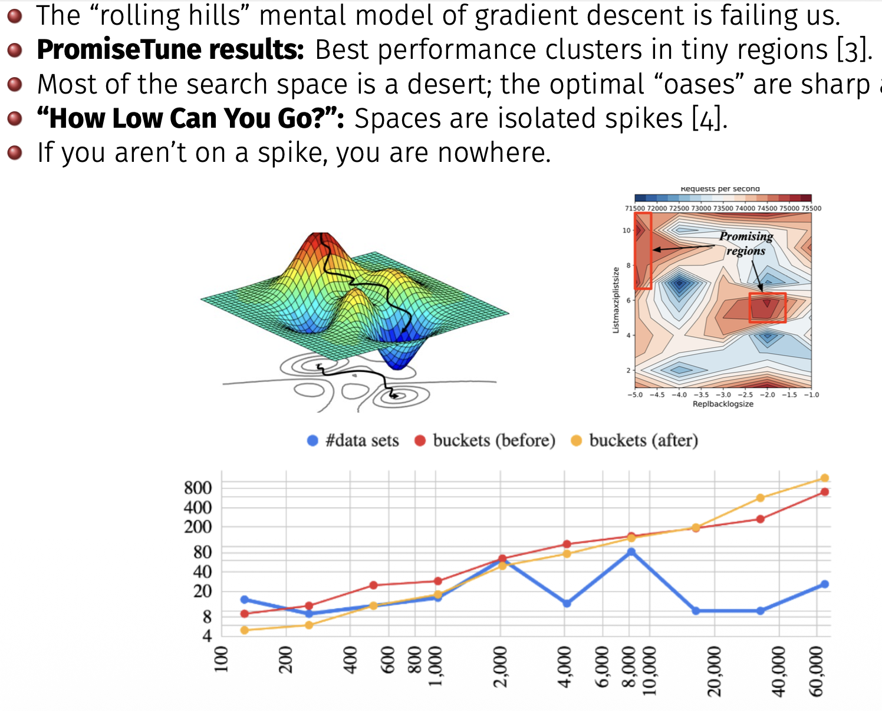
Landscape analysis

Slide 21
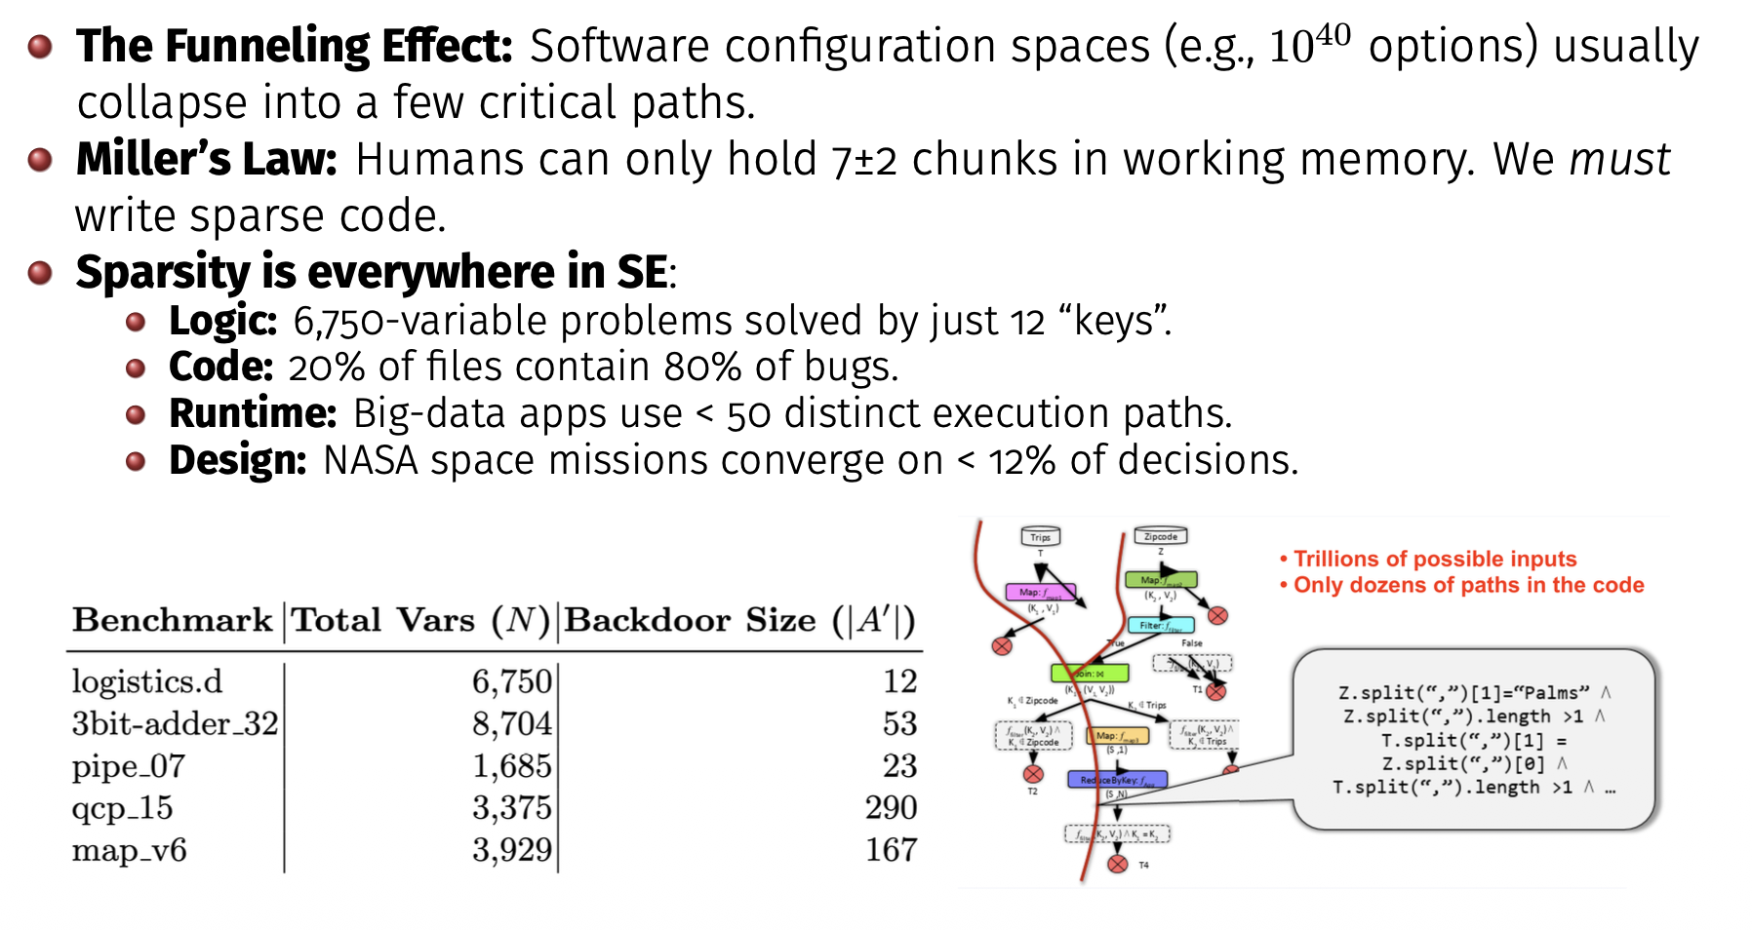

Slide 22
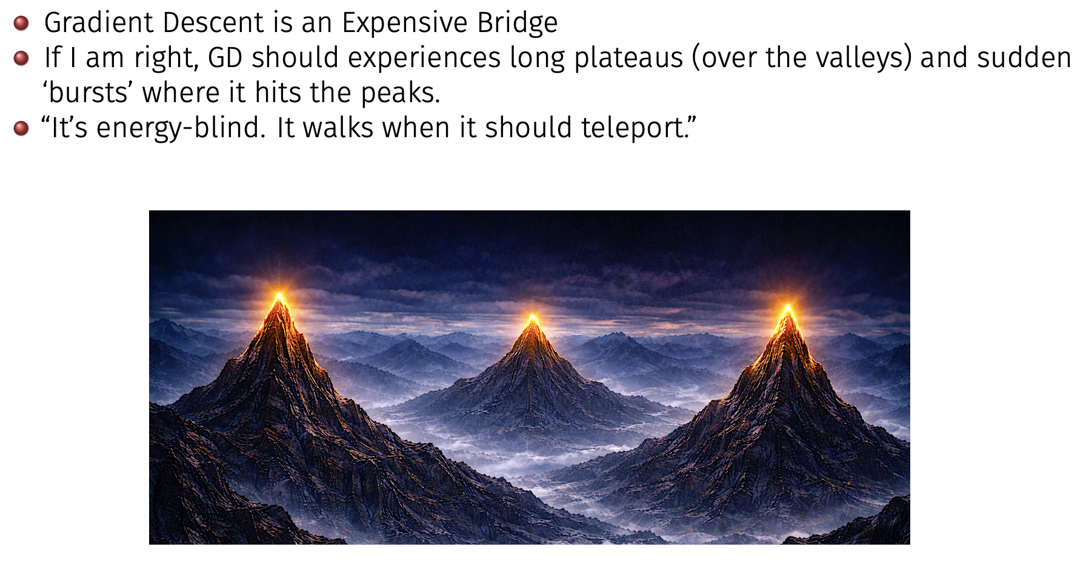

Slide 23
Q: Why not seen before?
A: cause no one looked

Slide 24
What does this mean for verification?
50-loc tree • every path auditable • reproducible with a seed • inference in ms • 3 of 24 features actually used • read the whole model in 2 min
70B LLM • 10^11 parameters • non-deterministic outputs • inference is a black box • all features 'used', none explain • verification requires testing, not reading
Verification is tractable iff (the model is small) AND (the decision surface is sparse).
Our finding: the decision surface IS sparse.
Compact AI is not just cheaper — it is the only AI that verification can reach.

Slide 25
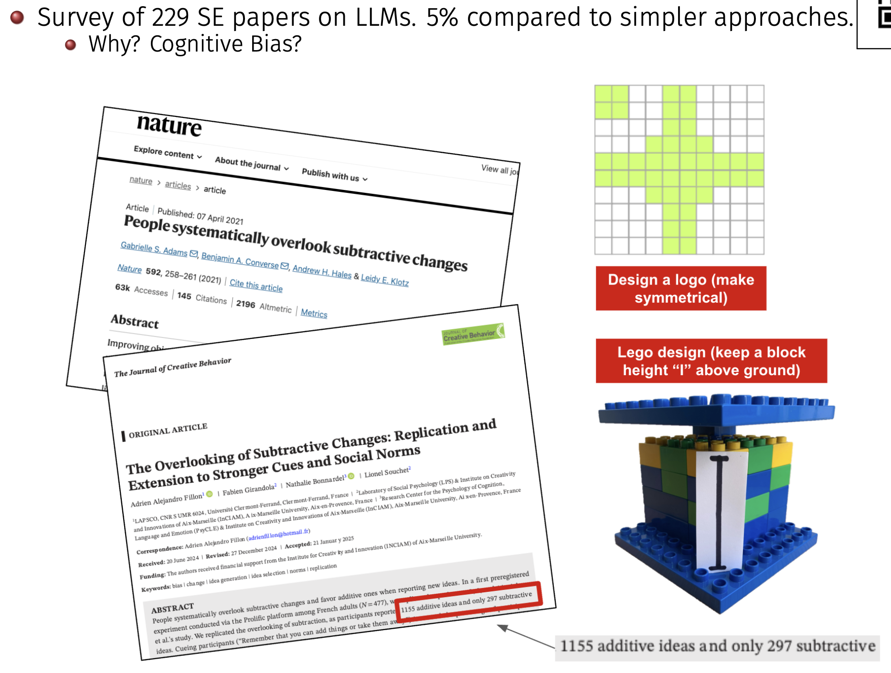

Slide 26
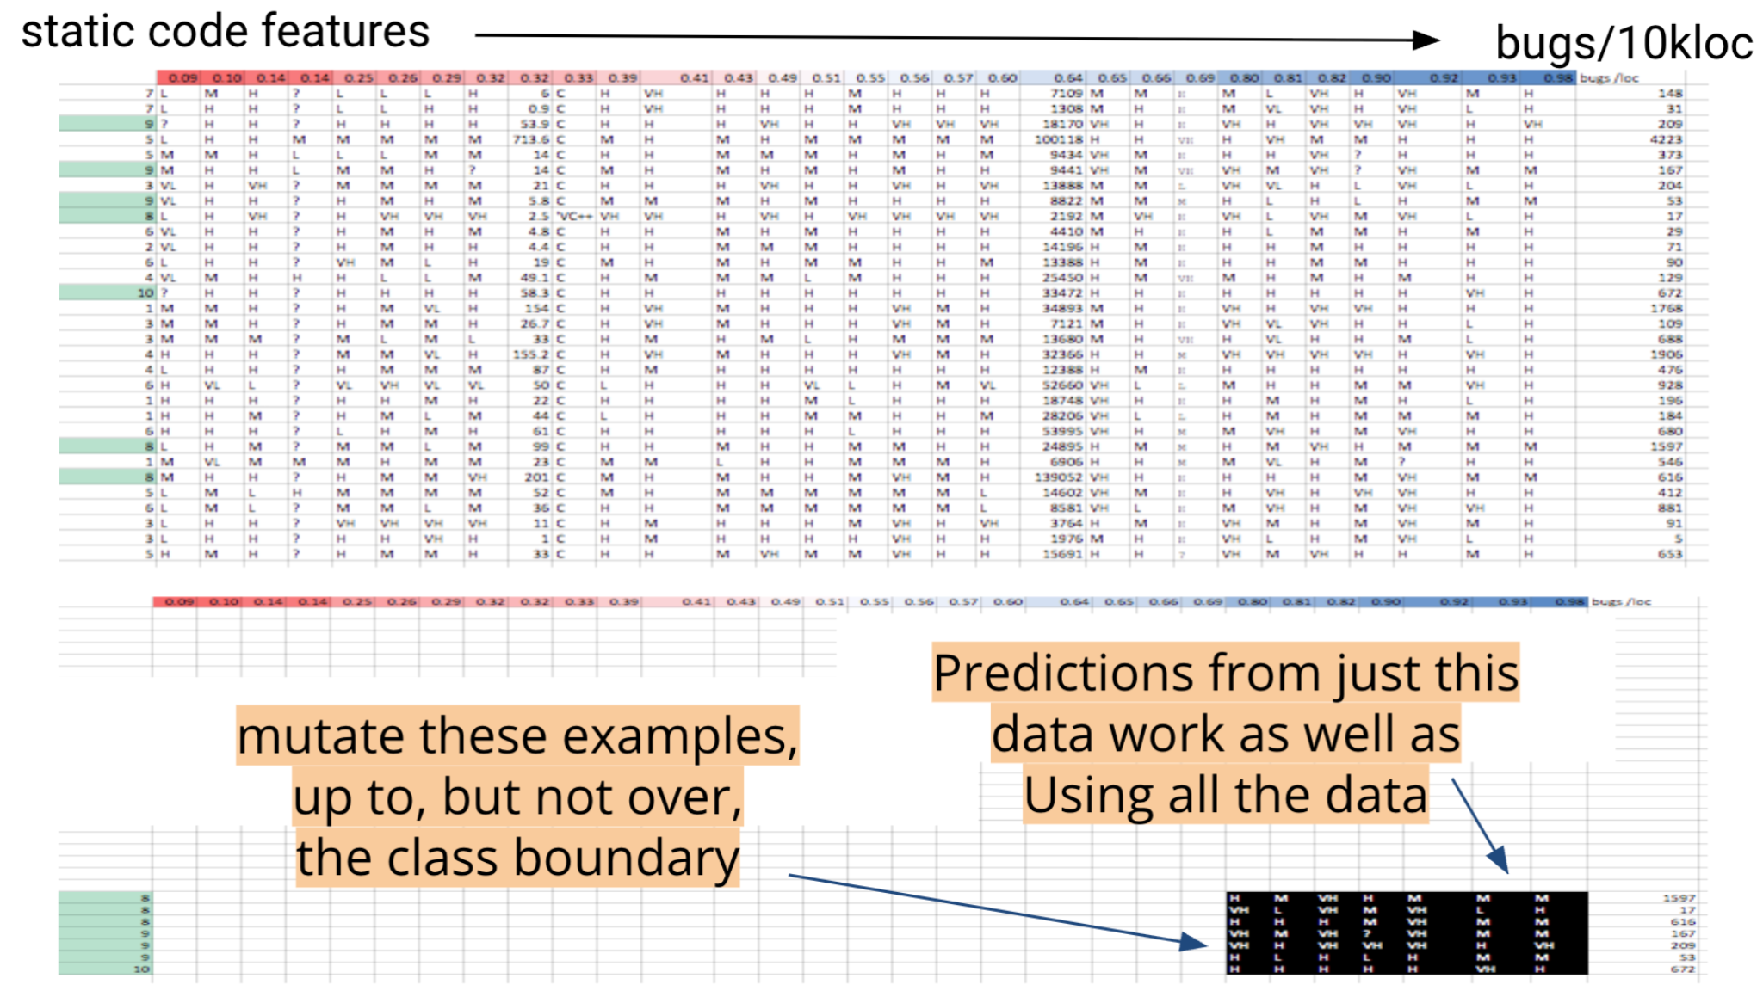
Simplicity and Privacy

Slide 27
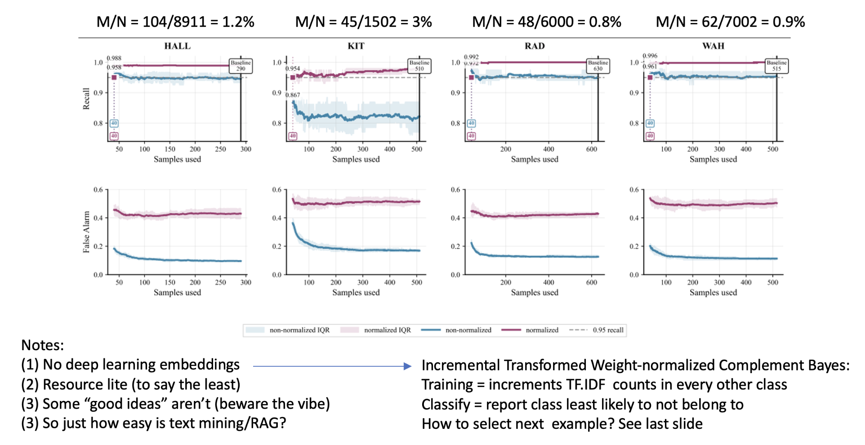
Rolling your own RAG (simpler)

Slide 28
So much room for
explainable, simpler, faster AI
Meanwhile, the world has gone mad on complexity

Slide 29
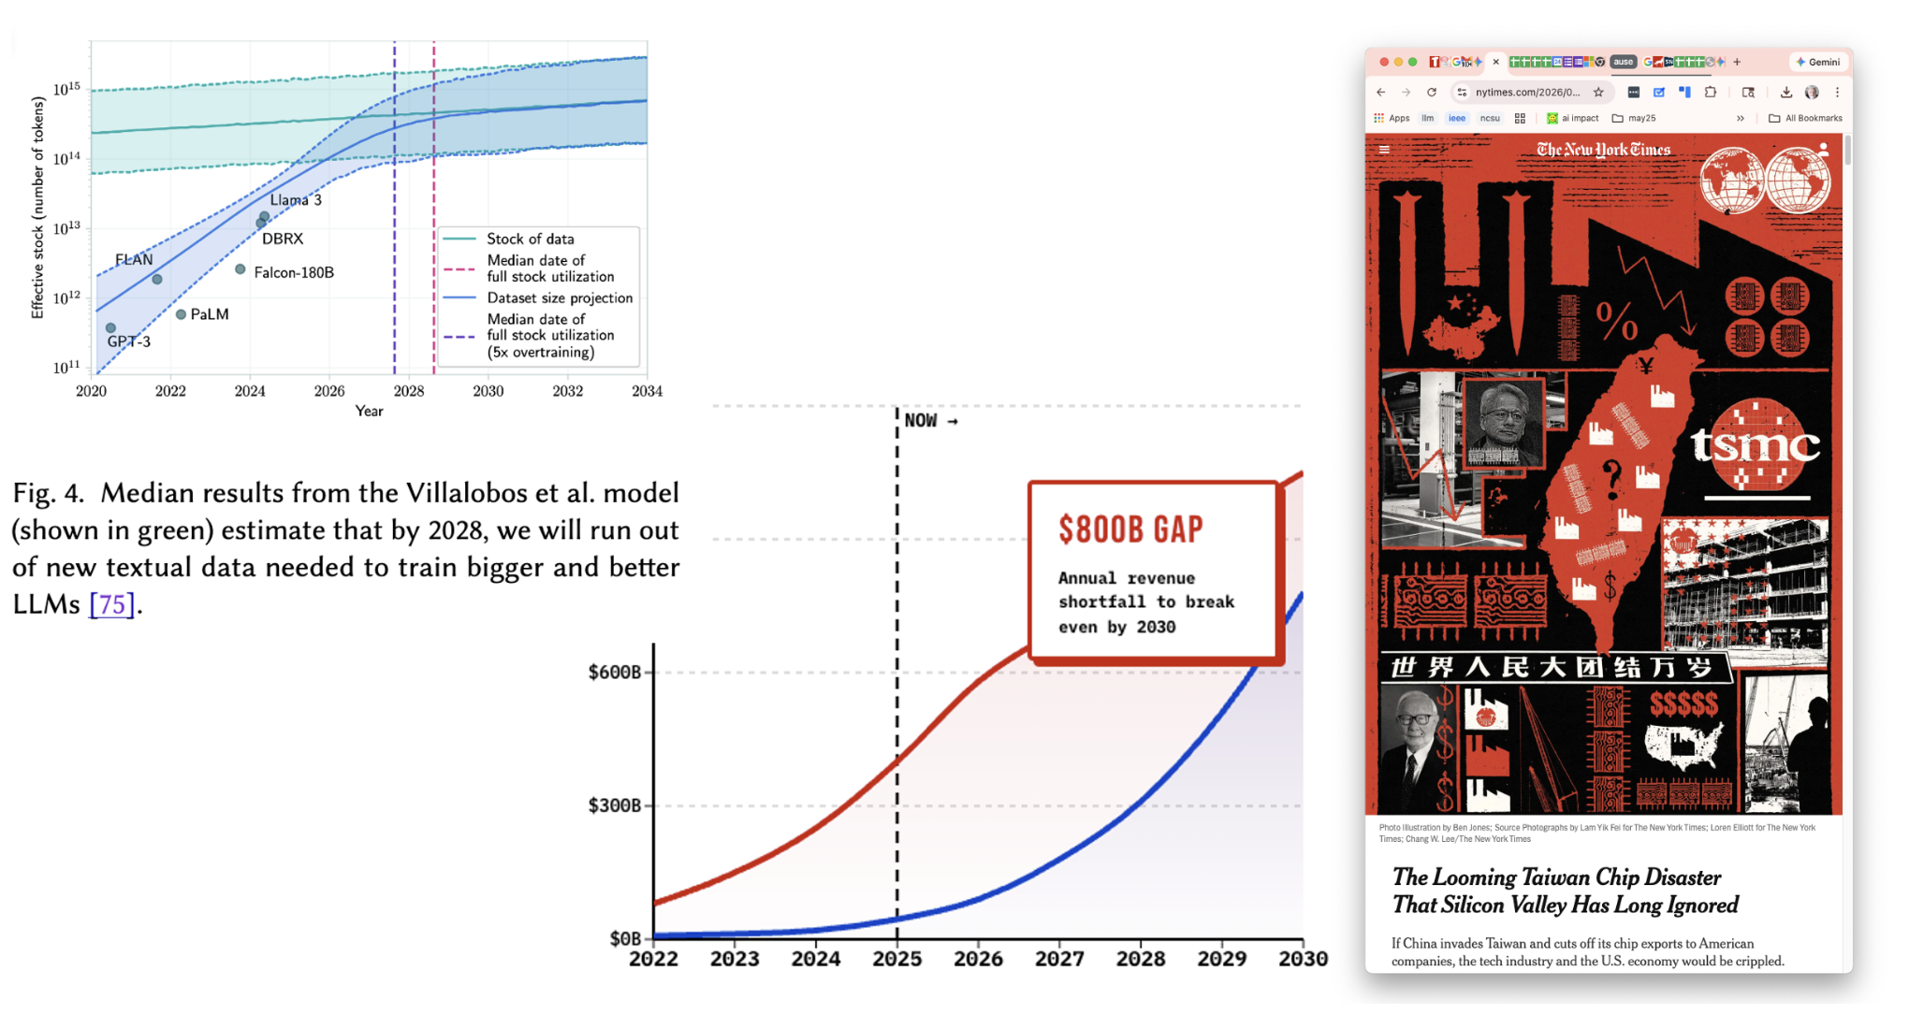

Slide 30
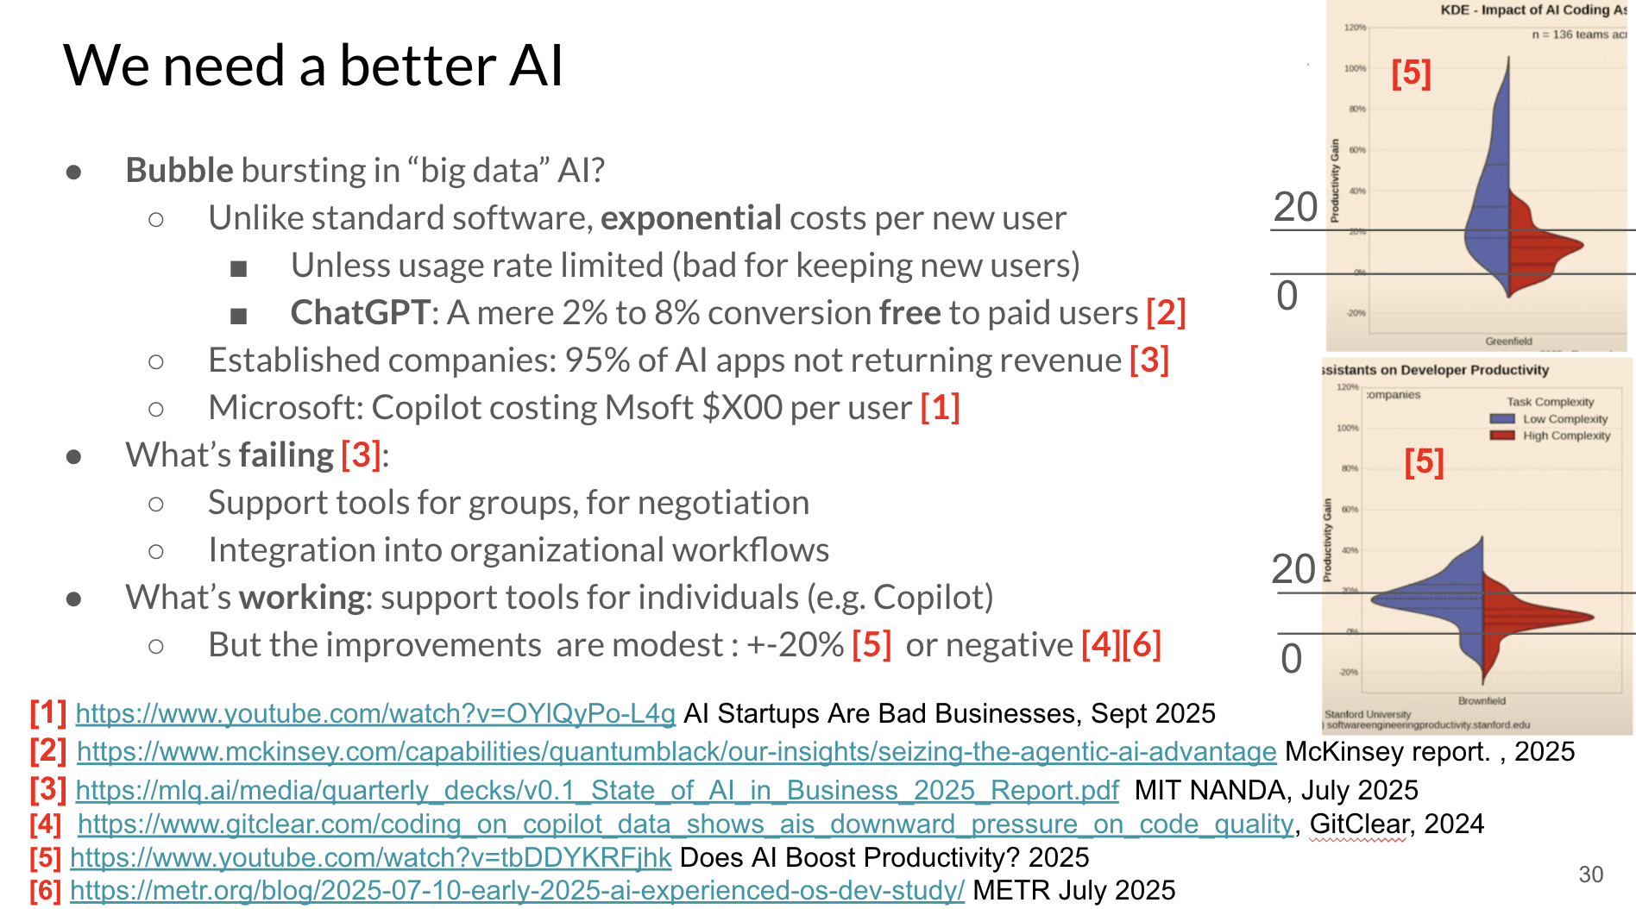

Slide 31
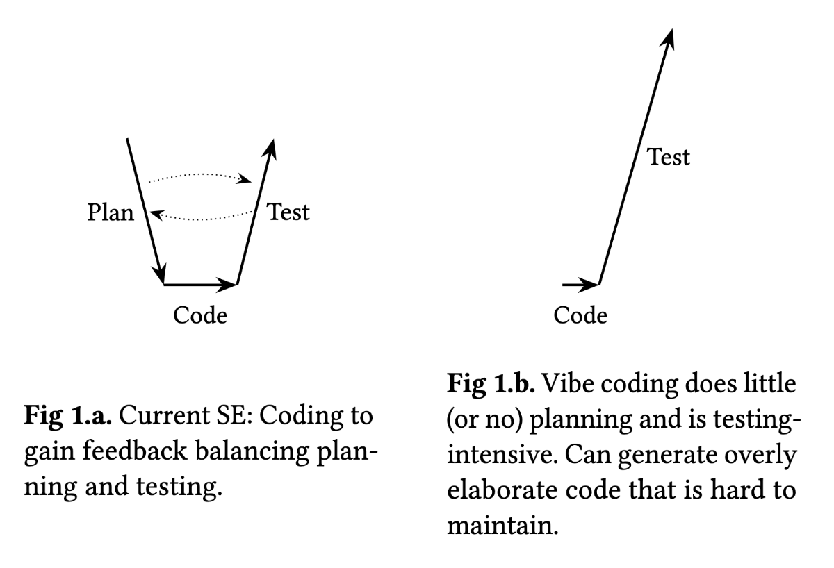
Vibe effects

Slide 32
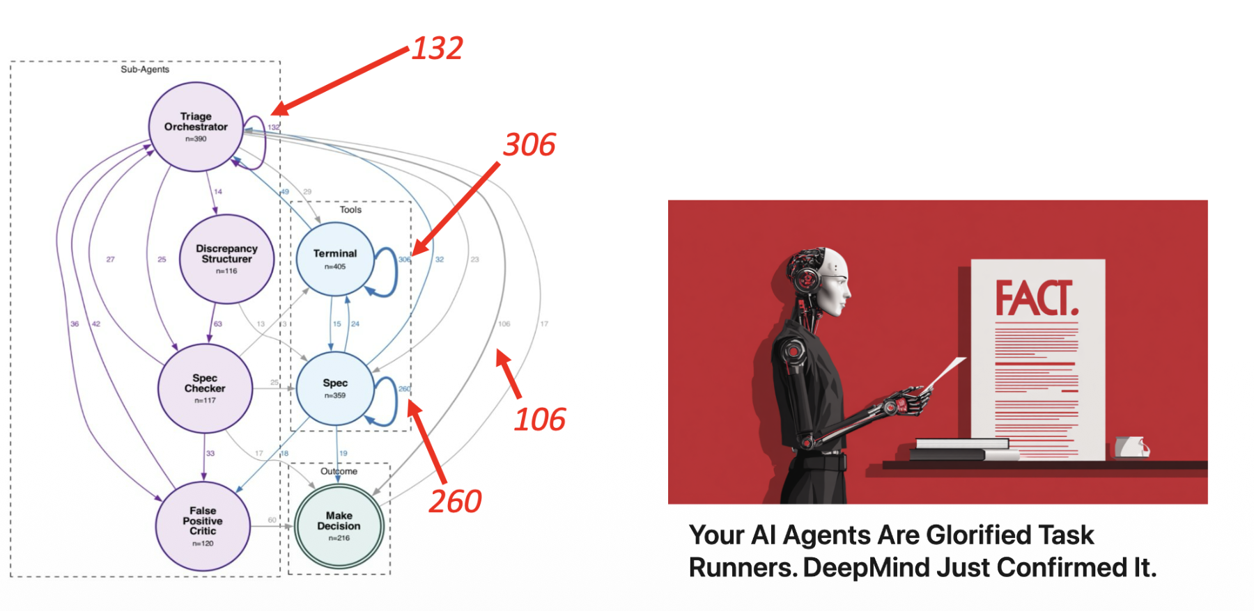

Slide 33
Critiquing AI doesn't mean I hate it; it means I'm demanding better, more responsible science. Are we suffering from a collective syndrome? Hype has replaced critical thinking? Barming both our environment and scientific process.
The Illusion of Choice: Are we onditioned to believe massive, expensive LLMs are the only option. Highly efficient, local alternatives exist are missing from public discourse. Some campaign to lock us into corporate ecosystem?.
The Cost to Science: True science requires reproducible experiments. When only a few mega-corporations have the money and compute power to run tests, independent research is effectively dead.
The Environmental Blind Spot: irresponsible to accept the massive energy consumption of LLMs as the "cost of doing business" instead of actively discussing how to reduce it.
The Syndrome of Hype: Our failure to routinely question the massive failure rates, black-box designs, and staggering costs of these models is a symptom of blind consumerism over rigorous engineering.
Advocating for transparent, efficient, and accessible AI isn't anti-progress. It’s about taking back control and ensuring technology empowers everyone, rather than draining our natural resources and scientific integrity to enrich a few.

Slide 34
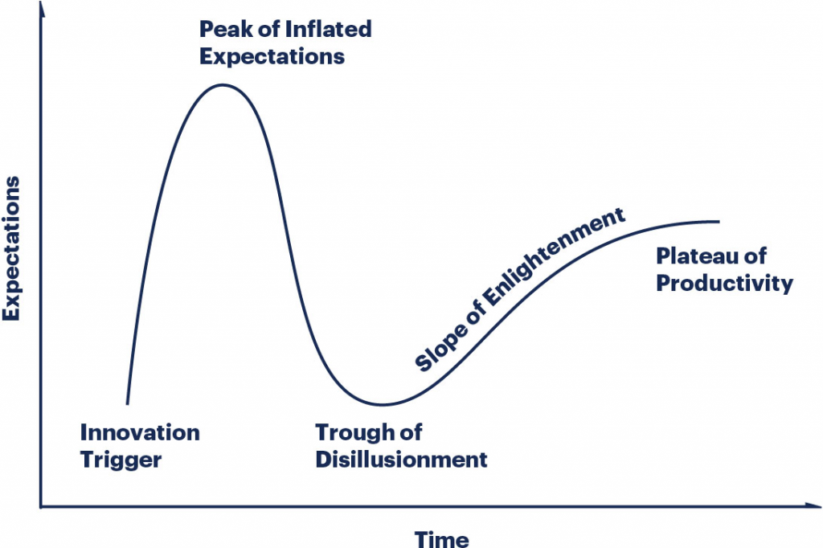
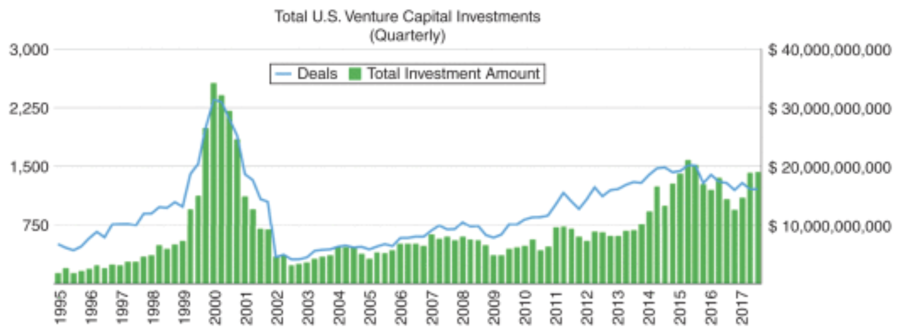

Slide 35
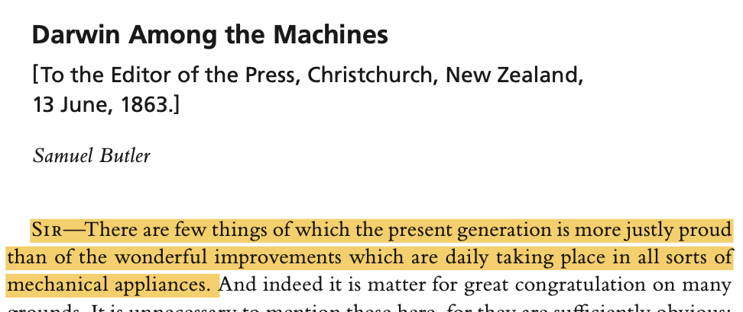
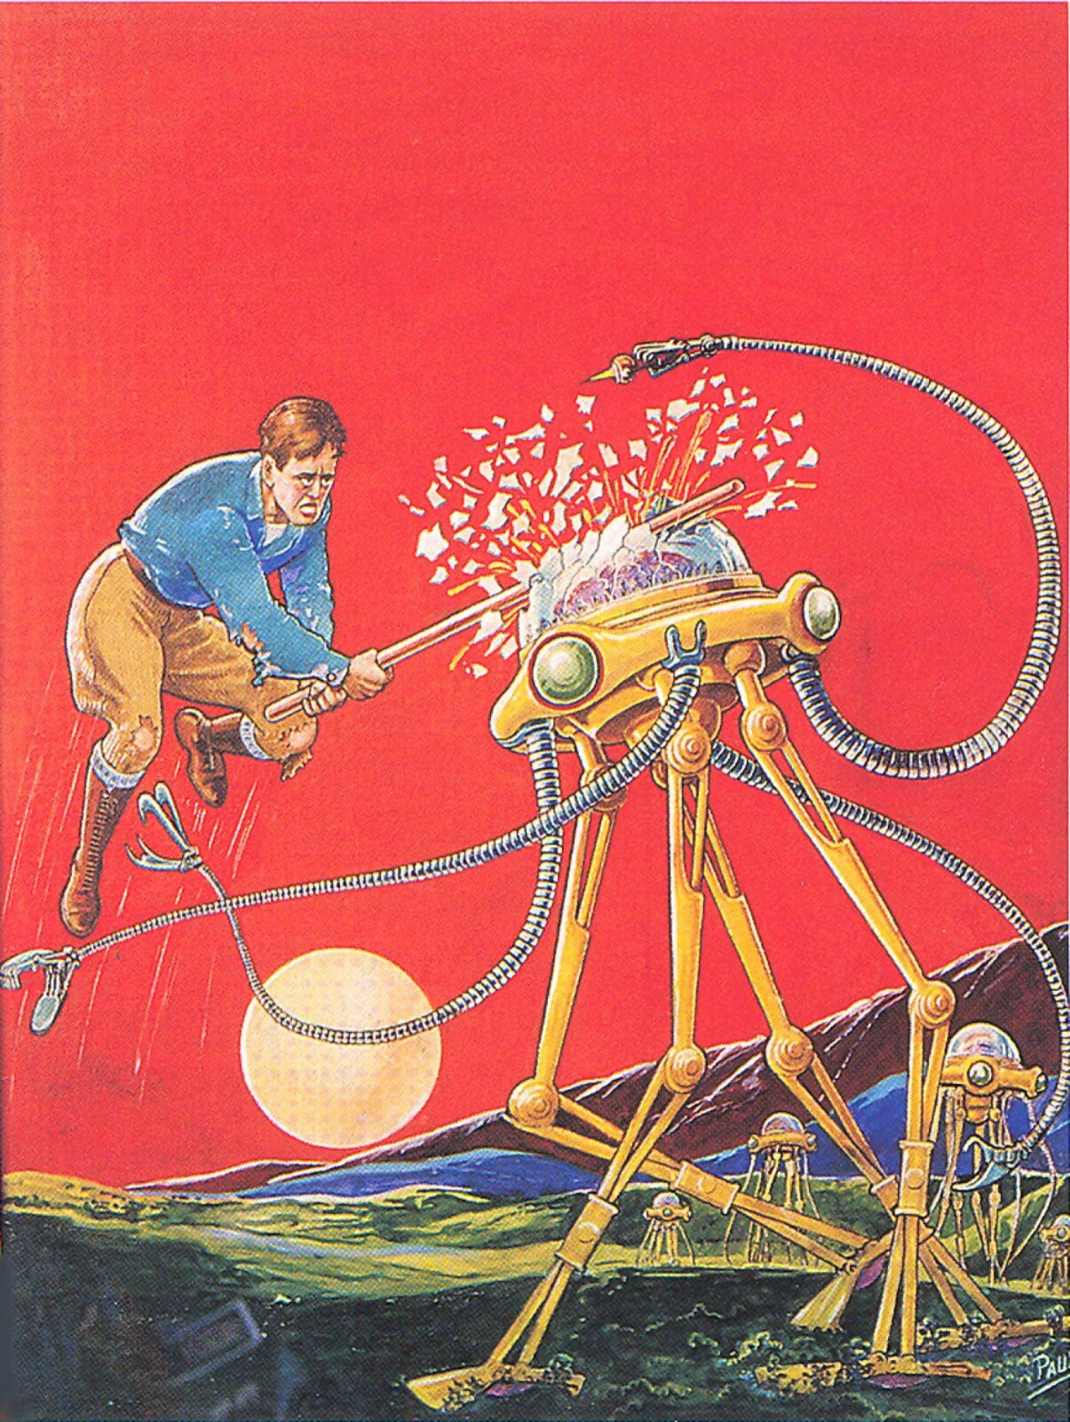
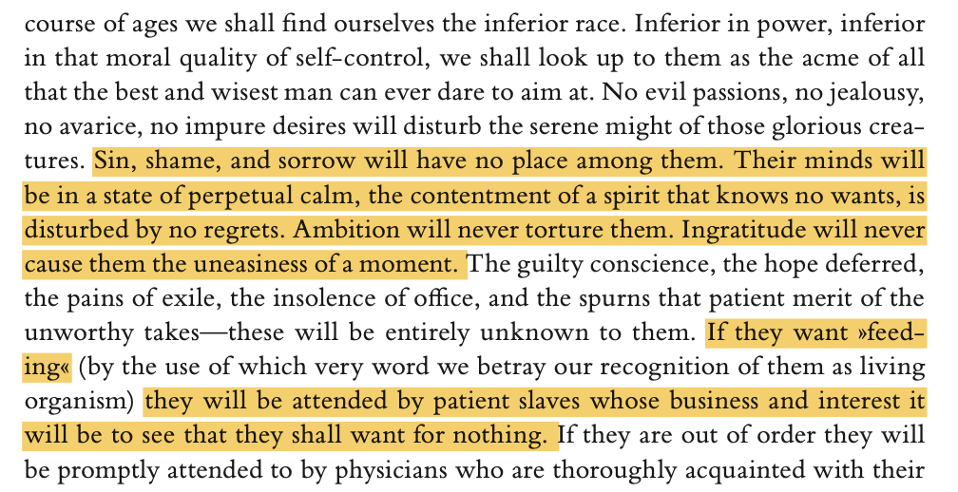
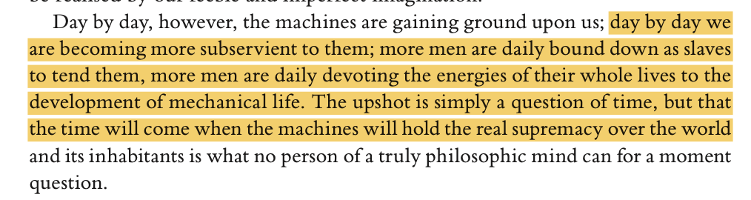
Butlerian Jihad

Slide 36
Agentic software? Sure!
All agents LLMs? No!
Questions? Comments?

