Slide 1
Scripts update for HL products
Procedure to update scripts for ALTAIR products

Slide 2
Scripts update for new products
Current use of the scripts:
Each product (or set of products) has a dedicated code in the scripts.
For example :HL7650:
HARD_TYPE=200 ➔ This code is used for generic HL LTE products.
HardType_LTE=13
For VIC00014 (based on HL7650):
HARD_TYPE=200 (same as HL7650 and whole HL LTE product)
HardType_LTE=14
Issue:
For the validation of a new product that should be compliant with HL7650 for example. We have 2 options:
1. Use the same code as HL7650.
2. Have a dedicated HardType_LTE.
Sierra Wireless Proprietary and Confidential

Slide 3
Issue for scripts use for new products (1)
1. Use of the same code as HL7650:
Pros:
- Scripts could be used without any update for Common feature with the same behavior.
- Optimization of campaign run duration.
Cons:
- Risk to affect other products validation when updating scripts.
- Flag (new parameter) should be created for Common features with different behavior (error codes ….).
- 1-Click or Full campaign can’t be run with the same product code and campaign should be split at least to 2 sub-campaigns.
Sierra Wireless Proprietary and Confidential

Slide 4
Issue for scripts use for new products (2)
1. Use of the same code as HL7650:
Example:
A_INTEL_LTE_GEN_ATI_0001.py
# Create a new parameter (new_param) in HL7800.cfg
# To be done for HL7650 standard mode
elif (HardType_LTE == "13"): # Doobie
……
  if new_param:
  # Specific_Behaviour for HL7800 # Dizzy
  ……
  We will have a great number of new parameters to manage : new_param1, ….
Sierra Wireless Proprietary and Confidential

Slide 5
Issue for scripts use for new products (3)
2. Have a dedicated HardType_LTE code.
Pros:
- No new parameter to create.
- One code dedicated per product ➔ more scripts legibility.
- More flexibility to update scripts with minimum risk to affect other product using the same script.
- All scripts (ready for 1-Click) could be run in one campaign.
Cons:
- All scripts related to TCs in product campaign should be updated ➔ Great workload to update scripts.
➔ Option used by HK
Sierra Wireless Proprietary and Confidential

Slide 6
Issue for scripts use for new products (4)
2. Have a dedicated HardType_LTE.
Example1:
A_INTEL_LTE_GEN_ATI_0001.py
# New HardType_LTE value (16 for Dizzy) in HL7800.cfg
# To be done for HL7650 standard mode
elif (HardType_LTE == "13"): # HL7650
……
elif (HardType_LTE == "16"): # HL7800
  …HL7650 code is duplicated and update for HL7800
  All scripts with HardType_LTE == "13“ should be updated in order to be used for HL7800. The pros is the good readability of the scripts.
  Minimum risk to affect scripts execution for other products.
  HL7800 scripts will not take leverage from any scripts update done for HL7650
Sierra Wireless Proprietary and Confidential

Slide 7
Issue for scripts use for new products (5)
2. Have a dedicated HardType_LTE.
Example2:
A_INTEL_LTE_GEN_ATI_0001.py
# New HardType_LTE value (16 for Dizzy) in HL7800.cfg
# To be done for HL7650 standard mode
elif (HardType_LTE == "13") or (HardType_LTE == "16"):
……
  if (HardType_LTE == "13") : # HL7650
  …..
elif (HardType_LTE == "16"): # HL7800
…..
  All scripts with HardType_LTE=="13“ should be updated in order to be used for HL7800. The pros is the good readability of the scripts.
  HL7800 scripts will take leverage from any scripts update done for HL7650
  Great risk to affect scripts execution for other products.

Slide 8
New process for Scripts update - 1
Ideas:
1. Carry on using one code per product to maintain scripts legibility.
2. Create a list in config file (HL78xx.cfg) with all codes for products to have mainly same behavior.
3. HL7650 is Intel Chipset and could be different from ALTAIR products, a second list will be created only for ALTAIR products (as it is expected to have usually the same behavior).
4. Scripts update take a long time that could affect strongly one product validation schedule ==> we will focus only on Doobie, Drums and Dizzy. We will modify only scripts related to HL7650 and inside those scripts, only parts applicable to HL7650 will be updated.
5. All features/commands implemented on Drums will be considered as supported on all products.
6. Each Feature/command on Dizzy but not supported on Drums will be linked a new parameter called AT_CMD that could be set to 0 or 1. The new parameter will be defined in Excel sheet available in SVN.
Sierra Wireless Proprietary and Confidential

Slide 9
New process for Scripts update - 2
1. Carrying on using one code (HardType_LTE) per product:
HARD_TYPE=200 is generic parameter used for all HL LTE products.
HardType_LTE is a parameter used to distinguish LTE products:
12 -> MCBL (Common features for HL7650, HL7588,…).
13 -> HL7650
14 -> VIC00014
16 -> HL7800
17 -> HL7719/49
The parameter is created in SVN: SVN_Applicative\trunk\Configuration\Hard\INTEL_HardTemplate.xls.
An Excel Macro is used to generate HARD_INI file that will be used by the scripts.
Sierra Wireless Proprietary and Confidential

Slide 10
New process for Scripts update - 3
New list with HardType_LTE values should added in HL7xxx.cfg
Generic_Behaviour_Product_List = [‘13’,16’,’17’]
To be used for all feature that we expect exactly the same behavior on Doobie (HardType_LTE=13) and Dizzy (HardType_LTE=16) and Drums ((HardType_LTE=17).
Specific_Behaviour_Product_List = [‘16’,’17’]
To be used for all feature that we expect different behavior on Doobie (HardType_LTE=13) comparing to Dizzy (HardType_LTE=16) and Drums ((HardType_LTE=17).
For example: AT+CGATT=? Returns +CGATT:(0,1) on INTEL but +CGATT: (0-1) on ALTAIR.
Basically, we expect to have the same behavior on Drums and Dizzy (on ALTAIR products) for Common features.
Sierra Wireless Proprietary and Confidential

Slide 11
New process for Scripts update - 4
Management of non Common AT commands:
All supported AT commands on Drums will be supported on Dizzy. In case of an command that is not supported yet on Dizzy, Dizzy team will manage it.
For AT commands not supported on Drums but are supported on Doobie or will be on Dizzy on Dizzy, Eurhythmics, PLT1250… new parameter called “AT_CMD” will be created. A new parameter will be created per AT command.
The parameter is created in SVN: SVN_Applicative\trunk\Configuration\Soft\INTEL_SoftTemplate.xls.
An Excel Macro is used to generate SOFT_INI file that will be used by the scripts.
In a scripts that has a non supported AT command, AT_CMD parameter should be called.
Sierra Wireless Proprietary and Confidential

Slide 12
Config Files update
Example: HL7800
Define in HL7800.cfg file 2 new parameters:
Generic_Behaviour_Product_List = [‘13’,16’,’17’]
Specific_Behaviour_Product_List = [‘16’,’17’]
For Eurythmics validation, we have only to add it HardType_LTE value in both list then we run scripts for Common features without any update except for features with different behaviour comparing to HL7800.
Define new AT commands parameters in HL78xx.HL7800_ALTAIR.ini
AT_ATX=0 (ATX AT command is not supported on HL7719/49)
AT_CCID=0 (CCID AT command is not supported on HL7719/49)
This file is generated automatically through an Excel Macro.
Sierra Wireless Proprietary and Confidential

Slide 13
Scripts update (1)
Example: A_INTEL_LTE_GPRS_CGDCONT_0001.py
1. Init update:
# -------------------------- AutoTest Initialization --------------------------------
# Variable Init
SIM_Pin1 = get_ini_value( SIM_INI, 'Security', 'Pin1')
VoiceNumber = get_ini_value( SIM_INI, 'Identification', 'VoiceNumber')
APN = get_ini_value( SIM_INI, 'gprs', 'APN')
HARD_TYPE = get_ini_value(HARD_INI, 'HardType', 'HardType')
Hard_INI_Product_Name = get_ini_value(HARD_INI, 'Module', 'WCPU_Name')
SOFT_INI_Soft_Version = get_ini_value(SOFT_INI, 'Soft', 'Version')
HardType_LTE = get_ini_value(HARD_INI, 'HardType_LTE', 'HardType_LTE’)
# define new flags for non supported AT commands on Drums
AT_CCID=int(get_ini_value( SOFT_INI, 'Features', 'AT_CCID'))
AT_EXCEPT = int(get_ini_value( SOFT_INI, 'Features', 'AT_EXCEPT’))
AX_PDP_CONTEXT=int(get_ini_value( SOFT_INI, 'Features', 'MAX_PDP_CONTEXT'))
Sierra Wireless Proprietary and Confidential

Slide 14
Scripts update (2)
Exemple: A_INTEL_LTE_GPRS_CGDCONT_0001.py
2. non supported commands (on Drums) update:
  SagSendAT(UART1, 'AT+CCID\r')
  SagWaitnMatchResp(UART1, ['\r\n+CCID: *\r\n'], 4000)
  SagWaitnMatchResp(UART1, ['\r\nOK\r\n'], 4000)
  Should be superseded by
if AT_CCID:
  SagSendAT(UART1, 'AT+CCID\r')
  SagWaitnMatchResp(UART1, ['\r\n+CCID: *\r\n'], 4000)
  SagWaitnMatchResp(UART1, ['\r\nOK\r\n'], 4000)
  ******************************************************************************************
  SagSendAT(UART1, 'AT+EXCEPT=255\r')
  SagWaitnMatchResp(UART1, ['\r\nOK\r\n'], 4000)
  SagSendAT(UART1, 'AT+EXCEPT\r')
  SagWaitnMatchResp(UART1, ['*\r\nOK\r\n'], 4000)
  Should be superseded by
if AT_EXCEPT:
  SagSendAT(UART1, 'AT+EXCEPT=255\r')
  SagWaitnMatchResp(UART1, ['\r\nOK\r\n'], 4000)
  SagSendAT(UART1, 'AT+EXCEPT\r')
  SagWaitnMatchResp(UART1, ['*\r\nOK\r\n'], 4000)
Sierra Wireless Proprietary and Confidential

Slide 15
Scripts update (3)
Example: A_INTEL_LTE_GPRS_CGDCONT_0001.py
3. Update feature behaviour on script:
  elif ((HardType_LTE in ["5","6","8","10“,”13”]):
  ……
  Will be superseded by
  elif ((HardType_LTE in ["5","6","8","10“]) or HardType_LTE in Generic_Behaviour_Product_List):
  ......
SagSendAT(UART1, "AT+CGDCONT=?\r")
    if (HardType_LTE in Specific_Behaviour_Product_List):
    SagWaitnMatchResp(UART1, ['\r\n+CGDCONT: (1-15),"IP",,,(0-3),(0-4),(0-1),(0-1),(0- 1)\r\n+CGDCONT: (1-15),"IPV6",,,(0-3),(0-4),(0-1),(0-1),(0-1)\r\n+CGDCONT: (1-15),"IPV4V6",,,(0-3),(0-4),(0-1),(0-1),(0-1)\r\n\r\nOK\r\n'], C_TIMER_LOW)
else:
SagWaitnMatchResp(UART1, ["\r\n+CGDCONT: (1-20),\"IP\",,,(0,1,2),(0,1,2,3,4),(0,1),(0,1),(0,1),(0,1)\r\n+CGDCONT: (1-20),\"IPV6\",,,(0,1,2),(0,1,2,3,4),(0,1),(0,1),(0,1),(0,1)\r\n+CGDCONT: (1-20),\"IPV4V6\",,,(0,1,2),(0,1,2,3,4),(0,1),(0,1),(0,1),(0,1)\r\n\r\nOK\r\n"], C_TIMER_LOW)
Sierra Wireless Proprietary and Confidential

Slide 16
Scripts update/use for coming ALTAIR products
Example: Eurythmics
Create new HardType_LTE for the product (example: 23)
2. Update HL78xx.cfg file:
Generic_Behaviour_Product_List = [‘13’,’16’,’17’,’23’]
Specific_Behaviour_Product_List = [‘16’,’17’,’23’]
➔All scripts updated for HL7800 can be used without scripts update except features with different behavior on HL7800 and HL78xx (the products have the same baseband so we expect basically the same behavior for Common features).
Sierra Wireless Proprietary and Confidential

Slide 17
Expected report for Dizzy campaign
For common featre with Drums:
Same scripts should be run on Drums and Dizzy for common features.
TMA should compare HL7800 results with Drums for common features. And provide a report for same and different behaviour.
TMA should report scripts update velocity: number of scripts updated daily per person.
Sierra Wireless Proprietary and Confidential

Slide 18
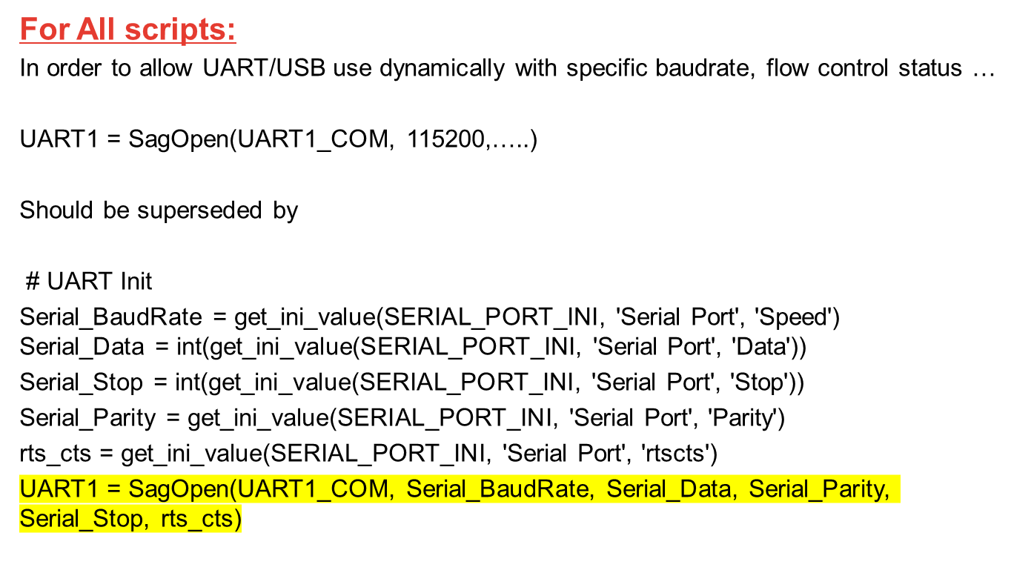
Update for UART/USB port opening
Sierra Wireless Proprietary and Confidential

Slide 19
New functions to be used for Init phase - 1
In order to have the same initialization steps and more flexibility for all scripts it is recommended to use the following new functions. The list of AT commands can be updated for the whole script through config file. The commands used for initialization phase can be managed up the supported AT commands on DUT.
SWI_Check_Module:
This function is to check that the module can answer AT commands.
If the command “AT” is not answered five times, the function tries different baudrates (300 to 460800) and checks the issue is related to a wrong baudrate. Then module will be set to the baudrate defined in the script and restarted.
Then the function will send some AT commands to get some information about tested device, FW …
Check_SIM_Ready:
This function is to check if SIM is Ready and to set PIN code if required.
Check_Network_Coverage:
Check DUT network registration status. The module will try many times some AT commands to check matching with the required network registration status.
Sierra Wireless Proprietary and Confidential

Slide 20
New functions to be used for Init phase - 2
SWI_Check_Module(UART, AT_CMD_List_Check_Module, AT_Resp_List_Check_Module, AT_Timeout_List_Check_Module, AT_Restart_CMD, AT_Restart_Resp, Booting_Duration)
This aim function is to have the same init steps for all scripts and also to manage dynamically commands used for Init phase without updating whole scripts. User can update the list up to supported commands on DUT
# Default configuration (*.cfg file):
AT_CMD_List_Check_Module=["ATE0", "AT+CGSN", "ATI3", "AT+CMGR", "AT+IPR?”]
AT_RESP_List_Check_Module=['*\r\nOK\r\n','*\r\nOK\r\n', '*\r\nOK\r\n', '*\r\nOK\r\n', '*\r\nOK\r\n’]
AT_Timeout_List_Check_Module=[1000, 1000, 1000, 1000]
AT_Restart_CMD="AT+CFUN=1,1”
AT_Restart_Resp='*\r\nOK\r\n'
Booting_Duration=30000 # time between AT+CFUN and getting DUT started.
Sierra Wireless Proprietary and Confidential

Slide 21
New functions to be used for Init phase - 3
SWI_Check_SIM_Ready(UART, SIM_PIN_CODE, SIM_Check_CMD, SIM_Check_RESP, SIM_SET_PIN_CMD, AT_SET_SIM_RESP, UNSOLICITED_Notif, SIM_TimeOut)
This aim function is to make SIM ready.
# Default configuration (*.cfg file):
SIM_PIN_CODE='"1234“’
SIM_Check_CMD="AT+CPIN?“
SIM_Check_RESP="\r\n+CPIN: READY\r\n\r\nOK\r\n", SIM_SET_PIN_CMD="AT+CPIN=“
AT_SET_SIM_RESP='*\r\nOK\r\n’
UNSOLLICITED_Notif='*\r\n+PBREADY\r\n’
SIM_TimeOut=33000
If no unsolicited notification is sent by module, the parameter should be set to empty: UNSOLLICITED_Notif=“”.
Sierra Wireless Proprietary and Confidential

Slide 22
New functions to be used for Init phase - 4
SWI_Check_Network_Coverage(UART, AT_CMD_List_Net_Registration, AT_RESP_List_Net_Registration, Max_Try_Net_Registration)
This aim function is to get required network registration after some tries.
# Default configuration (*.cfg file):
AT_CMD_List_Net_Registration=["AT+CREG?", "AT+CEREG?"], AT_RESP_List_Net_Registration=['\r\n+CREG: ?,1*\r\n\r\nOK\r\n', '\r\n+CEREG: ?,1*\r\n\r\nOK\r\n’]
Max_Try_Net_Registration=10
Another example for 2G:
AT_CMD_List_Net_Registration =["AT+CREG?"]
AT_RESP_List_Net_Registration =['\r\n+CREG: ?,1*\r\n\r\nOK\r\n’]
Max_Try_Net_Registration =10
The commands in AT_CMD_List_Net_Registration will be send “Max_Try_Net_Registration” times to get all required responses in AT_RESP_List_Net_Registration. Each sent command waits 1s in order to get the expected response. A sleep is set to 2s between iterations.
Sierra Wireless Proprietary and Confidential

Slide 23
Restart function
In order to manage dynamically restart command and response that could have different behavior depending on products design/baseband, it is recommended to use restart module suggested in the following example.
Example:
print "**** Reset module ****"
SagSendAT(UART, AT_Restart_CMD + "\r\n") # AT_Restart_CMD is defined in cfg file
SagWaitnMatchResp(UART, [AT_Restart_Resp], Booting_Duration) # AT_Restart_Resp is defined in cfg file
SagSleep(Booting_Duration+5000) # Booting_Duration is defined in cfg file
SagSendAT(UART, 'ATE0\r\n')
result=SagWaitnMatchResp(UART, ['*\r\nOK\r\n'], 3000)
SagSendAT(UART, 'AT+CMEE=1\r\n')
result=SagWaitnMatchResp(UART, ['*\r\nOK\r\n'], 3000)
Sierra Wireless Proprietary and Confidential

Slide 24
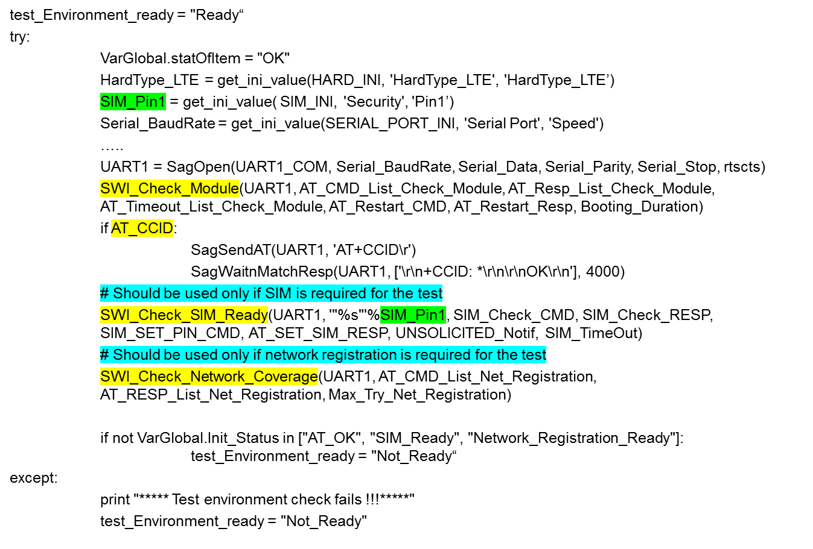
Script template – Initialization phase
Sierra Wireless Proprietary and Confidential

Slide 25
Script template – Generic TC steps
VarGlobal.statOfItem = "OK“
try:
if test_Environment_ready == "Not_Ready":
VarGlobal.statOfItem="NOK"
raise Exception("---->Problem: Test Environment Is Not Ready !!!")
….
…
…
…
except Exception, err_msg :
VarGlobal.statOfItem = "NOK"
print Exception, err_msg
PRINT_TEST_RESULT(test_ID, VarGlobal.statOfItem)
SagClose(UART1)
Sierra Wireless Proprietary and Confidential

Slide 26
Script template – TC steps with RAT
The following template allows you to run all your scripts with specific RAT (RAT_Supported_List=[“RAT_2G”]) or run all scripts with all supported RATs (RAT_Supported_List=[“RAT_2G”, “RAT_4G”]). Currently CAT-M is supported only through simulator and thus running scripts for all RATs will overbook simulators. It’s recommended to have the flexibility in a script to run it per RAT and with all supported RATs.
VarGlobal.statOfItem = "OK“
try:
if test_Environment_ready == "Not_Ready":
VarGlobal.statOfItem="NOK"
raise Exception("---->Problem: Test Environment Is Not Ready !!!")
for RAT_Param in RAT_Supported_List:
if RAT_Param=“RAT_2G”:
# 2G code part
elif RAT_Param=“RAT_4G”:
# 4G code part
else:
VarGlobal.statOfItem="NOK"
raise Exception("---->Problem: RAT is applicable !!!")
except Exception, err_msg :
VarGlobal.statOfItem = "NOK"
print Exception, err_msg
PRINT_TEST_RESULT(test_ID, VarGlobal.statOfItem)
SagClose(UART1)
Sierra Wireless Proprietary and Confidential

Slide 27
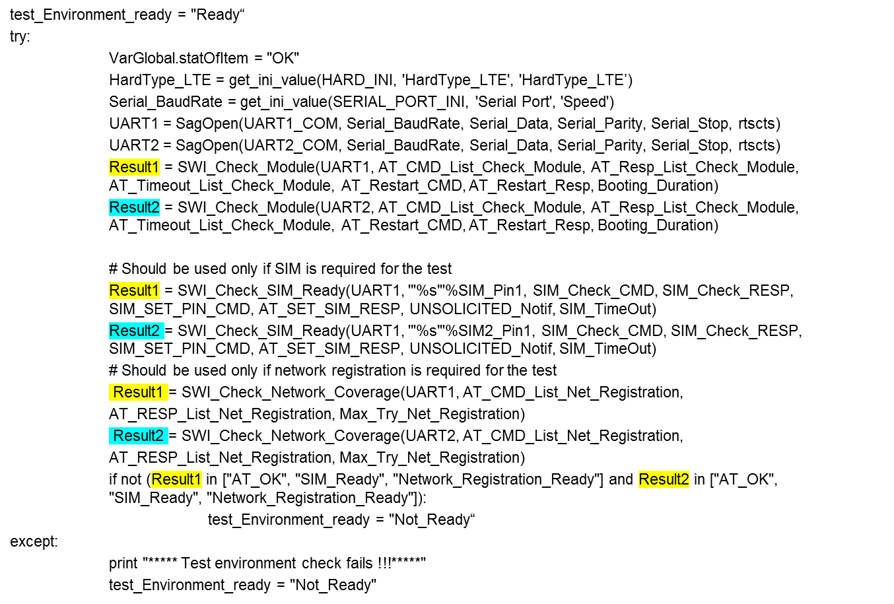
Script template – TC steps with many DUTs
Sierra Wireless Proprietary and Confidential

Slide 28
Sierra Wireless Proprietary and Confidential

