Slide 1

Sierra Wireless
Legato Application Framework
Aug 2016
Kha Nguyen
Cuong Bui

Slide 2
Outline
Legato SW Platform Introduction
Process to development/testing Embedded application

Slide 3
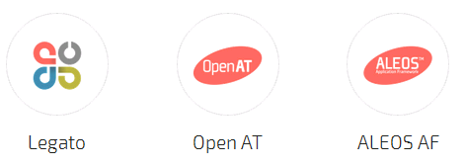
Embedded SW Platforms
AirVantage
Legato: Open source embedded platform built on Linux. AirPrime WP and AR series board
Open AT Application Framework: FXT and GL series
ALEOS AF: AirLink modems are highly configurable and can be scripted using the ALEOS Application Framework (AAF) to gather IoT data.
Not Hosted OS

Slide 4

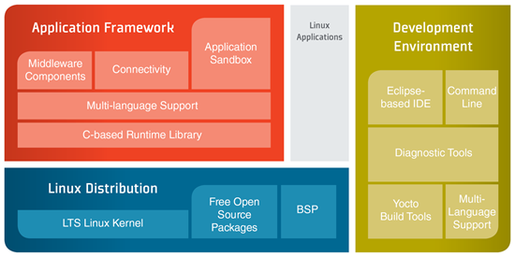
Legato™ Embedded Platform
Developing immediately with Legato pre-integrated, tested, and validated inside the application processors of AirPrime WP Series and AR Series.
Legato is an open source embedded platform built on Linux designed to simplify embedded IoT development.
Legato provide:
+Programming language APIs
+Target runtime environment
+Development and build tools

Slide 5
Linux-based Sierra Wireless IoT module has 3G or 4G radios
Sierra Wireless unveiled a Cortex-A5 based “AirPrime WP” IoT module with 3G or 4G radios, plus a modularly expandable, open-source “mangOH” carrier board.
We’ve seen plenty of low-power, Linux-ready Internet of Things computer-on-modules, mostly based on Qualcomm’s MIPS-based Atheros SoCs. The Linux-based AirPrime WP modules from Sierra Wireless instead tackle IoT and industrial M2M with integrated cellular radios. A 3G HSPA+/EDGE/GPRS/GSM version called WP75xx is due in the fourth quarter while a WP8548 version that adds 4G LTE is due in Q1 2016.

Slide 6
Legato Linux, which Sierra Wireless introduced in 2014 is built from Wind River’s Yocto-based Linux distribution. Legato adds an application sandbox that can host proprietary software and provide a secure place for third-party applications, says Sierra. AirPrime WP supports Sierra’s integrated AirVantage M2M Cloud services, including wireless data monitoring, application updates, and application business data services. All these services, as well as the Legato stack itself, offer OTA updates.

Slide 7
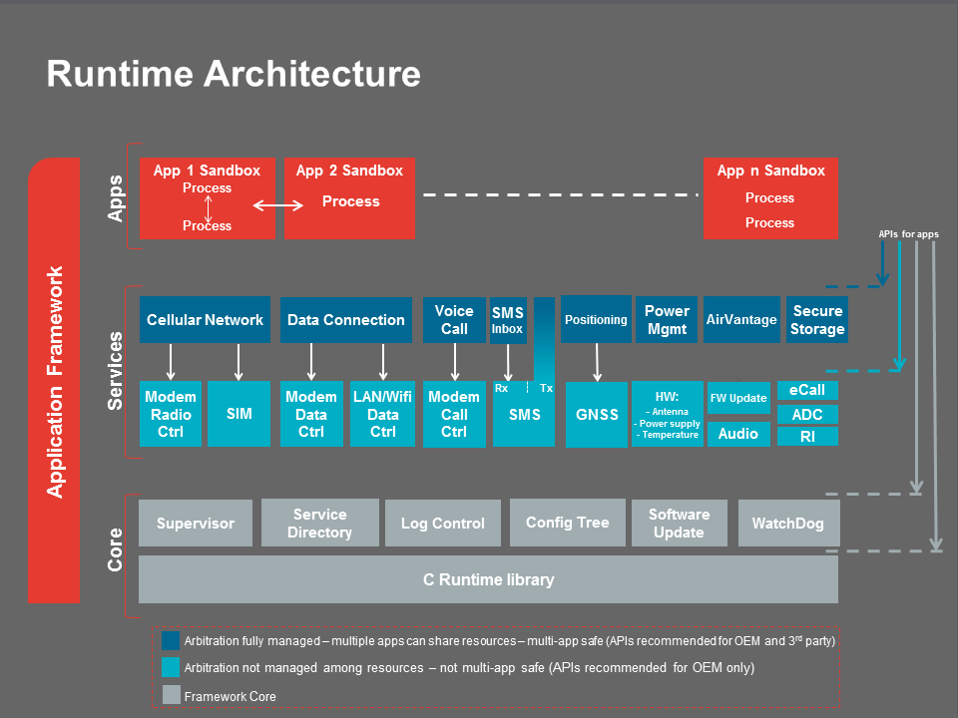

Slide 8
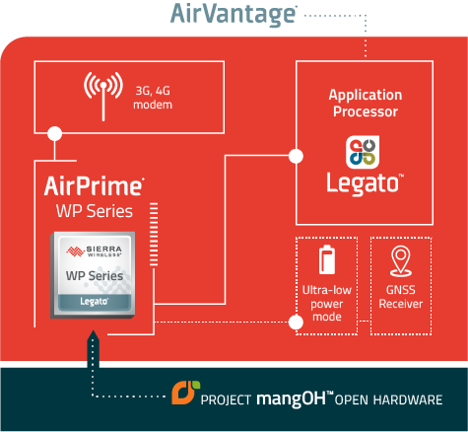
WP Series Overview
ARM core application processor with dedicated Flash and
RAM running Legato™
GNSS receiver enables tracking and location-based
services Ultra-low power mode
Compact CF3™ form factor
Secure boot and value-add firmware with
FREE unlimited firmware over-the-air (FOTA) upgrades
Interfaces include USB, UART, SDIO, HSIC, I2C, SPI, GPIO, ADC, PCM, and more
Open hardware reference design from Project mangOH™
Secure device-to-cloud architecture with AirVantage® pre-integrated into the Legato platform
Product Options | WP8548 | 3G: HSPA+ / EDGE / GPRS / GSM | Support and Technical Resources
 | WP75xx | 4G: LTE / HSPA+ / EDGE / GPRS / GSM | Technical resources available soon
Notes:
ARM core application processor with dedicated Flash and RAM running Legato™ enhances security, reduces system complexity, and lowers overall BOM (bill of materials)
GNSS receiver enables tracking and location-based services
Ultra-low power mode reduces power consumption by 200x for battery or solar powered applications
Compact CF3™ form factor with solder-down or snap-in socket options for ultimate flexibility in prototyping and build-to-order manufacturing
Secure boot and value-add firmware with FREE unlimited firmware over-the-air (FOTA) upgrades for the lifetime of the module to keep the connectivity optimized and secure
Interfaces include USB, UART, SDIO, HSIC, I2C, SPI, GPIO, ADC, PCM, and more
Open hardware reference design from Project mangOH™, enables rapid prototyping with industrial-grade components to get you to market faster
Secure device-to-cloud architecture with AirVantage® pre-integrated into the Legato platform

Slide 9
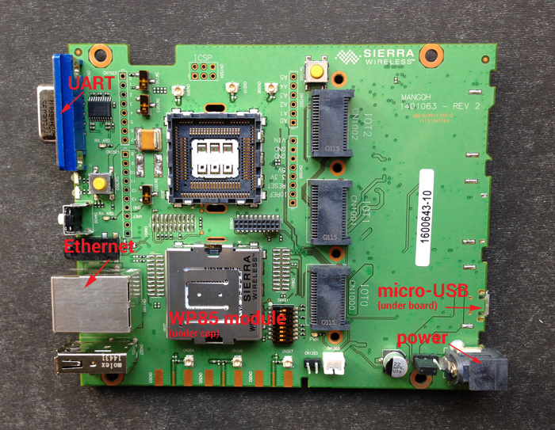
Project mangOH™ Open Hardware
Project MangOH™ is an open hardware initiative to enable rapid prototyping and faster time-to-market of new IoT devices and applications.
Designed to fit in a Euro card standard
size casing (120mm x 100mm), additional
hardware specs include:
1 USB 2.0 OTG
1 USB 2.0 Host
1 RS232/Serial
1 RJ45/Ethernet
Audio Jack
SD card
3 SMA antenna connectors
(Primary, Secondary/Diversity, GPS)
Accelerometer, Gyroscope
Battery/Battery Charging

Slide 10
Process to development Legato application
Install Legato
Run Developer Studio IDE
Create Legato Application Project
Build Project
Create connection to a Legato device
Run application

Slide 11
Install Legato
-On Linux host:
Developer Studio
or Command Line
-On Window host:
Developer Studio

Slide 12
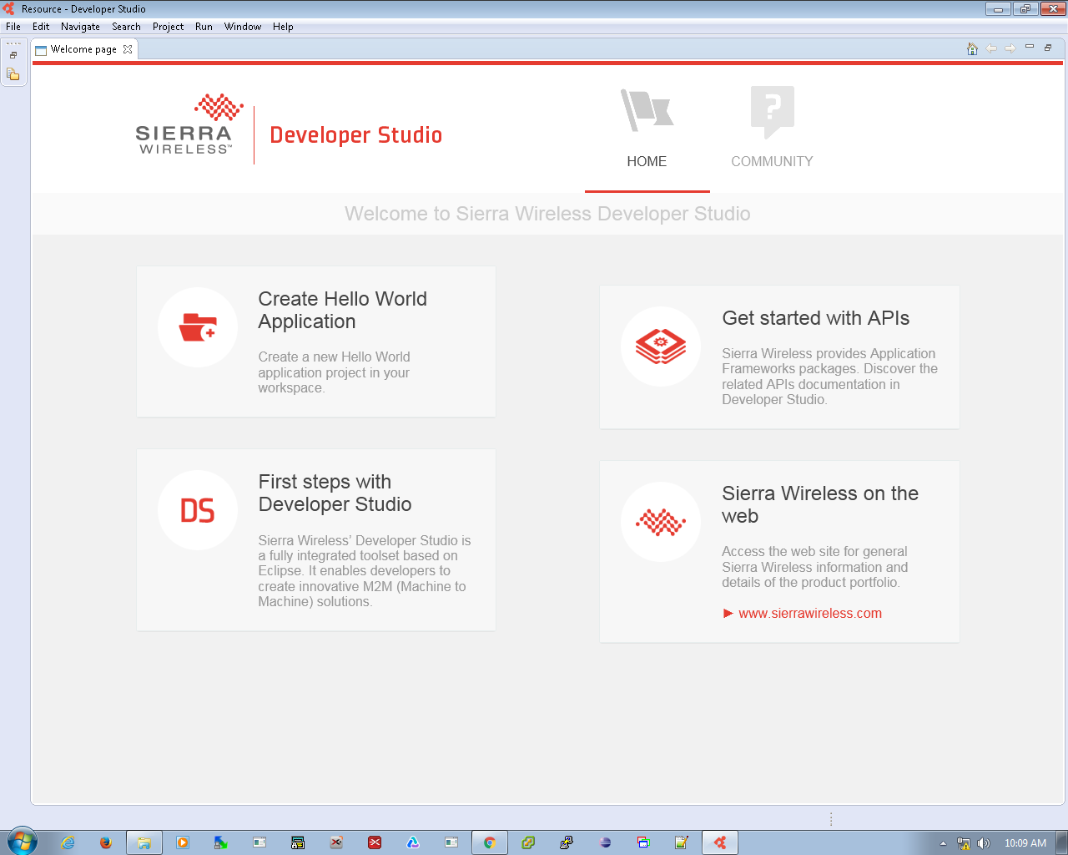
Run Developer Studio

Slide 13
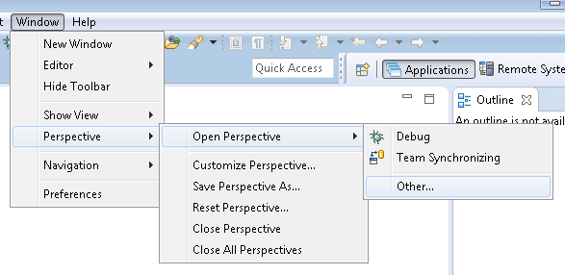
Create Legato Application Project

Slide 14
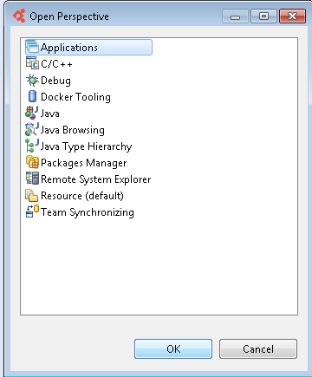
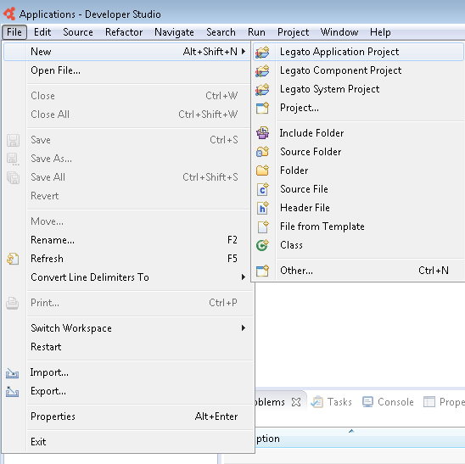
Create Legato Application Project

Slide 15
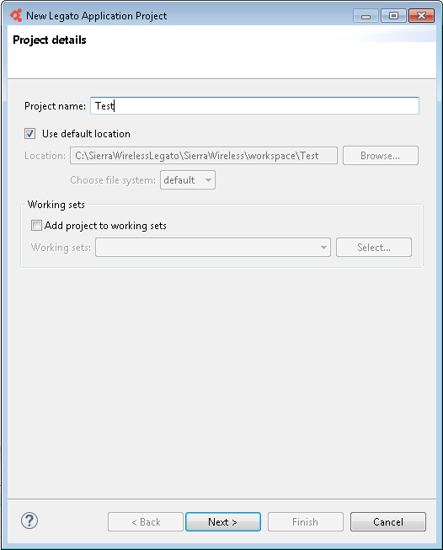
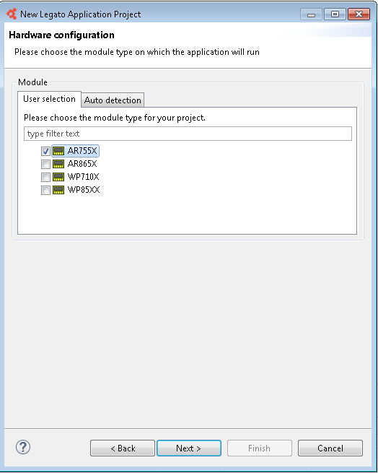
Create Legato Application Project

Slide 16
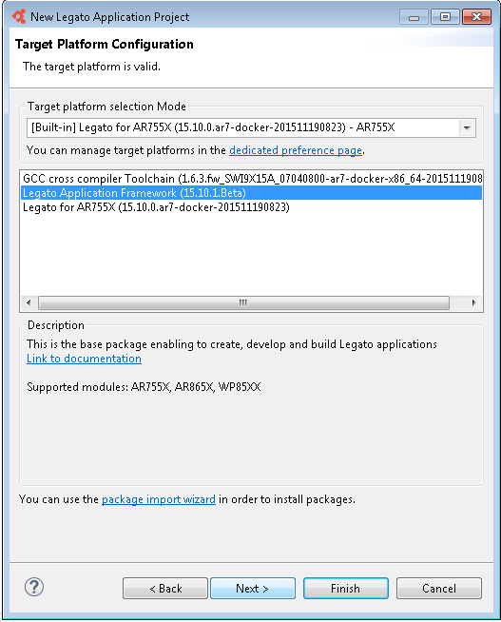
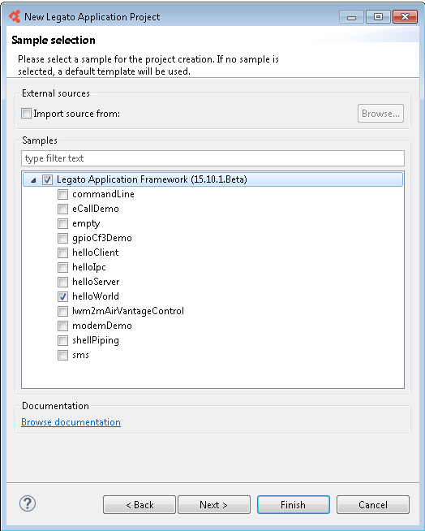
Create Legato Application Project

Slide 17
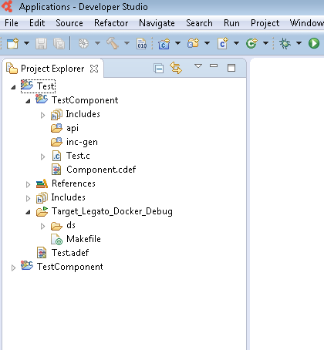
Create Legato Application Project

Slide 18
Build Project
- Is needed to compiled/Built before running?
-How to build?
Use Legato toolchain (cross compiler & linker)
-Cross compiler :
A cross compiler is a compiler capable of creating executable code for a platform other than the one on which the compiler is running.

Slide 19
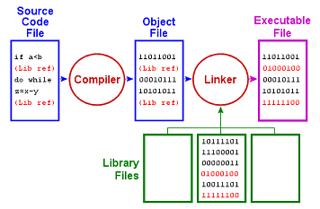
Build Project

Slide 20
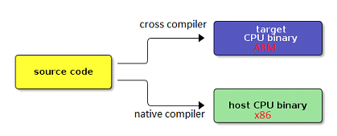
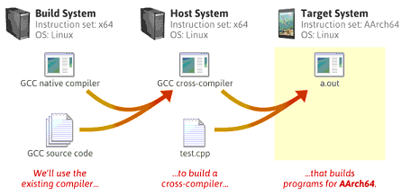
Build Project

Slide 21
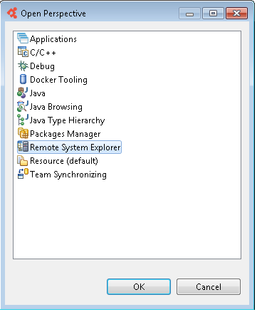
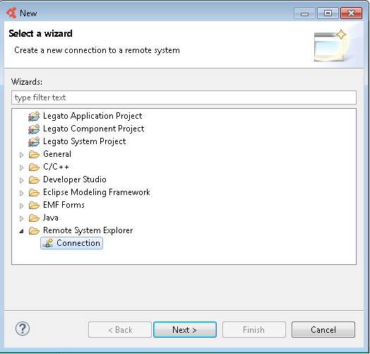
Create connection to a Legato device

Slide 22
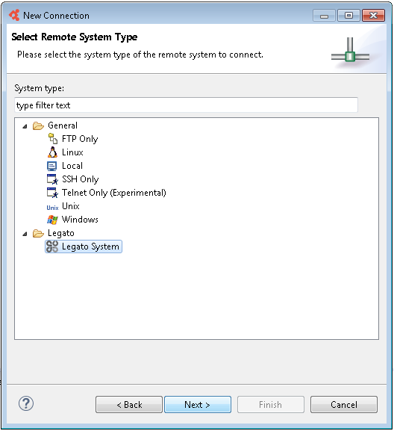
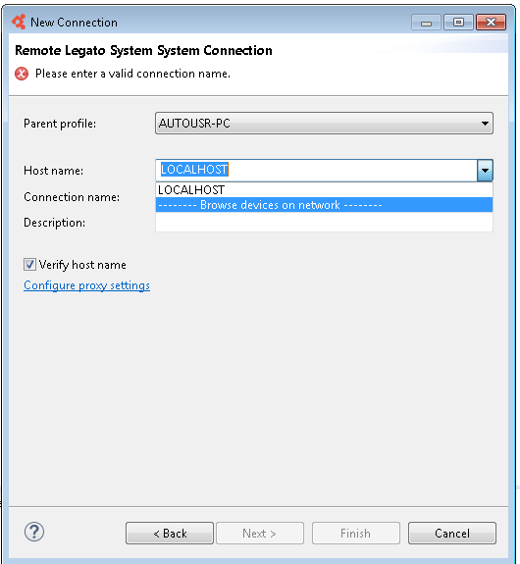
Create connection to a Legato device

Slide 23
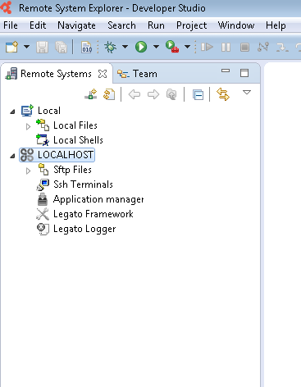
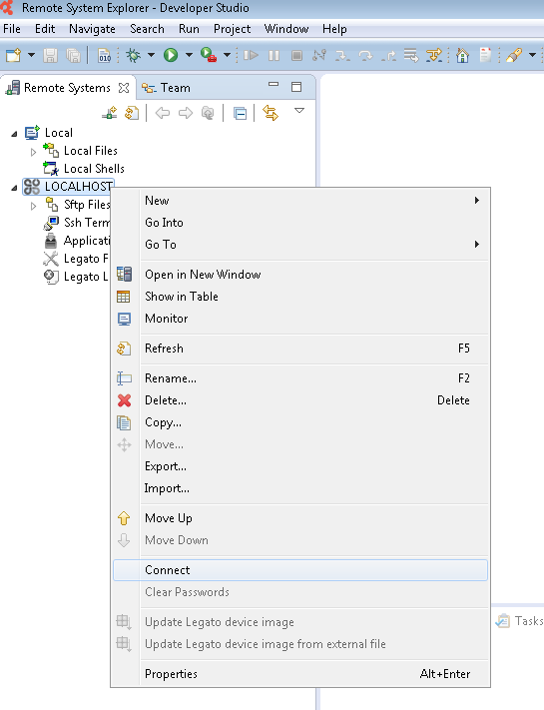
Create connection to a Legato device

Slide 24
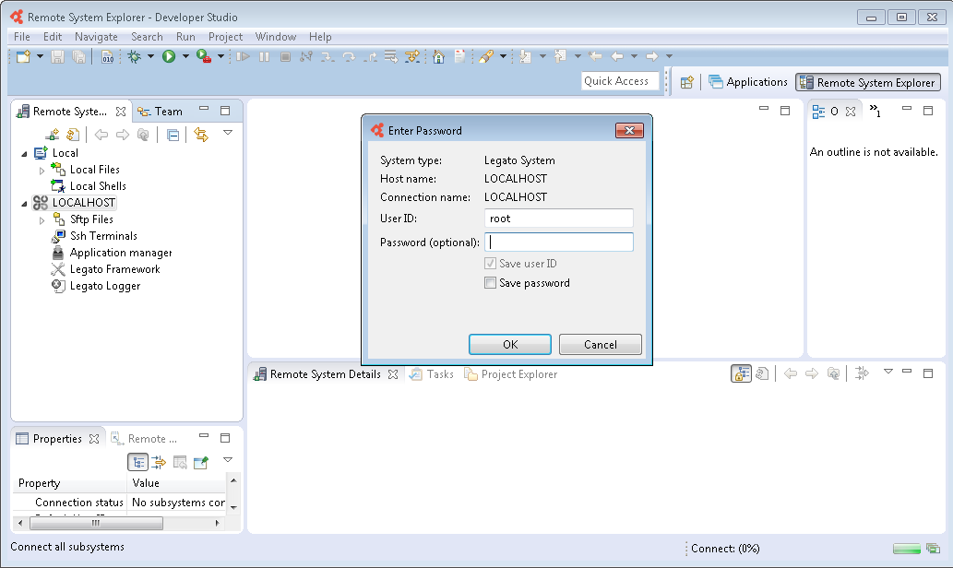
Create connection to a Legato device

Slide 25
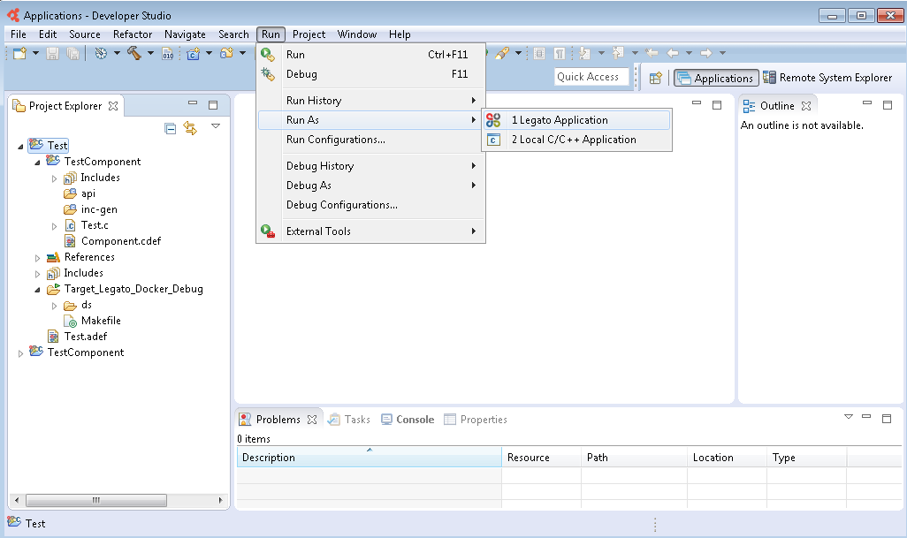
Run application

Slide 26
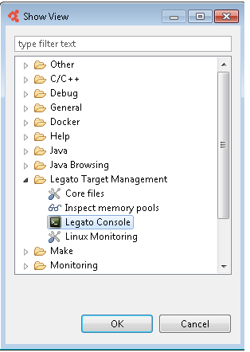
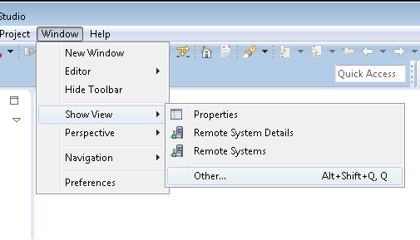
Run application

Slide 27
Testing
Similar to develop a Legato application.
Use Logging API (Le_Info, Le_Error …)

Slide 28
Testing
Example: Testing for send SMS
#include "legato.h"
#include "interfaces.h"
//--------------------------------------------------------------------------------------------------
//--------------------------------------------------------------------------------------------------
le_result_t smsmo_SendMessage
(
const char* destinationPtr,
const char* textPtr
)

Slide 29
Testing
{
le_result_t res;
le_sms_MsgRef_t myMsg;
myMsg = le_sms_Create();
if (!myMsg)
{
LE_ERROR("SMS message creation has failed!");
return LE_FAULT;
}
res = le_sms_SetDestination(myMsg, destinationPtr);
if (res != LE_OK)
{
LE_ERROR("le_sms_SetDestination has failed (res.%d)!", res);
return LE_FAULT;
}

Slide 30
Testing
res = le_sms_SetText(myMsg, textPtr);
if (res != LE_OK)
{
LE_ERROR("le_sms_SetText has failed (res.%d)!", res);
return LE_FAULT;
}
res = le_sms_Send(myMsg);

Slide 31
Testing
if (res != LE_OK)
{
LE_ERROR("le_sms_Send has failed (res.%d)!", res);
return LE_FAULT;
}
else
{
LE_INFO("\"%s\" has been successfully sent to %s.", textPtr, destinationPtr);
}
le_sms_Delete(myMsg);
return LE_OK;
}

Slide 32
Testing
When a message sending has failed and return Le_Fault we call le_sms_GetErrorCode() to retrieve the error code.
We can see the Le_Info,Le_Error at Legato Console

Slide 33
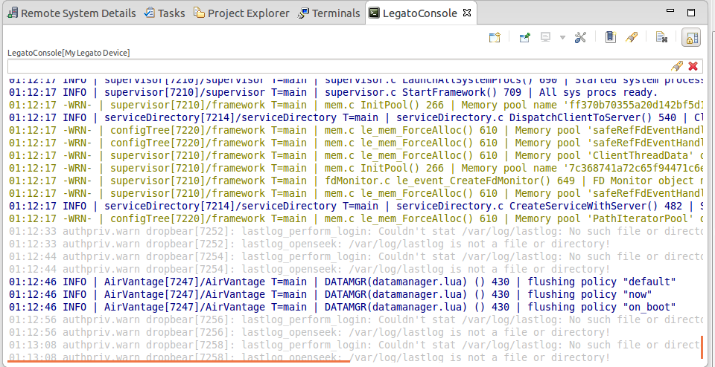
Testing

Slide 34
Testing
Some sms error code :
LE_SMS_RP_ERROR_DESTINATION_OUT_OF_ORDER | Destination out of order.
LE_SMS_RP_ERROR_UNIDENTIFIED_SUBSCRIBER | Unidentified subscriber.
LE_SMS_RP_ERROR_NETWORK_OUT_OF_ORDER | Network out of order.

Slide 35

Q&A

