Slide 1
Machine 2 Machine
When the machines start talking
May 2010

Slide 2
Content
1
Untangle the Mysteries of M2M
2
M2M Applications
3
M2M Challenge
4
Wrap up

Slide 3

Untangle the mysteries of M2M
Mobile market (quasi) saturated
50-70 billion machines -1% connected
Technology is available – Federation is key
European Legislation pushes for SMART
1
M2M mystery
M2M Application
3
M2M Challenge
4
Wrap up
Notes:
Today telcos mainly people to people OR people to application
This is reaching saturation point in developed world 7 billion worldwide 4 billion GSM connections
Telcos looking for new market, and connecting machines
M2M embedded devices connected via cellular network already estimated 420 Million and that’s only the tip of proverbial iceberg and a long way from the estimated 50 Billion connectable devices from robots to petrol pumps, health monitors, to intelligent fridges, the technology is here it is now just a question of making it happen.
The key challenge is connecting these distributed machines which can be in very diverse and sometime challenging environments
Mobile communication have a lot to offer but also fixed and hybrid communication.
Capillary networks using low power consumption radio technologies such as Zigbee or others as well as super efficient internet protocols such as IETF roll

Slide 4






























M2M Application #1 Smart metering
Wind Turbine
Home displays
TV, Computer
Data Center
Solar Panel
In-Home
Energy
Display
Wan
Communication
Light
Meters Coms
Appliances
Temperature
Breaker
Valves
Smart
Water
Smart
Gas
Smart Elec.
Remote Meter reading
Consumption management
Pricing info
Consumption info
Fault details
Threshold management
Gateway
1
M2M mystery
M2M Application
3
M2M Challenge
4
Wrap up

Slide 5

M/411 Smart Metering Mandate
  EC Mandate issued in March 2009 by DG TREN and sent to the 3 ESO's : CEN, CENELEC and ETSI
  Main objective: to build standards for European smart meters, allowing interoperability and Consumer actual consumption awareness.
  Time schedule :
    March 2009 + 9 months : state of the art of existing standards, gap analysis, and first Workprogram
    March 2009 + 30 months : Develop new smart metering standards
1
M2M mystery
M2M Application
3
M2M Challenge
4
Wrap up

Slide 6


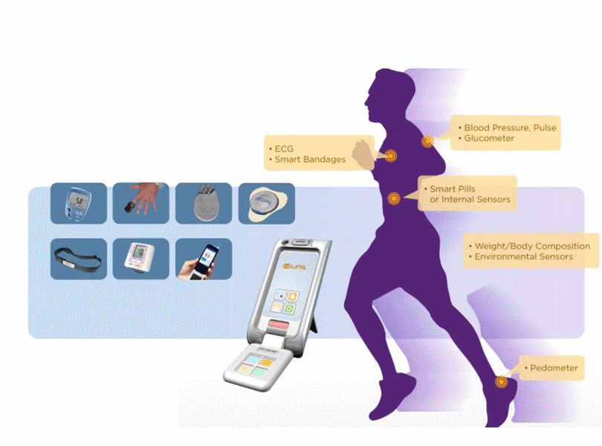


M2M Application #2 e-Health
Disease management
Remote monitoring
Ageing independently
Health Check
Personal fitness
On-line health records
Scheduling appointments
Lifestyle and dietary advice
1
M2M mystery
M2M Application
3
M2M Challenge
4
Wrap up

Slide 7
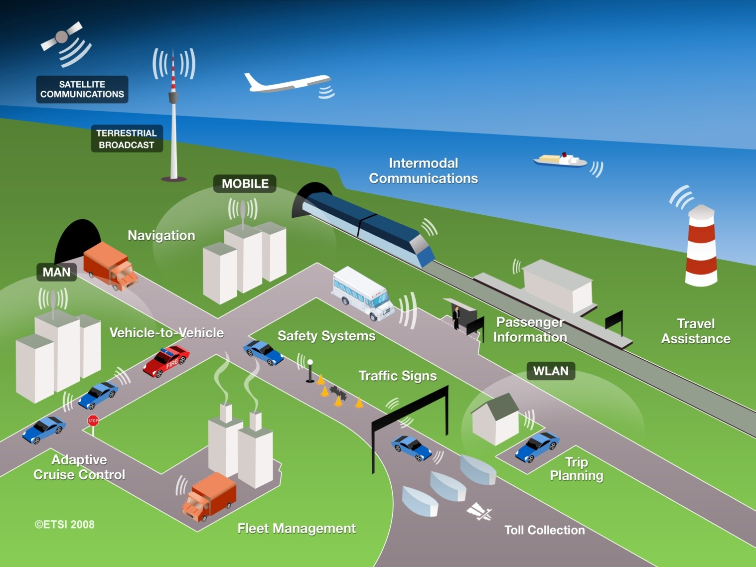


M2M #3 Automotive
Use Cases
for
Automotive applications
ETSI TC M2M
& TC ITS
cooperate
Automotive application integration in M2M platform
1
M2M mystery
M2M Application
3
M2M Challenge
4
Wrap up

Slide 8
The ETSI M2M Challenge
M2M technical solutions are highly fragmented and usually dedicated to a single application (e.g. fleet management, meter reading)
Multitude of technical solutions and dispersed standardization activities result in the slow development of the M2M market
Standardization is a key enabler to remove the technical barriers and ensure interoperable M2M services and networks
1
M2M mystery
M2M Application
3
M2M Challenge
4
Wrap up

Slide 9
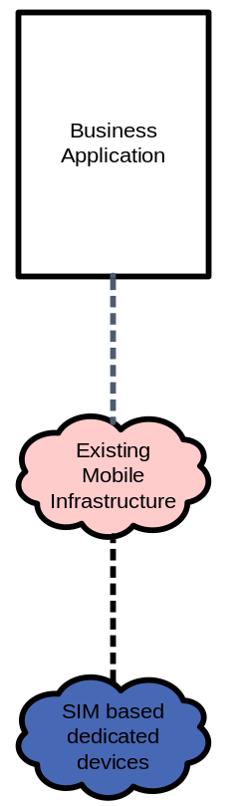
Inverting the pipes
existing proprietary
vertical applications…
applications share common
infrastructure, environments
and network elements
Business
Business
Business
Application
#
1
Application
#
i
Application
#
N
Application Infrastructure
Network Infrastructure
(
IP
Converged Network
+
mobile infrastructure
)
Gateways
/
Concentrators
M2M Device
#
M2M Device
M2M Device
#
With permission of HP
1
M2M mystery
M2M Application
3
M2M Challenge
4
Wrap up

Slide 10





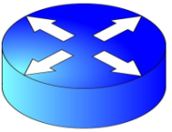





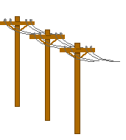


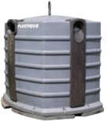



Simple M2M Architecture
M2M Application
M2M Area Network
M2M
Core
Service
Capabilities
M2M
Gateway
Client
Application
1
M2M mystery
M2M Application
3
M2M Challenge
4
Wrap up

Slide 11
Work Methodology, a stepwise approach
Use Case Technical Reports
TR 102 692
Smart Metering
TR 102 732
eHealth
TR 102 857
Connected consumer
TR 102 898
Automotive
TR 102 897
City automation
TS 102 689
M2M Service Requirements
DTS/M2M-00009
delivery of M/441 work
TR 102 725
M2M Definitions
TS 102 690
M2M Functional
Architecture
DTS/M2M-00010 Stage 3 Interfaces
Stage 3 Technical Specifications

Slide 12



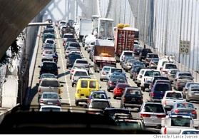

















Current M2M standards landscape
M2M Applications
API
M2M Platform
SP networks
(access, core)
6lowpan, roll, core
Gateway Layer
M2M area Network
…
Example for metering
applications
M2M Device
1
M2M mystery
M2M Application
3
M2M Challenge
4
Wrap up

Slide 13
Status of affairs
Requirements document stable, planned for approval June 2010
Architecture:
  Key capability identified
  Message flows documented
  Identified key interfaces for release 1 stage 3 work
  Target date for finalizing the architecture is: July 2010
Protocols:
  New WI agreed to the last meeting to progress stage 3 work for 3 interfaces: mId, dIa and mIa
1
M2M mystery
M2M Application
3
M2M Challenge
4
Wrap up

Slide 14
Progressing Stage 3 work
M2M Device/M2M Gateway
M2M Application
M2M Application
M2M Application is owned/run by the
M2M Service provider (may be the operator)
Stage 3 Scope for R1
dIa
mIa
M2M Service
Capabilities
Generic M2M Network Application Enablement (GMNAE) Capability
MDGM
NCSS
Routing
TM
M2M Capabilities
RADAR
CB
To Other capabilities in other networks
(For Further Study)
SC
HDR
mId
Generic M2M Device Application Enablement (GMDAE) Capability
Communication modules
Interfaces towards resources in Core Networks (based on existing
Interfaces: e.g. 3GPP, ETSI TISPAN)
Core Network A
Core Network B
1
M2M mystery
M2M Application
3
M2M Challenge
4
Wrap up

Slide 15
Glossary of M2M Capabilities
  Generic M2M Device Application Enablement (GMDAE)
  Generic M2M Network Application Enablement (GMNAE)
  Reachability, Addressing and Device Application Repository (RADAR)
  Network and Communication Service Selection (NCSS)
  M2M Device and M2M Gateway Management (MDGM)
  Security Capability (SC)
  History and Data Retention (HDR)
  Transaction Management (TM) Capability
  Compensation and Billing (CB) Capability
1
M2M mystery
M2M Application
3
M2M Challenge
4
Wrap up

Slide 16
Collaboration, relationship to work in other SDOs
ETSI M2M has as a guiding principle to reuse as much as possible
  OMA:
    identified requirements that may drive evolutions of DM protocols (both OMA DM and BBF TR069)
    REST style is another area where collaboration might be needed with OMA (REST is being considered at this stage)
  3GPP extensions for MTC are considered as optimizations but will not prevent the ETSI M2M framework to be deployed
  Considering work in the IETF on CoAP protocol
Operators are keen to have M2M R1 finalised by end of 2010
  Smart metering being one priority
  Driven by the need to avoid deployment of vertical applications and kick-off initial deployments of/migration to horizontal architectures
1
M2M mystery
M2M Application
3
M2M Challenge
4
Wrap up

Slide 17
Conclusions
M2M related technologies are in place and the market has massive potential for growth
Standardization is essential for long term development of the technology and for interoperability of networks and services
Operators, integrators and vendors have expressed the need to standardize end to end M2M
Regulation in Europe, USA and Asia is pushing for a standards based solution
It is essential to have globally compatible standards
1
M2M mystery
M2M Application
3
M2M Challenge
4
Wrap up

