Slide 1



TMA SOLUTIONS
Amarisoft Usage
Chau Nguyen (nhchau@tma.com.vn)

Slide 2
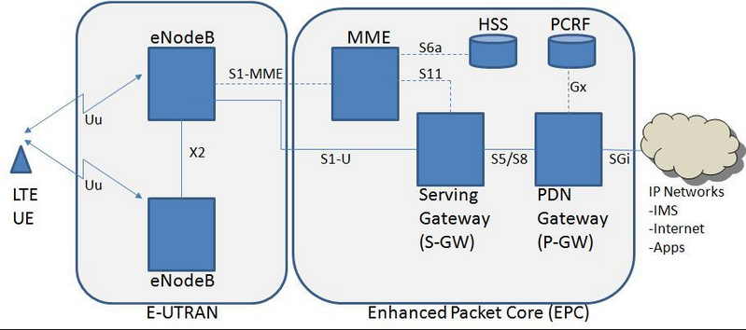
LTE network diagram
Amarisoft components mapping:
lteenb <---> eNodeB
ltemme <---> MME, HSS, S-GW, P-GW
lteims <---> IMS
trx_sdr <---> Radio Head or RF interface

Slide 3
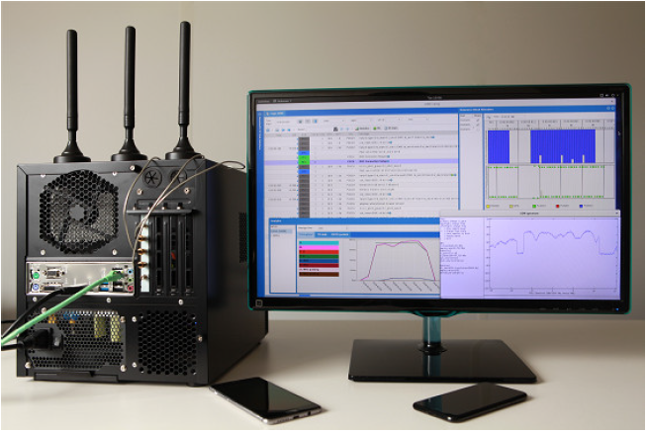
Amarisoft Hardware
Amarisoft devices:
PCIe SDR cards
PC box with Fedora core rls 26
Antennas which are connected to SDR cards. SISO: 01 TX and 01 RX, MIMO: 2 to 10

Slide 4

How to change configuration
The LTE automatic service starts each component with the following config files:
eNB /root/enb/config/enb.cfg
MME /root/mme/config/mme.cfg
IMS /root/mme/config/ims.cfg
MBMSGW /root/mbms/config/mbmsgw.cfg
Please note that these files are symbolic links to real configuration files as depicted below for enb.cfg. In order to see symbolic links, on terminal use command “ll”.

Slide 5
In order to change the configuration, you have two options:
Editing the above files to change the configuration directly.
Changing the symbolic link to point to another configuration file. Following example shows the commands to change the default config to a carrier aggregation configuration on eNodeB side.
cd /root/enb/config
rm enb.cfg
ln -s enb-ca.cfg enb.cfg
Once you have changed your config, you need to restart the LTE service using the following command:
service lte restart
In order to check LTE service status, using the following command:
service lte status

Slide 6
Components put their current logs in /tmp directory
Changing band of a cell:
In enb.cfg, modifying dl_earfcn based on http://niviuk.free.fr/lte_band.php
Restart LTE service.
Changing PLMN:
In enb.cfg, modifying plmn_list property.
In mme.cfg, modifying plmn property.
Restart LTE service.
Use multiple card together:
Need to check position of SDR card by sdr_util. Amarisoft supports up to 07 SDR cards which are identified by /dev/sdrx where x in range 0-7.
Define args in cfg file in sdr folder. E.g., first cell on card 0, second cell on card 1:
args: "dev0=/dev/sdr0,dev1=/dev/sdr1“,
sync: “internal”,

Slide 7
In order to require APN for network attachment, add the following property to mme.cfg:
ignore_initial_apn: false
If false, UE will be rejected if its desired APN is unknown.

Slide 8
How to test SDR cards
Change working directory to /root/enb/config/sdr then use sdr_util to enable or disable led blinking on each SDR card.
Disable led blinking on card 0: ./sdr_util –c 0 led 0
Enable led blinking on card 0: ./sdr_util –c 0 led 1
sdr_util can be used to verify that if an SDR card is occupied by lte service.

Slide 9
How to monitor LTE service
On terminal:
Run command: screen -x lte
Select component by: ctrl+a <window index>
Exit screen: ctrl+a d
Window index:
0 MME
1 eNB
2 MBMSGW
3 IMS

Slide 10
Demo for LTE CatM1
LTE catM1 band 28 on SDR0:
enb:
SDR config:
LTE catM1 band28 on SDR0 and band20 on SDR1:
enb:
SDR config:

Slide 11
THANK YOU
TMA SOLUTIONS

