Slide 1






JedAI: The Force behind Entity Resolution
George Papadakis
Leonidas Tsekouras
Emmanouil Thanos
George Giannakopoulos
Themis Palpanas
Manolis Koubarakis

Slide 2
What is the JedAI Toolkit?
JedAI can be used in three ways:
As an open source library that implements numerous state-of-the-art methods for all steps of an established end-to-end ER workflow.
As a desktop application for ER with an intuitive Graphical User Interface that is suitable for both expert and lay users.
As a workbench for comparing all performance aspects of various (configurations of) end-to-end ER workflows.

Slide 3


JedAI vs other tools
Magellan
JedAI
limited variety of (blocking) methods
rich variety available methods for every step in the end-to-end workflow

Slide 4
JedAI vs other tools
Magellan
JedAI
limited variety of (blocking) methods
restricted to relational data only
rich variety available methods for every step in the end-to-end workflow
applies to both structured and non-structured data

Slide 5
JedAI vs other tools
Magellan
JedAI
limited variety of (blocking) methods
restricted to relational data only
targeted to expert users, focusing on development of tailor-made methods
rich variety available methods for every step in the end-to-end workflow
applies to both structured and non-structured data
hands-off functionality through default configuration of every method, but also extensible

Slide 6
JedAI vs other tools
Magellan
JedAI
limited variety of (blocking) methods
restricted to relational data only
targeted to expert users, focusing on development of tailor-made methods
offers command-line interface, no GUI
rich variety available methods for every step in the end-to-end workflow
applies to both structured and non-structured data
hands-off functionality through default configuration of every method, but also extensible
intuitive GUI with guidelines even for novice users

Slide 7
JedAI vs other tools
Magellan
JedAI
limited variety of (blocking) methods
restricted to relational data only
targeted to expert users, focusing on development of tailor-made methods
offers command-line interface, no GUI
rich variety available methods for every step in the end-to-end workflow
applies to both structured and non-structured data
hands-off functionality through default configuration of every method, but also extensible
intuitive GUI with guidelines even for novice users
multi-core execution (coming soon)

Slide 8
How does the JedAI Toolkit work?
JedAI implements the following schema-agnostic, end-to-end workflow for both Clean-Clean and Dirty ER:
Step 1
Step 2
Step 3
Step 4
Step 5
Step 6
Step 7
Data Reading
Block
Building
Block
Cleaning
Comparison
Cleaning
Entity
Matching
Entity
Clustering
Evaluation & Storing
Reads files containing the entity profiles and the golden standard.
Creates
overlapping blocks.
Optional step that cleans blocks from useless comparisons (repeated, superfluous).
Optional step that operates on the level of individual comparisons to remove the useless ones.
Executes all retained comparisons.
Partitions the similarity graph into equivalence clusters.
Stores and presents performance results w.r.t. numerous measures.

Slide 9
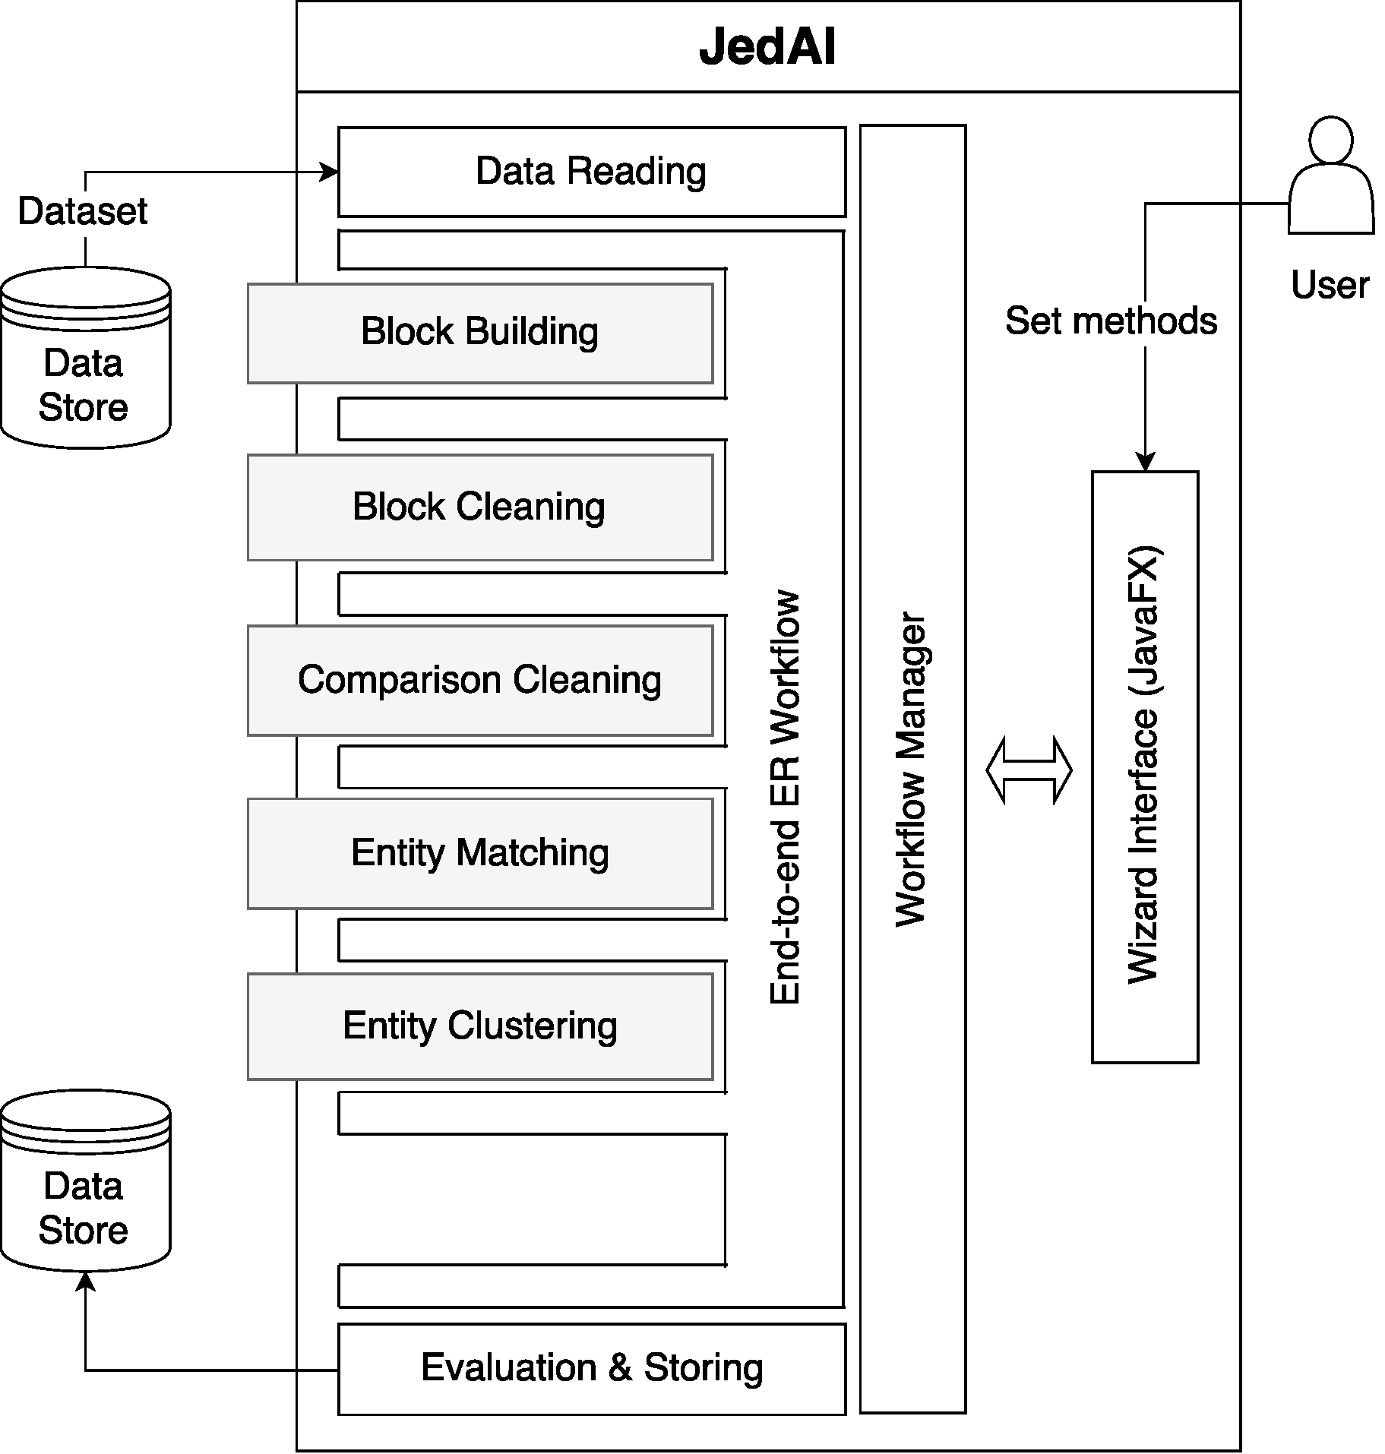
How is the JedAI Toolkit structured?
Modular architecture
one module per workflow step
Extensible architecture
e.g., ontology matching module
???

Slide 10
How can I build an ER workflow?
JedAI supports several established methods for each workflow step:
Step 1
Step 2
Step 3
Step 4
Step 5
Step 6
Step 7
Data Reading
Block
Building
Block
Cleaning
Comparison
Cleaning
Entity
Matching
Entity
Clustering
Evaluation & Storing
Possible to read CSV, RDF/XML files, SPARQL endpoints & relational DBs in any combination
Choose 1 out of 7 methods.
Specify any combination of 3 complementarymethods
Choose 1 out of 7 methods (including Meta-blocking)
Combine 1 out of 2
methods with 12 textual representation models and 10 similarity measures
Choose 1 out of 6 methods for Dirty ER. For Clean-Clean ER, 1 method is available
Store results as a CSV file

Slide 11
Which Data Formats are supported?
Data Formats
CSV files
Relational databases
XML/RDF/OWL files
SPARQL endpoints
Java Serialized Objects (using JedAI data model)

Slide 12
Which Blocking Methods are supported?
Block Building | Block Cleaning | Comparison Cleaning
Token Blocking | Block Filtering | Comparison Propagation
Sorted Neighborhood | Size-based Block Purging | Cardinality Edge Pruning (CEP)
Extended Sorted Neighborhood | Cardinality-based Block Purging | Cardinality Node Pruning (CNP)
Q-Grams Blocking | Block Scheduling | Weighted Edge Pruning (WEP)
Extended Q-Grams Blocking |  | Weighted Node Pruning (WNP)
Suffix Arrays |  | Reciprocal CNP
Extended Suffix Arrays |  | Reciprocal WNP

Slide 13
Which Entity Matching/Clustering Methods are supported?
Entity Matching | Entity Clustering
Group Linkage* | Center Clustering
Profile Matcher* | Connected Components
 | Cut Clustering
* In combination with bag and graph textual models based on token and character n-grams and various established string similarity measures | Markov Clustering
 | Merge-Center Clustering
 | Ricochet SR Clustering
 | Unique Mapping Clustering
Notes:
For Entity Matching, more methods will be added in JedAI v2. Profile Matcher builds a single vector or graph model for each entity profile, by aggregating all attribute values, regardless of the associated attribute names.
For Entity Clustering, all methods apply exclusively to Dirty ER, except for Unique Mapping Clustering, which applies exclusively to Clean-Clean ER.

Slide 14
Which Datasets are included?
Several datasets are available for testing
Clean-Clean ER (real) | D1 Entities | D2 Entities
Abt-Buy | 1,076 | 1,076
DBLP-ACM | 2,616 | 2,294
DBLP-Scholar | 2,516 | 61,353
Amazon-GP | 1,354 | 3,039
Movies | 27,615 | 23,182
DBPedia | 1,190,733 | 2,164,040
Dirty ER (synthetic) | Entities
10K | 10,000
50K | 50,000
100K | 100,000
200K | 200,00
300K | 300,00
1M | 1,000,000
2M | 2,000,000
can be used for Dirty ER, too

Slide 15
What are the next steps?
Version 2.0:
Includes support for schema clustering, multicore functionality, GNU Trove for higher time efficiency.
Available at the end of August, 2018.
Version 3.0:
Includes support for data fusion, progressive ER as well as a workflow builder.
Available at the end of December, 2018.
Version 4.0:
All functionality is implemented in Apache Spark.
Available at the end of December, 2019.
Notes:
Schema Clustering is similar to Schema Matching in the sense that it yields a mapping between attributes based on their relatedness, as inferred from the similarity of their structure, name and values. Yet, its purpose is fundamentally different: instead of seeking semantically identical attributes (e.g., "profession" and "job"), its goal is to improve the creation and processing of schema-agnostic blocks. This is accomplished by splitting large blocks into smaller ones according to the schema clusters that are associated with every signature. This idea has been successfully applied to blocking via Attribute Clustering and to meta-blocking via BLAST. JedAI 2.0 generalizes it to cover the first three steps of its workflow, from Block Building to Comparison Cleaning.

Slide 16
Where can I find JedAI Toolkit?
Project website: http://jedai.scify.org
Documentation (slides, videos, etc) available at github
Github repositories:
JedAI Library: https://github.com/scify/JedAIToolkit
JedAI Desktop Application and Workbench: https://github.com/scify/jedai-ui .
All code is implemented using Java 8.
All code is publicly available under Apache License V2.0.

Slide 17
Where can I find JedAI Toolkit?
Project website: http://jedai.scify.org
Documentation (slides, videos, etc) available at github
Github repositories:
JedAI Library: https://github.com/scify/JedAIToolkit
JedAI Desktop Application and Workbench: https://github.com/scify/jedai-ui .
All code is implemented using Java 8.
All code is publicly available under Apache License V2.0.
JedAI already used in the industry, and in university courses
When using JedAI, please cite: George Papadakis, Leonidas Tsekouras, Emmanouil Thanos, George Giannakopoulos, Themis Palpanas and Manolis Koubarakis: "JedAI: The Force behind Entity Resolution", in ESWC 2017

