Slide 1
Requirements Engineering
CSC 510
North Carolina State University
Dr. Annie I. Antón

Slide 2
“There’s no sense being exact about something if you
don’t even know what you’re talking about.”
John von Neumann
© A.I. Antón & M. Vouk, NCSU

Slide 3
Requirements Engineering Defined
“The development and use of cost-effective technology for the elicitation, specification and analysis of the stakeholder requirements which are to be met by software intensive systems.” [RENOIR]
© A.I. Antón & M. Vouk, NCSU

Slide 4
Why RE?
It is the toughest problem and most challenging aspect of software engineering!
© A.I. Antón & M. Vouk, NCSU

Slide 5
Fred Brooks ...
“The hardest single part of building a software system is deciding precisely what to build … No other part of the work so cripples the resulting system if it is done wrong. No other part is more difficult to rectify later.”
© A.I. Antón & M. Vouk, NCSU

Slide 6
Scope of Software Project Failures
WHY PROJECTS FAIL %
1. Incomplete Requirements 13.1
2. Lack of user involvement 12.4
3. Lack of resources 10.6
4. Unrealistic Expectations 9.9
5. Lack of executive support 9.3
6. Changing requirements 8.7
7. Lack of planning 8.1
8. Didn’t need it any longer 7.5
9. Lack of IT management 6.2
10. Technology illiteracy 4.3
Jim Johnson, The Standish Group International Project Leadership
Conference, May 1995, Chicago
© A.I. Antón & M. Vouk, NCSU

Slide 7
Requirements Engineering is difficult
Despite the clear benefits of getting requirements complete, right, and error-free early, they are the hardest part of the system development lifecycle to do right because:
  we don’t always understand everything about the real world that we need to know,
  we may understand a lot, but we cannot express everything that we know
© A.I. Antón & M. Vouk, NCSU

Slide 8
Ambiguity in Stating Requirements
Missing requirements
  (e.g. structure, functions, physical env’t.)
Ambiguous words
  E.g., small does not adequately specify the size of the group
  E.g., group implies that the people will interact, but it’s not clear how
Introduced elements
  E.g., Structure - “create a means” or “design a structure”
[Gause and Weinberg 1989]
© A.I. Antón & M. Vouk, NCSU

Slide 9
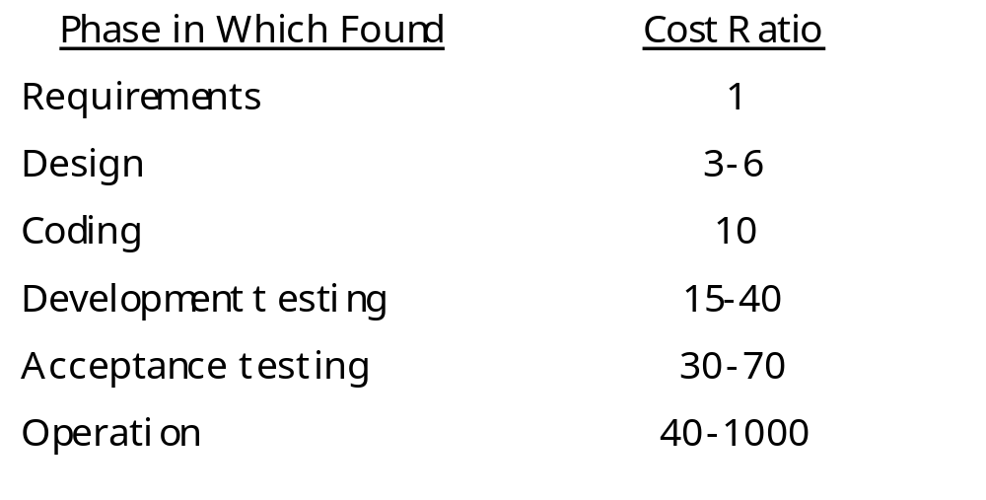
Relative Cost to Fix an Error
Boehm’s analysis of 63 s/w development projects (IBM, GTE, TRW, etc.) to
Determine ranges in cost for errors created by false assumptions in req’ts phase
But not detected till later phases
© A.I. Antón & M. Vouk, NCSU

Slide 10
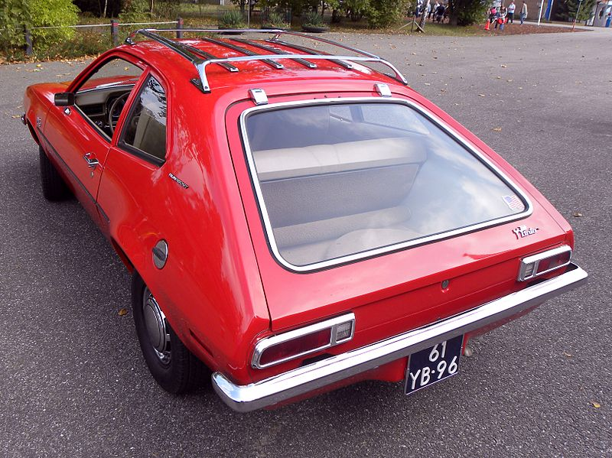
Ford Pinto
Manufactured in the 1970s
The position of the fuel tank mounting bolts was a good design based on an assumption:
  There will be no rear impact collisions!
Assumption proved to be false.
Ford spent $100 million in litigation & recall services
http://en.wikipedia.org/wiki/File:Ford_Pinto_runabout_(1).jpg
© A.I. Antón & M. Vouk, NCSU

Slide 11

Johns-Manville Corporation
Developed, manufactured and marketed asbestos building materials based on the assumption that asbestos, in the form of their products, was environmentally safe to all exposed people.
This high-level decision based on a false assumption produced 52,000 lawsuits costing approximately $2 billion in liabilities (company went bankrupt).
© A.I. Antón & M. Vouk, NCSU

Slide 12
Exploring to Remove Ambiguity
(What explorers do)
Move in some direction
Look at what they find there
Record what they find
Analyze their findings in terms of where they want to be
Use their analysis and recordings of what they find to choose the next direction
Go back to step 1 and continue exploring
© A.I. Antón & M. Vouk, NCSU

Slide 13
The RE Process
Process of establishing what the system should do:
  the services the system should provide
  the constraints under which the system must operate
Involves analysis and modeling [Leite & Freeman 1990]
Establishing what the customer requires from a software system
© A.I. Antón & M. Vouk, NCSU

Slide 14
***The RE Process [2]
Gives stakeholders a better understanding of:
  what is required
  why it is needed
  to what extent it is feasible
  what the constraints on achieving it are
Allows negotiation of conflicting goals
Ensures no important functions or constraints are omitted
Supports “value engineering”
  development of artifacts perceived as having good value
© A.I. Antón & M. Vouk, NCSU

Slide 15
Analysis ≈ Communication
User
Analyst
Customer
Analyst
Manager
Developer
© A.I. Antón & M. Vouk, NCSU

Slide 16
Sources of RE Difficulties
RE is where informal meets formal
Many requirements are created, not found.
Users, buyers, even developers may be unknown.
Stakeholders have conflicting objectives.
Multiple views exist
Inconsistency must be tolerated, for a while.
Requirements evolve during and after development.
© A.I. Antón & M. Vouk, NCSU

Slide 17
Multiple Viewpoints
😐
☺
Problem
☹
© A.I. Antón & M. Vouk, NCSU

Slide 18
What is a requirement?
Something that the product must do or a quality that the product must have.
A requirement exists because:
  the type of product demands certain functions or qualities OR
  The client wants the requirement to be a part of the delivered product
Requirements may serve a dual function
  May be the basis for a bid for a contract (interpreted)
  May be the basis for the contract itself (defined in detail)
© A.I. Antón & M. Vouk, NCSU

Slide 19
Functional Requirements Are:
Things the product must do
An action that the product must take to provide functionality for its user
Arise from the fundamental reason for the product’s existence
-> Something systems must do if it is to be useful within the context of the customer’s business needs.
The product shall produce an amended de-icing schedule when a change to a truck status means that previously scheduled work cannot be carried out as planned.
© A.I. Antón & M. Vouk, NCSU

Slide 20
Non-Functional / Quality Requirements Are:
properties, or qualities, that the product must have
may be critical to the product’s success
some NFRs may simply enhance the product:
NFRs are usually attached to the product’s functionality
  E.g., how it will behave, qualities it is to have, how big or fast it should be
The product shall determine ‘friend or foe’ in less than 0.25 seconds.
The product shall use company colors, standard company logos and standard company typefaces.
© A.I. Antón & M. Vouk, NCSU

Slide 21
Constraints Are:
global requirements that shape the requirements
apply to the entire product
The users of a product are a constraint since they dictate usability of the product:
Constraints may also be placed on the eventual design and construction of the product:
Passengers on board an aircraft will use the product.
The product shall run on the company’s existing UNIX machines.
© A.I. Antón & M. Vouk, NCSU

Slide 22
Contents of a Req’ts Specification
Product Constraints
Functional Requirements
Non-functional Requirements
Project Issues
© A.I. Antón & M. Vouk, NCSU

Slide 23
Product Constraints restrictions & limitations that apply to the product & problem
1. Purpose of Product - the reason for building it and the business advantage if we do so
2. Stakeholders - the people with an interest in the product
3. Users - the intended end-users, & how they affect the product’s usability
4. Requirements Constraints - limitations on the project & restrictions on product’s design
5. Naming Conventions & Definitions - vocabulary of the product
6. Relevant Facts - outside influences that make some difference to this product
7. Assumptions - that the developers are making
© A.I. Antón & M. Vouk, NCSU

Slide 24
Functional Requirements the functionality of the product
8. Scope of the Product - defines the product boundaries and its connections to adjacent systems
9. Functional & Data Requirements - things the product must do and the data manipulated by the functions
© A.I. Antón & M. Vouk, NCSU

Slide 25
Non-Functional Requirements the products qualities
10. Look & Feel Reqt’s - the intended appearance
11. Usability Reqt’s - based on the intended users
12. Performance Reqt’s - how fast, big, accurate, safe reliable, etc.
13. Operational Req’ts - the product’s intended operating envt.
14. Maintainability & Portability Reqt’s - how changeable the product must be
15. Security Reqt’s - the security, confidentiality & integrity of the product
16. Cultural & Political Reqt’s - human factors
17. Legal Reqt’s - conformance to applicable laws
© A.I. Antón & M. Vouk, NCSU

Slide 26
Project Issues apply to the project that builds the product
18. Open Issues - as yet unresolved issues w/ a possible bearing on the product’s success
19. Off-the-Shelf Solutions - components that may be used instead of building something
20. New Problems - caused by the introduction of new product
21. Tasks - things to be done to bring the product into production
22. Cutover - tasks to convert from existing systems
23. Risks - the risks the project is most likely to face
24. Costs - early estimates of cost or effort needed to build it
25. User Documentation - plan for building user documentation
26. Waiting Room - req’ts to be included in future releases
© A.I. Antón & M. Vouk, NCSU

Slide 27
Requirements Formulation Process
Feasibility study
Requirements analysis
Requirements definition
Feasibility report
Requirements specification
System models
Note: we are being agile even before building
any code
Definition of requirements
Requirements document
Specification of requirements
© A.I. Antón & M. Vouk, NCSU

Slide 28
The Requirements Engineering Process
Feasibility study
  Find out if the current user needs be satisfied given the available technology and budget?
Requirements analysis
  Find out what system stakeholders require from the system
Requirements definition
  Define the requirements in a form understandable to the customer
Requirements specification
  Define the requirements in detail
© A.I. Antón & M. Vouk, NCSU

Slide 29
The Requirements Document
The official statement of what is required of the system developers
Should include both a definition and a specification of requirements
It is NOT a design document
As far as possible, it should set of WHAT the system should do rather than HOW it should do it
© A.I. Antón & M. Vouk, NCSU

Slide 30
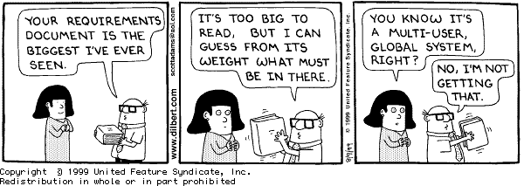
© A.I. Antón & M. Vouk, NCSU

Slide 31
Requirements Document Structure (1)
Introduction
  Describe need for the system and how it fits with business objectives
Glossary
  Define technical terms used
System models
  Define models showing system components and relationships
Functional requirements definition
  Describe the services to be provided
© A.I. Antón & M. Vouk, NCSU

Slide 32
Requirements Document Structure (2)
Non-functional requirements definition
  Define constraints on the system and the development process
System evolution
  Define fundamental assumptions on which the system is based and anticipated changes
Requirements specification
  Detailed specification of functional requirements
Appendices
  System hardware platform description
  Database requirements (as an ER model perhaps)
Index
© A.I. Antón & M. Vouk, NCSU

Slide 33
What goes into an SRD?
Project Title
General Description of System Concept
Model of Current Operations
Model of Planned Operations
List of Required Functions
Data Elements & Req’d Inputs & Outputs
Design Constraints
Implementation Constraints
© A.I. Antón & M. Vouk, NCSU

Slide 34
Guiding Principles for Requirements Engineering
Understand the problem before you begin to create the analysis model.
Develop prototypes that enable a user to understand how human-machine interaction will occur.
Record the origin of and reason for every requirement.
Use multiple views of requirements.
Prioritize requirements.
Work to eliminate ambiguity.
[Davis, 1995]
© A.I. Antón & M. Vouk, NCSU

Slide 35

Goals for Specifications
Completeness
Comprehensibility
Testability
Consistency
Unambiguity
Writeability
Modifiability
Implementability
© A.I. Antón & M. Vouk, NCSU

Slide 36
Achieving Specification Goals (1)
Strive for completeness
  No foolproof method
  User involvement helps
  Use models and/or scenarios
  Review specification
Make the specification consistent
  Use unique names for objects
  Identify & remove conflicting requirements
  Control elaboration of detail
© A.I. Antón & M. Vouk, NCSU

Slide 37
Achieving Specification Goals (2)
Make the specification
unambiguous and testable
  Be specific
  Use precise terminology
  Identify constraints
  Include performance and acceptance criteria
Make the specification comprehensible
  Know your audience
© A.I. Antón & M. Vouk, NCSU

Slide 38
Requirements Validation
Demonstrating that the requirements define the system that the customer really wants
Requirements error costs are high so validation is very important
  Fixing a requirements error after delivery may cost up to 100 times the cost of fixing an implementation error
Prototyping is an important technique of requirements validation
© A.I. Antón & M. Vouk, NCSU

Slide 39
Requirements Checking
Validity
  Does the system provide the functions which best support the customer’s needs?
Consistency
  Are there any requirements conflicts?
Completeness
  Are all functions required by the customer included?
Realism
  Can the requirements be implemented given available budget and technology
© A.I. Antón & M. Vouk, NCSU

Slide 40
Requirements Review Checks
Verifiability
  Is the requirement realistically testable?
Comprehensibility
  Is the requirement properly understood?
Traceability
  Is the origin of the requirement clearly stated?
Adaptability
  Can the requirement be changed without a large impact on other requirements?
© A.I. Antón & M. Vouk, NCSU

Slide 41
Requirements Classes
Enduring requirements
  Stable requirements derived from the core activity of the customer organization.
    E.g. a hospital will always have doctors, nurses, etc.
  May be derived from domain models
Volatile requirements
  Requirements which change during development or when the system is in use.
    In a hospital, requirements derived from health-care policy
© A.I. Antón & M. Vouk, NCSU

Slide 42
Some Requirements Notations
Main thing to note:
  Miles and miles above UML diagrams
At the requirements layer
  Details of classes, states, are tiny peripheral details
Q: Why?
  A: Language levels
  When you talk to programmers
    They want to talk “what” and “how”
  When you talk to high-end business users
    They want to talk about “why” and “why not”
© A.I. Antón & M. Vouk, NCSU

Slide 43
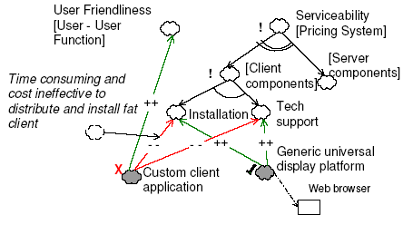
Requirements Notations :
Mylopolou’s SoftGoal Graphs
Soft goals are things we strive to achieve to some degree.
May be traded off if absolutely necessary
Details of class design etc, are tiny details on the edges of the goal graph
© A.I. Antón & M. Vouk, NCSU

Slide 44
Parts of the Mylopoulos ontology
Notes
  Depender (D), dependee (d)
Links
  Dependency (D to d)
  Part-of (decomposition)
  Means-end link
© A.I. Antón & M. Vouk, NCSU

Slide 45
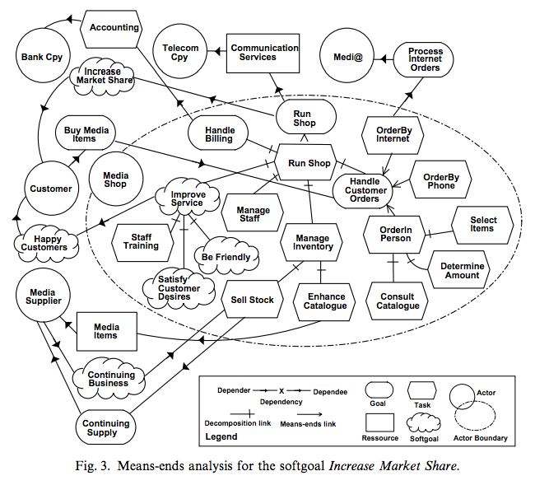
strategic dependency
Graph involving actors who have strategic dependencies among each other
Note: way above the level of UML
https://www.dropbox.com/s/7r6tur89avysiyw/Screenshot%202015-02-16%2010.57.39.png?dl=0
© A.I. Antón & M. Vouk, NCSU

