Slide 1
Lending Club case study
By Tamás Horváth

Slide 2
Business goal
Reduce the number of defaulted loans without significantly reducing business potential by rejecting borrowers who will pay off.

Slide 3
Data issues and cleaning
Lot of variables contain high amount (>90%) of missing data. (solution: remove variables)
Variables have unique data, not useful for analysis. (solution: remove variables)
Rows still contain missing variables. Data Imputation (global/local mean, median, mode) (not applied in this assignment)
Dates are read as string and converted to date type
Term parsed and rewritten to remove space
Interest rate: % removed, converted to float

Slide 4
Derived variables
installment_monthly_income_ratio
loan_amount_income_ratio
funded_percentage
issue_imonth

Slide 5
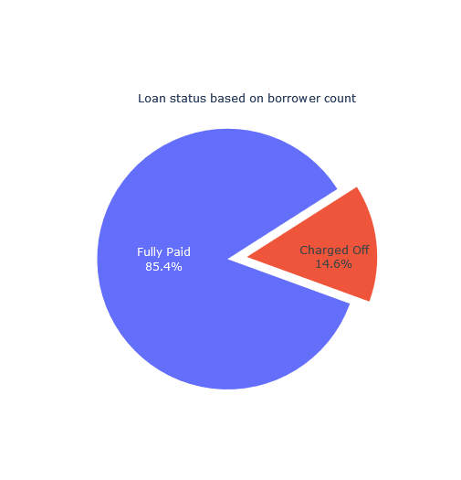
Charged Off distribution in data
14.6% of borrowers default on the loan.

Slide 6
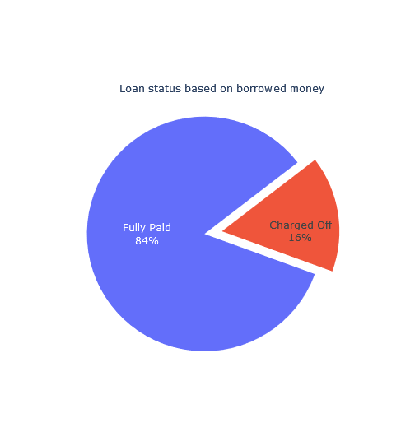
Charged Off distribution in data
If we check the borrowed amount (defaulted) it is even higher (16%), indicating that the average defaulted loan is slightly higher than the mean of loans. (see detailed distribution later)
The business goal is to reduce this number without significantly reducing business potential by rejecting borrowers who will pay off.

Slide 7
Drivers behind Charge Off

Slide 8
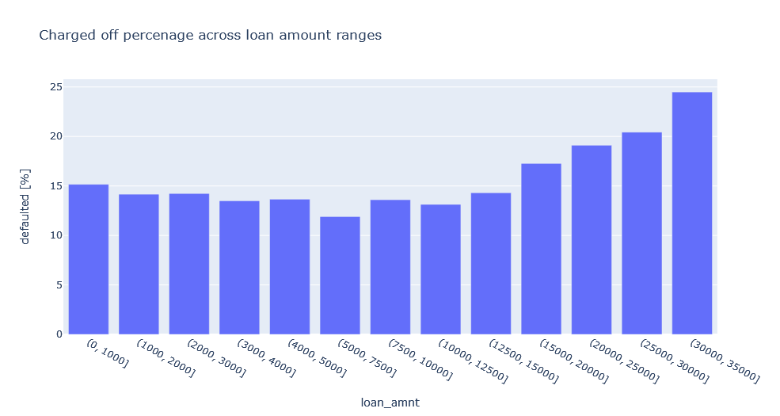
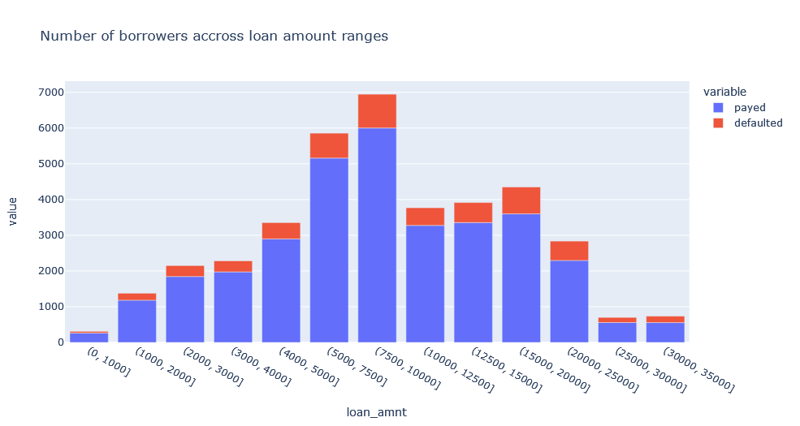
Loan amount
The risk of charge off is the lowest around 5000-7500 and start to increase above 15000.
Recommendations
On loans >15000 pay attention on other variables and potentially be more restrictive on the loan amount.

Slide 9
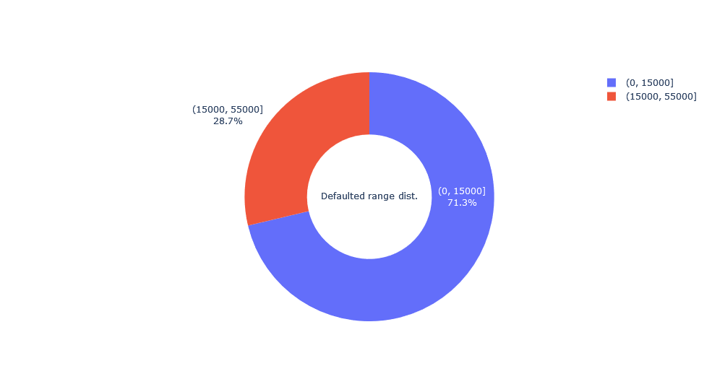
Loan amount
Almost 3/4 of the loans are from the <15000 range. Currently these loans are in the lower risk range. If the company starts to target a market of higher loans, should follow the above mentioned recommendations.

Slide 10
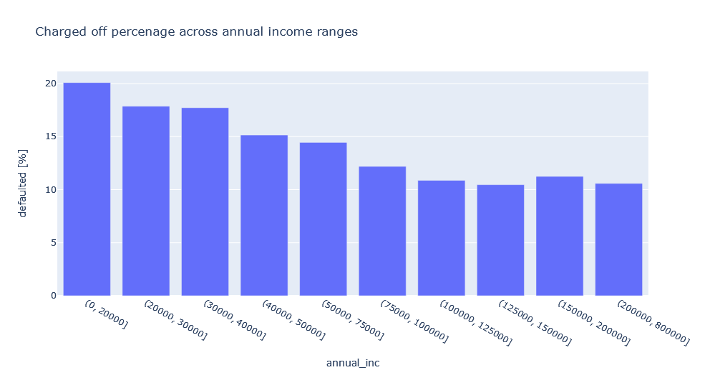
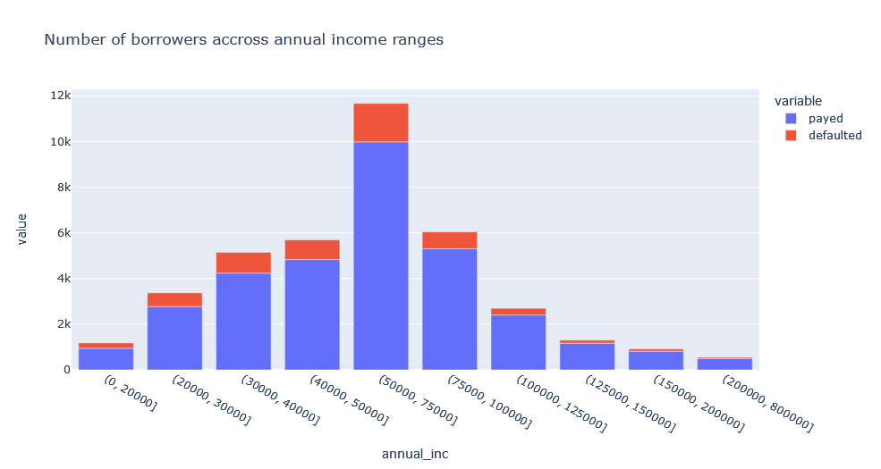
Annual Income
In general, lower annual income presents higher risk of default. Above 100k, income increase does not further decrease the risk of default.

Slide 11
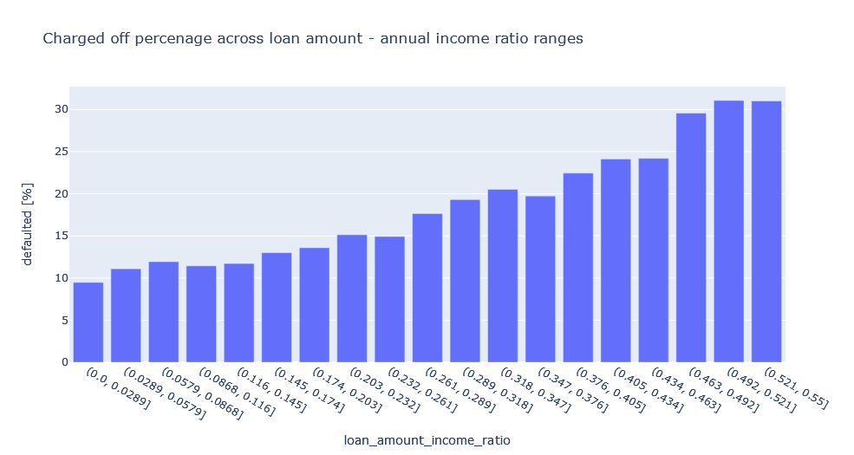
How borrowed amount relative to annual income affects default rate (percentage)
As the borrowed amount - annual income ratio (borrowed / annual income) increases the risk of default
Recommendation
for ratio >0.26 check other indicators and potentially decrease the accepted loan amountt increases as well.

Slide 12
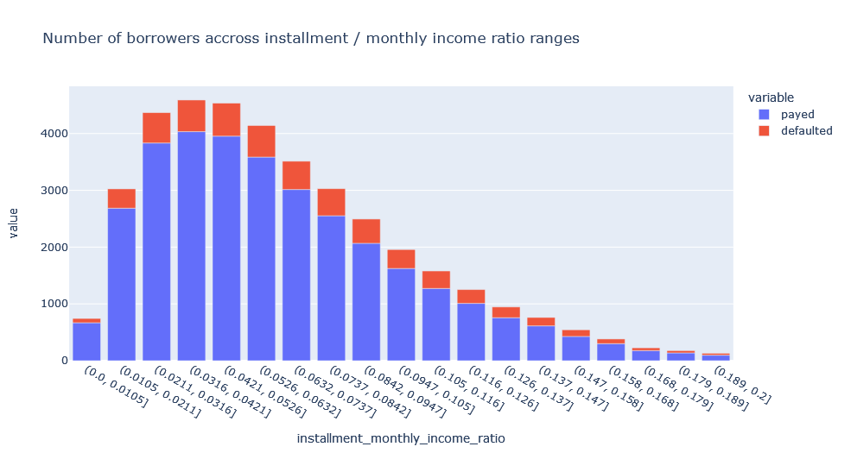
Installment
The number of borrowers accross installment / monthly income ratio ranges follows normal distributon.

Slide 13
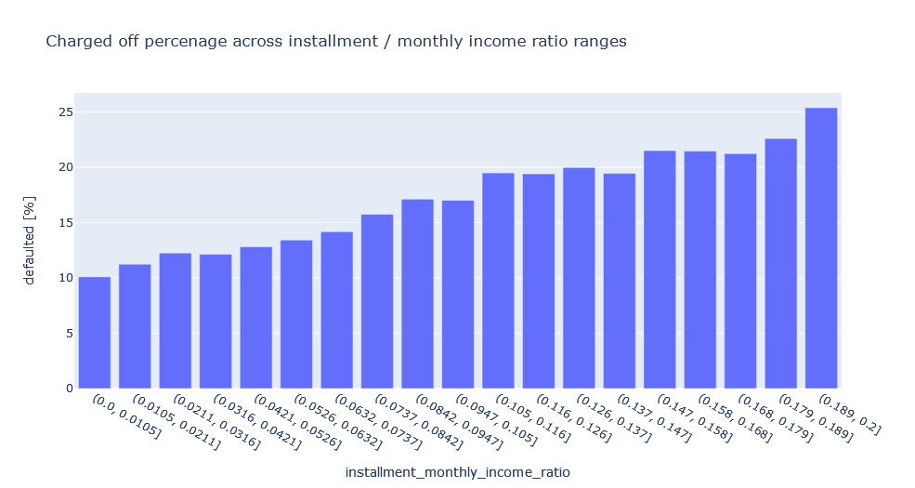
Installment
As the monthly instalment cost increase relative to the borrower's monthly income the chanche of default increases.
Recommendation
decrease the accepted loan amount therefore the ratio will decrease
offering longer term might decrease ratio but * see following analysis

Slide 14
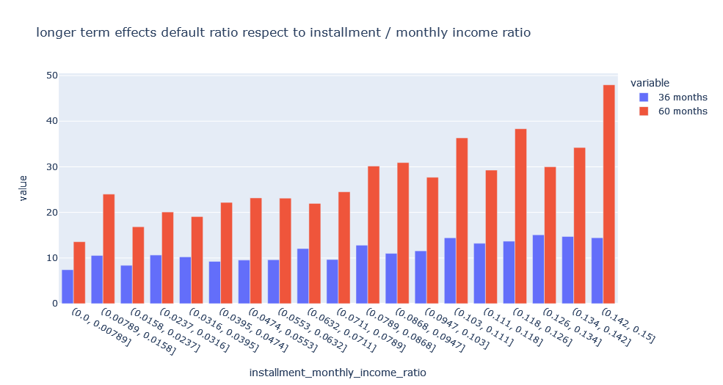
longer term effects default ratio respect to instalment / monthly income ratio
Based on the data, longer term loans has a significantly higher risk of default.
Even with lower installment / monthly income ratio the chance of default is higher for longer term. It is not recommended to offer significantly longer term for those who has higher installment / monthly income ratio.
40 or 48 months might be an option, but it needs data to prove.

Slide 15
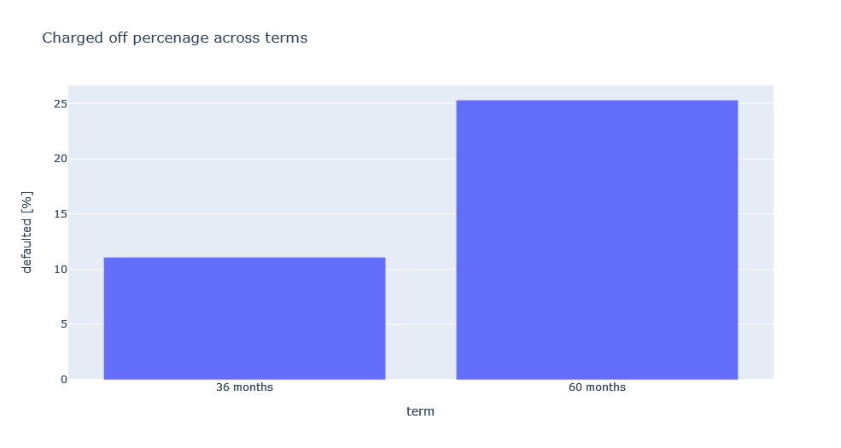
Term
In general longer term (60 months) has significantly higher (2x) risk of default.
Recommendation
Decrease the term to 36 if possible or decrease the loan amount to fit to the 36 months instalment. As shown later decreasing the loan amount keeping the 60 months does not decrease the risk of default
Check other risk factors and reject the loan if 60 months term coexist with them

Slide 16
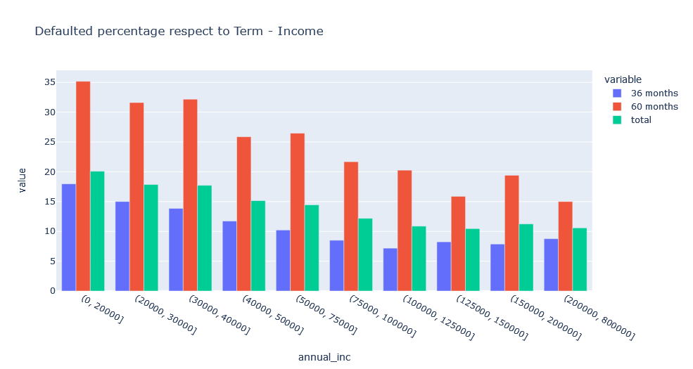
Defaulted percentage respect to Term - Income
Anual income increase lowers the risk for both terms (36 months, 60 months), indicating that annual income feature (variable) is a consistent predictor.

Slide 17
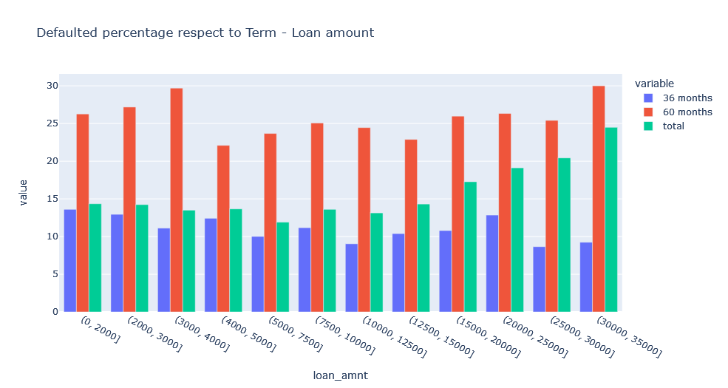
Defaulted percentage respect to Term - Loan amount
Decresing the loan ammount keeping the 60 months term does not decrease the risk of default.

Slide 18
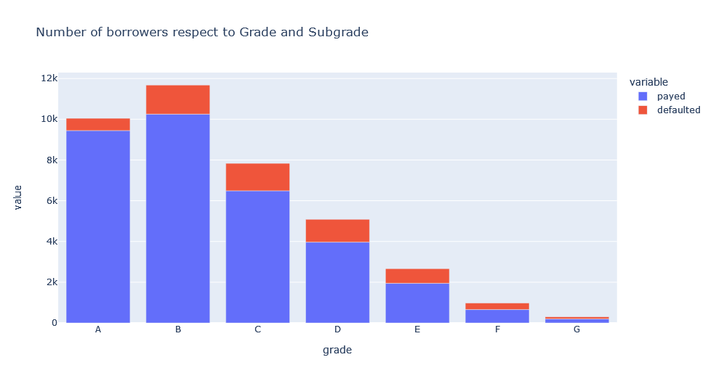
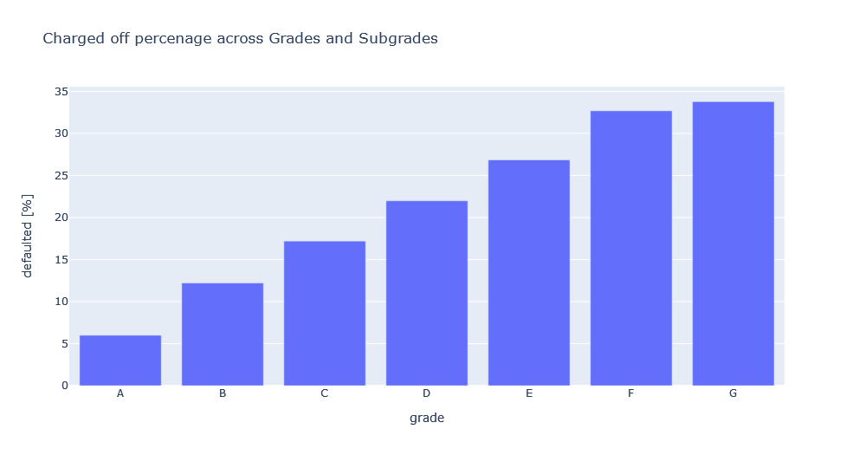
Grade
Grade is a strong indicator of charge off

Slide 19
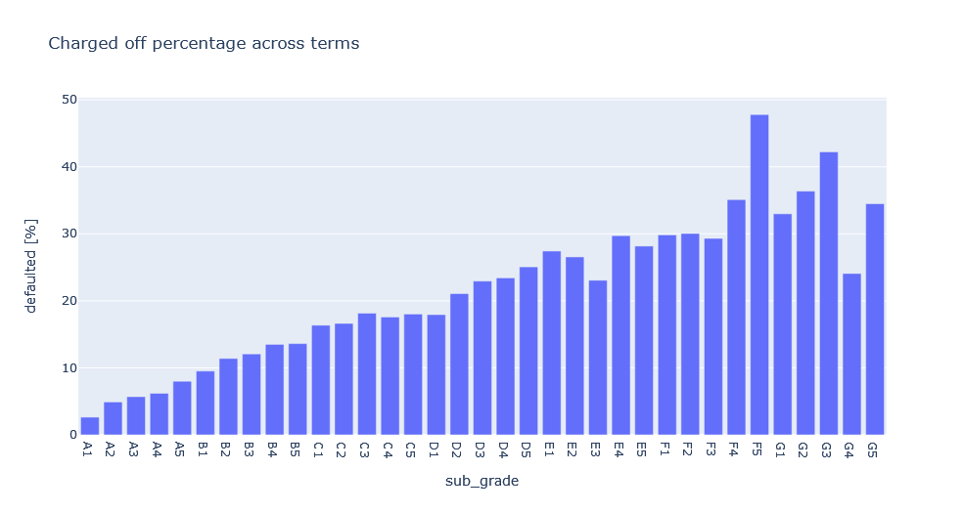
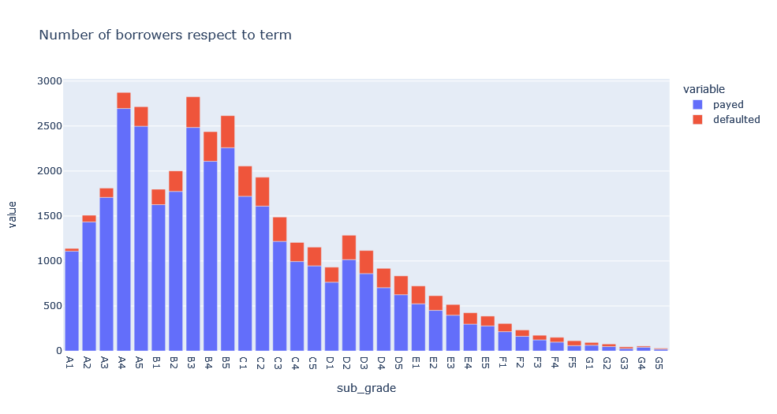
Subgrade
Sub Grade is a strong indicator of charge off. It provides reliable and consistent prediction of default between A-D. E and above subgrade does not give reliable indication.

Slide 20
Grade and Subgrade
Recommendation
Use grade and subgrade as a risk indicator between A-D.
E and above use grade subgrade dose not consistent.
As Grade decrease (A->G) consider other factors and decrease the loan amount or reject the loan.

Slide 21
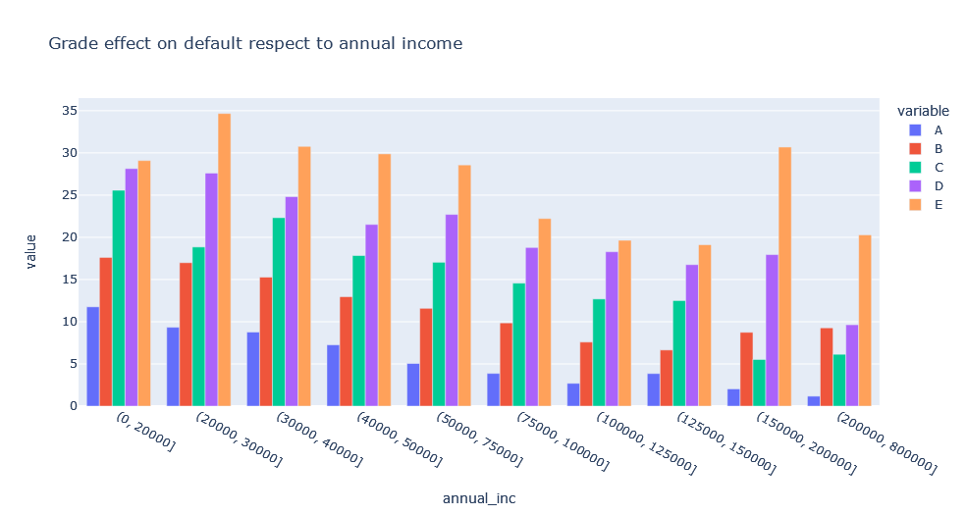
Grade effect on default respect to annual income
Both annual income and grade are strong and reliable indicators. F, G not included in the analysis because of low amount of data points per bin. But data shows that grade D, E have are less consistent and incur higher risk.
Recommendation
Annual income used in conjunction with grade can be a good predictor of default

Slide 22
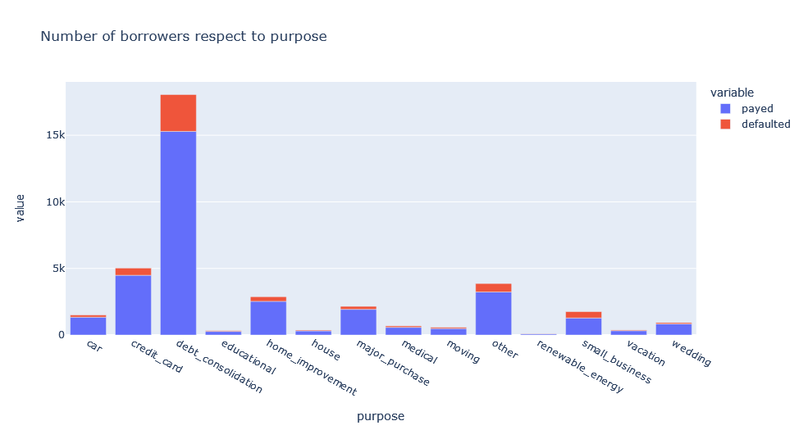
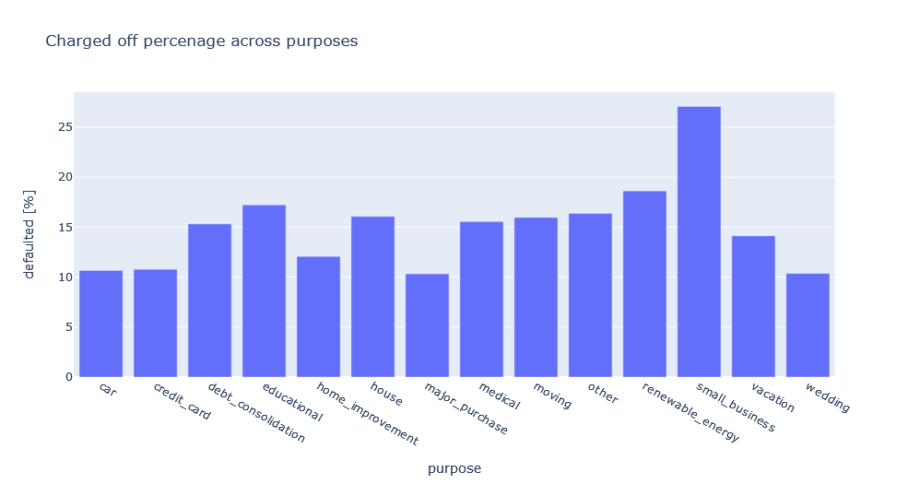
Purpose
Small business loans carry a significantly higher risk of default.
Recommendation
Check other variables in case of small business loans

Slide 23
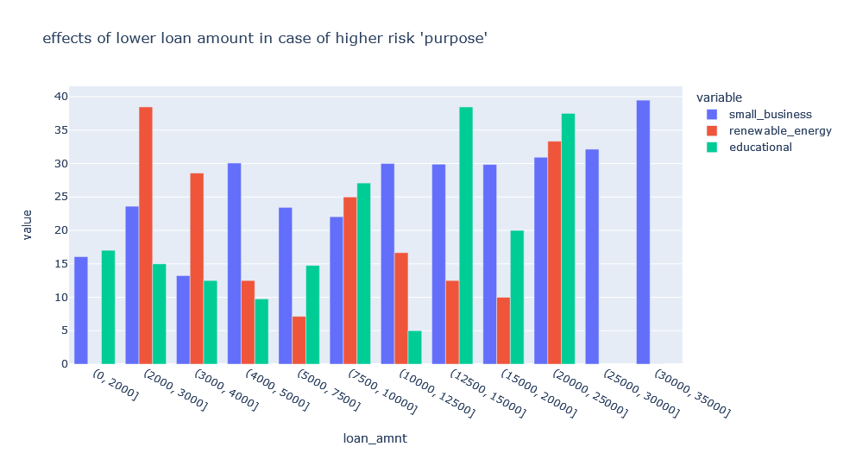
Possible effects of lower loan amount in case of higher risk 'purpose'
small business: Lower loan amount can slightly decrease the risk.
educational: Lower loan amount can decrease the risk.
renewable energy: Lower loan amount can increase the risk.

Slide 24
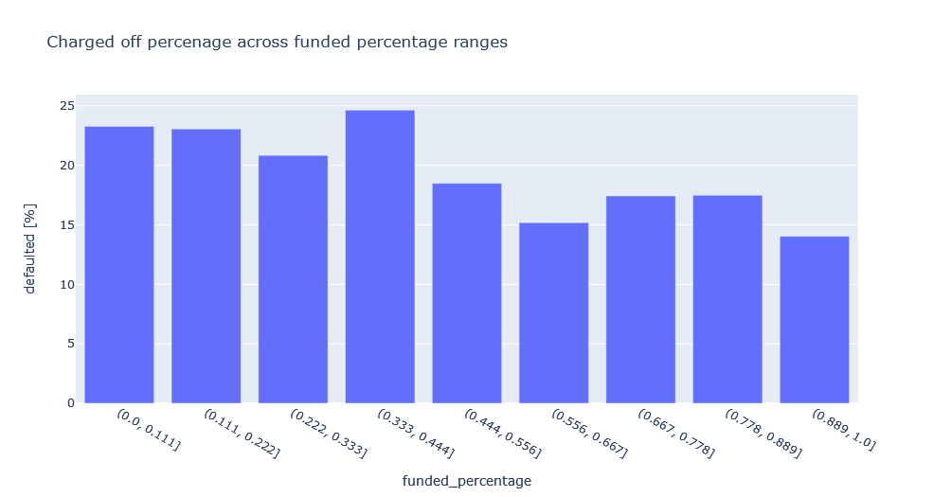
Funded percentage
Moderate underfunding (not providing the requested loan amount) does not increase the risk of default. Only substantial underfunding >50% can increase the risk.

Slide 25
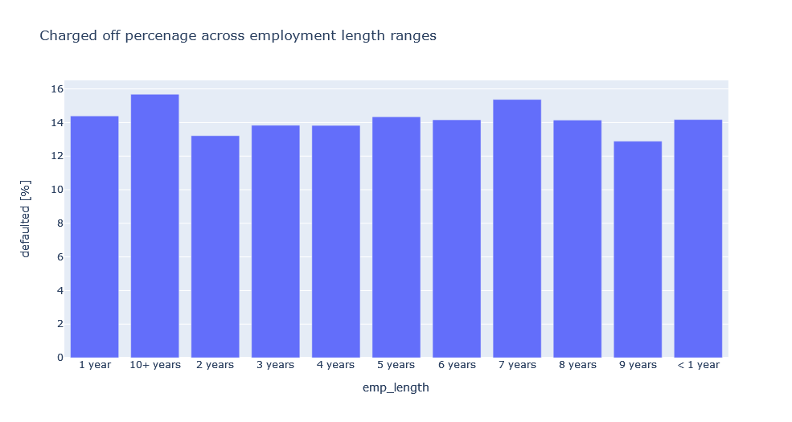
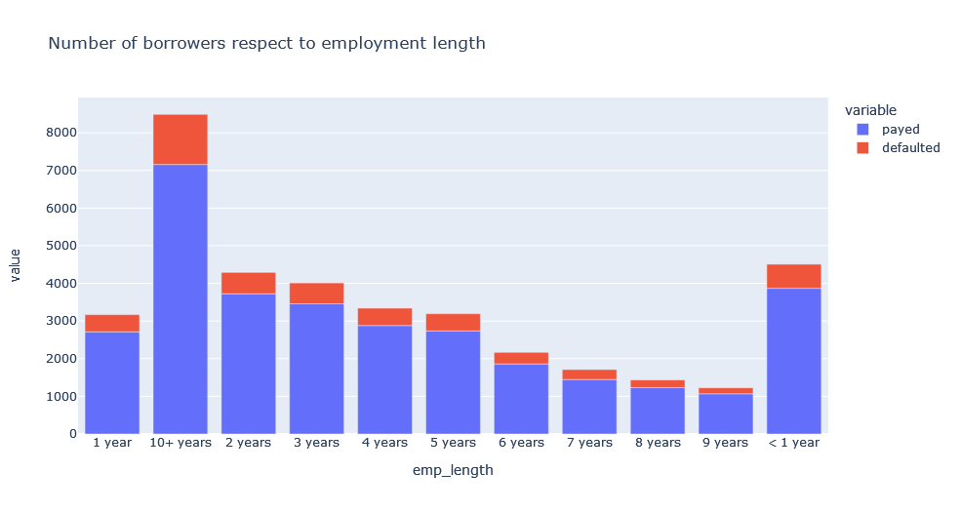
Employment length
Employment length is not a good predictor of default.
Not recommended to use it.

Slide 26
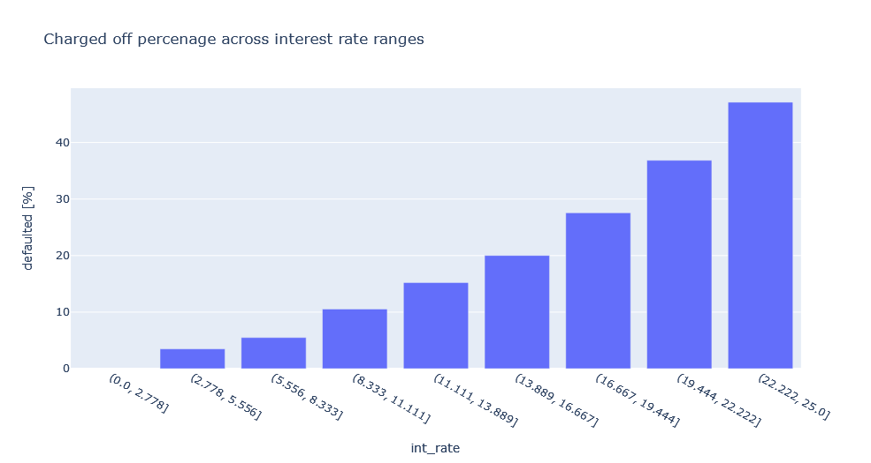
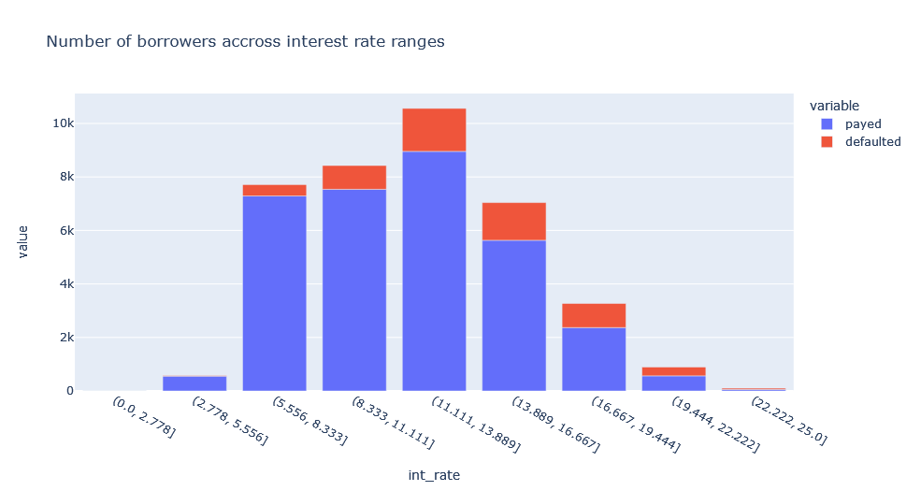
Interest rate
Interest rate is a good predictor of risk. High interest rate has significantly higher default rate. It is a very strong indicator.
Recommendation
If high interest rate combined with other strong negative predictors do not approve the loan.

Slide 27
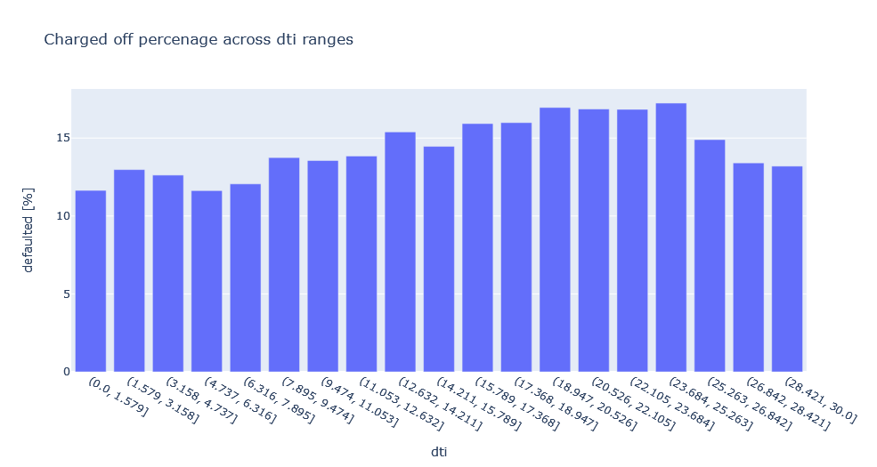
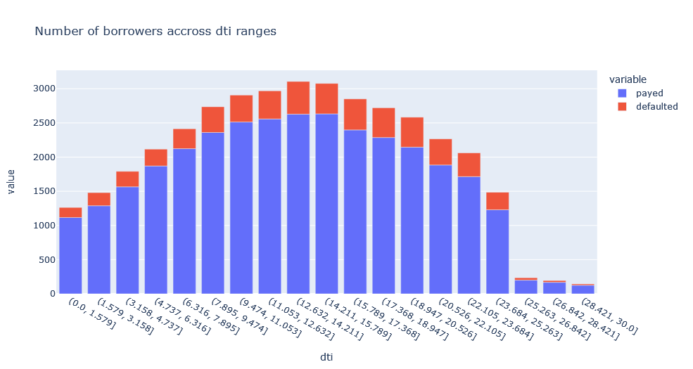
DTI
DTI between 15 and 25 shows a higher risk of default. Above 25 default ratio significantly drops. More data record in this range could reinforce this observation.
Recommendation
Not the best predictor, but can be used in conjunction with other stronger predictors.

Slide 28
Summary of Recommendations
Annual Income (strong predictor)
instalment / monthly income ratio
Term (longer = higher risk) (strong predictor)
Grade (strong predictor)
Subgrade (A-D reliable)
Annual income used in conjunction with grade can be a good predictor
Small business loans represent higher risk (check other predictors)
Moderate underfunding does not increase default
Employment length not relevant (do not use)
High interest rate = high risk (strong predictor)
Loan amount >15000 elevated risk, check other predictors

