Slide 1
Lakes
Environmental variation explains a lot
Residual correlations not as important
Shared environmental response can explain perceived species interactions (e.g., bass-walleye)
Cold/coolwater community clustering is apparent

Slide 2
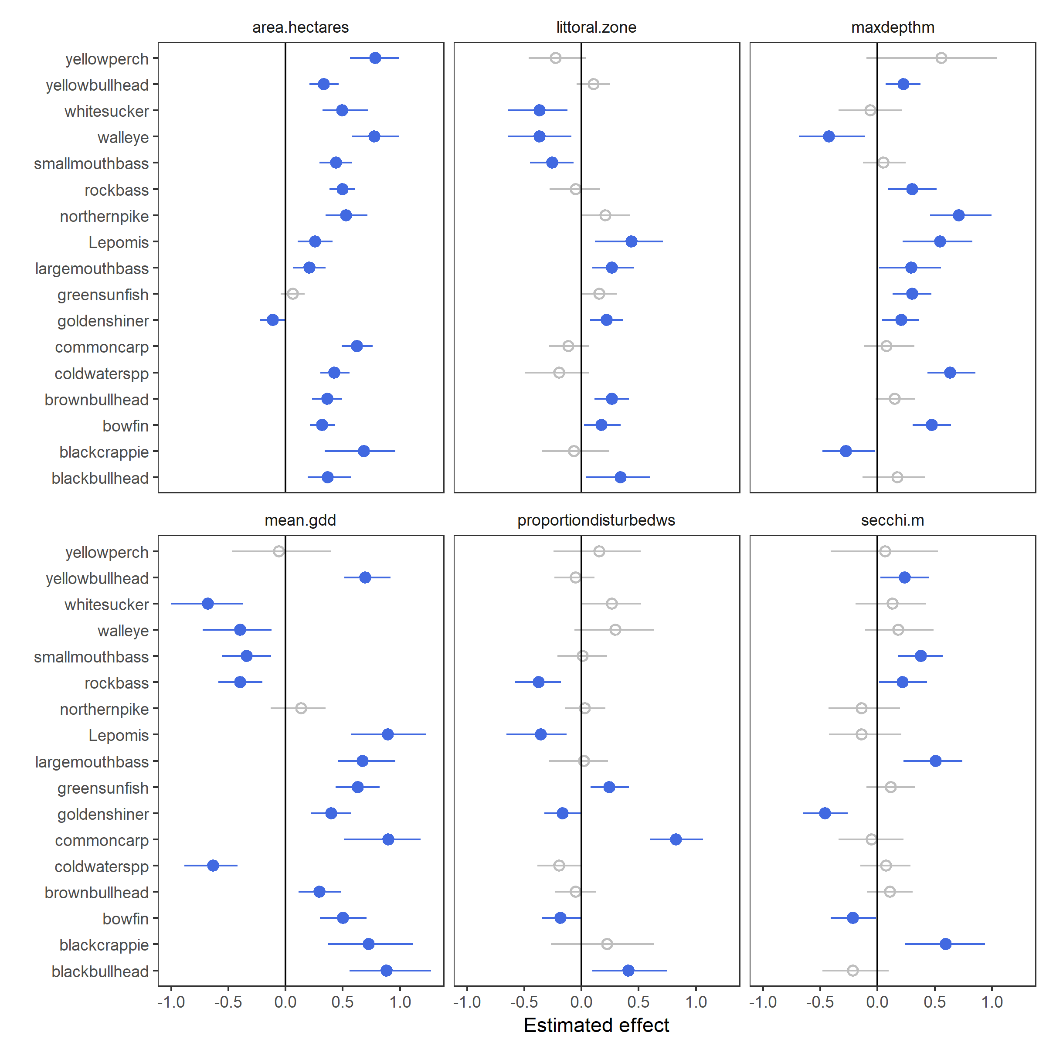

Slide 3
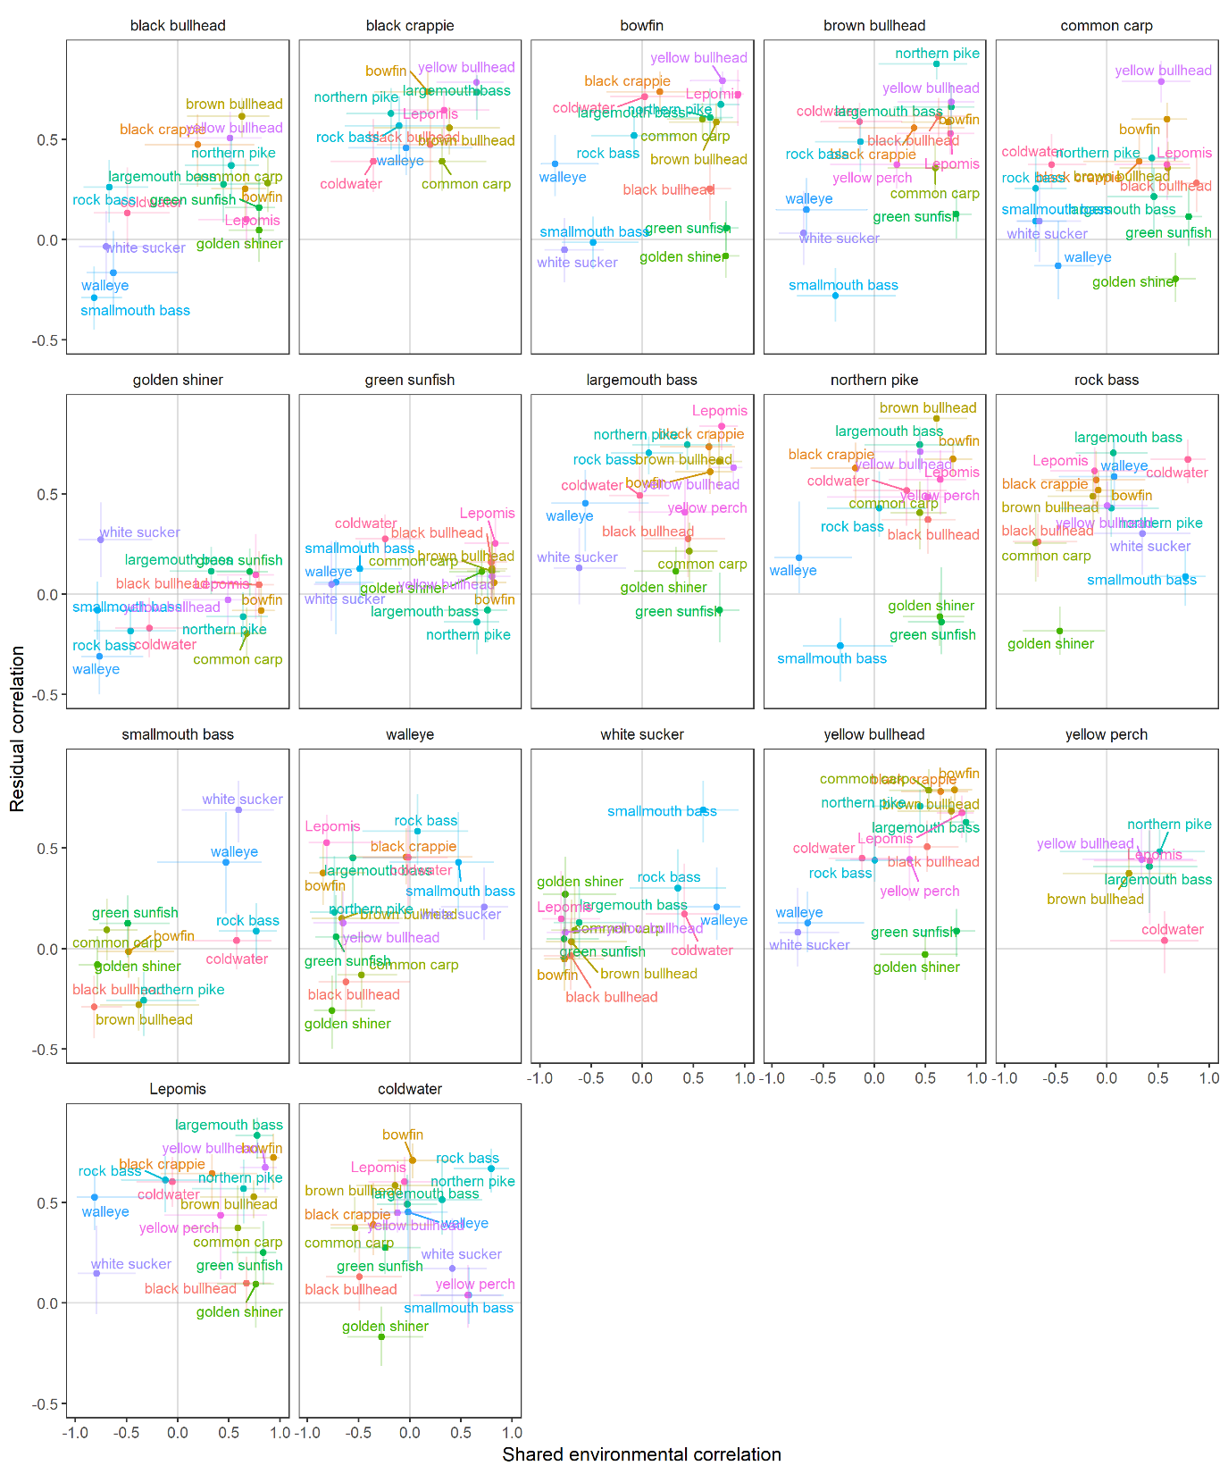
Residual correlation
Environmental correlation

Slide 4
Residual correlation
Environmental correlation

Slide 5
Residual correlations
Environmental correlations

Slide 6
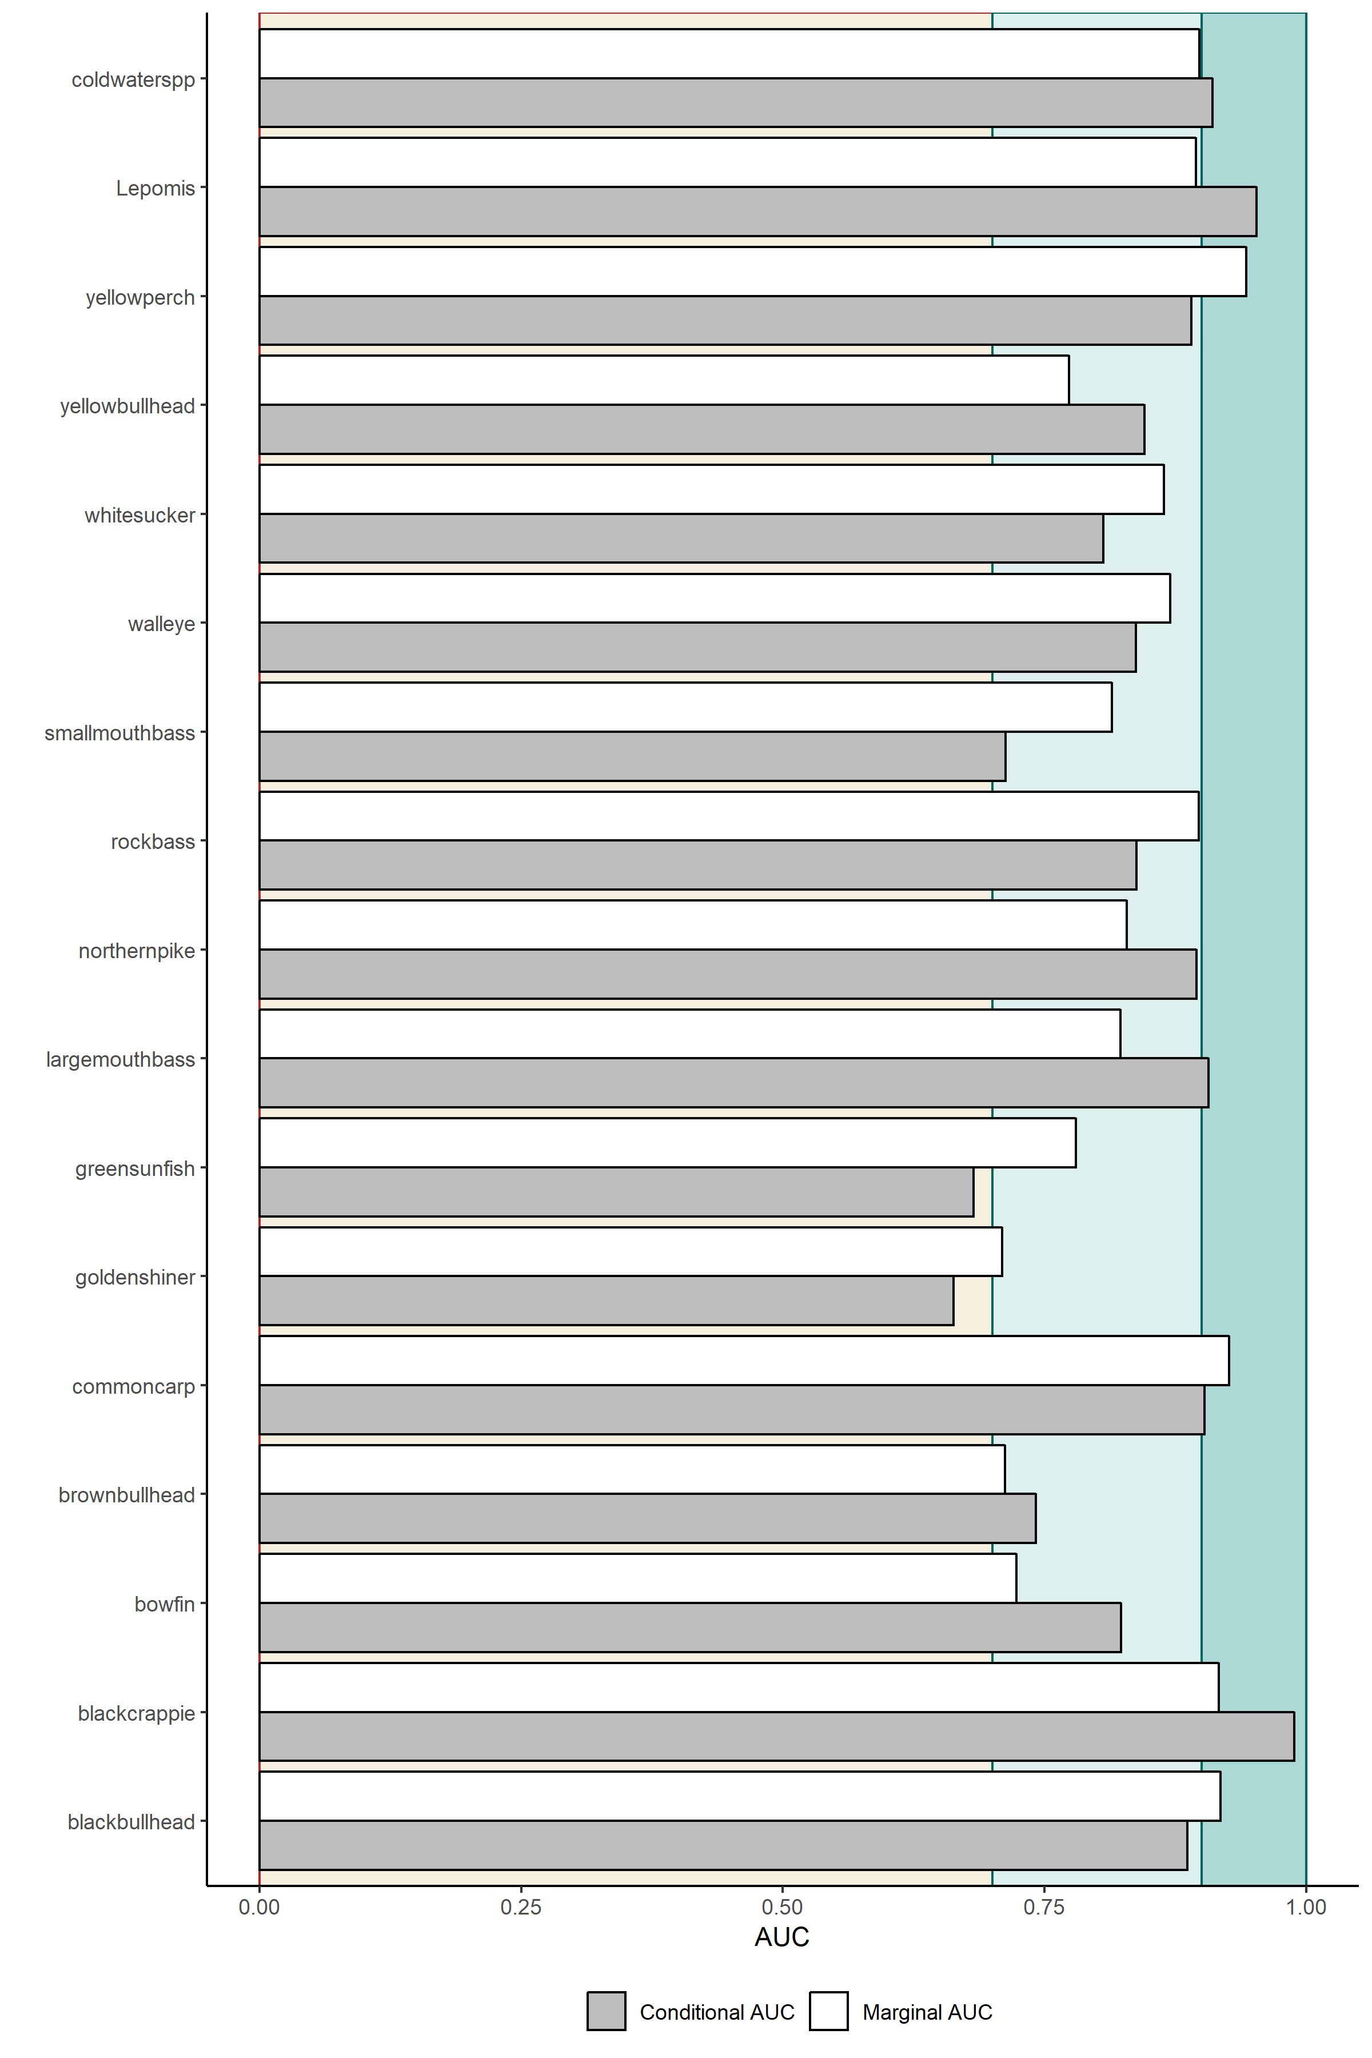

Slide 7
Streams
Environmental variables don’t explain much variance
Residual correlations are very important here

Slide 8
I didn’t have time to remake this to match the lakes one but you get the idea. Almost all of these would be non-significant (overlapping zero)

Slide 9
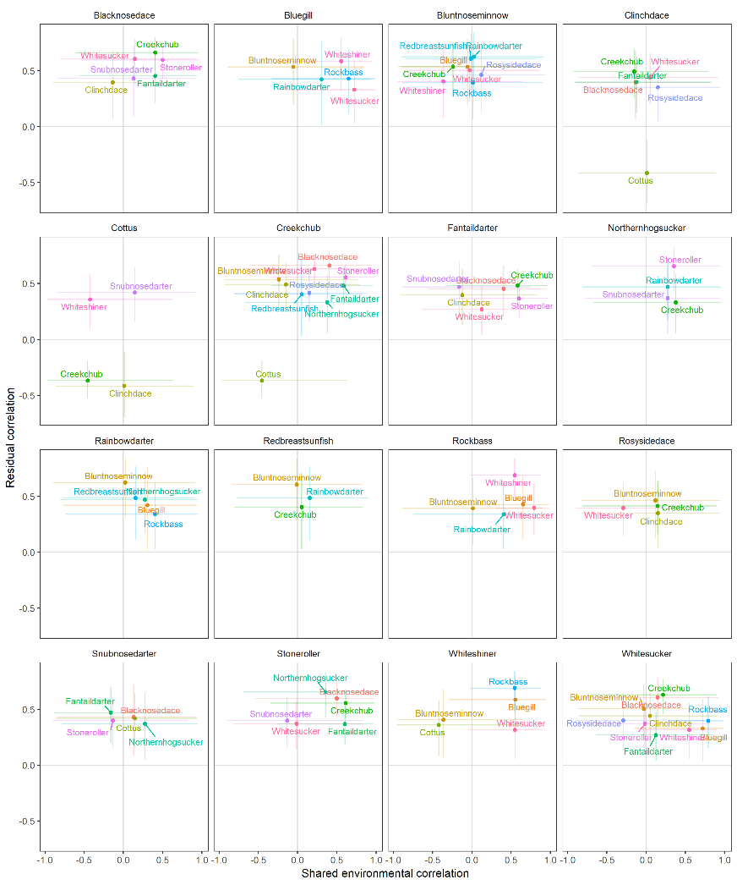
Residual correlation
Environmental correlation

Slide 10
Residual correlation
Environmental correlation

Slide 11
Residual correlations
Environmental correlations

Slide 12
