Slide 1
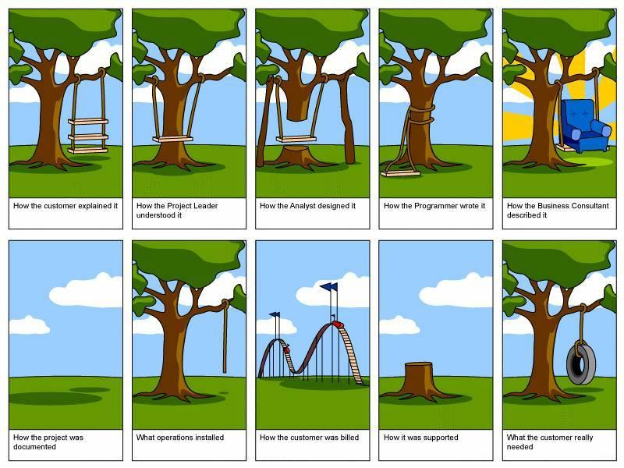
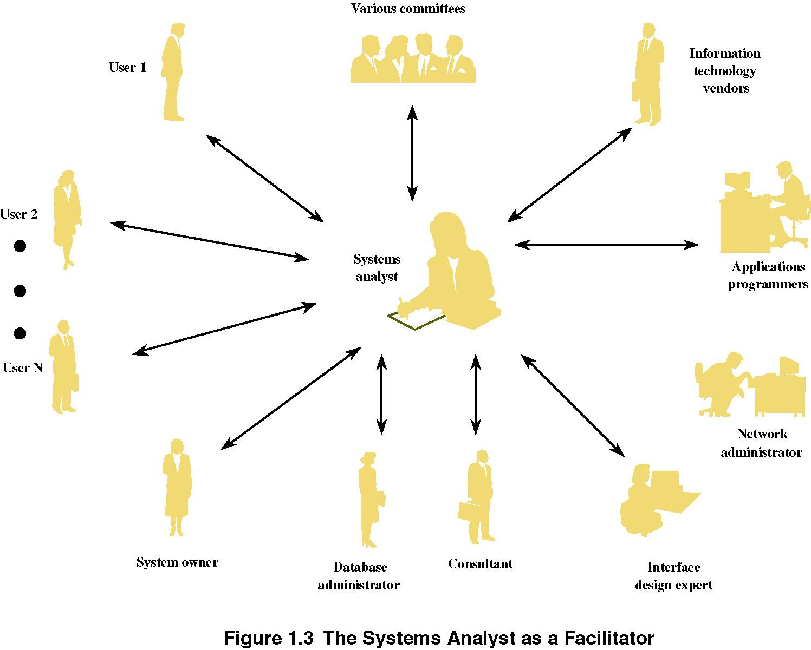
How the Customer explained it ?
Notes:
2

Slide 2
How the Project Leader
understood it ?
Notes:
2

Slide 3
How the Analyst designed it ?
Notes:
2

Slide 4
How the Programmer wrote it ?
Notes:
2

Slide 5
How the Business Consultant
described it ?
Notes:
2

Slide 6
系统非常简单
有三个功能：
（1）天空；
（2）白云；
（3）草地…
系统非常简单
有三个功能：
（1）天空；
（2）白云；
（3）草地…
系统非常简单
有三个功能：
（1）天空；
（2）白云；
（3）草地…
How the project was documented ?
Notes:
2

Slide 7

What operations installed ?
Notes:
2

Slide 8
How the Customer was billed ?
Notes:
2

Slide 9

How it was supported ?
Notes:
2

Slide 10
！
How the Customer really needed ?
Notes:
2

Slide 11
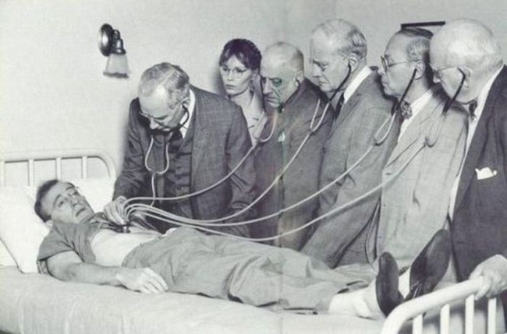
Notes:
2

Slide 12
Notes:
2

