Slide 1
The Pac-Man Projects
P0: UNIX/Python Tutorial
P1: Search
P2: Multi-Agent Search
P3: Reinforcement Learning
P4: BNs and HMMs: Ghostbusters
P5: Machine Learning: Classification

Slide 2
Ghostbusters and BNs
http://inst.cs.berkeley.edu/~cs188/sp20/project4/#ghostbusters-and-bns

Slide 3
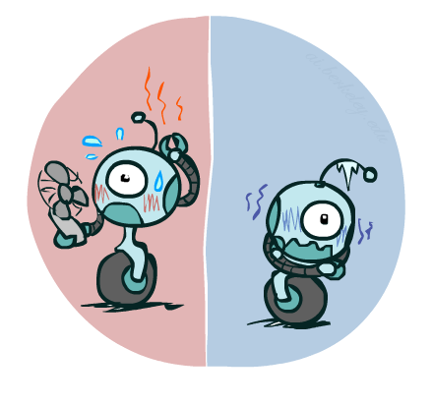

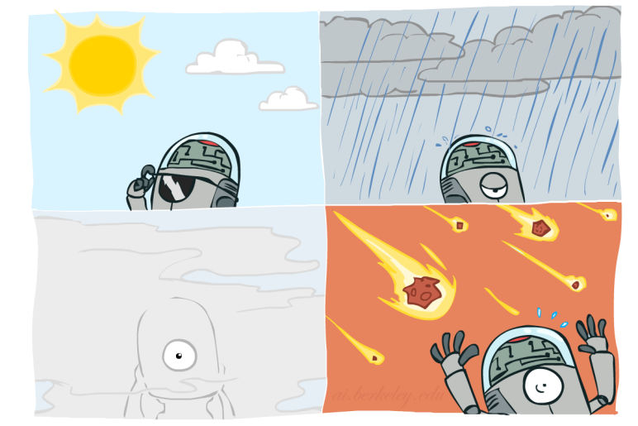

Probability Distributions
Associate a probability with each value
Temperature:
Weather:
W | P
sun | 0.6
rain | 0.1
fog | 0.3
meteor | 0.0
T | P
hot | 0.5
cold | 0.5

Slide 4
To Normalize
(Dictionary) To bring or restore to a normal condition
Procedure:
Step 1: Compute Z = sum over all entries
Step 2: Divide every entry by Z
Example 1
All entries sum to ONE
Example 2
W | P
sun | 0.2
rain | 0.3
Normalize
W | P
sun | 0.4
rain | 0.6
T | W | P
hot | sun | 20
hot | rain | 5
cold | sun | 10
cold | rain | 15
T | W | P
hot | sun | 0.4
hot | rain | 0.1
cold | sun | 0.2
cold | rain | 0.3
Normalize
Z = 0.5
Z = 50

Slide 5


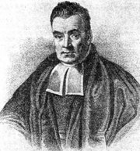
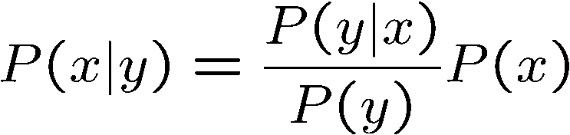
Bayes’ Rule（百度百科）
Two ways to factor a joint distribution over two variables:
Dividing, we get:
Why is this at all helpful?
Lets us build one conditional from its reverse
Often one conditional is tricky but the other one is simple
Foundation of many systems we’ll see later (e.g. ASR, MT)
In the running for most important AI equation!
That’s my rule!

Slide 6
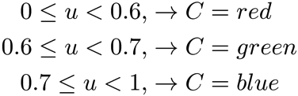

Sampling
Sampling from given distribution
Step 1: Get sample u from uniform distribution over [0, 1)
E.g. random() in python
Step 2: Convert this sample u into an outcome for the given distribution by having each target outcome associated with a sub-interval of [0,1) with sub-interval size equal to probability of the outcome
Example
If random() returns u = 0.83, then our sample is C = blue
E.g, after sampling 8 times:
C | P(C)
red | 0.6
green | 0.1
blue | 0.3

Slide 7
Question 0 (0 points): DiscreteDistribution Class
http://inst.cs.berkeley.edu/~cs188/sp20/project4/#question-0-0-points-discretedistribution-class

Slide 8
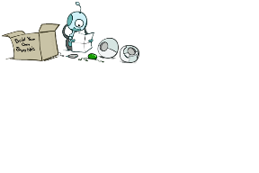


Bayes’ Net Semantics（知乎）
A set of nodes, one per variable X
A directed, acyclic graph
A conditional distribution for each node
A collection of distributions over X, one for each combination of parents’ values
CPT: conditional probability table
Description of a noisy “causal” process
A₁
A_{n}
X
A Bayes net = Topology (graph) + Local Conditional Probabilities

Slide 9
Question 1 (2 points): Observation Probability
http://inst.cs.berkeley.edu/~cs188/sp20/project4/#question-1-2-points-observation-probability

Slide 10
Question 2 (3 points): Exact Inference Observation
http://inst.cs.berkeley.edu/~cs188/sp20/project4/#question-2-3-points-exact-inference-observation

Slide 11
Question 3 (3 points): Exact Inference with Time Elapse
http://inst.cs.berkeley.edu/~cs188/sp20/project4/#question-3-3-points-exact-inference-with-time-elapse

Slide 12
Question 4 (2 points): Exact Inference Full Test
http://inst.cs.berkeley.edu/~cs188/sp20/project4/#question-4-2-points-exact-inference-full-test

Slide 13
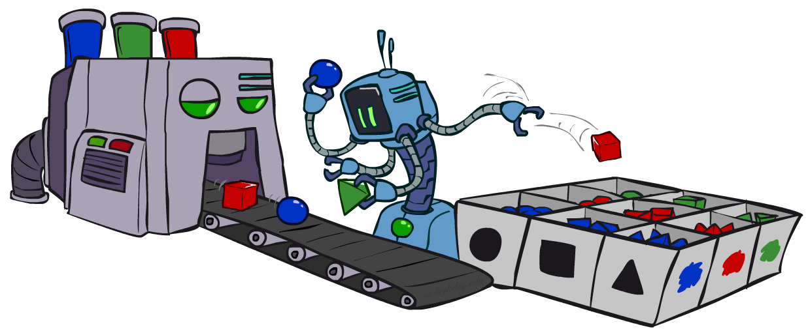
Sampling
Sampling is a lot like repeated simulation
Predicting the weather, basketball games, …
Basic idea
Draw N samples from a sampling distribution S
Compute an approximate posterior probability
Show this converges to the true probability P
Why sample?
Learning: get samples from a distribution you don’t know
Inference: getting a sample is faster than computing the right answer (e.g. with variable elimination)

Slide 14
关于Particle Filtering算法
怎样从实际场景上理解粒子滤波（Particle Filter）？ - 知乎 (zhihu.com)

Slide 15
Question 5 (2 points): Approximate Inference Initialization and Beliefs
http://inst.cs.berkeley.edu/~cs188/sp20/project4/#question-5-2-points-approximate-inference-initialization-and-beliefs

Slide 16
Question 6 (3 points): Approximate Inference Observation
http://inst.cs.berkeley.edu/~cs188/sp20/project4/#question-6-3-points-approximate-inference-observation

Slide 17
Question 7 (3 points): Approximate Inference with Time Elapse
http://inst.cs.berkeley.edu/~cs188/sp20/project4/#question-7-3-points-approximate-inference-with-time-elapse

Slide 18
Question 8 (1 points): Joint Particle Filter Observation
http://inst.cs.berkeley.edu/~cs188/sp20/project4/#question-8-1-points-joint-particle-filter-observation

Slide 19
Question 9 (3 points): Joint Particle Filter Observation
http://inst.cs.berkeley.edu/~cs188/sp20/project4/#question-9-3-points-joint-particle-filter-observation

Slide 20
Question 10 (3 points): Joint Particle Filter Time Elapse and Full Test
http://inst.cs.berkeley.edu/~cs188/sp20/project4/#question-10-3-points-joint-particle-filter-time-elapse-and-full-test

