Slide 1
The Pac-Man Projects
P0: UNIX/Python Tutorial
P1: Search
P2: Multi-Agent Search
P3: Reinforcement Learning
P4: BNs and HMMs: Ghostbusters
P5: Machine Learning: Classification

Slide 2
Installation 安装需要的第三方库
http://inst.cs.berkeley.edu/~cs188/sp20/project5/#installation

Slide 3
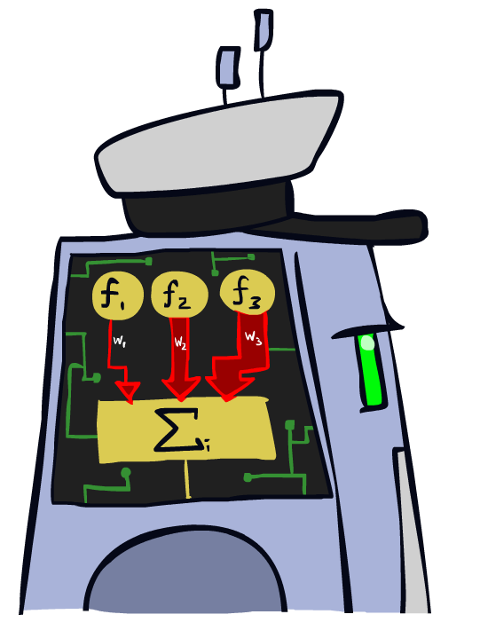
Linear Classifiers

Slide 4
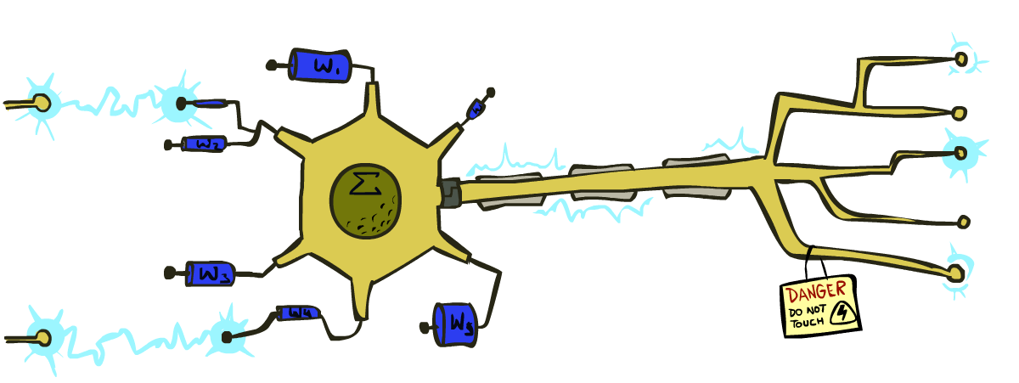
Some (Simplified) Biology
Very loose inspiration: human neurons

Slide 5
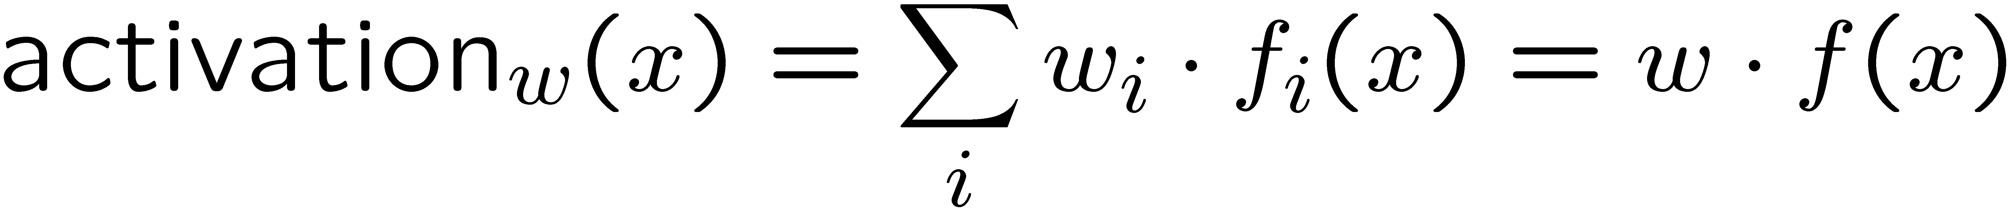
Linear Classifiers
Inputs are feature values
Each feature has a weight
Sum is the activation
If the activation is:
Positive, output +1
Negative, output -1
w₁
f₁
Σ
w₂
>0?
f₂
w₃
f₃

Slide 6

Weight Updates

Slide 7
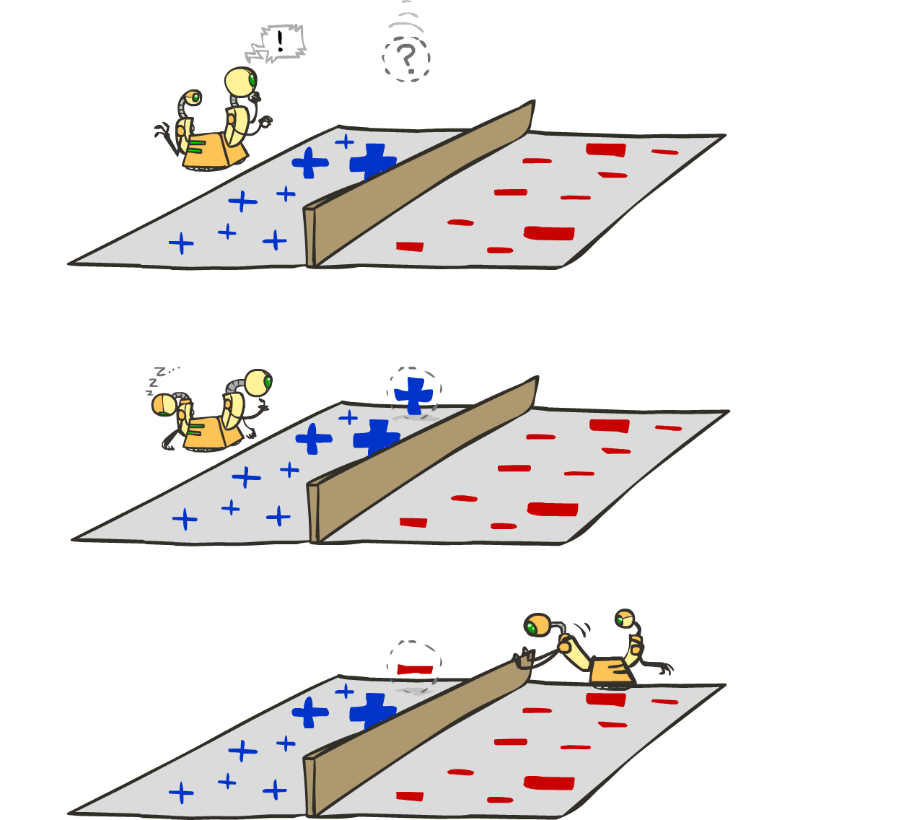
Learning: Binary Perceptron
Start with weights = 0
For each training instance:
Classify with current weights
If correct (i.e., y=y*), no change!
If wrong: adjust the weight vector
Notes:
http://isl.ira.uka.de/neuralNetCourse/2004/VL_11_5/Perceptron.html

Slide 8
Question 1 (6 points): Perceptron
http://inst.cs.berkeley.edu/~cs188/sp20/project5/#question-1-6-points-perceptron

Slide 9
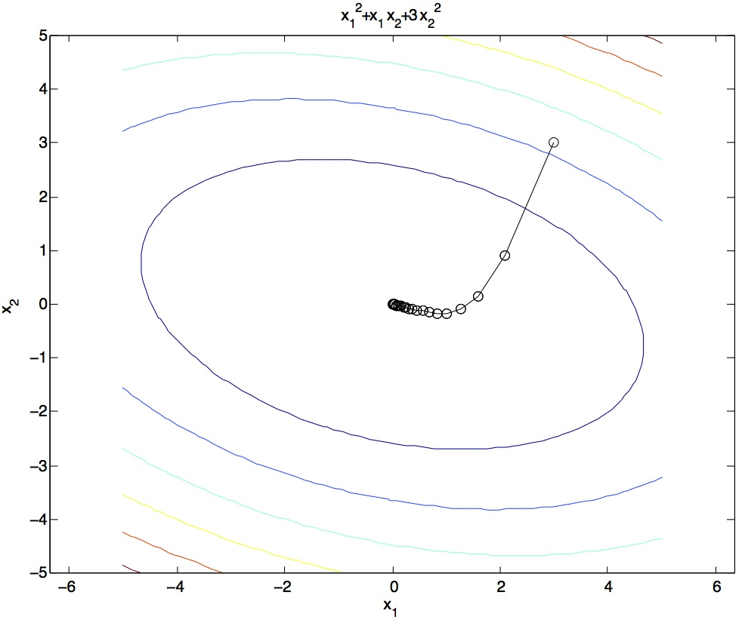
Gradient Ascent
Idea:
Start somewhere
Repeat: Take a step in the gradient direction
Figure source: Mathworks

Slide 10
Optimization Procedure: Gradient Ascent
init
for iter = 1, 2, …
: learning rate --- tweaking parameter that needs to be chosen carefully
How? Try multiple choices
Crude rule of thumb: update changes about 0.1 – 1 %

Slide 11
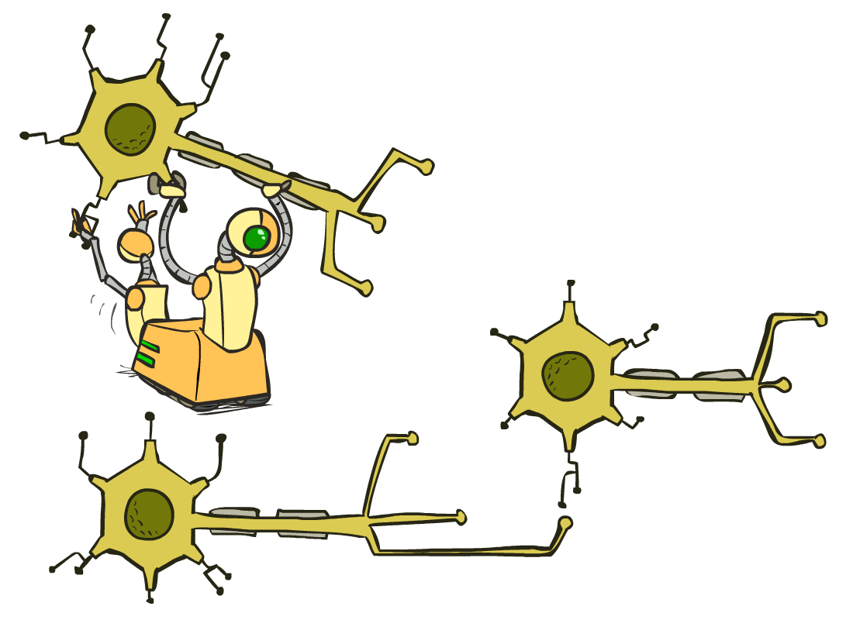
Neural Networks

Slide 12
Multi-class Logistic Regression
= special case of neural network
f₁(x)
z₁
softmax
f₂(x)
z₂
f₃(x)
…
z₃
f_{K}(x)

Slide 13
Example: Linear Regression
http://inst.cs.berkeley.edu/~cs188/sp20/project5/#example-linear-regression

Slide 14
Deep Neural Network = Also learn the features!
x₁
f₁(x)
softmax
x₂
f₂(x)
…
x₃
f₃(x)
…
…
…
…
…
x_{L}
f_{K}(x)
g = nonlinear activation function

Slide 15
Question 2 (6 points): Non-linear Regression
http://inst.cs.berkeley.edu/~cs188/sp20/project5/#question-2-6-points-non-linear-regression

Slide 16
Question 3 (6 points): Digit Classification
http://inst.cs.berkeley.edu/~cs188/sp20/project5/#question-3-6-points-digit-classification

Slide 17
Question 4 (7 points): Language Identification
http://inst.cs.berkeley.edu/~cs188/sp20/project5/#question-4-7-points-language-identification

