Slide 1
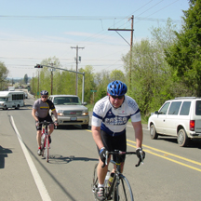
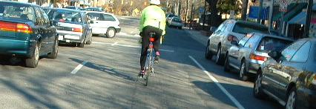
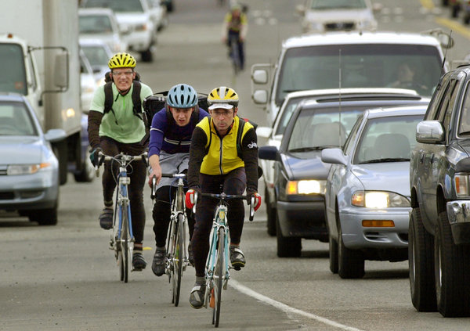
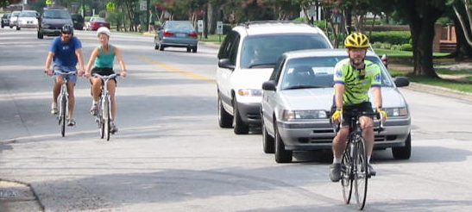
“Share the Road”
Driver’s Education Unit
Notes:
This presentation was developed by The Adam Little Foundation and cycling instructor Steven Goodridge

Slide 2
Bicyclists are Drivers of Vehicles
§ 20-4.01(49) Vehicle. – …for the purposes of this Chapter bicycles shall be deemed vehicles and every rider of a bicycle upon a highway shall be subject to the provisions of this Chapter applicable to the driver of a vehicle except those which by their nature can have no application.
Notes:
State law defines bicycles as vehicles and assigns bicyclists the rights and duties of drivers of vehicles.
Bicyclists are allowed to travel on all roadways except freeways.

Slide 3

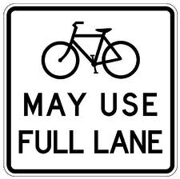
Approved Signage
Unambiguous & easy to understand
Ambiguous & not understood by all
Notes:
Share The Road signs are currently used throughout North Carolina. However, because they are misunderstood by many drivers, many advocates are pushing for the May Use Full Lane signs. Both signs mean the same thing but the sign on the right is much clearer and understood by drivers.

Slide 4
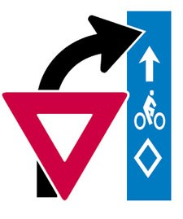
Always Yield to Bicyclists
When encountering a bicyclist in a bike lane (or on a path parallel to the lane), always yield to the bicyclist; this is analogous to a pedestrian crossing the street in a crosswalk.

Slide 5
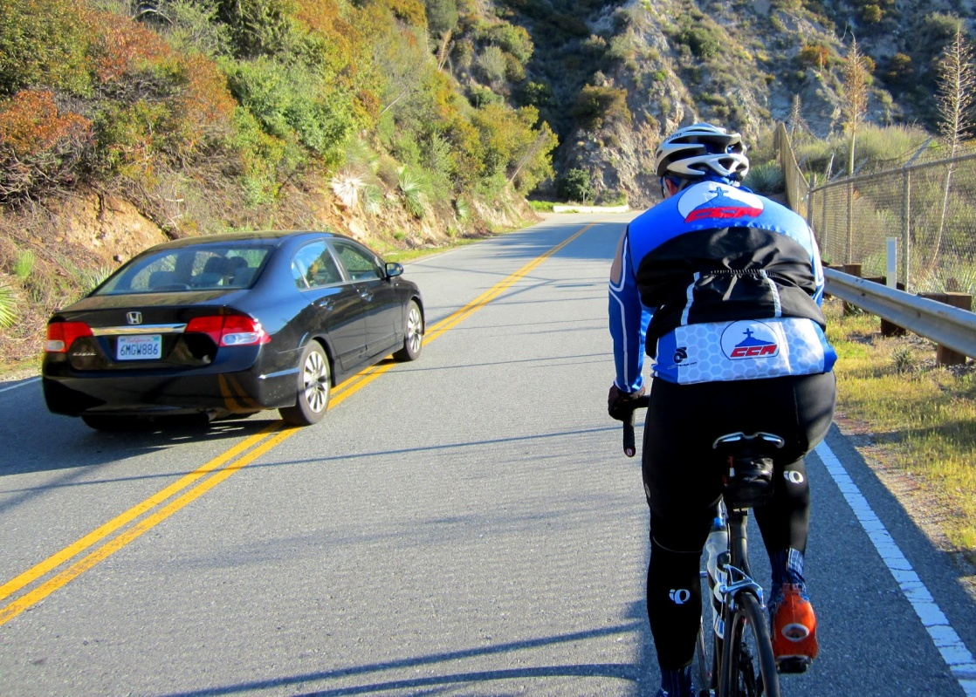
Passing a Bicyclist
Slow down as you approach the cyclist
Wait until it is safe and legal to pass
Allow the cyclist plenty of room; preferably, change lanes just as you would do to pass any motor vehicle

Slide 6
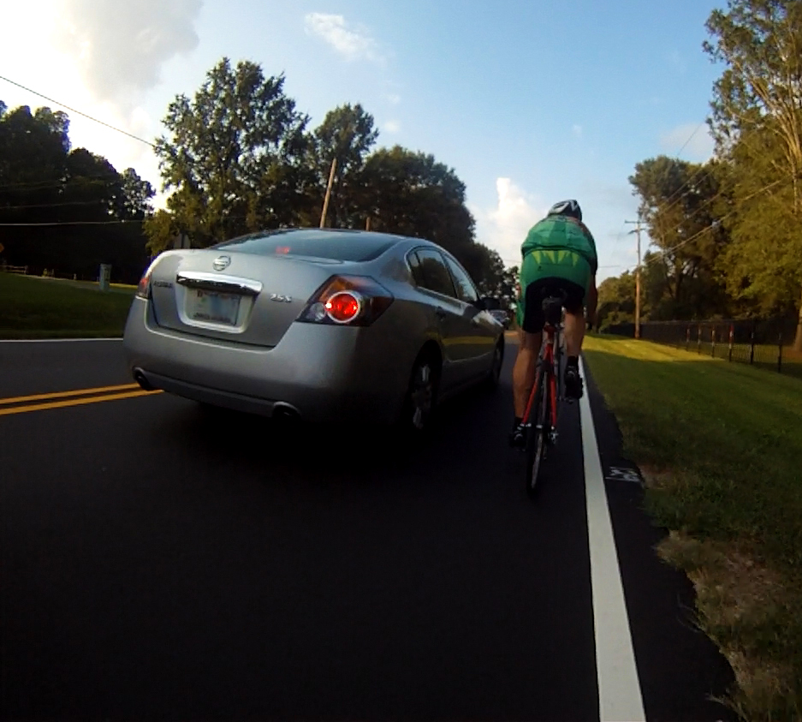
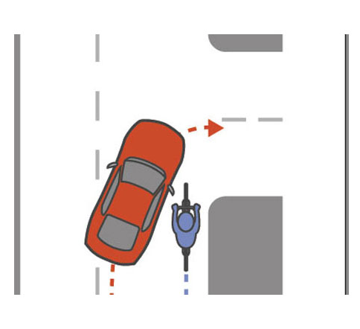
Passing a Bicyclist - What Not To Do
Do not slow down as you pass; do not stop quickly or turn sharply to the right once you’ve passed the bicyclist
Do not startle a bicyclist with loud noises, which includes blaring the horn
Notes:
Called a “hook”

Slide 7
Bicyclist Laws
Bicyclists have the right to full use of the traffic lane (and are not required to ride to the far right of the lane)
Bicycles are considered vehicles and bicyclists are drivers of vehicles
Bicycle operators have the same rights of the road as other drivers
Bicycle operators travel in the same direction as other traffic, not against traffic

Slide 8
The Most Common
Bicycle-Motorist Collisions

Slide 9
Accidents are often the result of a motorist underestimating a cyclist’s speed.
Recreational cyclists may ride 15 -18 mph while competitive cyclists may ride 20 - 25 mph or even, at times, 30 - 35 mph.
Notes:
Cyclists also contribute to certain types of accidents: A cyclist riding too far to the right may blend in with roadside elements. Cyclists who are not well lit (applies to daytime or evening) by lighting and/or clothing can go undetected. Motorists “shoot the gap” and may hit an undetected bicyclist.

Slide 10
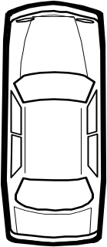

1. Motorist Left Turn (Left Cross)
X
Notes:
The thru cyclist has the right of way but the oncoming motorist turns left across the bicyclist’s path.
The motorist may overlook the narrow bike or misjudge the cyclist’s distance or speed.

Slide 11
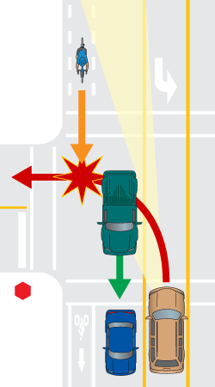
Avoiding Left Turn Crashes
Look twice for oncoming traffic before turning
Look for bicyclists obstructed by other oncoming vehicles
Be aware that bicycles may be traveling faster than you expect

Slide 12
2. Motorist Drive-Outs
X
X
Notes:
The motorist fails to yield at the stop sign, red light or driveway.

Slide 13
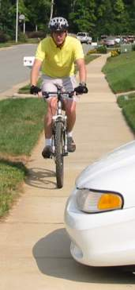
Avoiding Motorist Drive-out Crashes
Come to a full stop at stop signs, red lights, and crosswalks (e.g., as you exit your driveway) as required by law.
Look both ways before proceeding.

Slide 14
3. The Right Hook
X
Notes:
This occurs when a motorist executes a right turn from a position to the left of a bicyclist traveling straight; it generally occurs when a motorist overtakes a bicyclist just before turning right or when a motorist passes a cyclist and prematurely turns back into the lane.

Slide 15
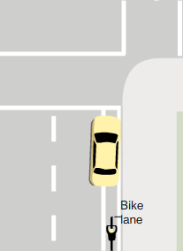
Avoiding Right Hook Crashes
Signal well in advance of your turn
Don’t try to pass a bicyclist just before your turn; be patient and wait for the bicyclist to get past the turn before you turn
After passing a bicyclist, ensure that you’re well beyond the bicyclist before reentering the lane
X

Slide 16
4. Overtaking
X
Notes:
Mostly occurs when a motorist is attempting to pass in the same lane as the bicyclist and passes too closely, either sideswiping or striking the cyclist from behind.

Slide 17
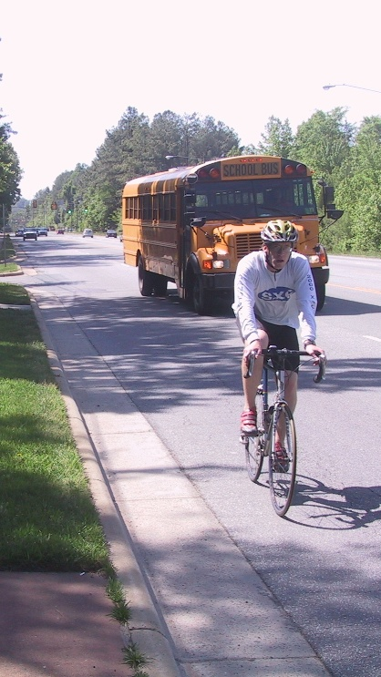
Avoiding Overtaking Crashes
Always slow down for slower traffic on the road
Look for and yield to traffic in the next lane before passing
Change lanes to pass (preferred)
Do not pass if there is oncoming traffic, limited sight distance, on the crest of a hill, or at an intersection

Slide 18
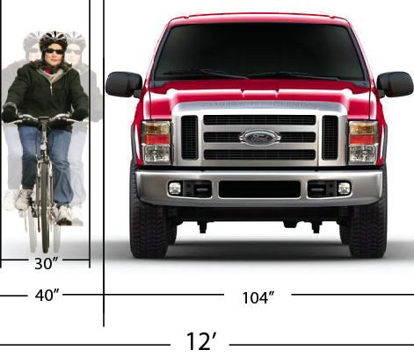
Space Required for Safe Passing
Bus, truck, van and large SUV drivers should not pass within the same lane as a bicyclist.

Slide 19
Visibility of Cyclists
Bicyclists are more difficult to see in traffic compared to other vehicles, for the following reasons:
  Bicycles are smaller and narrower than motorcycles and motor vehicles
  Bicyclists may be obstructed by larger vehicles traveling either behind or next to them

Slide 20

Bicyclists May Use Full Lane
“Bicyclists usually ride on the right side of the lane, but are entitled to use the full lane…. Drivers wishing to pass a bicyclist may do so only when there is abundant clearance and no oncoming traffic is in the opposing lane. When passing a bicyclist, always remember the bicyclist is entitled to use of the full lane.”
North Carolina Driver's Handbook
http://www.ncdot.gov/dmv/driver/
Notes:
Some states have laws limiting where within a marked lane a bicyclist may operate under certain conditions. North Carolina does not.
It is at the bicyclist’s discretion where to ride within a marked travel lane.
If a bicyclist elects to ride on the right side of the lane, another driver may legally pass within the bicyclist’s lane only if it can be done safely.

Slide 21
Road Position and Sight Lines
Bicyclists increase their visibility at junctions by riding closer to the middle of the road
Notes:
Many experienced cyclists ride farther from the right edge of the road in order to improve their visibility at junctions.
The cyclist operating farther left is seen by the motorist from farther away and is less likely to be lost in roadside clutter.

Slide 22
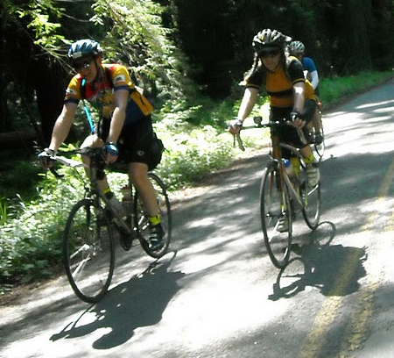
Riding Side-by-Side
Bicyclists may legally ride two or more abreast in a single lane
This improves conspicuity/visibility, reduces unsafe passing (passing in the same lane) by motorists, and makes it easier for motorists to pass groups of cyclists by making the group more compact in length.
Notes:
.

Slide 23
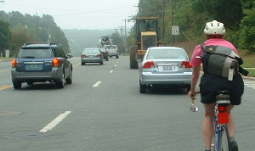
Bicyclists Cannot Be Cited for Impeding Traffic
§ 20-141. (h) No person shall operate a motor vehicle on the highway at such a slow speed as to impede the normal and reasonable movement of traffic except when reduced speed is necessary for safe operation or in compliance with law; provided, this provision shall not apply to farm tractors and other motor vehicles operating at reasonable speeds for the type and nature of such vehicles.
Notes:
The impeding traffic law is clearly written to only apply to vehicles that are capable of going faster. It exempts non-motorized vehicles entirely, and makes an explicit exception for motor vehicles that are slow by design.

Slide 24
All Roads Are Bicycle Facilities
Bicycles are allowed on all roads with the exception of freeways.
A freeway, by definition, has no at-grade intersections with other roads, railroads or multi-use trails. The crossing of freeways by other roads is typically achieved with under- or overpasses. Because traffic never crosses at-grade, there are generally no traffic lights or stop signs on a freeway. Bicycles are not allowed because freeways are specifically designed for high speed operation of motor vehicles.
Notes:
In NC, I540 and I40 are freeways, however, not all Interstates are freeways.

Slide 25
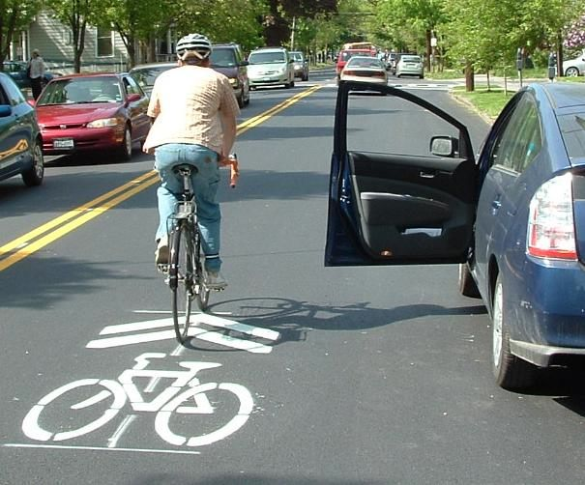

Shared Lane Markings
Reminds motorists to expect cyclists in the travel lanes but have no legal meaning

Slide 26
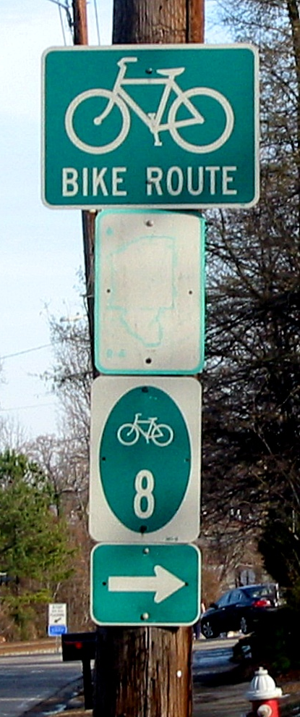
Signed Bike Routes
Bike routes are designated by each state and simply identify pleasant routes for bicycling. They, too, have no legal or other meaning.

Slide 27
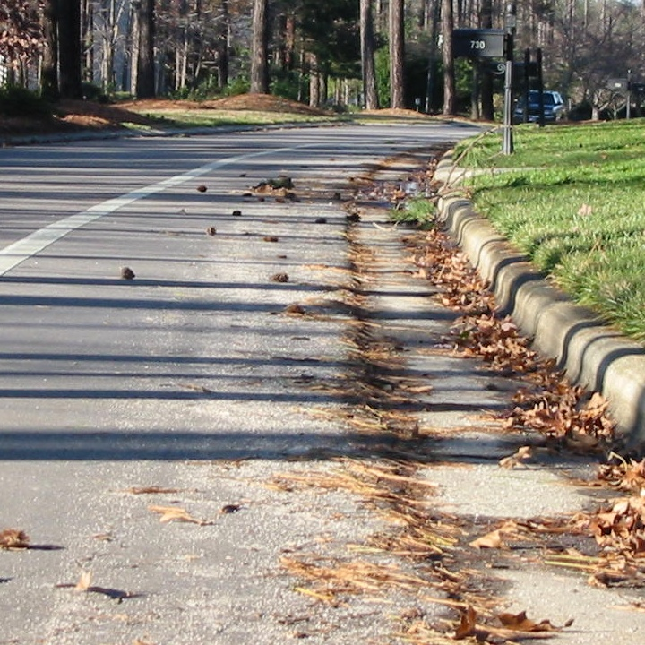
Paved Shoulders
Legally optional for bicyclists to use but may post significant safety hazards including
  poor surface conditions
  obstructions
  inadequate width

Slide 28
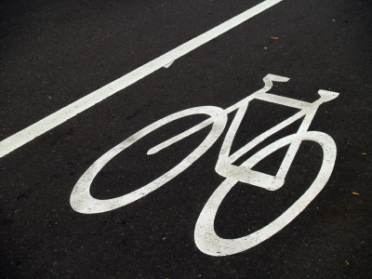
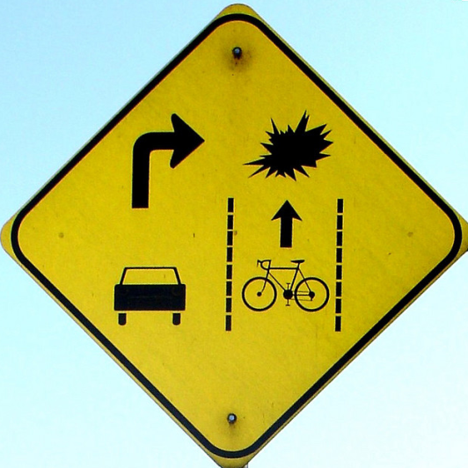
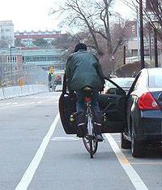
Striped Bike Lanes
Legally optional for cyclists to use
Some pose a door hazard
Motorists sometimes merge into the bike lane or even stop in the bike lane when preparing to turn right, however, this is not legal

Slide 29
Penalty For Failure to Yield the Right-of-Way
In North Carolina:
  Failure to yield the right-of-way to a bicyclist, pedestrian, motorcyclist or motor scooter operator, is 4 points.
  Failure to yield the right-of-way to another motor vehicle operator is 3 points.
Notes:
The reason for the higher penalty is because pedestrians and these other vehicle operators are more vulnerable/more likely to sustain an injury if a collision results.

Slide 30
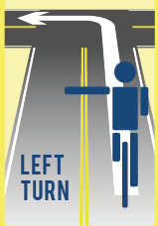
WHAT’S MY SIGN?
Left Turn Hand Signal
  Universal Left Turn Signal
  (Used by both motorists and bicyclists)

Slide 31
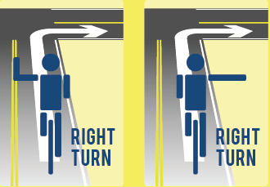
WHAT’S MY SIGN?
Right Turn Hand Signals
Universal Hand Signal
Hand Signal Used By Cyclists

Slide 32
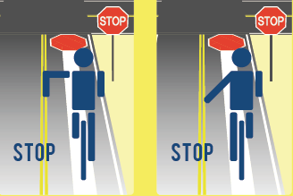
WHAT’S MY SIGN?
Hand Signals for Slow/Stop
Universal Hand Signal
Hand Signal Used By Cyclists

Slide 33
TAILGATING
It is especially dangerous for bicyclists when motor vehicles tailgate other motorists:
  See Next Slide
If the lead vehicle quickly moves left to give room to a cyclist traveling in the same lane, then the vehicle following too closely may not have time to react (i.e., move left) and may strike the cyclist.

Slide 34
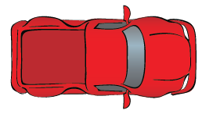
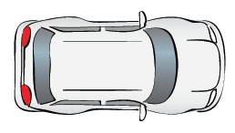

In SLIDESHOW MODE, click anywhere in the slide below to begin the animation.

Slide 35
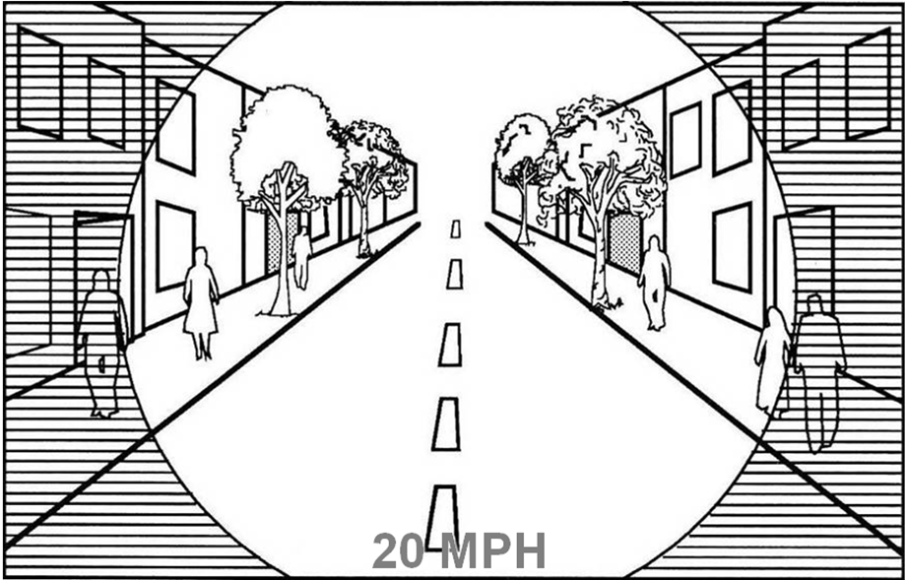
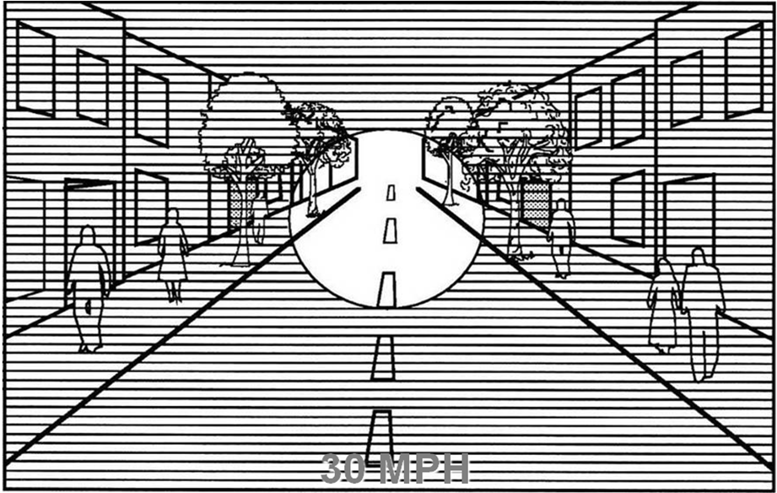
Driver Focus
After running into a bicyclist, many motorists report that they didn’t see the bicyclist. While this is most often due to driver inattentiveness, it may be due, in part, to a phenomena shown in the images below.
Notes:
As the driver’s speed increases, he/she becomes less aware of his/her surroundings and more focused on a small area in the distance. A cyclist riding as far to the right of the lane as possible may well be completely out of the motorist’s line of vision.

Slide 36
Driver Inattentiveness
This is the number one cause of fatal motorist accidents. Taking your eyes away from the road for even a second to change the station on the radio, put in a new CD, or answer a call takes your eyes off the road long enough for a fatal accident to occur.
Texting while driving is currently illegal in 39 states, including North Carolina. You wouldn’t want your surgeon texting while performing your surgery and likewise, you shouldn’t text while driving because you need to be focused on driving.
Don’t Text and Drive!

Slide 37
GENERAL “Share the Road”
SAFETY TIPS
Remain alert, attentive and focused at all times while driving
Be aware that bicyclists are also users of the roadways
Know the meaning of hand signals
Keep in mind that bicycles are generally moving slower than most motor vehicles (~10-25 mph)
Keep in mind that any collision with a bicyclist is likely to result in serious bodily injury to the cyclist and that it is your responsibility to make the safest choices possible
Keep in mind that it may be necessary for you to simply be patient for a few minutes when encountering a bicyclist

