Slide 1
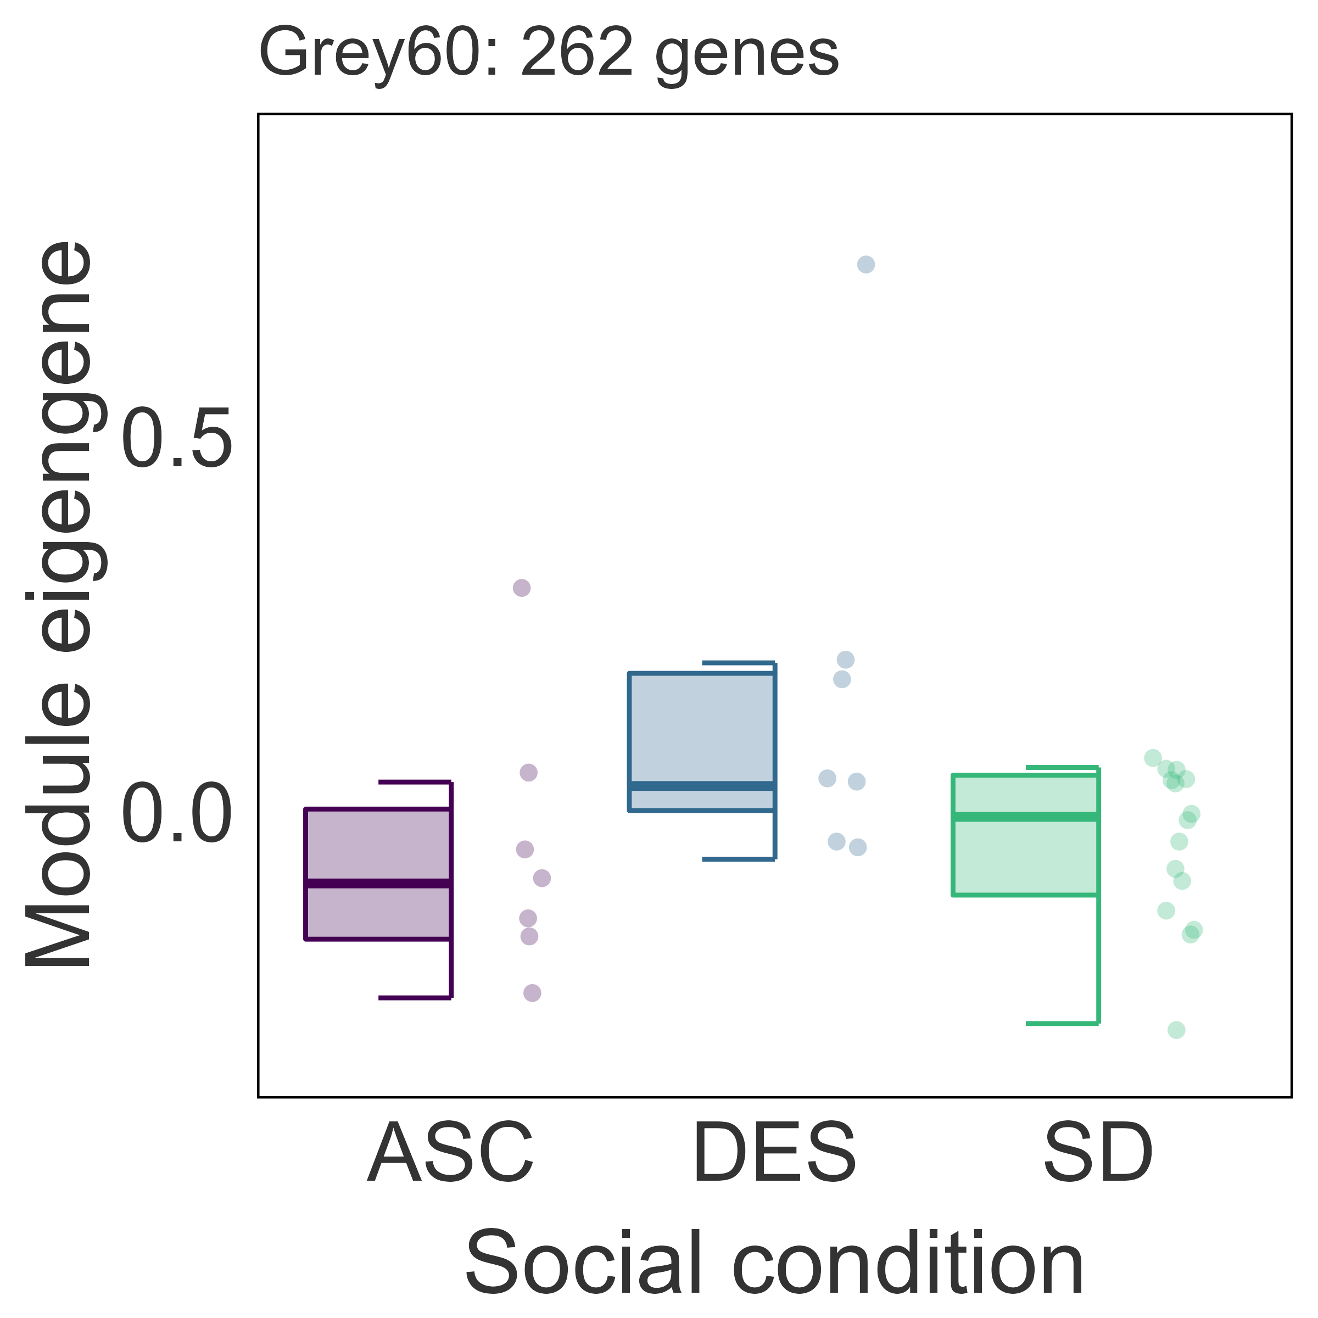
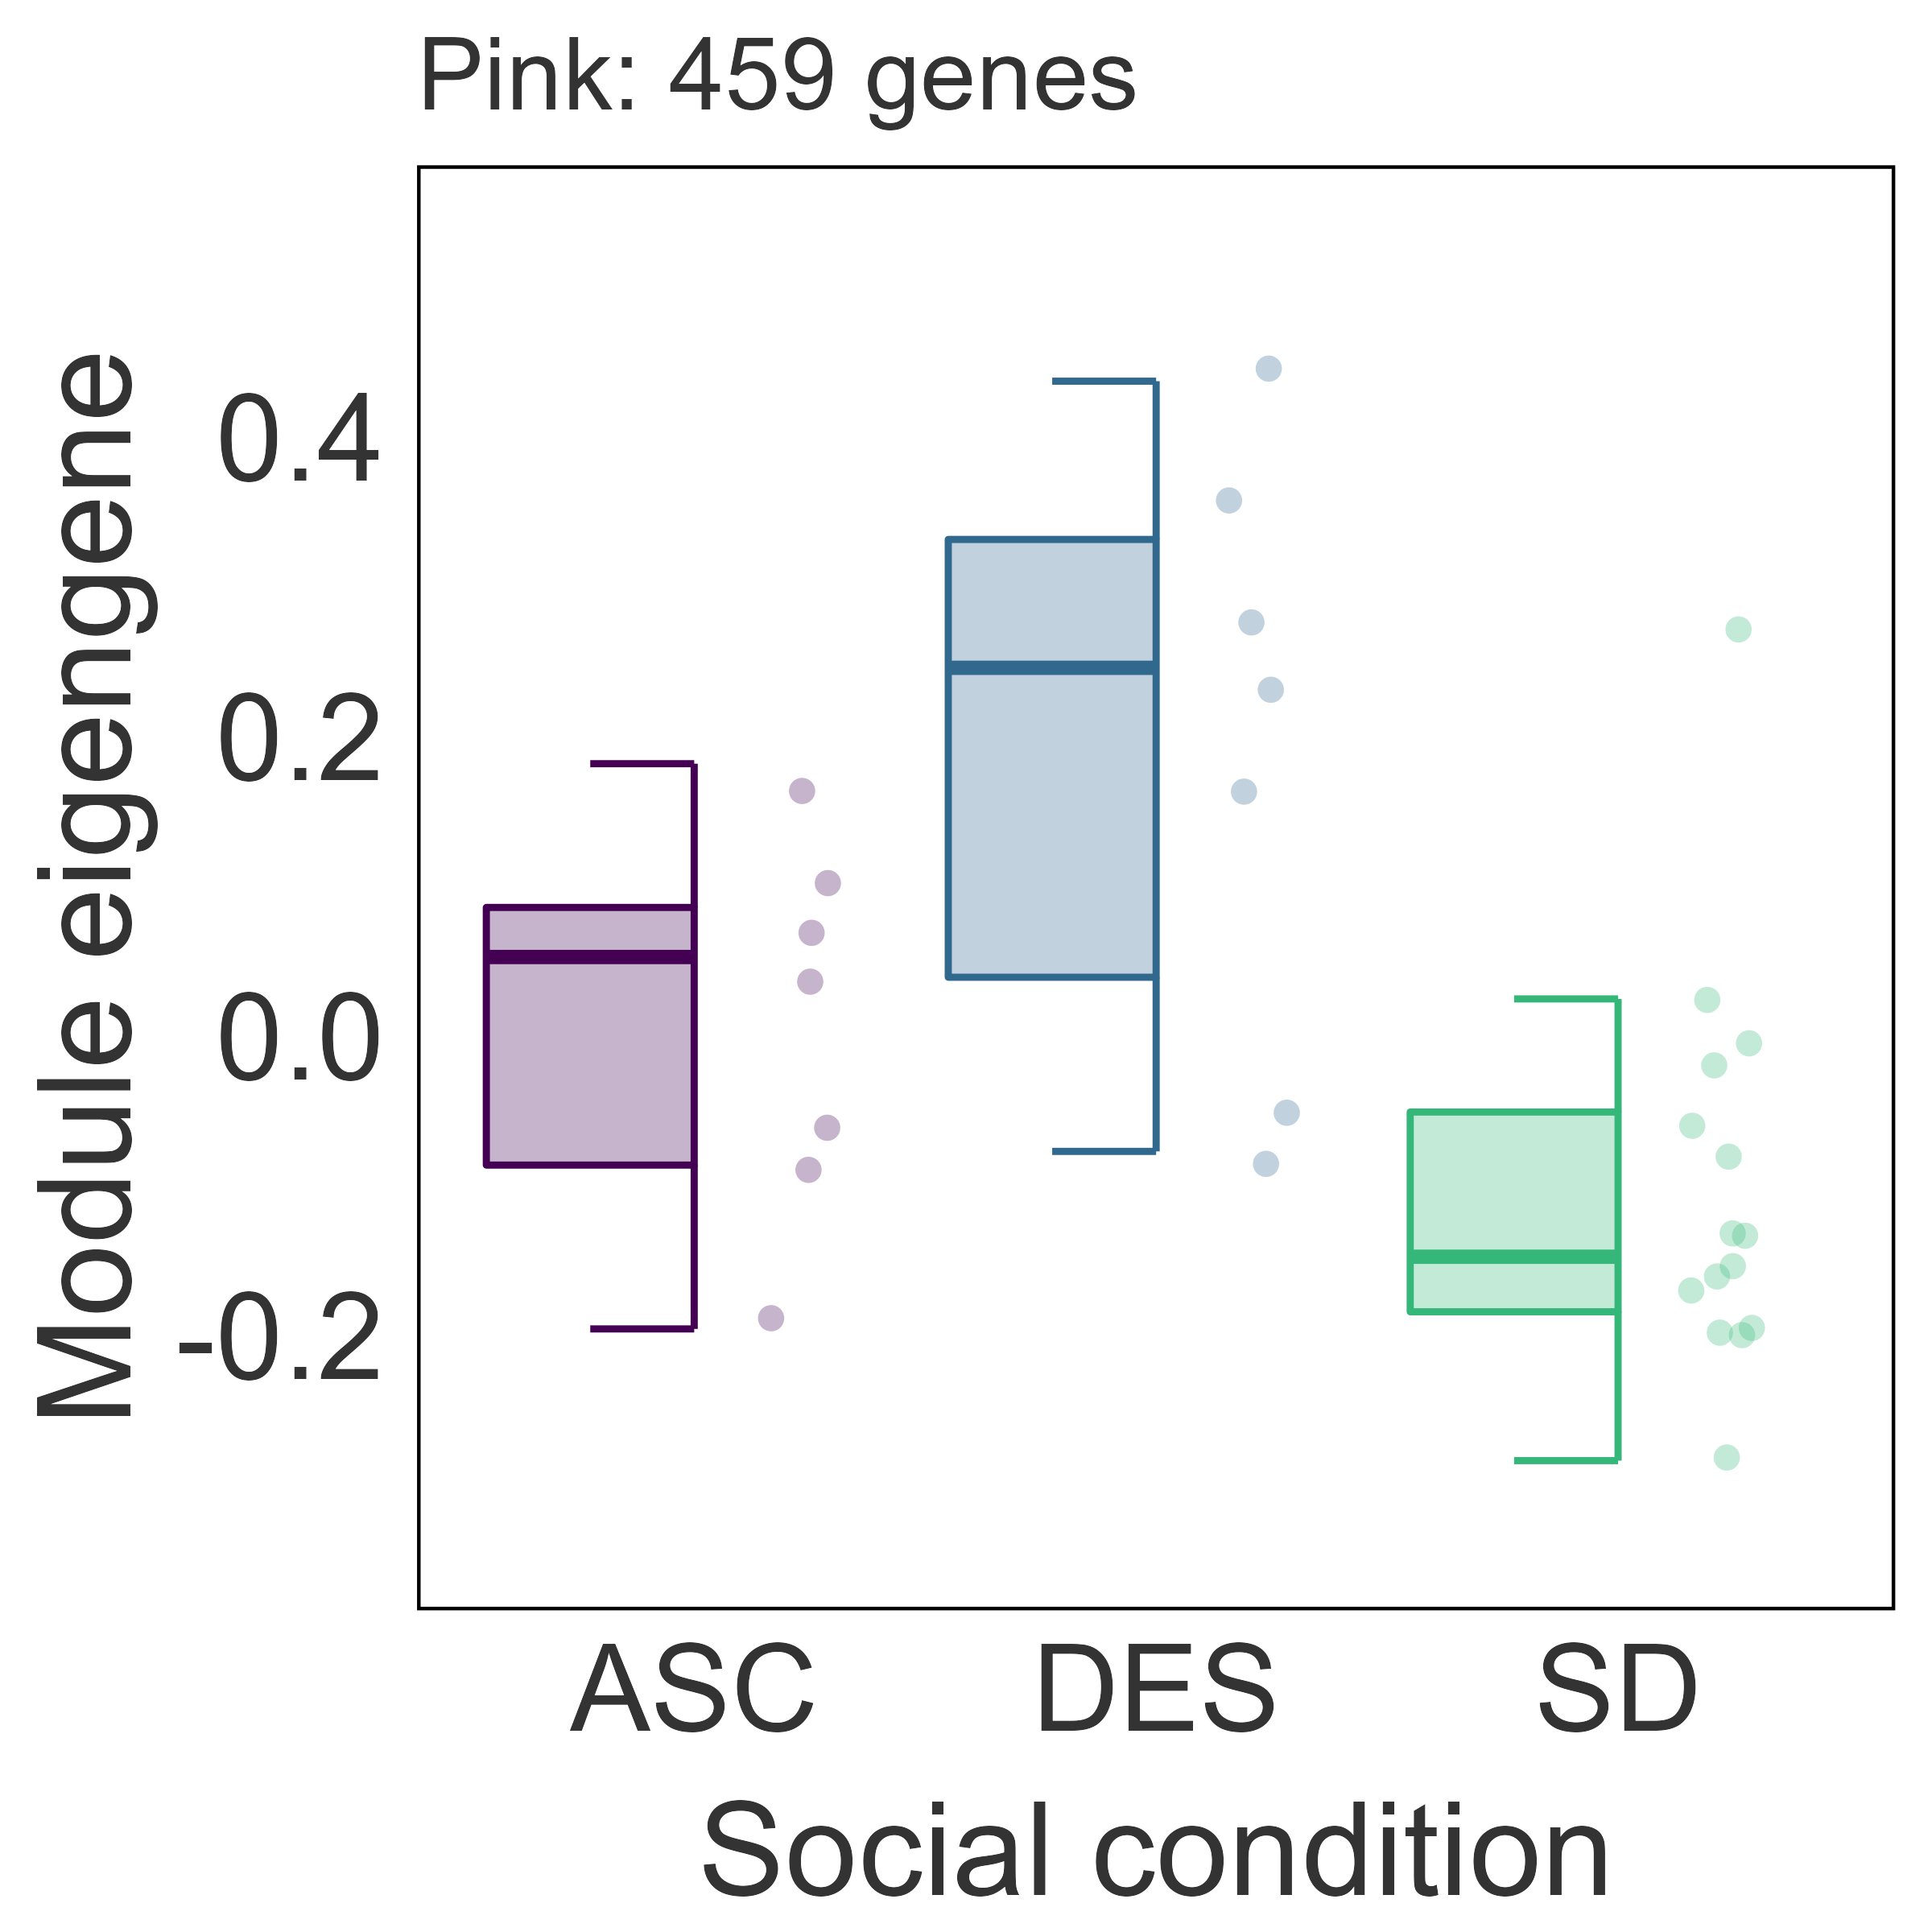
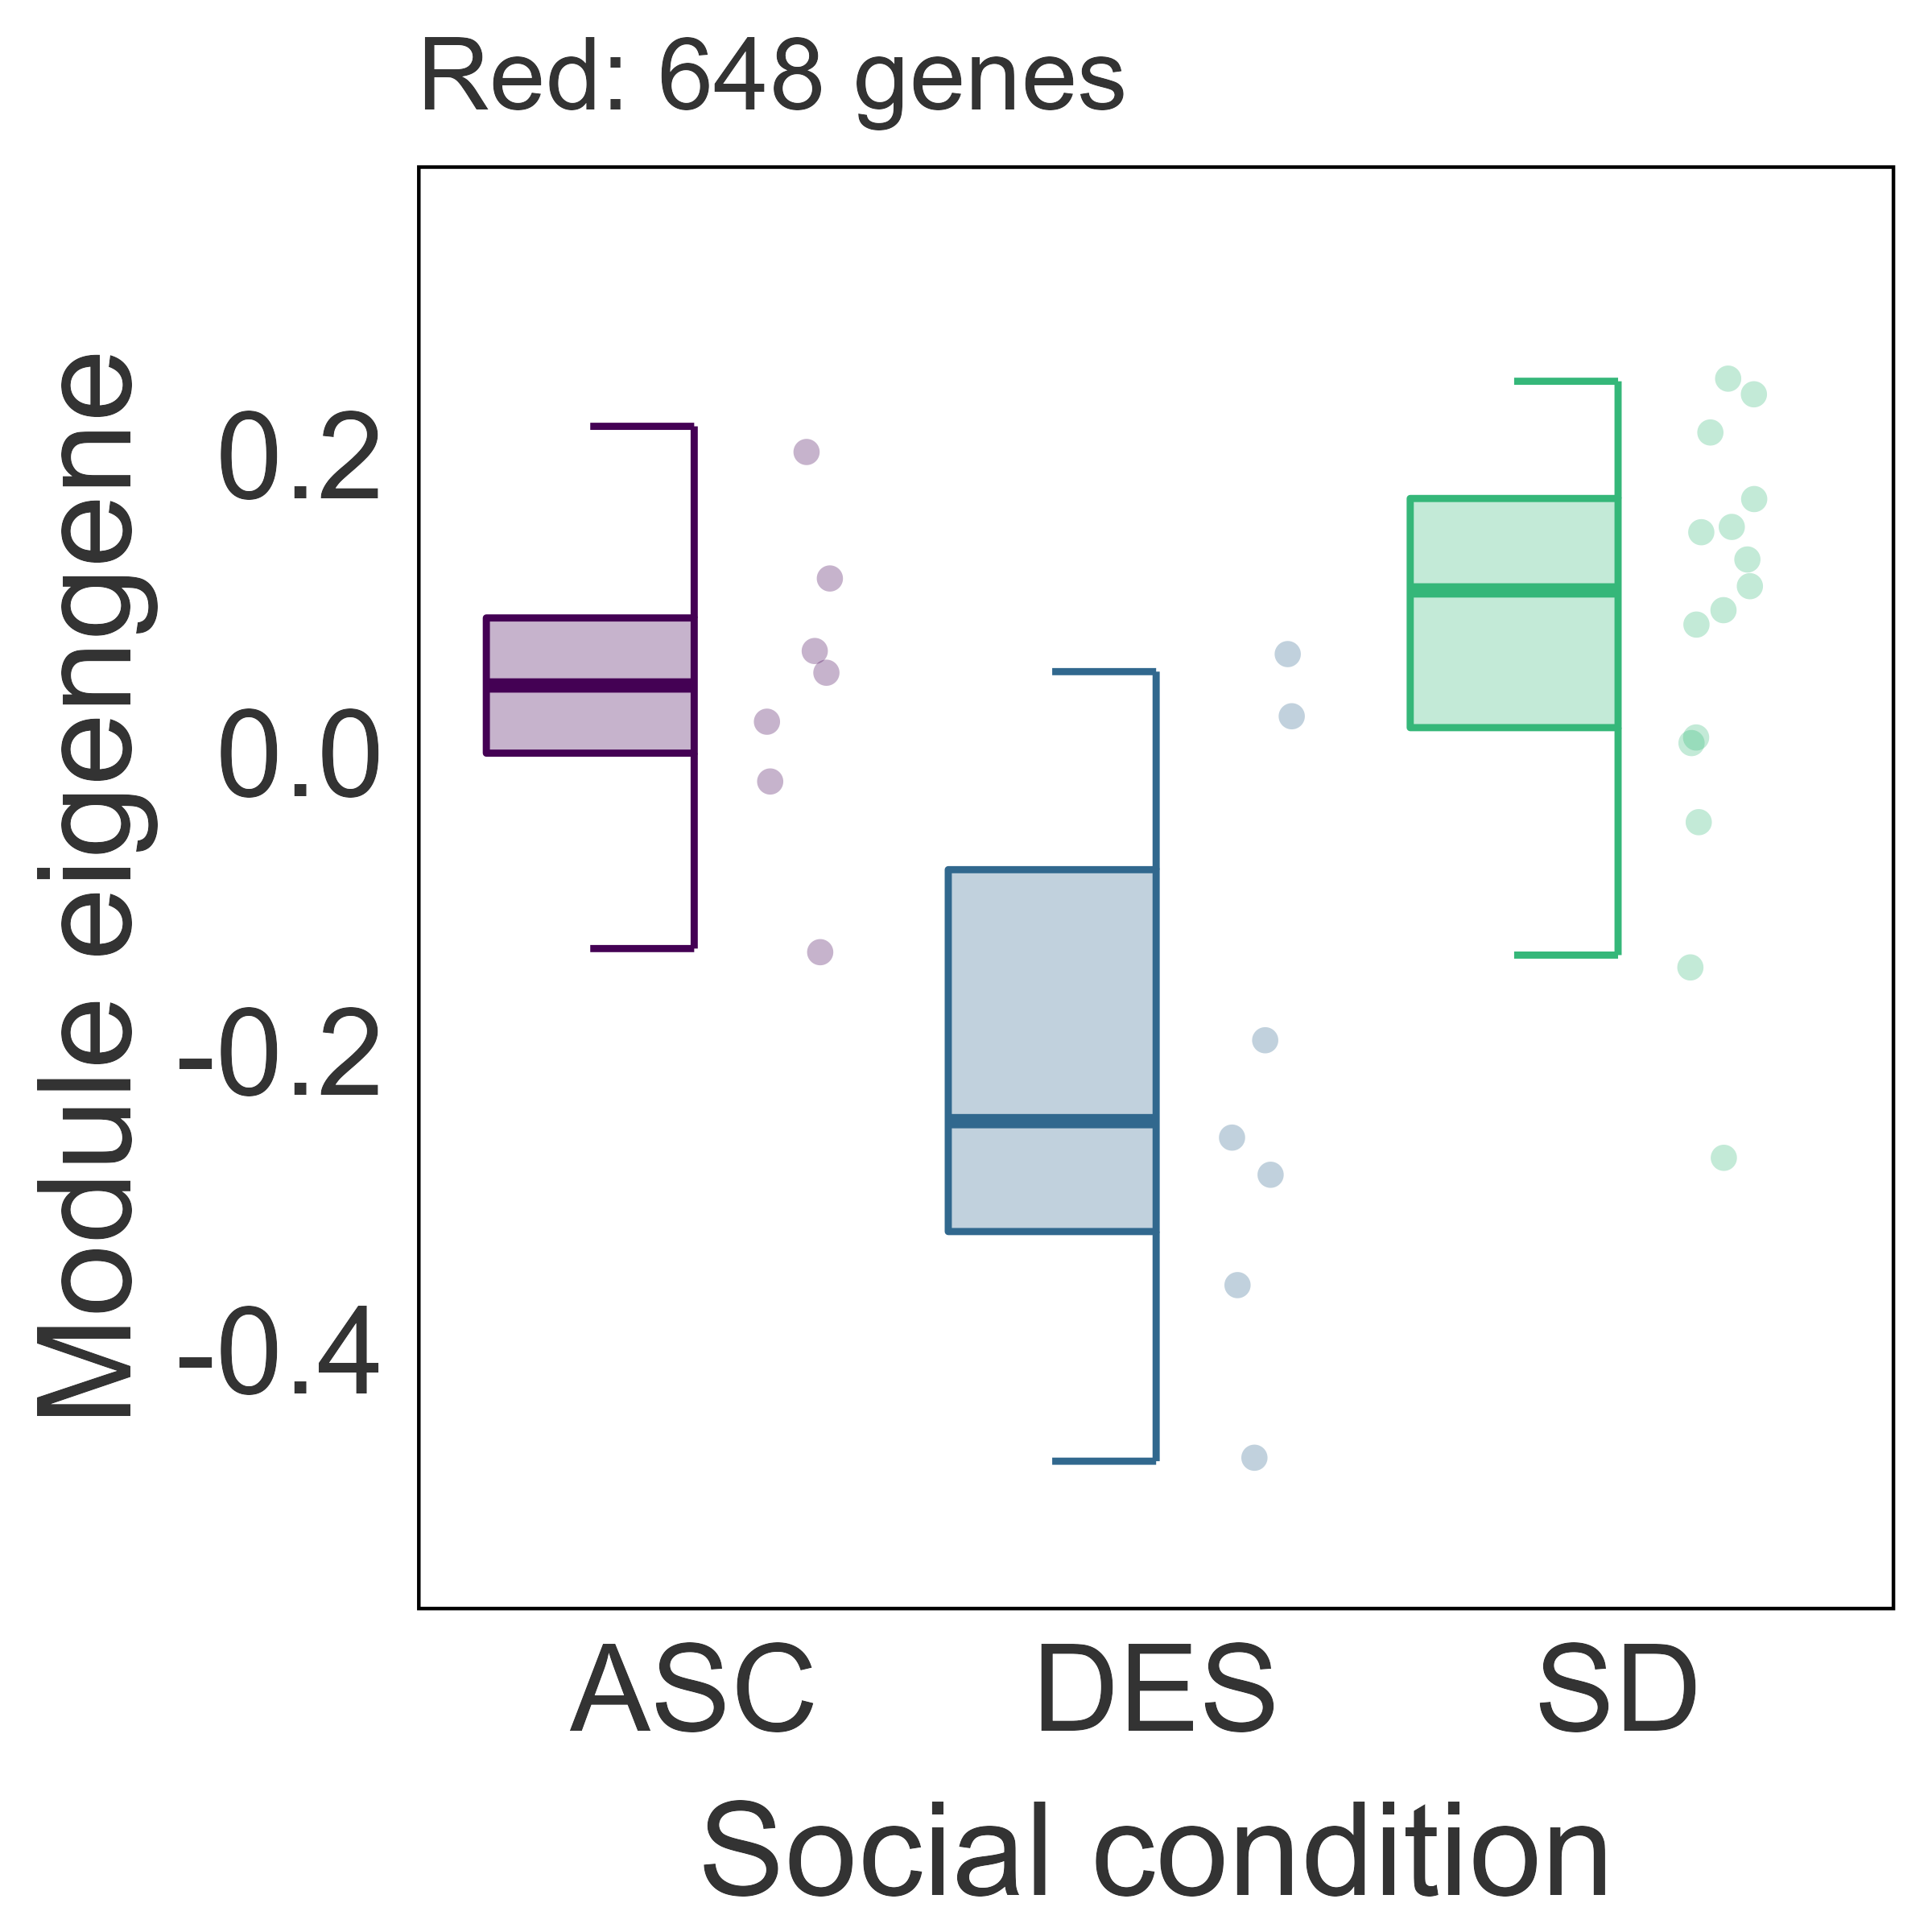
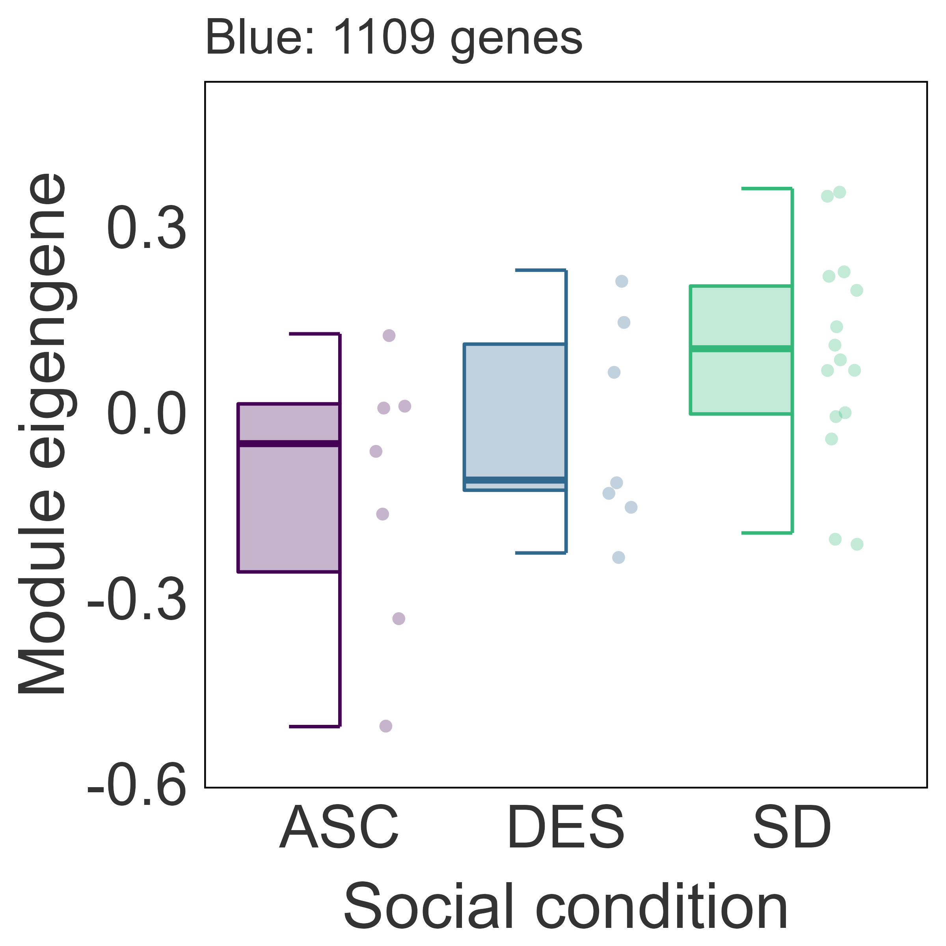
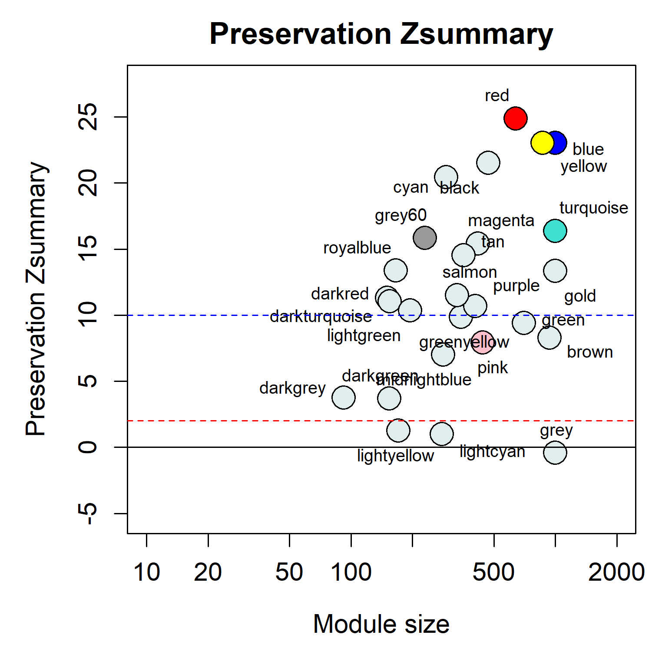
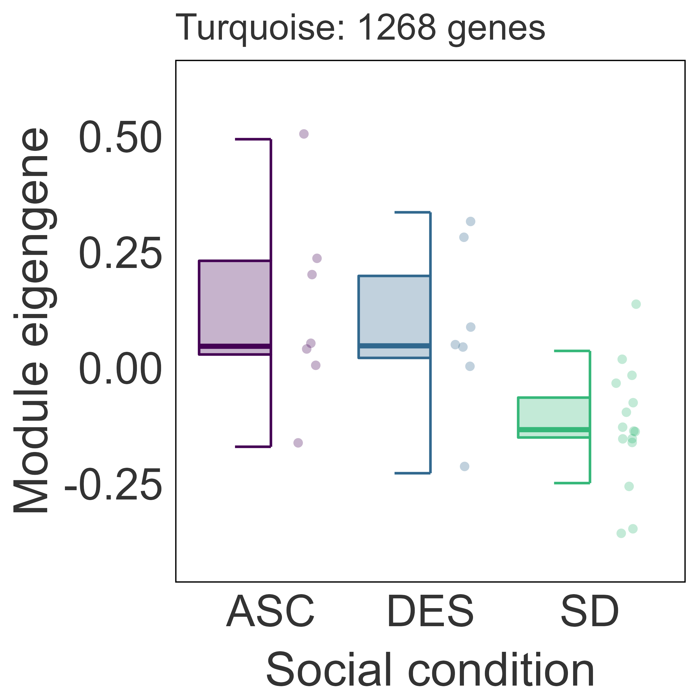
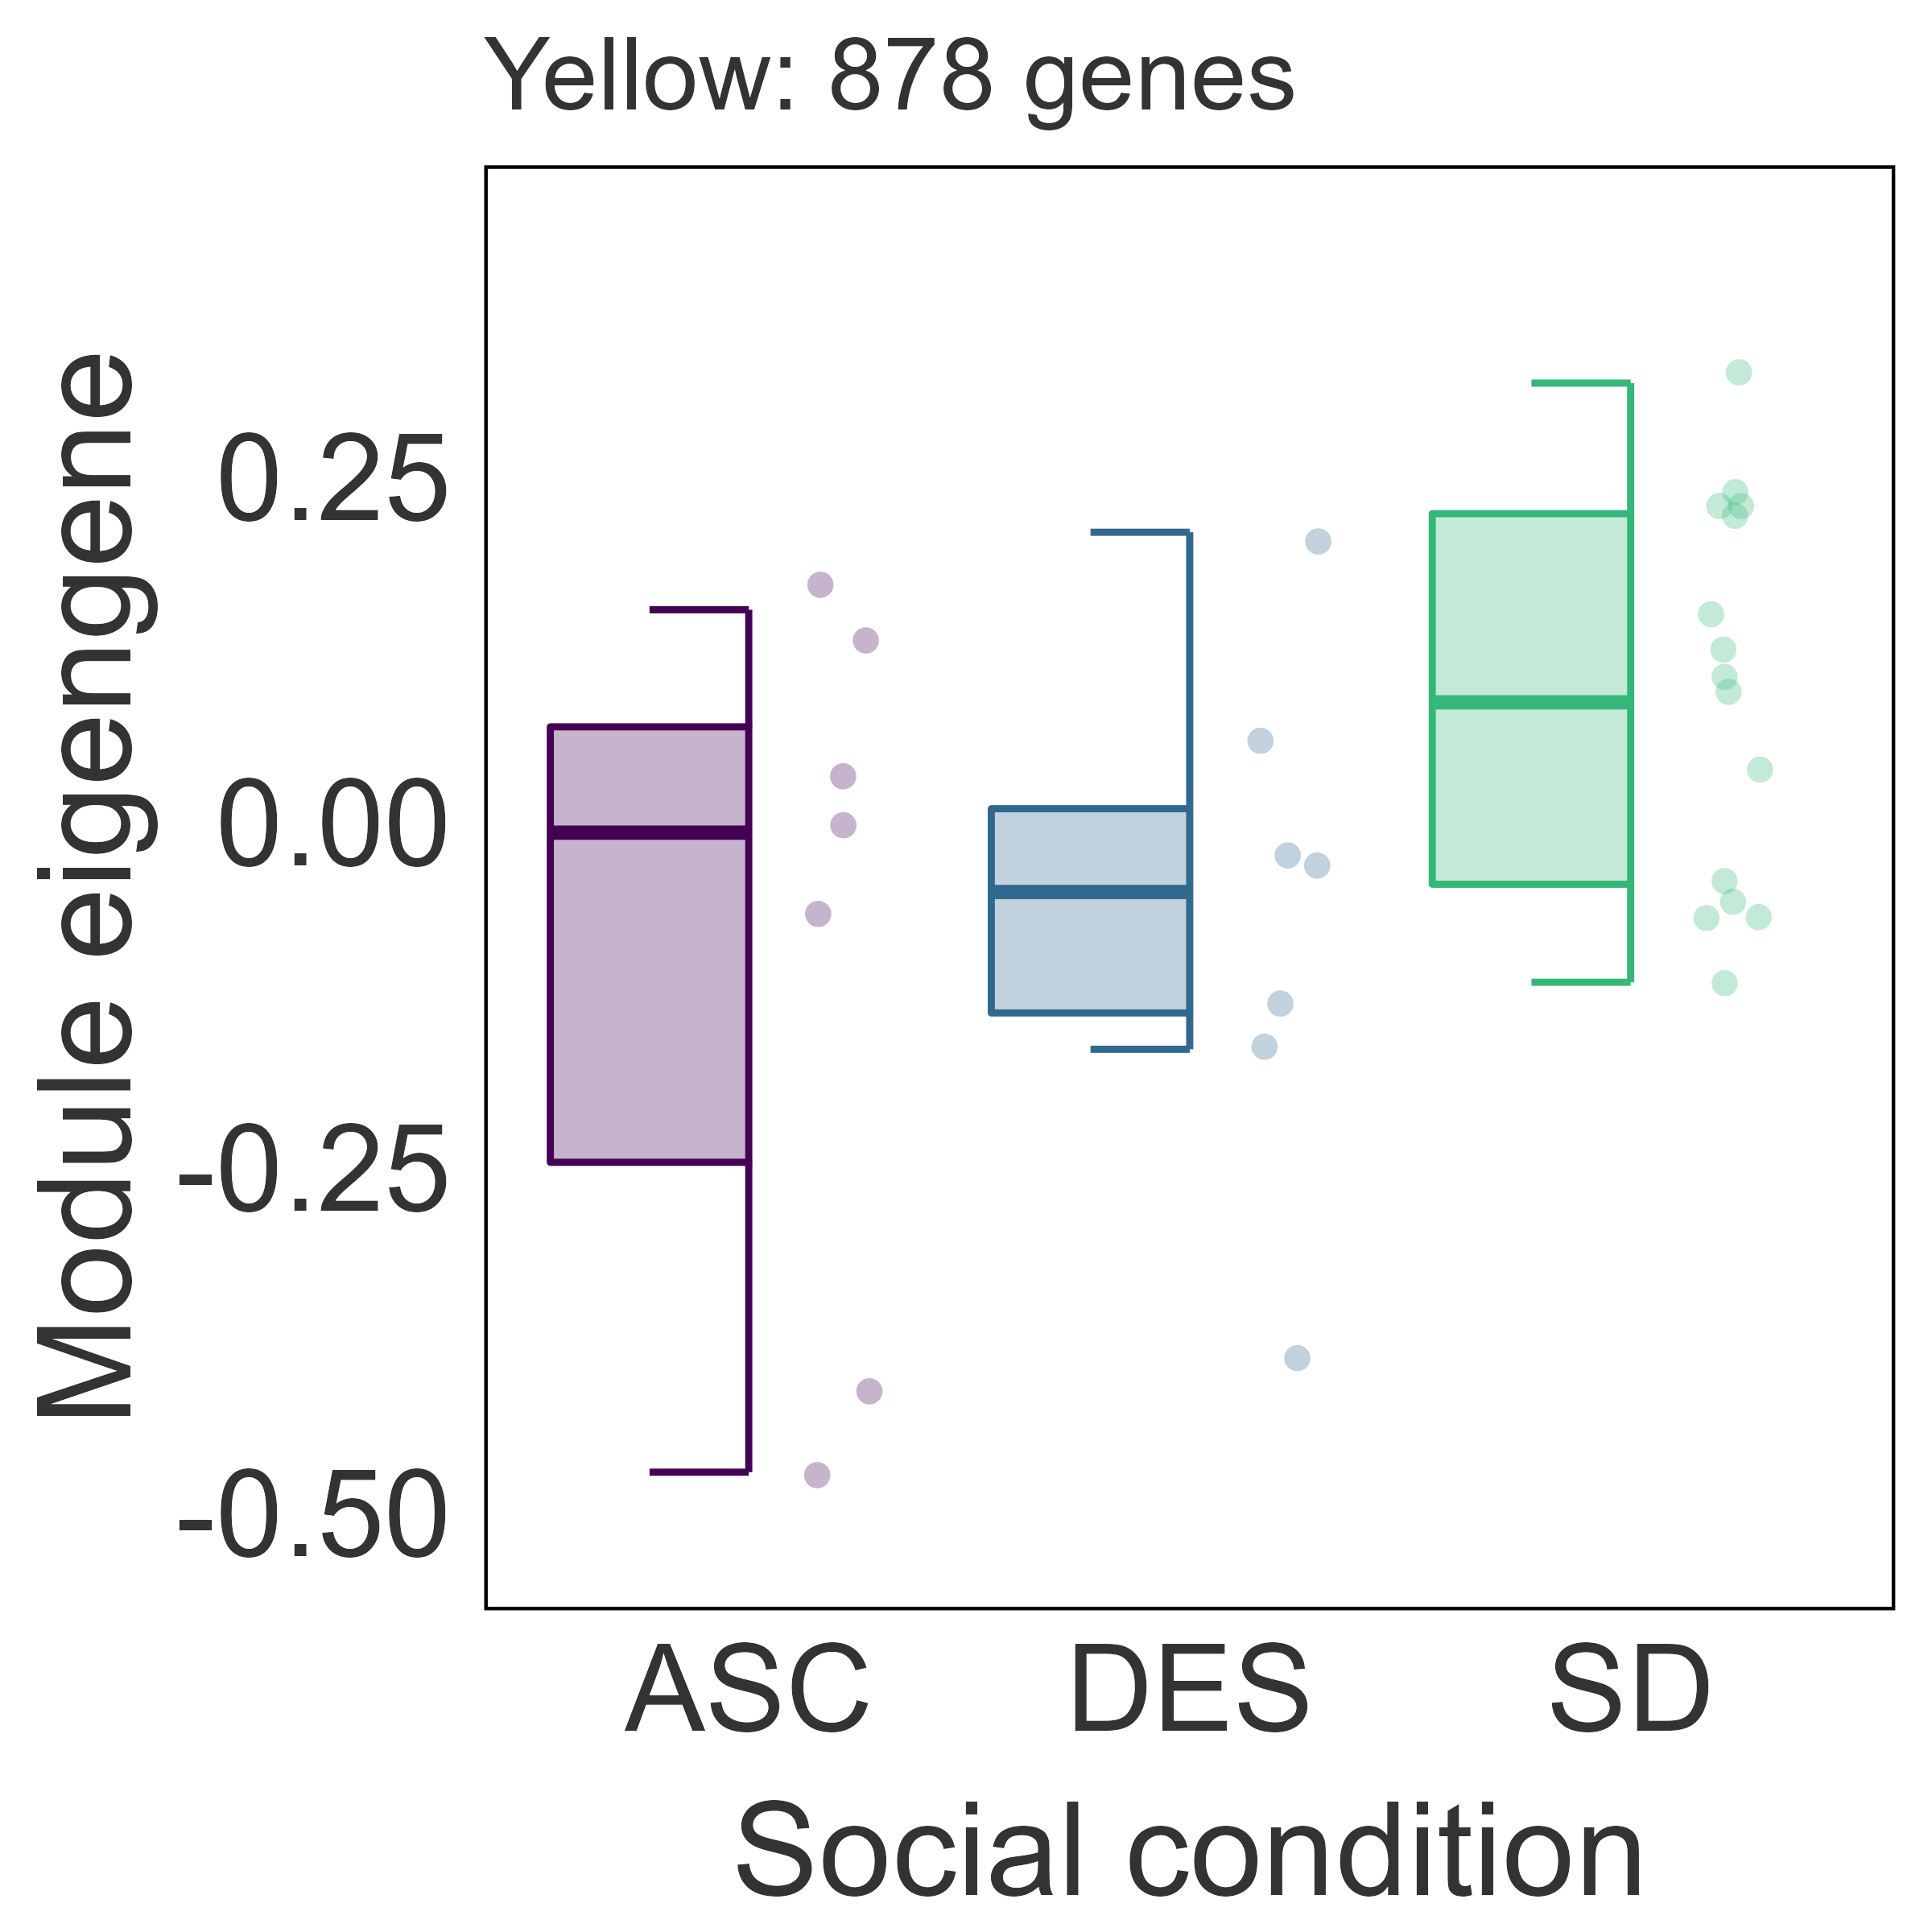
A)
DES Modules
TRN Module
Module: # of genes
GO-TERMS (BP) | regulation of inflammatory response cytokine-mediated signaling pathway regulation of immune effector process myeloid cell differentiation leukocyte migration | lipid modification glycerolipid metabolic process cellular carbohydrate metabolic process cellular lipid catabolic process cellular ketone metabolic process | regulation of synapse organization cell-cell signaling by wnt canonical Wnt signaling pathway synaptic transmission, glutamatergic | histone modification DNA recombination methylation ncRNA processing regulation of cell cycle process
TOP MM
b
a
a
b
c
a
b
a
b
a
a
a
Gfap (0.96)
Pdpn (0.90)
Vim (0.87)
Mt2 (0.86)
Adra2a (0.94)
Plekha2 (0.93)
Tafa2 (0.91)
Ppp1r2 (0.91)
Necab1 (0.94)
Rims3 (0.92)
Ne2f1 (0.91)
Cobl (0.91)
Ppp2ca (0.89)
Atp5j2 (0.88)
B)
ASC Modules
C)
a
a
b
a
a⁺
b
Module: # of genes
GO-TERMS (BP) | generation of precursor metabolites and energy energy derivation by oxidation of organic compounds cellular respiration ATP metabolic process aerobic respiration | histone modification peptidyl-lysine modification methylation regulation of translation regulation of mRNA metabolic process
TOP MM
Ppp2ca (0.89)
Atp5j2 (0.88)
Gm47951 (0.94)
Gm47628 (0.92)
Vmn2r60 (0.91)
Vm1r299 (0.86)

Slide 2
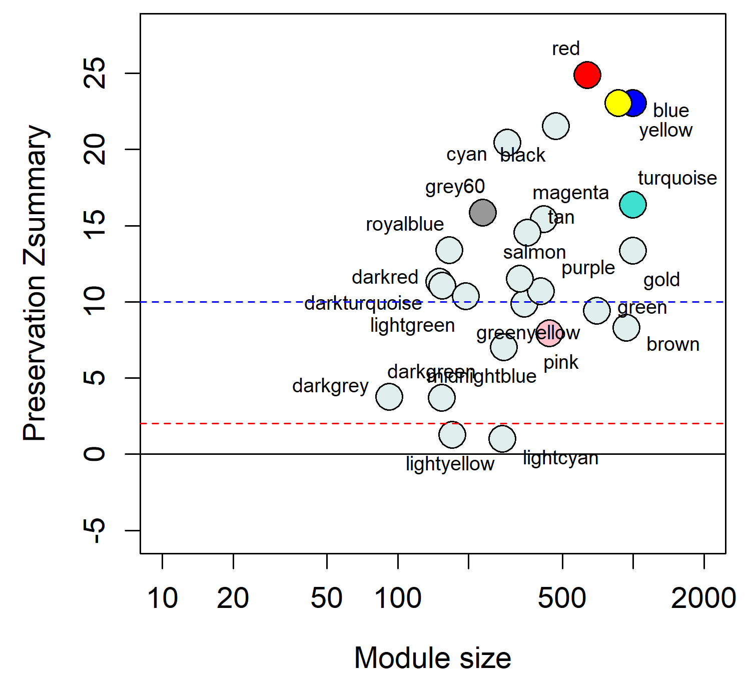
A) DES Modules
C) TRN Module
Module: # of genes
GO-TERMS (BP) | regulation of inflammatory response cytokine-mediated signaling pathway regulation of immune effector process myeloid cell differentiation leukocyte migration | lipid modification glycerolipid metabolic process cellular carbohydrate metabolic process cellular lipid catabolic process cellular ketone metabolic process | regulation of synapse organization cell-cell signaling by wnt canonical Wnt signaling pathway synaptic transmission, glutamatergic | generation of precursor metabolites and energy energy derivation by oxidation of organic compounds cellular respiration ATP metabolic process aerobic respiration
TOP MM
b
a
a
a
b
a
b
a
a
a
b
a
Gfap (0.96)
Pdpn (0.90)
Vim (0.87)
Mt2 (0.86)
Adra2a (0.94)
Plekha2 (0.93)
Tafa2 (0.91)
Ppp1r2 (0.91)
Necab1 (0.94)
Rims3 (0.92)
Ne2f1 (0.91)
Cobl (0.91)
Ppp2ca (0.89)
Atp5j2 (0.88)
B) ASC Modules
D) Preservation Zsummary
Module: # of genes
GO-TERMS (BP) | histone modification DNA recombination methylation ncRNA processing regulation of cell cycle process | histone modification peptidyl-lysine modification methylation regulation of translation regulation of mRNA metabolic process
TOP MM
a,b
b
a,b
b
a
a
Zntn37 (0.87)
Zfp953 (0.86)
Runx2 (0.86)
Aqp7 (0.85)
Gm47951 (0.94)
Gm47628 (0.92)
Vmn2r60 (0.91)
Vm1r299 (0.86)

