Slide 1
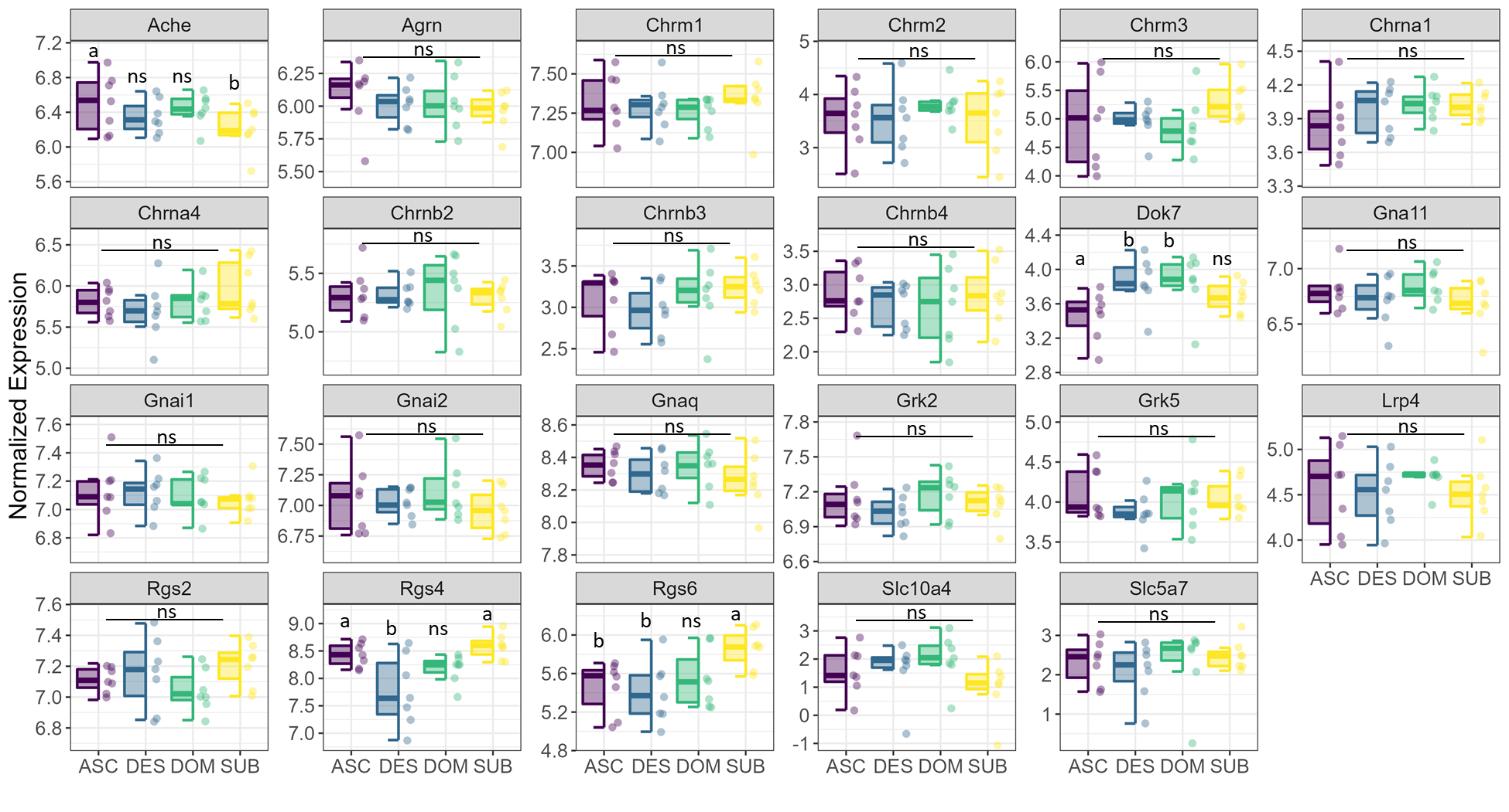
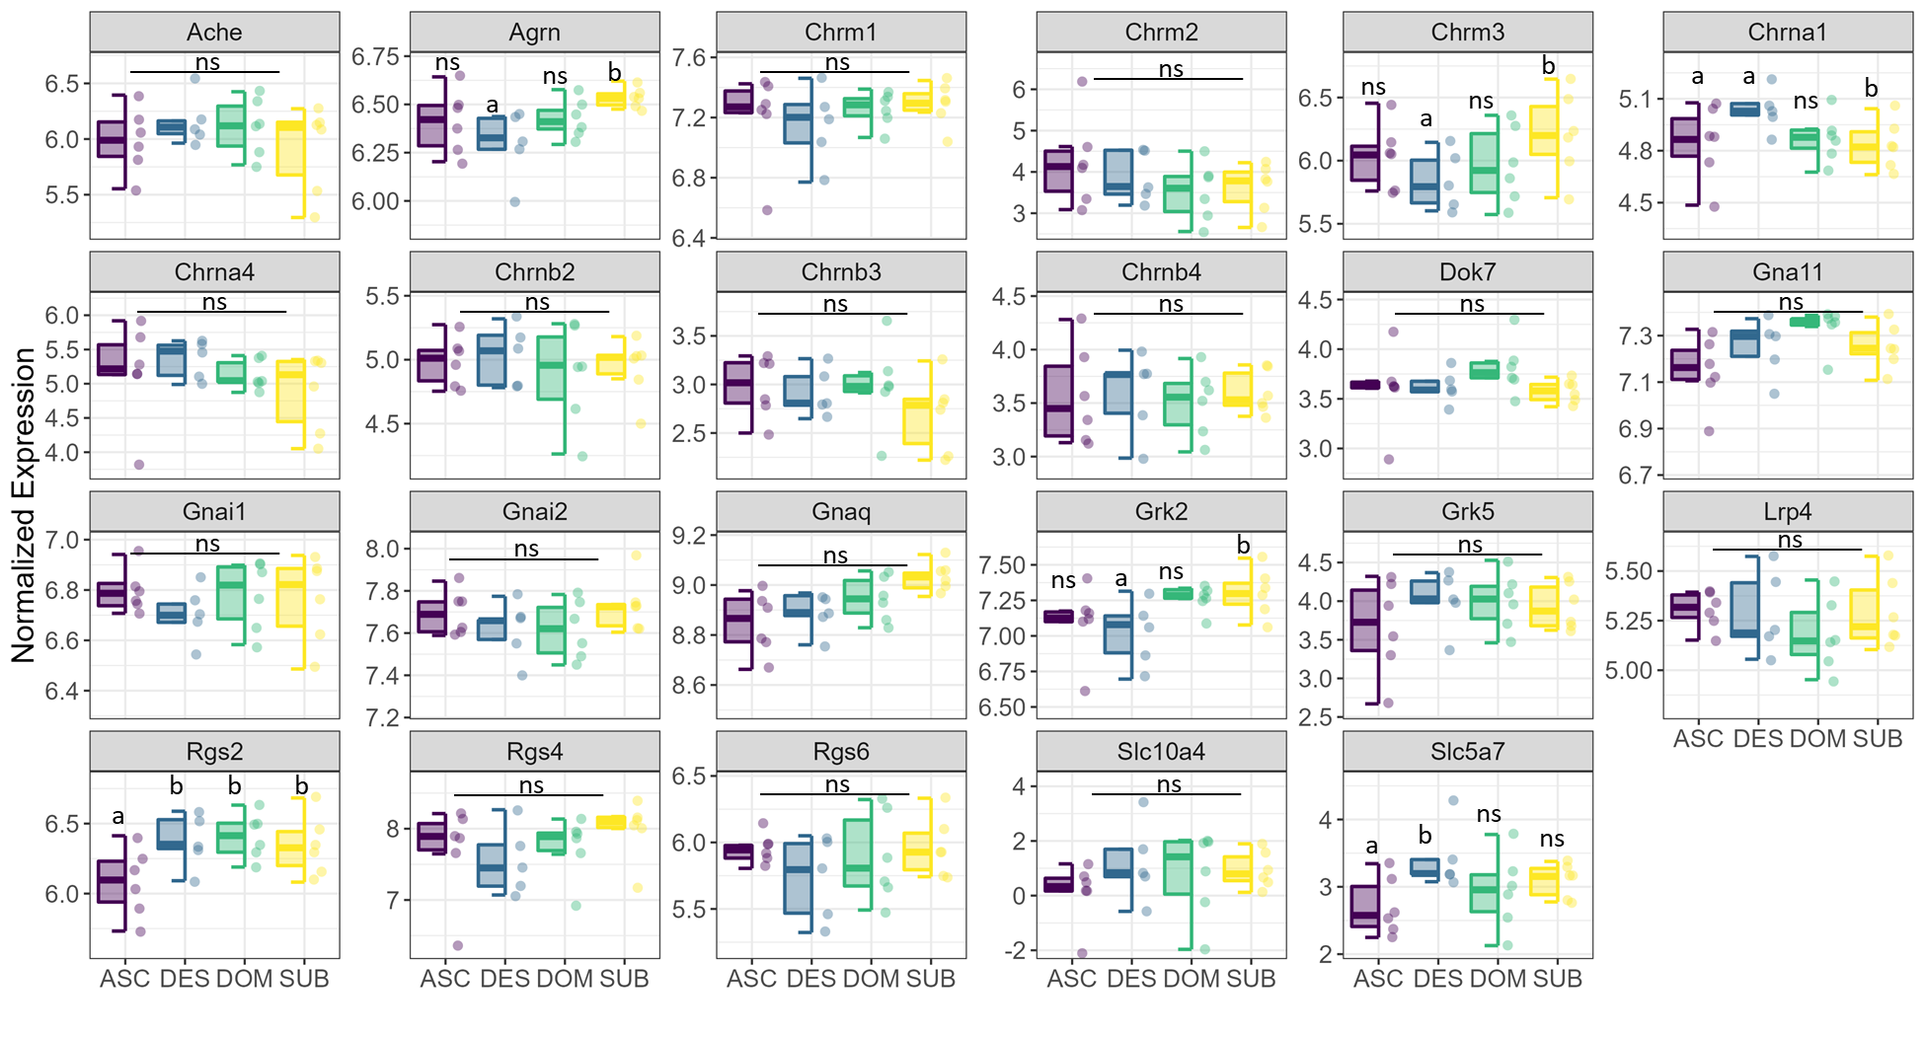
A) Cholinergic genes at 70 min
B) Cholinergic genes at 25 hr

