Slide 1
 | 70 min Social Reorganization |  |  |  |  |  |  |  | 25 hr Social Reorganization
 | ASC vs. DOM |  | DES vs. DOM |  | ASC vs. SUB |  | DES vs. SUB |  | ASC vs. DOM |  | DES vs. DOM |  | ASC vs. SUB |  | DES vs. SUB
Log Fold Change | ↑↑ | ↓↓ | ↑↑ | ↓↓ | ↑↑ | ↓↓ | ↑↑ | ↓↓ | ↑↑ | ↓↓ | ↑↑ | ↓↓ | ↑↑ | ↓↓ | ↑↑ | ↓↓
≥ 0.20 | 385 | 325 | 366 | 447 | 396 | 467 | 842 | 795 | 252 | 241 | 216 | 169 | 331 | 299 | 452 | 366
0.20 – 0.50 | 357 | 260 | 268 | 375 | 327 | 353 | 533 | 603 | 175 | 219 | 148 | 137 | 267 | 245 | 354 | 262
0.50 – 1.00 | 24 | 62 | 76 | 63 | 61 | 110 | 241 | 159 | 70 | 22 | 63 | 30 | 59 | 53 | 81 | 88
> 1.00 | 1 | 3 | 22 | 9 | 8 | 4 | 68 | 33 | 7 | 0 | 5 | 2 | 5 | 1 | 17 | 16

Slide 2
TRN vs. DOM
TRN vs. SUB
Transition Genes
70 minutes
 | ↑↑ DES vs. DOM | ↓↓ DES vs. DOM
↑↑ ASC vs. DOM | 66 | 0
↓↓ ASC vs. DOM | 0 | 62
 | ↑↑ DES vs. SUB | ↓↓ DES vs. SUB
↑↑ ASC vs. SUB | 150 | 0
↓↓ ASC vs. SUB | 0 | 140
 | ↑↑ TRN vs. DOM | ↓↓ TRN vs. DOM
↑↑ TRN vs. SUB | 8 | 0
↓↓ TRN vs. SUB | 0 | 10
25 hours
 | ↑↑ DES vs. DOM | ↓↓ DES vs. DOM
↑↑ ASC vs. DOM | 28 | 0
↓↓ ASC vs. DOM | 0 | 32
 | ↑↑ DES vs. SUB | ↓↓ DES vs. SUB
↑↑ ASC vs. SUB | 105 | 0
↓↓ ASC vs. SUB | 0 | 73
 | ↑↑ TRN vs. DOM | ↓↓ TRN vs. DOM
↑↑ TRN vs. SUB | 5 | 0
↓↓ TRN vs. SUB | 0 | 5
Overlap
 | ↑↑ DES vs. DOM | ↓↓ DES vs. DOM
↑↑ ASC vs. DOM | 0 | 0
↓↓ ASC vs. DOM | 0 | 0
 | ↑↑ DES vs. SUB | ↓↓ DES vs. SUB
↑↑ ASC vs. SUB | 2 | 0
↓↓ ASC vs. SUB | 0 | 4
 | ↑↑ TRN vs. DOM | ↓↓ TRN vs. DOM
↑↑ TRN vs. SUB | 0 | 0
↓↓ TRN vs. SUB | 0 | 0
Notes:
Up in TRN vs SUB: Ugt8a, Mobp
Down in TRN vs SUB: Magi3, Ift122, Zbtb46, Cdc42ep3

Slide 3
TRN vs. DOM
TRN vs. SUB
Transition Genes
 | ↑↑ DES vs. DOM | ↓↓ DES vs. DOM
↑↑ ASC vs. DOM | 66 | 0
↓↓ ASC vs. DOM | 0 | 62
 | ↑↑ DES vs. SUB | ↓↓ DES vs. SUB
↑↑ ASC vs. SUB | 150 | 0
↓↓ ASC vs. SUB | 0 | 140
 | ↑↑ TRN vs. DOM | ↓↓ TRN vs. DOM
↑↑ TRN vs. SUB | 8 | 0
↓↓ TRN vs. SUB | 0 | 10
70 minutes
 | ↑↑ DES vs. DOM | ↓↓ DES vs. DOM
↑↑ ASC vs. DOM | 28 | 0
↓↓ ASC vs. DOM | 0 | 32
 | ↑↑ DES vs. SUB | ↓↓ DES vs. SUB
↑↑ ASC vs. SUB | 105 | 0
↓↓ ASC vs. SUB | 0 | 73
 | ↑↑ TRN vs. DOM | ↓↓ TRN vs. DOM
↑↑ TRN vs. SUB | 5 | 0
↓↓ TRN vs. SUB | 0 | 5
25 hours
Notes:
Up in TRN vs SUB: Ugt8a, Mobp
Down in TRN vs SUB: Magi3, Ift122, Zbtb46, Cdc42ep3

Slide 4
Ascenders
Descenders
70 minutes
 | ↑↑ ASC vs. DOM | ↓↓ ASC vs. DOM
↑↑ ASC vs. SUB | 94 | 0
↓↓ ASC vs. SUB | 0 | 92
 | ↑↑ DES vs. DOM | ↓↓ DES vs. DOM
↑↑ DES vs. SUB | 168 | 0
↓↓ DES vs. SUB | 0 | 204
25 hours
 | ↑↑ ASC vs. DOM | ↓↓ ASC vs. DOM
↑↑ ASC vs. SUB | 54 | 0
↓↓ ASC vs. SUB | 0 | 13
 | ↑↑ DES vs. DOM | ↓↓ DES vs. DOM
↑↑ DES vs. SUB | 72 | 0
↓↓ DES vs. SUB | 0 | 58
Overlap
 | ↑↑ ASC vs. DOM | ↓↓ ASC vs. DOM
↑↑ ASC vs. SUB | 0 | 0
↓↓ ASC vs. SUB | 0 | 0
 | ↑↑ DES vs. DOM | ↓↓ DES vs. DOM
↑↑ DES vs. SUB | 1 | 0
↓↓ DES vs. SUB | 0 | 4
DES vs stable in both time points
UP: Strip2
DOWN: Pyroxd2, Etv6, Pitpnm3, Cxxc5
Notes:
DES vs stable in both time points
UP: Strip2
DOWN: Pyroxd2, Etv6, Pitpnm3, Cxxc5
GO terms:
ASC70: UP -> fatty acid beta-oxidation; fatty acid catabolic process; fatty acid oxidation; lipid oxidation Down -> no significant go –terms identified
ASC25: no significant go –terms identified
DES70:
UP -> leukocyte chemotaxis; myeloid leukocyte migration; mesenchymal cell differentiation; regulation of extrinsic apoptotic signaling pathway
DOWN -> no significant go –terms identified
DES25: no significant go –terms identified

Slide 5
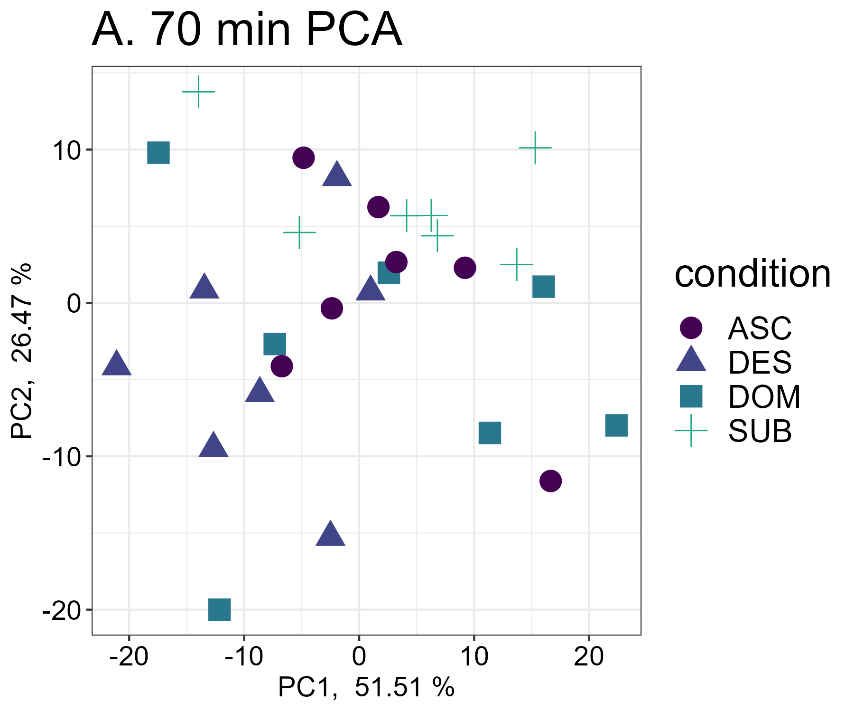
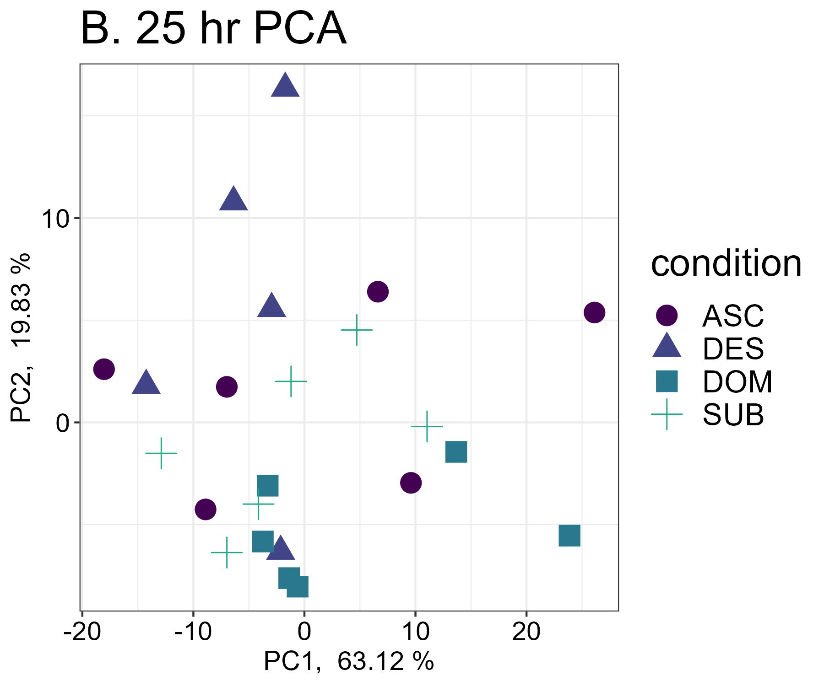

Slide 6
Cage A
Cage B
Cage C
Cage D
1
2
1
2
1
2
1
2
3
4
3
4
3
4
3
4
Alphas
Deltas
1
1
4
4
1
1
4
4
1
2
1
2
3
4
3
4
Previously
Dominant
Previously
Subordinate
1
DOM
1
ASC
4
DES
4
SUB

Slide 7
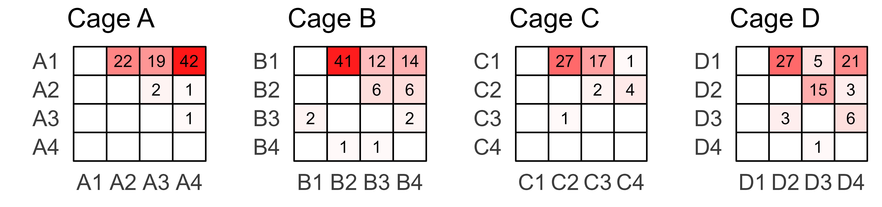
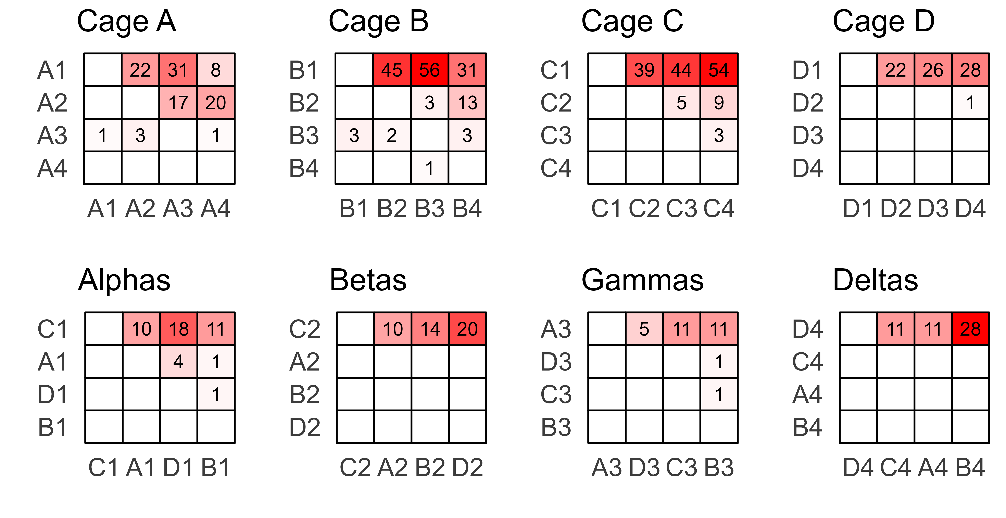
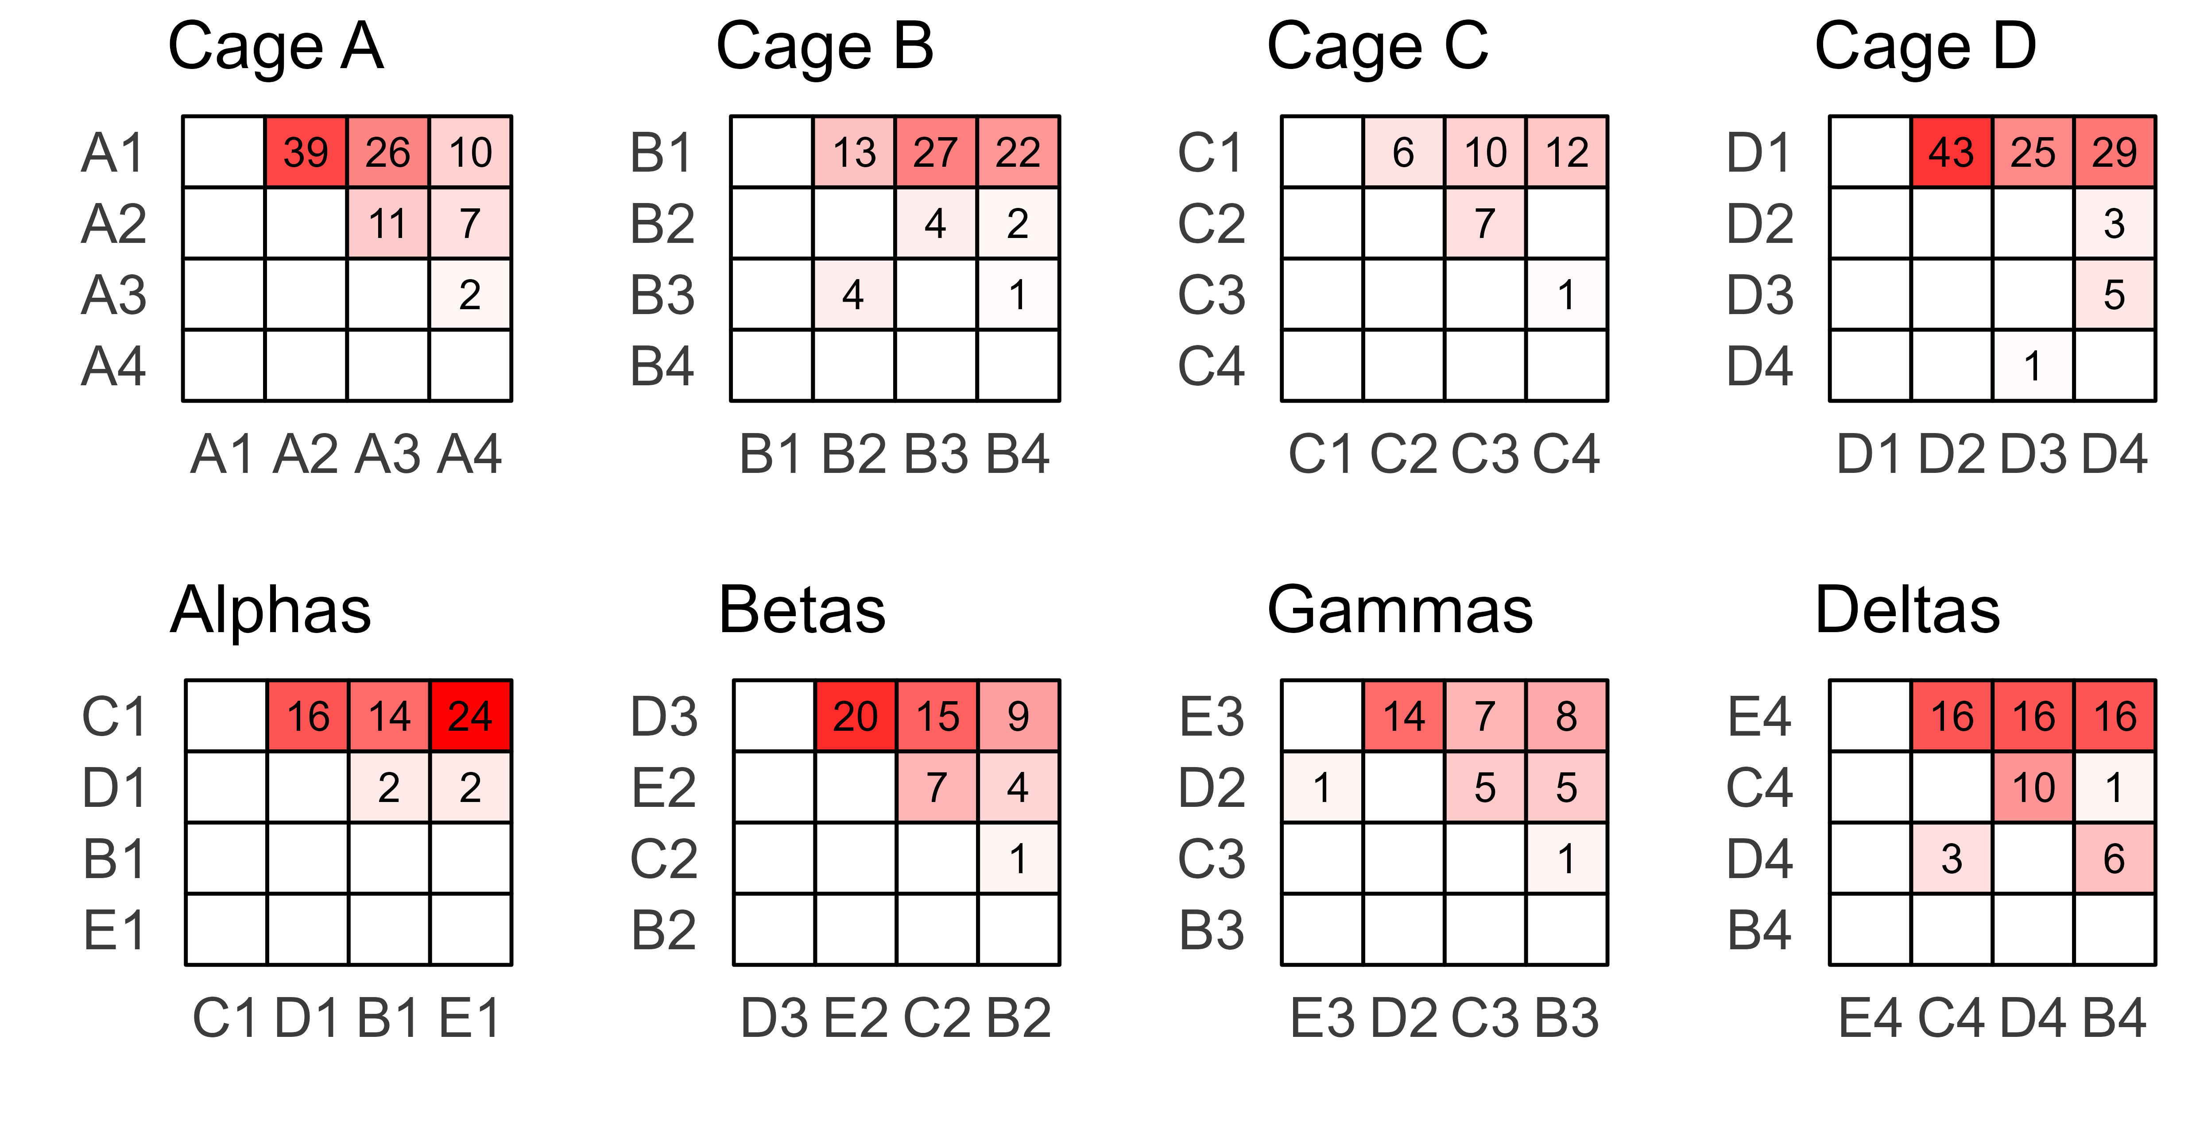

Slide 8
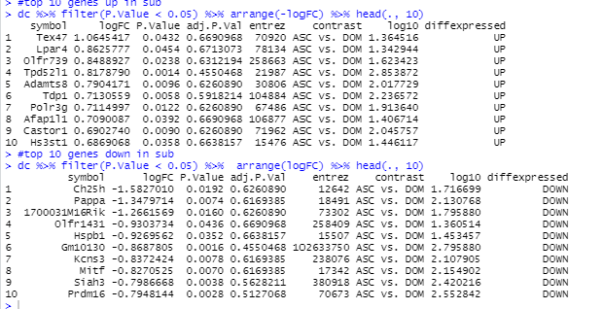
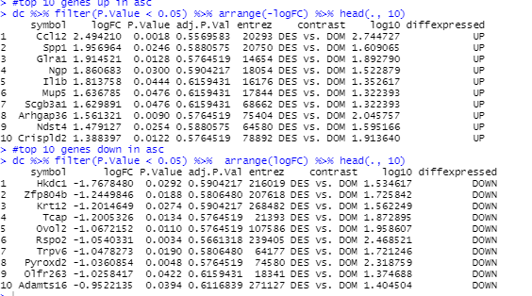
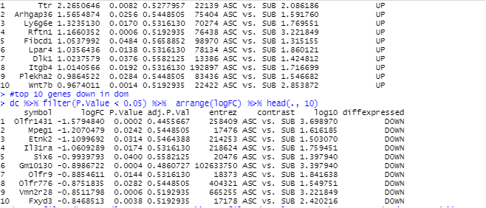
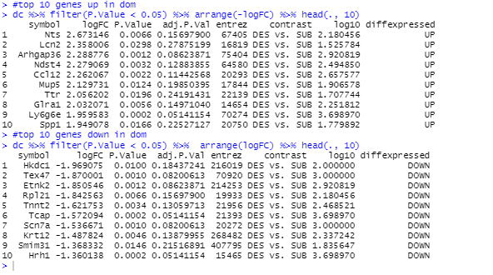

Slide 9
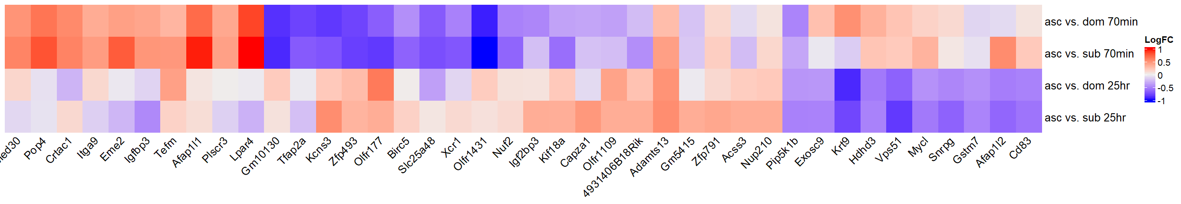

Slide 11
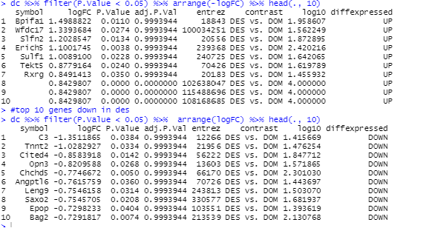
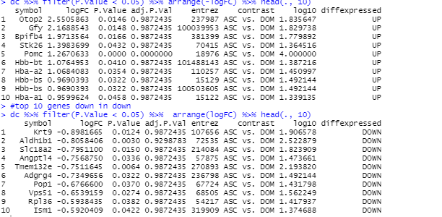
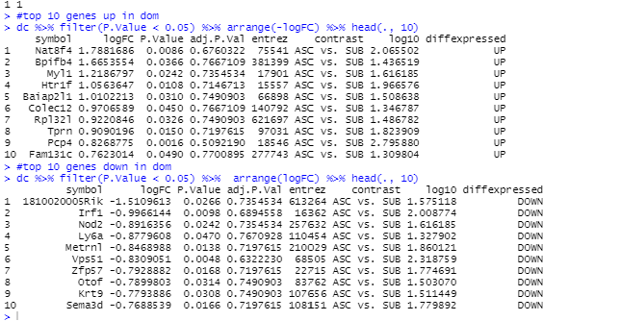
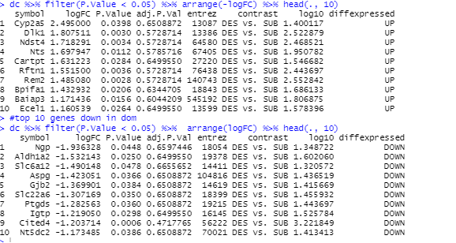

Slide 12
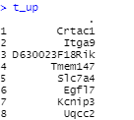
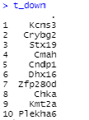
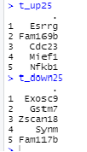
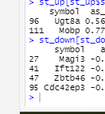
Trans 70 min
Trans 25hr
Overlap in TRN vs SUB at both time points

Slide 13
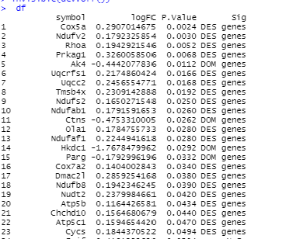

ATP70min:
ATP25hr:
DES-DOM

Slide 14
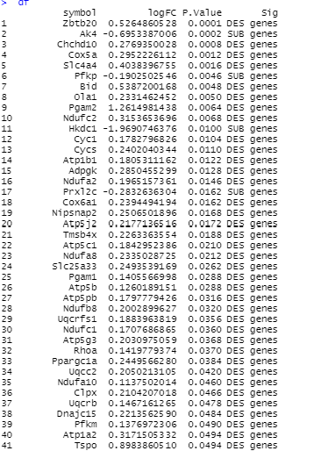
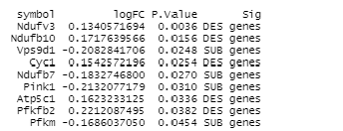
DES-SUB
ATP70min:
ATP25hr:

Slide 15
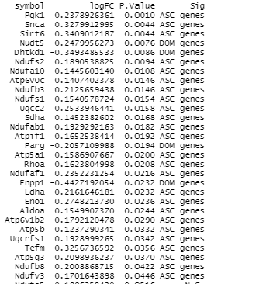
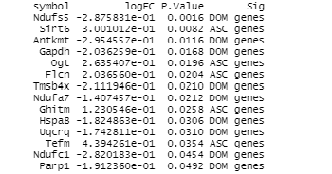
ATP70min:
ATP25hr:
ASC_DOM

Slide 16
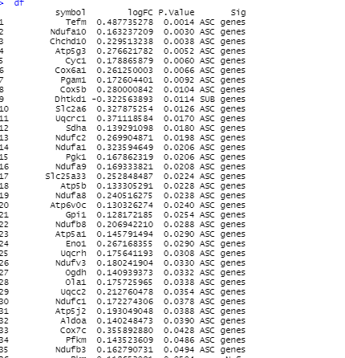
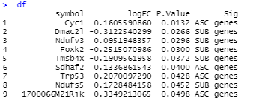
ATP70min:
ATP25hr:
ASC_SUB

Slide 17
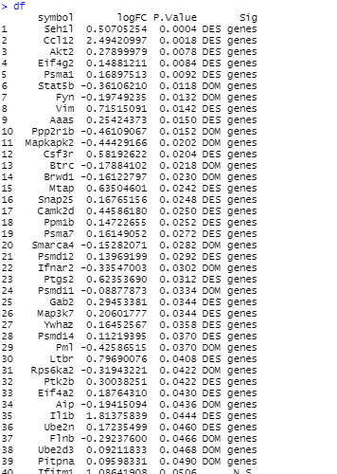
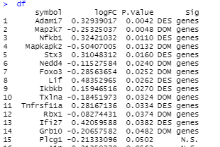
C70min:
cyt25hr:
DES-DOM

Slide 18
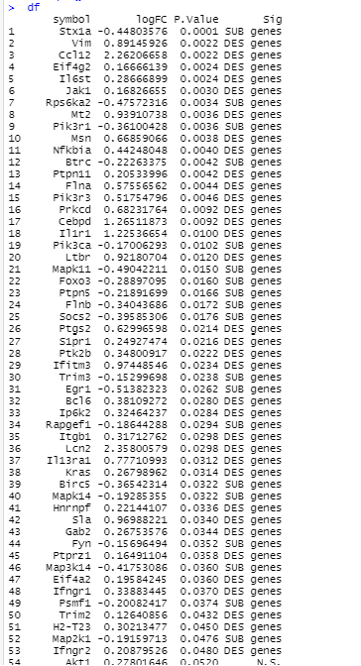
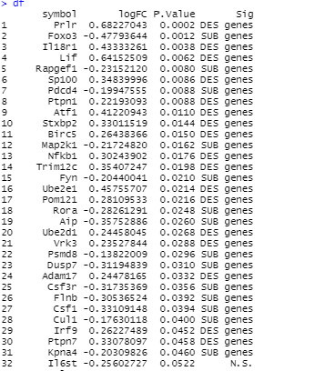
DES-SUB
cty70min:
cty25hr:

Slide 19
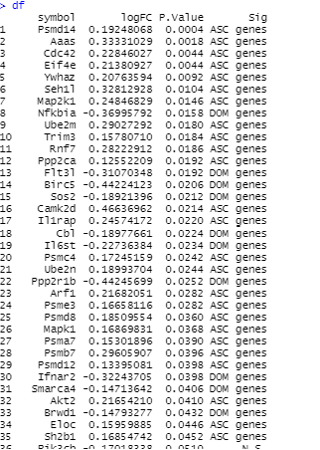
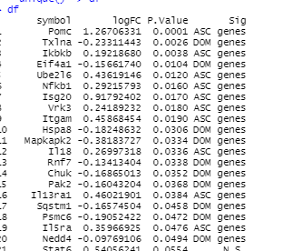
cty70min:
cty25hr:
ASC_DOM

Slide 20
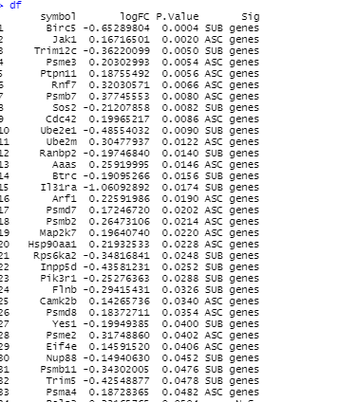
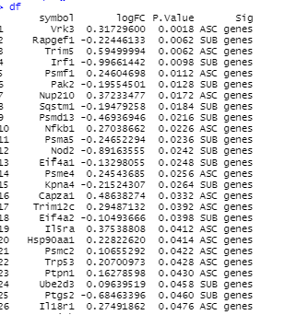
cty70min:
cty25hr:
ASC_SUB

Slide 21
my70min:
my25hr:
DES-DOM
symbol logFC P.Value Sig
1 Ercc2 -0.364242530 0.0170 DOM genes
2 Mtmr2 0.261067450 0.0386 DES genes
Mtor -0.198844282 0.0064 DOM genes
2 Nsun5 -0.483286319 0.0146 DOM genes
3 Rxrg 0.849141344 0.0350 DES genes

Slide 22
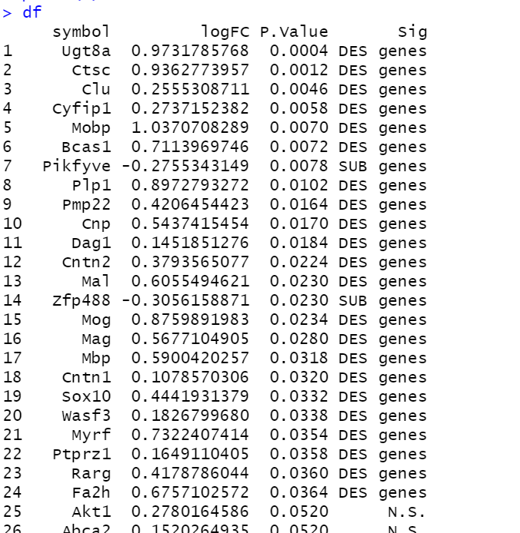
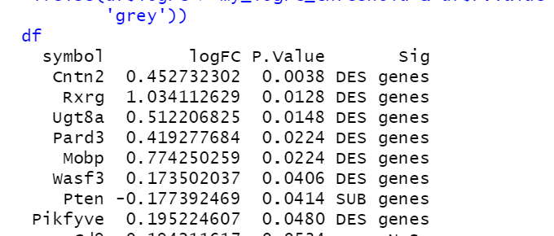
DES-SUB
my70min:
my25hr:
Pte, Pard3, and Rxrg are new at 25 hr
8 genes at 25hr and 5 are in 70 min
Pikfyve opposite directions

Slide 23
my70min:
my25hr:
ASC_DOM
symbol logFC P.Value Sig
1 Mtmr2 0.2680188989 0.0390 ASC genes
2 Pard3 -0.2585656522 0.0448 DOM genes

Slide 24
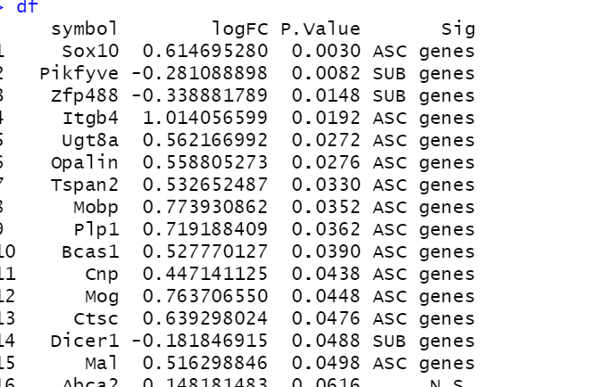
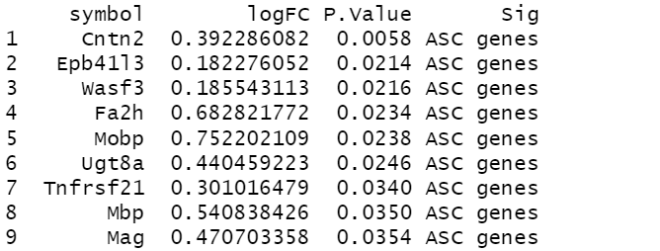
my70min:
my25hr:
ASC_SUB
Mobp and Ugt8a are at both peroids

