Slide 1
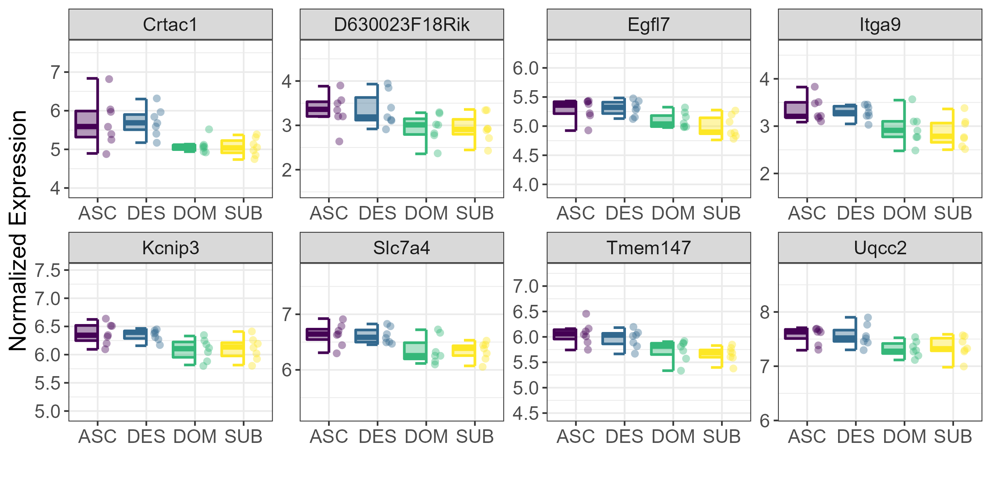
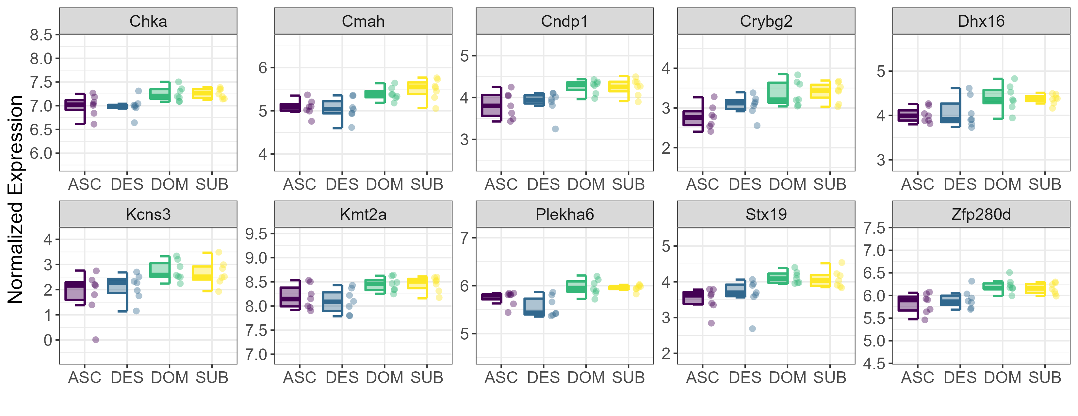
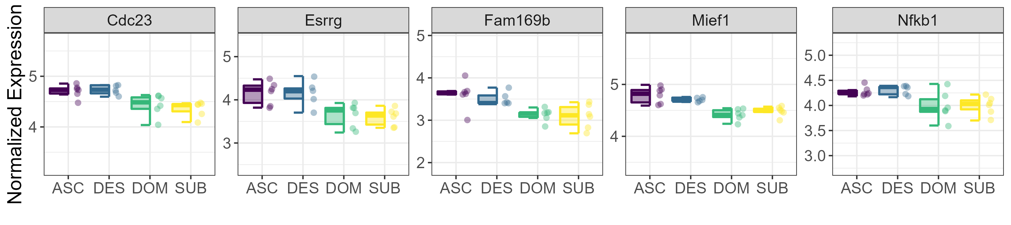
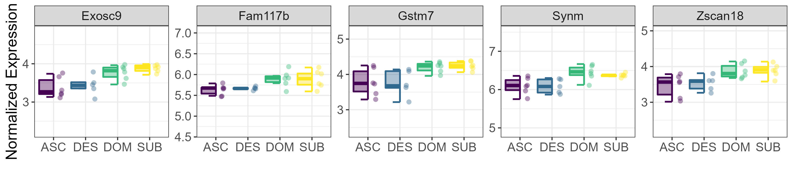
A) ↑↑ Higher in TRN at 70 min
B) ↓↓ Higher in TRN at 70 min
C) ↑↑ Higher in TRN at 25 hr
D) ↓↓ Higher in TRN at 25 hr

