Slide 1
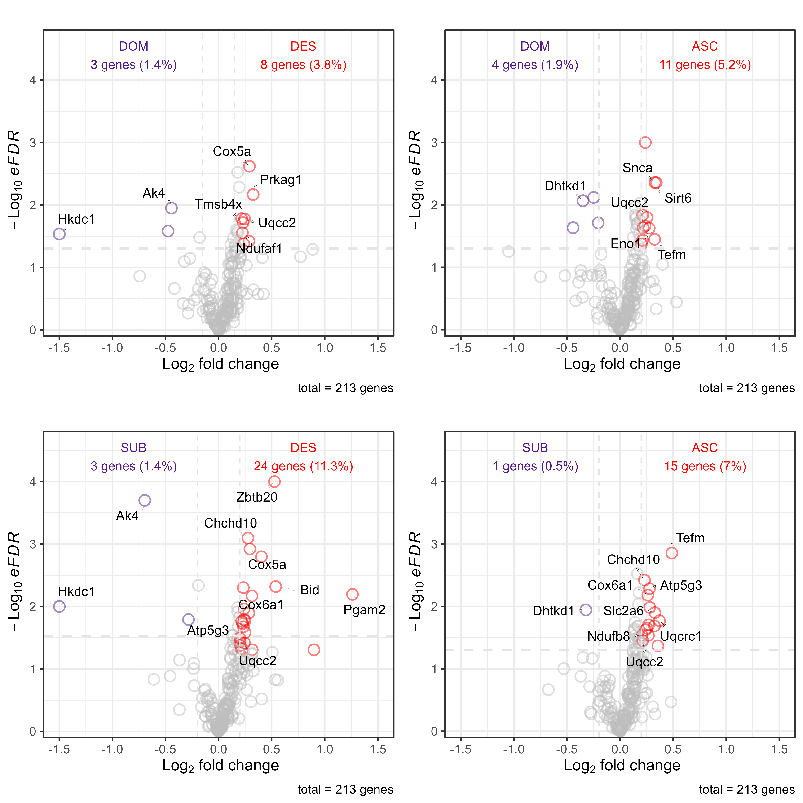
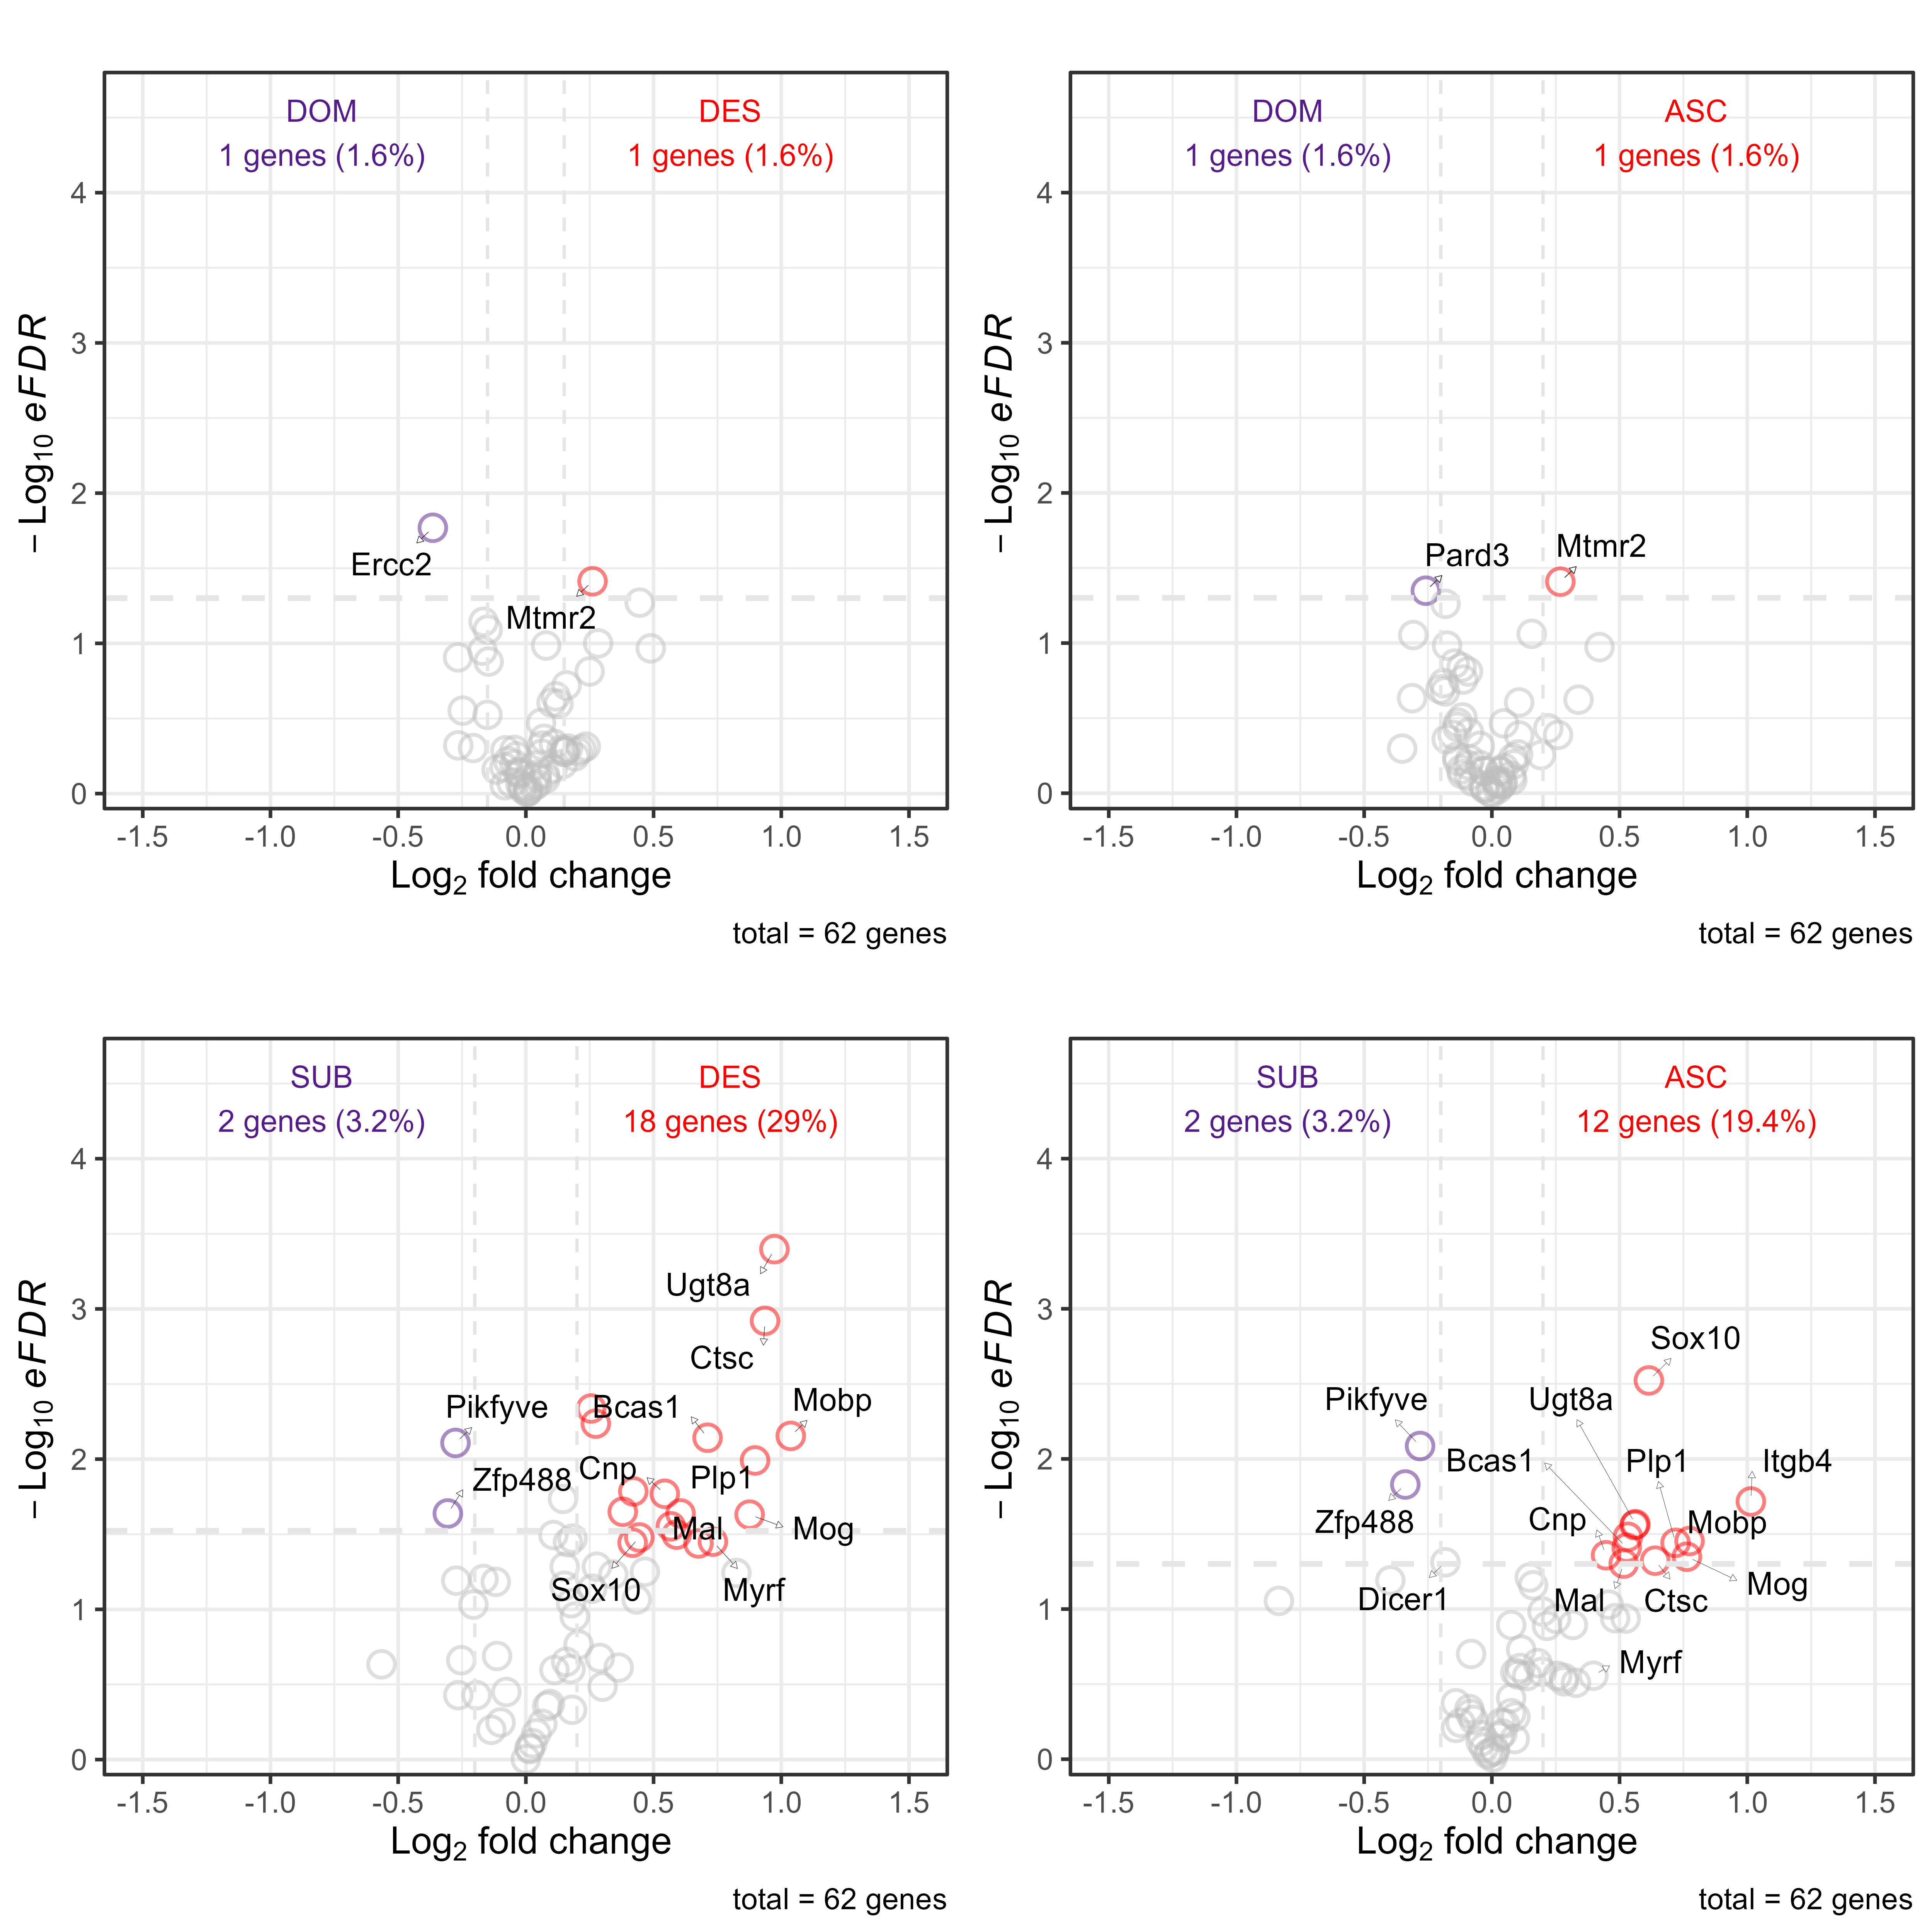
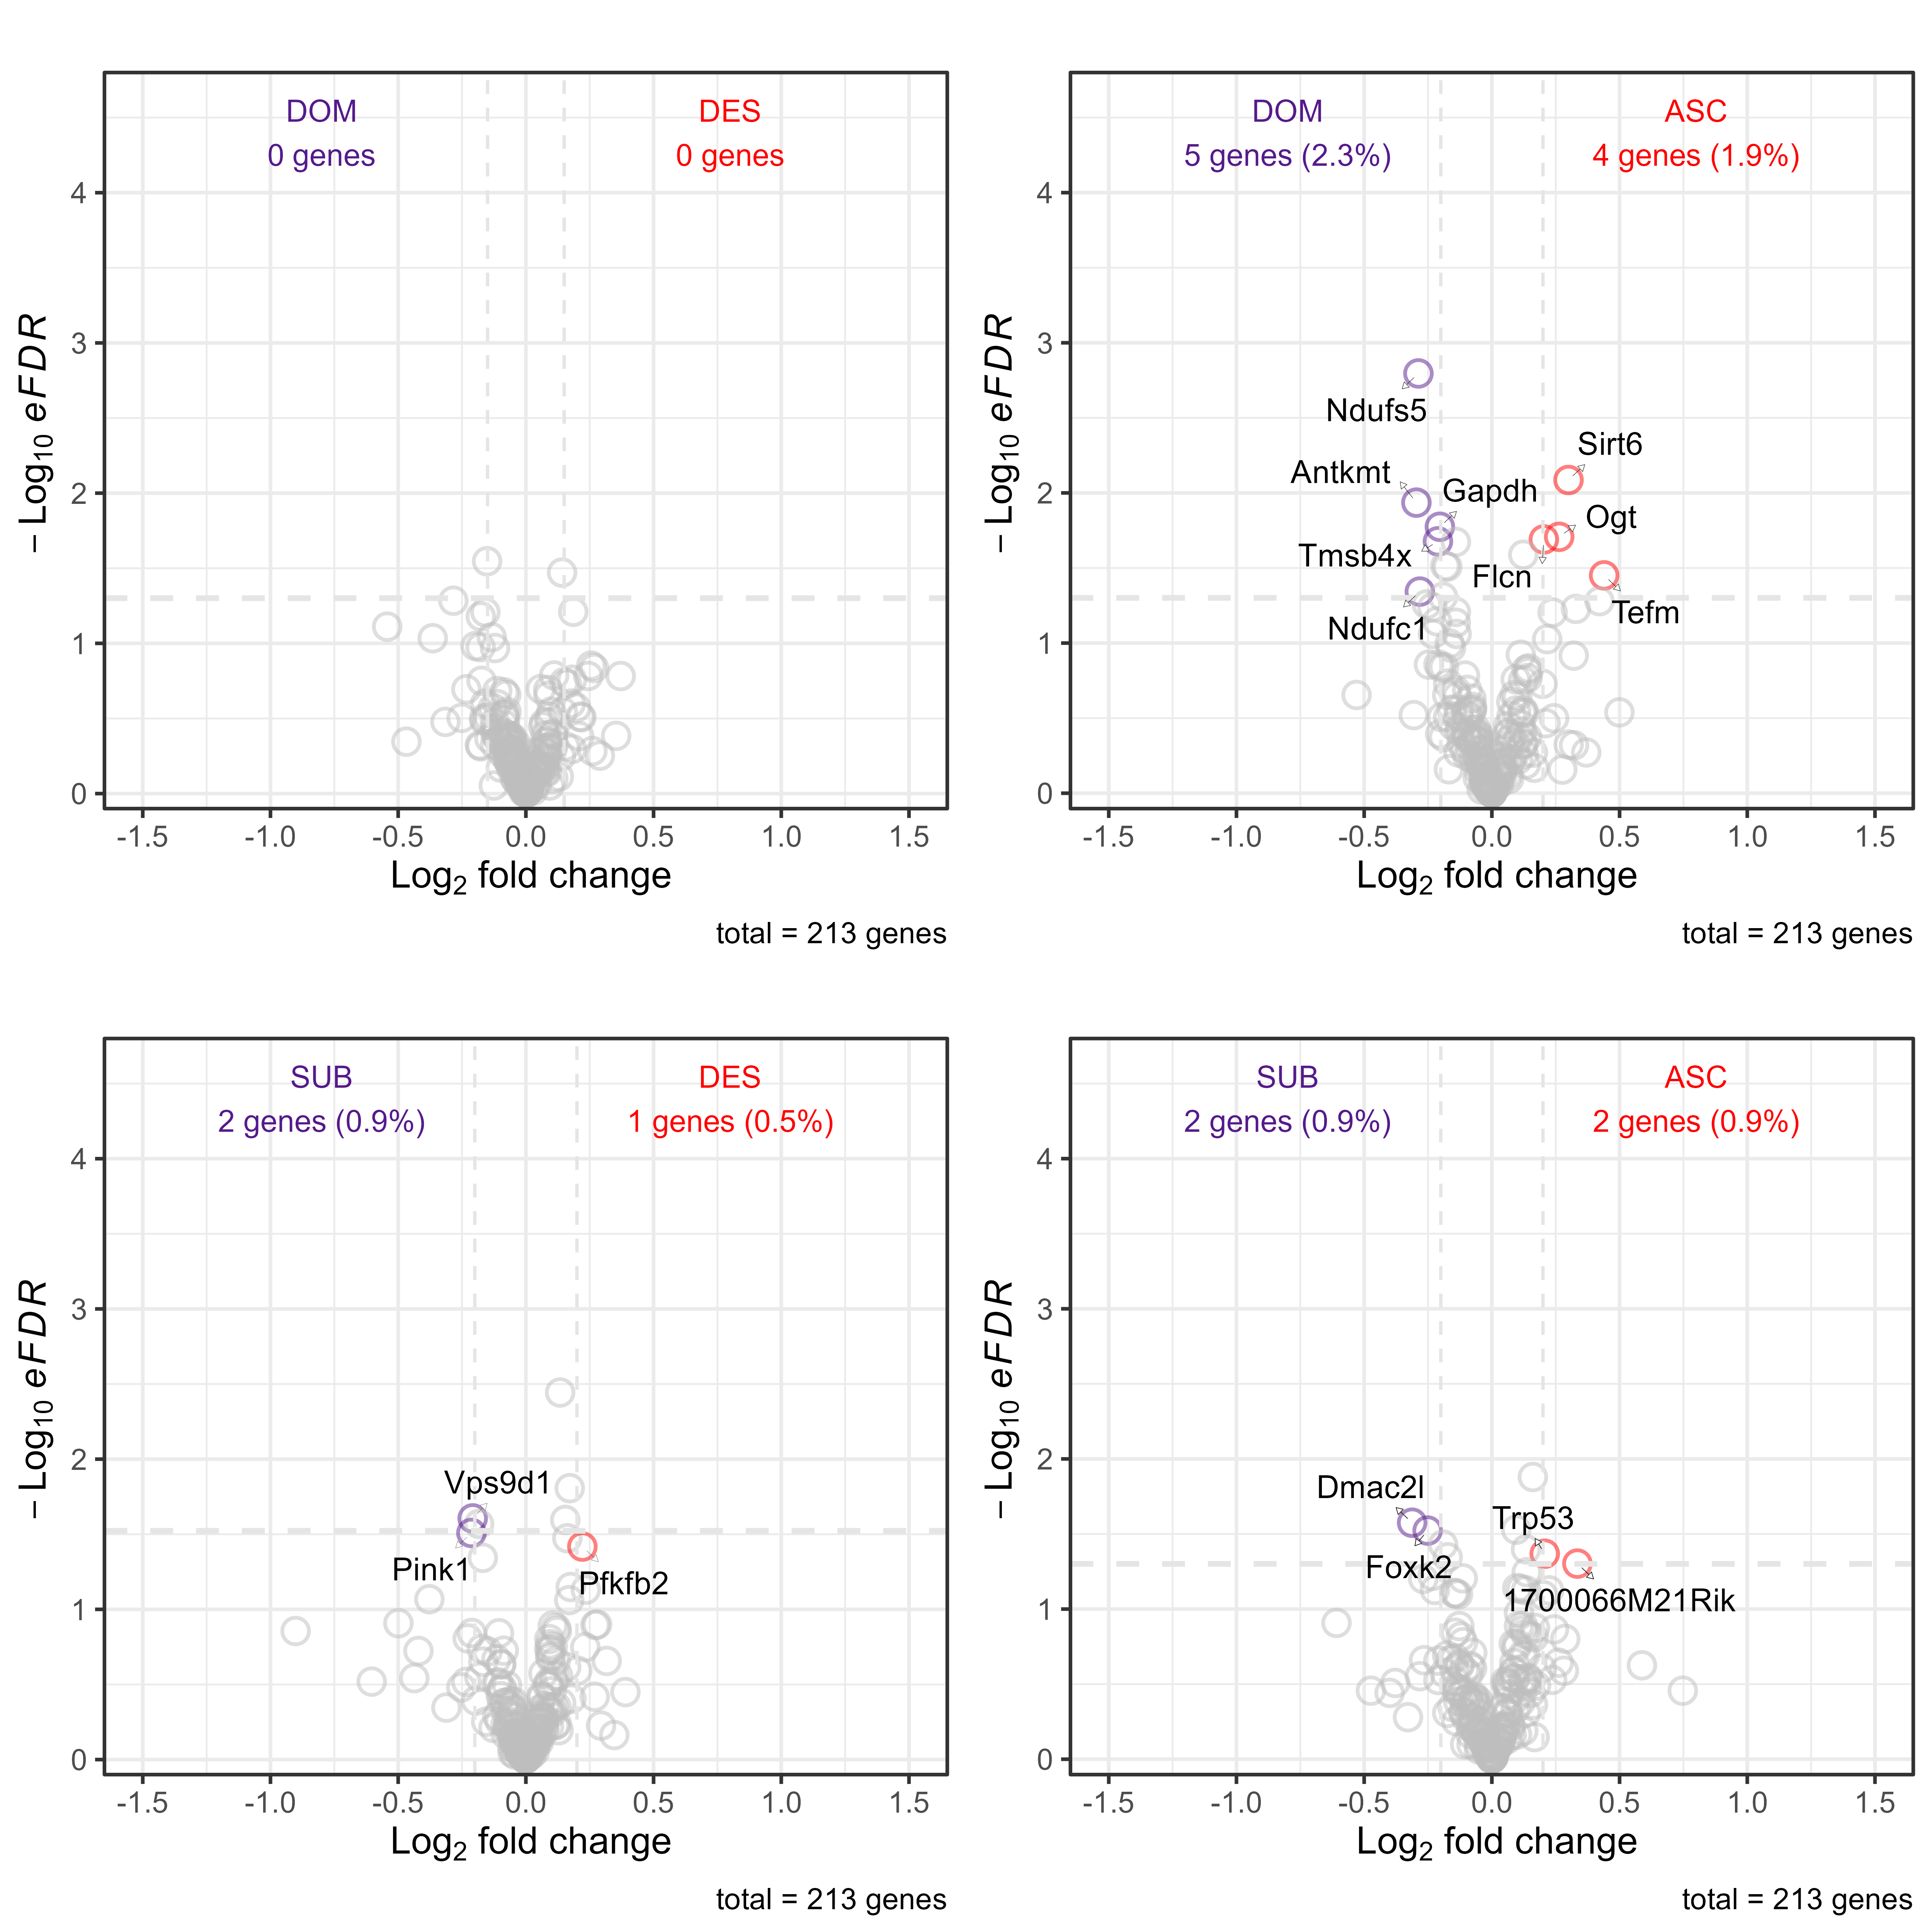
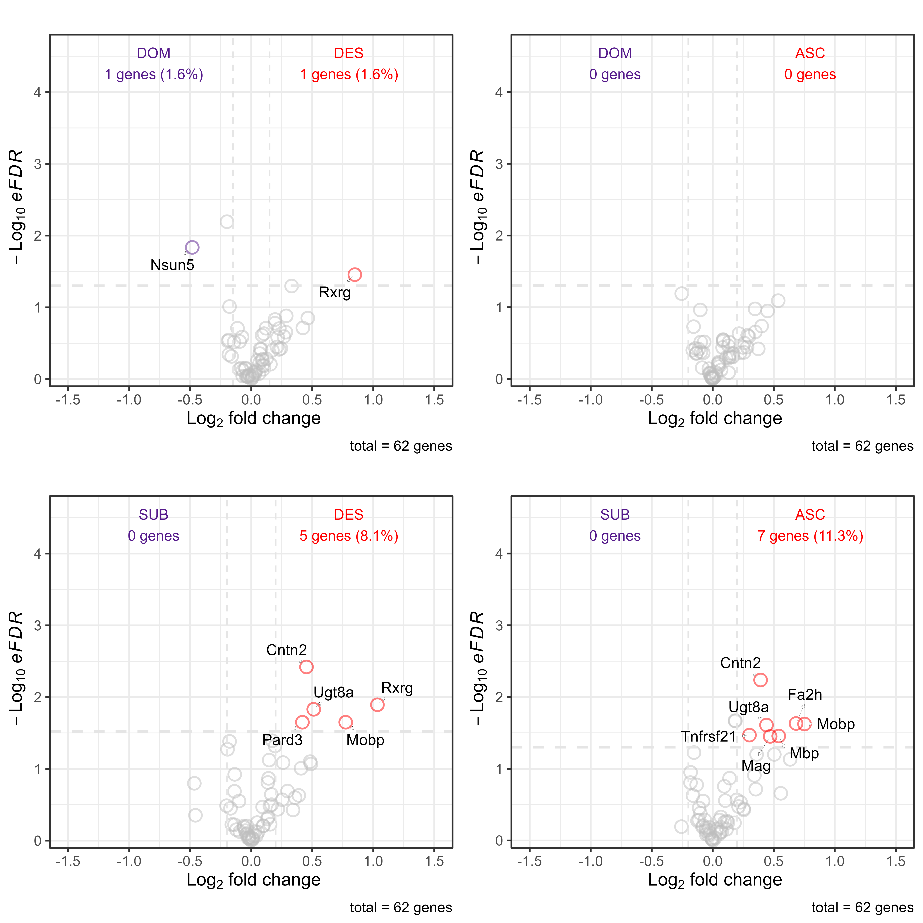
ATP Metabolism
Myelin Regulation
70 min
↑
↑
↑
↑
↑
↑
↑
↑
↑
↑
↑
↑
↑
↑
↑
↑
25 hr
↑
↑
↑
↑
↑
↑
↑
↑
↑
↑
↑
↑
↑
↑
↑
↑

