Slide 1
Project GRAIL – Accelerating DBMS performance through latency masking hardware multithreading
Ildar Absalyamov, PhD Candidate
Advisors: Prof. Vassilis Tsotras, Prof. Walid Najjar

Slide 2
Problem
Holy GRAIL of in-memory analytics:
Improving performance of analytical operations

Slide 3
Our solution
Use Hardware Multithreading to mask memory access latency

Slide 4
Outline
Motivation
Hardware Multithreading Approach
Use Cases
Hash Join
Hash Aggregation
Software & FPGA Implementations
Experiments
Conclusions & Future Work

Slide 5
Motivation
Hardware landscape 2016:
Gigabytes of RAM available on average server
Issues of scaling algorithms on multicores
Growing market for main-memory transaction processing & analytics

Slide 6
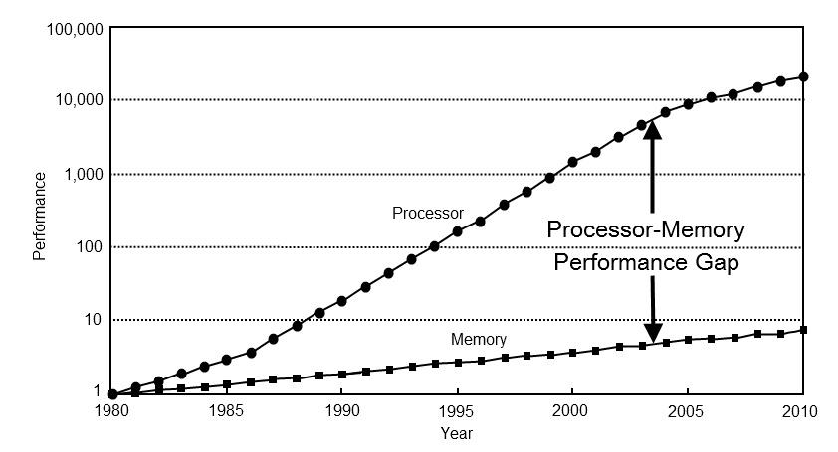
Memory Wall
The biggest in-memory analytics bottleneck
[Hennessy and Patterson. Computer Architecture: A Quantitative Approach. 5th edition]

Slide 7
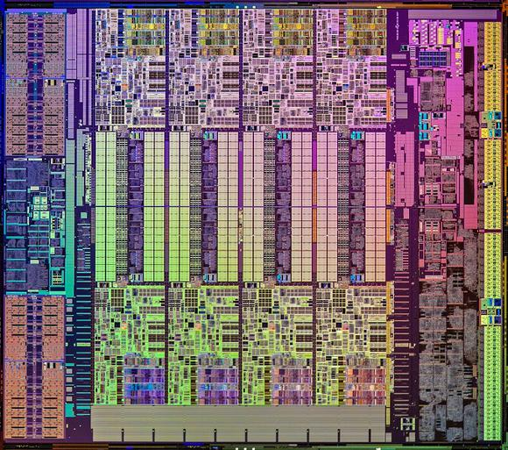
Caches
CPUs mitigate memory latencies by using caches
Pros:
Good abstraction
Cons:
Increase power consumption
Rely on data access locality
“Leaking” abstraction: complicated algorithms
Caches, caches caches!

Slide 8
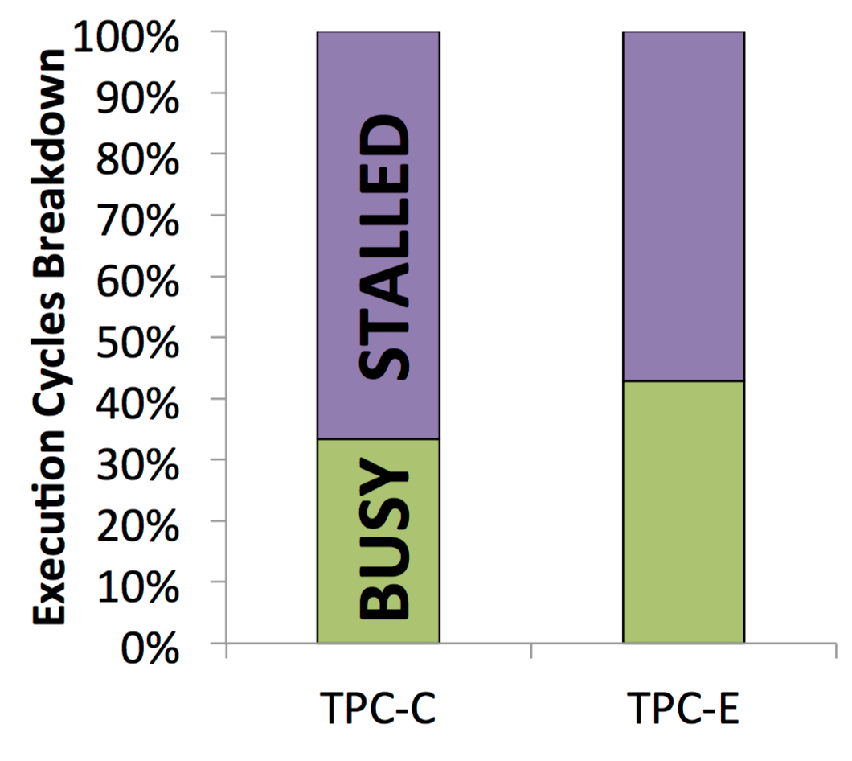
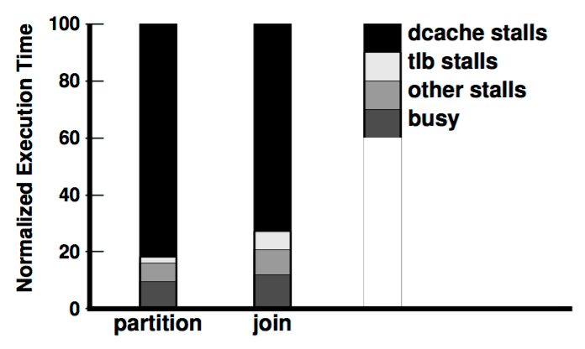
Cache Misses: Bottleneck
Cache misses are major source of stall cycles for both analytical [TODS’07] & transactional workloads [DaMoN’13]
[DaMoN’13] Tözün, P. et al. OLTP in wonderland: where do cache misses come from in major OLTP components?
[TODS’07] Chen, S. et al. Improving Hash Join Performance through Prefetching

Slide 9
Multithreading
Instantiating large number of threads
Fast thread context switching
Pros:
Fully mask latency if enough threads are available
General-purpose solution, does not rely on locality
Simple “as if single-core” algorithms
Cons:
Careful synchronization & scheduling
Performance degrades if # of threads is low

Slide 10
Multithreading: History
SPARC
Limited only to 64(8x8) hardware threads
Cray(Tera) XMT
Up to 128 threads, very custom high-end priced architecture
GPUs
Rigid control flow limitations

Slide 11
Outline
Motivation
Hardware Multithreading Approach
Use Cases
Hash Join
Hash Aggregation
Software & FPGA implementations
Experiments
Conclusions & Future Work

Slide 12
Data Path: Custom vs. Generic
CPU Data path: too generic
ICache misses
DCache misses
Branch mispredicts
Custom Data Path:
Computation performed by 1 thread
Hard wired digital circuit
Pros: Small working state (ID of the stage in the pipeline + some data)
Cons: hard to implement

Slide 13
Hardware Multithreading Approach
Customized data path
Application logic is a hardware circuit
Multithreading memory latency masking
1000s of active threads
FPGA-based multithreading implementation
Easy to prototype the approach

Slide 14
FPGA Hardware Multithreading
Preempting executing thread once it access memory
Ready & Waiting Threads Queues on FPGA fit 1000s of thread states
FPGA
Ready threads
ThreadM State
Next
thread
…
Thread N’ State
Memory
response
Main memory
Data Path
Executed
thread
ThreadN State
…
Memory
request
Thread1 State
Waiting threads

Slide 15
Hardware Multithreading: Use Cases
Algorithms with non-regular data access patterns:
Hash Join
Hash Group-by Aggregation
Graph algorithms (out of talk’s scope)

Slide 16
Main Assumptions
All data resides in memory
FPGA has direct access to the memory
Hash Table: traditional bucket-based
Coarse-grained synchronization: lock per bucket

Slide 17
Thread Synchronization
Hash table-based algorithms: synchronization during build phase
Problem: need to push locking down to FPGA
Initial approach – use platform-specific memory locking
Better solution – use CAM (Content Addressable Memory) as synchronizing primitive
CAMs allows single-cycle content-based lookup

Slide 18
Outline
Motivation
Hardware Multithreading Approach
Use Cases
Hash Join
Hash Aggregation
Software & FPGA implementations
Experiments
Conclusions & Future Work

Slide 19
Join Example: Build Phase
Build Relation: A C …
Lock CAM
Operation
HT Bucket
Create Node A
Outstanding memory requests
FPGA
Memory
HashTable

Slide 20

Join Example: Build Phase
Build Relation: A C …
Lock CAM
Operation
h(A)=𝛼
HT Bucket
Create Node A
𝛼
Update Bucket 𝛼
Outstanding memory requests
FPGA
Memory
HashTable
Bucket 𝛼
Node A

Slide 21
Join Example: Build Phase
Build Relation: A C …
Lock CAM
Operation
HT Bucket
𝛼
Update Bucket 𝛼
Create Node C
Outstanding memory requests
FPGA
Memory
HashTable
Bucket 𝛼
Node A

Slide 22
Join Example: Build Phase
Build Relation: A C …
Lock CAM
h(C)=𝛼
Operation
HT Bucket
𝛼
Update Bucket 𝛼
Create Node C
Outstanding memory requests
Recycled jobs
Key | Bucket
C | 𝛼
FPGA
Memory
HashTable
Bucket 𝛼
Node A
Node C

Slide 23
Join Example: Build Phase
Build Relation: A C …
Lock CAM
Operation
Update Bucket 𝛼
HT Bucket
𝛼
Outstanding memory requests
Recycled jobs
Key | Bucket
C | 𝛼
FPGA
Memory
HashTable
Bucket 𝛼
Node A
Node C

Slide 24
Join Example: Build Phase
Build Relation: A C …
Lock CAM
Operation
HT Bucket
Update Bucket 𝛼
𝛼
Outstanding memory requests
Recycled jobs
Key | Bucket
C | 𝛼
FPGA
Memory
HashTable
Bucket 𝛼
Node A
Node C

Slide 25
Join Example: Build Phase
Build Relation: A C …
Lock CAM
Operation
Update Bucket 𝛼
HT Bucket
𝛼
Outstanding memory requests
Recycled jobs
Key | Bucket
FPGA
Memory
HashTable
Bucket 𝛼
Node A
Node C

Slide 26
Join: Probe Phase
For each tuple from Probe relation:
Calculate hash value
Probe Hash Table for linked list head pointer
Search linked list for a match
Output tuples which match

Slide 27
Hash Join Bottlenecks
Main factors affecting join performance:
Synchronization during build phase
Assumption: Hash Table is built for smaller relation
Worst case: relations have equal size
Long linked list chains (e.g. heavily skewed data)
Optimization: maintaining sorted order of linked list & early termination

Slide 28
Outline
Motivation
Hardware Multithreading Approach
Use Cases
Hash Join
Hash Aggregation
Software & FPGA implementations
Experiments
Conclusions & Future Work

Slide 29
Hash Group-by Aggregation: Differences
Single phase, synchronization always required
E.g. no read-only phase
Search before adding a node
Lock should be acquired earlier
Some temporal locality
Depends on grouping key cardinality

Slide 30
Aggregation: CAMs
Lock CAM maintains locks for hash table buckets which are searched, thus ensuring serialization
Filter CAM pre-aggregates tuples with the same grouping keys locally on FPGA
Notes:
change the order of the CAMs?

Slide 31
Aggregation Example
Outstanding memory requests
Grouping keys sequence : A C C A
Operation
Filter CAM
Lock CAM
Search A
Key | Count
HT Bucket
1
h(A)=𝛼
𝛼
A
Hash Table
Key | Count
FPGA
Memory

Slide 32
Aggregation Example
Outstanding memory requests
Grouping keys sequence : A C C A
Bucket 𝛼 locked by another thread
Operation
Search A
Filter CAM
Lock CAM
Key | Count
A | 1
HT Bucket
𝛼
1
h(C)=𝛼
C
Hash Table
Key | Count
Recycled jobs
Key | Bucket
C | 𝛼
FPGA
Memory

Slide 33
Aggregation Example
Outstanding memory requests
Grouping keys sequence : A C C A
Operation
Search A
Filter CAM
Lock CAM
Key | Count
A | 1
C | 1
HT Bucket
𝛼
Insert {A:1}
Key A was not found
Insert new entry for A
Hash Table
Key | Count
Recycled jobs
Key | Bucket
C | 𝛼
FPGA
Memory

Slide 34
Aggregation Example
Outstanding memory requests
Grouping keys sequence : A C C A
Operation
Insert {A:1}
Filter CAM
Lock CAM
Key | Count
C | 1
HT Bucket
Search C
𝛼
Hash Table
Key | Count
Recycled jobs
Key | Bucket
C | 𝛼
FPGA
Memory

Slide 35
Aggregation Example
Outstanding memory requests
Grouping keys sequence : A C C A
Key C locally aggregated
In Filter CAM
Operation
Search C
Insert {A : 1}
Filter CAM
Lock CAM
Key | Count
C
HT Bucket
𝛼
2
1
Hash Table
Key | Count
A
1
FPGA
Memory

Slide 36
Aggregation Example
Outstanding memory requests
Grouping keys sequence : A C C A
Operation
Search C
Filter CAM
Lock CAM
Key | Count
C | 2
HT Bucket
𝛼
Insert {C:2}
Key С was not found
Insert new entry for С
Hash Table
Key | Count
A | 1
FPGA
Memory

Slide 37
Aggregation Example
Outstanding memory requests
Grouping keys sequence : A C C A
Operation
Insert {C:2}
Filter CAM
Lock CAM
Key | Count
HT Bucket
Search A
h(A)=𝛼
A
1
𝛼
Hash Table
Key | Count
A | 1
FPGA
Memory

Slide 38
Aggregation Example
Outstanding memory requests
Grouping keys sequence : A C C A
Operation
Insert {C:2}
Search A
Filter CAM
Lock CAM
Key | Count
A | 1
HT Bucket
𝛼
Hash Table
Key | Count
A | 1
C
2
FPGA
Memory

Slide 39
Aggregation Example
Outstanding memory requests
Grouping keys sequence : A C C A
Operation
Search A
Filter CAM
Lock CAM
Key | Count
A | 1
HT Bucket
𝛼
Update {A:1+1}
Key A:1 was found
Update existing entry for A
Hash Table
Key | Count
A | 1
С | 2
FPGA
Memory

Slide 40
Aggregation Example
Outstanding memory requests
Grouping keys sequence : A C C A
Operation
Update {A: 2}
Filter CAM
Lock CAM
Key | Count
HT Bucket
Hash Table
Key | Count
A
C | 2
2
1
FPGA
Memory

Slide 41
Hash Aggregation: Bottlenecks
Main factors affecting aggregation performance:
CAM size: current design scales to 128 entries
We explore alternative CAM designs which trades off size for speed (e.g. several-cycle lookup)
Hash Table merge post-processing
Function of cardinality, does not depend on data size

Slide 42
Outline
Motivation
Hardware Multithreading Approach
Use Cases
Hash Join
Hash Aggregation
Software & FPGA implementations
Experiments
Conclusions & Future Work

Slide 43
FPGA Engine Parallelism
Target platform: Convey-HC
4 Xilinx Virtex 6 FPGAs x 16 Memory channels\FPGA
Designs
Replicated join (4 chans/eng, 4 eng/FPGA)
Replicated aggregation (4 chans/eng, 4 eng/FPGA)
Multiplexed aggregation (2.5 chans/eng, 6 eng/FPGA)
Multiplexed Engine Design
Replicated Engine Design
Main Memory
Main Memory
1
2
..Memory channels..
15
16
1
2
..Memory channels..
15
16
Multiplexed Engines
Engine1
…
Engine4
Engine1
Engine2
…
Notes:
!!!!!!Mention merging!!!!!!

Slide 44
Software Comparison
2 join algorithms
Non-partitioned
Partitioning-based
Hardware-oblivious
[ICDE’13]
Hardware-conscious
5 aggregation algorithms
Independent Tables
Shared Table
Partition & Aggregate
Hybrid Table
Partition with Local Aggregation Table
Hardware-oblivious [VLDB’07]
Hardware-conscious [VLDB’07]
Hybrid [DAMON’11]
[ICDE’13] Balkesen, C. et al. Main-memory Hash Joins on Multi-core CPUs: Tuning to the underlying hardware.
[VLDB’07] J. Cieslewicz et al. Adaptive Aggregation on Chip Multiprocessors.
[DAMON’11] Y. Ye et al. Scalable aggregation on multicore processors

Slide 45
Experiments: “Skinny” Tables
Columnar data format with two 4-byte wide fields:
32bit primary key
32bit payload(grouping key)
Distributions: Unique, Uniform(Random), Heavy Hitter, Moving Cluster, Self Similar, Zipf
Relation sizes 1M to 1B
Grouping key cardinalities 1K to 4M

Slide 46
Experiments: TPC-H
Schema from TPC-H benchmark
Only join between Orders & Customers tables (no projections\selections yet)
Part of Q3, Q5, Q7, Q8, Q10, Q13, and Q18
Always probe-dominated
Scale factors from 1 to 10

Slide 47
Outline
Motivation
Hardware Multithreading Approach
Use Cases
Hash Join
Hash Aggregation
Software & FPGA implementations
Experiments
Conclusions & Future Work

Slide 48
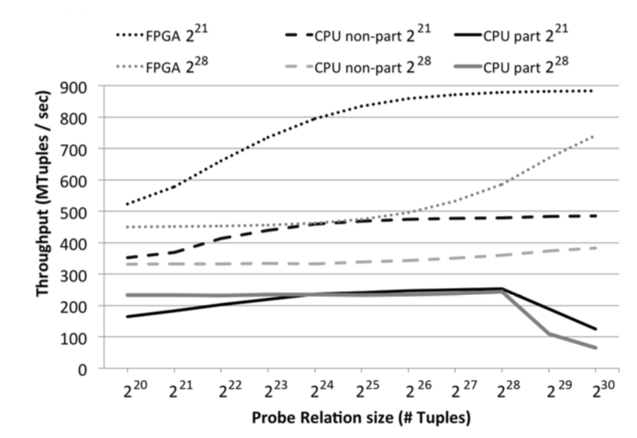
Join: Unique Throughput
2x

Slide 49
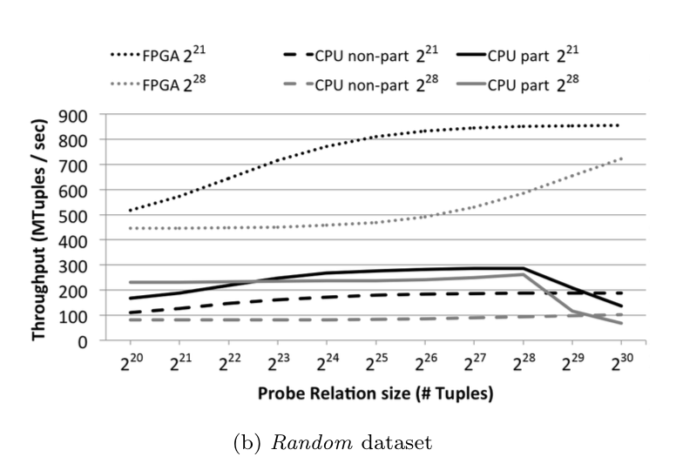
Join: Uniform Throughput
3x

Slide 50
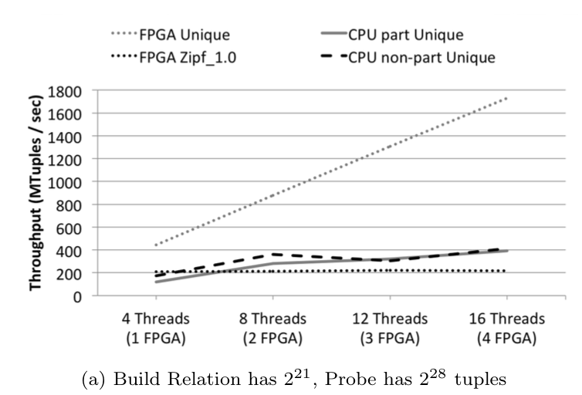
Join: Scale Up (Probe Dominated)
Each 4 CPU threads vs. 1 FPGA (roughly matches memory bandwidth)
4x

Slide 51
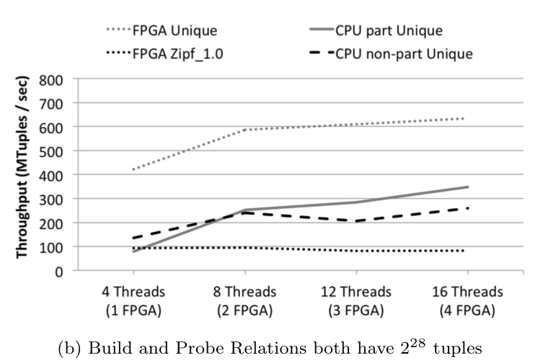
Join: Worst Case Scale Up |R|=|S|
2x

Slide 52
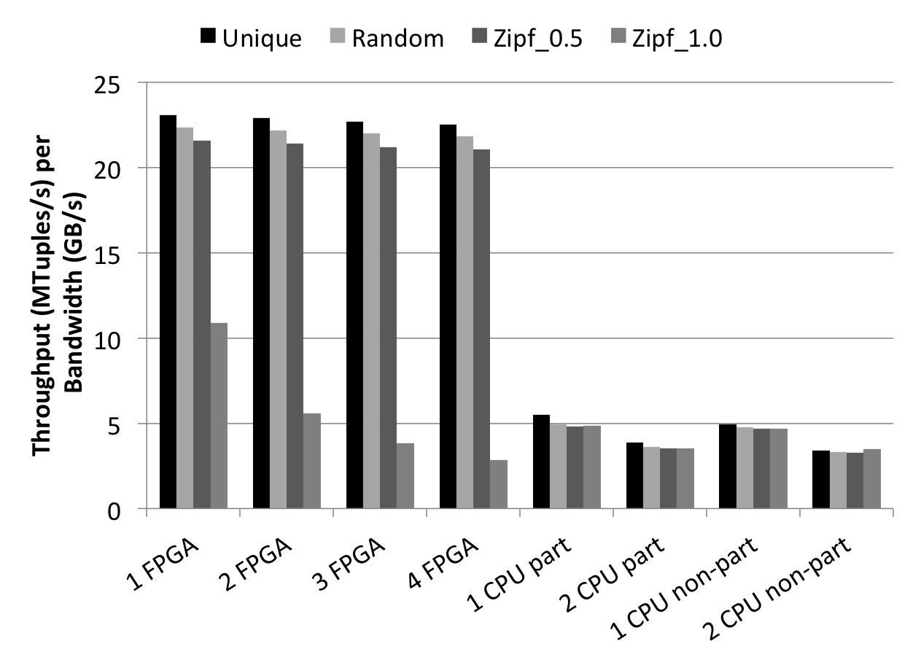
Join: Normalized Throughput
4x

Slide 53
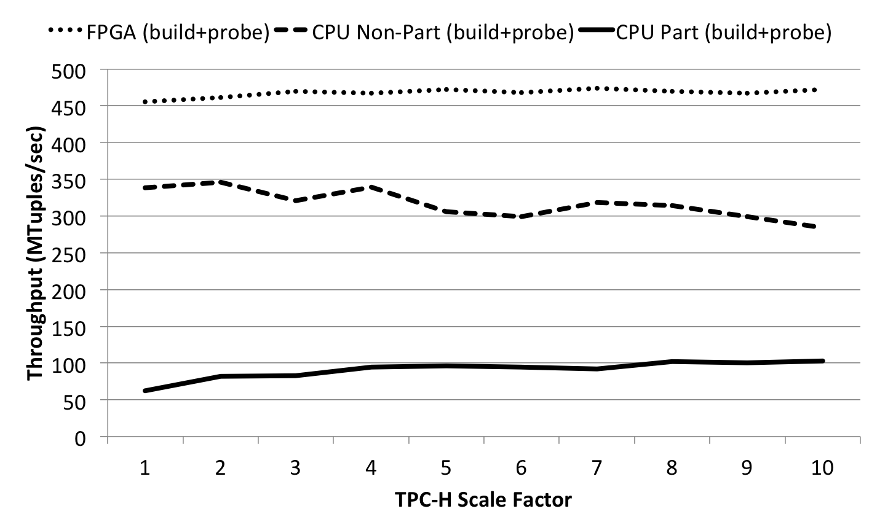
Join: TPC-H Throughput
Orders ⋈_{custkey} Customer
1.5x

Slide 54
Aggregation: Self Similar Throughput
10x

Slide 55
Aggregation: Final Merge Effects
Merge
Overhead
128M
Merge
Overhead
8M
Merge operation introduces a constant overhead, which diminishes as relation grows

Slide 56
Aggregation: Bandwidth Utilization
FPGA implementation achieves much higher memory bandwidth utilization

Slide 57
Outline
Motivation
Hardware Multithreading Approach
Use Cases
Hash Join
Hash Aggregation
Software & FPGA implementations
Experiments
Conclusions & Future Work

Slide 58
Conclusions
Implemented an FPGA-accelerated hash join by aggregation operator [CIDR’15]
Proposed an FPGA-accelerated hash group by aggregation operator [DaMoN’16]
Explored CAMs as a pre-aggregation cache & synchronization primitive [DaMoN’16, ICCAD’15]
[CIDR’15] Halstead, R. et al. FPGA-based Multithreading for In-Memory Hash Joins.
[ICCAD’15] Windh, S. et al. CAMs as Synchronizing Caches for Multithreaded Irregular Applications on FPGAs
[DaMoN’16] Absalyamov, I. et al. FPGA-accelerated group-by aggregation using synchronizing caches.

Slide 59
Future Work
Implement other relational operators to build fully-fledged query processor
Explore tradeoff between CAM size vs. speed
Apply hardware multithreading to transactional workloads (e.g. implement CAM-based concurrency control)

Slide 60

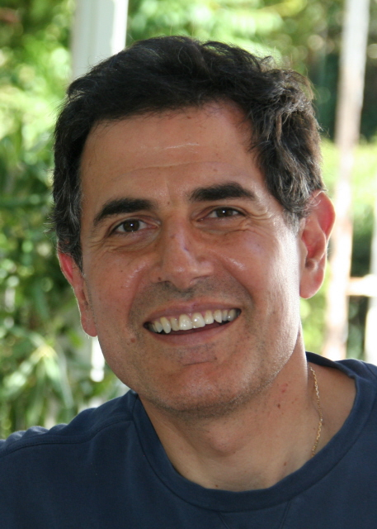



UCR Team
Prof. Walid A. Najjar
Prof. Vassilis J. Tsotras
Robert J. Halstead
Skyler Windh
Prerna Budhkar

Slide 61
Questions?

Slide 62
Backup slides

Slide 63
Experimental Evaluation
Four synthetically generated datasets with varied key distribution
Unique: Shuffled sequentially increasing values (no-repeats)
Random: Uniformly distributed random values (few-repeats)
Zipf: Skewed values with skew factor 0.5 and 1
Each dataset has a set of relation pairs (R&S) ranging from 1M to 1B tuples
Results were obtained on Convey-MX heterogeneous platform
Hardware Region
FPGA board | Virtex-6 760
# FPGAs | 4
Clock Freq. | 150 MHz
Engines per FPGA | 4 / 3
Memory Channels | 32
Memory Bandwidth (total) | 76.8 GB/s
Software Region
CPU | Intel Xeon E5-2643
# CPUs | 2
Cores / Threads | 4 / 8
Clock Freq. | 3.3 GHz
L3 Cache | 10 MB
Memory Bandwidth (total) | 102.4 GB/s

Slide 64
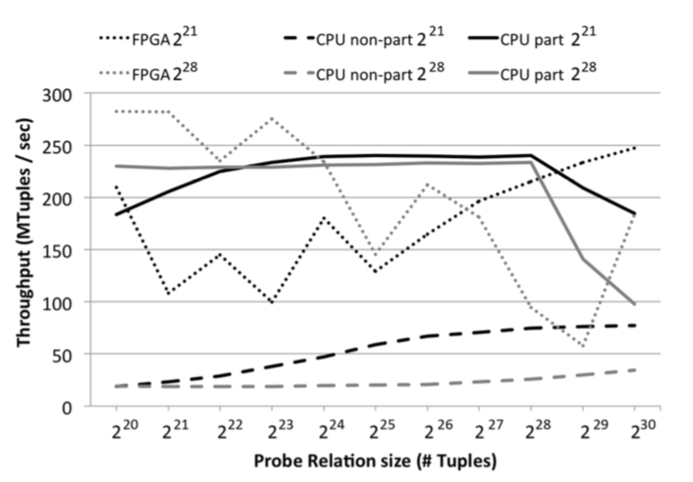
Throughput Results: Zipf_1.0 dataset
FPGA throughput decreases significantly due to stalling during probe phase

Slide 65
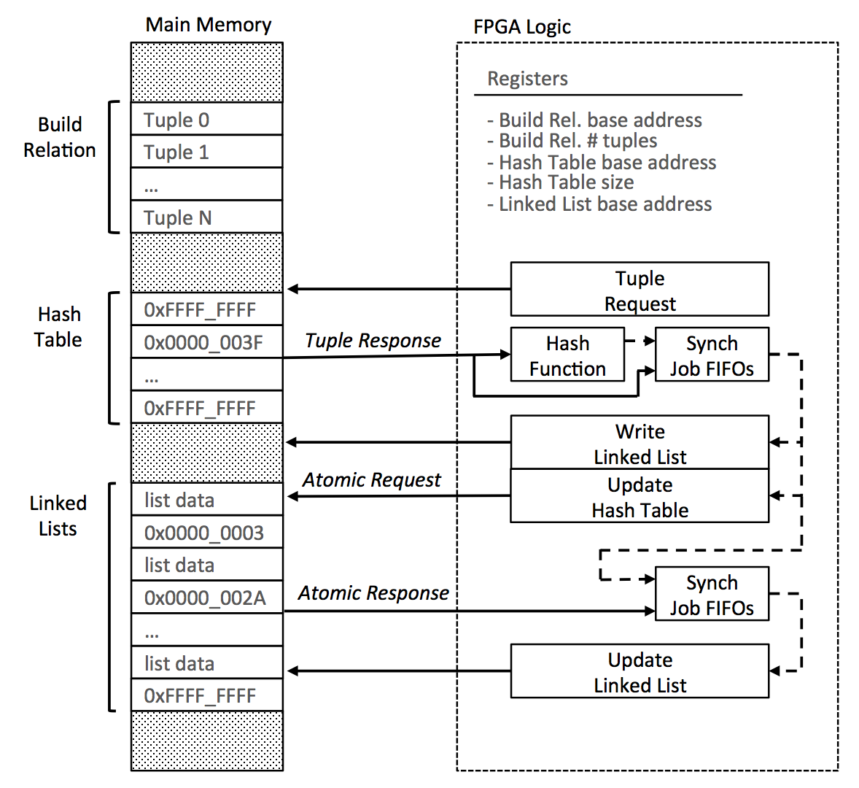
FPGA Implementation: Build Phase Engine
Every cycle a new tuple enters the FPGA engine
Every tuple in R is treated as a unique thread:
Fetch tuple from memory
Calculate hash value
Create new linked list node
Update Hash Table
Has to be synchronized via atomic operations
Insert the new node into the linked list
Notes:
Robert: does the link list append use atomic operation? (no, the HT request does an atomic read/update operation. Whatever is read goes to the linked list update.)

Slide 66
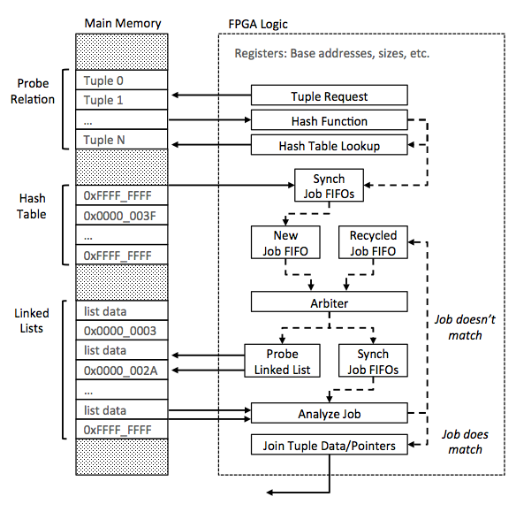
FPGA Implementation: Probe Phase Engine
Every tuple in R is treated as a unique thread:
Fetch tuple from memory
Calculate hash value
Probe Hash Table for linked list head pointer
Drop tuples if the hash table location is empty
Search linked list for a match
Recycle threads through the data-path until they reach the last node
Tuples with matches are joined
Stalls can be issued between New & Recycled Jobs

Slide 67
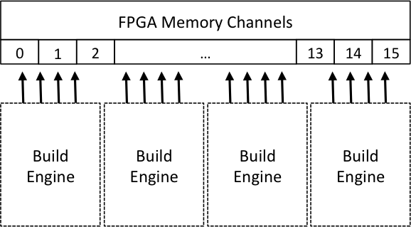
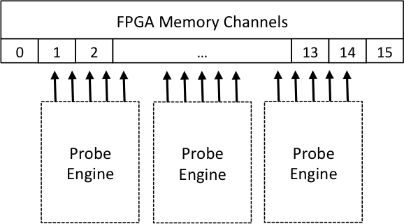
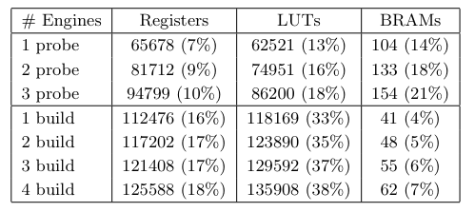
FPGA Area & Memory Channel Constraints
Target platform: Convey-MX
Xilinx Virtex 6 760 FPGAs
4 FPGAs
16 Memory channels per FPGA
Build engines need 4 channels
Probe engines need 5 channels
Designs are memory channel limited

