Slide 1
Satellite Classification for Post-hurricane Damage
Yui Cao, Zean Dong, Tianyue Zhang
Fall 2023
Link: https://github.com/ty1erz/Satellite-Classification-for-Post-hurricane-Damage

Slide 2
Executive summary
Advancements in deep learning
Efficient natural disaster management
Faster response & disaster mapping
Analyzing aerial & satellite imagery to swiftly and accurately pinpoint areas impacted by disasters
Deep Learning for Flood monitoring
assess water levels
forecast potential flooding
more effective early warning systems- damage prevention & recovery
Convolutional Neural Networks (CNNs) and Vision Transformers
Goal :efficiently and accurately classifies satellite imagery of regions affected by hurricanes
Hurricane Harvey Dataset: 11,000 training images, 2,000 validation images, and 9,000 testing images
2 classes: damaged, no damage
Intentional inclusion of disproportionate representation of classes
rigorously test and enhance the model's ability to generalize in varied and challenging conditions.

Slide 3
Motivation / Related works
Deep Convolutional Neural Network for Flood Extent Mapping Using Unmanned Aerial Vehicles Data, Gebrehiwot et al. (2019)
Flood extent mapping of UAV images using fine-tuned VGG16 model
4 classes: water, building, vegetation, road
Further Improvement:
small image size
solely uses VGG models ( performance can be outmatched by more recent architectures like ResNets or EfficientNets that are optimized for speed and accuracy.)
UAV not satellite images
Classification of Building Damage Using a Novel Convolutional Neural Network Based on Post-Disaster Aerial Images
Novel convolutional neural network
earthquake building damage classification net (EBDC-Net)—for assessment of building damage based on post-disaster aerial images
Performance of EBDC-Net evaluated using a public dataset, and a large-scale damage assessment was performed using a dataset of post-earthquake unmanned aerial vehicle (UAV) images
Further Improvement: Exploring the classification of building damage under complex conditions through the use of multimodal and multi-temporal remote sensing images
A Deep Learning Approach of Recognizing Natural Disasters on Images using Convolutional Neural Network and Transfer Learning, Valdez & Godmalin (2021)
New dataset for the joint classification of natural disasters and intensity
MobileNetV3 with transfer learning with two classification heads for the two tasks: detecting normal/no-disaster images
Recognizes disaster intensity
Further Improvement:
validate the model performance under uncontrolled conditions
dataset found manually on open source tool
Source: 1) Gebrehiwot A, Hashemi-Beni L, Thompson G, Kordjamshidi P, Langan TE. Deep Convolutional Neural Network for Flood Extent Mapping Using Unmanned Aerial Vehicles Data. Sensors (Basel). 2019 Mar 27;19(7):1486. doi: 10.3390/s19071486. PMID: 30934695; PMCID: PMC6479537. 2) Hong Z, Zhong H, Pan H, Liu J, Zhou R, Zhang Y, Han Y, Wang J, Yang S, Zhong C. Classification of Building Damage Using a Novel Convolutional Neural Network Based on Post-Disaster Aerial Images. Sensors. 2022; 22(15):5920. https://doi.org/10.3390/s22155920 3) Daryl B. Valdez and Rey Anthony G. Godmalin. 2021. A DeepLearning Approach of Recognizing Natural Disasters on Imagesusing Convolutional Neural Network and Transfer Learning . InInternational Conference on Artificial Intelligence and its Applica-tions (icARTi ’21), December 9–10, 2021, Virtual Event, Mauritius.ACM, New York, NY, USA, 7 pages. https://doi.org/10.1145/3487923.3487927

Slide 4
Method/Approach
AlexNet
Our project incorporates an AlexNet as our based model, which renowned for its performance in large-scale image classification tasks. The model use ReLU as the activation, and consists of five convolutional layers followed by three fully connected layers.
VGG-16
A notable characteristic of VGG16 is the use of uniformly small filter sizes (3x3) in all convolutional layers, which aids in capturing detailed image features while reducing computational complexity compared to models like AlexNet.
Resnet-with-Transfer-Learning
ResNet50 architecture enables the training of much deeper networks than was previously feasible, without loss in performance due to increased depth. We want to examine if transfer learning would increase the efficiency of our training while reaching the same level of accuracy.
Vision Transformer (ViT)
More recent architecture
Adapts the transformer architecture to the realm of computer vision
Relies on self-attention mechanisms to process data in a parallel manner
sequence of words or pixels in an image
Consider the entire image, allowing them to capture global dependencies and make more informed predictions
Less bias

Slide 5
Implementation/Experimentation details
AlexNet
Modified input size to 128*128 to match data size
Applied BatchNorm and Dropout with probability of 0.4
Adam optimizer with lr=0.001
Sparse categorical cross-entropy Loss
20 epochs, batch size 32.
VGG-16
Resize data to 224*224, aligning with standard VGG-16 input size
Applied Dropout with probability of 0.5
Adam optimizer with lr = 0.01
Sparse categorical cross-entropy Loss
20 epochs, batch size 32.
Resnet-with-Transfer-Learning
Modified input size to 128*128 with data augmentation
Pretrained Resnet50 + Global Average Pooling + FC Layer
Adam optimizer with Binary cross-entropy Loss
15 epochs of feature extraction with lr = 0.01
40 epochs of finetuning on all except first 15 layers with lr = 0.001
Vision Transformer
Model from scratch: suffered from low accuracy
small data size and lack of complexity in images
Resized images to 224*224 using Torchvision
patch size = 16
# of patches = (224/16) * (224/16) = 196 patches
Pre-trained on ImageNet1K
Adam optimizer
Sparse categorical cross-entropy
10 epochs, batch size 32, lr = 0.003
Default values mentioned in ViT papers
Notes:
VGG: since the original data size 128x128 led to a stagnation in validation accuracy at around 0.5

Slide 6
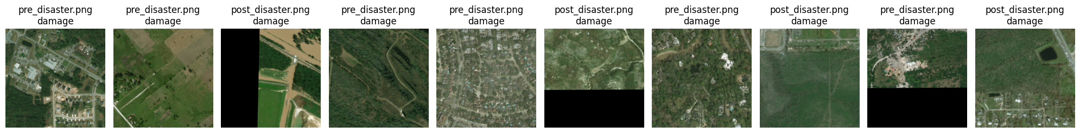
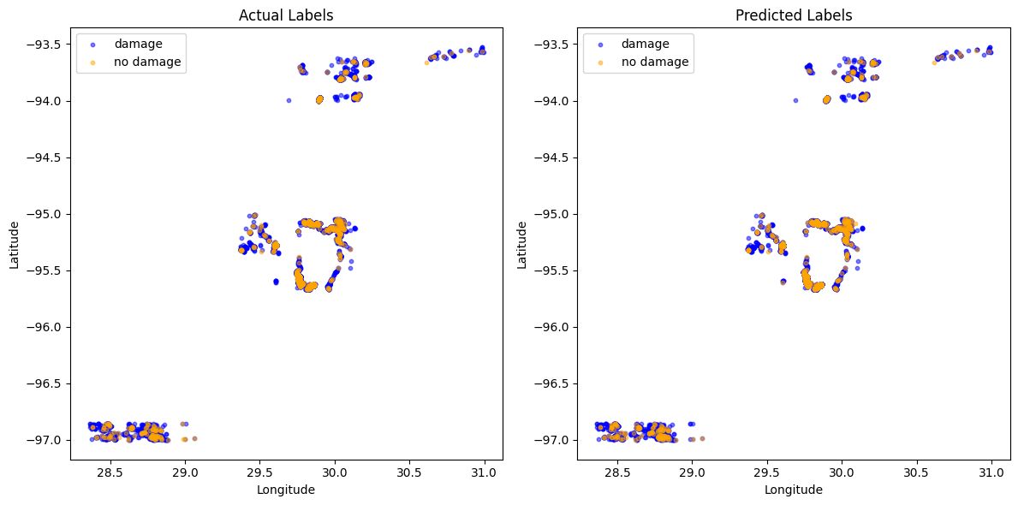
Demos
Testing on new Satellite img that has Occurrence of nature disaster
Top: Occurrence of Disaster
Bottom: Predicted Damage

Slide 7
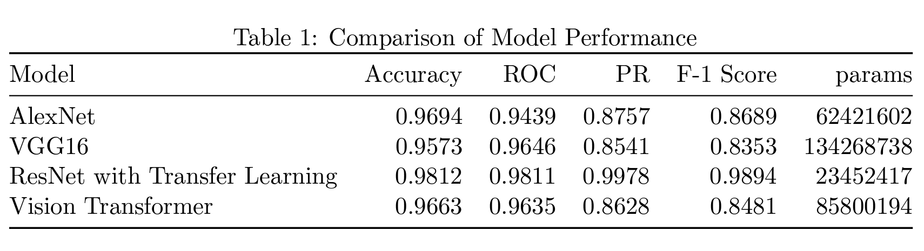
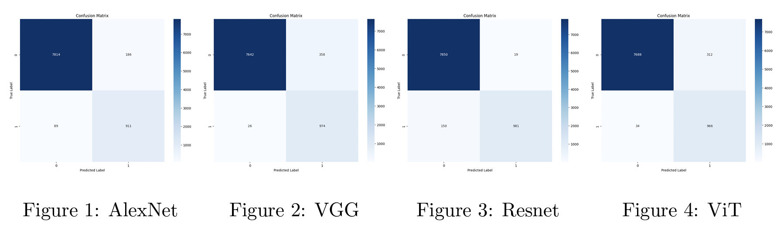
Results/Experimental evaluation

Slide 8
Conclusion
Resnet with TL out-performs rest of the model, with the best f-1 score, accuracy, and smallest number of parameters
Other models has reasonable performances as well, along with different performance levels and complexities.
Limitations
Training and testing data limits to flood damage, overlooks collateral damage
Struggle to classify other types of damage
Performance diminishes on unbalanced datasets
Future Improvements
Ensemble learning combining other disaster detector
A dataset including diverse disaster types

Slide 9
Thank You!

