Slide 1
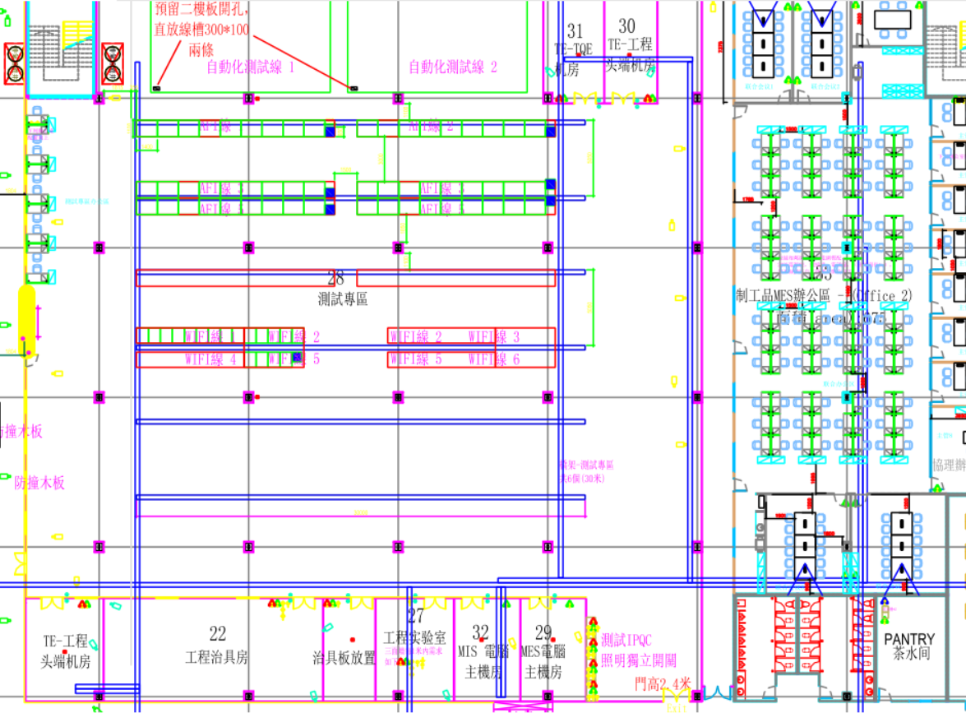
X4(40m)
X4(30m)
X4(35m)
1
X8(40m)
2
目前規劃頭端皆放在TE-TQE機房，
Server皆放在TE工程頭端機房
X4(45m)
3
AFI測試線第二列希望由4條改佈8條
(因站台數兩倍)
X3(50m)
4
WIFI測試線以後的都由4條改3條
(4、5、6) (實際上可能用不到且效率低)
X3(55m)
5
工程實驗室由4條改2條
(站台需求少，線路損失約20dB，仍可分接)
X3(60m)
6
Total_1: 1845m
X4(60m)
X4(55m)
工程實驗室
IPQC

Slide 2
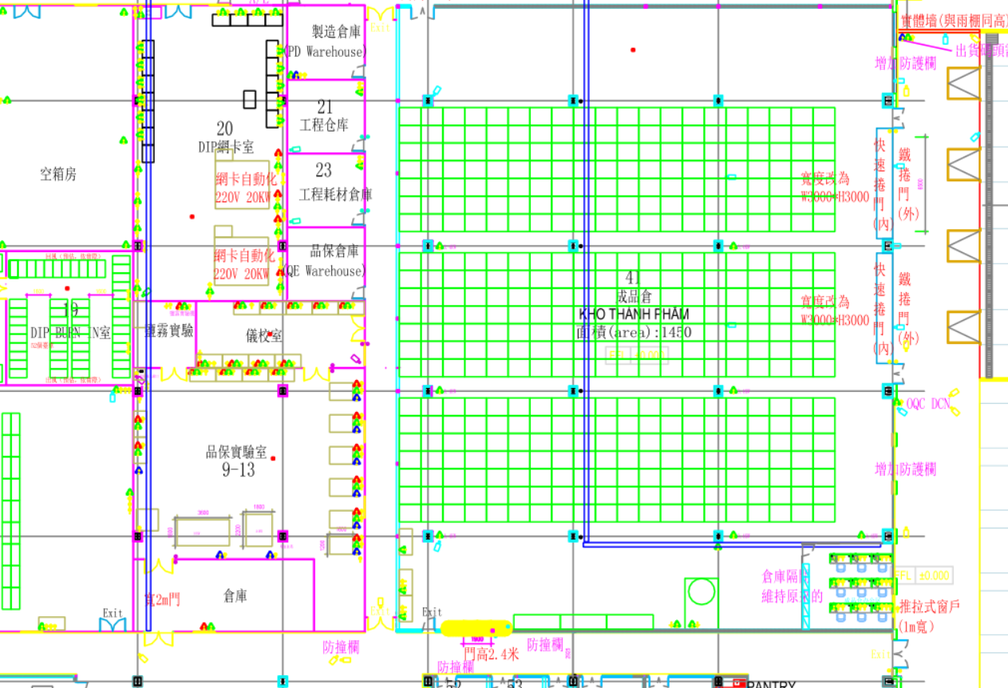
品保實驗室8條110m
線損約37dB可能需加放大器
X8(110m)
Total_2: 880m

Slide 3
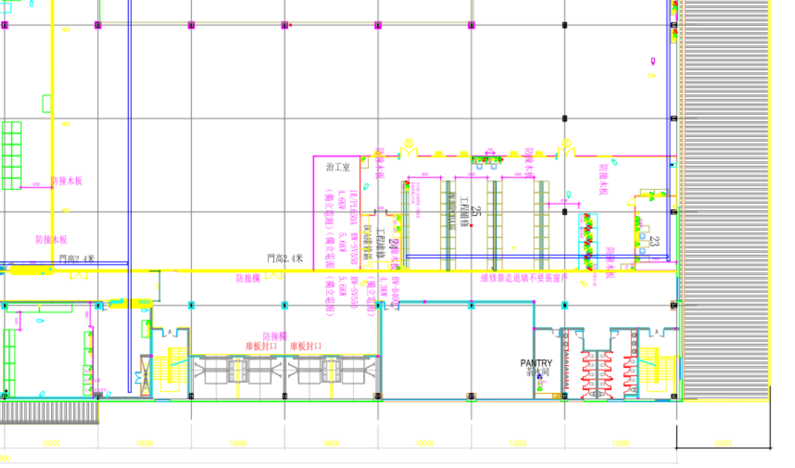
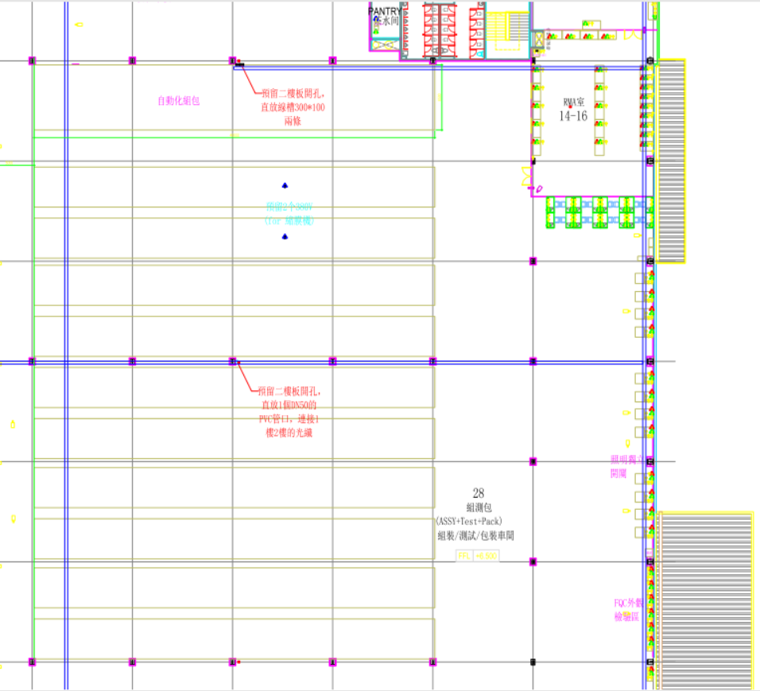
RMA
工程維修
X8(60m)
X4(40m)
X8(10m)
景宏頭端
X4(45m)
X4(50m)
X4(55m)
X4(60m)
FQC
X4(65m)
X4(70m)
X8(105m)
二樓佈置離頭端較遠可能需放大器
工程維修放至一個景宏頭端使用
X4(75m)
X4(80m)
X4(85m)
Total_3: 3900m
Total_1_2_3: 6600m

Slide 4
15m*4
20m*8
15m*4

Slide 5
18~30
30~42
5.8
7.4
9
10.6
12.2
13.8
15.4
17

Slide 6
Euro
NA
1010
~
1030
1031
~
1061
1130~
1160
1161~
1191
261
267
273
281
289
297
630
636
644
652
963
971
979
987
993
999
18~30
30~42
5.8
7.4
9
10.6
12.2
13.8
15.4
17

Slide 7
Euro
NA
1010
~
1030
1031
~
1061
261
267
273
630
636
987
993
999
18~30
5.8
7.4
9
10.6

Slide 8
Euro
NA
1010
~
1030
1031
~
1061
261
267
273
630
636
987
993
999

Slide 9
32 channel
833
~
1025
1026
~
1218
261
267
447
453
18~80
5.8
7.4
9
10.6
12.2
13.8
15.4
17

Slide 10
Euro
NA
32 channel
833
~
1025
1026
~
1218
261
267
447
453

Slide 11
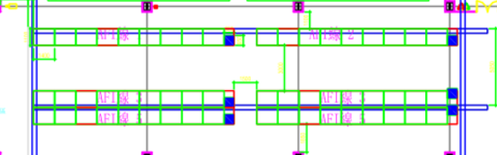
DS1
US1
0.3dB loss
Diplexer (204/258)
3.6dB loss
10dB loss
2way-Splitter
6way Splitter
自動化線
8.2dB loss
12dB loss
Loss: 0.3+3.6+10+8.2+12= 34.1 + cable loss
4way Splitter
8way Splitter
4 AFI station in 1 Line
8 port connection in 1 AFI station

Slide 12
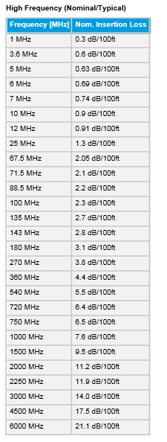

LOSS
L0: 0.3+8.2+8.2+12=28.7+calbe loss
L1: 0.3+8.2+8.2+12=28.7+calbe loss
L2: 0.3+8.2+8.2+12=28.7+calbe loss
L3: 0.3+8.2+8.2+12=28.7+calbe loss
L4: 0.3+3.6+8.2+12=24.1+calbe loss
L5: 0.3+3.6+8.2+12=24.1+calbe loss
L6: 0.3+3.6+8.2+12=24.1+calbe loss
L7: 0.3+3.6+8.2+12=24.1+calbe loss
L8: 0.3+3.6+8.2+12=24.1+calbe loss
L9: 0.3+3.6+8.2+12=24.1+calbe loss
DS1
US1
DS2
US2
DS3
US3
DS4
US4
Diplexer (204/258)
Diplexer (204/258)
Diplexer (204/258)
Diplexer (204/258)
0.3dB loss
RMA
1m = 0.26dB loss
X8(60m)
8.2dB loss
X4(40m)
4way Splitter
X4(45m)
3.6dB loss
X4(50m)
2way Splitter
X4(55m)
8.2dB loss
12dB loss
3.6dB loss
X4(60m)
FQC
4way Splitter
8way Splitter
2way Splitter
X4(65m)
X4(70m)
X8(105m)
3.6dB loss
4 station in 1 Line
8 port connection in 1 station
2way Splitter
X4(75m)
X4(80m)
X4(85m)

Slide 13
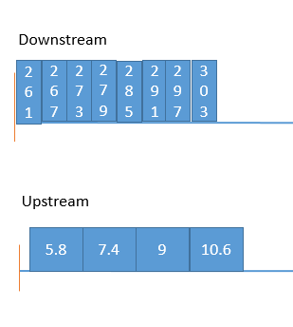
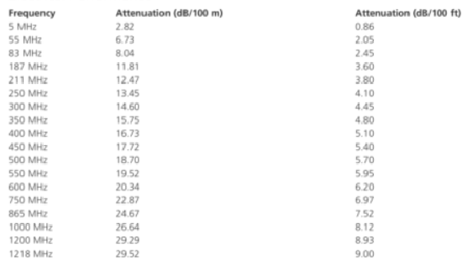
Put Downstream signal lower than 540MHz
5.5(540MHz)/30m = 0.18/1m
115m >> 0.18*115=20.7dB
LOSS
L0: 0.3+12+8.2+12=32.5+(40*0.18)=39.7
L1: 0.3+12+8.2+12=32.5+(45*0.18)=40.6
L2: 0.3+12+8.2+12=32.5+(50*0.18)=41.5
L3: 0.3+12+8.2+12=32.5+(55*0.18)=42.4
L4: 0.3+12+8.2+12=32.5+(60*0.18)=43.2
L5: 0.3+12+8.2+12=32.5+(65*0.18)=44.1
L6: 0.3+12+8.2+12=32.5+(70*0.18)=45
L7: 0.3+12+8.2+12=32.5+(75*0.18)=45.9
L8: 0.3+3.6+8.2+12=24.1+(80*0.18)=38.5
L9: 0.3+3.6+8.2+12=24.1+(85*0.18)=39.4
DS1
US1
DS2
US2
Diplexer (204/258)
Diplexer (204/258)
RMA
12dB loss
X8(60m)
8way Splitter
X4(40m)
X4(45m)
X4(50m)
X4(55m)
8.2dB loss
12dB loss
X4(60m)
4way Splitter
8way Splitter
FQC
X4(65m)
3.6dB loss
X4(70m)
X8(105m)
2way Splitter
4 station in 1 Line
8 port connection in 1 station
X4(75m)
X4(80m)
X4(85m)

Slide 14
組測包
Euro
NA
281
289
297
644
652
963
971
979
Downstream
261
267
273
279
285
291
297
303
Upstream
5.8
7.4
9
10.6

Slide 15
LOSS
L0: 0.3+12+8.2+12=32.5+(40*0.18)=39.7
L1: 0.3+12+8.2+12=32.5+(45*0.18)=40.6
L2: 0.3+12+8.2+12=32.5+(50*0.18)=41.5
L3: 0.3+12+8.2+12=32.5+(55*0.18)=42.4
L4: 0.3+12+8.2+12=32.5+(60*0.18)=43.2
L5: 0.3+12+8.2+12=32.5+(65*0.18)=44.1
L6: 0.3+12+8.2+12=32.5+(70*0.18)=45
L7: 0.3+12+8.2+12=32.5+(75*0.18)=45.9
L8: 0.3+3.6+8.2+12=24.1+(80*0.18)=38.5
L9: 0.3+3.6+8.2+12=24.1+(85*0.18)=39.4

Slide 16
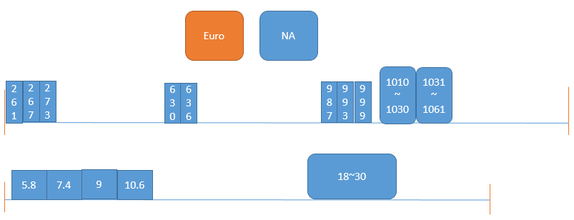
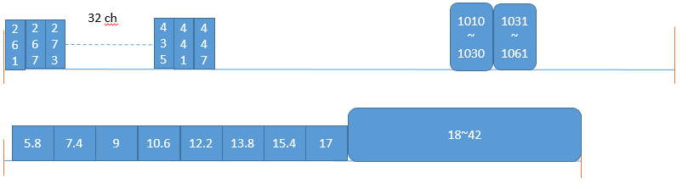
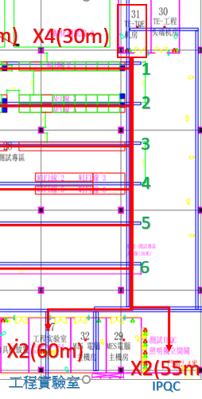
DS1
US1
DS2
US2
工程實驗室
IPQC
Diplexer (204/258)
Diplexer (204/258)
X dB loss
X dB loss
X dB loss
X dB loss
X-way Splitter
X-way Splitter
X-way Splitter
X-way Splitter

Slide 17
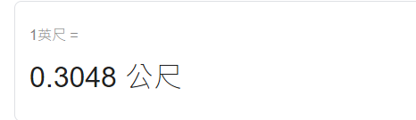
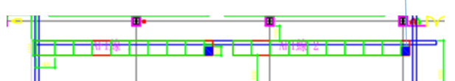
Line1, Line3
Brazil Test Line, Assembly Line
DS1
US1
Ds Pwr: 40dBmV
0.3dB loss
Diplexer (204/258)
Loss: 0.3+8.2+12+10(AFI)=30.5+cable loss
RF switch AFI inside:
100ft or 333m cable length are workable
1.2G =~ 8.2dB < 9.5(loss left)
8.2dB loss
12dB loss
4way Splitter
8way Splitter
4 AFI station in 1 Line
8 port connection in 1 AFI station

Slide 18
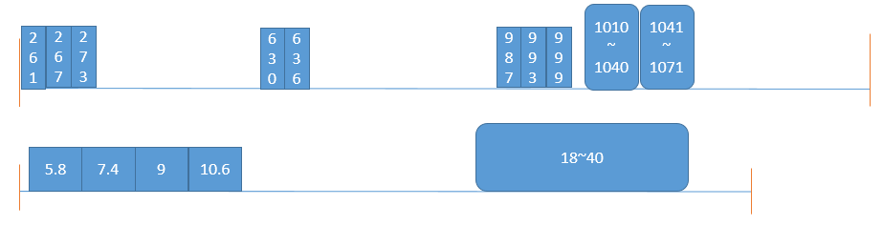
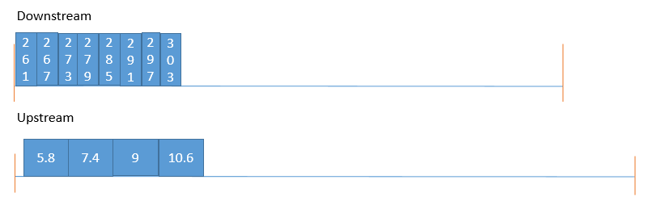
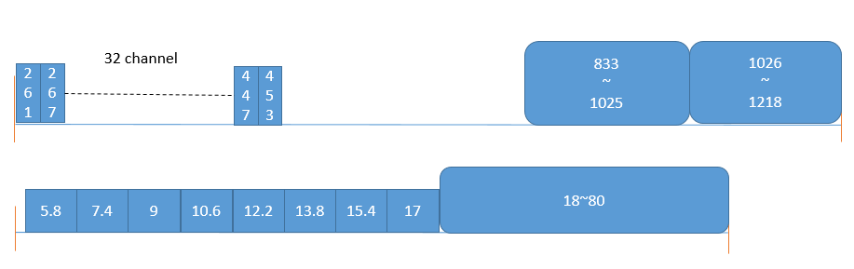
Brazil Test(Line1,2)
Brazil Assembly(Line3)
QA(Line4)

Slide 19
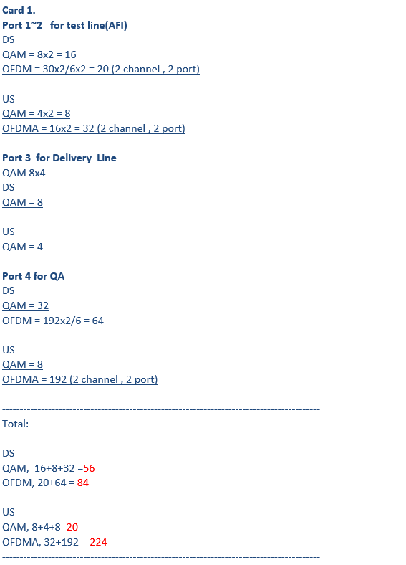

Slide 20
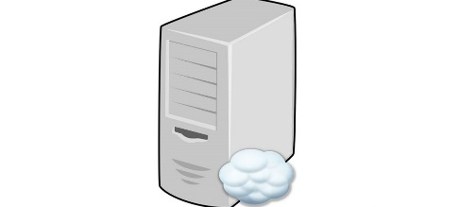


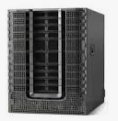


Cisco Smart Center
Switch
VLAN131,VLAN132
VLAN131
VLAN132
VLAN132
Test Line
MES
CBR8
PNR Server

