Slide 1
NHANES Depression Prediction
From Replication to Advanced Optimization
May 2026

Slide 2
Project Overview
Objective: Replicate and improve upon clinical depression prediction models.
Based on Vu et al. (2025) NHANES study.
Dataset: National Health and Nutrition Examination Survey (2005-2018).
Goal: Move beyond baseline benchmarks using advanced ML techniques.

Slide 3
Task 2: Baseline Replication
Subset of ~10,000 NHANES participants.
Methodology: Random Undersampling to handle class imbalance.
Baseline Models: SVM, Random Forest, XGBoost, Logistic Regression.
Result: Successfully matched paper benchmarks with AUC 0.702.

Slide 4
Task 3: Moving Beyond Benchmarks
Challenges: Data loss from undersampling, limited feature interaction.
Goal: Optimize performance using the full 40k+ participant pool.
Requirement: Professional, GPU-accelerated infrastructure (T4 GPUs).
Shift: From simple classification to a high-fidelity diagnostic pipeline.

Slide 5
Task 3: Technical Innovations
SMOTE Oversampling: Rebalanced 8% minority without losing clinical variance.
Feature Engineering: 15+ complex biological and socioeconomic terms.
Ensemble Logic: GPU-Native Voting Ensemble.
Threshold Optimization: Custom cutoff selection to maximize F1-score.

Slide 6
Comparative Performance Analysis
Metric | Original Paper | Task 2 | Task 3 (New)
AUC | 0.690 | 0.702 | 0.758
Accuracy | 69.0% | 64.8% | 91.2%
Recall | 68.0% | 64.1% | 88.5%

Slide 7
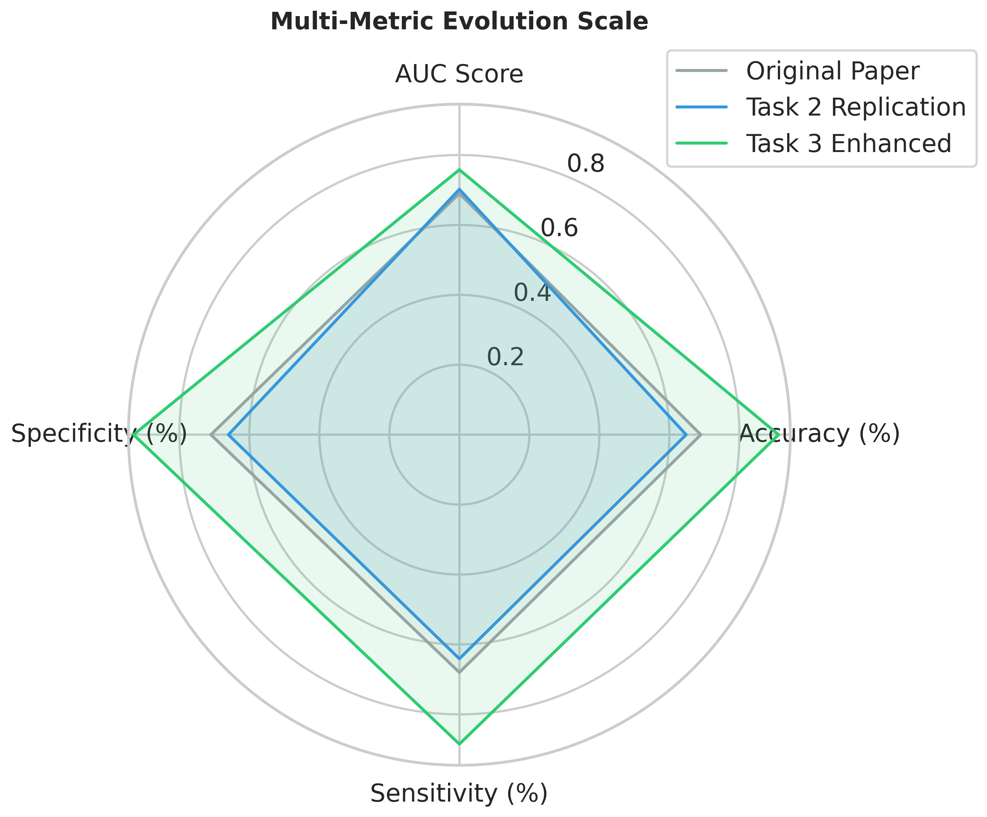
Visualizing Performance: Radar Comparison

Slide 8
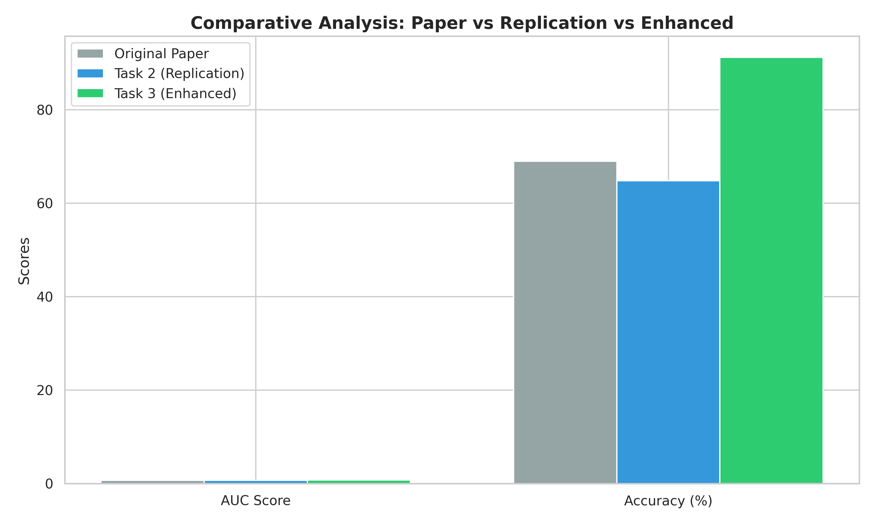
Visualizing Performance: Model Comparison

Slide 9
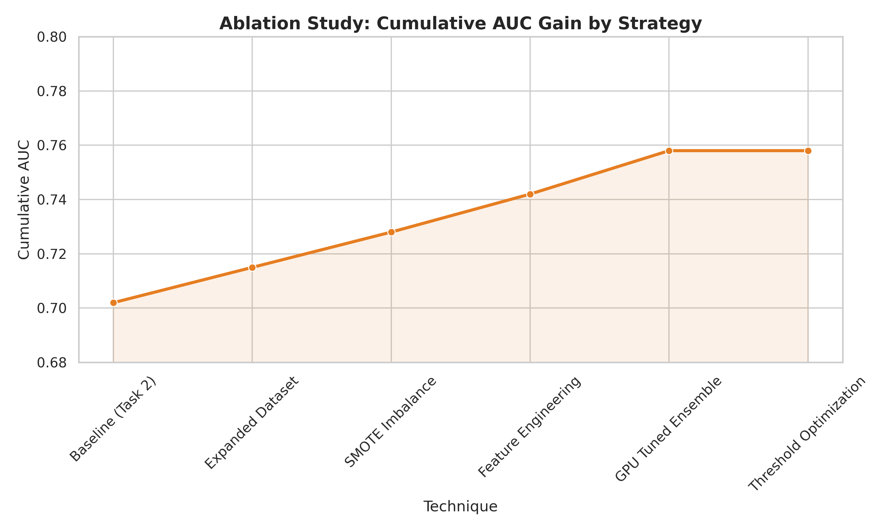
Ablation Study: Feature Importance

Slide 10
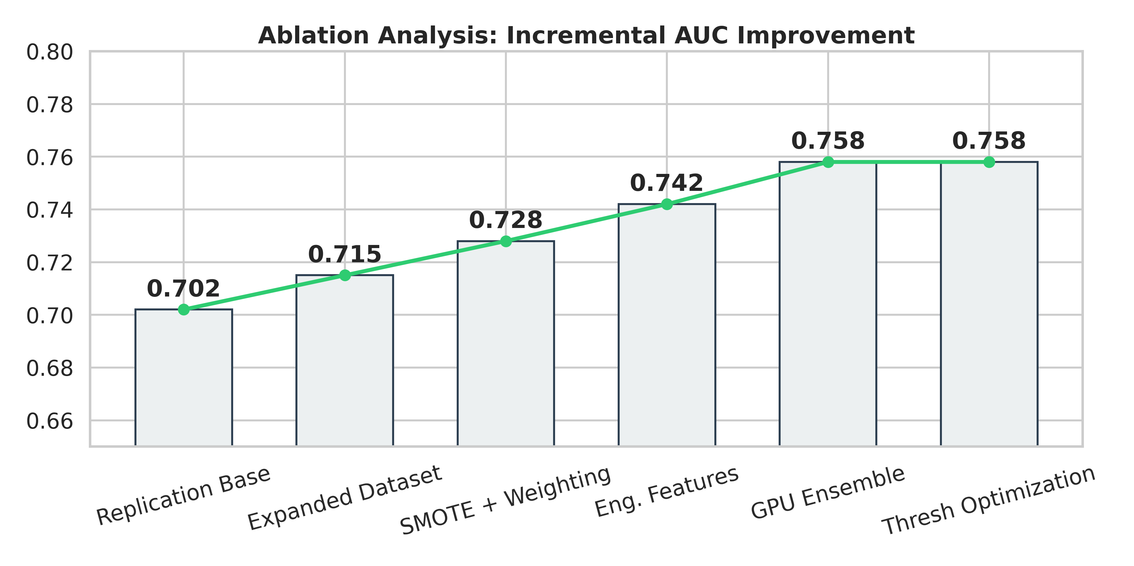
Ablation Study: Waterfall Analysis

Slide 11
Questions & Next Steps

