Slide 1


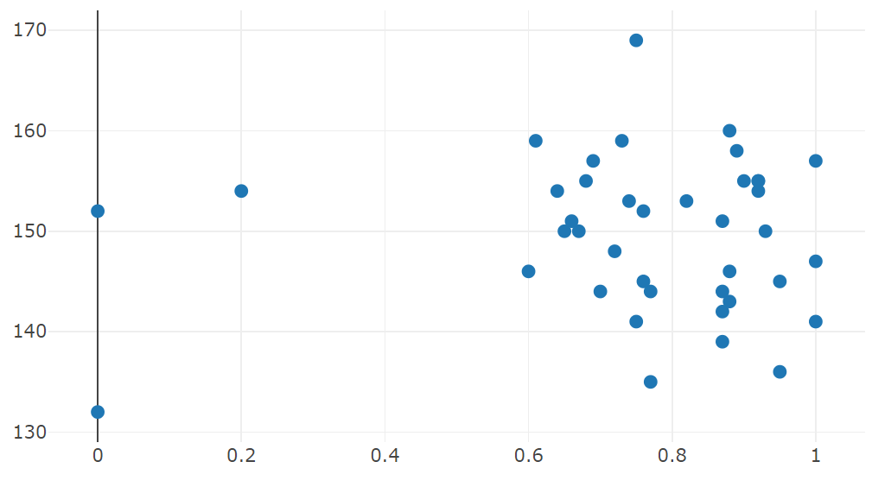
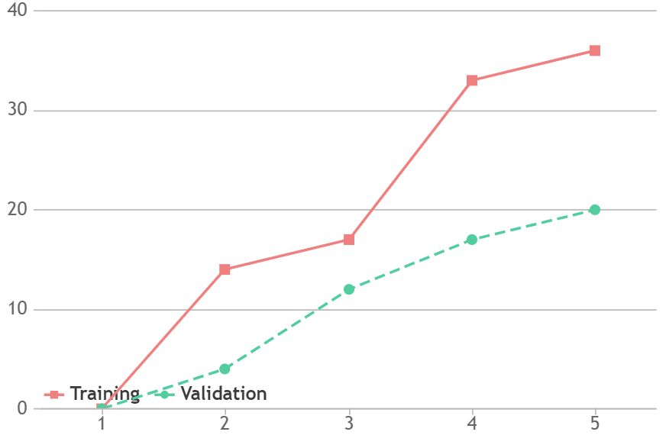
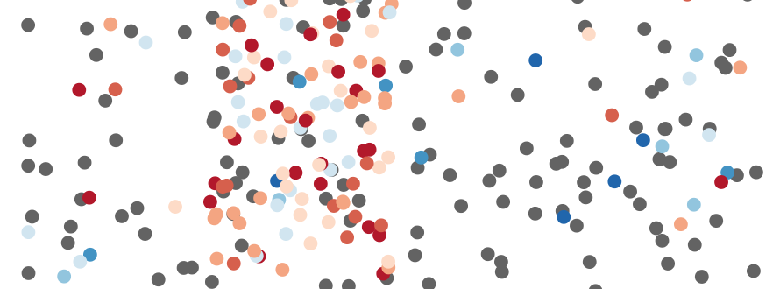

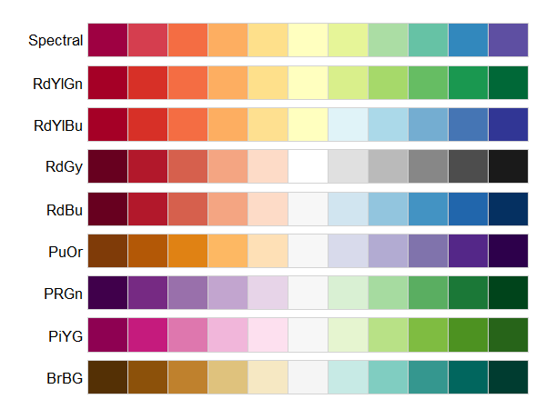
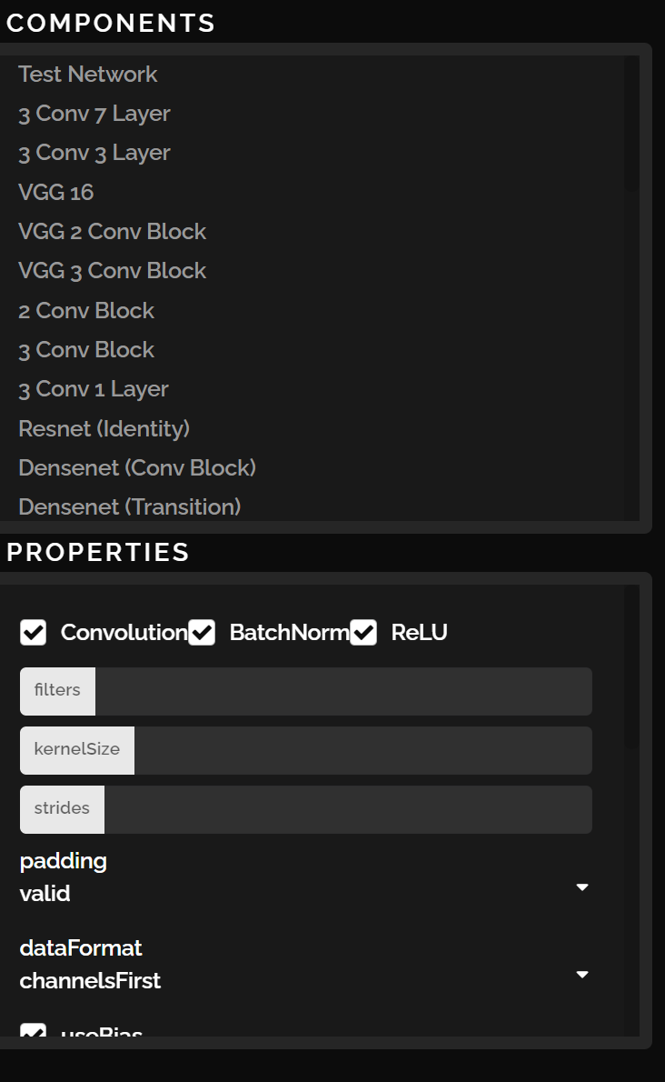


Block Information (B)
Search Space (C)
Accuracy Chart (D)
Block Frequency
Accuracy
Low Accuracy
High Accuracy
Fitness Score
Epochs
Lego View (A)
Example Convolutional Block

Slide 2
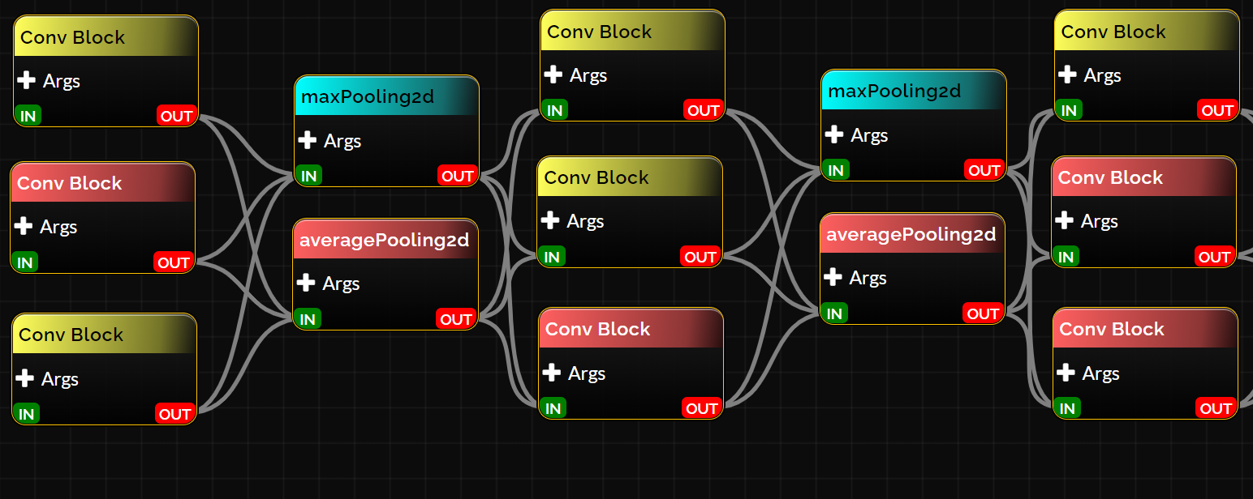
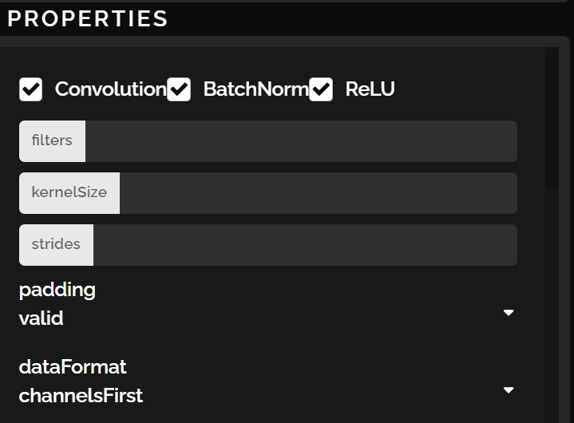

Layer 1
Layer 2
Layer 3
Layer 4
Layer 5

