Slide 1
OXYGEN CYLINDER MANAGEMENT SYSTEM

Slide 2
Team Members
Rounak Gangrade
Ramya M
Revanth
Risha Saha
Priyanshu Tyagi

Slide 3
Introduction
​​Oxygen Cylinder Management System is an application that allows user to book Oxygen cylinder from the comfort of their home.
The Application has four components Login, Registration, User, Admin.
Admin manages user interaction and registrations.
Person gets notified when new booking is done.
User can provide the cylinder and can also book a cylinder.
User can access cart to buy products as well.

Slide 4
Problem Statement
With the increase in the number of COVID patients, better management of oxygen cylinder system is required. The oxygen cylinder management system focuses on improving the management of oxygen cylinders in a city or town. “What If you can check whether a oxygen cylinder is available at the adequate place or not through your phone?” or “what if instead of having different contacts for persons you can just have one?”

Slide 5
Technology Used
Front End
HTML
CSS
Bootstrap
Angular 8
Back End
Oracle
Middleware
Spring Boot JPA

Slide 6
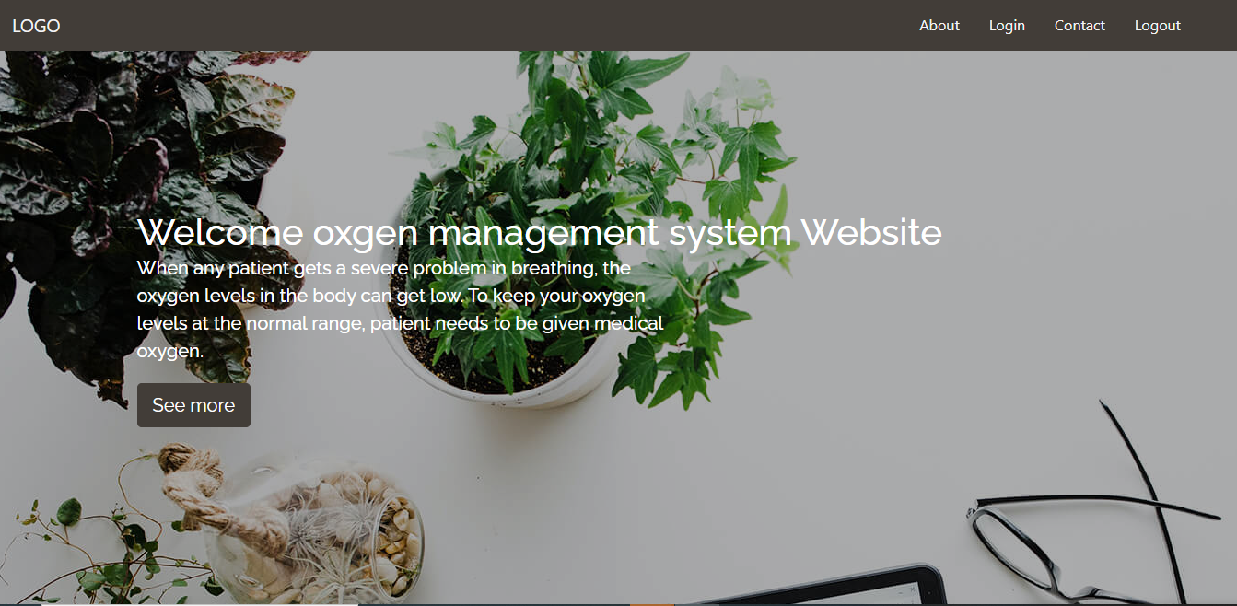
Demo

Slide 7
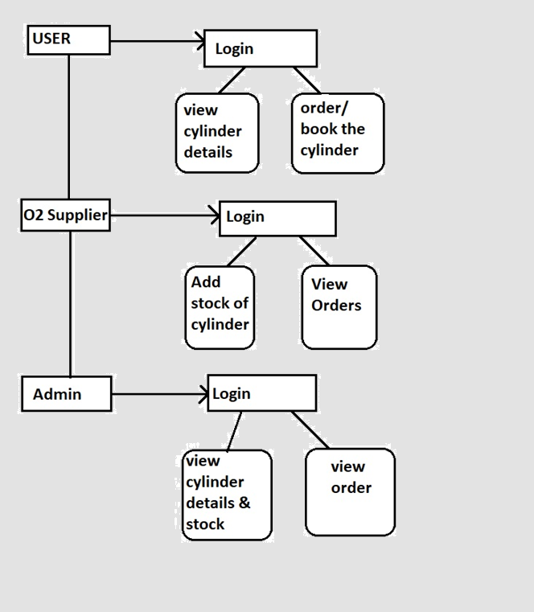
Application Flow Diagram

Slide 8
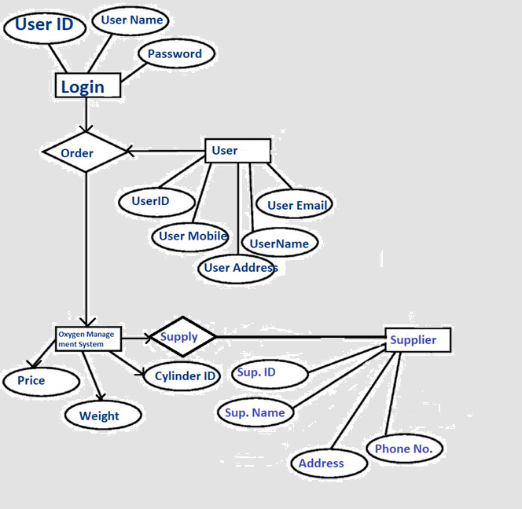
ER Diagram

Slide 9
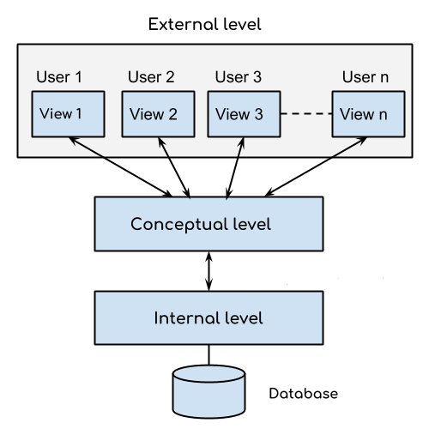
Database Architecture

Slide 10
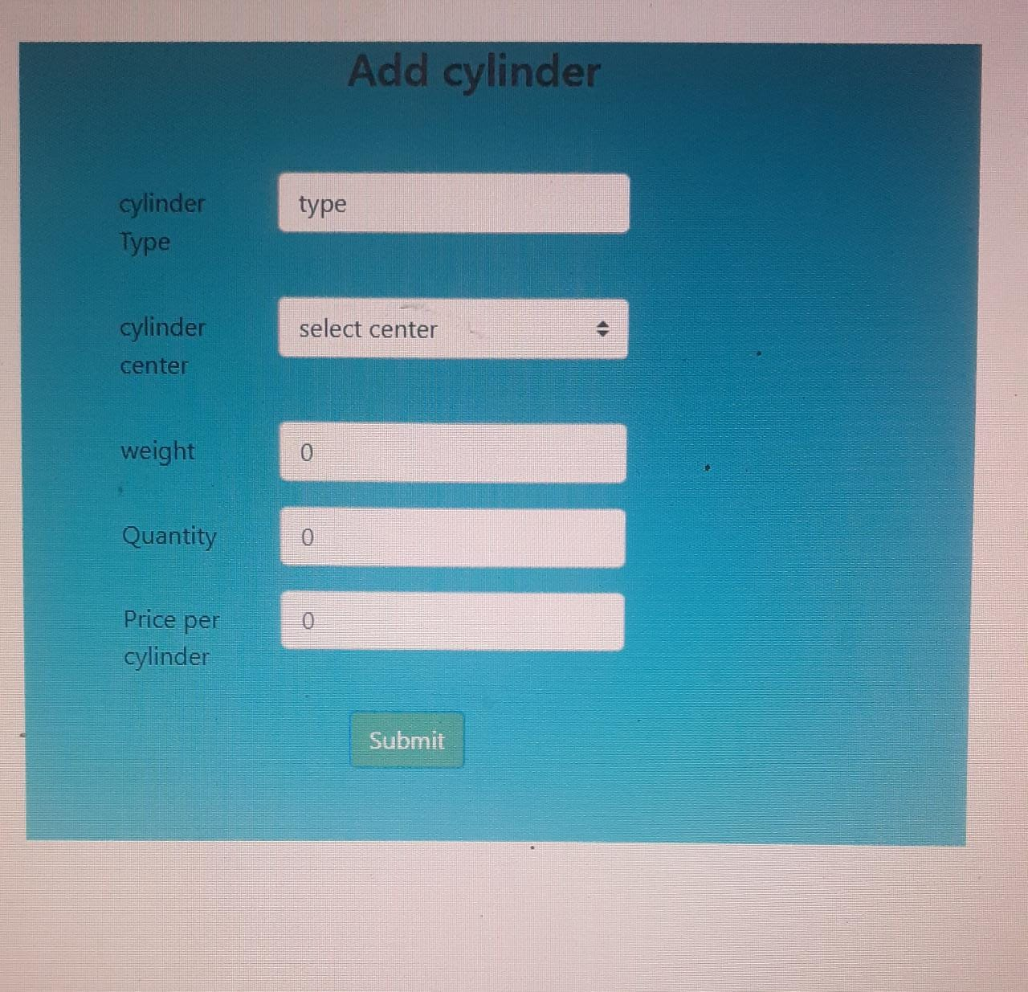
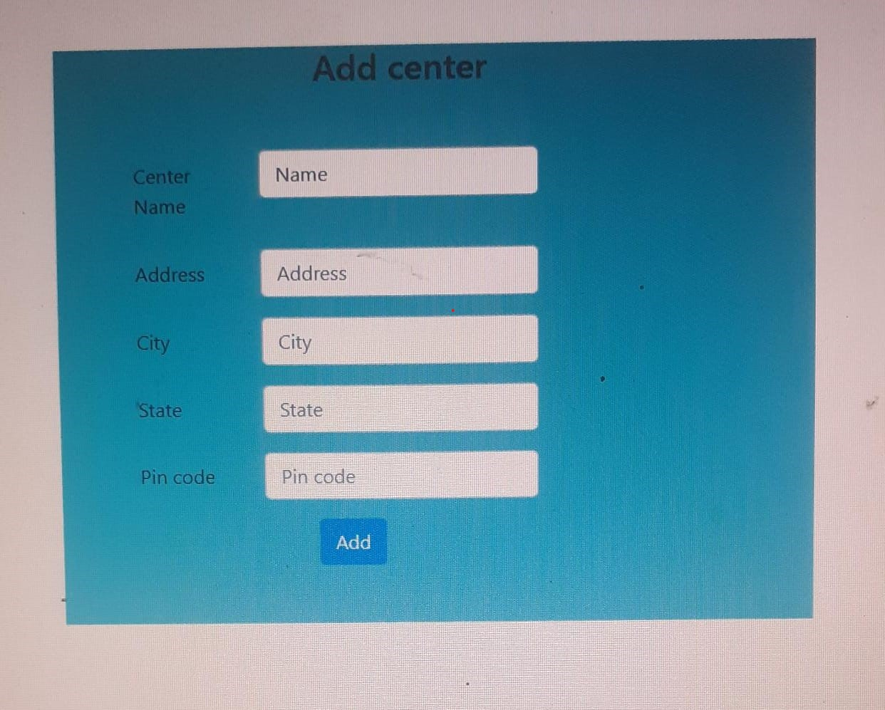
Screenshots

Slide 11
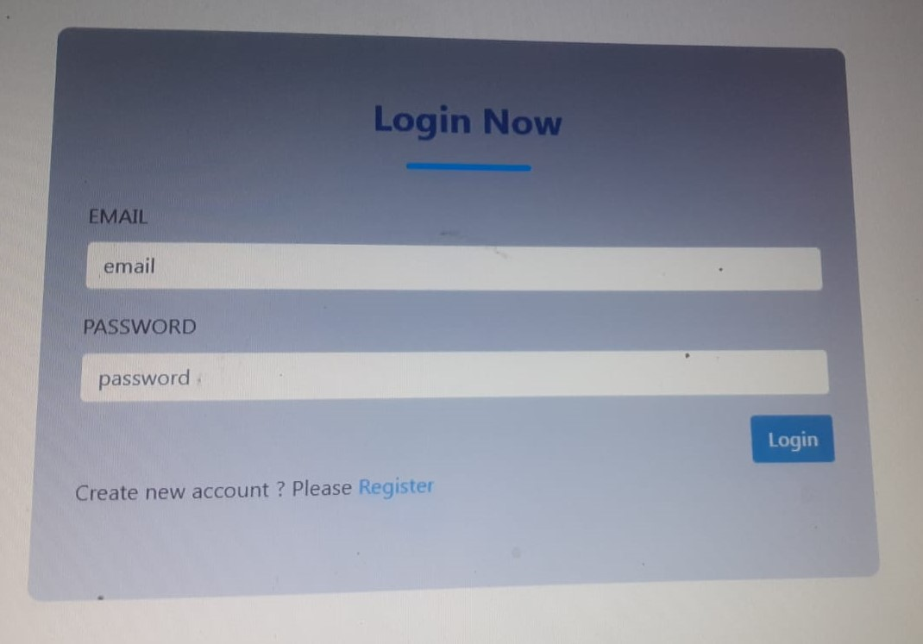
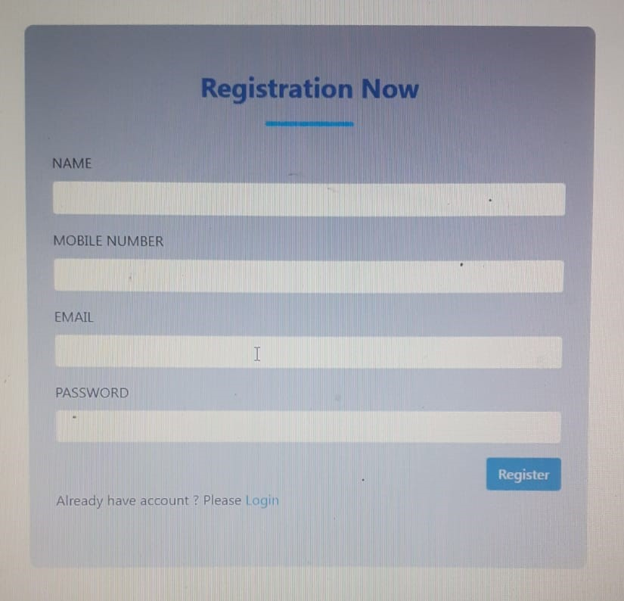
Screenshots

Slide 12
Conclusion
It will take care of the current cylinder detail at any point of time.
The cylinder booked, returned will update the current cylinder details automatically show that user will get the update current cylinder details.
The main purpose of this project is to reduce the manual work.
This software is capable of managing various cylinder details as well.
Generating various reports for record keeping according to end user requirements.

Slide 13
Thank You

