Slide 1
B.TECH ARTIFICIAL INTELLIGENCE & MACHINE LEARNING · CA2 CAPSTONE PROJECT
Decision Debt OS
Turning business decisions into measurable learning
Decision
Assumption
Forecast
Outcome
Name: Utsav Tyagi PRN: 26070126233 Branch: AI/ML
Division: C-3 Institution: Symbiosis Institute of Technology, Pune Academic Year: 2026-27
Notes:
Welcome. This project is Decision Debt OS, a decision-to-outcome tracking platform. The core idea in one line: mostteams track what happened, but almost nobody systematically records what they believed would happen before theyacted, and then checks whether that belief turned out to be true. We'll walk through the problem, the workflow, theprototype built on a synthetic customer-retention dataset, the real machine-learning results from that dataset, thearchitecture, and an honest look at differentiation, risk, and what's next. Please fill in your name, PRN, branch,division, institution and academic year in the placeholder bar before presenting or submitting.

Slide 2
THE PROBLEM
Decisions get made. Assumptions get forgotten.
Decision
made
Assumption
forgotten
Outcome
unclear
Same mistake
repeated
REPEATS
Dashboards and BI tools show what happened. Project trackers show what is scheduled. Neither one records what a team believed would happen before they acted — so when the belief turns out to be wrong, nothing captures that it was ever tested, and the same unexamined assumption drives the next decision.
The Problem
DECISION DEBT OS
02 / 18
Notes:
Teams make important, recurring decisions (pricing a discount, launching a feature, changing an onboarding flow)without ever writing down the measurable belief behind the decision. A dashboard will later show churn went up ordown, but it won't show whether that matched what the team expected, by how much, or why. Because the originalassumption was never captured in a structured, queryable way, nobody can systematically check it later, and the sameflawed assumption quietly resurfaces in the next planning cycle. This is the gap Decision Debt OS targets: notreporting on outcomes, but closing the loop between a stated belief and what actually happened.

Slide 3
LITERATURE REVIEW — LAST 3 YEARS
Four Recent Papers, Four Different Gaps
AUTHOR(S) & YEAR | TITLE | PROS | CONS | DIFFERENTIATION FROM DECISION DEBT OS
Scheibel & Rinderle-Ma (CAiSE 2023) | An End-to-End Approach for Online Decision Mining and Decision Drift Analysis | Monitors decision rules at runtime, not just after the fact; detects “decision drift”; validated on 4 synthetic + 1 real-life log | Tracks how an automated decision RULE changes — not whether a human's stated assumption about an outcome came true; needs existing event logs | We track a human assumption vs. a measured outcome; they track automated rule drift inside a process log — adjacent problem, different object
Goossens, De Smedt & Vanthienen (2024, KU Leuven) | Extracting Process-Aware Decision Models from Object- Centric Process Data | First object-centric decision-mining algorithm (IODDA); discovers decision structure + rules directly from logs; open benchmark released | Purely retrospective — reconstructs a model from data that already exists; can't recover an assumption that was never logged; no deadline/validation concept | We capture the assumption BEFORE the outcome is known (forward-looking); they mine structure AFTER the fact (backward-looking) — complementary, not a substitute
Natarajan, Mathur, Sidheekh, Stammer & Kersting (AAAI-25) | Human-in-the-loop or AI-in- the-loop? Automate or Collaborate? | Directly tackles when to automate a decision vs. keep a human in control; argues evaluation over-weights the model, under-weights the human expert | A conceptual/positional framework, not a deployable system; no mechanism to record or later validate the human's stated assumption | We operationalise exactly this division of labour: the model scores risk, a human approves + states the assumption, the system checks the outcome later
Gruetzemacher, Lee & Paradice (2024) | Calibration Training for Improving Probabilistic Judgments Using an Interactive App | Shows forecast calibration can be measurably improved with short, repeated feedback — supports asking for a stated confidence number | Small exploratory study (153 students, a sports-forecasting tournament); trains general forecasting skill, not tied to any business decision or metric | We don't train forecasting skill in the abstract — we capture a one-off, decision-specific forecast and check it against a real business metric
All four papers published 2023–2025 (peer-reviewed / top-tier preprint) — verified titles, authors and venues. See References for full citations.
Literature Review
DECISION DEBT OS
03 / 18
Notes:
Four recent, verified papers, each covering a different piece of the 'existing technology' this project sits beside.Scheibel and Rinderle-Ma (CAiSE 2023) monitor automated decision rules at runtime and flag when they drift. That isclose in spirit, but the object being tracked is a rule inside a process log, not a human's stated businessassumption. Goossens, De Smedt and Vanthienen (2024, KU Leuven) mine decision structure from object-centric logsafter the fact. That is valuable, but strictly backward-looking, so it can never recover an assumption nobody loggedin the first place. Natarajan et al. (AAAI-25) argue for a clearer division between automated and human-controlleddecisions, which is exactly the division Decision Debt OS operationalises: the model scores risk, a human approvesand states the assumption, the system checks the outcome later. Gruetzemacher, Lee and Paradice (2024) show forecastcalibration can be trained, direct support for asking decision-makers to state a confidence number, though theirintervention trains general forecasting skill in the abstract rather than tracking one specific, real businessdecision. Together these four papers cover runtime rule-monitoring, retrospective decision mining, human/AI decisionauthority, and forecast calibration, four adjacent pieces, none of which close the full assumption-to-outcome loopthe way this project does.

Slide 4
CORE INSIGHT
A decision is not finished when it is made.
“A business decision is incomplete until its original assumption is compared with the real-world outcome.”
This gap has a name:
Decision Debt — the accumulation of decisions whose assumptions were never checked against reality.
Core Insight
DECISION DEBT OS
04 / 18
Notes:
This is the thesis of the whole project. Borrow the idea of technical debt: shortcuts in code that aren't fixedaccumulate and quietly slow a team down. The same thing happens with decisions. Every decision made without astated, checkable assumption, or whose assumption was stated but never verified, is a small piece of debt.Individually each one looks harmless. It's just one discount campaign, one feature flag. Collected across a year, anorganisation is running on dozens of untested beliefs it has forgotten it is relying on. Decision Debt OS exists tomake that debt visible, the same way a linter makes code debt visible.

Slide 5
DEFINING THE PROBLEM
What Is Decision Debt?
Unresolved Assumptions
A decision was made, but its underlying belief was never written down in a checkable form.
Overdue Reviews
A deadline for checking the outcome has passed, and no one has looked at the result.
Invalidated Assumptions Still Driving Work
The assumption was checked, found false, but the decision or policy it justified is still active.
Repeated Forecasting Errors
The same type of assumption keeps failing across different decisions, and no one notices the pattern.
Defining Decision Debt
DECISION DEBT OS
05 / 18
Notes:
Decision Debt has four recognisable forms, and this dashboard view is how the product would actually show them to ateam. First, unresolved assumptions: decisions live in Slack or meeting notes with no structured, checkable beliefattached. Second, overdue reviews: a review deadline passed and nobody looked. Third, and most dangerous, isinvalidated assumptions still driving work. The team found out the belief was wrong, but the policy built on it isstill running, costing money every day it continues. Fourth, repeated forecasting errors: the same kind ofoverconfident or miscalibrated forecast keeps showing up across unrelated decisions, which is a signal about theforecaster or the process, not just one bad call. None of these are visible in a normal project tracker, becausenone of them are about task status. They are about belief status.

Slide 6
THE SOLUTION
Capture → Structure → Forecast → Measure → Evaluate → Learn
Capture
Natural-language
decision note
Structure
Fields extracted
& validated
Forecast
Confidence +
target set
Measure
Live metric
tracked
Evaluate
State assigned
at deadline
Learn
Pattern fed back
to next decision
“Let's offer the 10% discount to high-risk customers — I think it'll cut churn to around 18% within a month.”
STRUCTURED DECISION RECORD
INTERVENTION 10% retention discount
TARGET METRIC 30-day churn, high-risk cohort
FORECAST 25% → 18%
CONFIDENCE 62%
DEADLINE +30 days
UNSTRUCTURED INPUT
The Solution
DECISION DEBT OS
06 / 18
Notes:
This is the core product loop. A manager types a sentence the way they already talk, with no form-filling up front.An LLM-assisted capture step extracts the structured fields: the intervention, the target metric, the forecastnumbers, and a deadline. The system then asks for one more number that most teams never state out loud, a confidencelevel, because a forecast without a stated confidence can't later be checked for calibration. From that point thedecision is a row in a database, not a sentence in a chat thread, so it can be measured, reviewed, and eventuallymarked validated or invalidated.

Slide 7
WORKED EXAMPLE
One Decision, Fully Specified
“We believe a 10% retention discount will reduce 30-day churn among high-risk customers from 25% to 18%.”
OWNER
Retention Lead, Growth Team
CONFIDENCE (FORECAST)
62% self-reported probability
INTERVENTION
10% discount, auto-applied at checkout
TARGET METRIC
30-day churn rate, high-risk cohort
DEADLINE
30 days from decision date
ESTIMATED COST
~$4.80 / customer (10% of avg. order)
KILL CONDITION
If interim churn > 25% at day 15, stop offer
ACTUAL RESULT
Pending — 30-day window not yet elapsed
Baseline shown here (25%) is one risk-tier definition; the dataset's observed high-risk cohort baseline is 37% — see Slide 7.
Worked Example
DECISION DEBT OS
07 / 18
Notes:
This is what one row in the decision database actually looks like: every field a human filled in or confirmed beforethe decision went live. Note the 'kill condition': an explicit rule for when the team would abandon the interventionearly, which most decisions never specify. And note 'Actual result' is honestly marked pending. In a live deploymentthis field only populates once the deadline passes and the metric pipeline has enough data; for this capstone demoit is the dataset's synthetic timestamp horizon that limits a fully closed example, which we show in the evaluation-engine slide instead using a simulated batch of decisions.

Slide 8
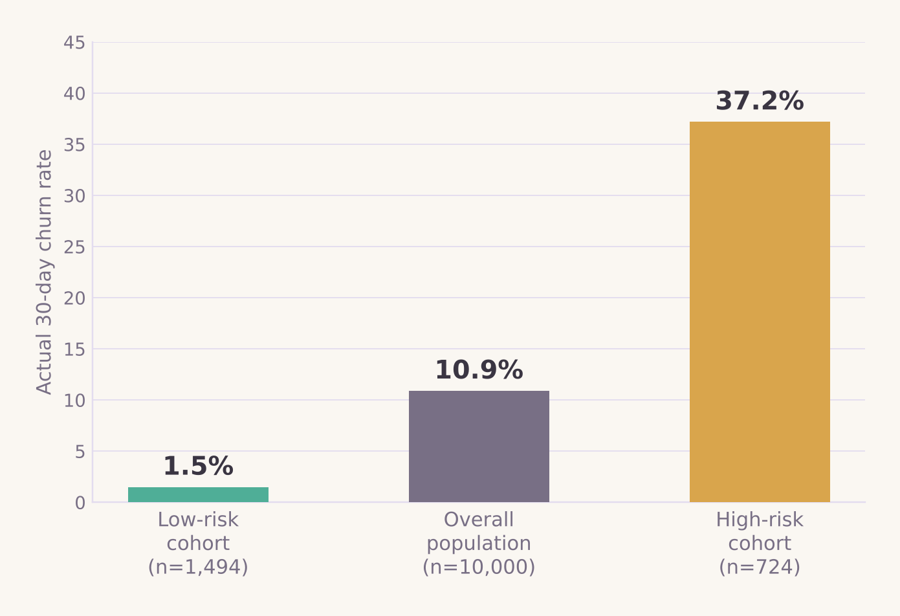
DATASET & PIPELINE — SYNTHETIC, FOR DEMONSTRATION ONLY
From Customer Record to Decision Evaluation
Customer
profile
Churn-risk
prediction
Retention
decision
Treatment /
control group
30-day
outcome
Decision
evaluation
SYNTHETIC CUSTOMER-RETENTION DATASET
RECORDS 10,000 fictional customer rows
FIELDS age, gender, country, income, spending score, purchases, avg. order value, membership years, site visits/mo, cart-abandon rate, churn flag, feedback text, last purchase date
STATUS Clearly labelled synthetic data — used for demonstration only; not a real company's data
Real, observed churn rate by risk segment
Dataset & Pipeline
DECISION DEBT OS
08 / 18
Notes:
This is the one dataset used across the whole prototype, and it is explicitly synthetic and fictional, generated fordemonstration, with no link to any real company or real customers. The pipeline shows how a raw customer row becomesa decision record: a churn-risk score is computed per customer, a retention decision is attached to the highest-riskcustomers, those customers are conceptually split into a treated group and a held-out comparison group, a 30-dayoutcome window is observed, and the decision-evaluation engine assigns a validation state. The chart on the right isreal, not illustrative: computed directly from the uploaded dataset. Customers matching a high-risk profile (cart-abandonment at or above 70% and a spending score at or below 25) actually churn at 37.2% within this dataset,against 1.5% for a clearly low-risk profile and 10.9% overall. That gap is what makes risk-based targeting worthdoing in the first place.

Slide 9
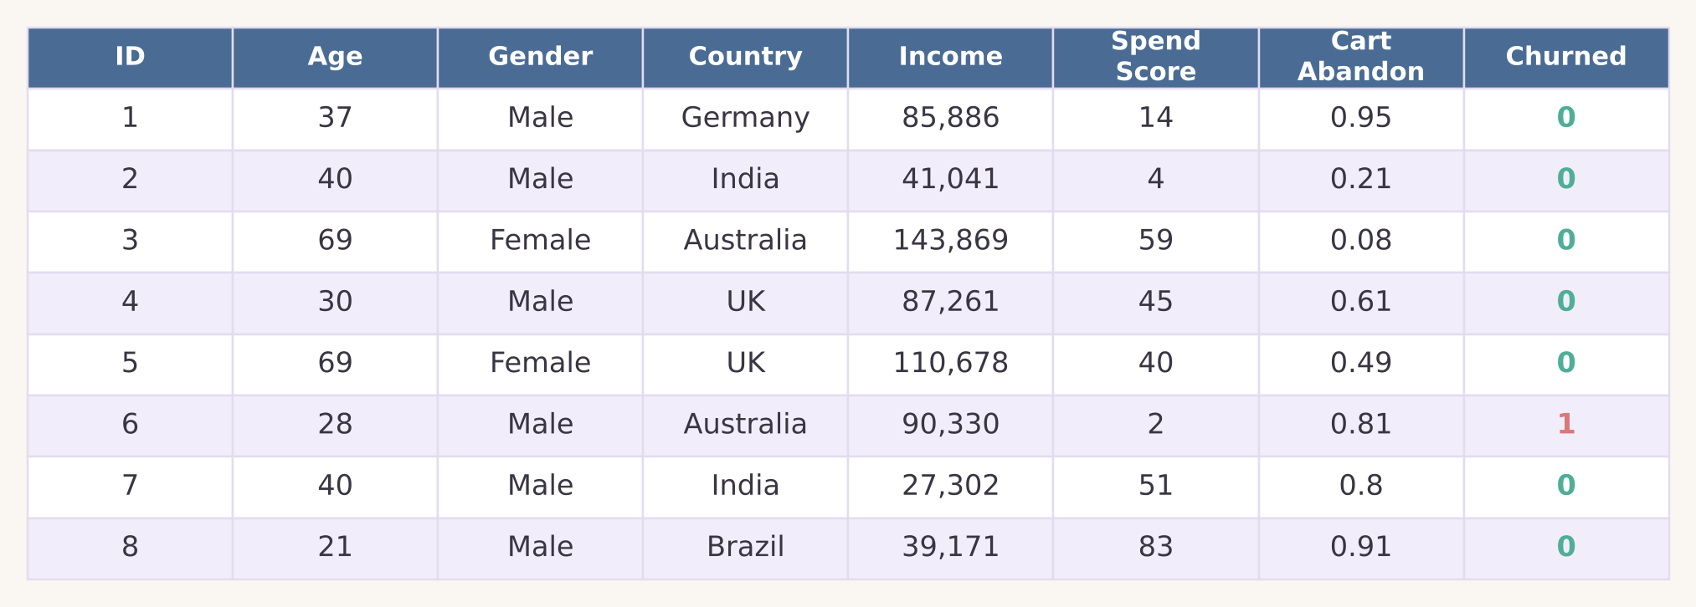
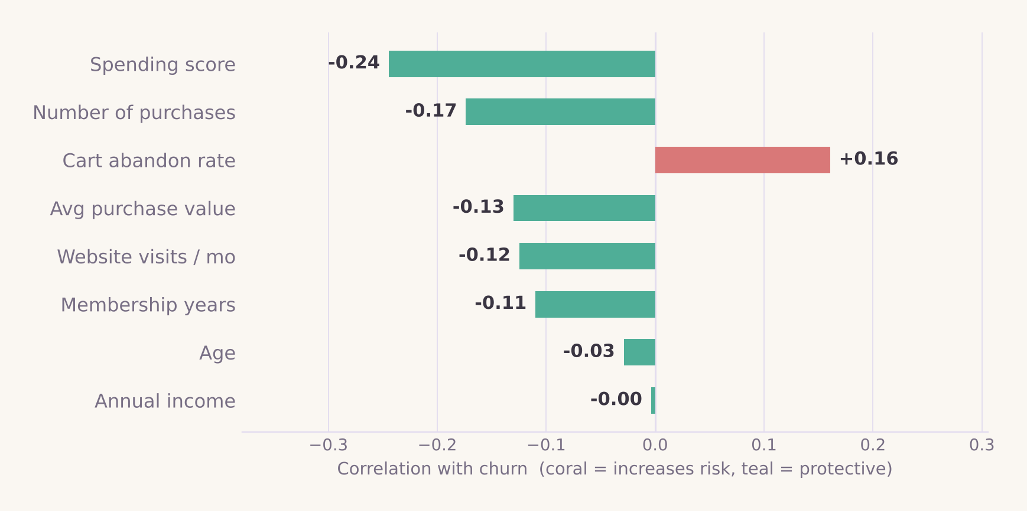
DATASET PREVIEW
What the Raw Rows Actually Look Like
First 8 rows of Customer_Transactions.csv
(8 of 14 columns shown)
Which features actually move churn
(real, signed correlations)
10,000 rows × 14 columns
Clearly labelled synthetic / fictional data, generated for this project — not drawn from any real company's customers. No column was dropped or reshaped for this preview; these are the literal supplied values.
Cart-abandon rate is the only feature that increases churn risk among these eight — everything else (spending, purchase frequency, tenure) is protective. This matches the model's own feature-importance ranking one slide over.
Dataset Preview
DECISION DEBT OS
09 / 18
Notes:
Two real views of the same raw data. On top, the first eight rows of the actual CSV exactly as supplied. Nothing wassynthesized for the slide, this is what training data for this project literally looks like, row by row. Below,correlation coefficients between each numeric feature and the churn flag, computed directly on the full 10,000-rowdataset. Note this is correlation, not the model's feature importance. They're computed differently, but they agreehere: spending score and purchase count are the strongest protective signals, cart-abandon rate is the strongestrisk signal, and age and income barely matter. That agreement between two independent statistical views is a smallbut real piece of evidence that the model learned something real in the data, not noise.

Slide 10
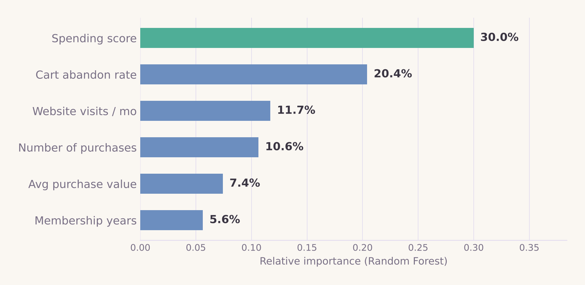
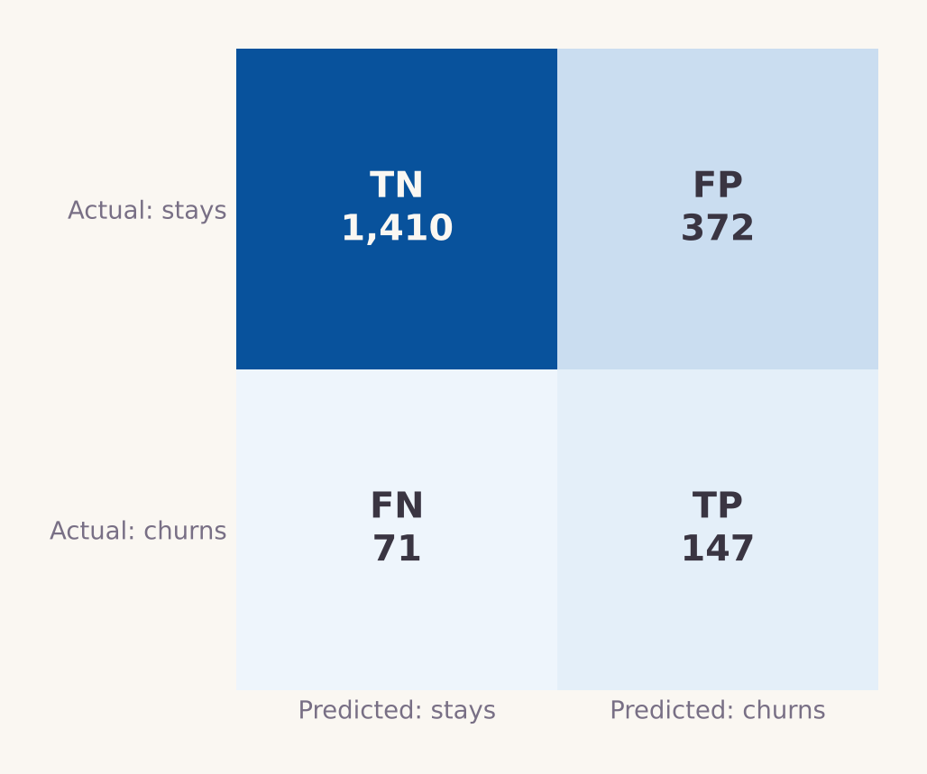
MACHINE LEARNING COMPONENT
Predicting Risk, Not Proving Causation
HOW IT'S BUILT
TASK Binary classification — churned vs. retained
FEATURES Spending score, cart-abandon rate, site visits/mo, purchases, avg. order value, membership years, income, age, gender, country
PREPROCESSING Standardization (numeric) + one-hot encoding (categorical)
SPLIT 80 / 20 train-test, stratified by class
MODELS COMPARED Logistic Regression vs. Random Forest (300 trees)
0.28
Precision
0.67
Recall
0.40
F1-score
0.84
ROC-AUC
Random Forest · held-out test set · n = 2,000 (live, reproducible — same numbers the running Verdikt prototype shows)
Top churn-risk drivers
Confusion matrix
A model that flags churn risk does not prove an intervention caused a customer to stay — prediction identifies candidates for a decision; it does not validate the decision's outcome.
Machine Learning
DECISION DEBT OS
10 / 18
Notes:
These are the real, calculated numbers from training on the uploaded dataset. Nothing here is a placeholder, andthese are the exact numbers the live Verdikt prototype shows too, since both run the identical training script.Churn is imbalanced at 10.9%, so we used class-weighted models and optimised for recall over precision: catchingtrue churners matters more than being right every time we flag someone, because the cost of a missed at-riskcustomer is higher than the cost of one unnecessary discount. Random Forest reaches 0.67 recall and 0.84 ROC-AUC at0.28 precision. The confusion matrix on the left shows exactly where those errors land: a sizeable false-positivecount, which is expected and acceptable because this score feeds a human-reviewed decision, never an automaticaction. Spending score and cart-abandon rate dominate feature importance, matching the raw correlations in the datashown on the previous slide. The callout at the bottom is the single most important caveat in the whole deck: thismodel ranks risk, it does not and cannot show that any specific retention action caused a customer to stay. Thatrequires a controlled comparison, which is what the evaluation engine is for.

Slide 11
SYSTEM ARCHITECTURE
Seven Layers, One Feedback Loop
User Interface
Where a manager types a decision in plain language
Decision Capture Layer
Parses the note into a draft structured record
Assumption & Metric Layer
Binds the decision to one measurable target metric
ML Risk-Prediction Layer
Scores churn risk to prioritise which customers/decisions matter
Data Integration Layer
Pulls in product, billing and CRM data to track the metric live
Outcome Evaluation Engine
Checks deadline, sample size and target at review time
Decision Debt Dashboard
Shows every decision's state — and what's overdue or invalidated
BUILT WITH (REAL, RUNNING PROTOTYPE)
Python
FastAPI
SQLAlchemy
Scikit-learn
React + TypeScript
System Architecture
DECISION DEBT OS
11 / 18
Notes:
Seven layers, each with one job, connected top to bottom in one direction except for the feedback that flows backfrom the dashboard into future decisions. The UI captures intent in natural language; the capture layer turns itinto a draft record; the assumption-and-metric layer forces a single, bound target metric rather than vague successcriteria; the ML layer scores risk to help prioritise which customers or segments a decision applies to; the data-integration layer pulls in the live numbers needed to actually measure the metric over time from product, billing orCRM systems; the evaluation engine runs the four checks at review time; and the dashboard is where a team sees everyopen, overdue, or invalidated decision at a glance. This is not a hypothetical stack. It's what the actual workingVerdikt prototype is built on, shown running on the next slide: FastAPI and SQLAlchemy for the backend and datalayer, Scikit-learn for the risk model, React and TypeScript for the dashboard UI. Boring, well-understoodtechnology on purpose. The value is in the workflow, not the tooling.

Slide 12
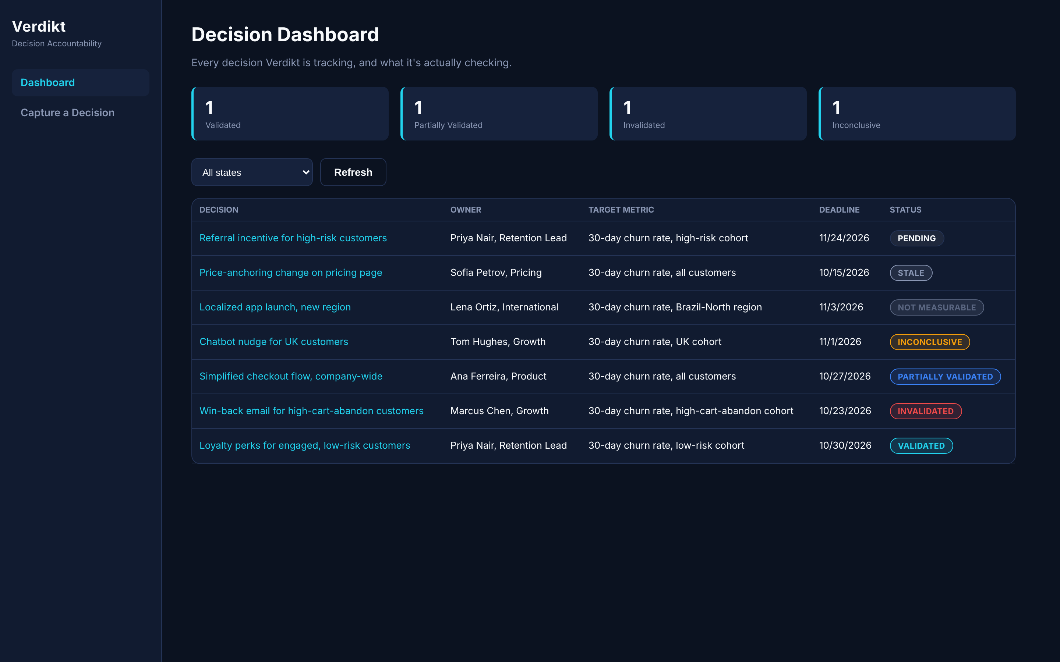
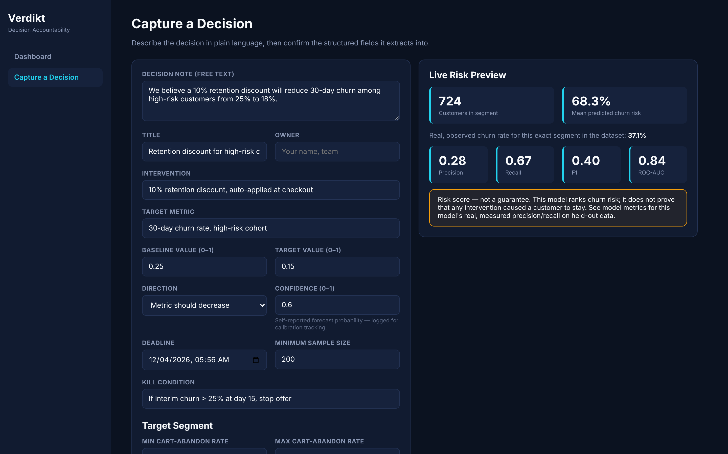
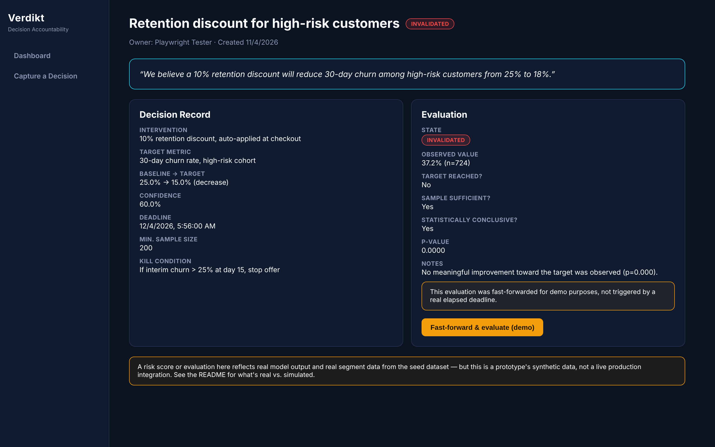
WORKING PROTOTYPE — VERDIKT
Not a Mockup. A Running Application.
Decision Dashboard
Capture — Live Risk Preview
Decision Detail — Evaluated
7 seeded decisions, every validation state represented
Real segment scoring as the form is filled in
Real p-value, real state: Invalidated
All three screens captured from the actual running app (FastAPI backend + React frontend, real SQLite data) — not a design mockup.
Working Prototype
DECISION DEBT OS
12 / 18
Notes:
This is the single strongest piece of evidence in the whole deck: three real screenshots, captured from the actualrunning Verdikt prototype with a headless browser, not designed in Figma. Left: the dashboard loaded with sevenseeded decisions, one for each of the six validation states plus a pending example, with color-coded status badges,filterable by state. Middle: the Capture screen mid-use, with the live risk-preview panel on the right actuallycalling the trained model as the form's segment filters change. That 68.3% mean churn risk and 724-customer segmentsize are real numbers from a real API call, not hardcoded. Right: a newly created decision after clicking 'fast-forward and evaluate'. The evaluation engine computed a real p-value of 0.0000 and assigned Invalidated, visiblylabelled as a demo fast-forward rather than a real elapsed deadline. If asked in a viva: yes, this can be run live,right now, with two terminal commands documented in the project's README.

Slide 13
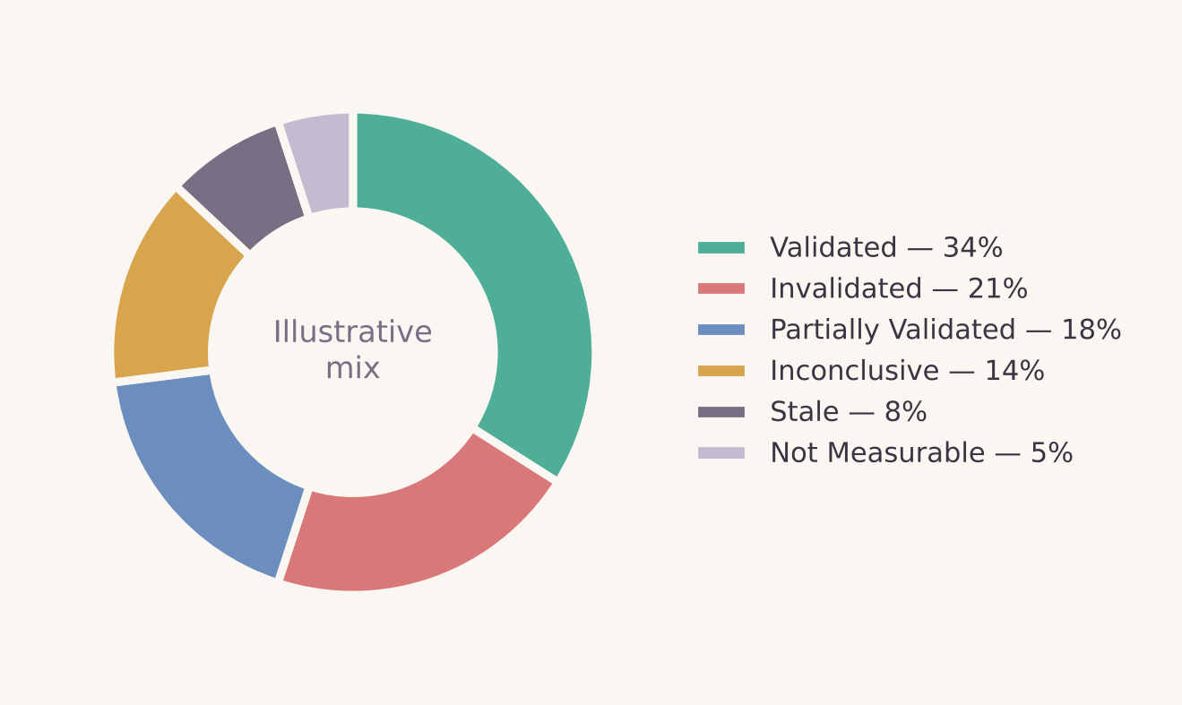
DECISION EVALUATION ENGINE
Four Checks, Six Possible States
Was the target metric reached?
Illustrative state mix — simulated for demonstration
Has the review deadline passed?
Was the sample size large enough to trust the result?
Is the result statistically conclusive, or still noisy?
Validated / Invalidated = target clearly met or missed, with enough data. Partially Validated = directionally right, underpowered. Inconclusive = evidence too weak either way. Stale = deadline passed, never reviewed. Not Measurable = metric or data unavailable.
Decision Evaluation
DECISION DEBT OS
13 / 18
Notes:
The evaluation engine is rule-based, not another model. It runs four checks against each decision record at or afterits deadline and assigns one of six states. This keeps the logic auditable: anyone can see exactly why a decisionwas marked Validated versus Inconclusive. The pie chart here is explicitly illustrative: a simulated mix of outcomestates across a batch of synthetic decisions, built to demonstrate what the dashboard would show. It is not ameasured result from real deployments, and the deck is careful to label it that way rather than imply it'sempirical. The six states matter because the real failure mode this project targets is 'Stale' and 'Invalidated-but-still-active' decisions, the ones nobody goes back to check.

Slide 14
DIFFERENTIATION & PRIOR ART
Honest Positioning: The Pieces Exist. The Workflow Is New.
Captures
decisions
Explicit
assumption
Forecasts
outcome
Closes loop w/
measured outcome
Built for product
& retention teams
BI dashboards
(Looker, Tableau, Power BI)
–
–
–
–
–
Jira / Linear / Notion
◐
–
–
–
◐
Corporate prediction markets
(P0, Hypermind)
–
◐
✓
◐
–
Investment decision trackers
✓
◐
◐
◐
–
Enterprise decision intelligence
(Vigil, org-memory patents)
✓
✓
◐
◐
–
Prediction/outcome journals
(RationalGo, Reckon, Condelo)
✓
◐
✓
◐
–
Decision Debt OS (this project)
✓
✓
✓
✓
✓
NOVELTY, SCORED HONESTLY
3/10
Algorithmic & technical novelty
8/10
Workflow & combination novelty
Not a new machine-learning technique. The real argument is the workflow combination, and even that is close to at least three small existing tools.
Differentiation
DECISION DEBT OS
14 / 18
Notes:
Every individual capability in this table already exists somewhere. BI dashboards report outcomes. Jira, Linear and Notion capture decisions as tickets or docs but never bind them to a measurable forecast. Corporate prediction markets like P0 and Hypermind are excellent at forecasting a specific question but aren't built around a company's own decision log. Investment decision trackers and patents around organisational memory (EP1402435A4) and decision lifecycle management (US20250217680A1) capture decisions and sometimes rationale, but are generally heavyweight, enterprise-wide systems, not something a five-person growth team adopts in an afternoon. A deeper search also found prediction-and-outcome journals (RationalGo, Reckon, Condelo) that already combine a stated forecast, a confidence level, and a later outcome check, which is closer to this project's core loop than anything in the original literature review. The honest novelty score reflects that: 3 out of 10 on the machine-learning and statistics, which are textbook methods, and 8 out of 10 on the specific workflow combination, which has not been found bundled together with a published six-state evaluation engine and a working prototype. The claim on this slide is deliberately narrow and should be defended that way, not inflated.

Slide 15
TARGET CUSTOMER & BUSINESS MODEL
B2B SaaS, 20–150 Employees, Active Growth Teams
BUYER
VP Product or Head of Growth / Retention at a venture-backed B2B SaaS company
INITIAL USE CASE
Churn-intervention decisions — discounts, win-back campaigns, onboarding changes
PILOT PRICE
$499 / month per workspace
EXPANSION PATH
Retention decisions → pricing & packaging → feature launches → org-wide decision registry
BUSINESS MODEL
B2B SaaS subscription, per-workspace, usage-based tiers above the pilot
Business hypothesis — not yet validated with paying customers or signed pilots.
Target Customer & Model
DECISION DEBT OS
15 / 18
Notes:
This is deliberately a hypothesis slide, not a validated market finding. The target buyer is a VP Product or Head ofGrowth/Retention inside a mid-sized SaaS company, large enough to have a dedicated retention motion and realdecision volume, and small enough that a five-hundred-dollar-a-month tool is an easy yes without procurementfriction. The initial wedge is narrow on purpose: churn-intervention decisions, because that's exactly what theprototype and dataset demonstrate. Expansion into pricing, feature-launch, and eventually an org-wide decisionregistry only makes sense after the narrow wedge proves the workflow is worth adopting. No pilot customers, signedcontracts, or market-sizing research back this slide yet. That is the next validation step, not a claim alreadyproven.

Slide 16
RISKS & LIMITATIONS
What Could Go Wrong — And the Mitigation
RISK
MITIGATION
Synthetic data cannot prove real-world value
Pilot with design-partner companies' real (anonymised) data before any efficacy claim.
No guaranteed causal inference from churn prediction
Treat scores as risk triage only; require a held-out comparison group before crediting any intervention.
Metric-binding errors — wrong metric tied to a decision
Shared metric ontology plus reviewer sign-off before a decision record goes live.
Poor data quality / integration gaps
Data-quality checks at ingestion; low-confidence source feeds are flagged, not trusted silently.
Forecast manipulation — gaming confidence scores
Track forecaster calibration over time so gaming becomes visible, not just the raw score.
Privacy — customer PII inside decision records
Field-level encryption, role-based access, minimal PII in ML features.
False alerts / alert fatigue from risk scoring
Tunable thresholds and a batched digest instead of per-customer pings.
User resistance / adoption friction
Natural-language capture to avoid new process overhead; start with one team, not the whole org.
Prior-art & patent overlap (e.g., EP1402435A4, US20250217680A1)
Freedom-to-operate review before commercial launch; keep claims to the workflow, not the method.
Risks & Limitations
DECISION DEBT OS
16 / 18
Notes:
Nine concrete risks, each with a specific mitigation rather than a vague reassurance. The two most severe, marked inred, are foundational: the dataset is synthetic so it cannot by itself prove real-world value, and churn predictioncannot by itself prove causation. Both are addressed by requiring real pilot data and controlled comparisons beforeany efficacy claim is made externally. Privacy is flagged red because decision records can contain customer PII bynature of referencing specific customers, so field-level encryption and role-based access are non-negotiable beforeany production use. Prior-art overlap is also flagged red and deliberately tied to the two patents cited earlier. Afreedom-to-operate legal review is listed as a precondition for commercial launch, not an afterthought.

Slide 17
CONCLUSION & ROADMAP
Decision Debt OS Doesn't Replace Judgment. It Makes It Checkable.
“Decision Debt OS does not replace human judgment. It makes the assumptions behind human decisions visible, measurable and reviewable.”
ROADMAP
CSV
Prototype
PostHog /
Slack Integration
Calibration
Analytics
Metric
Ontology
Enterprise
Governance
“The goal is not to automate responsibility. The goal is to prevent important decisions from disappearing into memory.”
Conclusion & Roadmap
DECISION DEBT OS
17 / 18
Notes:
To close: this project does not claim to make decisions for anyone, and it does not claim to prove that any oneintervention works. What it claims, modestly, is that making an assumption explicit and checking it later is betterthan letting it quietly disappear. The roadmap moves in deliberate stages, from this CSV-based prototype, to liveintegrations with tools teams already use like PostHog and Slack, to calibration analytics that track whetherspecific forecasters or teams are over- or under-confident over time, to a shared metric ontology that preventsmetric-binding errors, and eventually to governance features for larger organisations. Every stage after theprototype requires real usage data to build responsibly, which is why none of it is overpromised here. Thank you.Happy to take questions.

Slide 18
REFERENCES
Related Work & Sources
LITERATURE REVIEW — LAST 3 YEARS
1.
Scheibel, B. & Rinderle-Ma, S. (2023). An End-to-End Approach for Online Decision Mining and Decision Drift Analysis in Process-Aware Information Systems. CAiSE 2023 Forum / arXiv:2303.03961
2.
Goossens, A., De Smedt, J. & Vanthienen, J. (2024). Extracting Process-Aware Decision Models from Object-Centric Process Data. arXiv:2401.14847 (KU Leuven)
3.
Natarajan, S., Mathur, S., Sidheekh, S., Stammer, W. & Kersting, K. (2025). Human-in-the-loop or AI-in-the-loop? Automate or Collaborate? Proc. AAAI-25, 39(27), 28594–28600
4.
Gruetzemacher, R., Lee, K.B. & Paradice, D. (2024). Calibration Training for Improving Probabilistic Judgments Using an Interactive App. Futures & Foresight Science, 6(2), e177
BACKGROUND & PRIOR ART
1. Organisational Memory and Decision Rationale — ScienceDirect
2. Operational Decision Discovery from Data — Springer
3. Corporate Prediction Markets & Decisions — Cambridge / Experimental Economics
4. Incentive-Compatible Forecasting — INFORMS / Management Science
5. P0 — Internal Prediction Markets — priorityzero.ai
6. Hypermind — Crowd Forecasting — hypermind.com
7. Vigil — Decision Tracking Use Cases — trustvigil.com
8. Patent EP1402435A4 — Google Patents
9. Patent US20250217680A1 — Google Patents
References
DECISION DEBT OS
18 / 18
Notes:
Thirteen sources in total. The top four are real, independently verified papers published 2023 to 2025. Full detailsare on the Literature Review slide (precision, F1/ROC-AUC style methodology notes aside, this is where novelty getsdefended). The remaining nine are background and prior-art sources from the original project brief: two academicpapers on organisational memory and operational decision discovery, two on corporate prediction markets andincentive-compatible forecasting, two commercial products (P0 and Hypermind) in the forecasting-market space, onedecision-tracking product (Vigil), and two patents covering related decision-lifecycle and organisational-memoryconcepts. All thirteen should be read before claiming novelty in any written report that accompanies this deck.

