Slide 1
B.TECH ARTIFICIAL INTELLIGENCE & MACHINE LEARNING · CA2 CAPSTONE PROJECT
Decision Debt OS
Turning business decisions into measurable learning
Decision
Assumption
Forecast
Outcome
Name: [Student Name] PRN: [PRN Number] Branch: [Branch]
Division: [Division] Institution: [Institution Name] Academic Year: 2026–27
Notes:
Welcome. This project is Decision Debt OS — a decision-to-outcome tracking platform. The core idea in one line: most teams track what happened, but almost nobody systematically records what they believed would happen before they acted, and then checks whether that belief turned out to be true. We'll walk through the problem, the workflow, the prototype built on a synthetic customer-retention dataset, the real machine-learning results from that dataset, the architecture, and an honest look at differentiation, risk, and what's next. Please fill in your name, PRN, branch, division, institution and academic year in the placeholder bar before presenting or submitting.

Slide 2
THE PROBLEM
Decisions get made. Assumptions get forgotten.
Decision
made
Assumption
forgotten
Outcome
unclear
Same mistake
repeated
REPEATS
Dashboards and BI tools show what happened. Project trackers show what is scheduled. Neither one records what a team believed would happen before they acted — so when the belief turns out to be wrong, nothing captures that it was ever tested, and the same unexamined assumption drives the next decision.
Notes:
Teams make important, recurring decisions — pricing a discount, launching a feature, changing an onboarding flow — without ever writing down the measurable belief behind the decision. A dashboard will later show churn went up or down, but it won't show whether that matched what the team expected, by how much, or why. Because the original assumption was never captured in a structured, queryable way, nobody can systematically check it later, and the same flawed assumption quietly resurfaces in the next planning cycle. This is the gap Decision Debt OS targets: not reporting on outcomes, but closing the loop between a stated belief and what actually happened.

Slide 3
CORE INSIGHT
A decision is not finished when it is made.
“A business decision is incomplete until its original assumption is compared with the real-world outcome.”
This gap has a name:
Decision Debt — the accumulation of decisions whose assumptions were never checked against reality.
Notes:
This is the thesis of the whole project. Borrow the idea of technical debt: shortcuts in code that aren't fixed accumulate and quietly slow a team down. The same thing happens with decisions. Every decision made without a stated, checkable assumption, or whose assumption was stated but never verified, is a small piece of debt. Individually each one looks harmless — it's just one discount campaign, one feature flag. Collected across a year, an organisation is running on dozens of untested beliefs it has forgotten it is relying on. Decision Debt OS exists to make that debt visible, the same way a linter makes code debt visible.

Slide 4
DEFINING THE PROBLEM
What Is Decision Debt?
Unresolved Assumptions
A decision was made, but its underlying belief was never written down in a checkable form.
Overdue Reviews
A deadline for checking the outcome has passed, and no one has looked at the result.
Invalidated Assumptions Still Driving Work
The assumption was checked, found false, but the decision or policy it justified is still active.
Repeated Forecasting Errors
The same type of assumption keeps failing across different decisions, and no one notices the pattern.
Notes:
Decision Debt has four recognisable forms, and this dashboard view is how the product would actually show them to a team. First, unresolved assumptions — decisions live in Slack or meeting notes with no structured, checkable belief attached. Second, overdue reviews — a review deadline passed and nobody looked. Third, and most dangerous: invalidated assumptions still driving work — the team found out the belief was wrong, but the policy built on it is still running, costing money every day it continues. Fourth, repeated forecasting errors — the same kind of overconfident or miscalibrated forecast keeps showing up across unrelated decisions, which is a signal about the forecaster or the process, not just one bad call. None of these are visible in a normal project tracker, because none of them are about task status — they are about belief status.

Slide 5
THE SOLUTION
Capture → Structure → Forecast → Measure → Evaluate → Learn
Capture
Natural-language
decision note
Structure
Fields extracted
& validated
Forecast
Confidence +
target set
Measure
Live metric
tracked
Evaluate
State assigned
at deadline
Learn
Pattern fed back
to next decision
“Let's offer the 10% discount to high-risk customers — I think it'll cut churn to around 18% within a month.”
STRUCTURED DECISION RECORD
INTERVENTION 10% retention discount
TARGET METRIC 30-day churn, high-risk cohort
FORECAST 25% → 18%
CONFIDENCE 62%
DEADLINE +30 days
UNSTRUCTURED INPUT
Notes:
This is the core product loop. A manager types a sentence the way they already talk — no form-filling up front. An LLM-assisted capture step extracts the structured fields: the intervention, the target metric, the forecast numbers, and a deadline. The system then asks for one more number that most teams never state out loud — a confidence level — because a forecast without a stated confidence can't later be checked for calibration. From that point the decision is a row in a database, not a sentence in a chat thread, so it can be measured, reviewed, and eventually marked validated or invalidated.

Slide 6
WORKED EXAMPLE
One Decision, Fully Specified
“We believe a 10% retention discount will reduce 30-day churn among high-risk customers from 25% to 18%.”
OWNER
Retention Lead, Growth Team
CONFIDENCE (FORECAST)
62% self-reported probability
INTERVENTION
10% discount, auto-applied at checkout
TARGET METRIC
30-day churn rate, high-risk cohort
DEADLINE
30 days from decision date
ESTIMATED COST
~$4.80 / customer (10% of avg. order)
KILL CONDITION
If interim churn > 25% at day 15, stop offer
ACTUAL RESULT
Pending — 30-day window not yet elapsed
Baseline shown here (25%) is one risk-tier definition; the dataset's observed high-risk cohort baseline is 37% — see Slide 7.
Notes:
This is what one row in the decision database actually looks like — every field a human filled in or confirmed before the decision went live. Note the 'kill condition': an explicit rule for when the team would abandon the intervention early, which most decisions never specify. And note 'Actual result' is honestly marked pending — in a live deployment this field only populates once the deadline passes and the metric pipeline has enough data; for this capstone demo it is the dataset's synthetic timestamp horizon that limits a fully closed example, which we show in the evaluation-engine slide instead using a simulated batch of decisions.

Slide 7
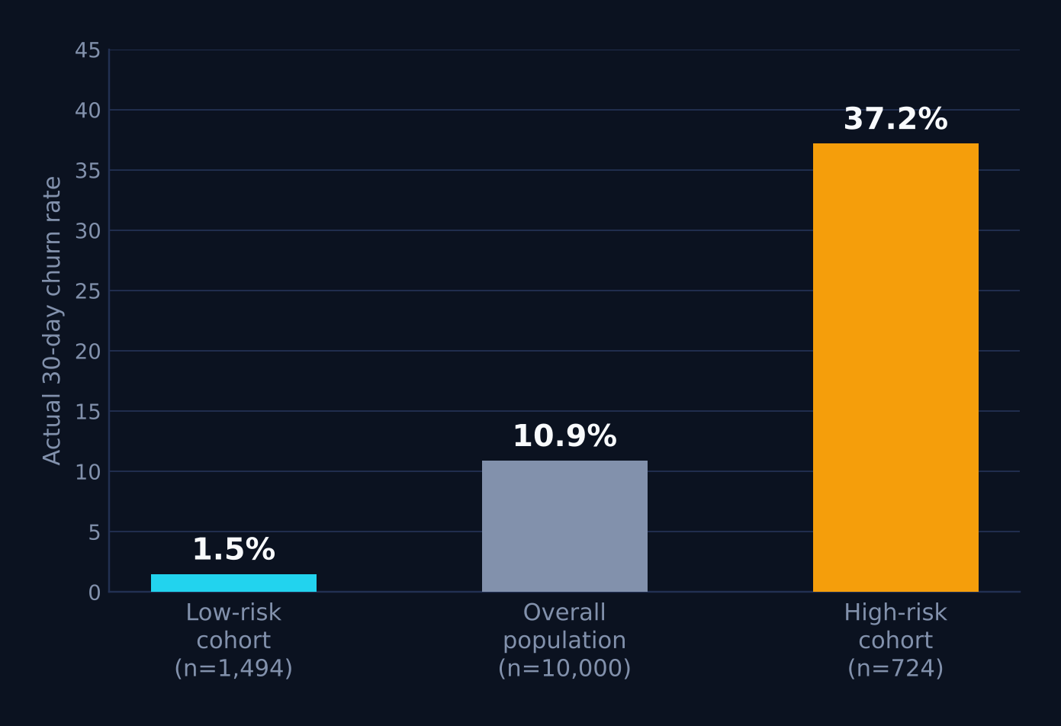
DATASET & PIPELINE — SYNTHETIC, FOR DEMONSTRATION ONLY
From Customer Record to Decision Evaluation
Customer
profile
Churn-risk
prediction
Retention
decision
Treatment /
control group
30-day
outcome
Decision
evaluation
SYNTHETIC CUSTOMER-RETENTION DATASET
RECORDS 10,000 fictional customer rows
FIELDS age, gender, country, income, spending score, purchases, avg. order value, membership years, site visits/mo, cart-abandon rate, churn flag, feedback text, last purchase date
STATUS Clearly labelled synthetic data — used for demonstration only; not a real company's data
Real, observed churn rate by risk segment
Notes:
This is the one dataset used across the whole prototype, and it is explicitly synthetic and fictional — generated for demonstration, with no link to any real company or real customers. The pipeline shows how a raw customer row becomes a decision record: a churn-risk score is computed per customer, a retention decision is attached to the highest-risk customers, those customers are conceptually split into a treated group and a held-out comparison group, a 30-day outcome window is observed, and the decision-evaluation engine assigns a validation state. The chart on the right is real, not illustrative: computed directly from the uploaded dataset. Customers matching a high-risk profile — cart-abandonment at or above 70% and a spending score at or below 25 — actually churn at 37.2% within this dataset, against 1.5% for a clearly low-risk profile and 10.9% overall. That gap is what makes risk-based targeting worth doing in the first place.

Slide 8
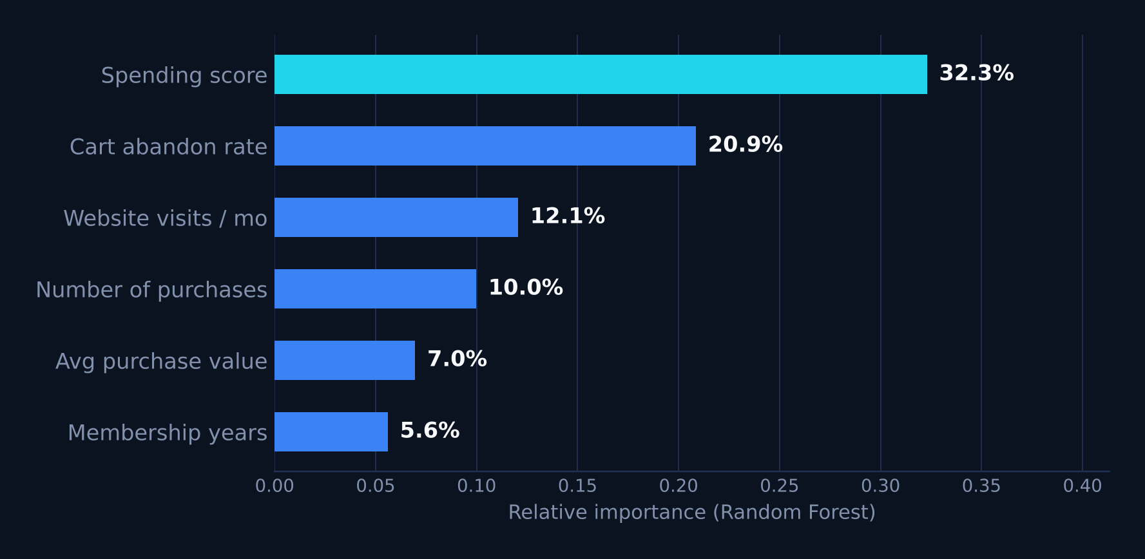
MACHINE LEARNING COMPONENT
Predicting Risk, Not Proving Causation
HOW IT'S BUILT
TASK Binary classification — churned vs. retained
FEATURES Spending score, cart-abandon rate, site visits/mo, purchases, avg. order value, membership years, income, age, gender, country
PREPROCESSING Standardization (numeric) + one-hot encoding (categorical)
SPLIT 80 / 20 train-test, stratified by class
MODELS COMPARED Logistic Regression vs. Random Forest (300 trees)
0.26
Precision
0.78
Recall
0.39
F1-score
0.84
ROC-AUC
Random Forest · held-out test set · n = 2,000 (real results, not placeholders)
Top churn-risk drivers (feature importance)
A model that flags churn risk does not prove an intervention caused a customer to stay — prediction identifies candidates for a decision; it does not validate the decision's outcome.
Notes:
These are the real, calculated numbers from training on the uploaded dataset — nothing here is a placeholder. Churn is imbalanced at 10.9%, so we used class-weighted models and optimised for recall: catching true churners matters more than being right every time we flag someone, because the cost of a missed at-risk customer is higher than the cost of one unnecessary discount. Random Forest reaches 0.78 recall and 0.84 ROC-AUC but only 0.26 precision — roughly three out of four flagged customers would not actually have churned, which is exactly why this score feeds a human-reviewed decision, not an automatic action. Spending score and cart-abandon rate dominate feature importance, which matches the raw correlations in the data. The callout at the bottom is the single most important caveat in the whole deck: this model ranks risk, it does not and cannot show that any specific retention action caused a customer to stay — that requires a controlled comparison, which is what the evaluation engine is for.

Slide 9
SYSTEM ARCHITECTURE
Seven Layers, One Feedback Loop
User Interface
Where a manager types a decision in plain language
Decision Capture Layer
Parses the note into a draft structured record
Assumption & Metric Layer
Binds the decision to one measurable target metric
ML Risk-Prediction Layer
Scores churn risk to prioritise which customers/decisions matter
Data Integration Layer
Pulls in product, billing and CRM data to track the metric live
Outcome Evaluation Engine
Checks deadline, sample size and target at review time
Decision Debt Dashboard
Shows every decision's state — and what's overdue or invalidated
BUILT WITH
Python
Pandas
Scikit-learn
Streamlit
Plotly
Notes:
Seven layers, each with one job, connected top to bottom in one direction except for the feedback that flows back from the dashboard into future decisions. The UI captures intent in natural language; the capture layer turns it into a draft record; the assumption-and-metric layer forces a single, bound target metric rather than vague success criteria; the ML layer scores risk to help prioritise which customers or segments a decision applies to; the data-integration layer pulls in the live numbers needed to actually measure the metric over time from product, billing or CRM systems; the evaluation engine runs the four checks at review time; and the dashboard is where a team sees every open, overdue, or invalidated decision at a glance. The prototype stack is intentionally boring and well-understood: Python and Pandas for data handling, Scikit-learn for the risk model, Streamlit for the interactive UI, and Plotly for the charts — nothing exotic, because the value is in the workflow, not the tooling.

Slide 10
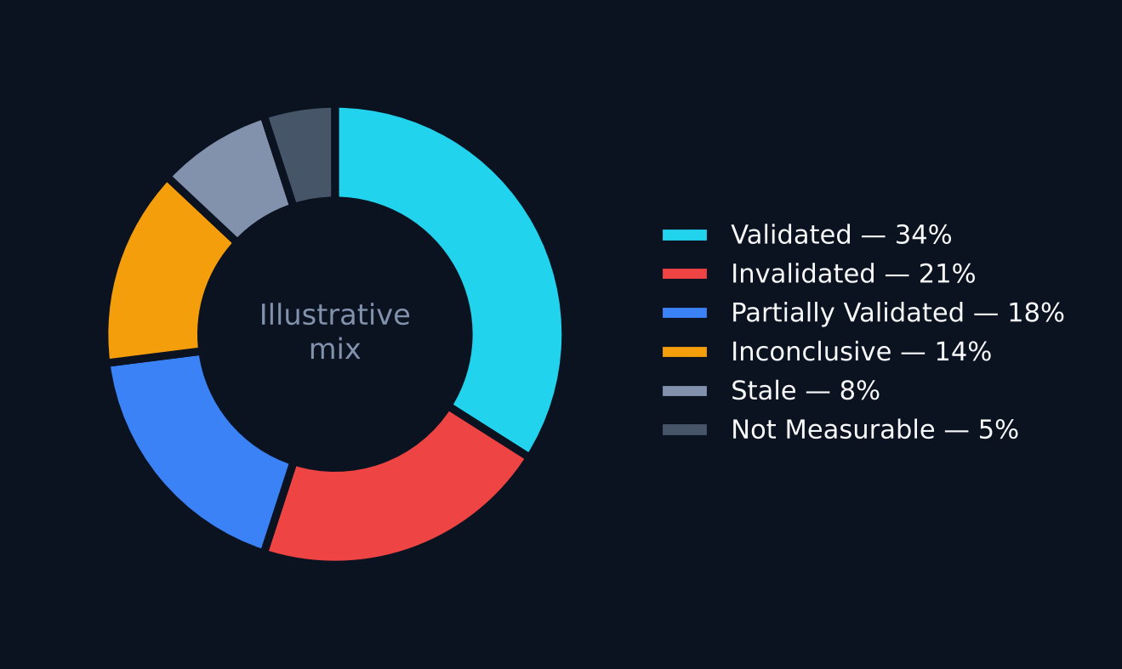
DECISION EVALUATION ENGINE
Four Checks, Six Possible States
Was the target metric reached?
Illustrative state mix — simulated for demonstration
Has the review deadline passed?
Was the sample size large enough to trust the result?
Is the result statistically conclusive, or still noisy?
Validated / Invalidated = target clearly met or missed, with enough data. Partially Validated = directionally right, underpowered. Inconclusive = evidence too weak either way. Stale = deadline passed, never reviewed. Not Measurable = metric or data unavailable.
Notes:
The evaluation engine is rule-based, not another model — it runs four checks against each decision record at or after its deadline and assigns one of six states. This keeps the logic auditable: anyone can see exactly why a decision was marked Validated versus Inconclusive. The pie chart here is explicitly illustrative: a simulated mix of outcome states across a batch of synthetic decisions, built to demonstrate what the dashboard would show — it is not a measured result from real deployments, and the deck is careful to label it that way rather than imply it's empirical. The six states matter because the real failure mode this project targets is 'Stale' and 'Invalidated-but-still-active' decisions — the ones nobody goes back to check.

