Slide 1
Bikes on Rent
Total booked bikes as per different situations

Slide 2
Booked as per days:
Days were in number from 0-6:
0 was considered as holiday
1 was Sunday and so on…

Slide 3
Bikes as per hour:

Slide 4
Bikes booked as per Days:

Slide 5
Bikes booked as per windspeed:

Slide 6
Bikes booked as per weather:

Slide 7
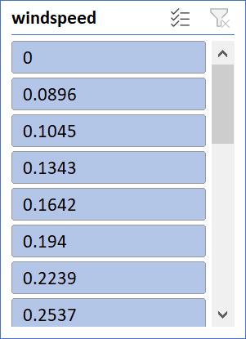
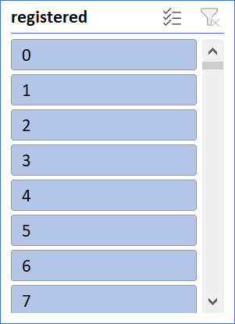
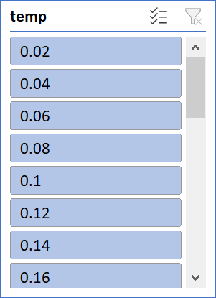
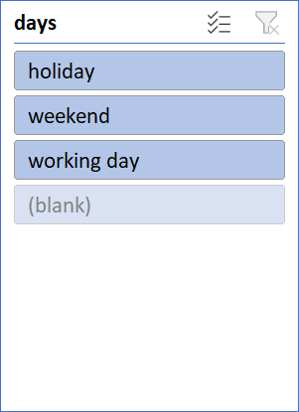
Report on Total bikes booked:
 |  |  |  |  |  |  | Report on total bikes booked for rent

