Slide 1


Oracle
APEX Globalization
An Accenture White Paper by
Vijayan Kumar
(
)
Vijayan.kumar@accenture.com
Mohit Tyagi
(
)
m.kumar.tyagi@accenture.com
October 2024
1

Slide 2
Table of Contents
1.EDITOR’S.......................................................................................................3
2.REVIEWED BY................................................................................................3
3.OBJECTIVE.....................................................................................................4
4.DISCLAIMER..................................................................................................4
5.OVERVIEW.....................................................................................................4
6.Globalization Oracle APEX Applications........................................................5
6.1 Create desktop navigation menu entries for switching languages.........5
6.2 Create Application Item and Application Process...................................9
6.3 Specifying the primary language for an application.............................11
6.4 Translation of an Application................................................................13
6.5 Test your application.............................................................................23
7. CONCLUSION..............................................................................................23
8.REFERENCES...............................................................................................23
2

Slide 3
1.EDITOR’S
S.N
Date
Author
Email Id
Proje
o
ct
1
03-Oct-
Mohit Tyagi
Role
2024
m.kumar.tyagi@accenture.com
Team
Lead
2.REVIEWED BY
Name
Author
Project/Org
Review Date
Role
Vijayan
vijayan.kumar@accenture.
Manager
03-Oct-2024
Kumar
com
3

Slide 4
3.OBJECTIVE
The objective of this white paper is to provide a comprehensive guide
that provide the steps involved in APEX Globalization.
4.DISCLAIMER
The information provided in this white paper is based on the
knowledge available at the time of writing, up to October 2024. While every
effort has been made to ensure the accuracy of the content and there may
be updates or changes that are not reflected in this document. Readers are
advised to refer to the official documentation and community resources for
the most up-to-date information.
5.OVERVIEW
To run applications built in App Builder concurrently in different
languages. By following the steps outlined, you can ensure a smooth
transition and start leveraging the apex globalization.
4

Slide 5
6.Globalization Oracle APEX Applications
To translate an APEX application, map the primary and target language,
seed and export text to a translation file, translate the text, apply the
translation file, and publish the translated application.
➢
Create Desktop Navigation menu entries for switching languages.
➢
Create Application Item and Application Process.
➢
Specifying the primary language for an application.
➢
Translation of the application
➢
Test the application.
6.1 Create Desktop Navigation menu entries for switching
languages
Go to App Builder and select an application which you want to Translate
(or) Create a new Application.
The next step is to create navigation menu entries that will appear on
every page to allow the users to switch languages.
•
Click “Shared Components”
•
Under “Navigation”, click “Navigation Bar List”
•
Click “Navigation Bar”
We will create three navigation bar entries:
•
Currently selected language,
•
English, and
•
German.
5

Slide 6
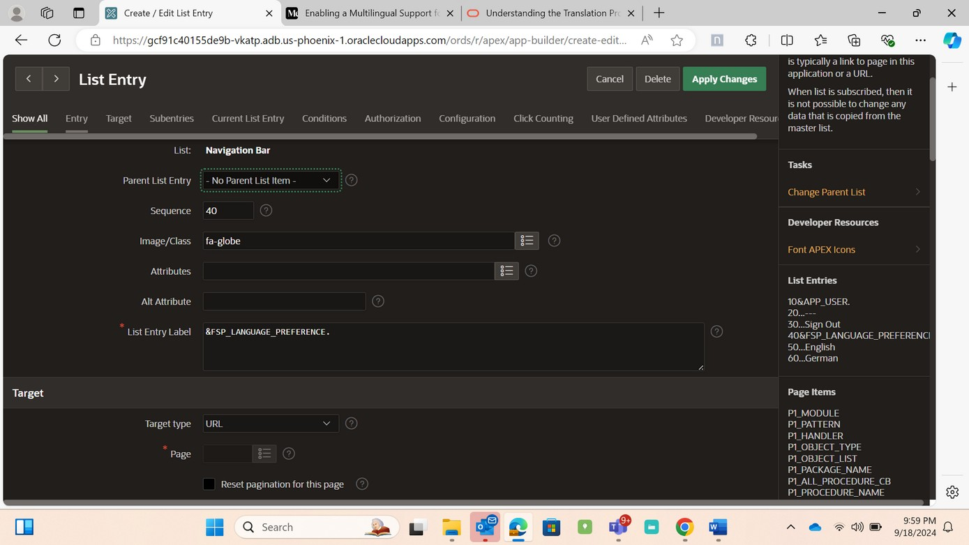
To create the first entry for displaying the currently selected language,
click “Create Entry”
•
Parent List Entry — No Parent List Item -Image/Class: fa-globe
•
List Entry Label: &FSP_LANGUAGE_PREFERENCE. (Note: A dot after
PREFERENCE is required).
•
Target Type: URL
•
URL Target: #
•
Click “Create and Create Another”
Creating List Entry for the currently Selected Language in Navigation Bar .
Set values for the second list entry, English language.
•
Parent List Entry: &FSP_LANGUAGE_PREFERENCE. (Note: A dot after
PREFERENCE is required).
•
List Entry Label: English
•
Target Type: Page in this application
•
Page: &APP_PAGE_ID. (Note: A dot after ID is required).
•
Request: LANG
6

Slide 7
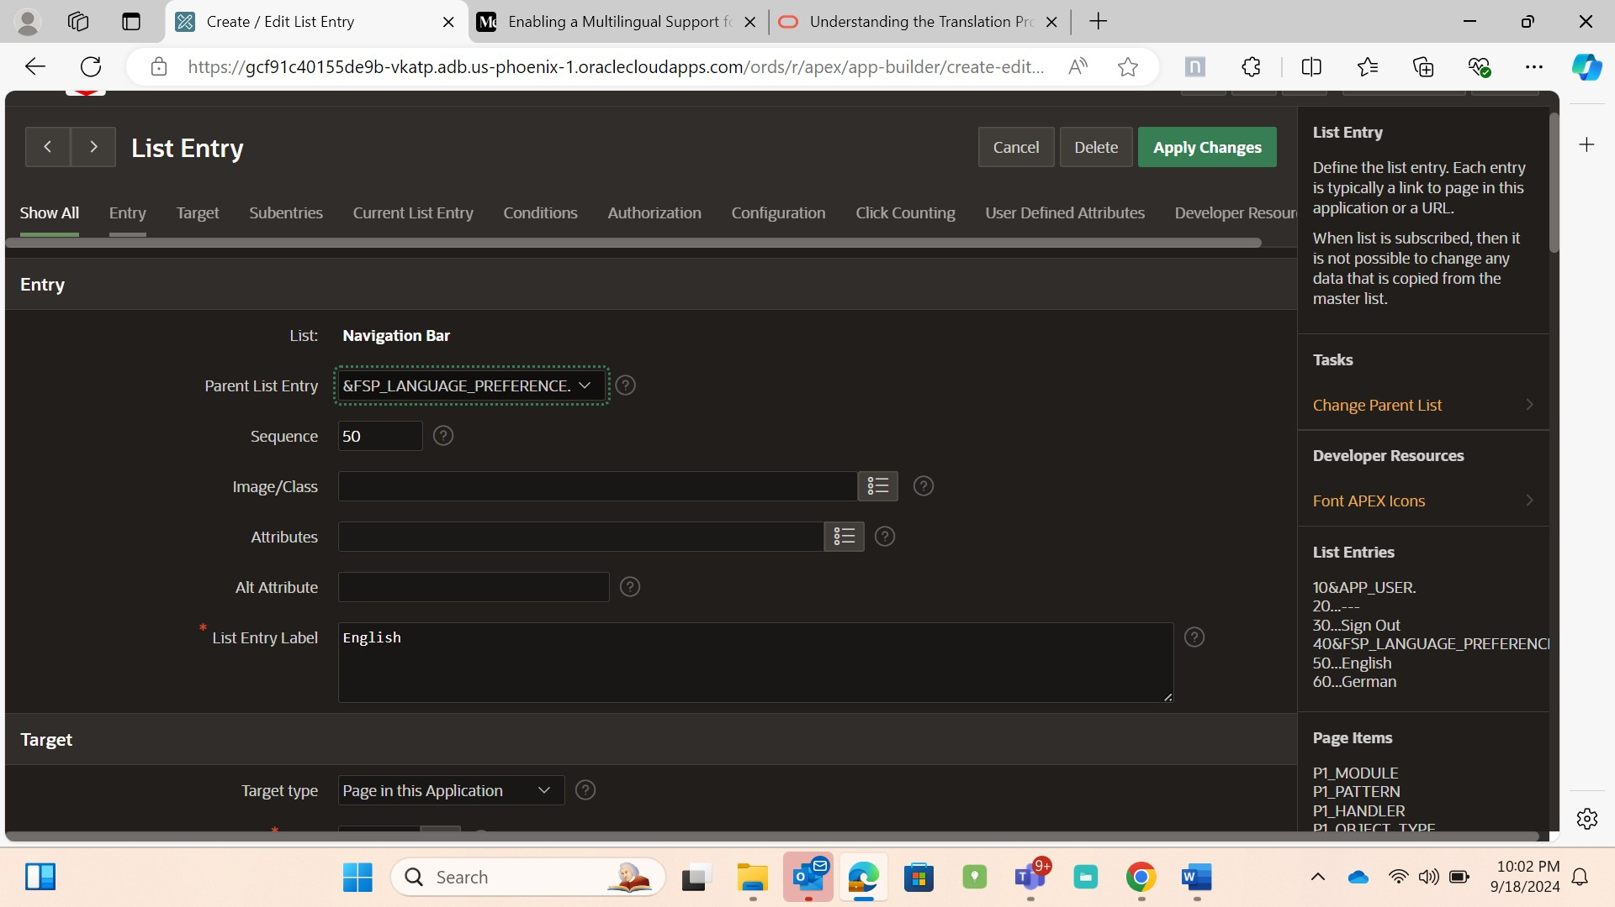
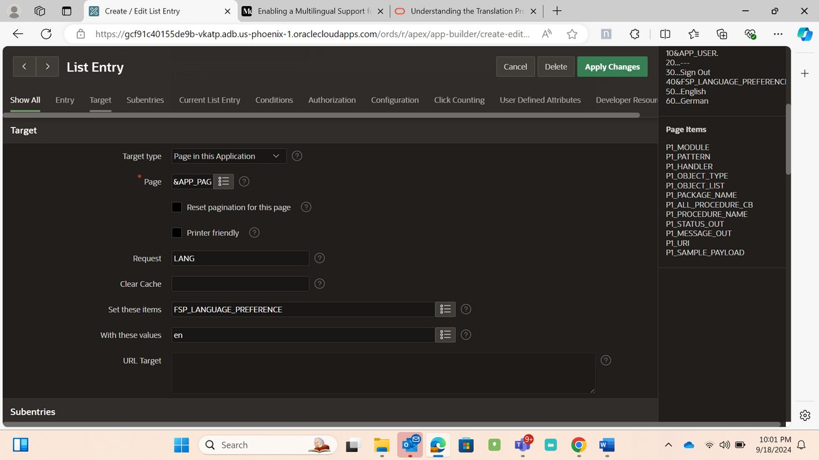
•
Set these items: FSP_LANGUAGE_PREFERENCE
•
With this value: en
•
Click “Create and Create Another”
Creating List entry for the Second language (English -en) in Navigation
Bar.
Set values for the third list entry, German language.
•
Parent List Entry: &FSP_LANGUAGE_PREFERENCE. (Note: A dot after
PREFERENCE is required).
7

Slide 8
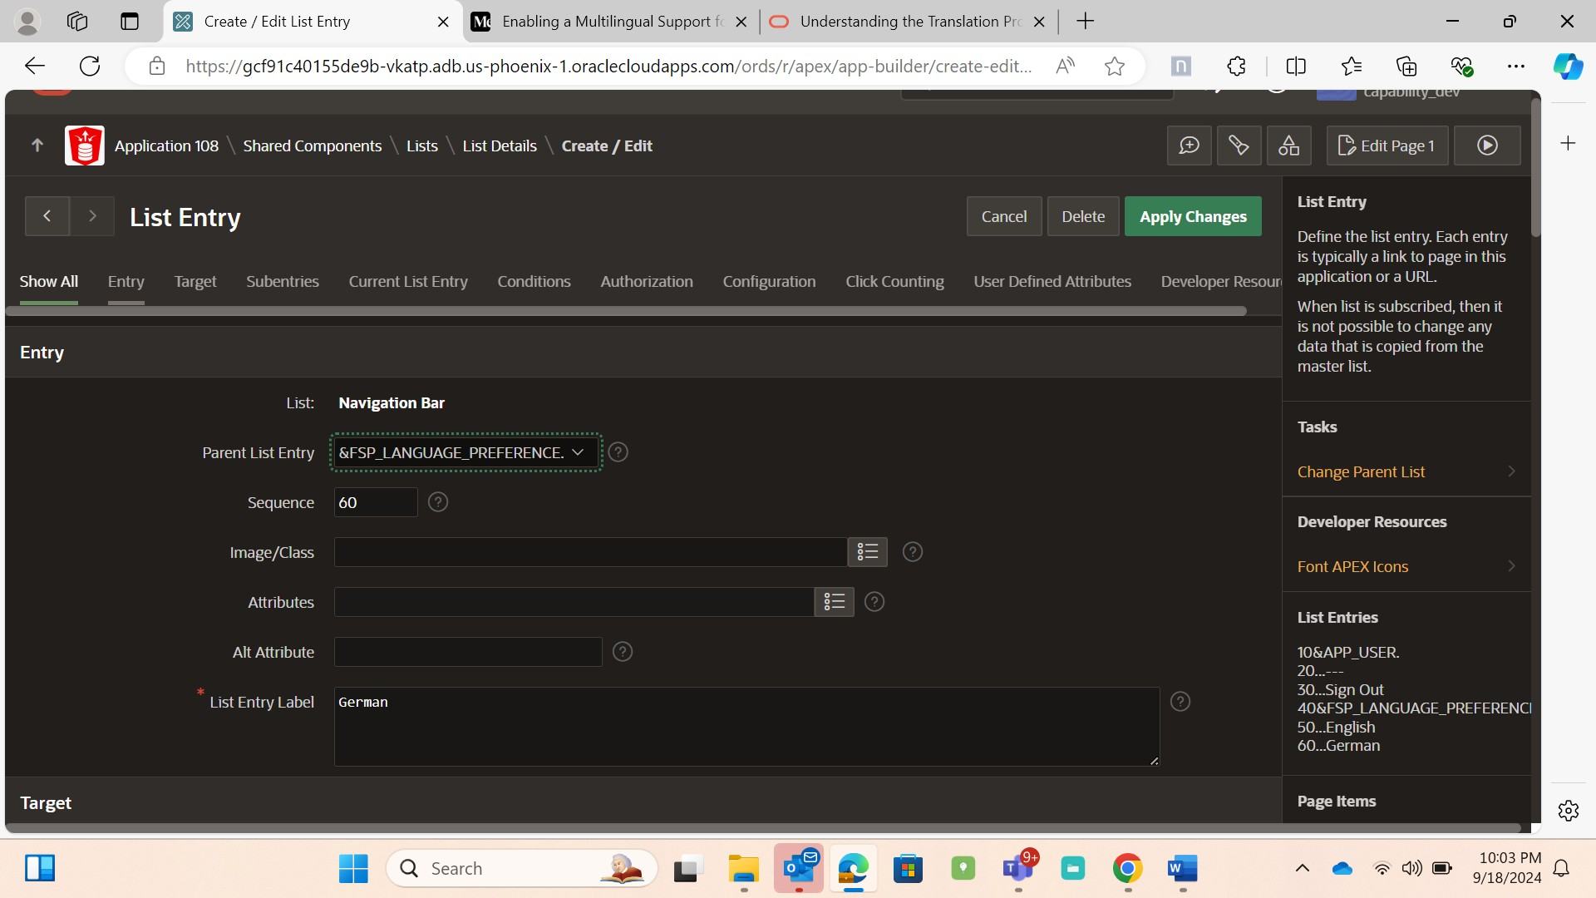
•
List Entry Label: German
•
Target Type: Page in this application
•
Page: &APP_PAGE_ID. (Note: A dot after ID is required)
•
Request: LANG
•
Set these items: FSP_LANGUAGE_PREFERENCE
•
With this value: de
•
Click “Create List Entry”
•
Creating List entry for Third language (German - de) in Navigation Bar .
8

Slide 9
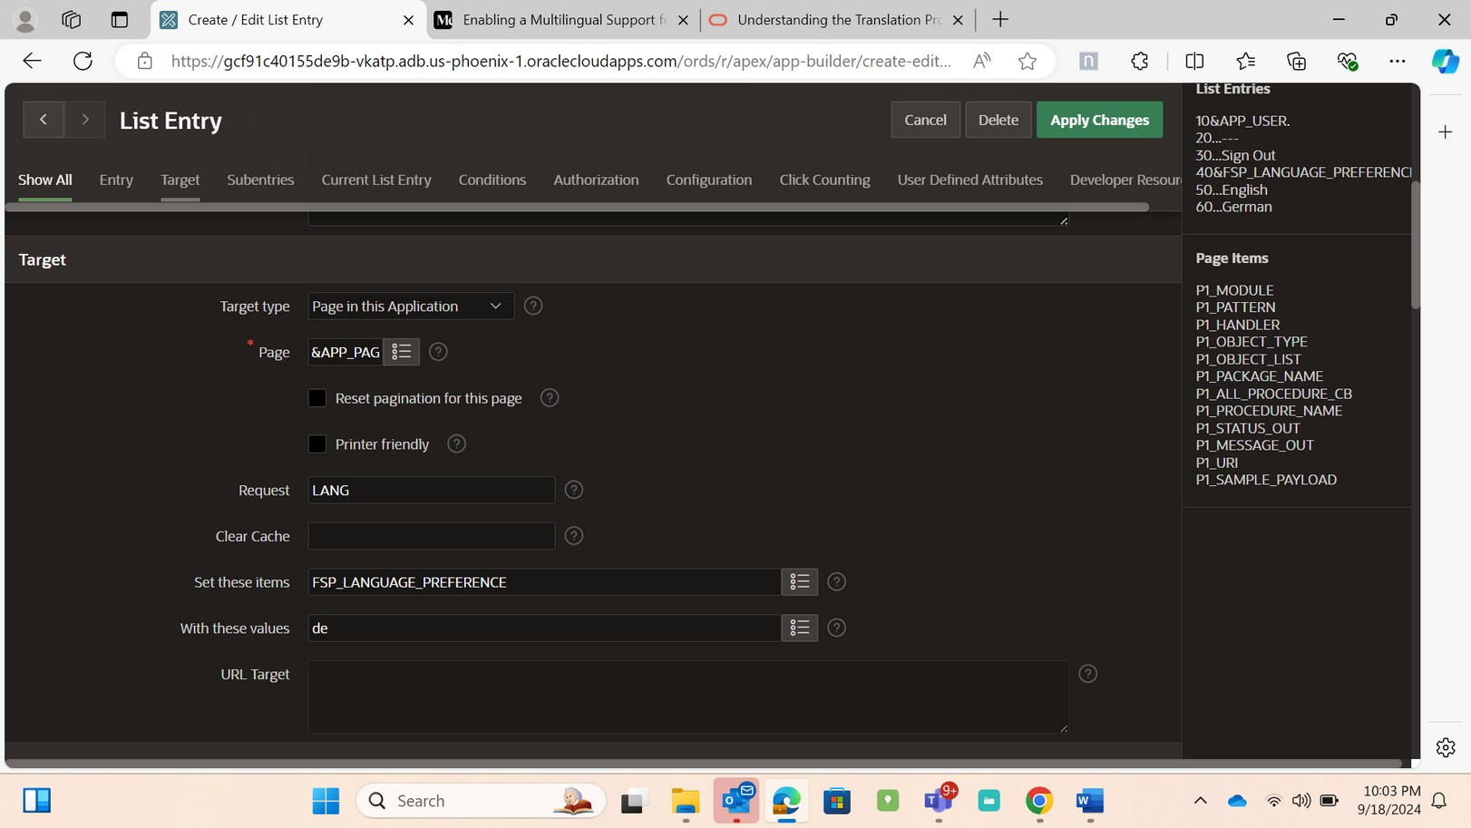
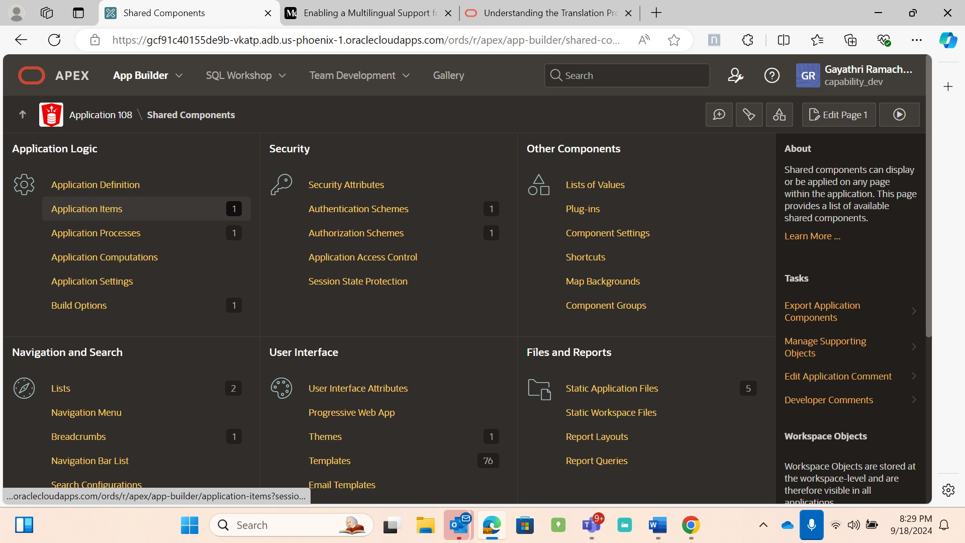
6.2 Create Application Item and Application Process
To create an application item, follow the below steps
•
Shared Components →Application Logic →Create →then
•
Name | FSP_LANGUAGE_PREFERNECE
•
Scope | Application
•
Session state problem | Checksum Required – Application Level →
•
Create Application item.
Select an Application Items from Shared Components
9

Slide 10
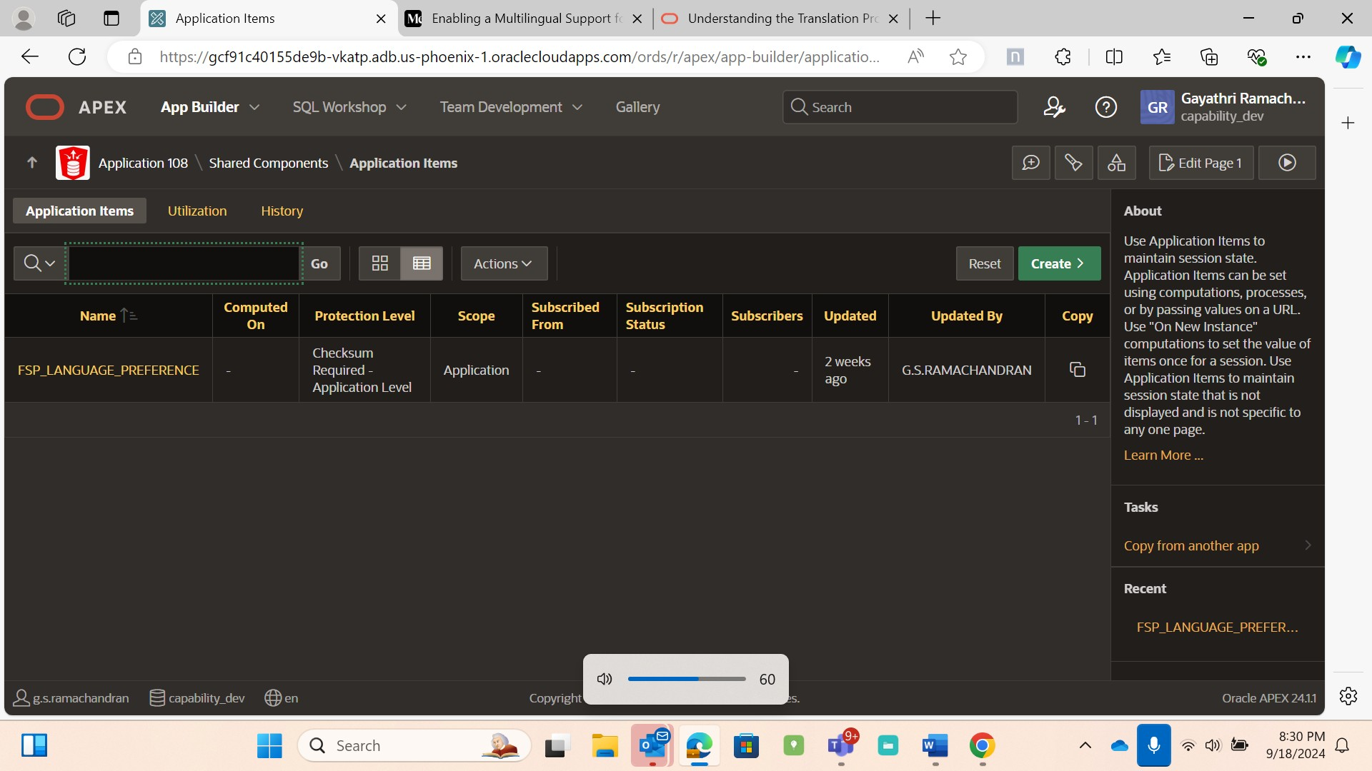
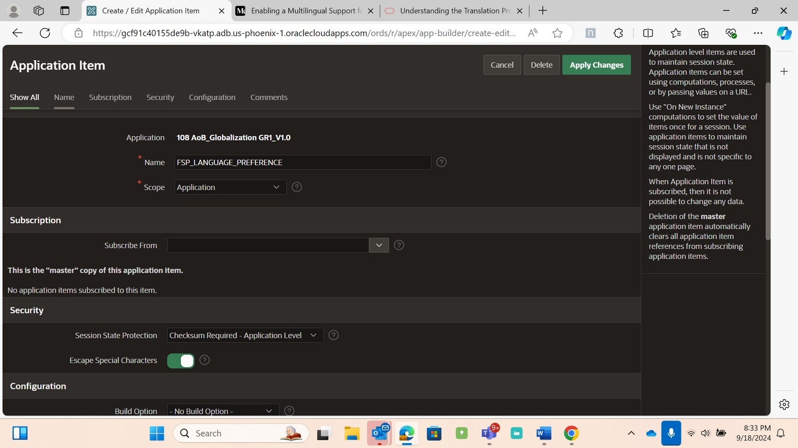
Click on Create
Fill the Details as mentioned above for FSP_LANGUAGE_PREFERNECE
To create an application process, follow the below steps
Shared Components →Application Logic →Create →
•
Name | set_language
•
Sequence | 1
•
Point |On Load: Before Header (page template header)
•
Language |PL/SQL
•
Code :
BEGIN
apex_util.redirect_url(p_url => '&APP_PAGE_ALIAS.'||'?
session='||'&APP_SESSION.');
END;
10

Slide 11
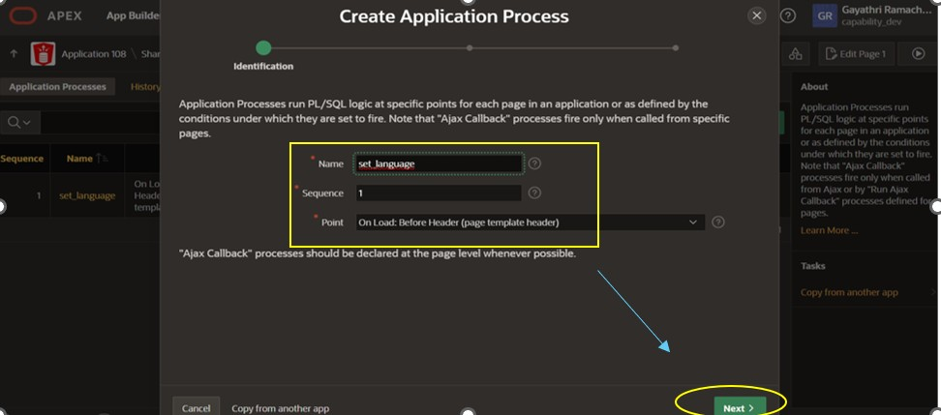
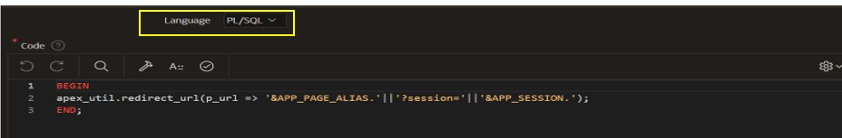
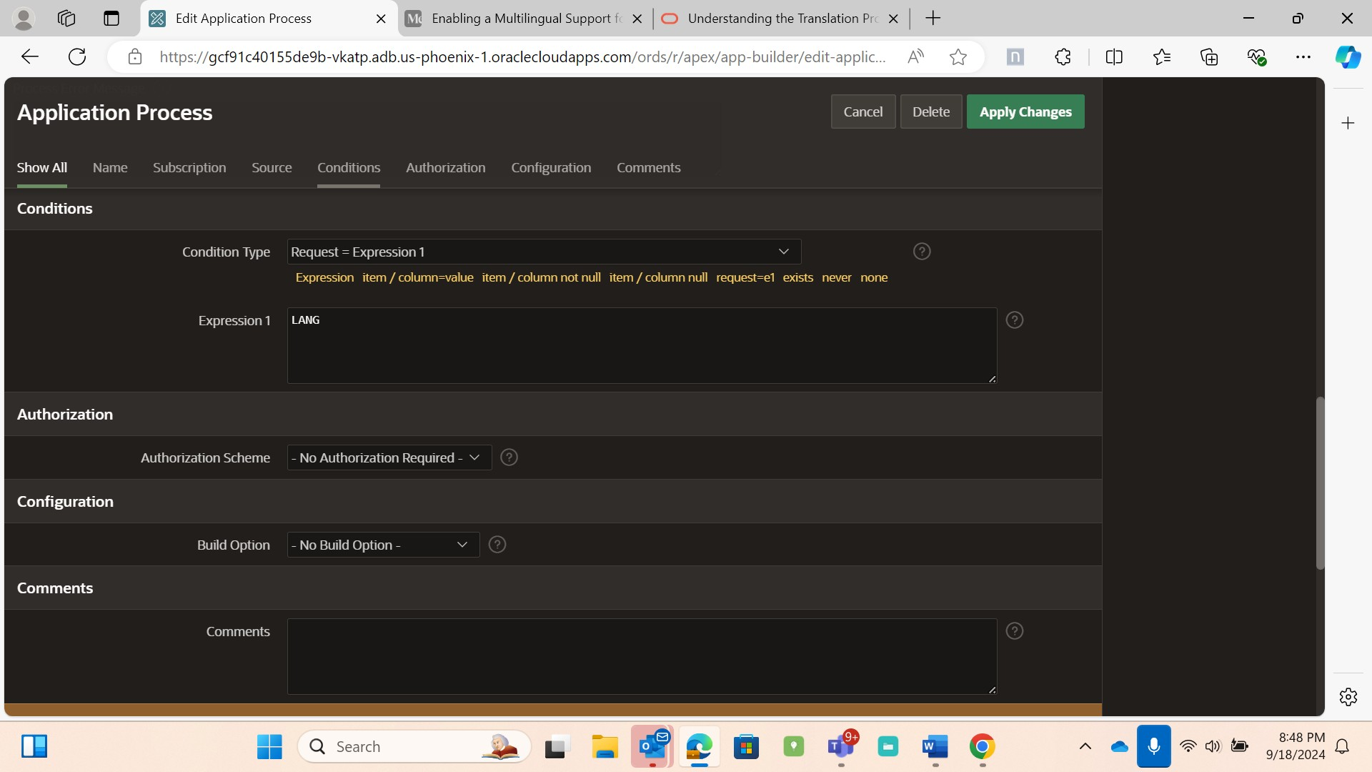
•
Condition Type | Request = Expression 1. Expression1 | LANG
Create an Application Process as Set_Language
Enter the PL/SQL code in Code Editor
Enter the below code
After following the above steps, we have created navigation menu entries for
switching languages in the Application.
11

Slide 12
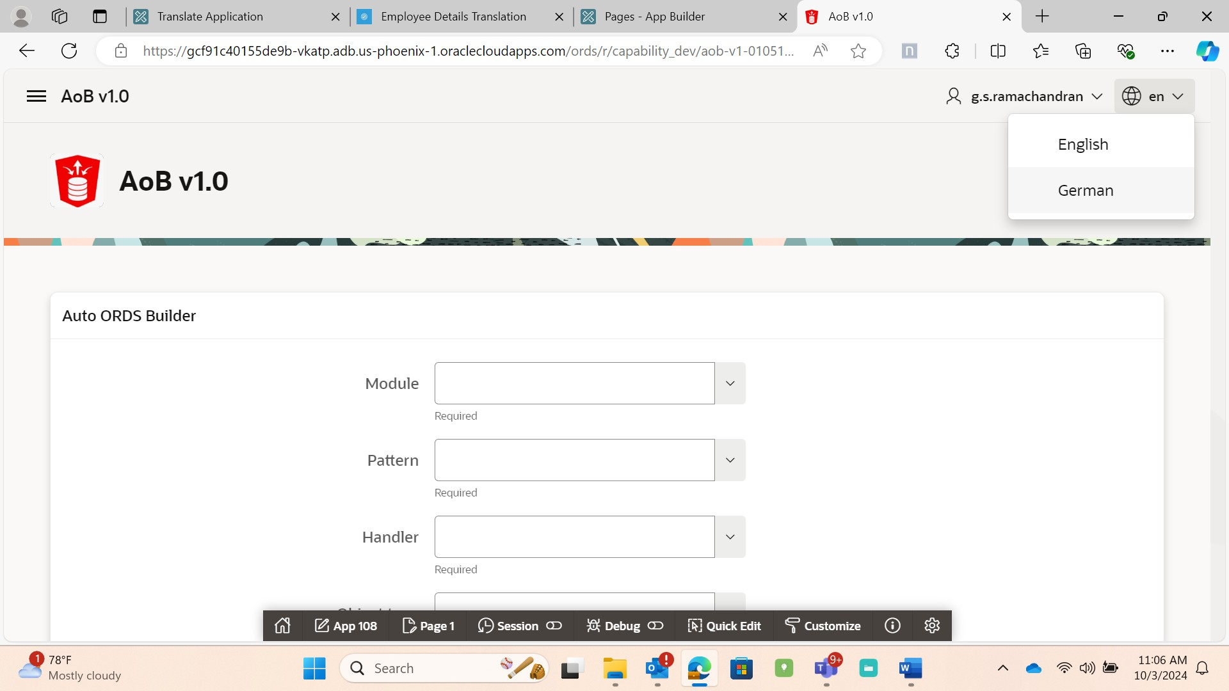
6.3 Specifying the primary language for the application
Below are the two ways to specify primary language.
•
Workspace homepage → Edit Application Definition → Globalization →
select Primary Language _English (en) , Application Language derived
from : Item preference and remaining as Default
•
Workspace homepage → App builder → Shared Components →Under
Globalization → Globalization attributes → select Primary Language
_English (en), Application Language derived from: Item preference and
remaining as Default.
To access Globalization to specify Primary Language.
12

Slide 13
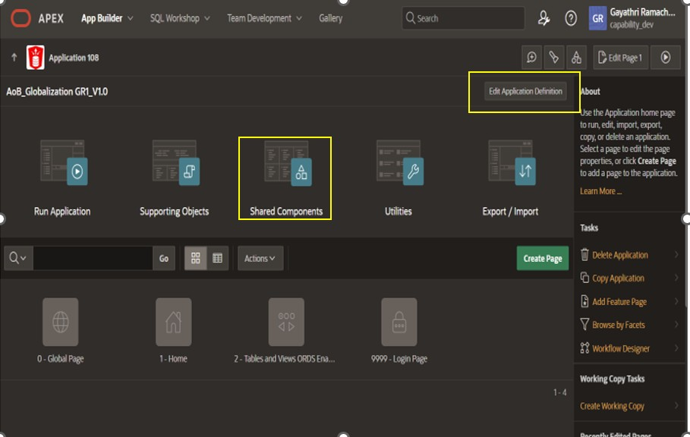
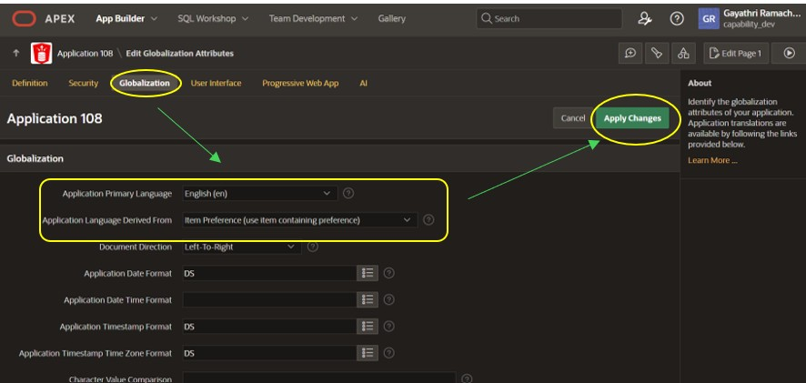
Select the Globalization Attribute then Specify the primary language
and Application Language derived from then Apply changes
13

Slide 14
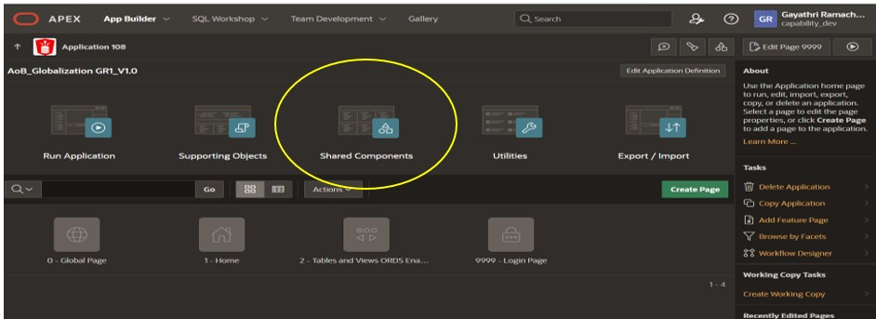
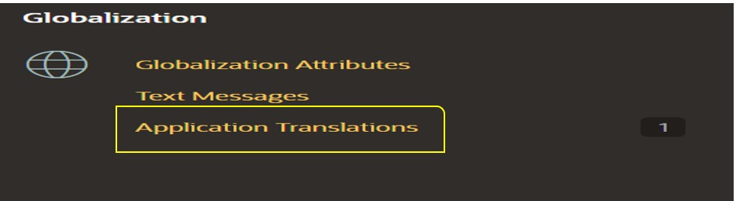
6.4 Translation of an Application
•
Go to Workspace Home page →Shared Components →Globalization →
Application translations
•
To review the candidate objects, click the number link under
the Candidate Objects column.
•
On the Upgrade page, select the objects to upgrade and click Upgrade.
•
Run and test your application.
Under Globalization - Select Application Translations
1) Define Application Languages
14

Slide 15
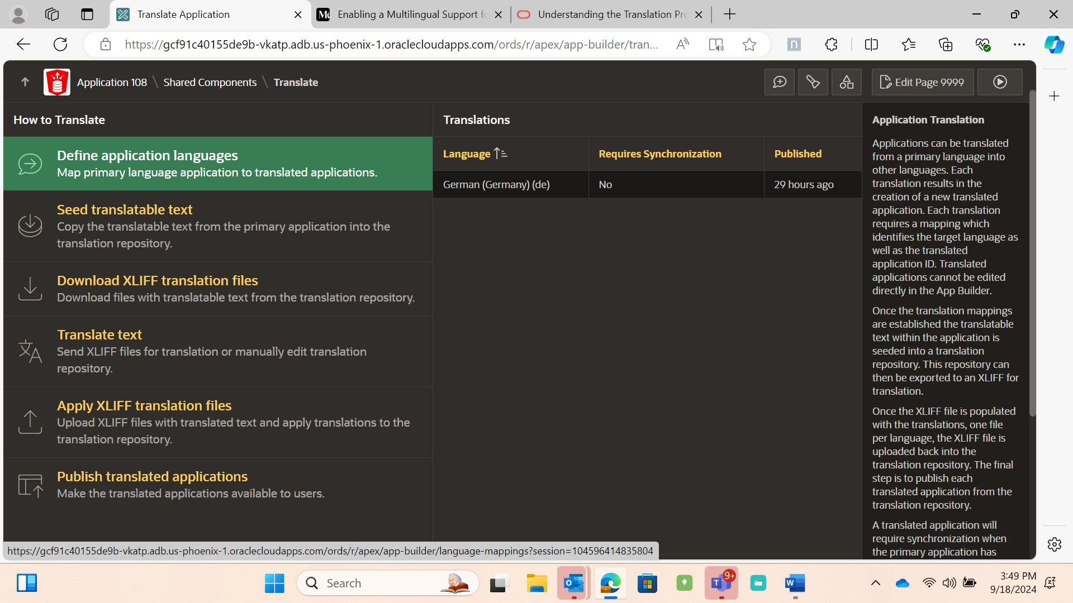
The first step in translating an application is to map the primary and
target application language. The primary application is an application to be
translated. The target application is the resulting translated application.
➢
Select Define application Languages in Application translations.
➢
Define application Languages → create →Enter a unique integer value
that identifies an application (not the present application id )
→Language | Select the language to be translated.
➢
Enter the details as mentioned above and Apply changes.
15

Slide 16
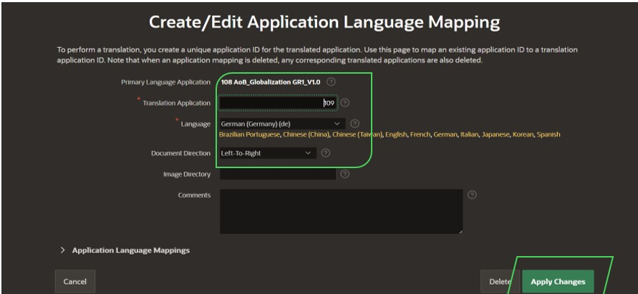
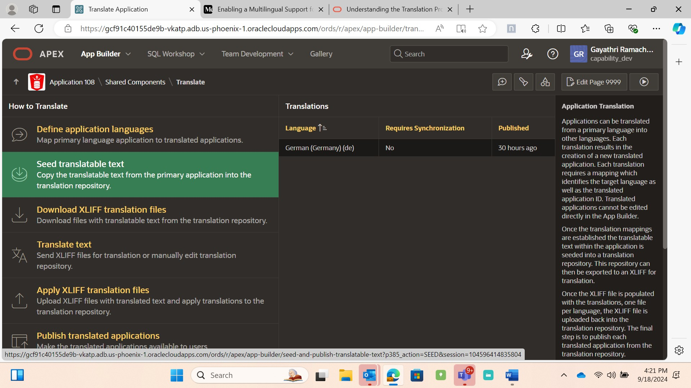
2) Seed translatable text
Seed the translation table and then export the translation text to a
translation file.
➢
Select Seed translatable text in Application translations.
16

Slide 17
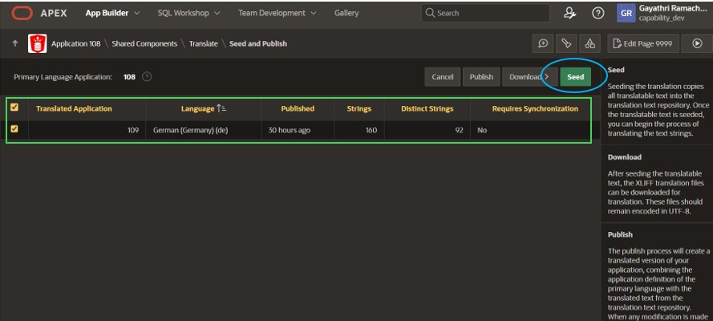
➢
Select the appropriate target application (check the target application)
→ click on Seed →Successfully seeded translatable text. (message
should appear) →Requires Synchronization -No
➢
Seed the selected Translated Application.
3)Translation of Application
To translate an application, we have 2 options to do this.
Approach 1-Click Seed →Manual Translation in Translation Repository
(Label and Message translation) →Publish Translated application.
Approach 2 -You can also Seed →Download XLIFF translation File
→Apply Translation File →Publish Translated application.
➢
After Seeding →Translation Repository →Select the page number where
you want to translated text → Edit →Type the translated text in
“Translate to Text” Box → Check all the occurrences if needed → Apply
changes.
➢
Publish Translated Application.
17

Slide 18
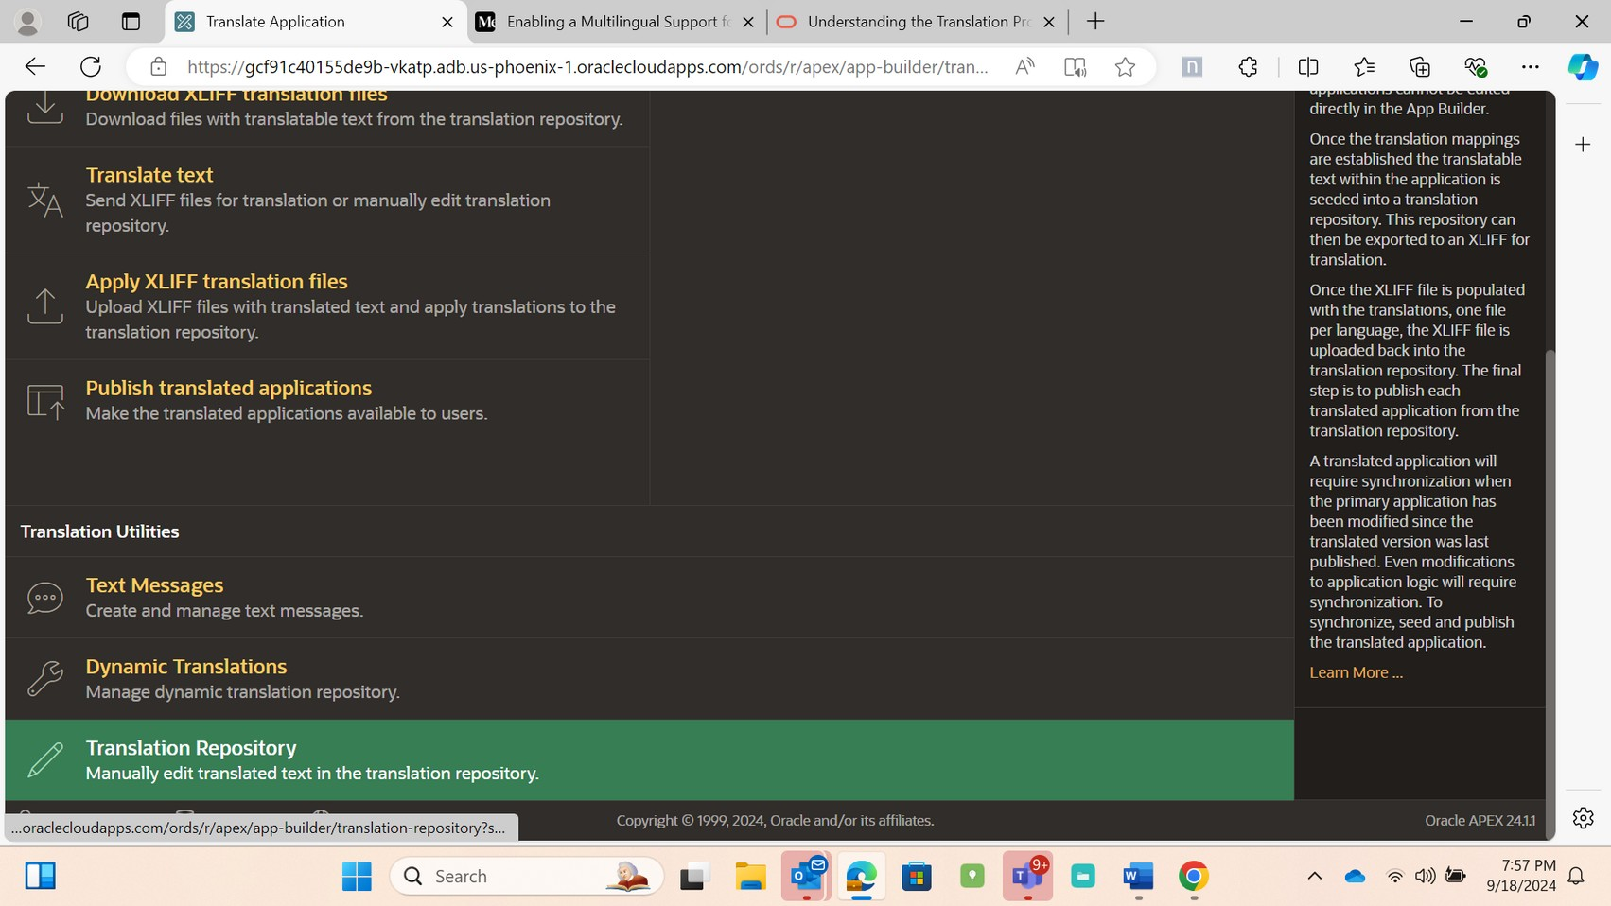
➢
After seeding, Click Translation Repository to change the translatable
text.
Approach 1-Click Seed →Manual Translation in Translation Repository
→Publish Translated application.
Label translation
➢
In Translation repository, we can Change the label of an application
by selecting the page number and browse the column description for
labels and translate the labels and other Page items.
18

Slide 19
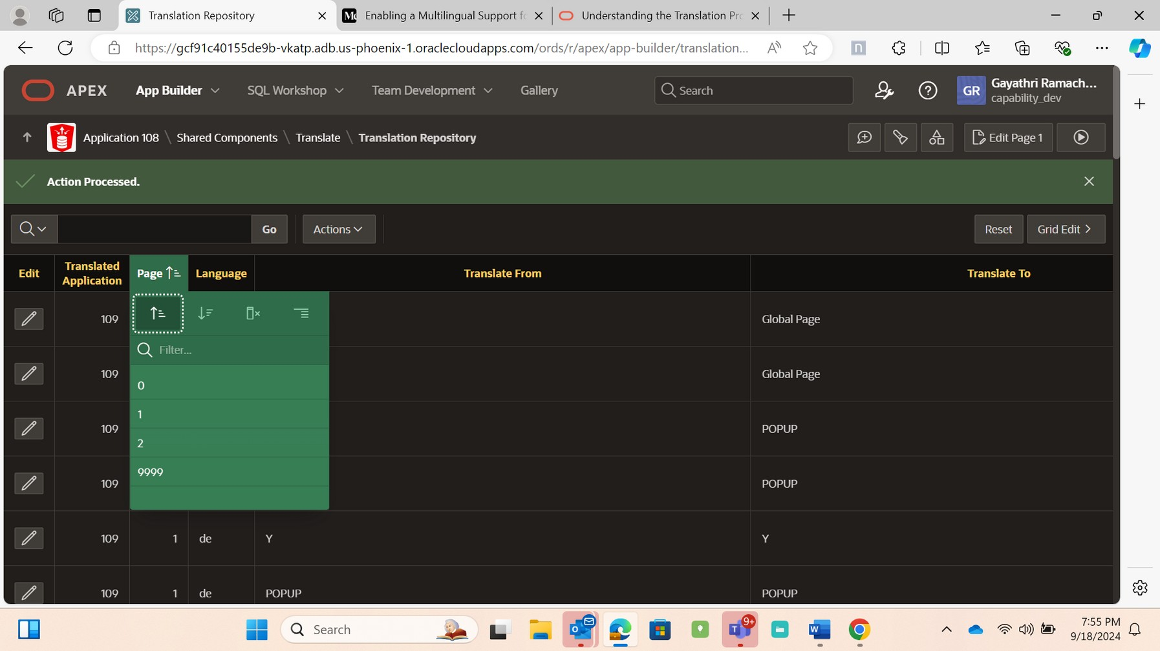
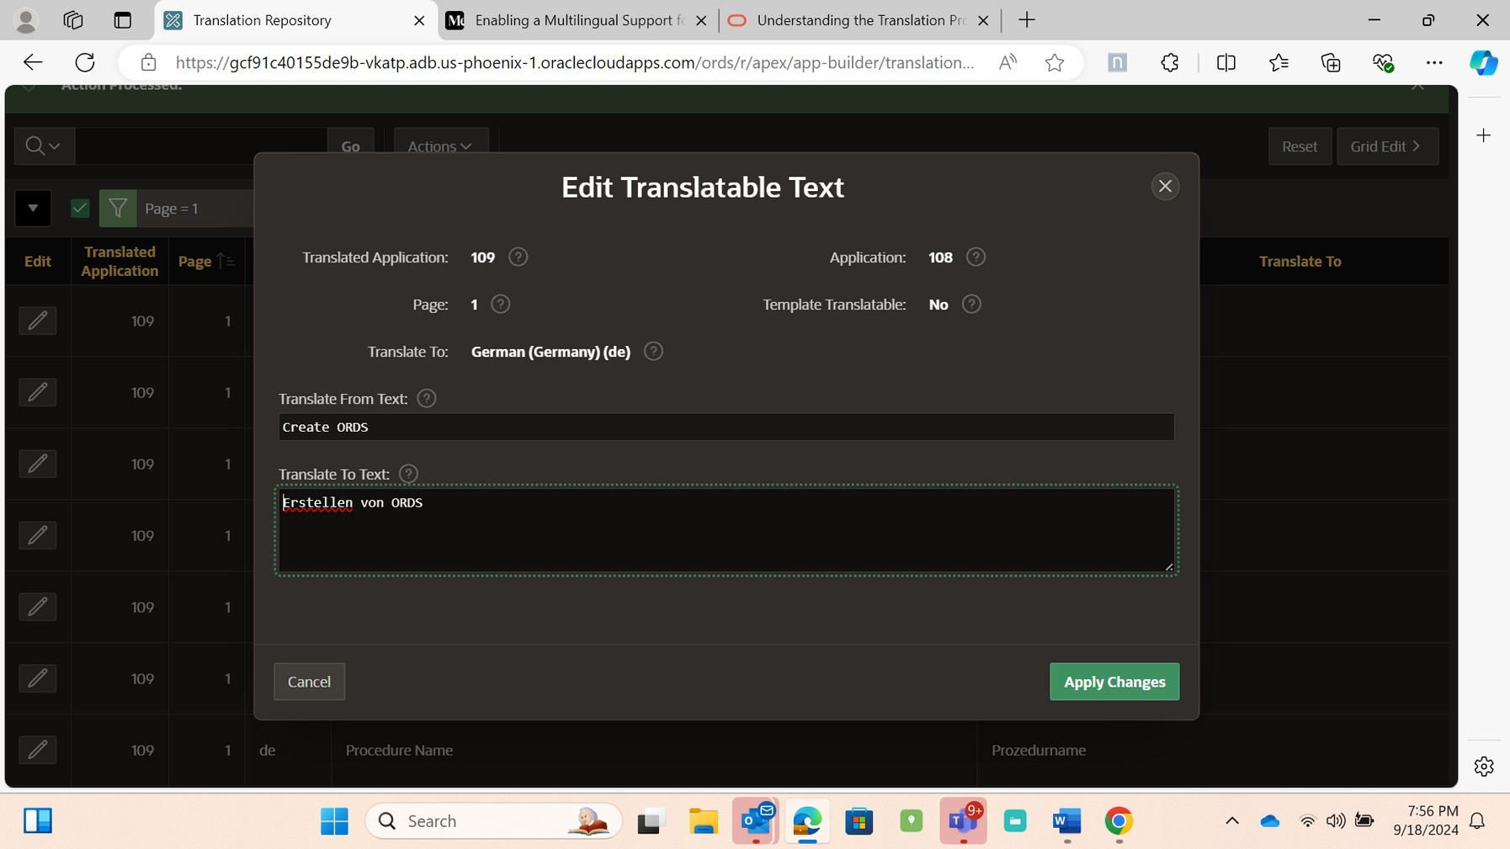
➢
Translate the text which you want to change in German using Online
Translator and Apply changes
Message Translation
➢
In Translation repository, browse for column description with message
and translate the message and Apply changes.
19

Slide 20
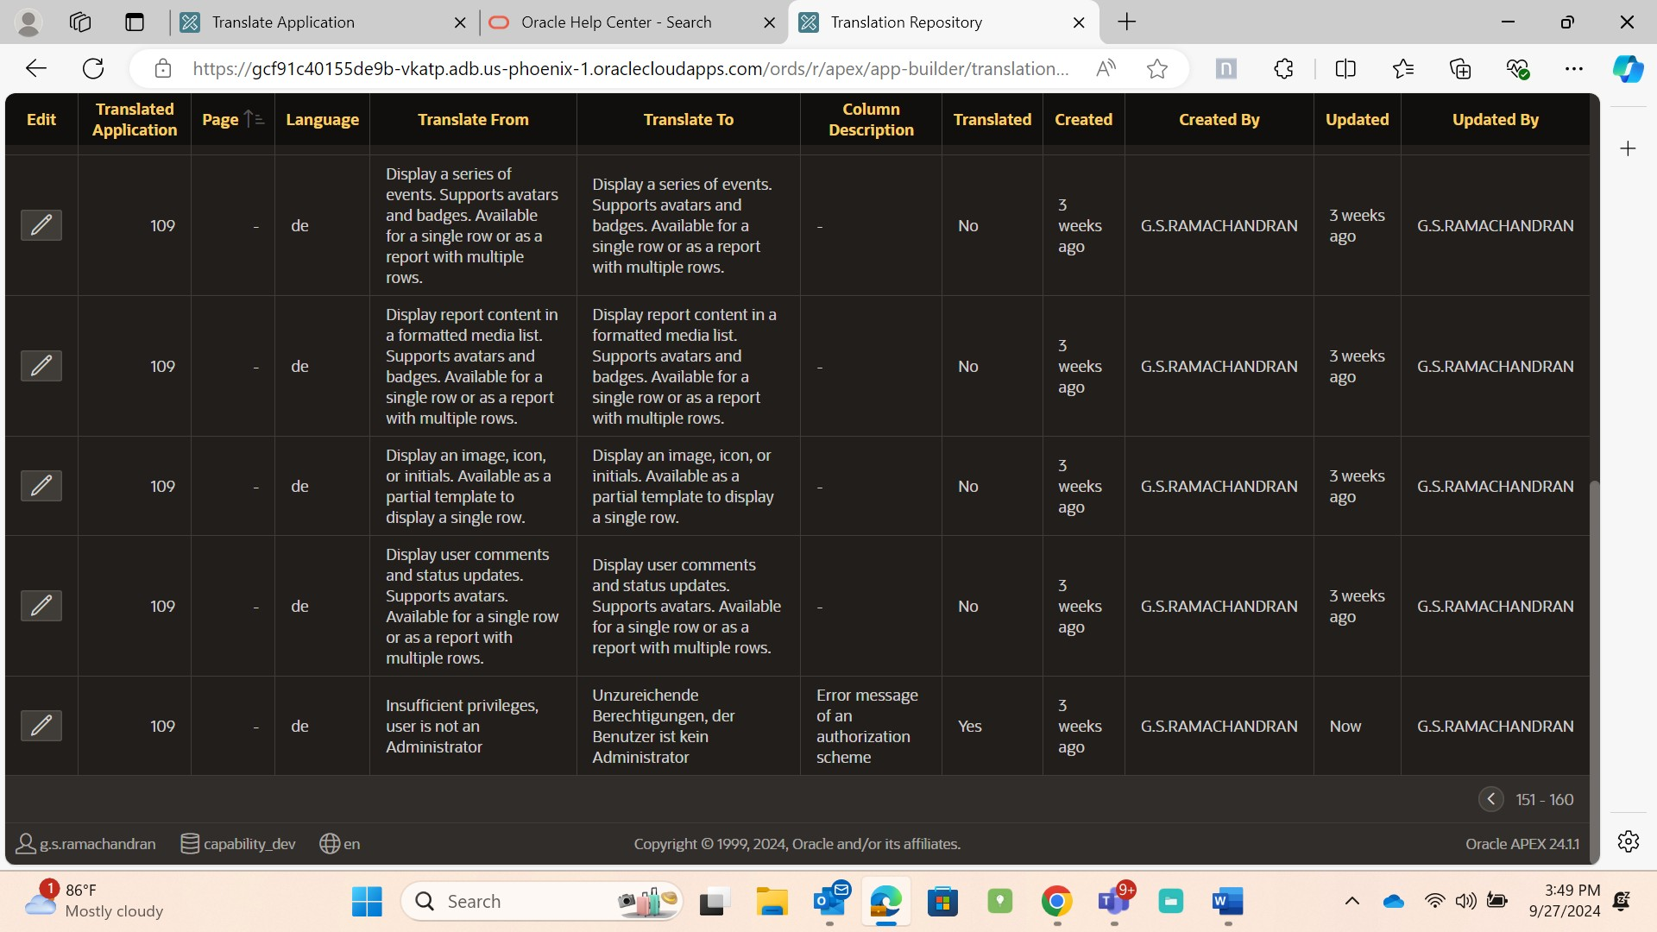
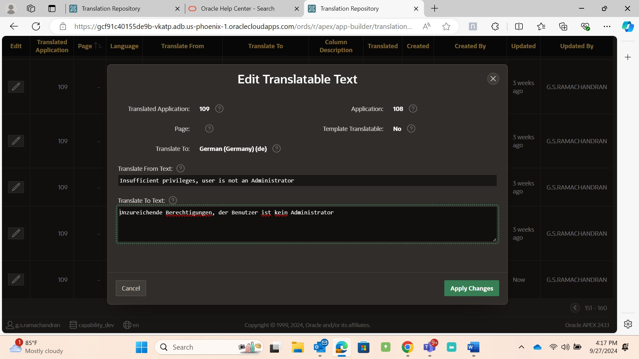
➢
After translation, we must Publish Translated Application.
20

Slide 21
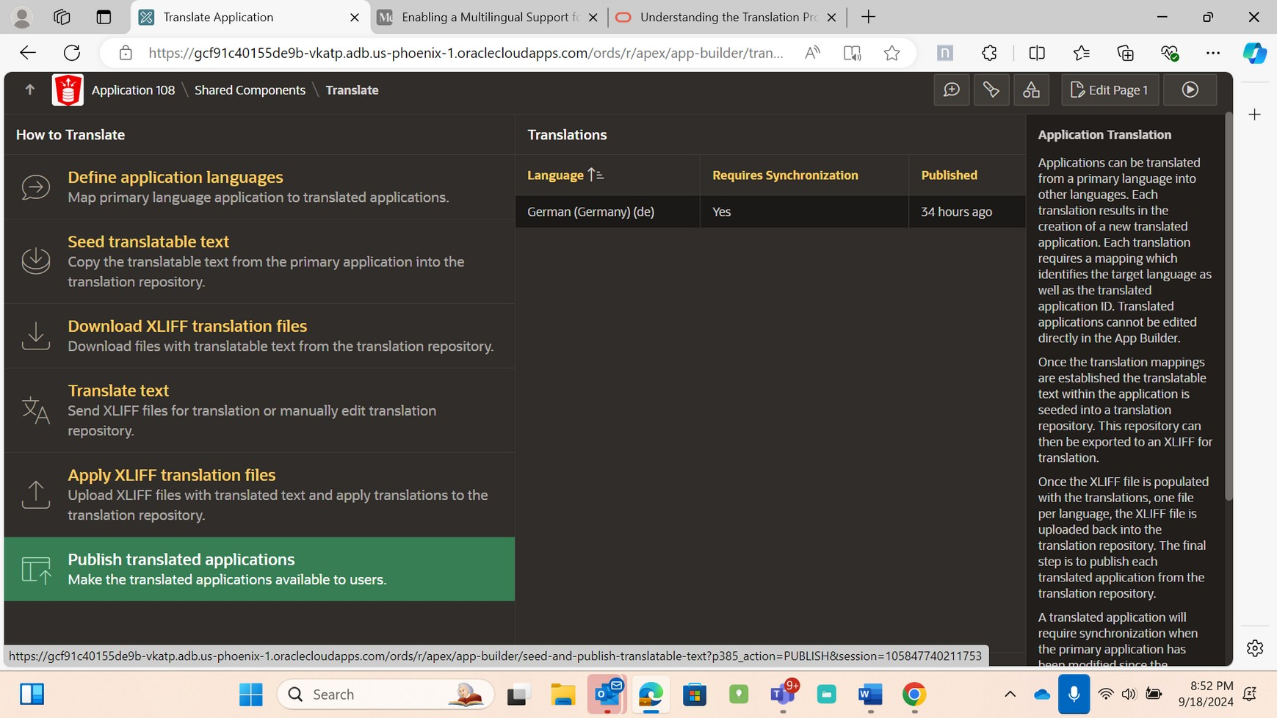
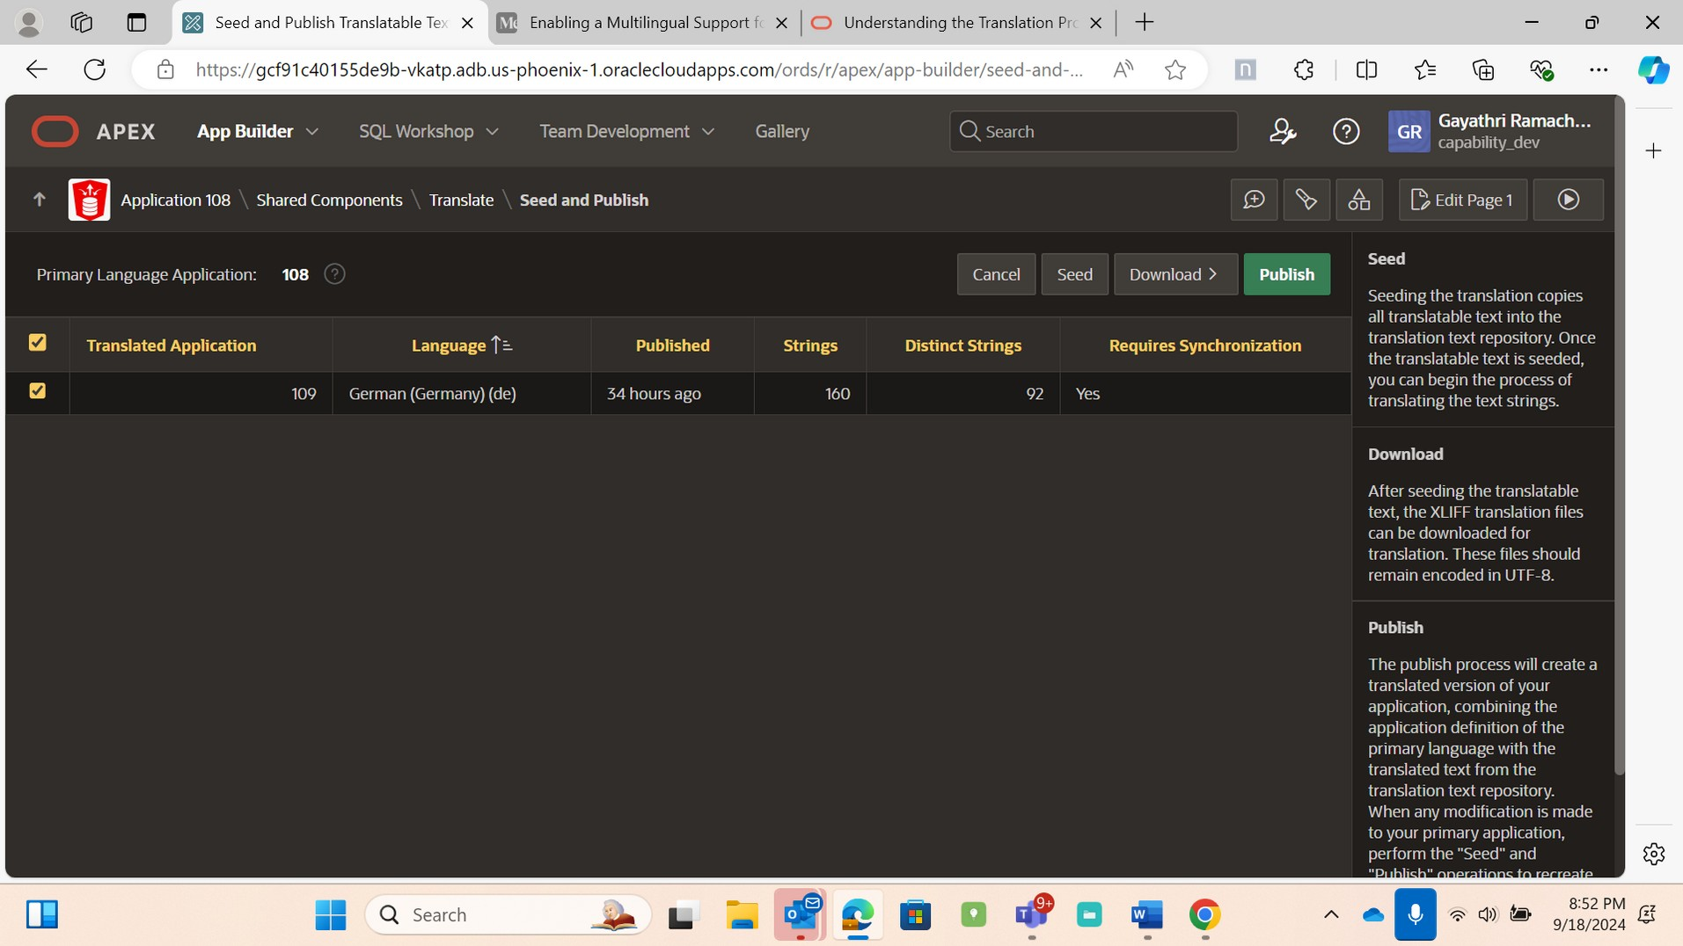
➢
Check the box which Application you want to translate and then
Publish.
Approach2 -You can also translate an application by uploading the
translated file
Seed->Download XLIFF translation File->Apply Translation File->Publish
Translated application
21

Slide 22
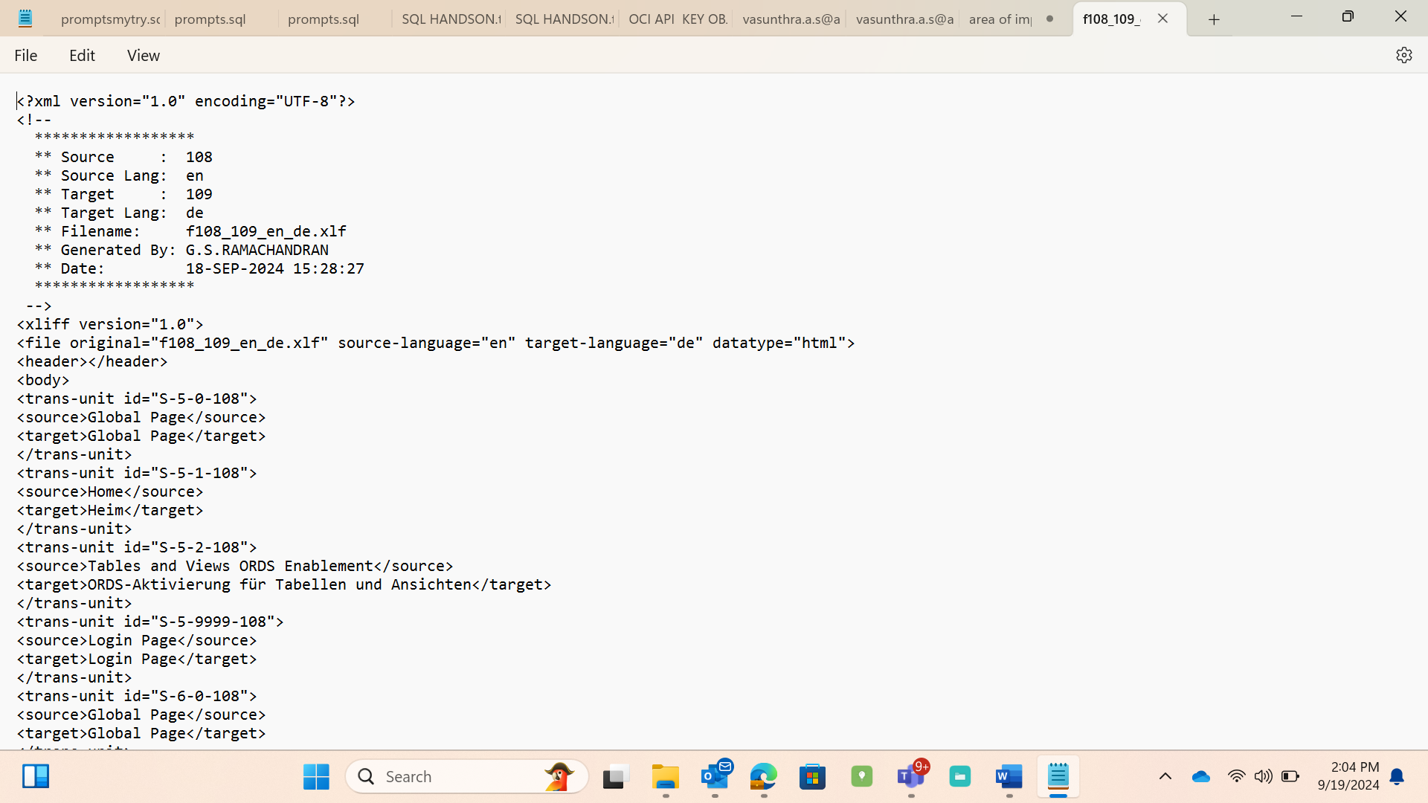
➢
Download files with translatable text of whole Application or a
particular page from the translation repository.
➢
Select language (translating language :de)→ Download XLIFF file for
complete application /Download XLIFF for Application Page → Export
file for application
➢
Select Download XLIFF Translation files
➢
Select the language [example: German (de)] and include XLIFF Target
Elements and Click Export XLIFF file for Application.
➢
Open the XLIFF file from downloads in File Explorer and open in
Notepad
➢
In notepad , for which Label or button or page item , Change the
translated text in Target as highlighted below and save the file.
➢
The XLIFF file is parsed, and the contents is applied to the translation
repository. Once this process is complete, you must publish an
application for each translation.
22

Slide 23
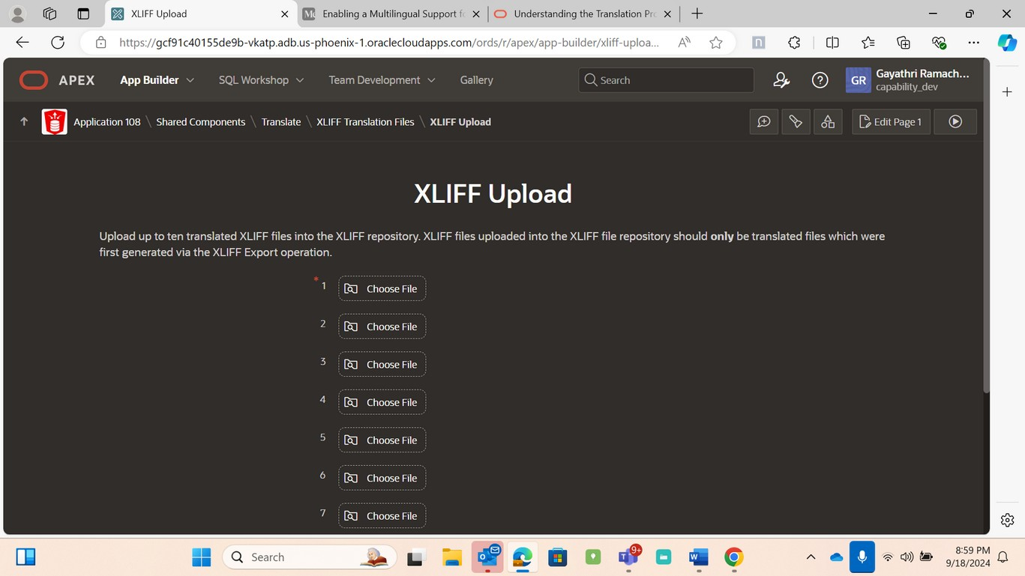
➢
Apply XLIFF translation files →Upload the downloaded XLIFF file
→Upload →
➢
Select “Apply to Translation” [for example here English to German |
108→109(de)] →Check the target Application and Publish.
➢
Select Apply XLIFF translation Files.
Click on Upload files
➢
Choose the XLIFF file that has been translated above.
➢
After selecting the file, click on Upload
➢
After uploading the file, check the filename as mentioned below and
click on Publish.
23

Slide 24
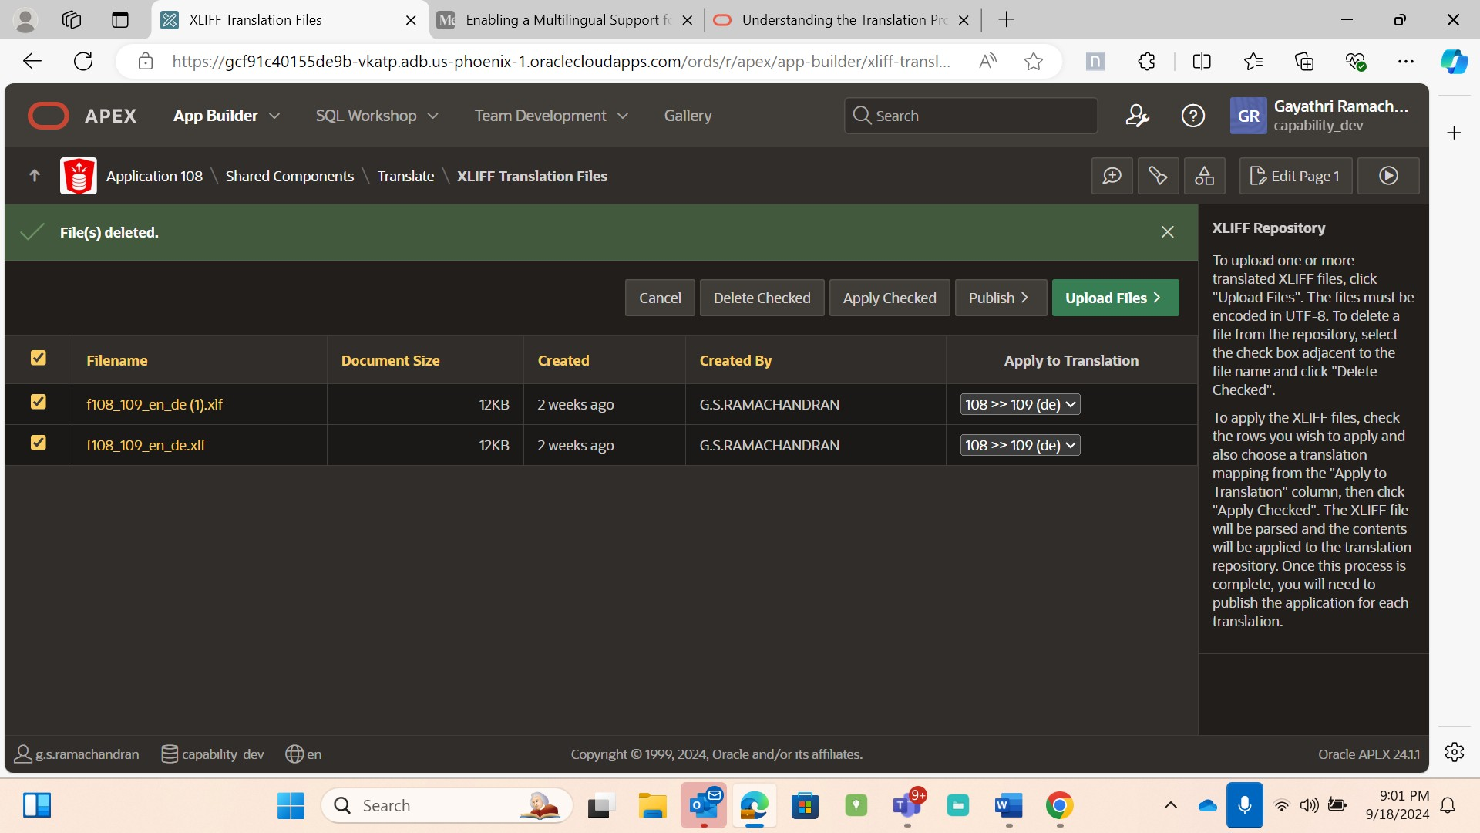
➢
It will direct you to Publish translated Application, there click on
Publish.
6.5 Test your application
After testing an application yourself, the next step is to ask your
users to use the application that is globalized to ensure that the
24

Slide 25
translated application is performing well and correctly in a multiple
languages.
7. CONCLUSION
This paper highlights the steps to be performed to ensure a smooth
transition and start leveraging the apex globalization. After following
the mentioned steps it’s advised to run and test your application.
8.REFERENCES
➢
Managing Application Globalization (oracle.com)
➢
https://supphachai.medium.com/enabling-a-multilingual-support-for-
oracle-apex-applications-3b09b9d7b3a2
25

