Slide 1

UNDERGRADUATE PROJECT (ME-392)
Prediction of Properties of Additively
Manufactured Parts for Haynes 282
PART II | EXPERIMENTAL VALIDATION AND JOINT INVERSE DESIGN
Taha Hassan Khan (23135147) | Shivarpan Tyagi (23135151) | Shivam Kumar (23135152)
Prachi Singh (23135158) | Satyam Kumar Mishra (23135162)
Under the guidance of
Dr. Pawan Sharma
Department of Mechanical Engineering | Indian Institute of Technology (BHU), Varanasi
NOVEMBER 2026

Slide 2
Project extension
From a broad process-property workflow to a mechanically validated, multi-property study
PART I | FOUNDATION
PART II | THIS STUDY
Four LPBF inputs
Relative-density prediction and process mapping
Initial forward and inverse application
Measured hardness and UTS added to relative density
Sample-wise error checks at two process settings
Joint inverse search for diverse candidates
•
20 specimen-level records report hardness, tensile strength, and relative density.
•
The 500-point set is synthetic augmentation generated from training-only models; it is not 500 additional independent experiments.
•
This deck reports the new mechanical-property checks separately from the earlier broad-dataset model scores.
ME-392
2

Slide 3
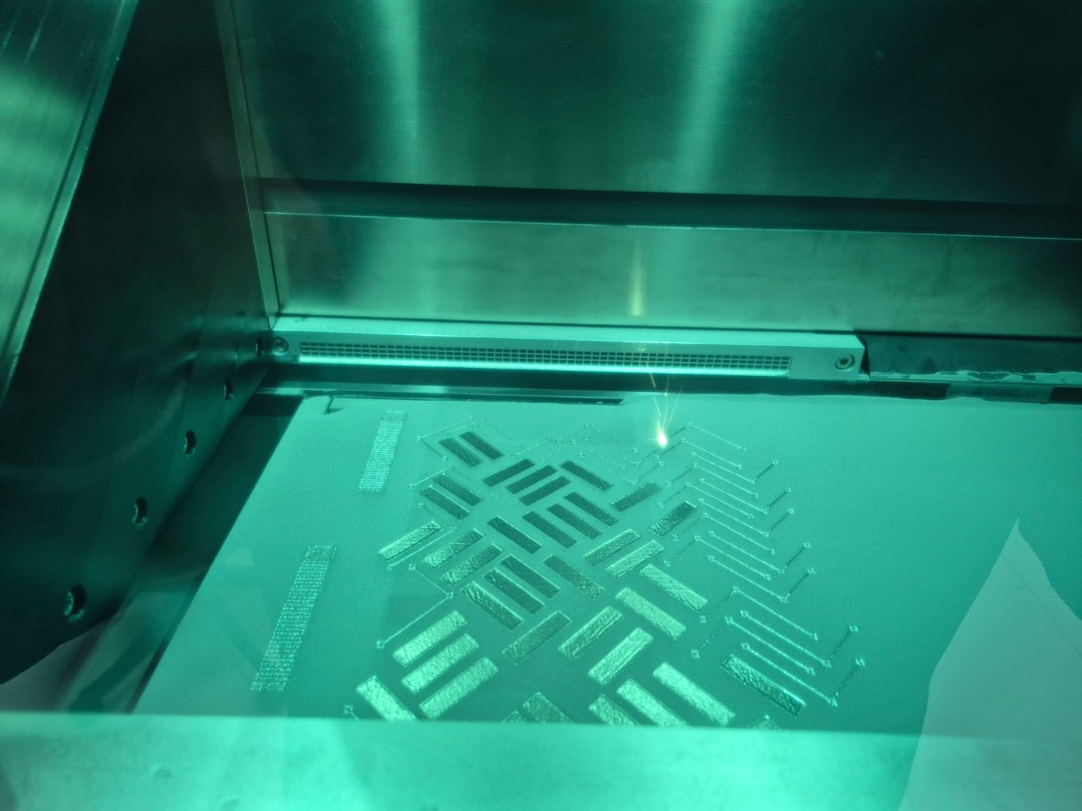
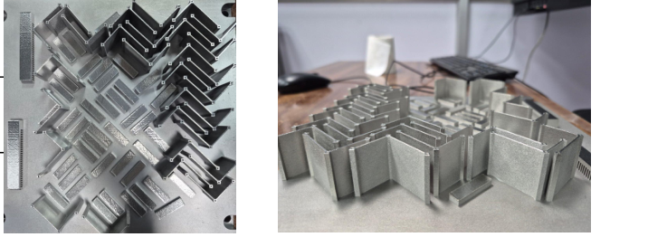
Experimental campaign and validation design
Specimens are reported individually; model checks use held-out conditions
20 RECORDS
13 TRAIN SETTINGS
15 unique settings
All layer thicknesses: 0.04 mm
Used for training-only LOOCV and the validation-fold surrogate
SAMPLES 4, 16-20
SAMPLE 11
LIVE LPBF BUILD
Six individually measured specimens
Each specimen reported separately
Sample 11
280 W | 1550 mm/s | 0.085 mm hatch
Hardness composite: mean of the perpendicular-group mean and parallel-group mean; each orientation has equal weight.
Hardness readings are in HV; UTS in MPa; relative density in percent.
ME-392
3

Slide 4
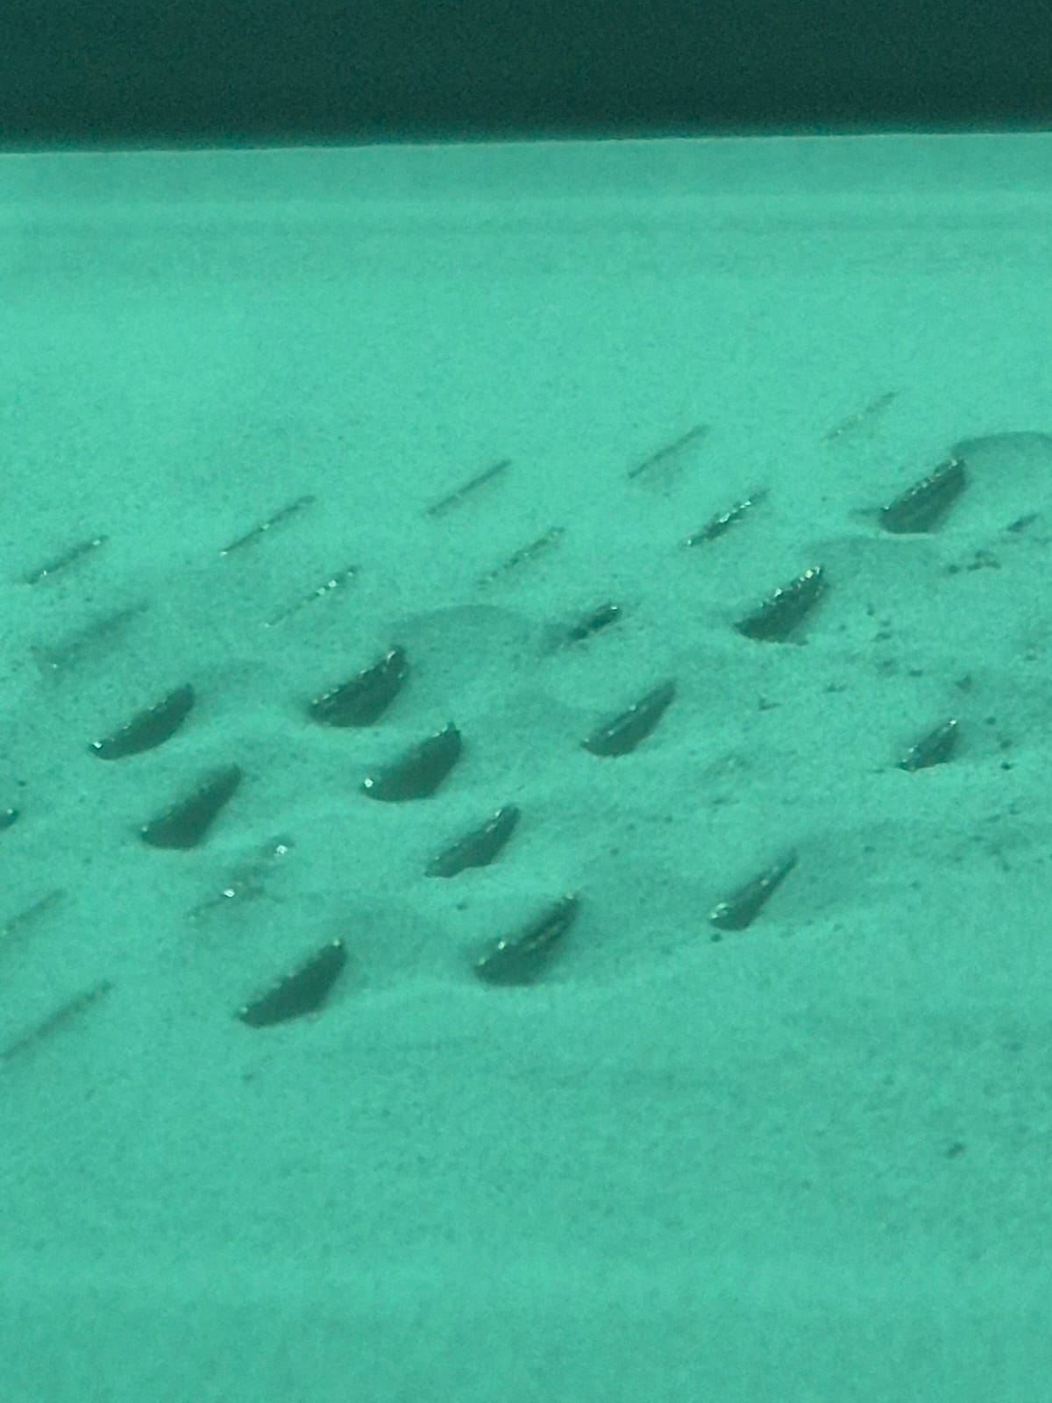
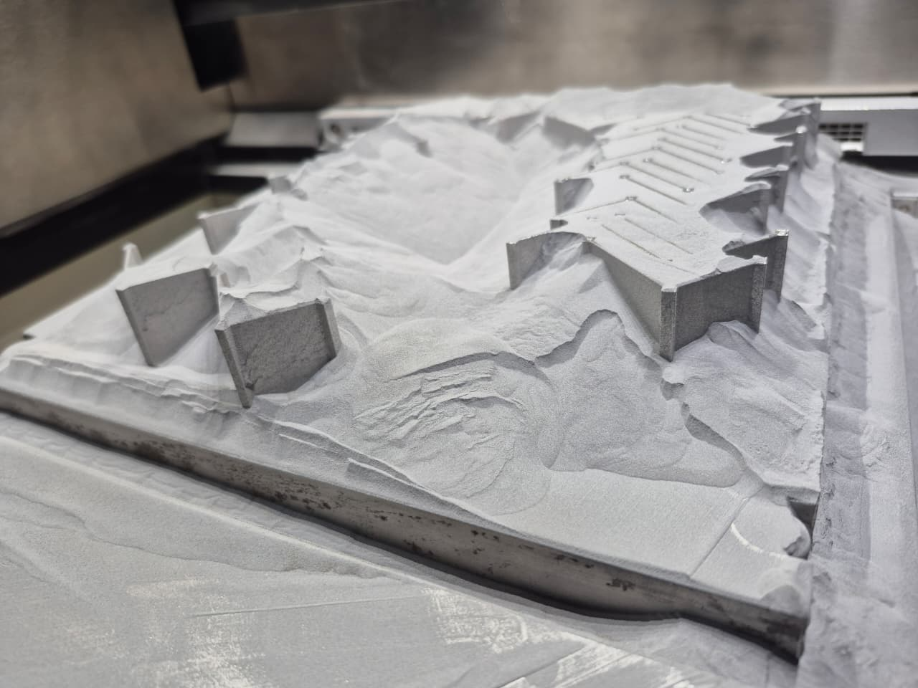
Post-build inspection
Sample parts which over melted due to less wall thickness hence heat concentration
ADD DEFECTIVE PART / MICROGRAPH IMAGE
Replace this area with a post-build photo or microscopy image. Add sample ID, process setting, and observed defect type in the caption.
ME-392
6

Slide 5
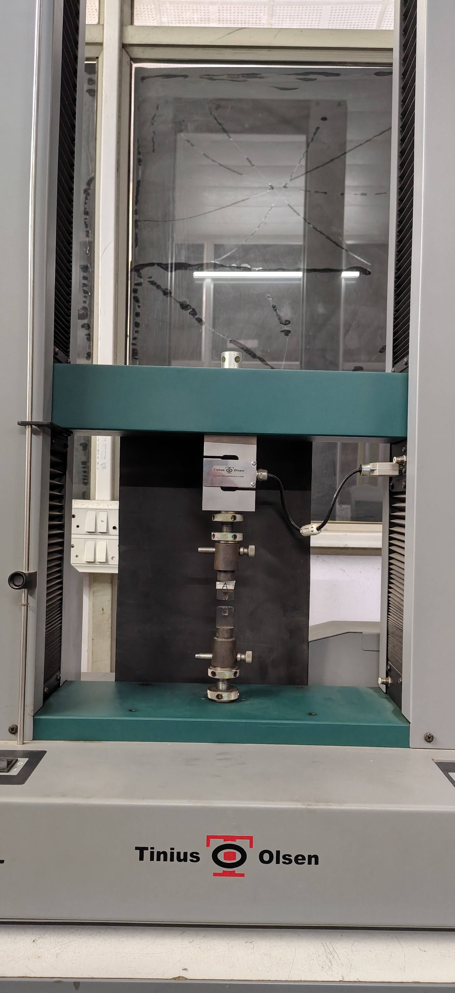
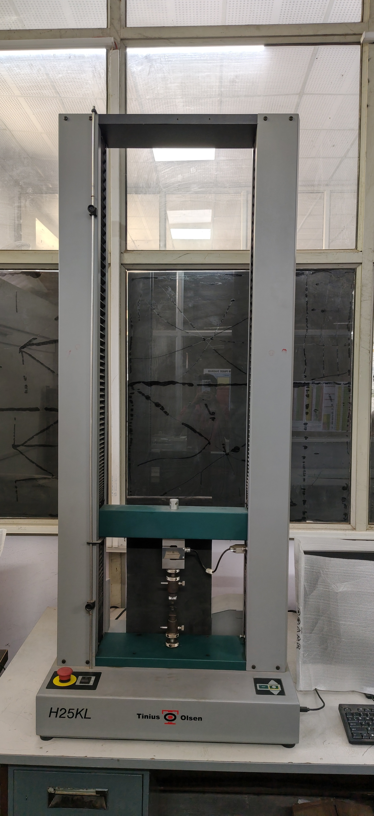
UTS experimental setup
Tensile testing on the Tinius Olsen frame
TEST MACHINE
Tinius Olsen H25KL tensile testing frame
MEASUREMENT
Each specimen is loaded in tension while force and extension are recorded. UTS is derived from peak load divided by the original cross-sectional area.
DATA LINK
UTS measurements are matched to the same laser power, scan speed, hatch distance, and layer thickness as hardness and density.
ME-392
4

Slide 6
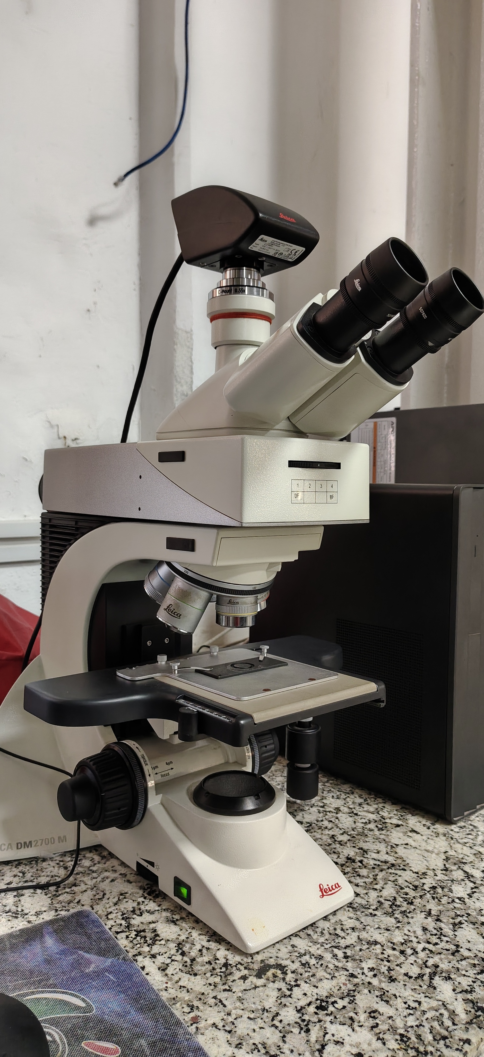
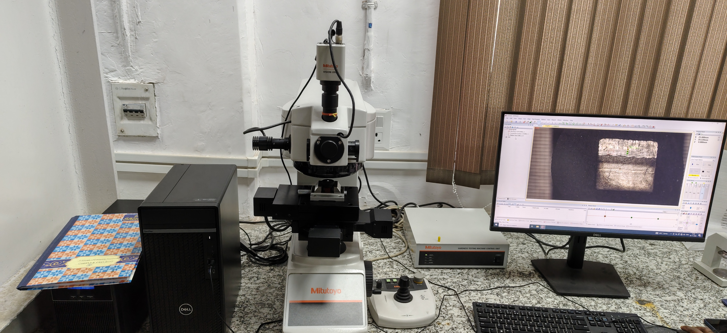
Hardness experimental setup
Mitutoyo HM-200 with optical indentation measurement
HARDNESS INSTRUMENT
Mitutoyo HM-200 hardness tester
READING STRATEGY
Multiple indent readings were taken in two orientations: six perpendicular and three parallel readings per sample.
COMPOSITE VALUE
Hardness_HV = mean of the two orientation means, giving each orientation equal weight.
ME-392
5

Slide 7
Methodology | leakage-aware training pipeline
Real process settings are kept separate from synthetic augmentation
1 | ALIGN
2 | GROUP SPLIT
3 | TEACHER
20 paired records
15 unique settings
Four process inputs + three measured properties
13 training settings
2 held-out settings
All repeated settings stay together
Ridge models
Leave-one-condition-out residuals
Training fold only
4 | AUGMENT
5 | STUDENT
6 | EVALUATE
Generate 500 process points
Within training support
Bootstrap centered residuals
Extra Trees regressors
Synthetic coverage + weighted real anchors
One model per property
Predict held-out measured settings
Report RMSE, MAE, R², and % error
Then refit on all 15 settings
The 500 points are model-generated augmentation, not 500 new experiments.
ME-392
7

Slide 8
Methodology | why this design
A practical compromise for sparse experiments, with limits stated explicitly
GROUP BY PROCESS SETTING
HOLD OUT BEFORE SYNTHESIS
Replicate coupons at identical settings are not split across training and validation; this prevents an overly optimistic test.
The two validation settings are excluded before the 500 synthetic rows are generated, so their measurements do not seed the validation model.
AUGMENT COVERAGE, NOT EVIDENCE
REPORT WEAK RESULTS HONESTLY
Synthetic points help the student model cover the measured parameter region; only real measurements can establish experimental performance.
Negative LOOCV R² and a weak UTS miss at sample 11 indicate that more unique experimental settings are needed before strong claims.
Inverse optimization proposes experiments; it does not experimentally certify the recommended parameters.
ME-392
8

Slide 9
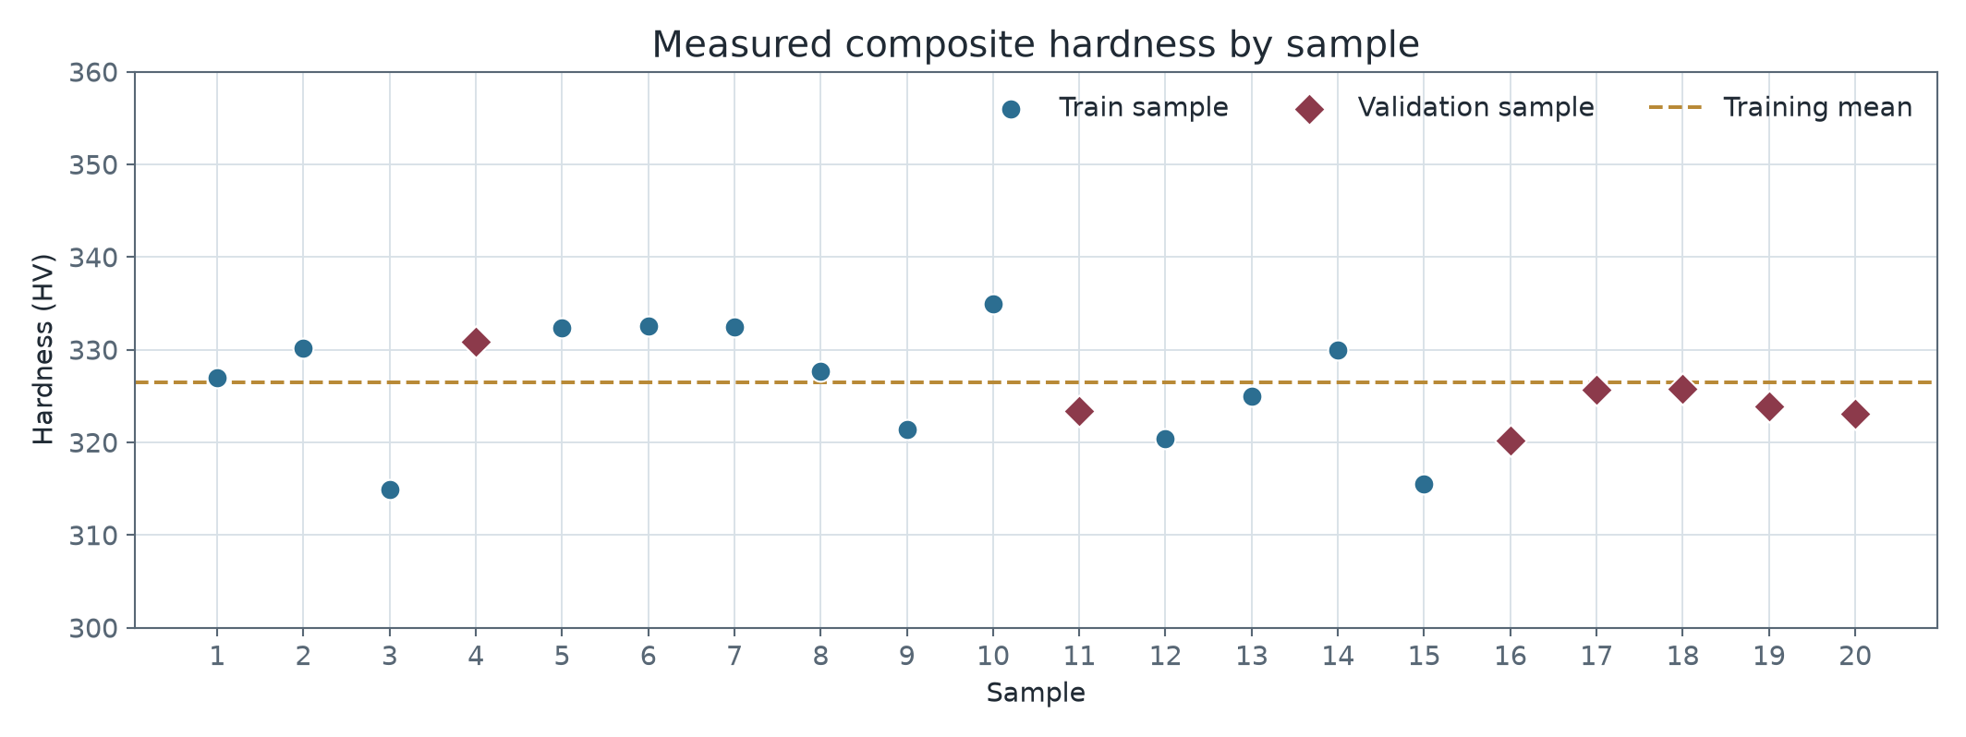
Hardness measurements
Orientation-averaged composite hardness; samples 4, 11, and 16-20 are highlighted
TRAIN MEAN
326.5 HV
SAMPLES 4, 16-20
Mean 324.90 HV
SD 3.55 HV
SAMPLE 11
323.38 HV
One source reading was confirmed as 320 HV before the composite was calculated.
ME-392
9

Slide 10
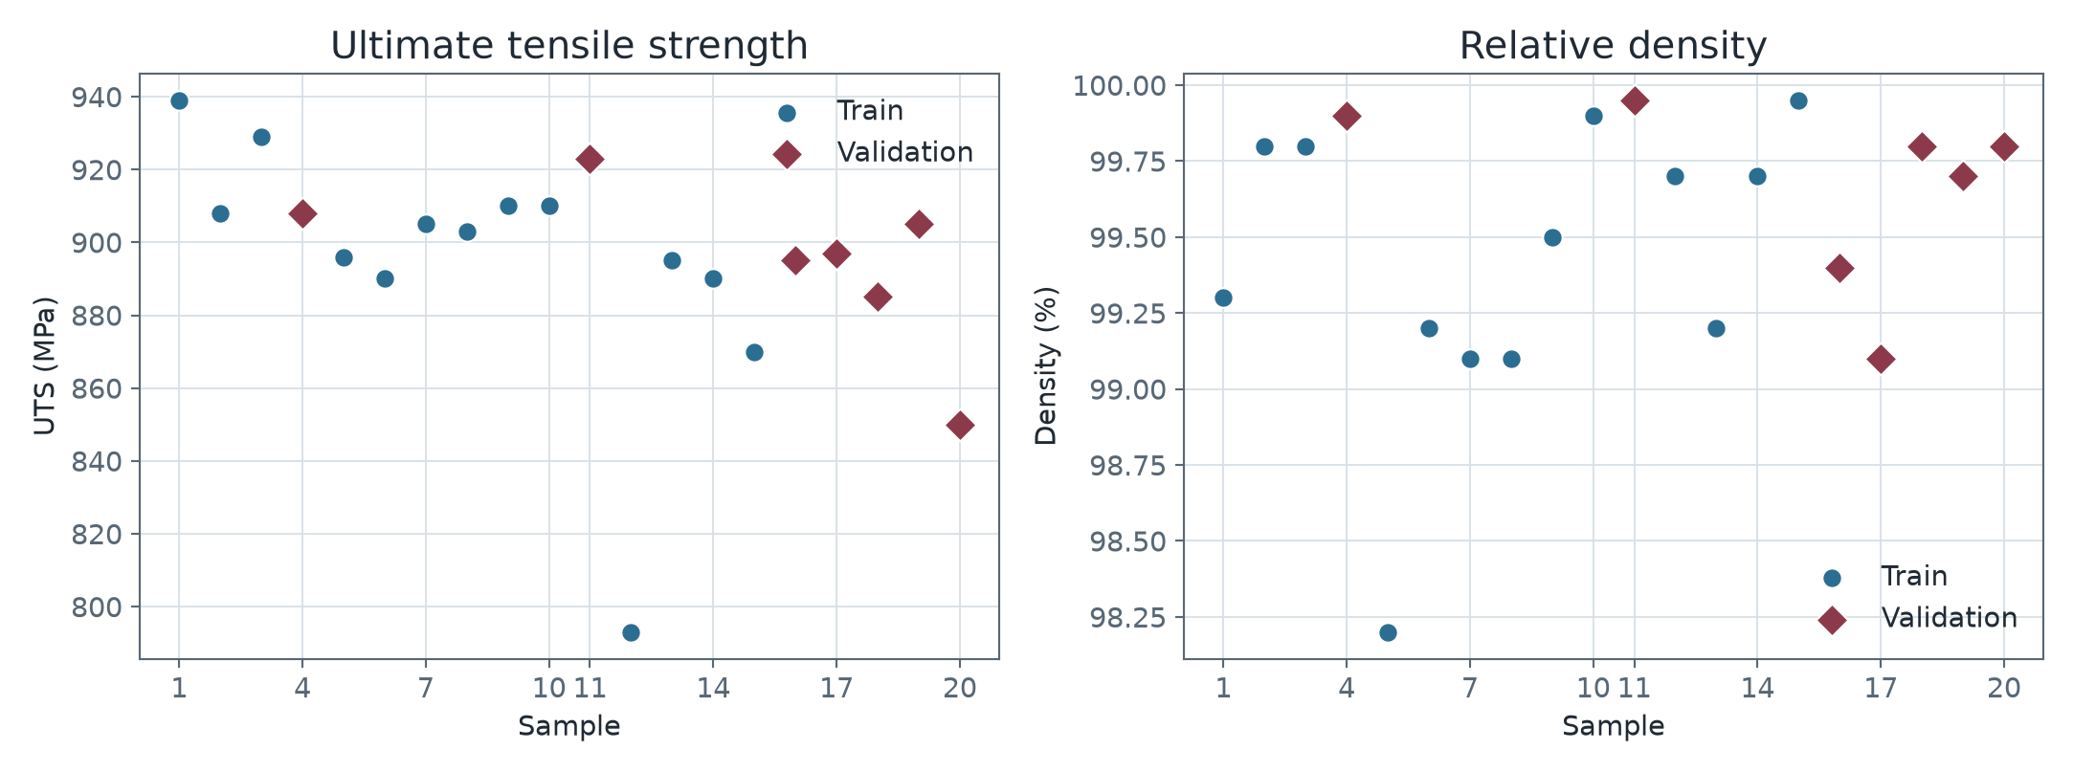
Measured UTS and relative density
Paired measurements link the mechanical targets
Samples 4, 16-20 mean: UTS 890.0 MPa | density 99.617%
Sample 11: UTS 923 MPa | density 99.95%
ME-392
10

Slide 11
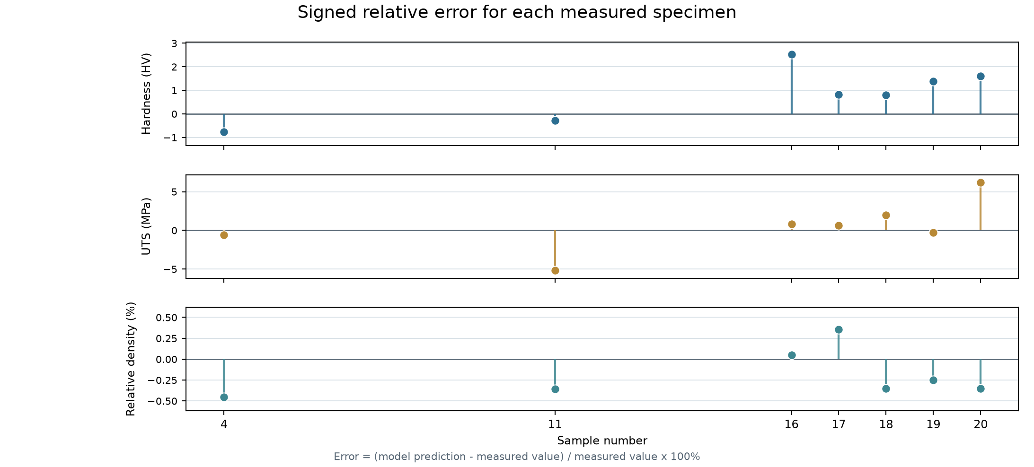
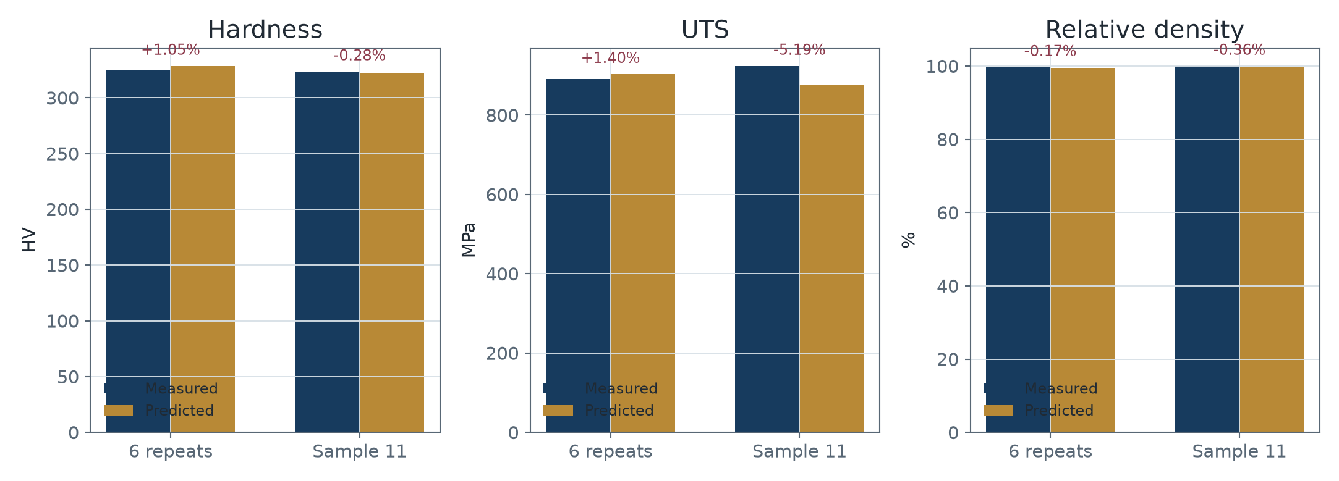
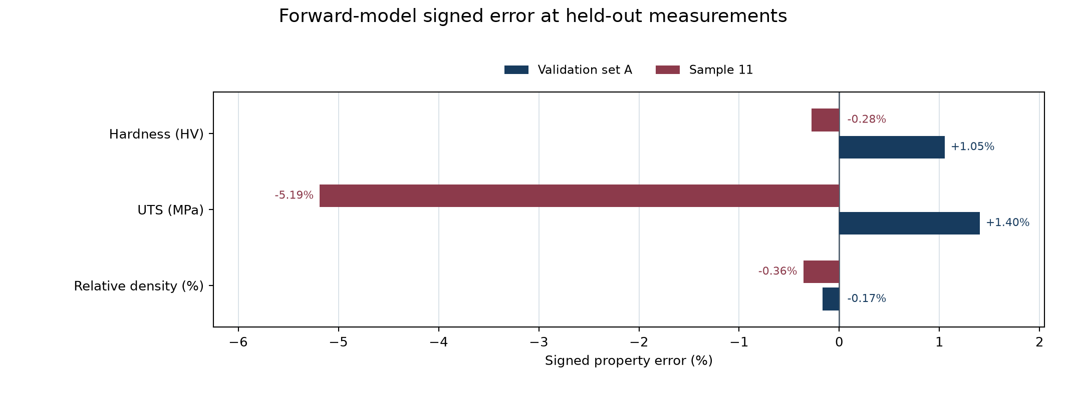
Sample-wise forward-model errors
Each specimen is compared with its setting-specific prediction; errors are relative (%)
Closest overall (mean absolute relative error across all three properties): Sample 17 (0.59%) and Sample 4 (0.61%).
ME-392
11

Slide 12
Training-only LOOCV diagnostics
Ridge teacher predictions across 13 unique training settings
Property | N | R2 | RMSE | MAE | MAPE
UTS | 13 | -0.305 | 38.74 MPa | 27.02 MPa | 3.11%
Density | 13 | -0.062 | 0.48 percentage points | 0.35 percentage points | 0.35%
Hardness | 13 | -0.347 | 7.39 HV | 6.24 HV | 1.92%
INTERPRETATION
All three LOOCV R2 values are below zero: on these 13 unique settings, out-of-fold predictions did not beat the mean-target baseline.
These are diagnostics for the real-data Ridge teacher, not a claim that the 500 synthetic rows are independent measurements.
ME-392
12

Slide 13
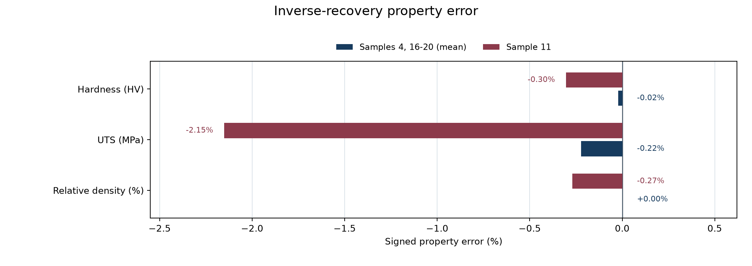
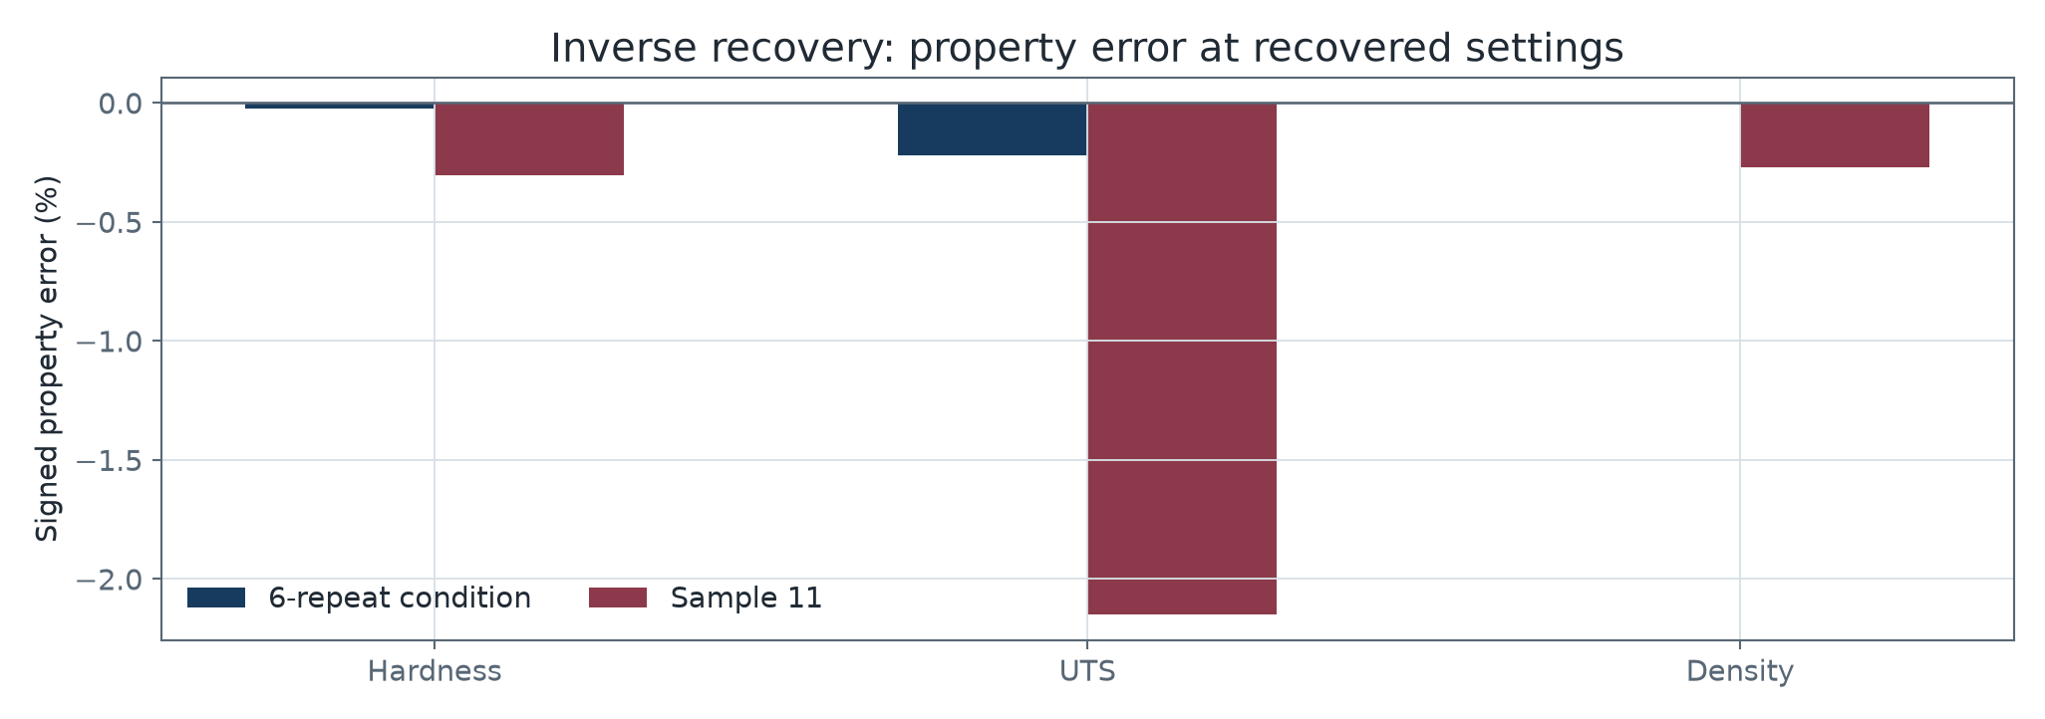

Inverse recovery: matching properties is not recovering the same setting
Inverse search uses models trained on the other 13 process settings
Target | Actual P/v/h | Recovered P/v/h
Samples 4,16-20 | 270/1500/0.080 | 280.2/1534.2/0.0788
Sample 11 | 280/1550/0.085 | 270.2/1420.8/0.0900
The mean properties of samples 4, 16-20 matched at a different setting, demonstrating non-unique inverse solutions.
Sample 11 inverse property errors: hardness -0.30%, UTS -2.15%, density -0.27%.
ME-392
13

Slide 14
Joint inverse search: six Pareto candidates
All outputs are forward-model estimates; separate candidates lead on separate properties
# | Power W | Speed mm/s | Hatch mm | Hardness HV | UTS MPa | Density %
1 | 268.2 | 1402 | 0.0799 | 331.47 | 905.2 | 99.771
2 | 286.0 | 1409 | 0.0796 | 328.18 | 892.9 | 99.805
3 | 251.8 | 1582 | 0.0701 | 327.15 | 931.2 | 99.144
4 | 273.8 | 1584 | 0.0710 | 327.83 | 905.7 | 99.328
5 | 262.4 | 1526 | 0.0784 | 326.94 | 907.9 | 99.370
6 | 270.9 | 1554 | 0.0882 | 322.17 | 910.3 | 99.534
MAX HARDNESS
MAX UTS
MAX DENSITY
Candidate 1 | 331.47 HV
Candidate 3 | 931.16 MPa
Candidate 2 | 99.805%
The six candidates are a screening shortlist, not experimentally validated settings. Confirm machine increments and build feasibility before printing.
ME-392
14

Slide 15
Dataset description
20 individually measured specimens | three measured properties
Specimen | Hardness (HV) | UTS (MPa) | Rel. density (%) | Specimen | Hardness (HV) | UTS (MPa) | Rel. density (%)
1 | 327.01 | 939 | 99.30 | 11 | 323.38 | 923 | 99.95
2 | 330.20 | 908 | 99.80 | 12 | 320.42 | 793 | 99.70
3 | 314.88 | 929 | 99.80 | 13 | 324.94 | 895 | 99.20
4 | 330.84 | 908 | 99.90 | 14 | 330.00 | 890 | 99.70
5 | 332.37 | 896 | 98.20 | 15 | 315.53 | 870 | 99.95
6 | 332.59 | 890 | 99.20 | 16 | 320.21 | 895 | 99.40
7 | 332.49 | 905 | 99.10 | 17 | 325.64 | 897 | 99.10
8 | 327.64 | 903 | 99.10 | 18 | 325.73 | 885 | 99.80
9 | 321.35 | 910 | 99.50 | 19 | 323.83 | 905 | 99.70
10 | 334.93 | 910 | 99.90 | 20 | 323.12 | 850 | 99.80
Hardness is the orientation-averaged composite; density is relative density.
ME-392 | Haynes 282 | Part II
15

Slide 16
Conclusion and future work
A practical result: use the models to choose informative builds, then measure them
•
Hardness, UTS, and density share one specimen-level table and one held-out-condition evaluation.
•
Samples 4, 16-20 describe within-setting variation; sample 11 probes a second condition.
•
Current LOOCV R2 is negative for all three targets, so more unique real settings are the highest-value next data.
•
Inverse search shows trade-offs and non-uniqueness; recommended parameters must be verified by printing and testing.
PROPOSED FIRST BUILDS
MEASURE AND UPDATE
Choose candidates 1, 2, and 3 to probe balanced, density-led, and UTS-led trade-offs.
Record actual settings, UTS, density, and orientation-specific hardness; append the results and retrain.
Thank you
ME-392
16

Slide 17
UI testing | forward and inverse workflows
Test the input, prediction, constraint, and recommendation paths
1 | FORWARD TEST
Enter a known setting and compare predicted properties with the measured record.
2 | TARGET TEST
ADD UI QR CODE
Enter target hardness, UTS, and density; check the returned setting and property errors.
Replace with QR code linked to the live interface or demo.
3 | FEASIBILITY TEST
Confirm parameter bounds, layer thickness, and volumetric energy-density window.
4 | REVIEW
Show trade-offs and label all outputs as model estimates pending experimental checks.
Demo / interface link
ME-392
17

Slide 18
Bibliography
References
1.
2.
3.
4.
5.
6.
ME-392
18

Slide 19
THANK YOU
We are open to questions
Prediction of Properties of Additively Manufactured Parts for Haynes 282
ME-392 | IIT (BHU), Varanasi

