Slide 1

UNDERGRADUATE PROJECT (ME-392)
Prediction of Properties of Additively
Manufactured Parts for Haynes 282
PART II | EXPERIMENTAL VALIDATION AND JOINT INVERSE DESIGN
Taha Hassan Khan (23135147) | Shivarpan Tyagi (23135151) | Shivam Kumar (23135152)
Prachi Singh (23135158) | Satyam Kumar Mishra (23135162)
Under the guidance of
Dr. Pawan Sharma
Department of Mechanical Engineering | Indian Institute of Technology (BHU), Varanasi
NOVEMBER 2026

Slide 2
Project extension
From a broad process-property workflow to a mechanically validated, multi-property study
PART I | FOUNDATION
PART II | THIS STUDY
Four LPBF inputs
Relative-density prediction and process mapping
Initial forward and inverse application
Measured hardness and UTS added to relative density
Grouped holdout checks at two process settings
Joint inverse search for diverse candidates
•
20 experimental records cover 15 unique process settings.
•
The 500-point set is synthetic augmentation generated from training-only models; it is not 500 additional independent experiments.
•
This deck reports the new mechanical-property checks separately from the earlier broad-dataset model scores.
ME-392 | Haynes 282 | Part II
2

Slide 3
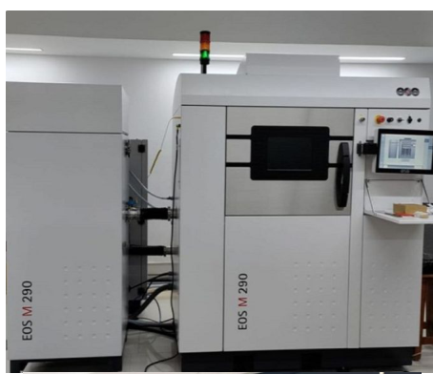
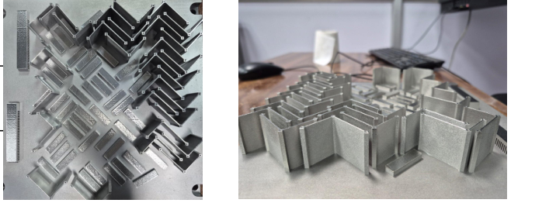
Experimental campaign and validation design
Real measurements are grouped by process setting before training or validation
20 RECORDS
13 TRAIN SETTINGS
15 unique settings
All layer thicknesses: 0.04 mm
Used for training-only LOOCV and the validation-fold surrogate
6-REPLICATE HOLDOUT
SAMPLE 11 HOLDOUT
270 W | 1500 mm/s
0.08 mm hatch
6 repeated samples = 1 setting
280 W | 1550 mm/s
0.085 mm hatch
1 independent setting
Hardness composite: mean of the perpendicular-group mean and parallel-group mean; each orientation has equal weight.
Hardness readings are in HV; UTS in MPa; relative density in percent.
ME-392 | Haynes 282 | Part II
3

Slide 4
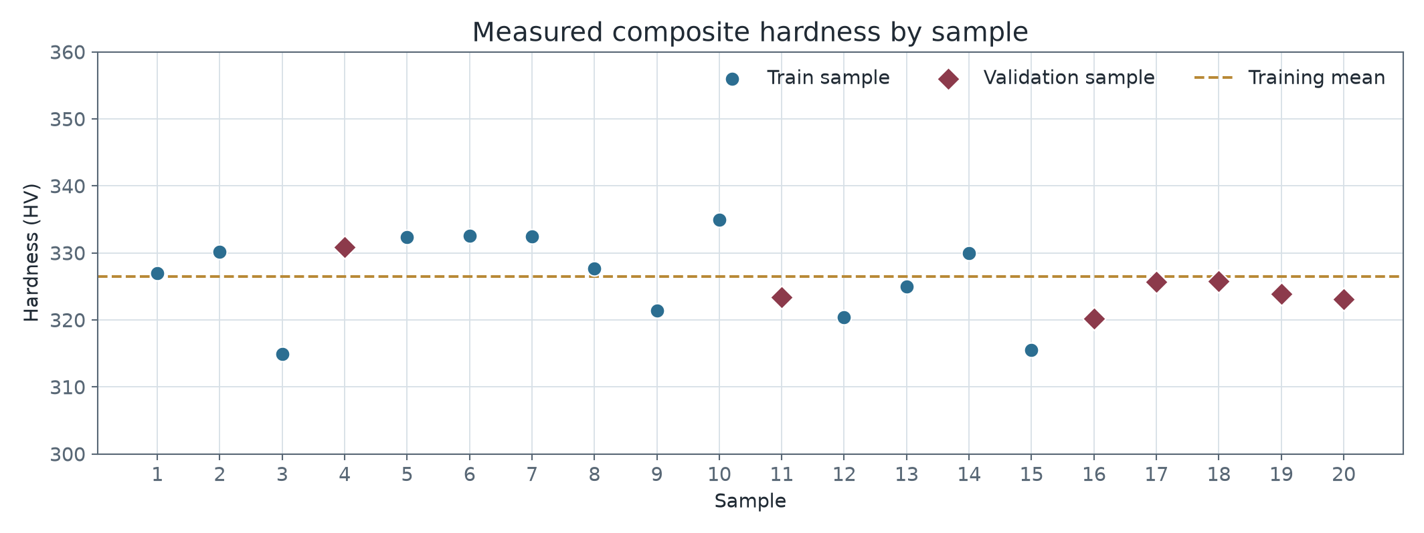
Hardness measurements
Orientation-averaged composite hardness; validation settings are highlighted
TRAIN MEAN
326.5 HV
6-REPEAT HOLDOUT
Mean 324.90 HV
SD 3.55 HV
SAMPLE 11
323.38 HV
One source reading was confirmed as 320 HV before the composite was calculated.
ME-392 | Haynes 282 | Part II
4

Slide 5
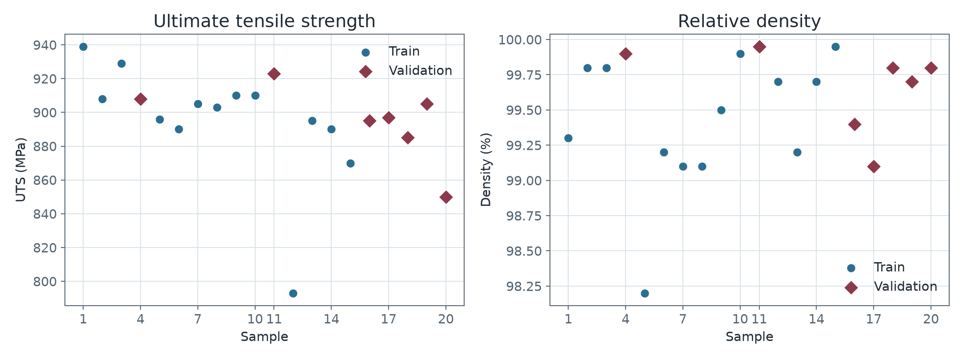
Measured UTS and relative density
The same experimental settings link the mechanical targets
Six-repeat condition mean: UTS 890.0 MPa | density 99.617%
Sample 11: UTS 923 MPa | density 99.95%
ME-392 | Haynes 282 | Part II
5

Slide 6
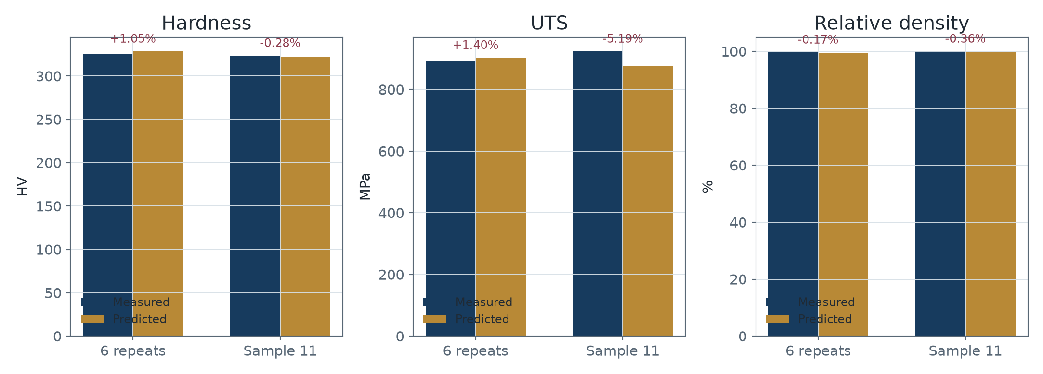
Forward-model holdout results
Predictions at measured settings; error is relative to the measured property
Setting | Property | Measured | Predicted | Error
6 repeats | UTS | 890.00 | 902.48 | +1.40%
6 repeats | Density | 99.62 | 99.45 | -0.17%
6 repeats | Hardness | 324.90 | 328.31 | +1.05%
Sample 11 | UTS | 923.00 | 875.13 | -5.19%
Sample 11 | Density | 99.95 | 99.59 | -0.36%
Sample 11 | Hardness | 323.38 | 322.47 | -0.28%
Sample 11 UTS is the main miss (-5.19%); additional unique-condition experiments are needed.
ME-392 | Haynes 282 | Part II
6

Slide 7
Training-only LOOCV diagnostics
Ridge teacher predictions across 13 unique training settings
Property | N | R2 | RMSE | MAE | MAPE
UTS | 13 | -0.305 | 38.74 MPa | 27.02 MPa | 3.11%
Density | 13 | -0.062 | 0.48 percentage points | 0.35 percentage points | 0.35%
Hardness | 13 | -0.347 | 7.39 HV | 6.24 HV | 1.92%
INTERPRETATION
All three LOOCV R2 values are below zero: on these 13 unique settings, out-of-fold predictions did not beat the mean-target baseline.
These are diagnostics for the real-data Ridge teacher, not a claim that the 500 synthetic rows are independent measurements.
ME-392 | Haynes 282 | Part II
7

Slide 8
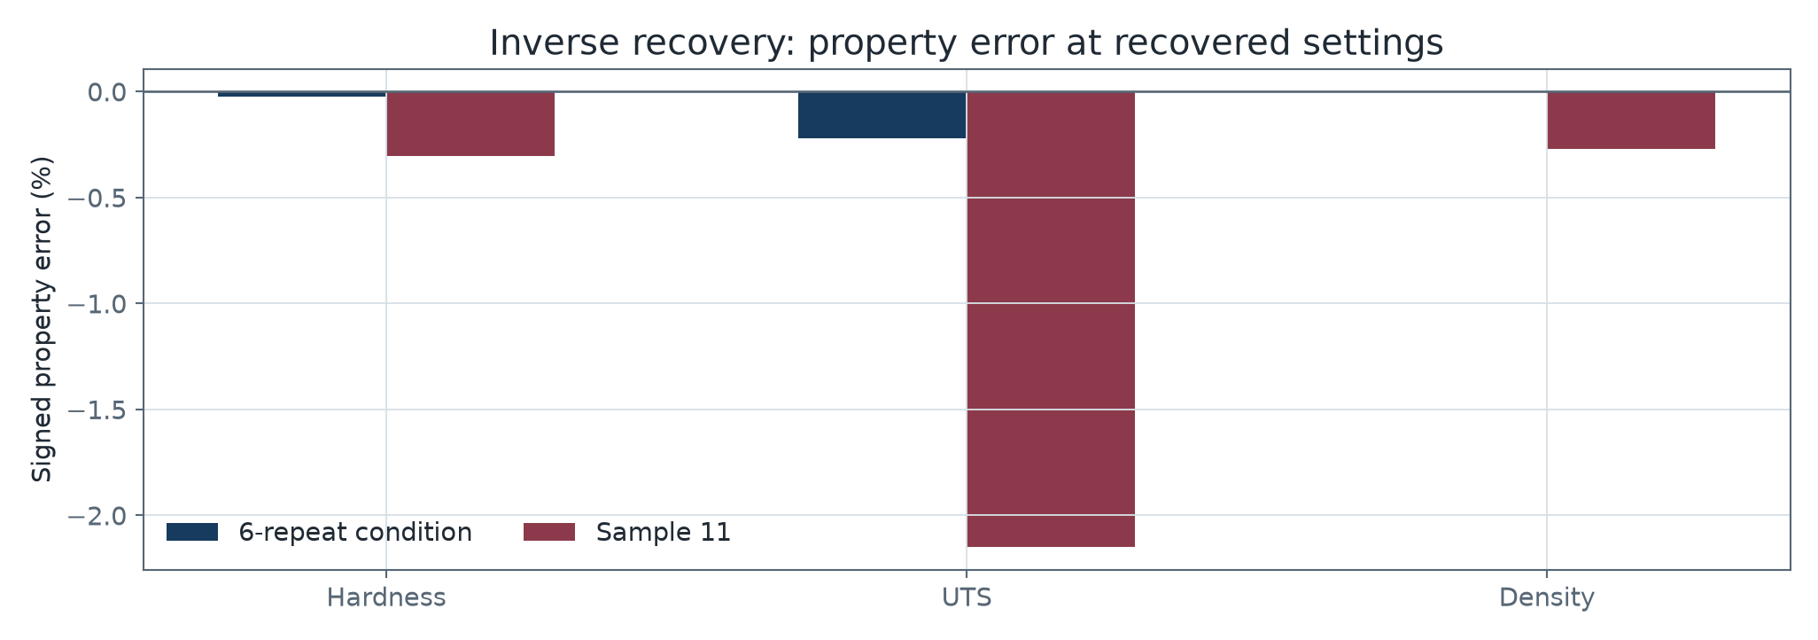
Inverse recovery: matching properties is not recovering the same setting
The validation-fold inverse uses models trained on the other 13 settings
Target | Actual P/v/h | Recovered P/v/h
6-repeat | 270/1500/0.080 | 280.2/1534.2/0.0788
Sample 11 | 280/1550/0.085 | 270.2/1420.8/0.0900
First condition: properties matched closely at a different setting. This demonstrates non-unique inverse solutions.
Sample 11 inverse property errors: hardness -0.30%, UTS -2.15%, density -0.27%.
ME-392 | Haynes 282 | Part II
8

Slide 9
Joint inverse search: six Pareto candidates
All outputs are forward-model estimates; separate candidates lead on separate properties
# | Power W | Speed mm/s | Hatch mm | Hardness HV | UTS MPa | Density %
1 | 268.2 | 1402 | 0.0799 | 331.47 | 905.2 | 99.771
2 | 286.0 | 1409 | 0.0796 | 328.18 | 892.9 | 99.805
3 | 251.8 | 1582 | 0.0701 | 327.15 | 931.2 | 99.144
4 | 273.8 | 1584 | 0.0710 | 327.83 | 905.7 | 99.328
5 | 262.4 | 1526 | 0.0784 | 326.94 | 907.9 | 99.370
6 | 270.9 | 1554 | 0.0882 | 322.17 | 910.3 | 99.534
MAX HARDNESS
MAX UTS
MAX DENSITY
Candidate 1 | 331.47 HV
Candidate 3 | 931.16 MPa
Candidate 2 | 99.805%
The six candidates are a screening shortlist, not experimentally validated settings. Confirm machine increments and build feasibility before printing.
ME-392 | Haynes 282 | Part II
9

Slide 10
Conclusions and next experimental step
A practical result: use the models to choose informative builds, then measure them
•
Hardness, UTS, and density now share one measured-condition table and one grouped validation design.
•
The six-replicate holdout checks repeatability at one setting; sample 11 checks transfer to a second setting.
•
Current LOOCV R2 is negative for all three targets, so more unique real settings are the highest-value next data.
•
Inverse search shows trade-offs and non-uniqueness; recommended parameters must be verified by printing and testing.
PROPOSED FIRST BUILDS
MEASURE AND UPDATE
Choose candidates 1, 2, and 3 to probe balanced, density-led, and UTS-led trade-offs.
Record actual settings, UTS, density, and orientation-specific hardness; append the results and retrain.
Thank you
ME-392 | Haynes 282 | Part II
10

