Slide 1
Storm Readiness AI
AI-powered storm preparedness & response intelligence — from a forecast to a staged, reviewed resource plan.
Team of 4 · Hackathon submission · Build freeze Oct 5 · Submit Oct 9
1

Slide 2
Forecasts say where the storm goes — not what it costs your county
Emergency managers
Organizations
Residents
● Own staging decisions
● Get the full plan, scenario spread, what-if answers
● Approve, reject or edit every recommendation
● Food banks, school districts, utility partners
● Get resource needs relevant to them
● See their facilities at risk
● Plain-language, location-specific alerts
● Generated from the approved plan
● Available in Spanish
Large operators run 24/7 ops centers linking forecast to logistics. Most counties and nonprofits don't.
2

Slide 3
The pipeline mirrors the sponsor's own seven-stage design, stage for stage
1
2
3
4
5
6
7
Detect
Forecast
Impact
Risk
Resources
Actions
Decision
Every advisory re-runs all seven stages automatically — a human still approves the output.
3

Slide 4
All 10 MVP-required components ship — three are the ones teams skip
Natural-language interface
Why an area is high-risk
Underlying data & sources
● Chat panel in the web app
● Backed by the agent's own tool-calling loop
● Not a separate, unverified free-text answer
● Impact model's feature importance
● Shown in plain language
● e.g. “wind exposure and low canopy, not population”
● Every recommendation names its inputs
● Which advisory, model version, scenario set
● Drawn from the trust layer's own check
Full 10-component MVP compliance table in the appendix.
4

Slide 5
Each job goes to the tool that's actually good at it
1
2
3
4
Scenarios
Impact Model
Optimizer
AI Agent
NHC forecast-error AR(1) models
XGBoost, 10-yr EAGLE-I outages
2-stage stochastic (Bhattarai & Song)
Orchestrates, model-agnostic
The one failure we can't accept: an LLM inventing quantities in a life-safety setting — this design rules it out.
5

Slide 6
Every AI output is checked against the models before a human ever sees it
Check
Method
On failure
Numbers match the models
Deterministic: every quantity must match a tool output
Blocked and regenerated
Confidence fits lead time
Rules tied to forecast lead time and scenario spread
Rewritten with uncertainty stated
Required steps followed
Checks the agent's tool-call sequence
Blocked
Actionable
LLM-as-judge, validated against human labels first
Flagged for reviewer
This is the differentiator — not a bolt-on safety check, but the layer between the model and the decision-maker.
6

Slide 7
Runs end-to-end on GCP's serverless tier — no BigQuery required
Public data
(NHC, EAGLE-I, Census, facilities)
● Storage & processing — Cloud Storage (Parquet), DuckDB, GeoPandas — no BigQuery needed
● Serving — Cloud Run (API + web app), Cloud Scheduler every 6h
● State — Firestore review log
● LLM (swappable) — Vertex AI Gemini/Claude, or self-hosted Gemma — model-agnostic
Scenarios + Impact model + Optimizer
AI agent + Trust layer
Web app + review log
The LLM is a config setting, not an architecture decision.
7

Slide 8
Every data source is public, grouped into three categories
Hazard & forecast
Impact & vulnerability
Assets, guidance & phase-2
● NHC advisories + GIS (every 6h)
● NHC forecast-error verification stats
● HURDAT2 best tracks
● EAGLE-I outages, 2014–2024 (ORNL/DOE)
● US Census / ACS
● CDC SVI + FEMA National Risk Index
● HIFLD/OSM facilities, FEMA distribution centers
● FEMA / Ready.gov guidance
● Phase-2: NFHL, Overture roads, HIFLD grid
All public data — access confirmed before we depend on any source.
8

Slide 9
Backtested leave-one-storm-out against ten years of real storms
Question
Metric
Baseline
Does the impact model predict outages?
MAE on peak % out; hardest-hit county recall
Wind-threshold rule; NRI-only model
Does staging reduce unmet demand?
Unmet demand & cost under actual outages
Single-track plan; paper's shelter-only plan
Are the scenarios well calibrated?
Share of actual positions inside scenario spread
n/a
Can the agent's outputs be trusted?
Mismatch rate, block rate, human approve rate
No trust layer
Candidate storms: Florence 2018 (reproduction), Ian 2022, Helene 2024, Milton 2024.
9

Slide 10
Multi-hazard is scoped and data-ready — deliberately not built for the MVP
● One tested model beats three untested ones by Oct 5
● Flood, road, transit are the sponsor's own phase-2 examples — data already scoped
● Next model after MVP: road/transit/flood predictor, same backtest discipline
● Meets the predictive-capability bar now; credible path to the fuller vision
Deferred by design, not by gap — §11.
10

Slide 11
Designed to keep running every hurricane season at near-zero idle cost
● Idle between storms — Cloud Scheduler polls NHC every 6h, services scale to zero
● Auto-activates when a storm threatens US land
● Public post-storm scorecard — predicted vs. actual outages, published every storm
● Pilot partner sought for the 2027 season
Continuously re-tested against real events, not just at launch.
11

Slide 12
Four workstreams run in parallel toward an Oct 5 build freeze
Timeline
Workstreams
● Sep 24–29 — architecture, data pipeline, scenario generator, baseline model
● Sep 30–Oct 2 — backtest, optimizer, trust layer wired to real tools
● Oct 3–5 — end-to-end replay, accessibility pass, build freeze
● Oct 5–9 — demo video, submit by Oct 9, 9:00 PM PT
● A — Data & impact model — Ingestion, features, XGBoost training, backtest
● B — Scenarios & optimization — Forecast-error scenarios, Pyomo model, Florence reproduction
● C — Agent & trust layer — Tool definitions, agent loop, trust checks, judge validation
● D — App, accessibility & demo — Three user views, map, NL chat, review flow, video
Build freeze Oct 5. Submit early — deadline Oct 9, 9:00 PM PT.
12

Slide 13
Four sponsor decisions would materially change what we can build
● Proprietary models — Gemini/Claude on Vertex AI — is per-token billing covered by the budget?
● GPU quota — ≥ 1 NVIDIA L4 for the open-weights path — who requests it?
● BigQuery — Disabled, or just unbudgeted? Our design doesn't require it.
● Post-hackathon hosting — Whose GCP project runs it after Oct 16?
Model-agnostic either way — these answers shape scope, not feasibility.
13

Slide 14
Appendix
14

Slide 15
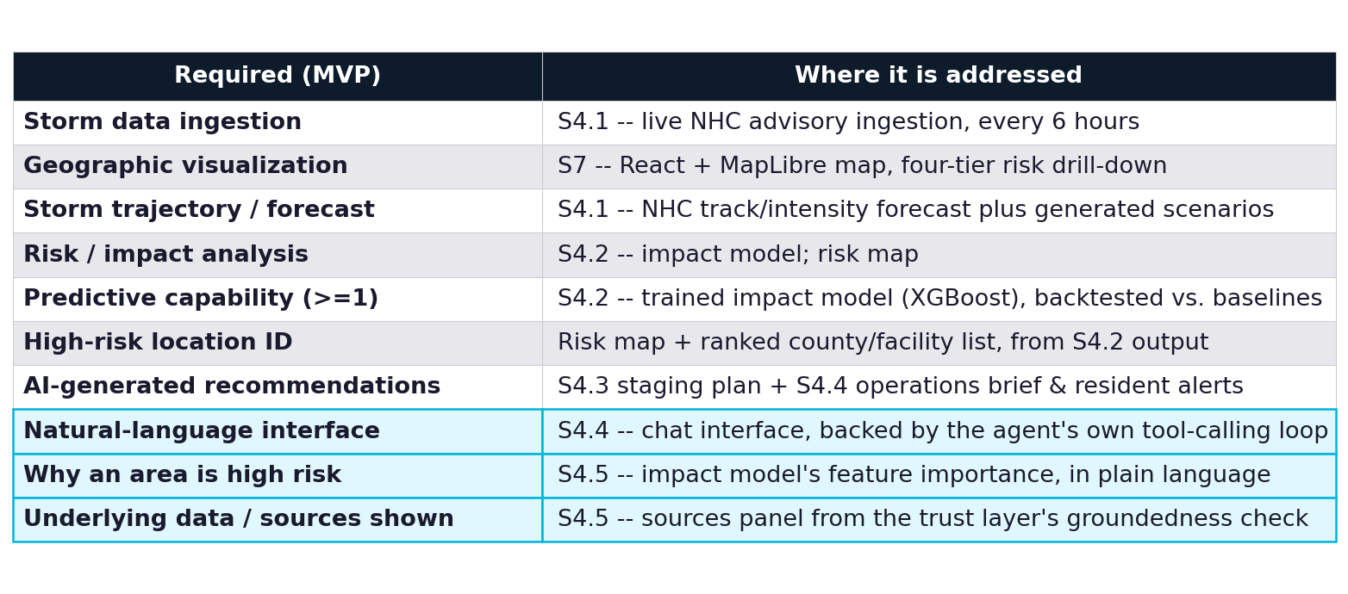
Full MVP compliance: all 10 required components, mapped to spec section
Source: proposal.md §2.1
A1

