Slide 1

Preparatory analysis for brace model
防災科学技術研究所
兵庫耐震工学研究センター
研究員 山下 拓三

Slide 2
Summary
Simulation plan corresponding to construction order is required. That is, installation of brace should be done after self loading analysis. Here, soundness of brace is investigated for the case not applying gravity(or self load).
It is found that stiffeners are required for reinforcing gusset plate of brace to keep soundness.
Results of push-over analysis are provided. Adequate difference of stiffness between the models with and without brace is confirmed for the braces of M14

Slide 3
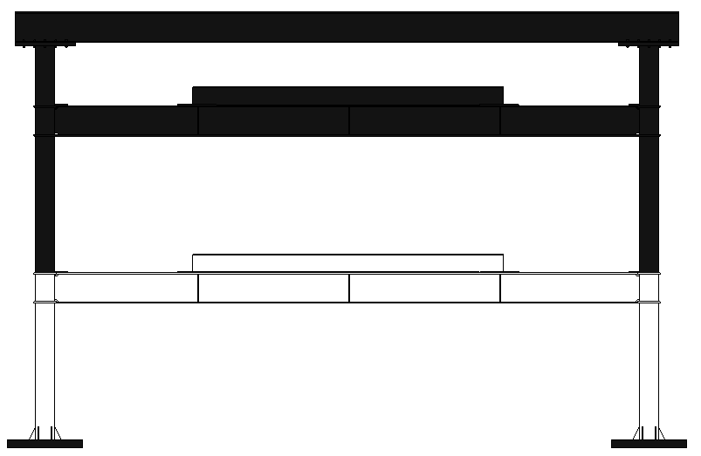
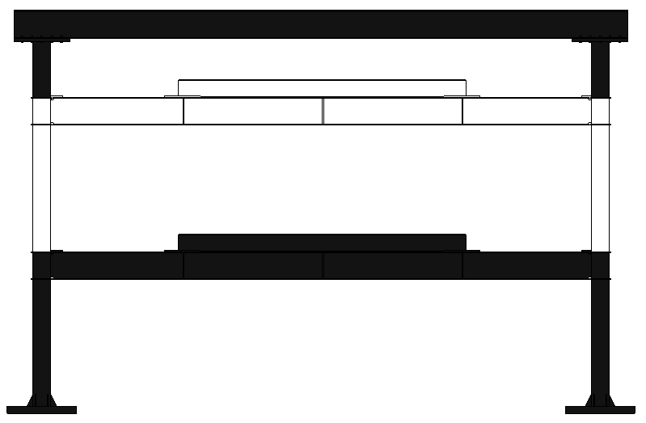
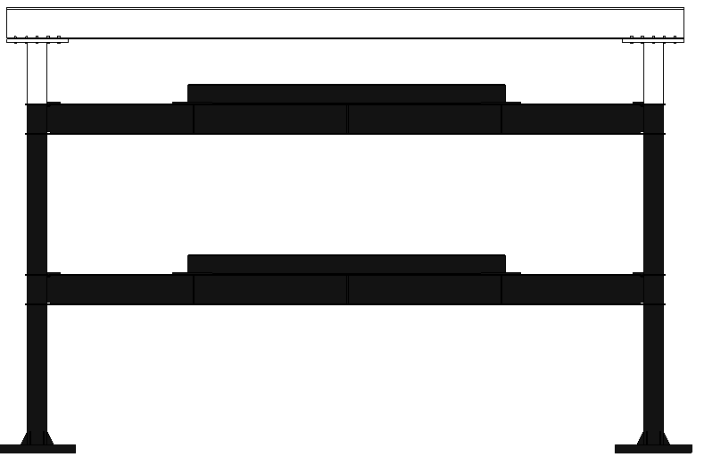
試験体骨組質量
1層（ベースプレート含まず）
2層
3+4層
解析モデルから情報取得 | 体積(mm3) | 質量(kg)
試験体（床面補強後） | 2.24E+08 | 1757
1層（ベースプレート含まず） | 7.95E+07 | 624
2層 | 7.91E+07 | 621
3+4層 | 6.43E+07 | 504

Slide 4
Analysis case
name | brace | Weight | Diameter of brace | Self load | memo
Case3 | No | H26 experiment |  |  | Not shown in this ppt
Case5 | Yes (No reinforcement on gusset plate) | H26 experiment | M14 | No
 |  |  |  | Yes
Case3_1 | No | H28 experiment | --- | Yes
Case5_1 | Yes (reinforcement on gusset plate) | H28 experiment | M14 | Yes
 |  |  | M14 | No
 |  |  | M16 | No
 |  |  | M20 | No

Slide 5
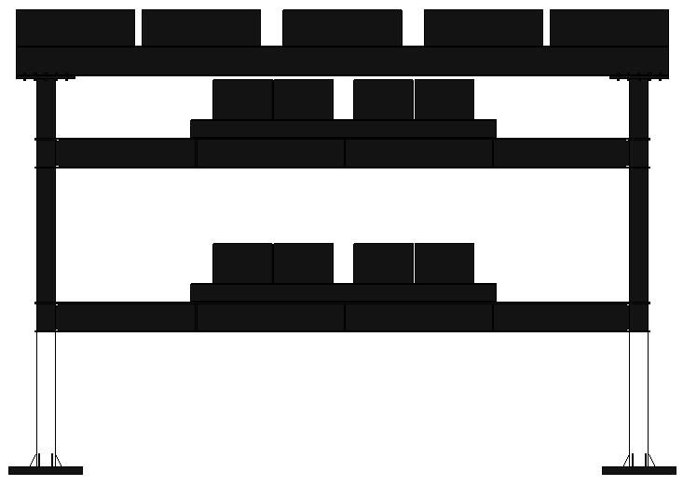
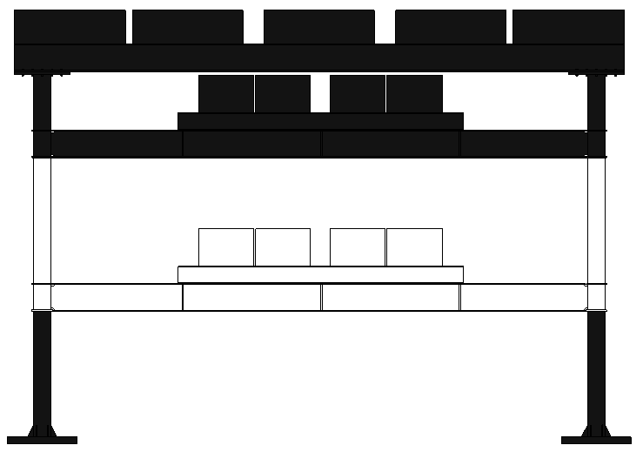
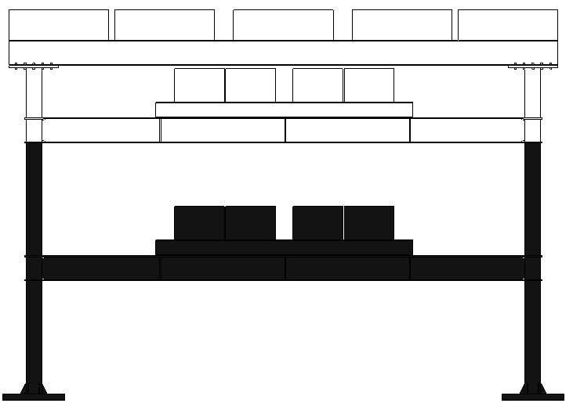
Weight of Case3（ used for 2-DOF model）
M1
参考資料
このスライドのデータは用いない
M0
M2
 | 体積 [mm3] | 質量 [kg]
M0 | 9.083e+06 | 71.3
M1 | 4.184e+08 | 3284.4
M2 | 1.252e+09 | 9828.2
M | 1.679e+09 | 13180.2
M2
M1
M=M0+M1+M2

Slide 6
Weight of Case3_1（used for 2-DOF model）
M1
M0
M2
 | 体積 [mm3] | 質量 [kg]
M0 | 9.083e+06 | 71.3
M1 | 4.414E+08 | 3465.0
M2 | 1.327E+09 | 10417.0
M | 1.777E+09 | 13949.5
M2
M1
M=M0+M1+M2

Slide 7
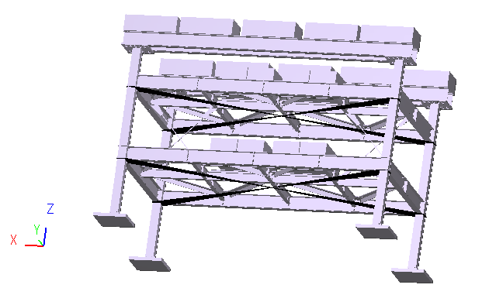
Static earthquake load
Virtual node which load is applied to
Virtual node and nodes on the section of columns are connected by using “InterpolationConstraintElement”
(the same way used in 10RC)
 | T | Rt | Floor | load[kN] | Sum [kN] | α_i | A_i | C_i | Q_i[kN] | F_i[kN]
case3 | 0.214 | 1.0 | M2 | 96.8 | 96.8 | 0.722 | 1.119 | 0.224 | 21.65 | 21.65
 |  |  | M1 | 32.8 | 129.5 | 0.966 | 1.013 | 0.203 | 26.25 | 4.60
 |  |  | M0 | 4.5 | 134.1 | 1.000 | 1.000 | 0.200 | 26.82 | ---
Case3_1 |  |  | M2 | 102.1 | 102.1 | 0.747 | 1.108 | 0.222 | 22.6 | 22.6
 |  |  | M1 | 34.0 | 136.0 | 0.995 | 1.002 | 0.200 | 27.3 | 4.60
 |  |  | M0 | 0.7 | 136.7 | 1.000 | 1.000 | 0.200 | 27.3
Simulation should be done by using load in Case3_1, but all the simulations in this report were done by using load in Case3. However, it is assumed that the difference is much small.

Slide 8
Check of brace model

Slide 9
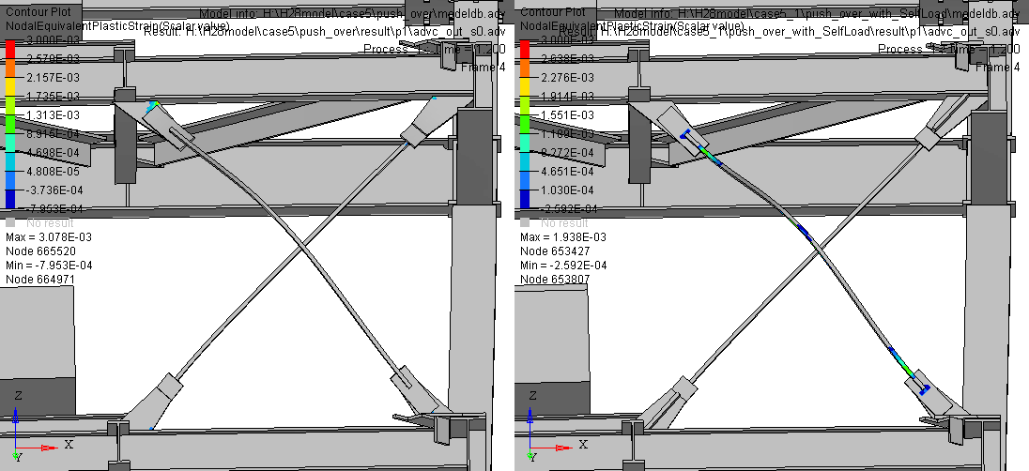
Soundness of gusset plate
Result of Self Loading analysis. Contour of equivalent plastic strain
Brace has damage for both case if self loading analyses are conducted after installing brace
Case5(No reinforcement)
considering self load
case5_1(reinforcement)
considering self load
Damage is seen on the gusset plate
Damage is seen on the brace

Slide 10
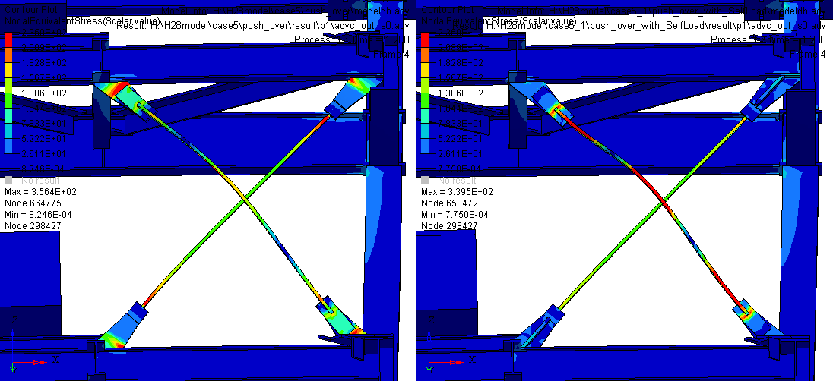
Soundness of gusset plate
Result of Self Loading analysis. Contour of equivalent stress
Brace has damage for both case if self loading analyses are conducted after installing brace
Case5(No reinforcement)
considering self load
case5_1(reinforcement)
considering self load
Stress concentration is seen on the gusset plate
Stress concentration is seen on the braces and battledores

Slide 11
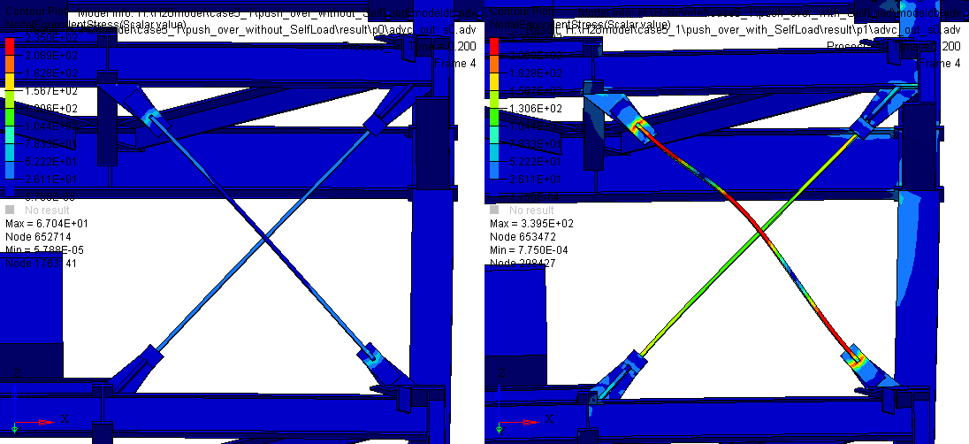
Soundness of gusset plate
Result of push-over analysis with C0=0.2. Contour of equivalent stress
case5_1 (reinforced)
not considering self load
case5_1(reinforced)
Considering self load
Braces are not damaged
Braces are damaged

Slide 12
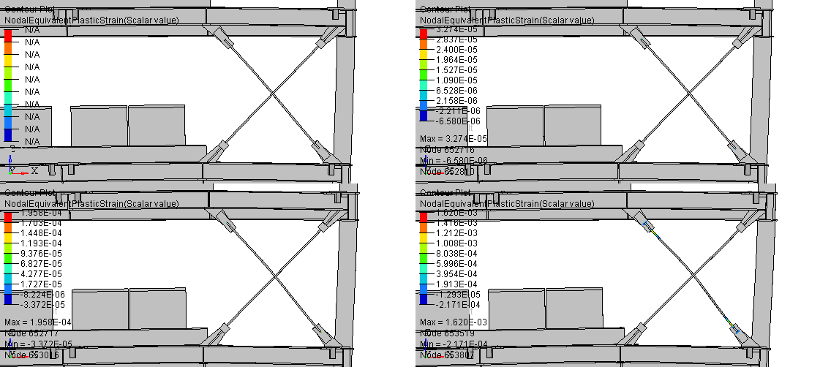
Progress of damage on brace（case5_1,woSL）
C0=0.4
C0=0.45
C0=0.5
C0=0.6
Braces are not damaged until C0=0.4

Slide 13
Push-over analysis

Slide 14
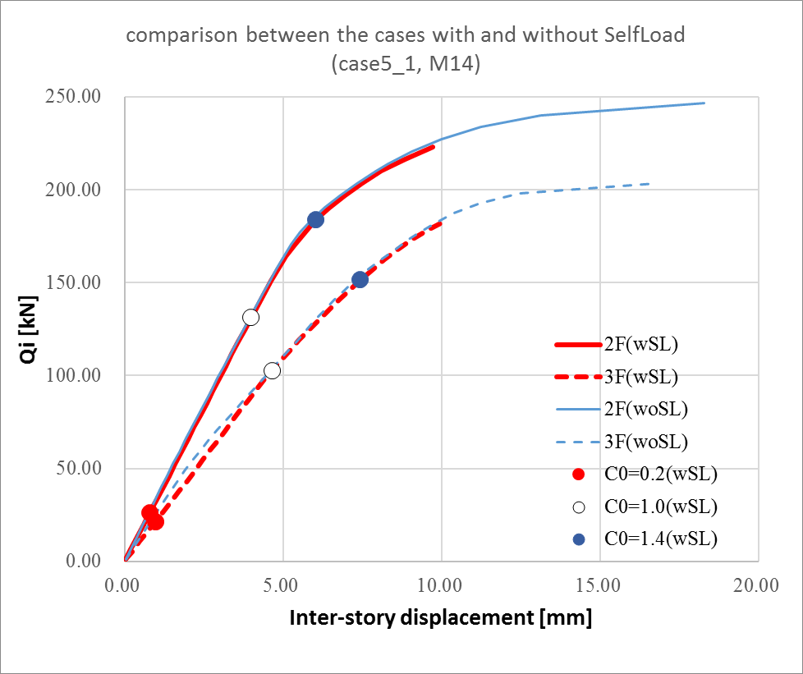
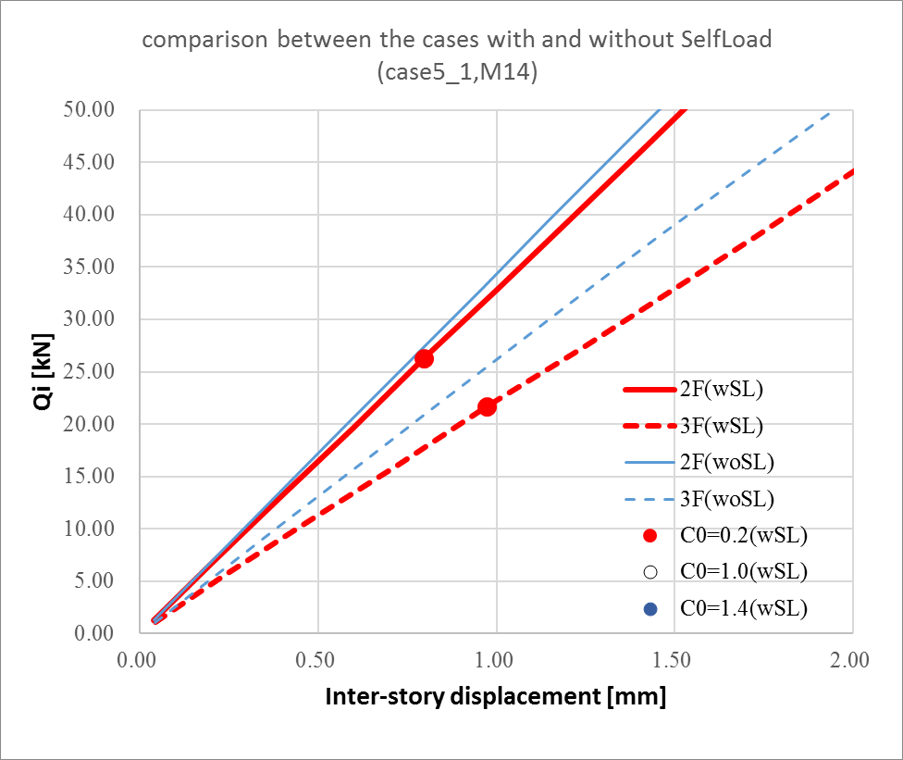
Effect of Self-Weight
For the case applying self load, stiffness is not much increased because damage was seen in the previous self loading analysis.

Slide 15
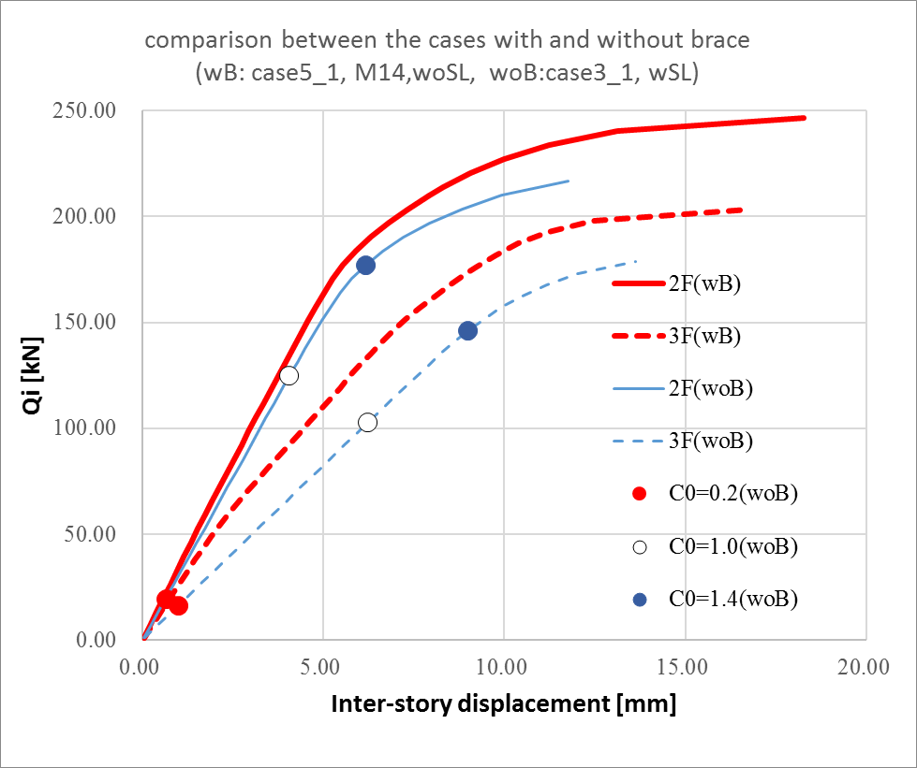
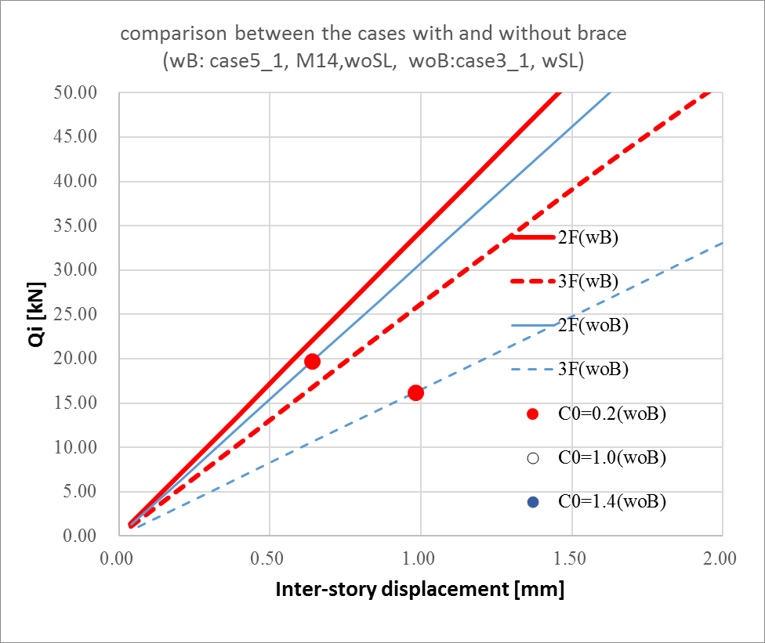
Effect of brace
Stiffness of 3F(2nd layer) is 40% larger than the model without brace.

Slide 16
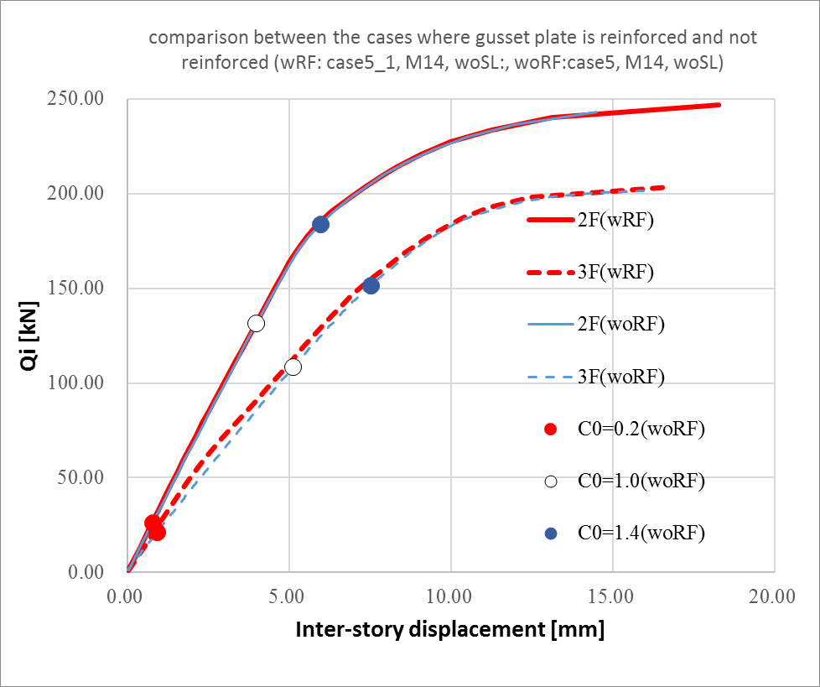
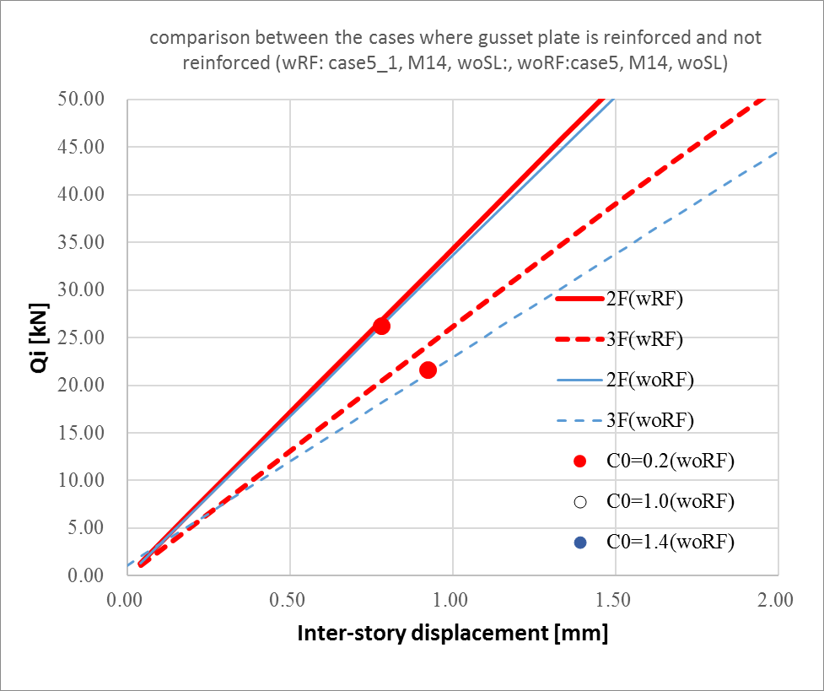
Effect of reinforcement of gusset plate
Difference is seen in the elastic region. Behavior after damage is almost the same.

Slide 17
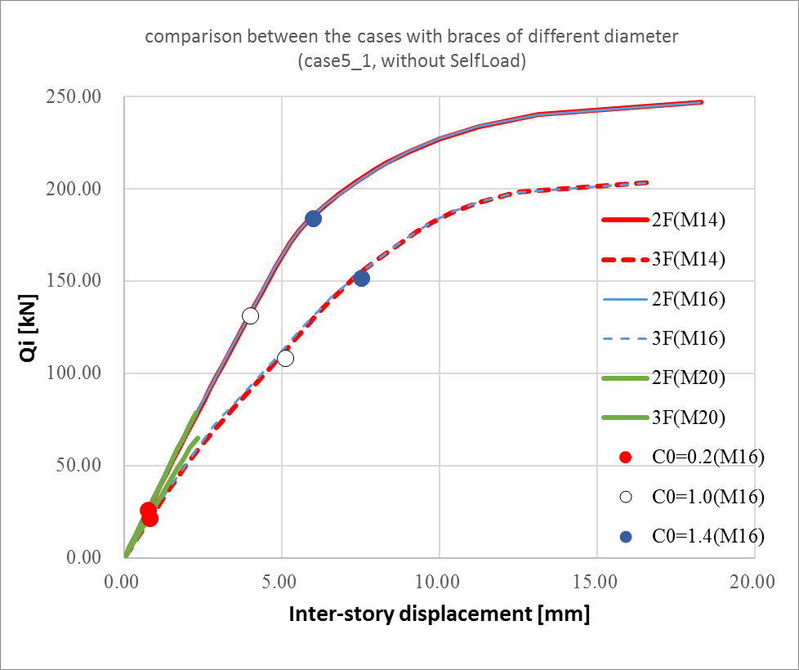
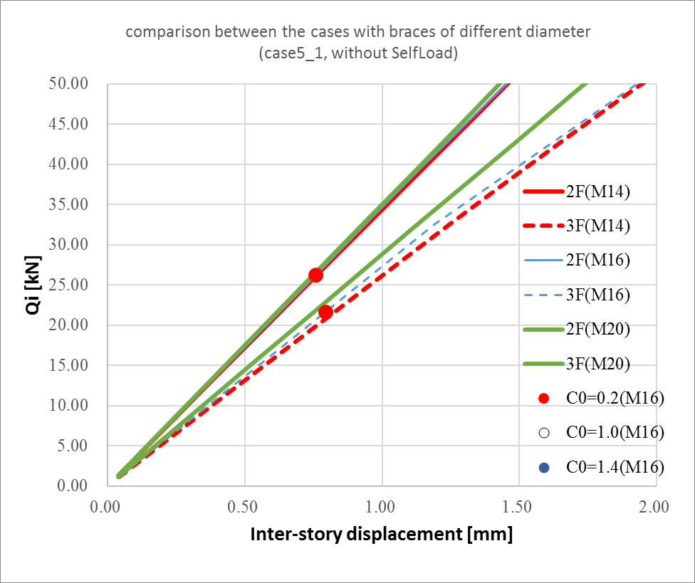
Parameter study for different diameter
Not so big difference is seen between M14 and M16
Simulation for M20 is diverged in an early stage.
I want to decide to use M14 for braces.

