Slide 1
Regularization
Machine learning | Regularization | Ridge | Lasso | Elastic Net
Taeyang Yang
Oct. 2020
https://tyami.github.io/

Slide 2
Contents
#
Regularization
Ridge
Lasso
Ridge VS Lasso
Elastic Net

Slide 3
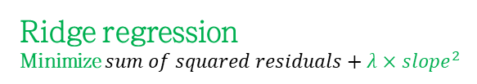
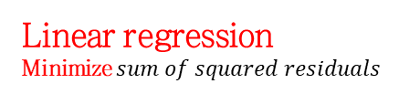

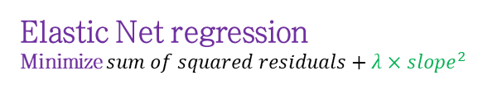
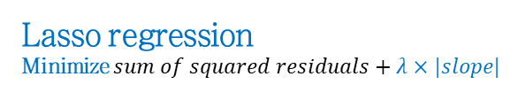
Regularization
Overview
Linear regression
Minimize $sum of squared residuals$
Ridge regression
Minimize $sum of squared residuals+λ×{slope}^{2}$
Size
Lasso regression
Minimize $sum of squared residuals+λ×|slope|$
Elastic Net regression
Minimize $sum of squared residuals+λ×{slope}^{2}$
$$+λ×|slope|$$
Weight

Slide 4
Regularization
Example data
Size
Weight

Slide 5

Regularization
Linear regression
$$Size=0.9+0.75×Weight$$
Size
Weight

Slide 6

Regularization
Linear regression with small data
Fit a line with Least Squares
Size
Minimize $sum of squared residuals$
Weight

Slide 7


Regularization
Linear regression with small data: result
$$Size=0.4+1.3×Weight$$
Size
$$residual=0$$
Weight

Slide 8
Regularization
Linear regression with small data: test data
Large residuals ➔ High variance
(Overfitting)
New test data
Size
Weight

Slide 9

Regularization
Concept of regularization
Increased small bias, but significantly less variance
$$Size=0.9+0.8×Weight$$
Size
Weight

Slide 10
Regularization
Overview
Linear regression
Minimize $sum of squared residuals$
Ridge regression
Minimize $sum of squared residuals+λ×{slope}^{2}$
Size
Lasso regression
Minimize $sum of squared residuals+λ×|slope|$
Elastic Net regression
Minimize $sum of squared residuals+λ×{slope}^{2}$
$$+λ×|slope|$$
Penalty
Weight

Slide 11
Ridge regression
Definition
Linear regression
Minimize $sum of squared residuals$
Ridge regression
Minimize $sum of squared residuals+λ×{slope}^{2}$
Size
Weight

Slide 12


Ridge regression
Power of penalty ($λ=1$)
Linear regression
Minimize $sum of squared residuals$
$$Size=0.4+1.3×Weight$$
$$residuals=0^{2}+0^{2}+1×{1.3}^{2}=1.69$$
$$Size=0.9+0.8×Weight$$
Ridge regression
Minimize $sum of squared residuals+λ×{slope}^{2}$
Size
$$residuals={0.3}^{2}+{0.1}^{2}+1×{0.8}^{2}=0.74$$
Weight

Slide 13
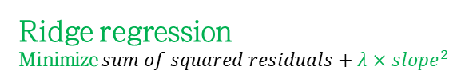






Ridge regression
The higher $λ$, the less slope, resulting in zero-like slope
Ridge regression
Minimize $sum of squared residuals+λ×{slope}^{2}$
$$λ=0$$
$$λ=1$$
$$λ=10$$
$$λ=100$$
Size
$$λ=10000$$
$Large λ$ ➔ asymptotic to zero
Weight

Slide 14



Ridge regression
Linear regression with discrete variable
$$Size=1.5+0.7×High fat Diet$$
Size
$$0.7$$
$$1.5$$
Normal diet
(0)
High fat diet
(1)

Slide 15

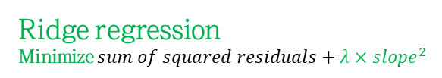

Ridge regression
Ridge regression with discrete variable
$$Size=1.5+0.5×High fat Diet$$
Ridge regression
Minimize $sum of squared residuals+λ×{slope}^{2}$
Less slope !
Size
$$0.5$$
$$1.5$$
Normal diet
(0)
High fat diet
(1)

Slide 16
Ridge regression
Ridge regression with both continuous and discrete variable
$$Size=y−intercept+β_{1}×Weight+β_{2}×High fat diet$$
Minimize $sum of squared residuals+λ×(β_{1}^{2}+β_{2}^{2})$
High fat diet
Size
Normal diet
Weight

Slide 17
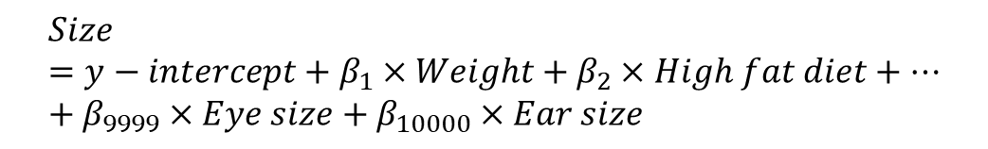
Ridge regression
Usage of Ridge regression (regularization)
$$Size=y−intercept+β_{1}×Weight$$
To estimate one variable, we need at least two samples
$$Size=y−intercept+β_{1}×Weight+β_{2}×High fat diet$$
To estimate two variables, we need at least three samples
$$Size=y−intercept+β_{1}×Weight+β_{2}×High fat diet+…+β_{9999}×Eye size+β_{10000}×Ear size$$
To estimate 10,000 variables, do we need at least 10,001 samples?

Slide 18

Lasso regression
Definition
Linear regression
Minimize $sum of squared residuals$
Size
Lasso regression
Minimize $sum of squared residuals+λ×|slope|$
Weight

Slide 19






Lasso regression
The more $λ$, the less slope, resulting in slope=0
Lasso regression
Minimize $sum of squared residuals+λ×|slope|$
$$λ=0$$
$$λ=1$$
$$λ=10$$
$$λ=100$$
Size
$$λ=10000$$
$Large λ$ ➔ zero
Weight

Slide 20
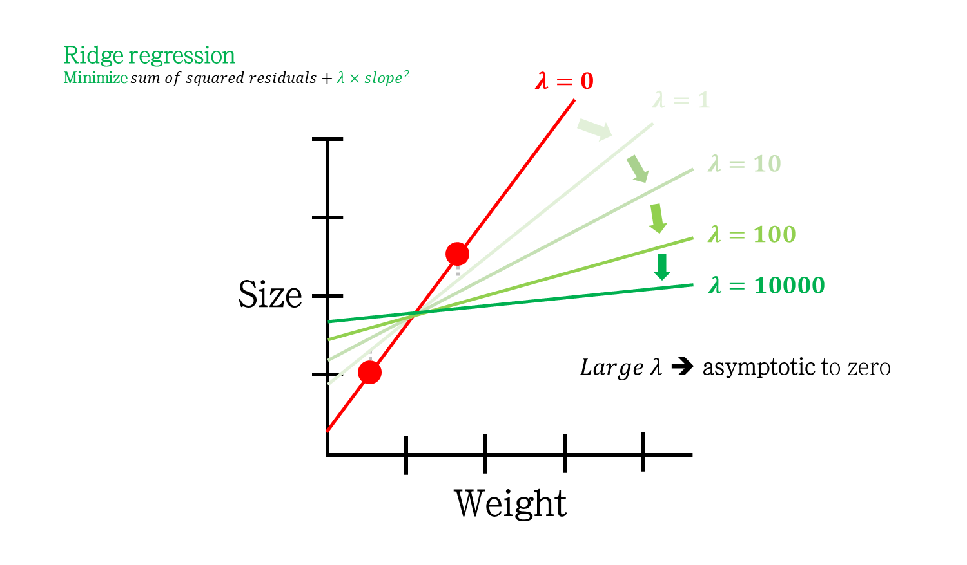
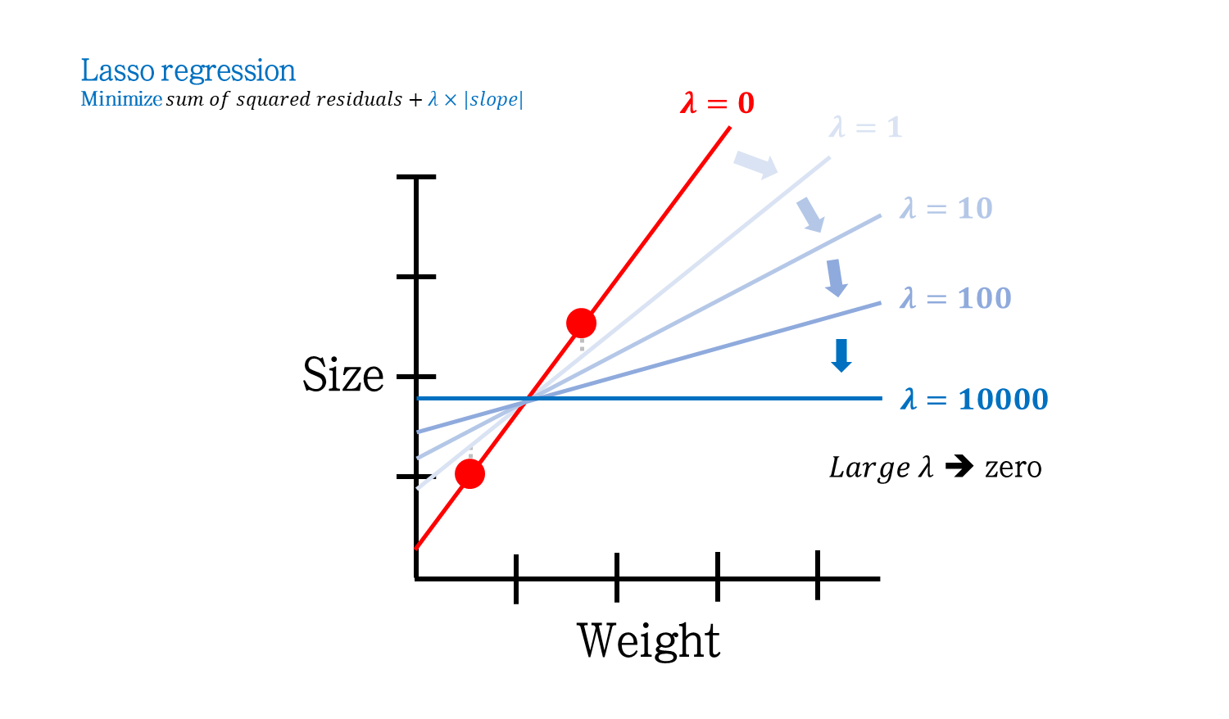
Ridge VS Lasso
Different thing

Slide 21










Ridge VS Lasso
Different thing (Geometric perspective)
Ridge
Lasso
$$β_{2}$$
$$β_{2}$$
$$\hat{β}$$
$$\hat{β}$$
$$s$$
$$s$$
$$s$$
$$β_{1}$$
$$s$$
$$β_{1}$$
$$β_{1}^{2}+β_{2}^{2}<s$$
$$|β_{1}|+|β_{2}|<s$$
Notes:
$β_{1}$와 $β_{2}$는 slope를 의미한다. 또한 $\hat{β}$는 least square를 갖는 지점이고, 빨간 등고선은 동일한 RSS를 나타내는 선이다.
Ridge의 초록색 원과 Lasso의 파란색 마름모는 각각 Ridge와 Lasso의 제약, 즉 $β_{1}^{2}+β_{2}^{2}<s$와 $\left|β_{1}\right|+\left|β_{2}\right|<s$ 영역을 의미한다.
각 방법은 해당 범위 내에서, 가능한 가장 작은 RSS를 갖는 값으로 계수를 추정한다.
$s$가 작다는 것은, slope들에 제약 조건을 더 많이 건다는 것이다. 즉 $λ$가 큰 것을 의미한다.
반면, $s$가 충분히 큰 것은 $λ$가 작은 것을 의미한다. $s$가 충분히 커서 $\hat{β}$의 점을 포함하게 된다면 앞에서도 나왔듯이 least square와 같은 값을 추정하게 된다 (즉, 앞의 예시에서 붉은 선을 추정하게 된다)
결론을 말하면, 위 그림에서 추정된 계수는 주어진 제약범위와 가장 작은 RSS등고선이 만나는 지점의 값이 된다.
Ridge에서 제약범위와 RSS 등고선이 만나는 지점의 slope 값들은 0이 되지 않는다. $λ$가 커질 때 ($s$가 작아질 때)도 0에 가까운 값은 되어도, 0 자체가 될 수는 없다.
반면, Lasso에서는 제약범위와 RSS 등고선이 만나는 지점이 마름모의 모서리가 될 확률이 높다 (확률이라고 하는 것은 $λ$에 따라 모서리가 아닐 수도 있기 때문이다. 사각형을 키워보면 직관적으로 이해할 수 있다). $λ$가 커질 때 ($s$가 작아질 때)도 아예 0 값을 갖는 slope가 나올 확률이 높아진다.

Slide 22



Elastic Net regression
Overview
Ridge regression
Minimize $sum of squared residuals+λ×{slope}^{2}$
Lasso regression
Minimize $sum of squared residuals+λ×|slope|$
Elastic Net regression
Minimize $sum of squared residuals+λ_{2}×{slope}^{2}+λ_{1}×|slope|$

Slide 23




Elastic Net regression
Geometry
$$β_{2}$$
$$\hat{β}$$
$$s$$
$$s$$
$$β_{1}$$
$$α\left(β_{1}^{2}+β_{2}^{2}\right)+(1−α)(\left|β_{1}\right|+\left|β_{2}\right|)<s$$
$$α=\frac{λ_{2}}{λ_{1}+λ_{2}}$$

Slide 24
Elastic Net regression
Geometry
$$β_{2}$$
$$s$$
$$s$$
$$β_{1}$$
Ridge
Elastic Net
Lasso

Slide 25
References
StatQuest
Regularization Part 1: Ridge (L2) Regression
https://www.youtube.com/watch?v=Q81RR3yKn30
Regularization Part 2: Lasso (L1) Regression
https://www.youtube.com/watch?v=NGf0voTMlcs
Regularization Part 3: Elastic Net Regression
https://www.youtube.com/watch?v=1dKRdX9bfIo

