Slide 1
Weekly meeting
09 28 2023
Ty Bottorff

Slide 2
Outline
Summary of findings and weaknesses of T cell characteristics associated with toxicity to immune checkpoint blockade in patients with melanoma (Newman lab)
Progress in reproducing data from Newman lab paper
Plans to explore unanalyzed data from Newman lab paper

Slide 3
Main findings from Newman lab paper
Activated CD4 effector memory T cell abundance and TCR diversity associated with irAEs in melanoma patients
Also find elevated activated CD4 TM cells in autoimmune disease patients
Notes:
- CD4 effector memory T cells at higher levels in pretreatment blood associated with severe irAE
- perhaps a common immunological mechanism between irAEs and autoimmunity

Slide 4
Main findings related to T cell clonal expansion
Peripheral TCR clonal expansion linked to severe irAEs
Hypothesis: pre-treatment TCR clonotypes in peripheral blood might show greater propensity to expand in patients destined to develop severe irAEs after ICI
Why not only specifically expansion of self-reactive T cells hypothesized to be linked to irAEs?
Results: increased TCR clonal expansion and persistence of baseline clones in patients developing severe irAEs (preferential expansion of activated CD4 TEM)
Notes:
- prior evidence of clonally expanded self/virus-reactive T cells in affected tissue linking self/pathogen-recognizing T cell clones to irAEs (**I wonder why viral antigen recognition would lead to irAEs, good for the viral-infected cells to be attacked, right? but perhaps its an inappropriately strong immune response**)

Slide 5
Weaknesses
Unanswered questions: do these activated CD4 TM cells recognize self antigens?
Limitations
Retrospective
Different ICIs studied have different irAE risks
May have missed long to arise after ICI irAEs
Notes:
- unanswered question: do circulating activated CD4 TM cells (their abundance here found to correlate with irAE development) exhibit a higher propensity to recognize self-antigens in patients at risk for severe ICI induced irAEs?
- most irAEs occur within first 3 months but some can occur later (which would have been missed here, median time to severe irAE here was ~6 weeks with no irAEs after 3 months)

Slide 6
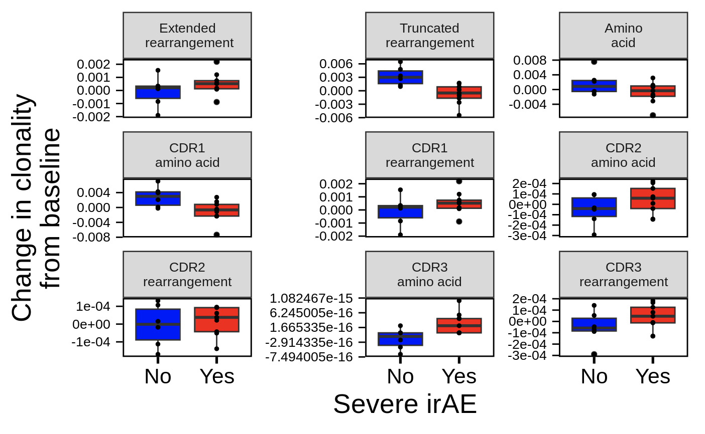
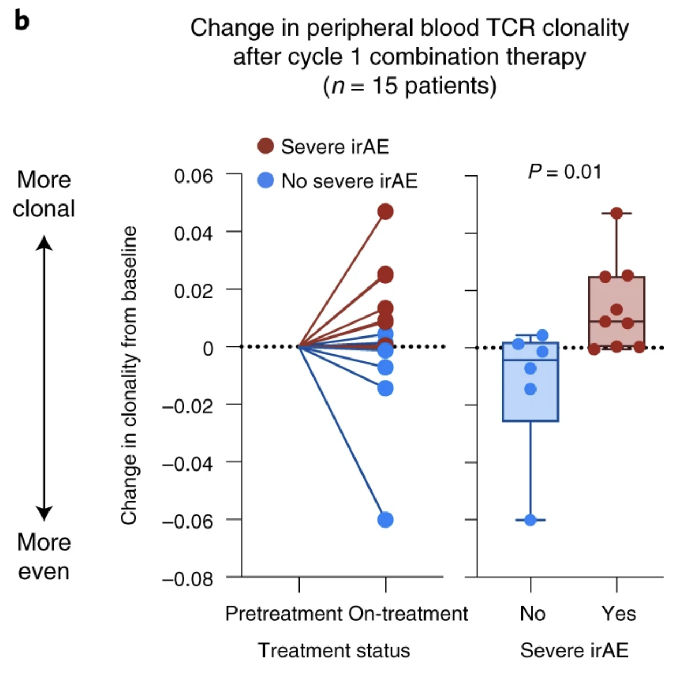
Change in TCR clonality analysis somewhat matches theirs
Notes:
TCR clonality index that is robust to variation in the number of clones captured (Pielou’s evenness)
the complement of clonal evenness (1-Pielou’s index) is often used to get a clonality score of 0 representing a maximally diverse population with even frequencies and values close to 1, a repertoire driven by clonal dominance.
Shannon entropy provides a comprehensive measure of diversity that considers both the variety of T-cell clones and their relative abundances.
Richness measures the total number of unique T-cell clones, regardless of their abundances.
Clonality assesses the dominance or evenness of T-cell clones in a population.

Slide 7
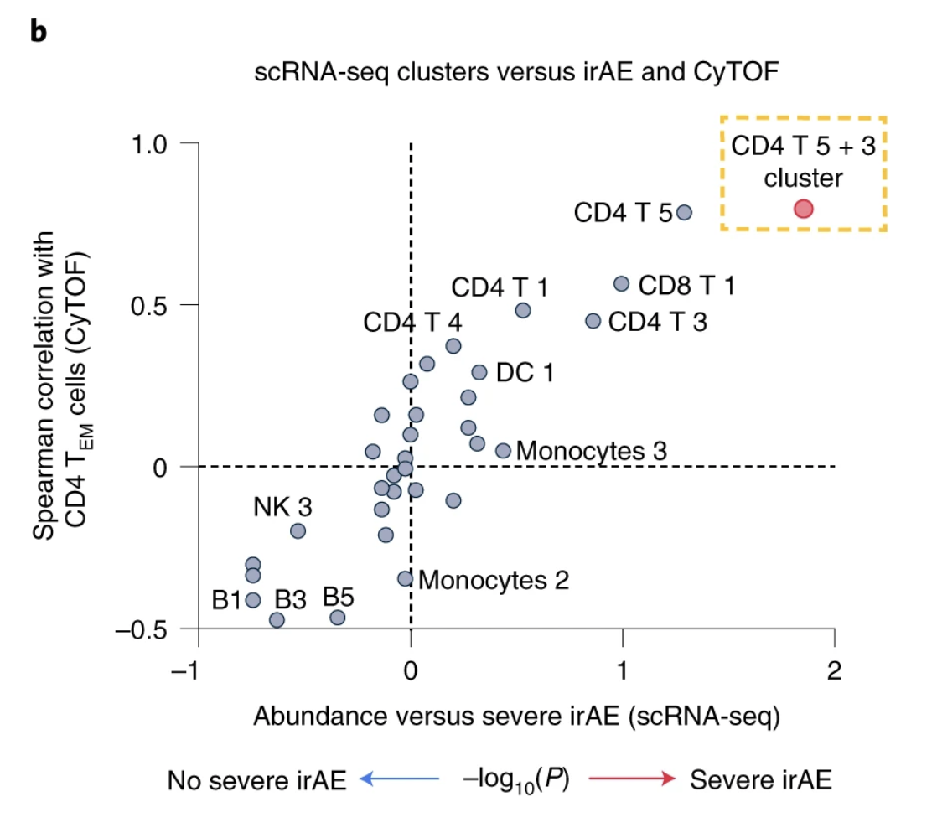
Struggled to extract subclusters of interest via this plot

Slide 8
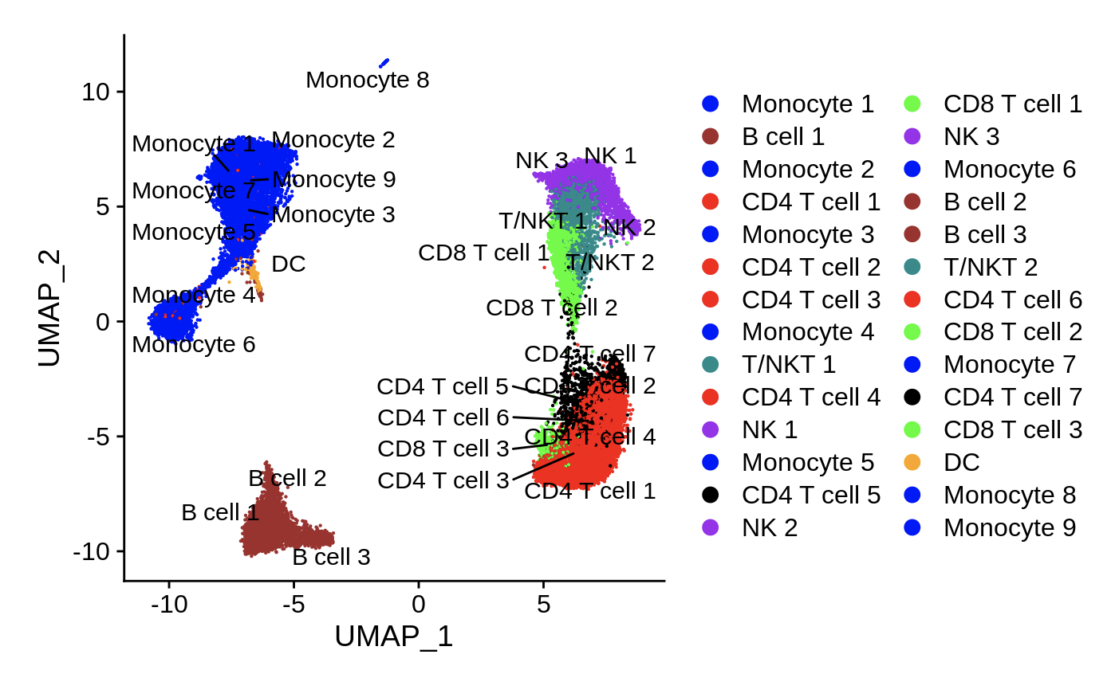
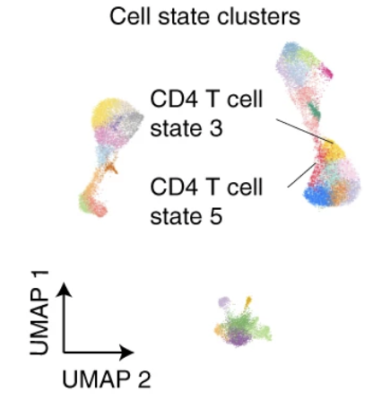
Instead compared UMAPs to find CD4 subclusters of interest

Slide 9
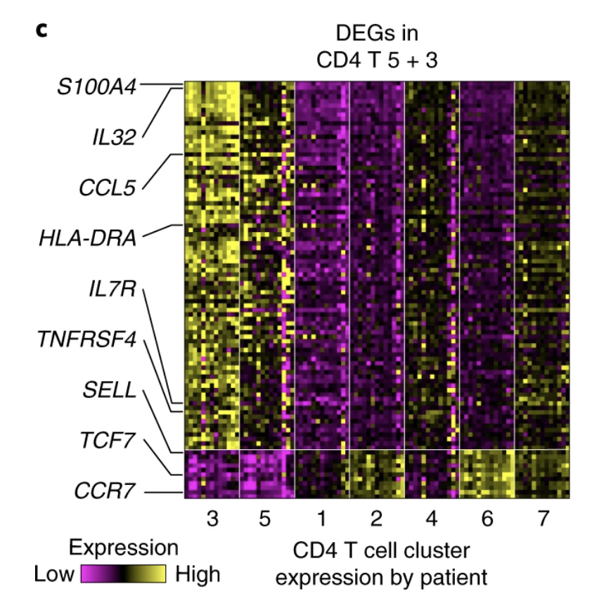
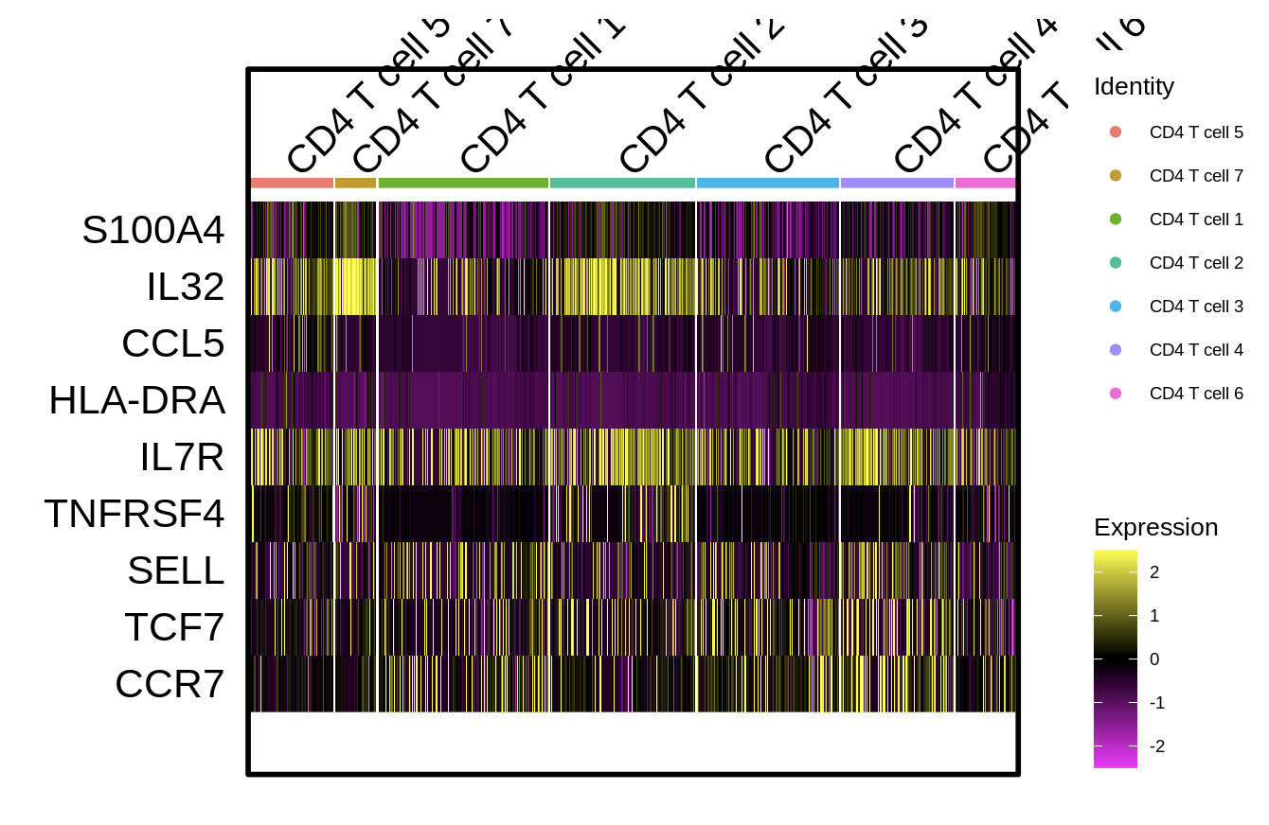
DEGs in CD4 T cell subclusters do not look very similar

Slide 10
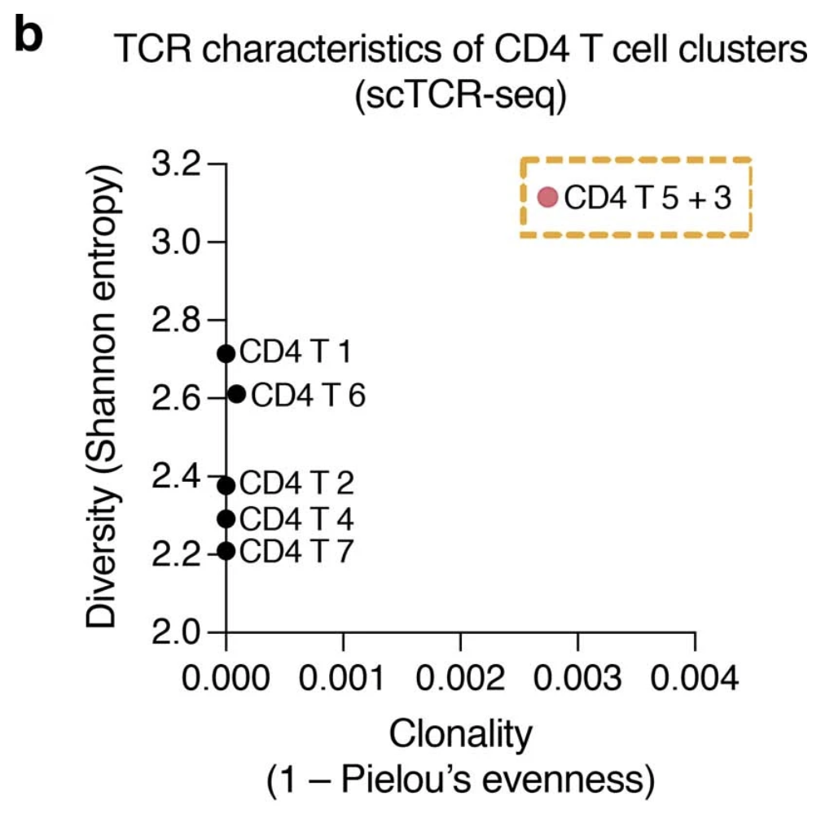
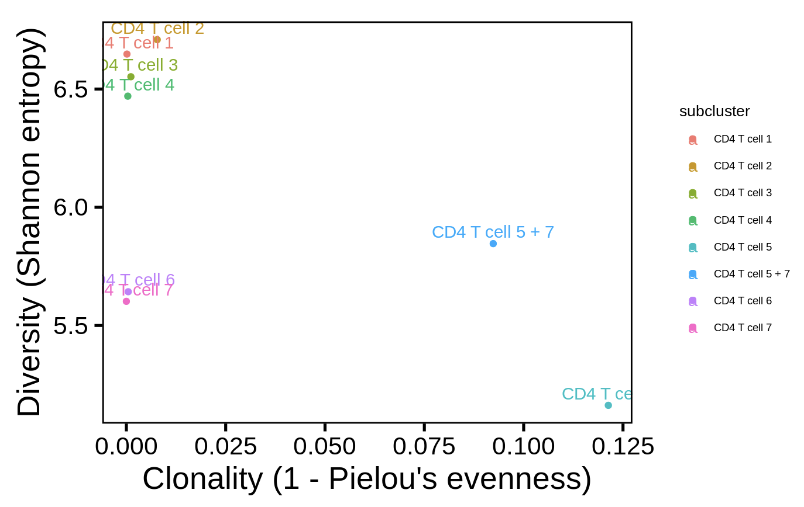
Same subclusters somewhat stand out in diversity vs. clonality plot
Notes:
Shannon entropy provides a comprehensive measure of diversity that considers both the variety of T-cell clones and their relative abundances.
Richness measures the total number of unique T-cell clones, regardless of their abundances.
Clonality assesses the dominance or evenness of T-cell clones in a population.
Trying to wrap my head around what it means for subset to be high in both diversity and clonality (initially kind of seem mutually exclusive…)

Slide 11
Plan to explore unanalyzed data
Analyze characteristics of expanded cells’ TCRs
Length
Germline-ness

