Slide 1
Weekly meeting
11 2 2023
Ty Bottorff

Slide 2
Outline
Myocarditis irAE dataset progress
Methods
Results
Conclusions
Next steps

Slide 3
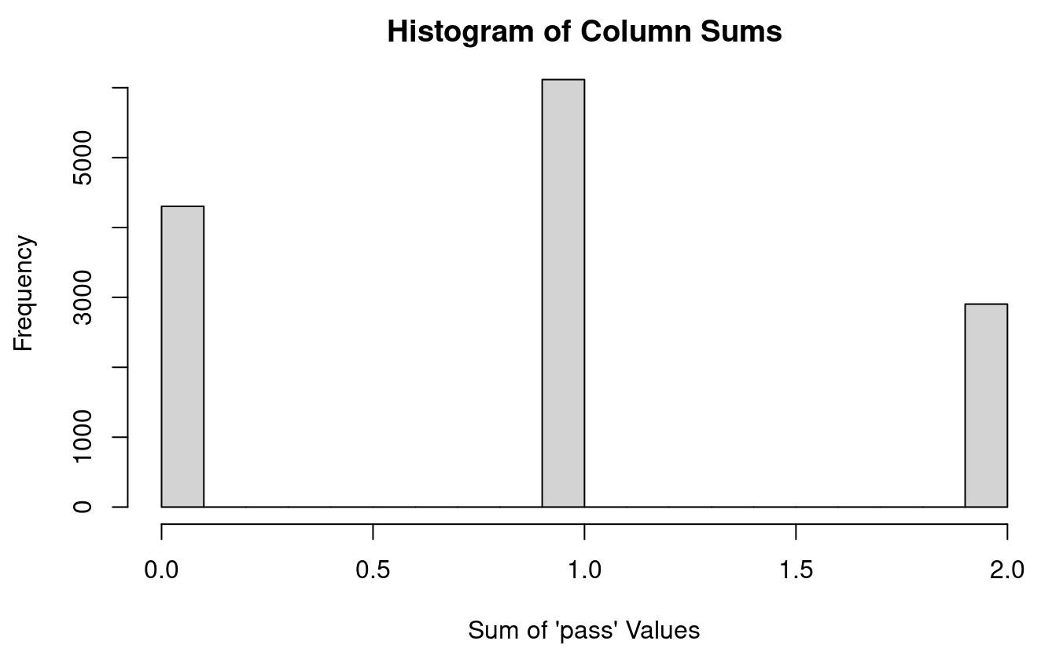
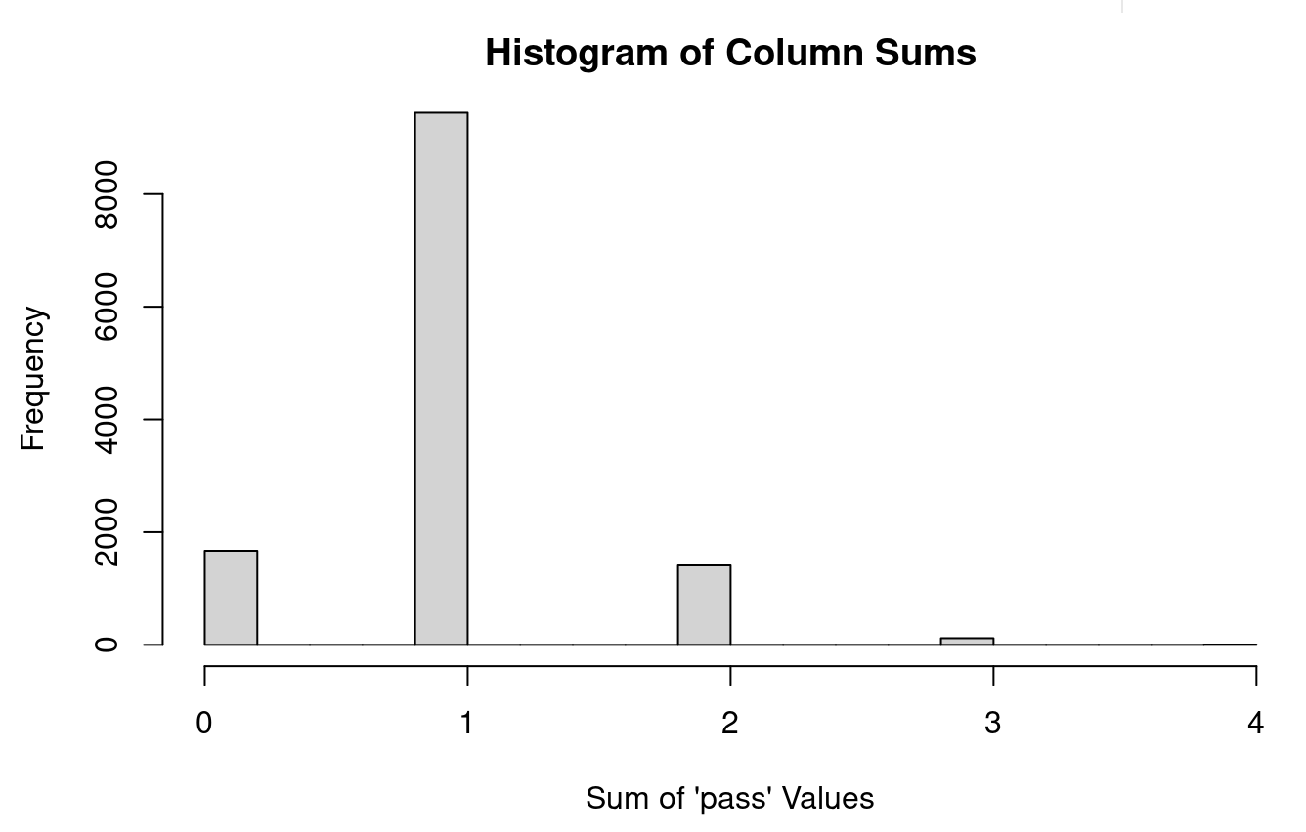
Dehashing mixed samples
Vary count cutoffs to maximize number of barcodes with single hash matches (1 ‘pass’)
Notes:
Cutoffs in ~55-75 percentile range

Slide 4
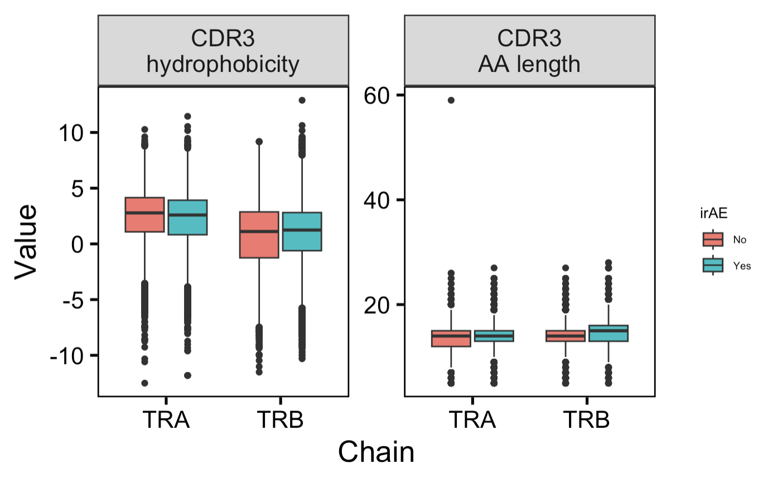
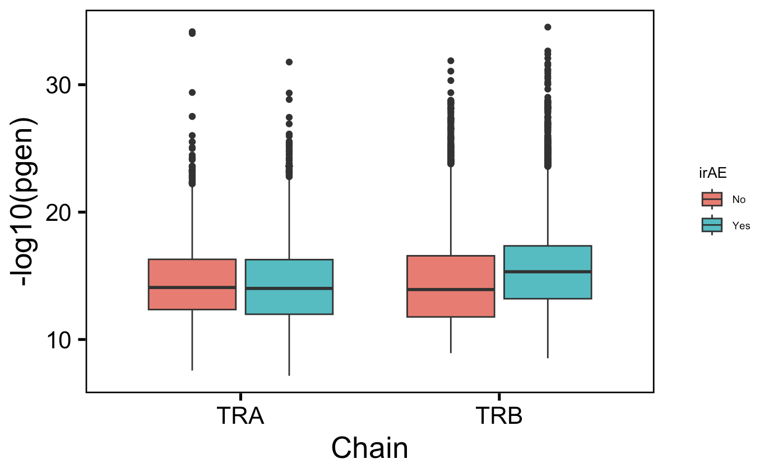
Significant differences seen between most TCR features across all TCRs (large sample sizes)
n.s.
Notes:
TRA CDR3 hydro: p-value = 2.719e-13
TRB CDR3 hydro: p-value = 3.964e-16
TRA CDR3 length: p-value = 1.823e-13
TRB CDR3 length: p-value < 2.2e-16
Pgen TRB: p-value < 2.2e-16

Slide 5
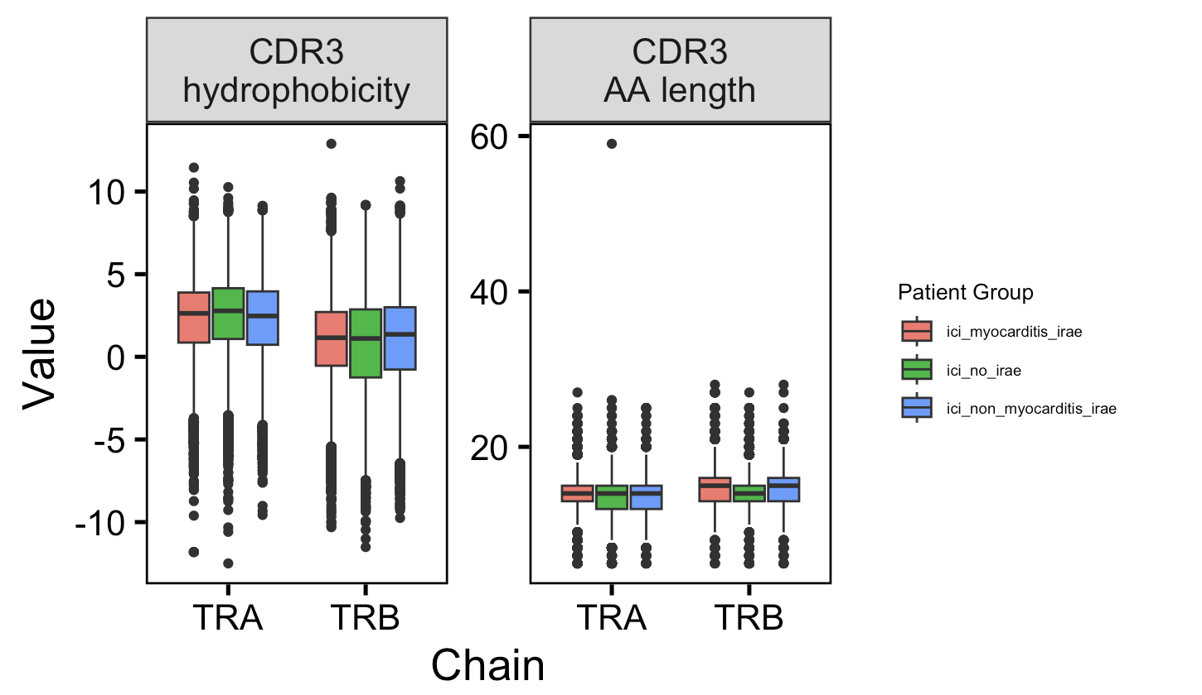
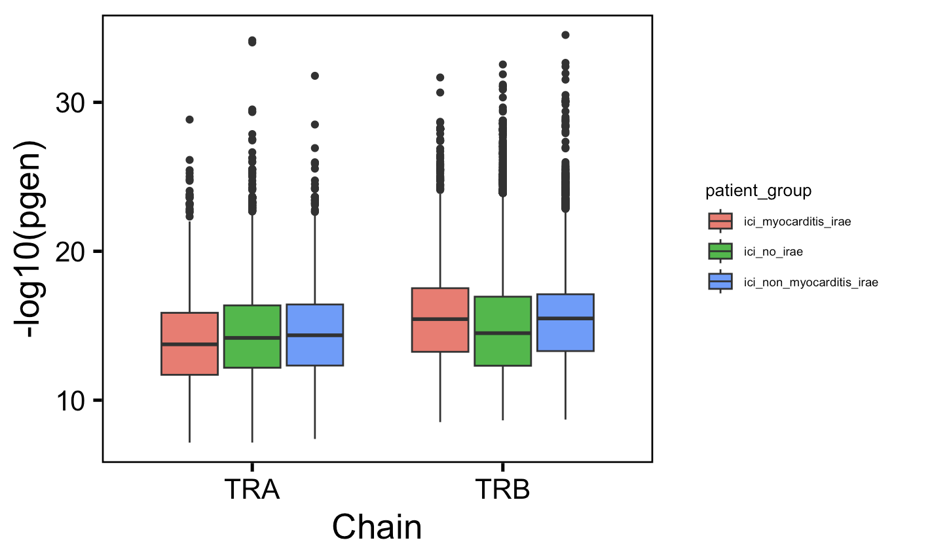
TRB Pgen differences observed across all TCRs between no irAE and irAE patient groups
**
**
Notes:
pgen
Red vs, green TRB: p-value < 2.2e-16
Blue vs. green TRB: p-value < 2.2e-16
-log10(pgen): higher is less germline-like (less cross-reactive), so it’s the opposite difference that I would expect… (i.e. green having lower –log10(pgen) i.e. being more germline-like and more cross-reactive)

Slide 6
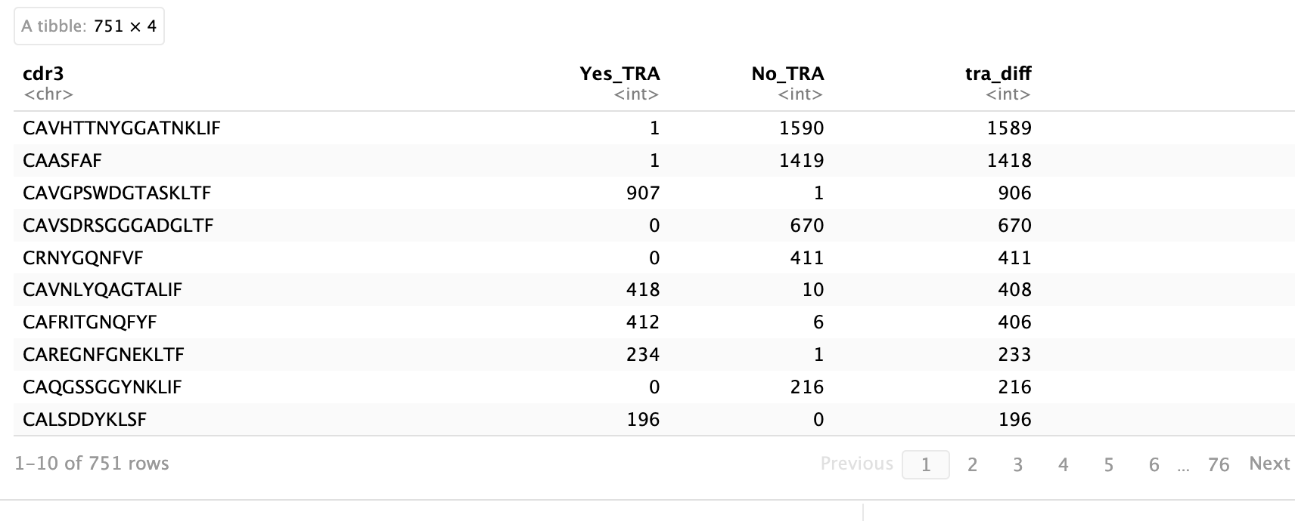
Search for most differentially encountered TCRs
Separately for TRA and TRB…
Count # of times each CDR3 sequence appears in each group
Calculate difference
Filter for most variably encountered CDR3 sequences

Slide 7
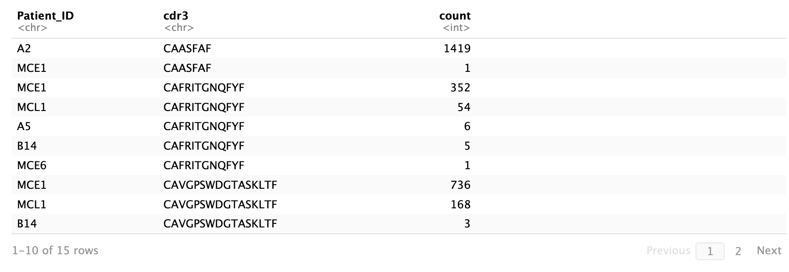
Differentially encountered CDR3s mostly single patient-driven
Notes:
Probably unsurprising

Slide 8
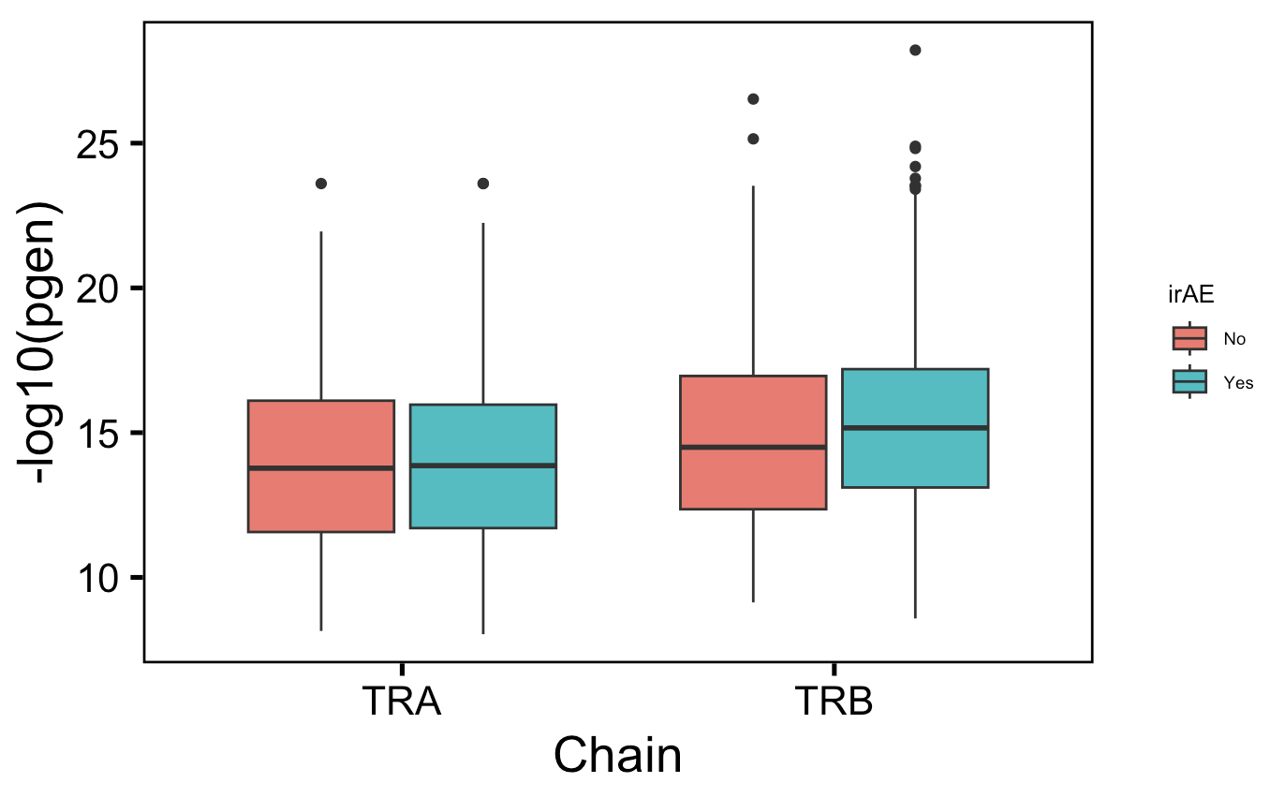
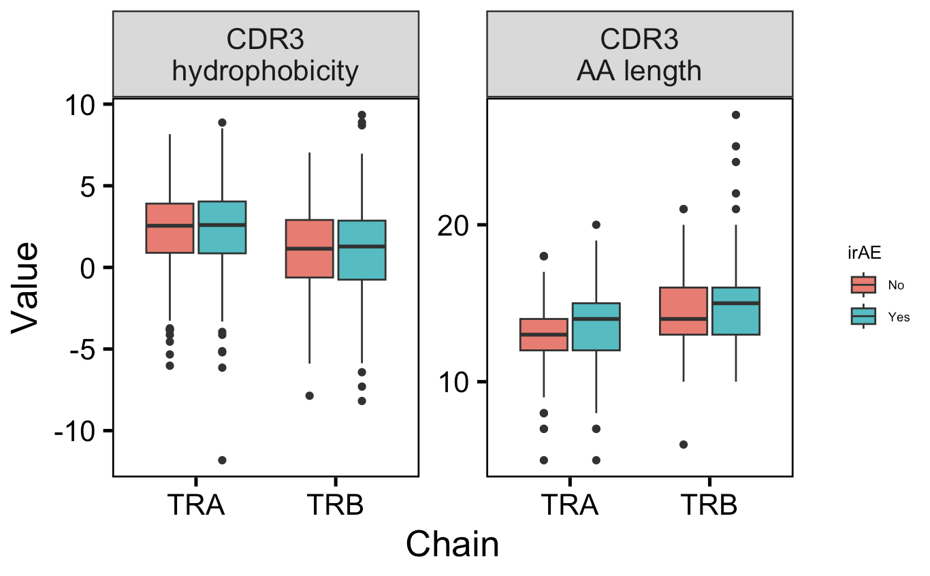
~No differences remain significant with unique differentially encountered CDR3
P = 0.055

Slide 9
Conclusions
When comparing unique differentially encountered TCRs, TRA CDR3s marginally longer in patients with irAE
Haven’t yet stratified by cell type, but seems opposite to conclusion from BRI data (crossreactive CD8 TRA chains shorter)
TRB chain repertoire probability of generation scores higher in patients without irAEs (holds true in 3 group analysis)
Opposite of hypothesis that higher pgen means more germline-like and more germline-like TCRs are more crossreactive and more crossreactive TCRs underlie irAEs

Slide 10
Next steps
Optimize dehashing count cutoffs?
Analyze IMGT/HighV-Quest data
Use Seurat reference mapping to assign cell types → stratify TCR feature analysis by cell type
Notes:
I dehashed with count cutoffs with same percentile for all 4 hashes for each mixed sample

Slide 11
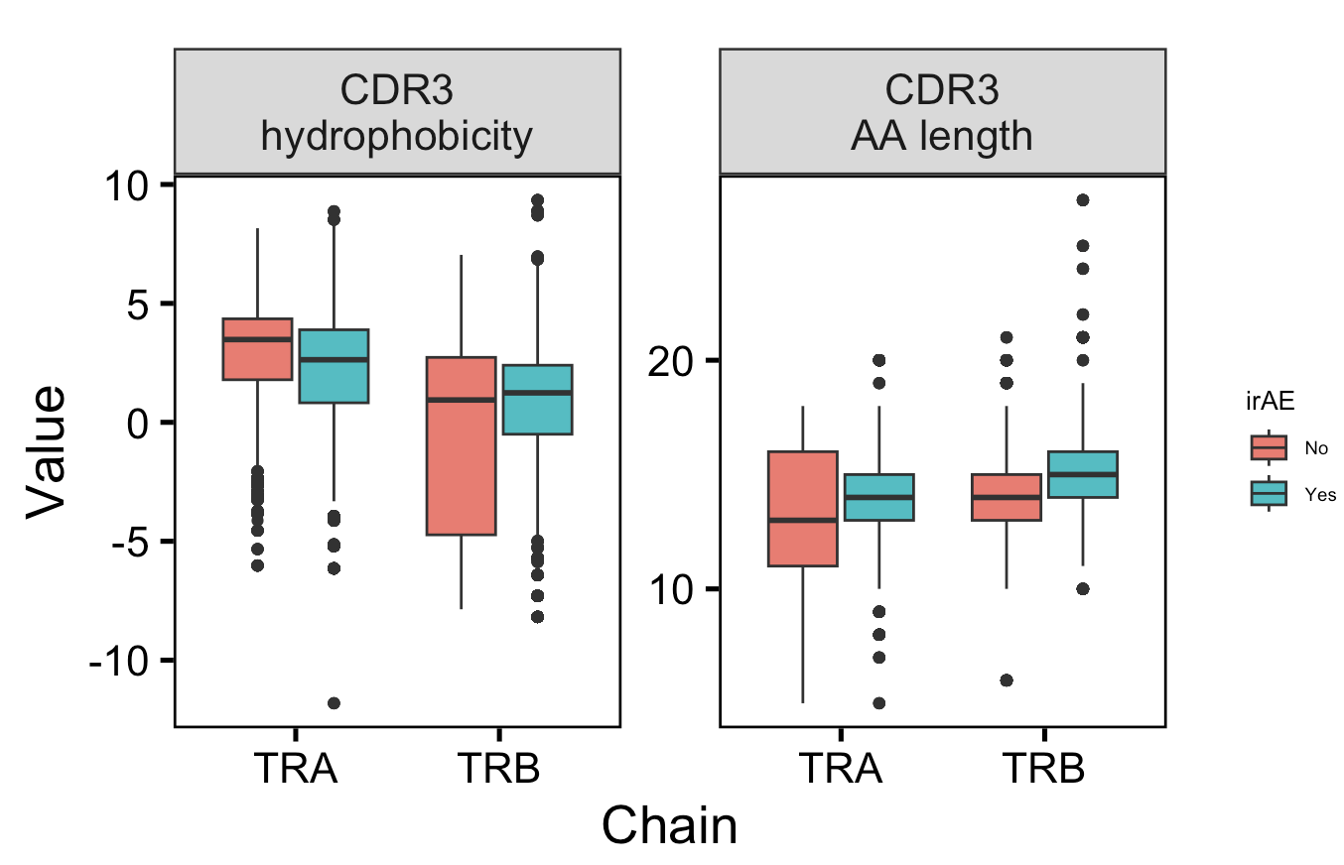
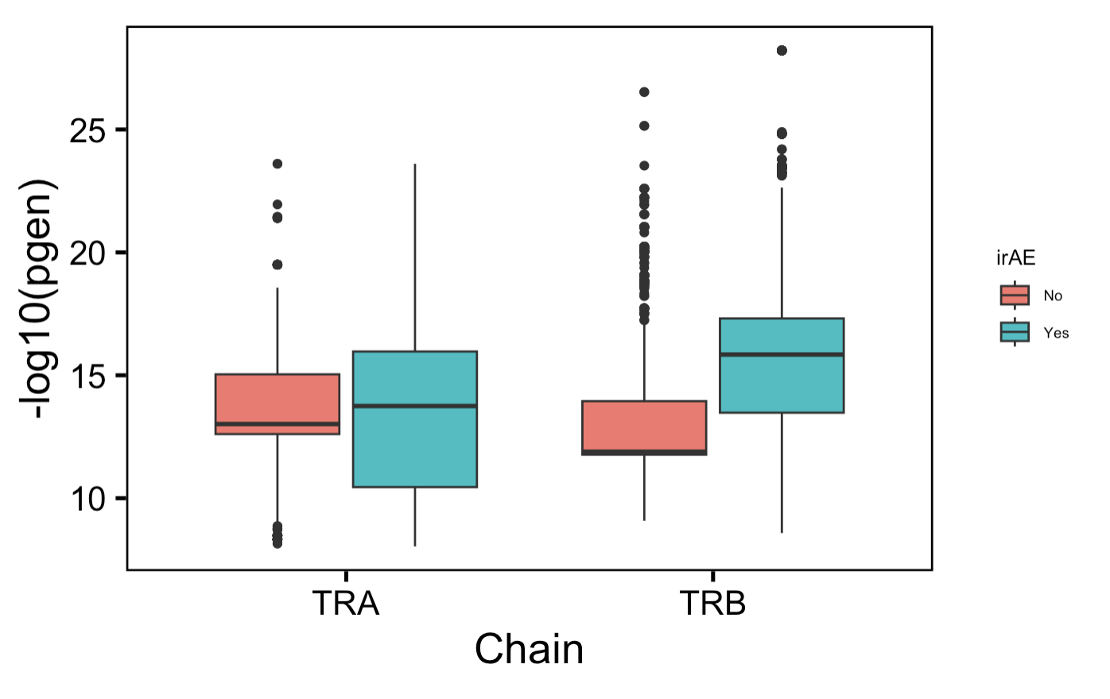
Significant differences seen between all TCR features across all top ~1% of differentially encountered TCRs

Slide 12
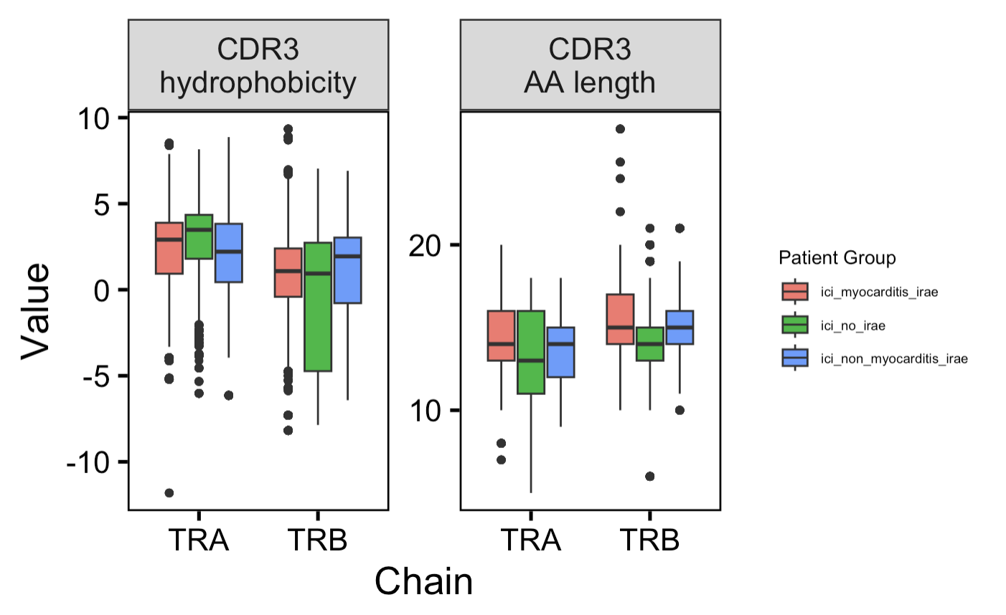
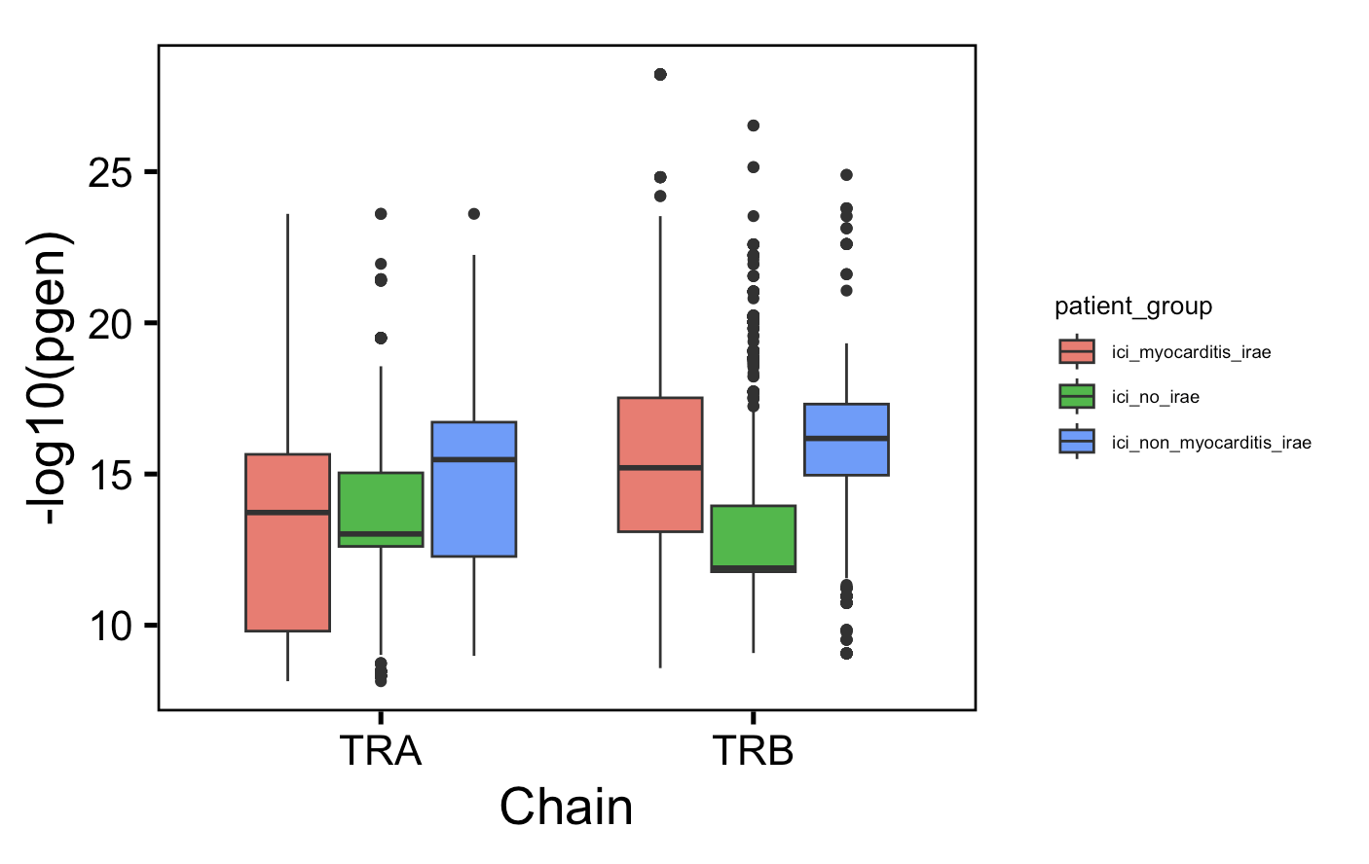
Significant differences seen between all TCR features across all top ~1% of differentially encountered TCRs
Notes:
Pgen not yet dehashed but not expecting big differences
Basically everything statistically significant here

Slide 13
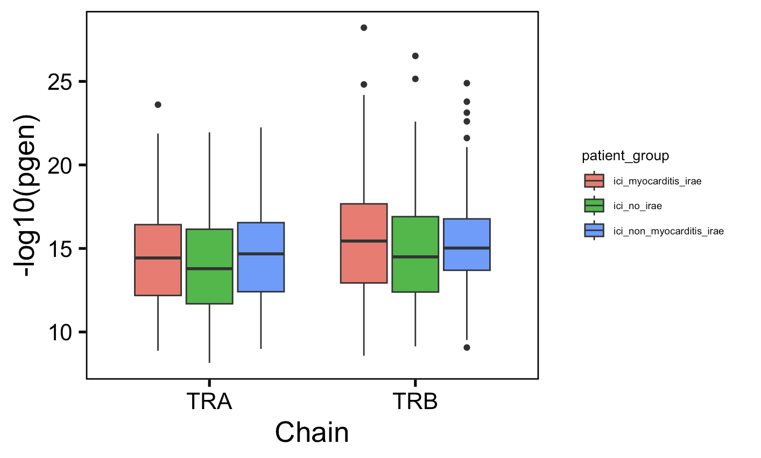
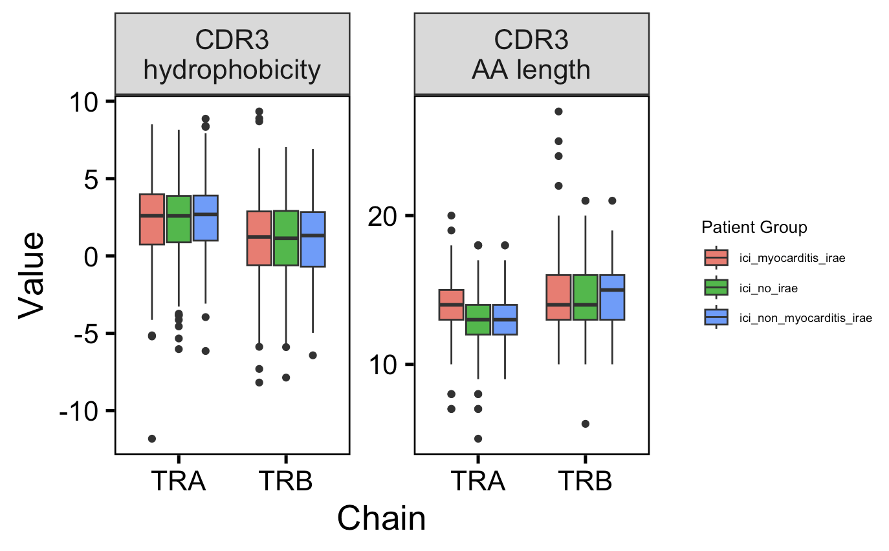
No differences remain significant with unique differentially encountered CDR3
Notes:
Unique counts
p-value = 0.39 for CDR3 AA length TRA red vs. green
p-value = 0.09 for red vs. green TRB pgen

Slide 14
Significant differences seen between all TCR features across all top ~1% of differentially encountered TCRs

Slide 15
Significant differences seen between all TCR features across all top ~1% of differentially encountered TCRs

