Slide 1
Weekly meeting
11 30 2023
Ty Bottorff

Slide 2
Outline
Progress in myocarditis dataset
Patient bias & downsampling analysis
VDJdb analysis
TCR repertoire diversity analysis
Next steps

Slide 3
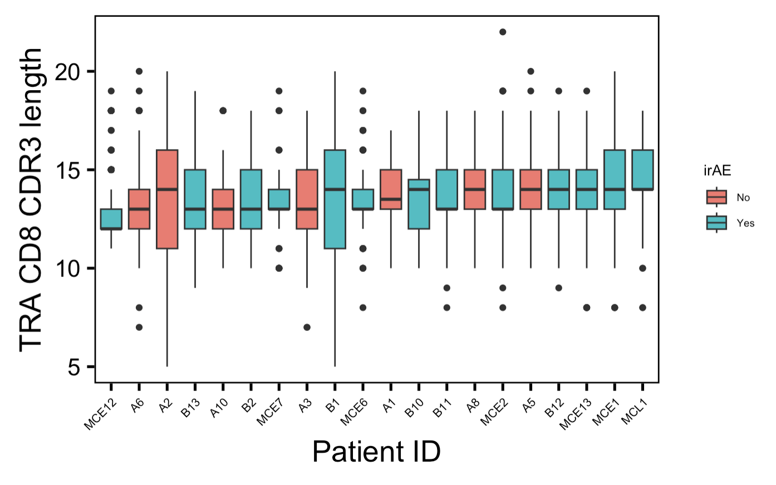
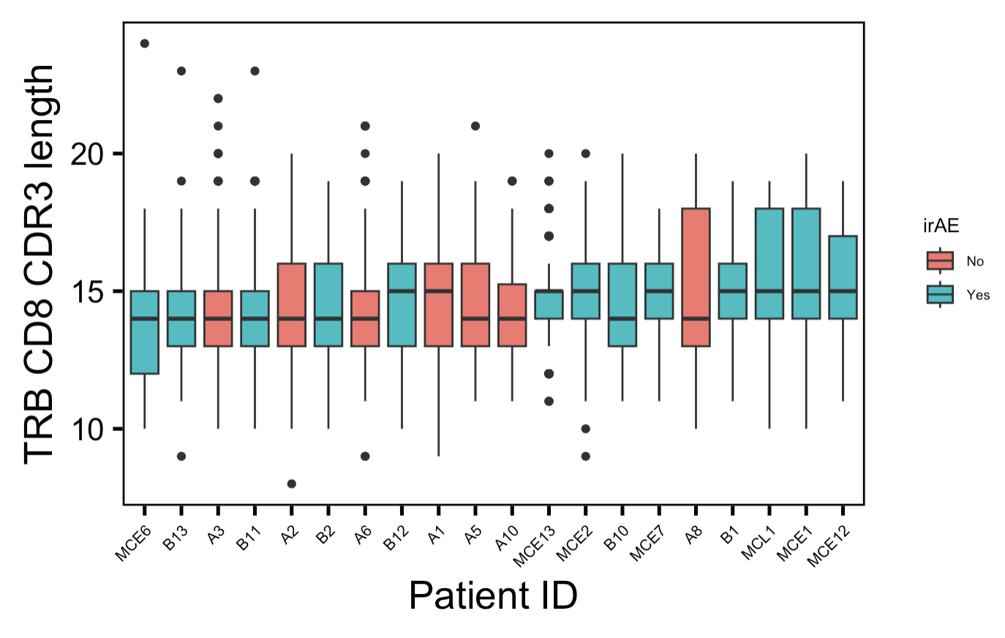
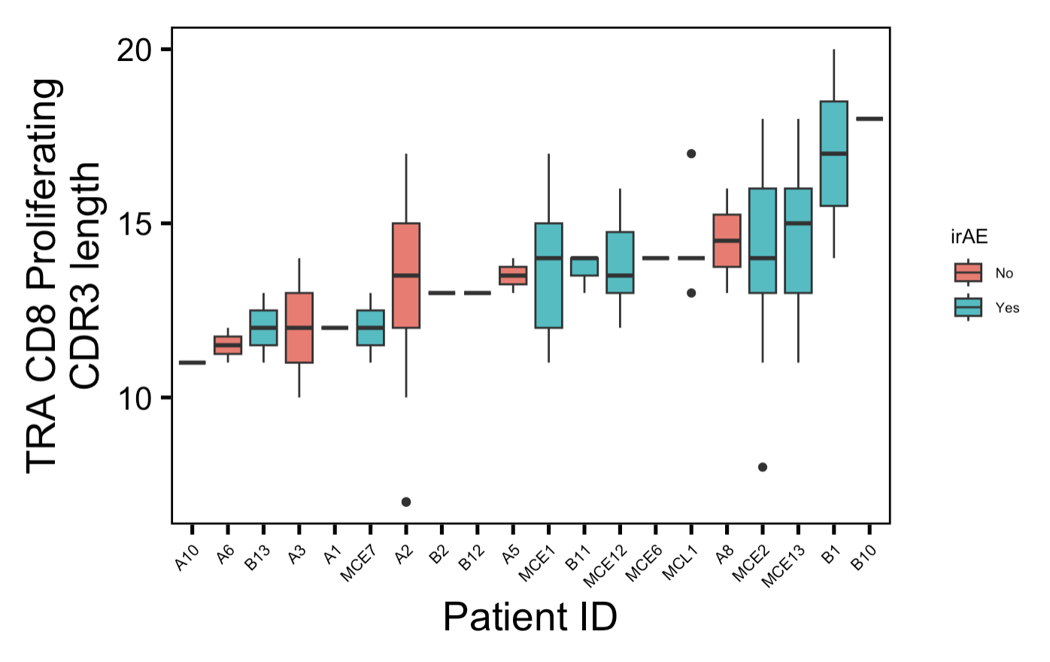
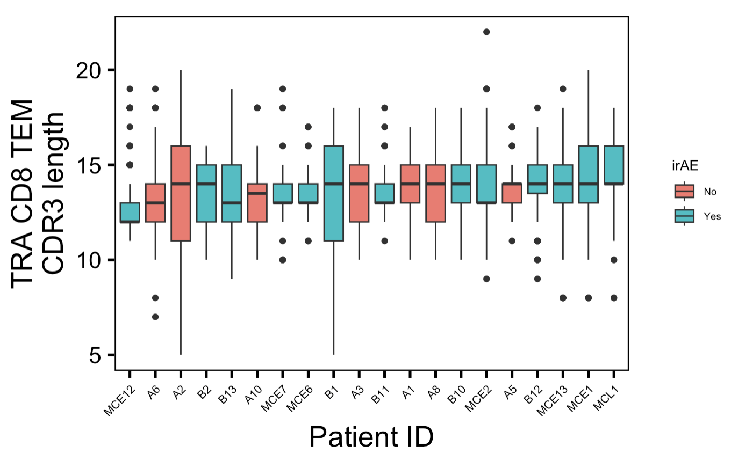
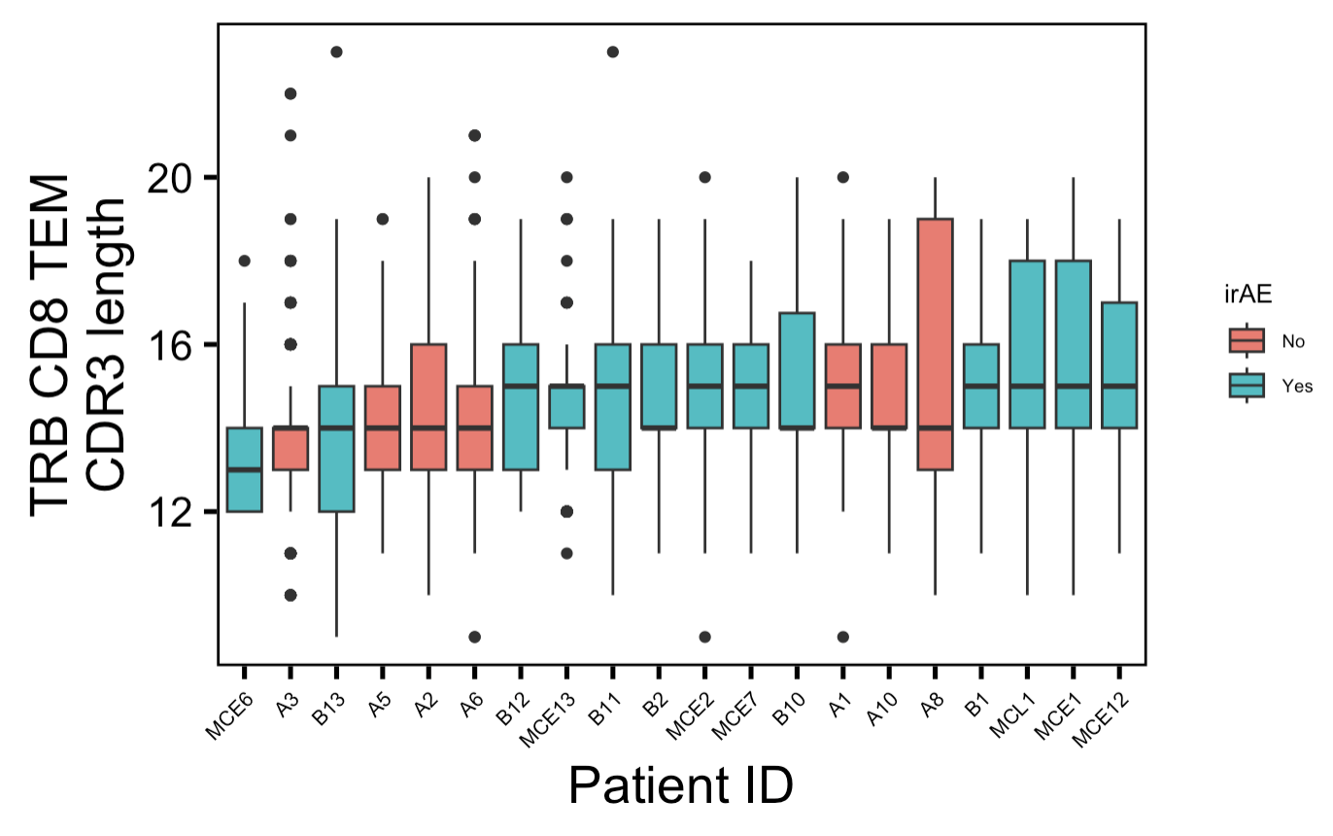
Looking at all TCRs, there doesn’t seem to be large patient bias in main conclusion of longer CD8 CDR3s in irAE patients
Notes:
CD8 CDR3s generally longer in those developing irAEs, particularly interested in highly expanded T cell groups effects
CD8 TRA
CD8 TEM TRB

Slide 4
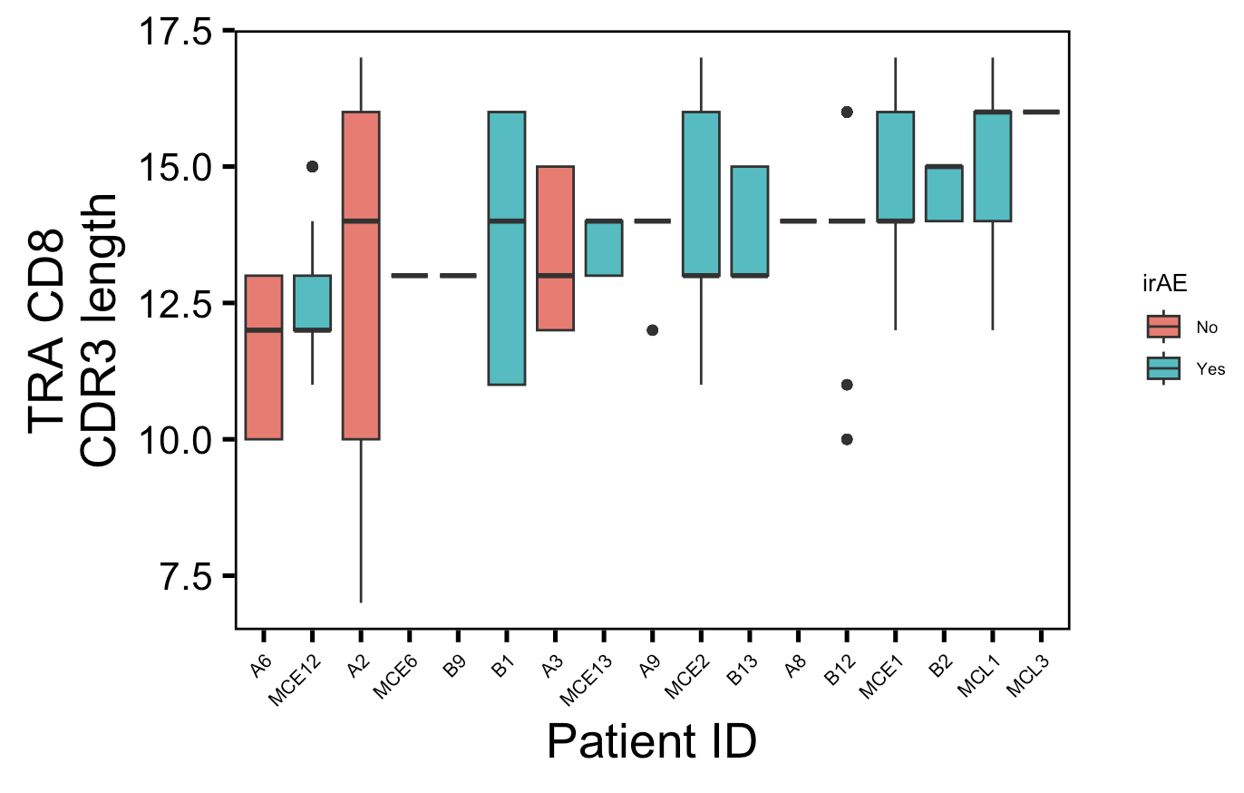
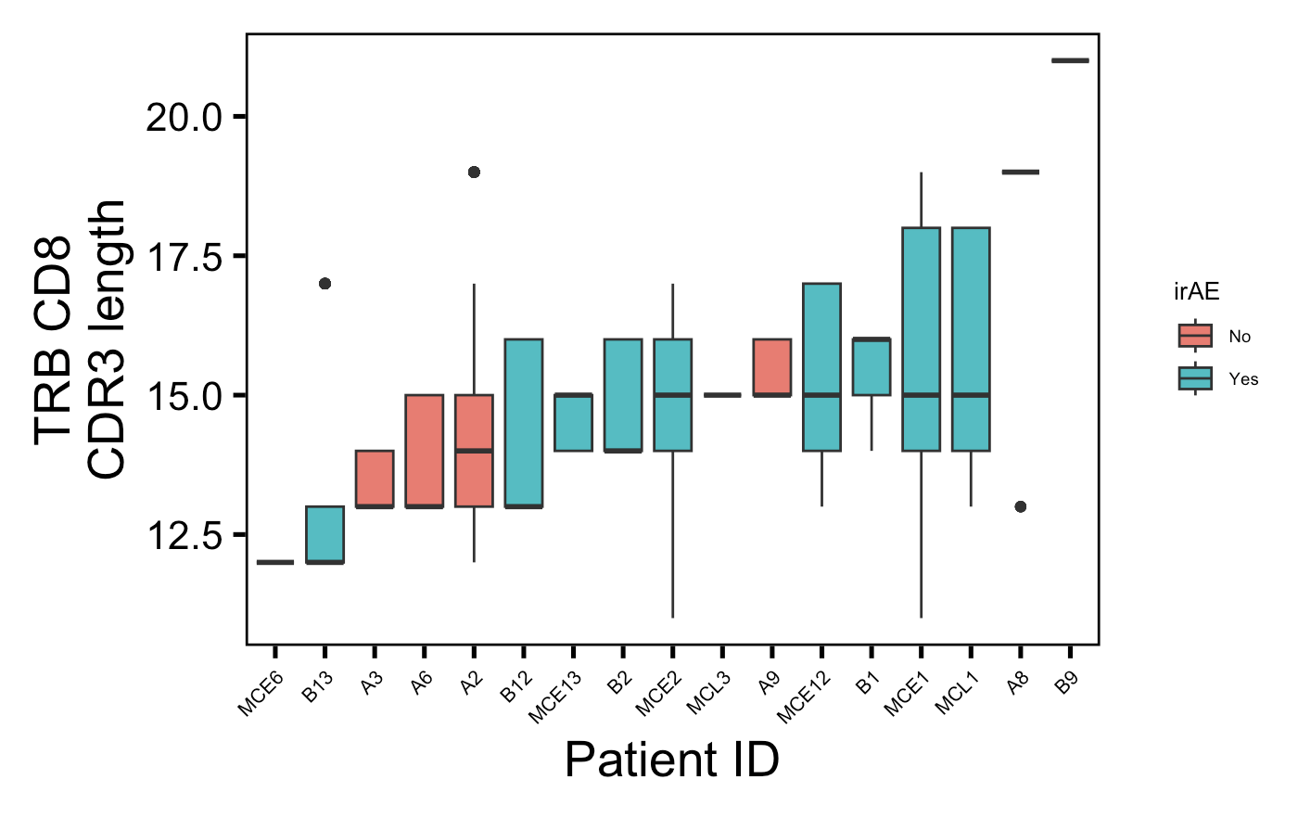
Looking at highly expanded CD8s, there doesn’t seem to be large patient bias in main conclusion of longer CD8 CDR3s in irAE patients
Notes:
Highly expanded here also could be just thought of as top clonotypes
CD8 CDR3s generally longer in those developing irAEs, particularly interested in highly expanded T cell groups effects
CD8 TRA
CD8 TEM TRB

Slide 5
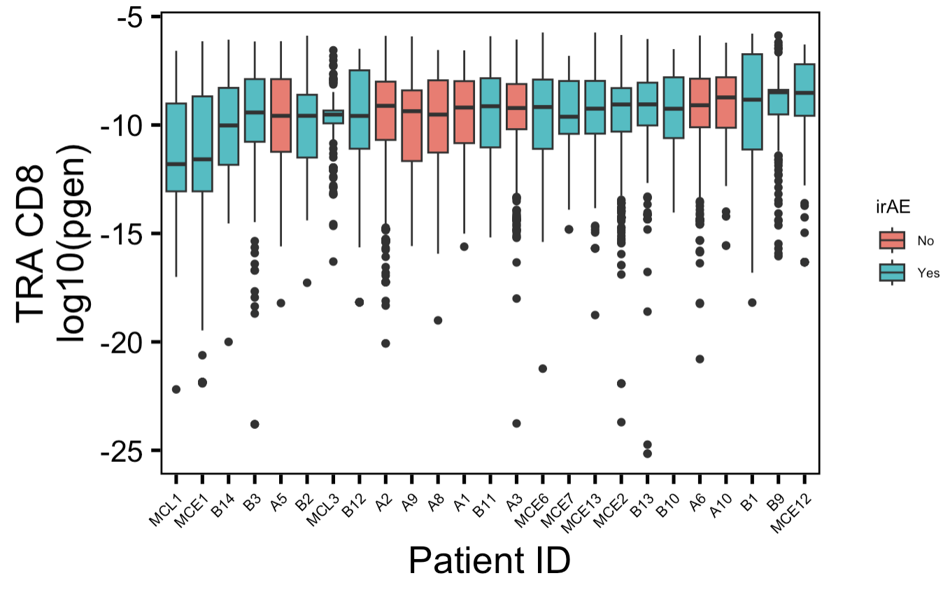
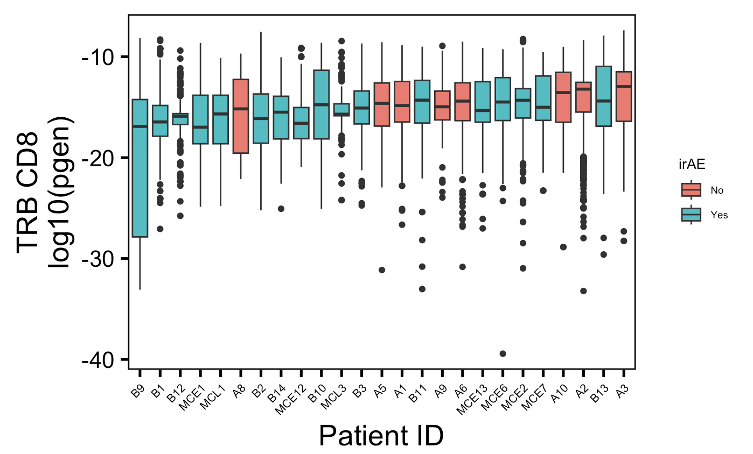
Looking at all TCRs, there may be some patient bias in main conclusion of less germline-like TCRs in irAE patients
Notes:
Contrary to germline-ness hypothesis, some TCRs are less germline-like in patients developing irAEs
Proliferating CD8 TRA TCRs
TEM CD8 TCRs
Highly expanded CD4 TCRs

Slide 6
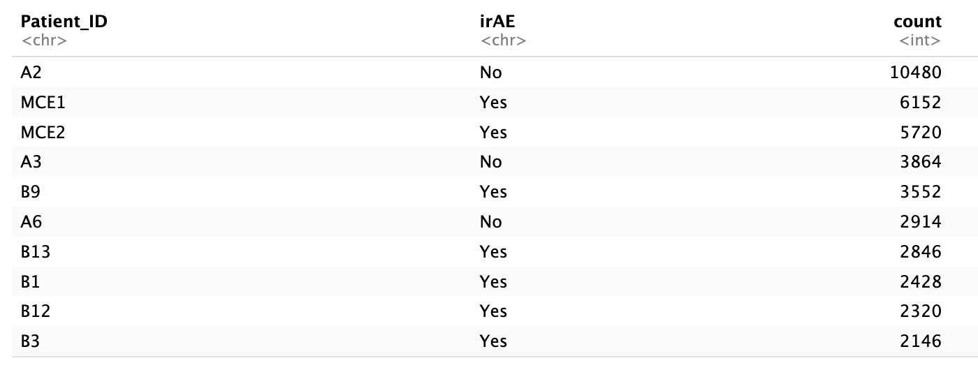
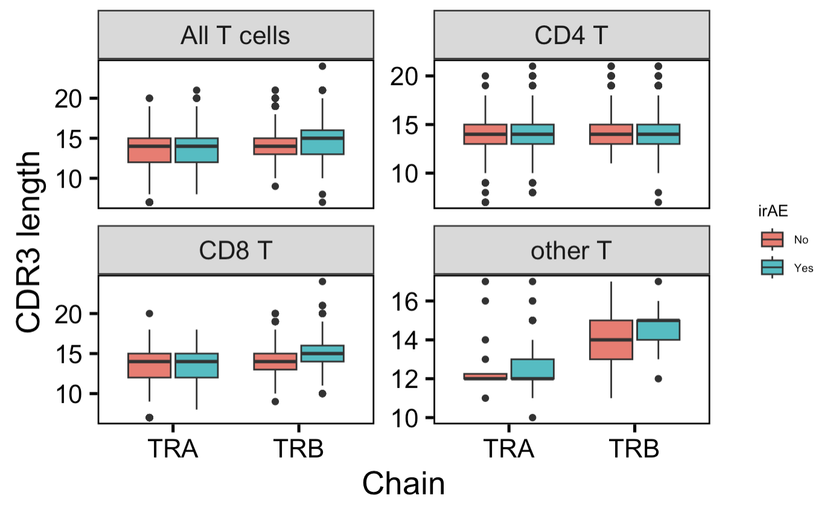
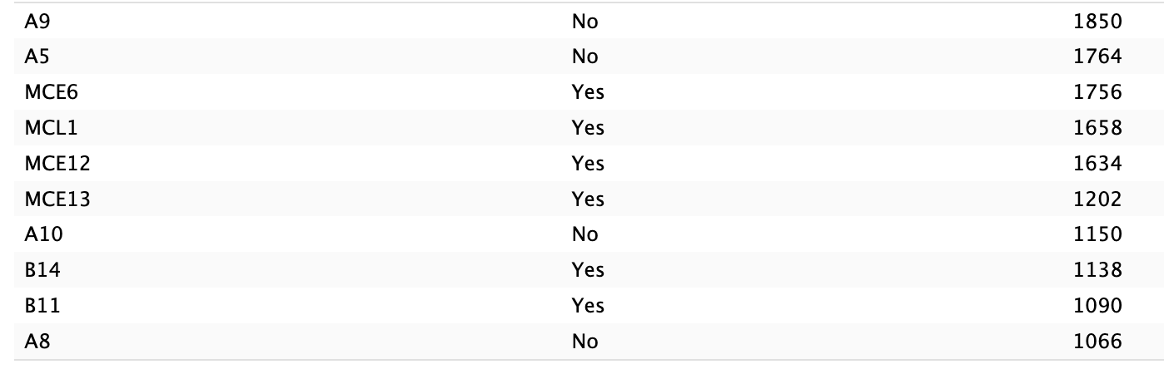
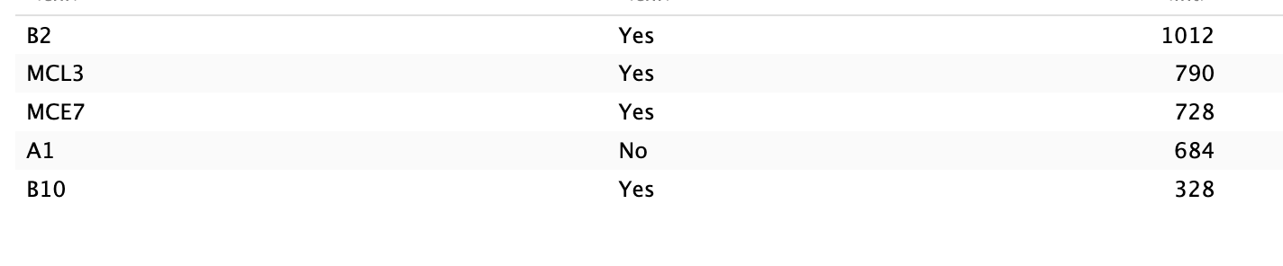
After downsampling, CD8 CDR3 length conclusion still generally holds, more so for TRB
Notes:
CD8 CDR3s generally longer in those developing irAEs, particularly interested in highly expanded T cell groups effects
CD8 TRA
CD8 TEM TRB

Slide 7
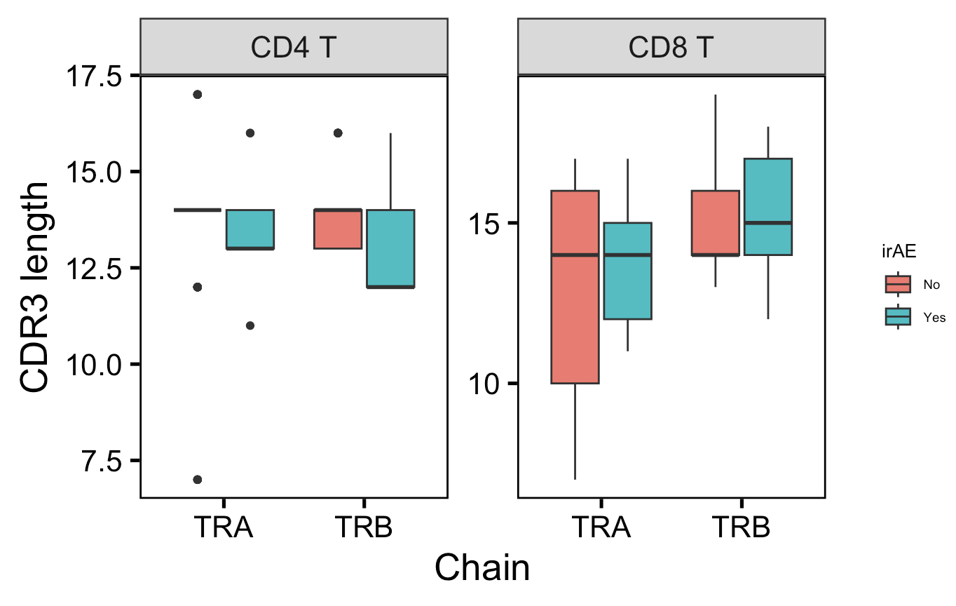
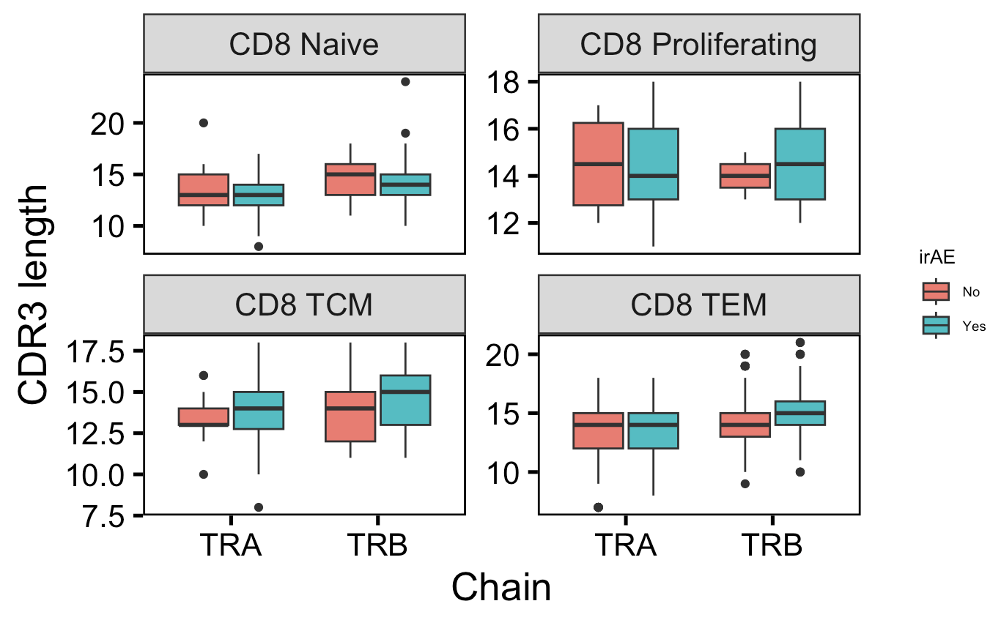
After downsampling, CD8 CDR3 length conclusion still generally holds, more so for TRB
Highly expanded T cells

Slide 8
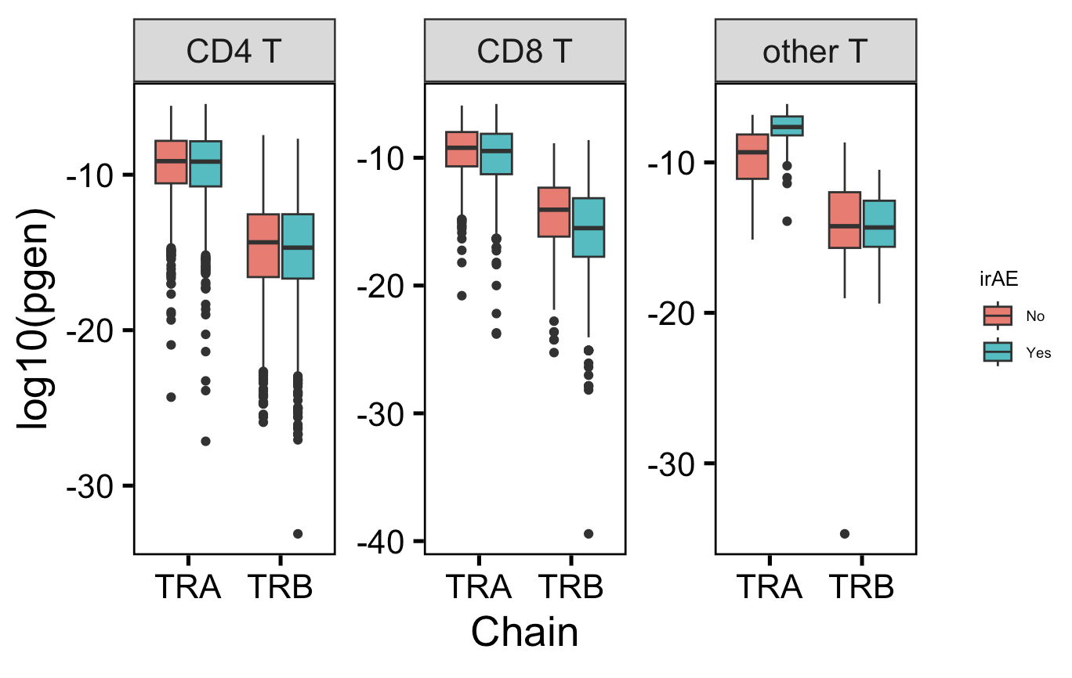
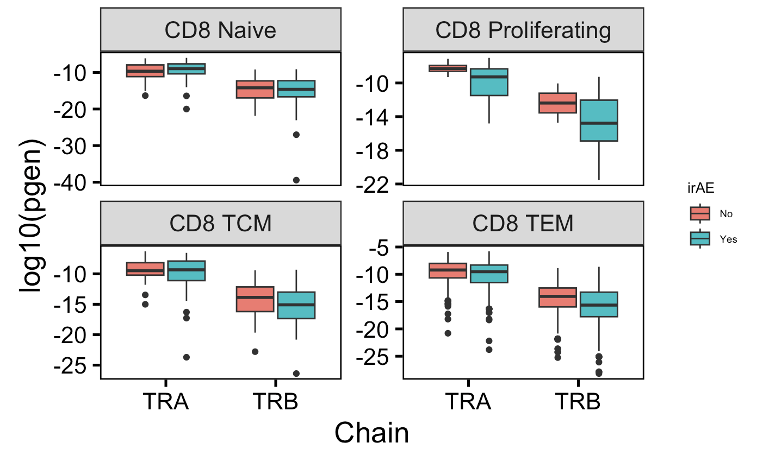
After downsampling, pgen conclusion still generally holds
Notes:
Contrary to germline-ness hypothesis, some TCRs are less germline-like in patients developing irAEs
Proliferating CD8 TRA TCRs
TEM CD8 TCRs
Highly expanded CD4 TCRs

Slide 9
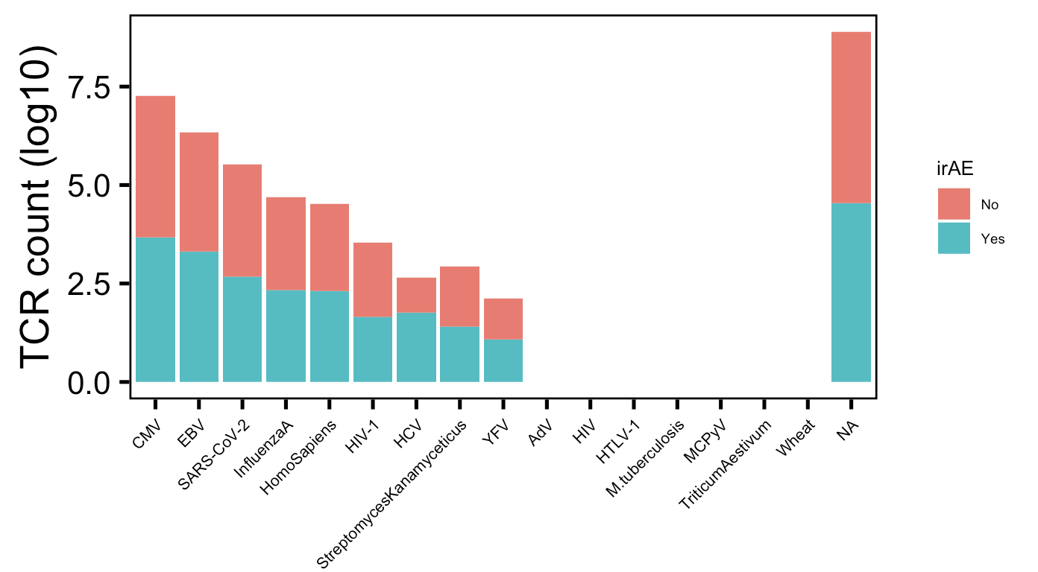
~20% of TCRs are in VDJdb, usually specific for viral epitopes. No clear irAE trends
Notes:
Worth to ask authors for patient MHC info (genes and alleles)?

Slide 10
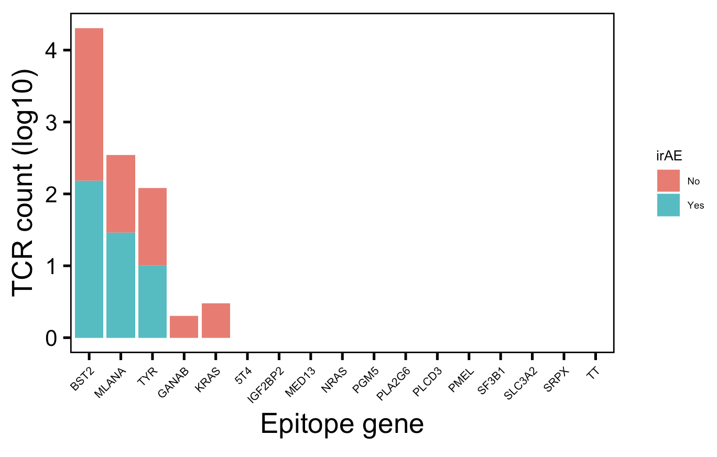
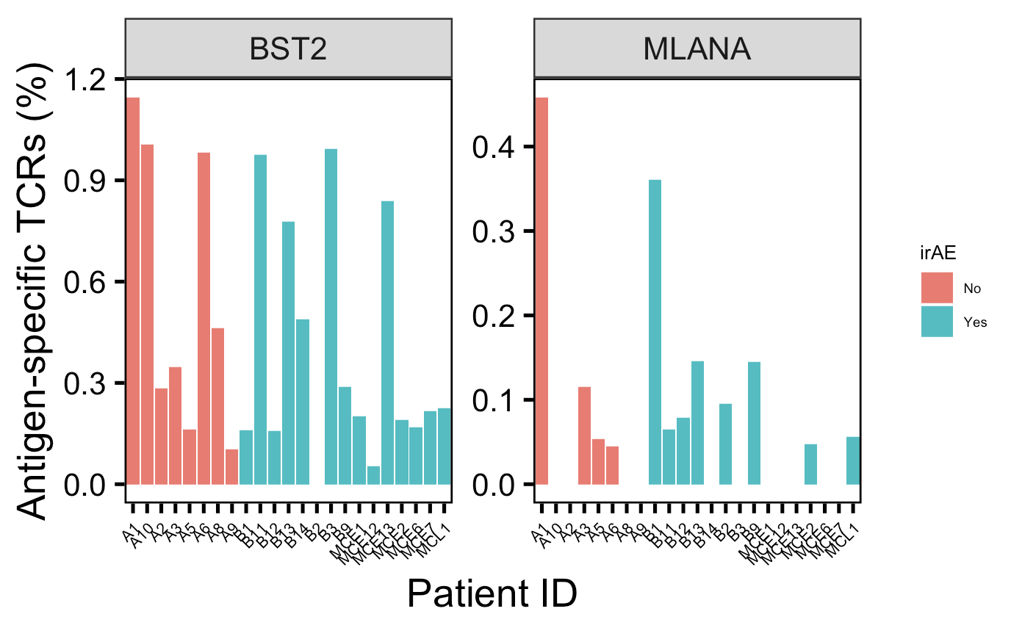
Human epitopes mostly from BST2 gene, no clear irAE trends
Notes:
% on right means % of sequenced repertoire
BST2: CD317, tetherin, bone marrow stromal antigen 2, innate immunity, inhibits release of enveloped virus from infected cells (especially HIV-1) by tethering them to infected cells
Melanoma: A6, A8, B3B (also has vitiligo), B4-5, B12, MCE12

Slide 11
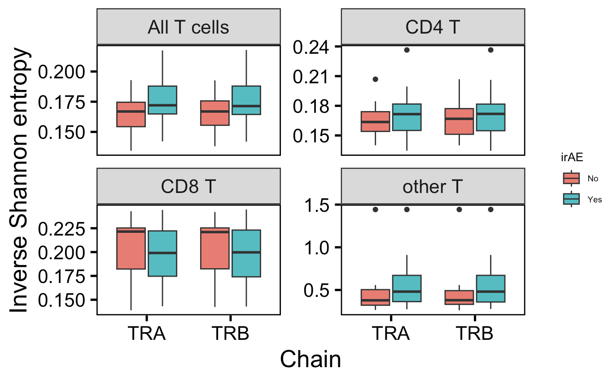
Junction diversities similar across cell types and irAE development
n.s.
n.s.
n.s.
n.s.
n = 8
n = 17
n.s.
n.s.
n.s.
n.s.
Notes:
Higher inverse means more monoclonal, lower inverse means more polyclonal

Slide 12
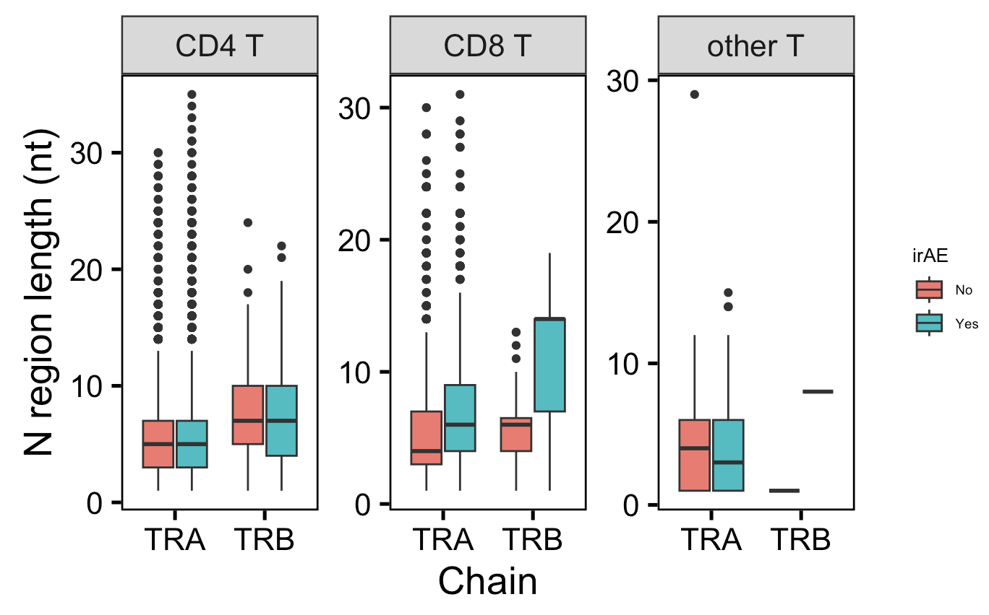
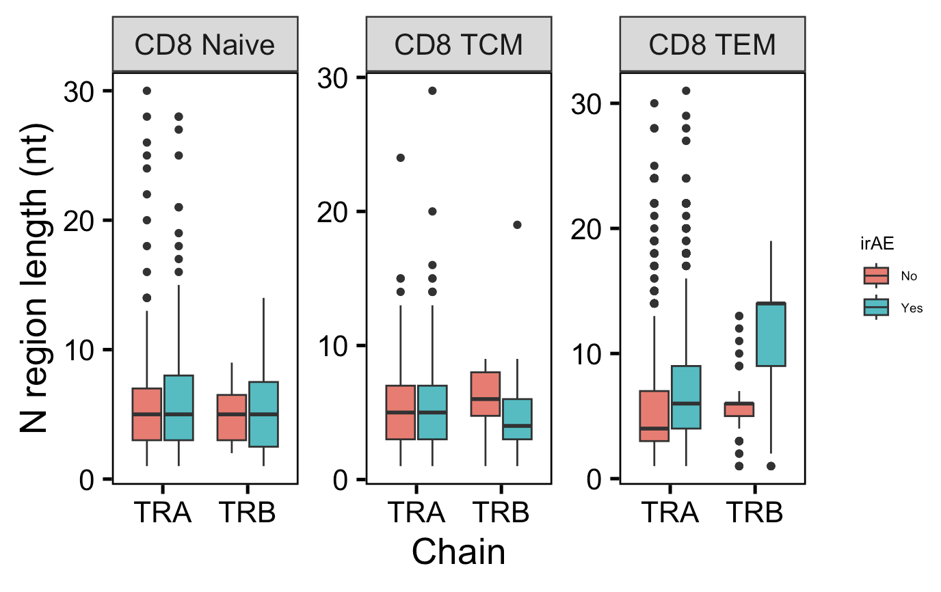
N region feature analysis generally mirrors CDR3 length conclusion (longer in CD8 TRAs in patients with irAEs)

Slide 13
Conclusions
Major conclusions from CDR3 length analysis and TCR germline-ness (pgen) generally hold with downsampling and accounting for patient bias
~20% of myocarditis dataset TCRs are in VDJdb, mostly specific for viral antigens
Junction diversities are similar across cell types and irAE development
N region length feature analysis generally mirrors CDR3 length conclusion
V(D)JC gene usage looks similar between yes/no irAE development (data not shown)
No consistent trends from CDR1/2 feature analysis (data not shown)

Slide 14
Next steps
Look into framework regions for length/hydrophobicity analysis?
See if main conclusions from myocarditis dataset hold in other datasets
Interleukin 21 drives CXCR6⁺ CD8⁺ T cell mediators in autoimmune checkpoint inhibitor thyroiditis
Thyroid immune infiltrates → TCRseq
HC (n = 3), Hashimoto’s thyroiditis (n = 5), irAE thyroiditis (n = 5)
In email communication with author for TCRseq data
Distinct molecular and immune hallmarks of inflammatory arthritis induced by ICI for cancer therapy
20 patients with arthritis-irAE
Notes:
Antigen specificity of the T-cell receptor (TCR) is determined in part by the sequence of complementarity-determining regions (CDRs) and framework regions encoded by the T-cell receptor beta (TCRB) variable (TRBV) gene

