Slide 1
Weekly meeting
12 7 2023
Ty Bottorff

Slide 2
Outline
Solid conclusions from myocarditis dataset
Going over NCI meeting slides

Slide 3
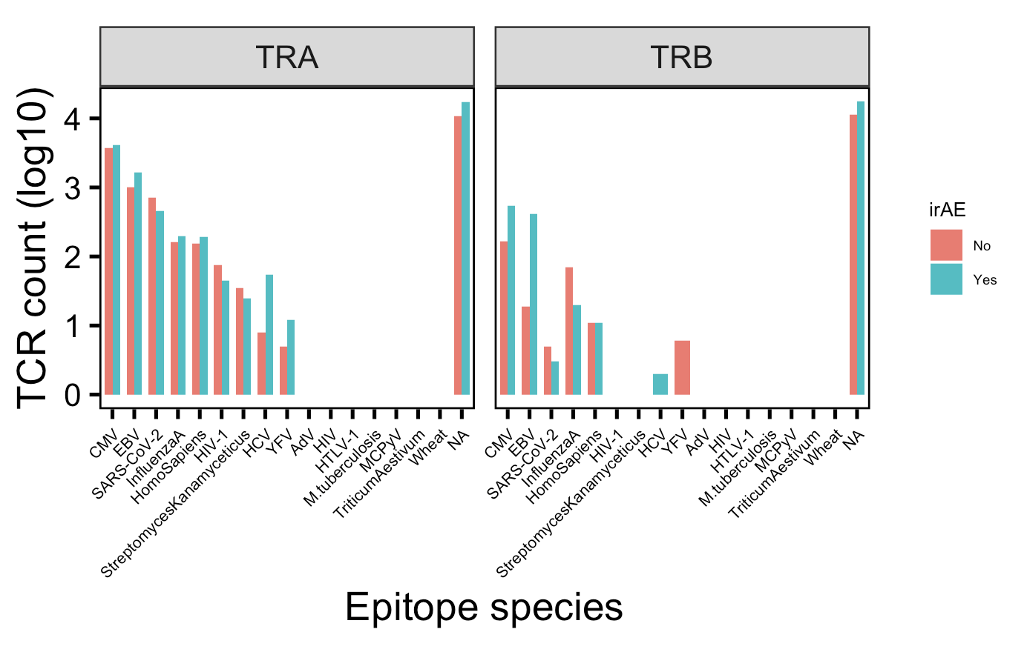
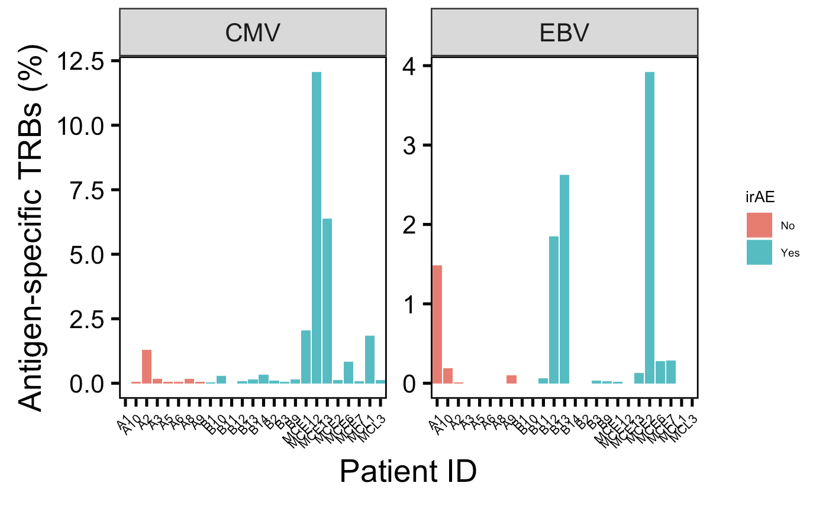
There are many more TRBs specific for CMV and EBV in those developing irAEs, mostly driven by a few patients
Notes:
Perhaps related to connection between infections before autoimmune development? Or just bystanders?
VDJdb mostly MHC class I (80k, 4k class II)

Slide 4
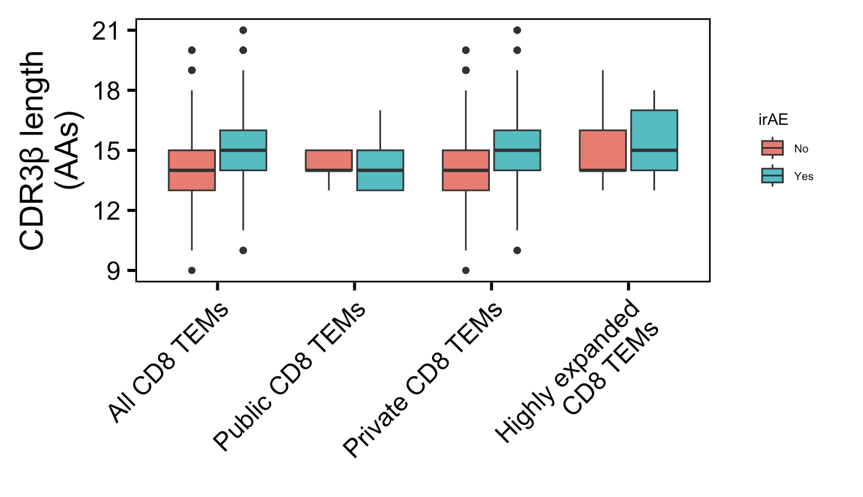
Solid conclusion #1 from myocarditis dataset: private CD8 TEM CDRβs longer in those developing irAEs
**
n.s.
**
**
n = 278
n = 816
n = 11
n = 52
n = 267
n = 764
n = 50
n = 306
Wilcoxon rank sum test. ****, padj <1e-4; **, padj <1e-2; *; padj <0.05
Notes:
Downsampled

Slide 5
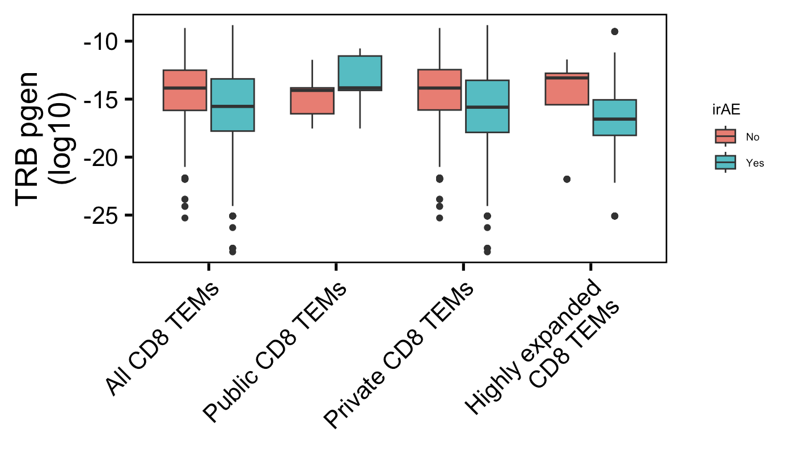
Solid conclusion #2 from myocarditis dataset: private CD8 TEM TRBs less germline-like in those developing irAEs
→
****
n.s.
****
****
More germline-like
Less germline-like
→
n = 278
n = 816
n = 11
n = 52
n = 267
n = 764
n = 50
n = 306
Wilcoxon rank sum test. ****, padj <1e-4; **, padj <1e-2; *; padj <0.05
Notes:
Downsampled

Slide 6
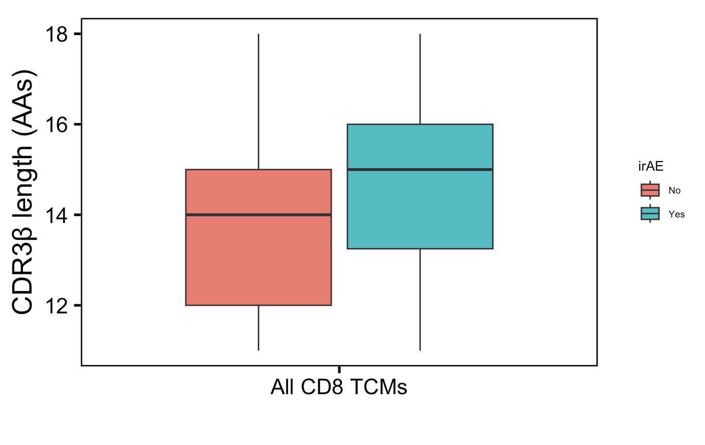
Somewhat solid conclusion #1 from myocarditis dataset: CD8 TCM CDR3βs longer in those developing irAEs
p = 0.09
n = 29
n = 46
Notes:
Downsampled

Slide 7
Unanswered questions from myocarditis dataset
Are the longer private CDR3B CD8 TEMs and less germline-like private CD8 TEM TRBs more crossreactive? If so, for what antigens are they crossreactive, i.e. tumor, self?

Slide 8
Conclusions
Main conclusions solidified from myocarditis dataset
No non-V genes found as DE genes between longest and shortest CDR3βs from CD8 Ts nor highest and lowest pgen TCRBs of CD8 Ts (data not shown)
Notes:
took longest 50 and shortest 50 CDR3βs from CD8 T cells per patient, only see V genes in DE gene list padj < 0.05

Slide 9
Next steps
Ponder…
why only see length and germline-ness differences in private TCRs
why we see opposite of germline-ness hypothesis
Perhaps germline-ness here is a anti-correlate of CDR3 length (i.e. longer CDR3s more likely to come from less germline-like TCRs with more non-templated insertions at junctions?)
See if main conclusions from myocarditis dataset are recapitulated in thyroiditis dataset
Caveats
myocarditis dataset was PBMCs, thyroiditis dataset is thyroid samples
thyroiditis dataset doesn’t have many cells, ~15k irAE + autoimmune (waiting on HCs)… might be underpowered

Slide 10
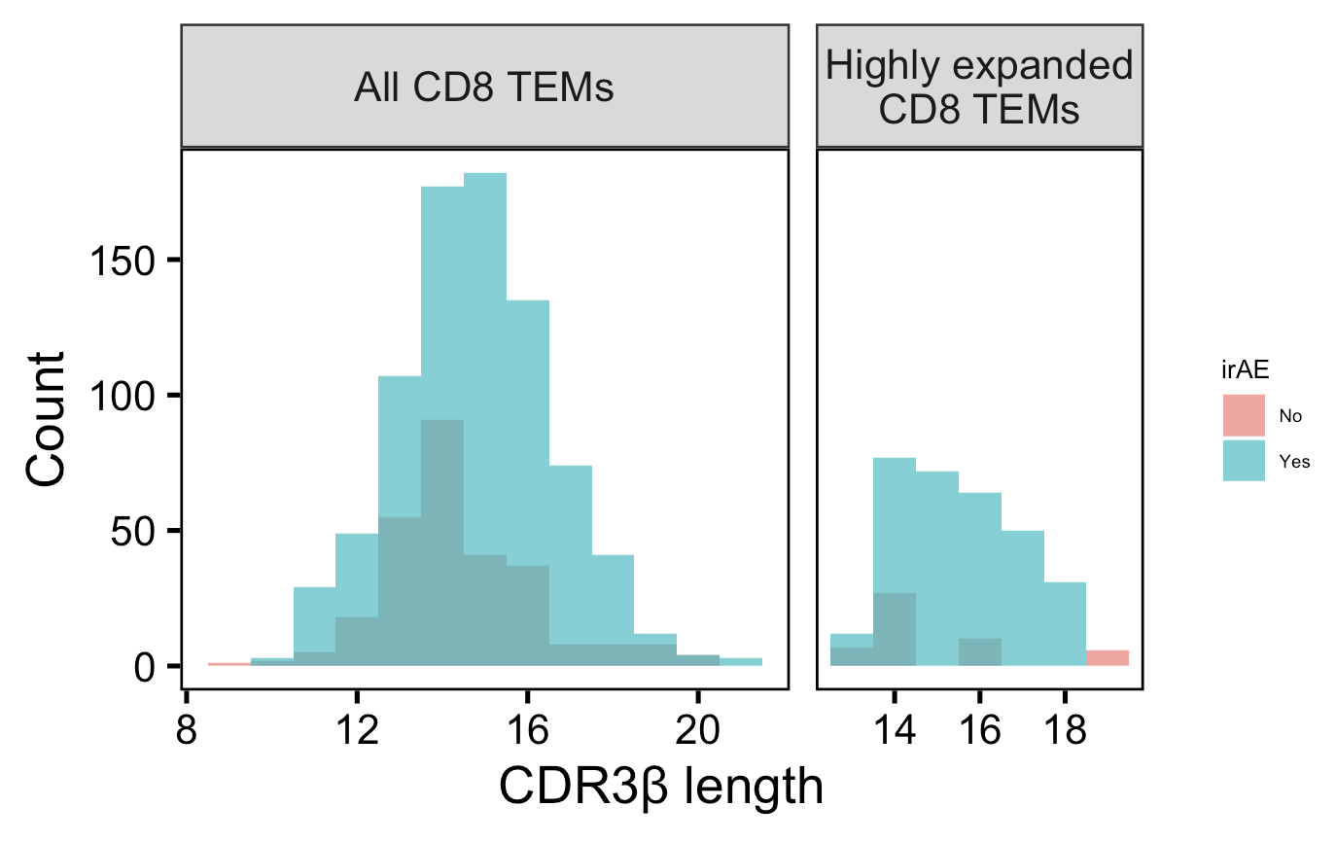
Histogram instead of box plots
**
**
n = 278
n = 816
n = 50
n = 306
Wilcoxon rank sum test. ****, padj <1e-4; **, padj <1e-2; *; padj <0.05
Notes:
Downsampled

