Slide 1
Weekly meeting
09 28 2023
Ty Bottorff

Slide 2
Outline
Progress in reproducing data from T cell characteristics associated with toxicity to immune checkpoint blockade in patients with melanoma (Newman lab)
Next steps

Slide 3
Methods: QC
24,807 cells
“Outlier cells were identified and removed based on the following criteria: (1) >25% mitochondrial content or (2) cells with less than 100 or greater than 1,500–3,000 expressed genes, depending on sample-level distributions”
I assume they already removed these cells before uploading data to GEO (I filter 0 cells out)

Slide 4
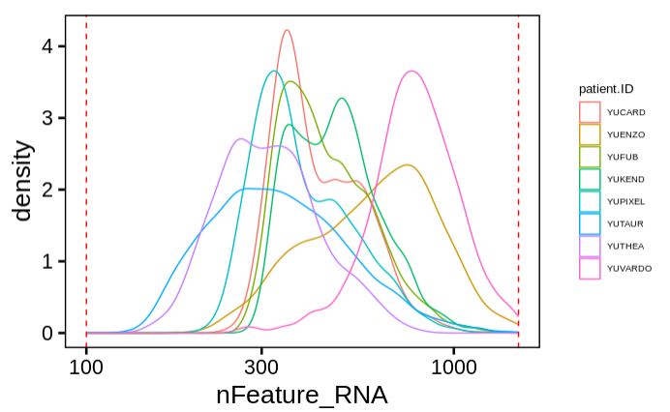
100 < nFeature_RNA < 1500

Slide 5
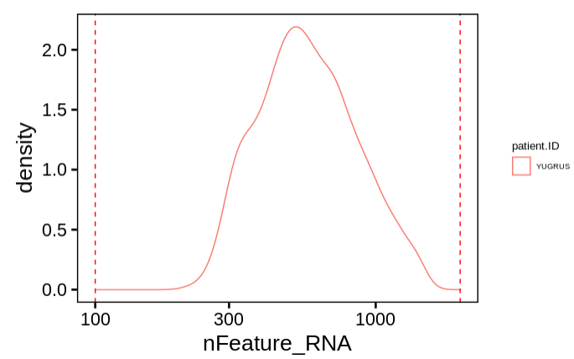
100 < nFeature_RNA < 2000

Slide 6
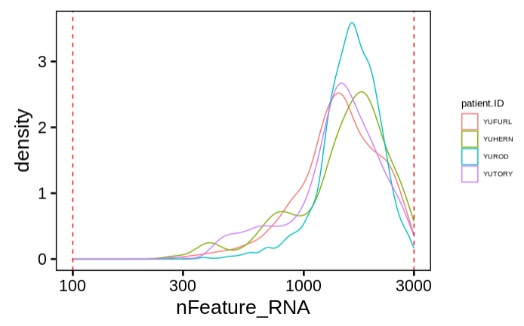
100 < nFeature_RNA < 3000

Slide 7
Methods continued
Integrate data by finding anchors across patient samples
PCA
UMAP
Find clusters
Find cluster biomarkers
Assign cell types, filter RBCs/platelets
Repeat steps 2-6
No RBCs/platelets filtered out 2nd round
Notes:
1: 2000 variable features
2-3: 30 PCs
4: resolution = 3, see different number of clusters than authors for step 4 (28 instead of their 37)
5: immune.markers <- FindAllMarkers(immune.combined, only.pos = TRUE, min.pct = 0.25, logfc.threshold = 0.25)
6: CD3D/CD3E^{hi} = T cells; CD8A/CD8B^{hi} and NKG7/GNLY^{lo} = CD8 T cells; non-CD8 T cells with high IL7R expression and low NKG7/GNLY = CD4 T cells; NKG7/GNLY^{hi} and CD3D/CD3E^{lo} = NK cells; CD14 or FCGR3A^{hi} = monocytes; FCER1A^{hi} = dendritic cells (DCs); MS4A1^{hi} = B cells; HBB^{hi} = red blood cells; PPBP^{hi} = platelets. Cells with high expression of CD3D/E and GNLY/NKG7 that were not annotated as CD8/CD4 T cells were included in a T or NKT cell group, denoted T/NKT

Slide 8
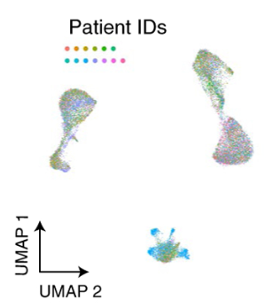
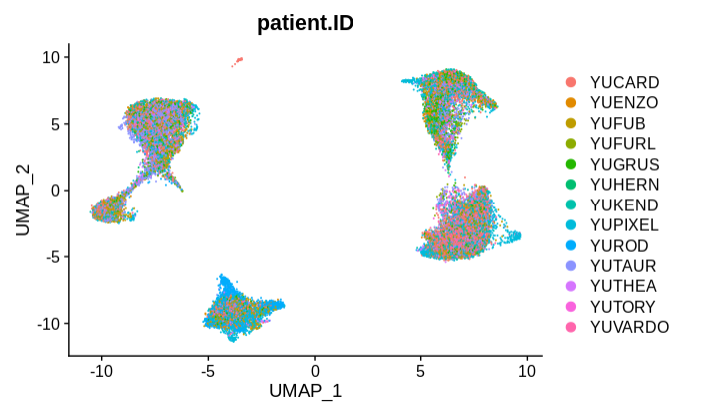
scRNAseq UMAP colored by patient ID largely recapitulates figure 3A
Newman lab figure 3a
Ty’s data reproduction
Notes:
Caveat: using Seurat_4.3.0 instead of v.3.1.5 or v.3.2.1 that authors used

Slide 9
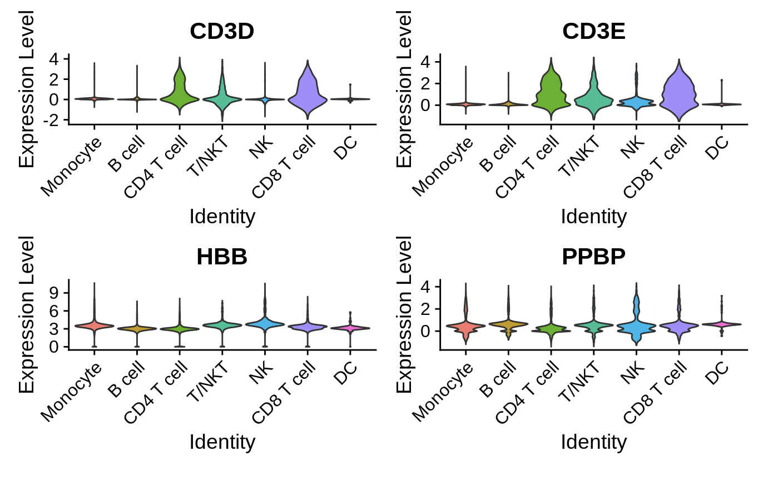
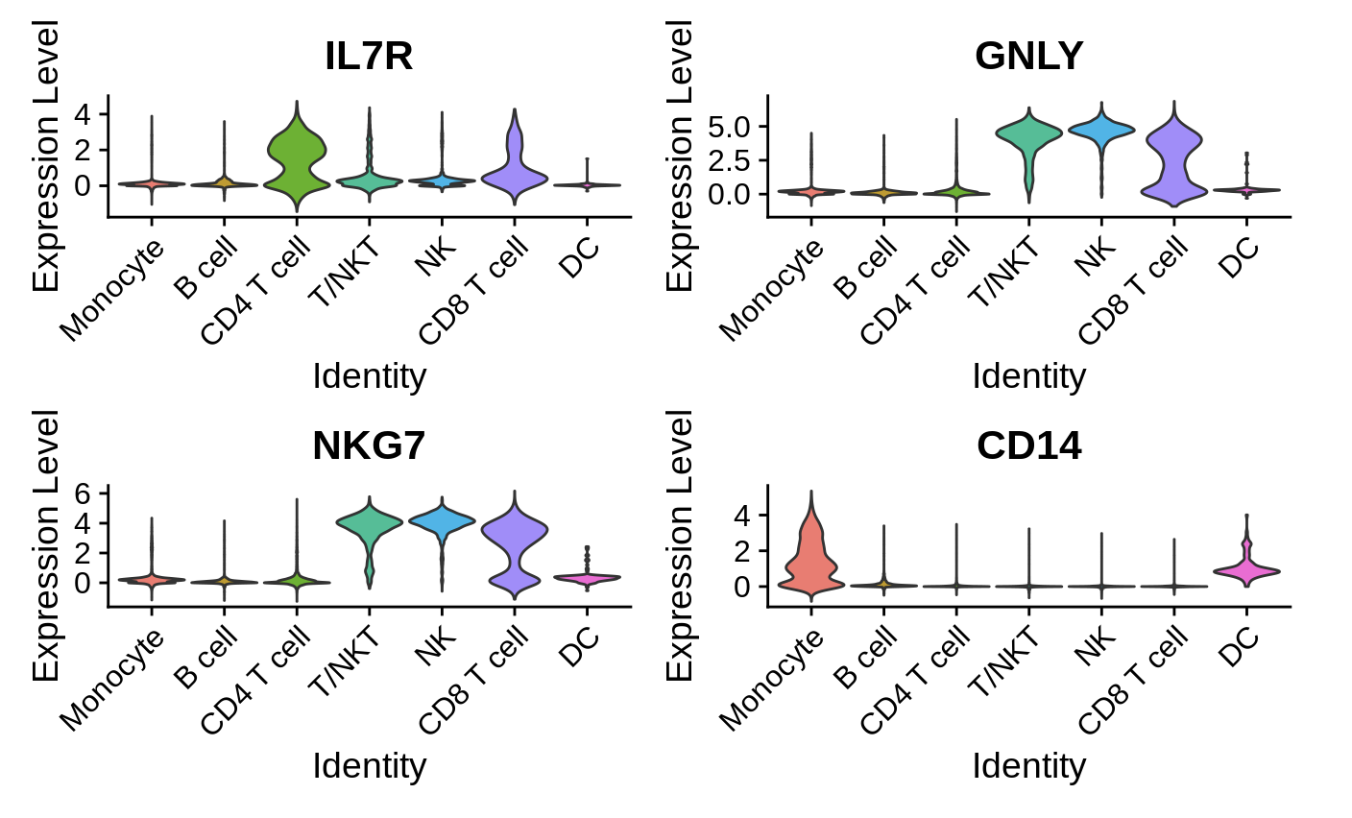
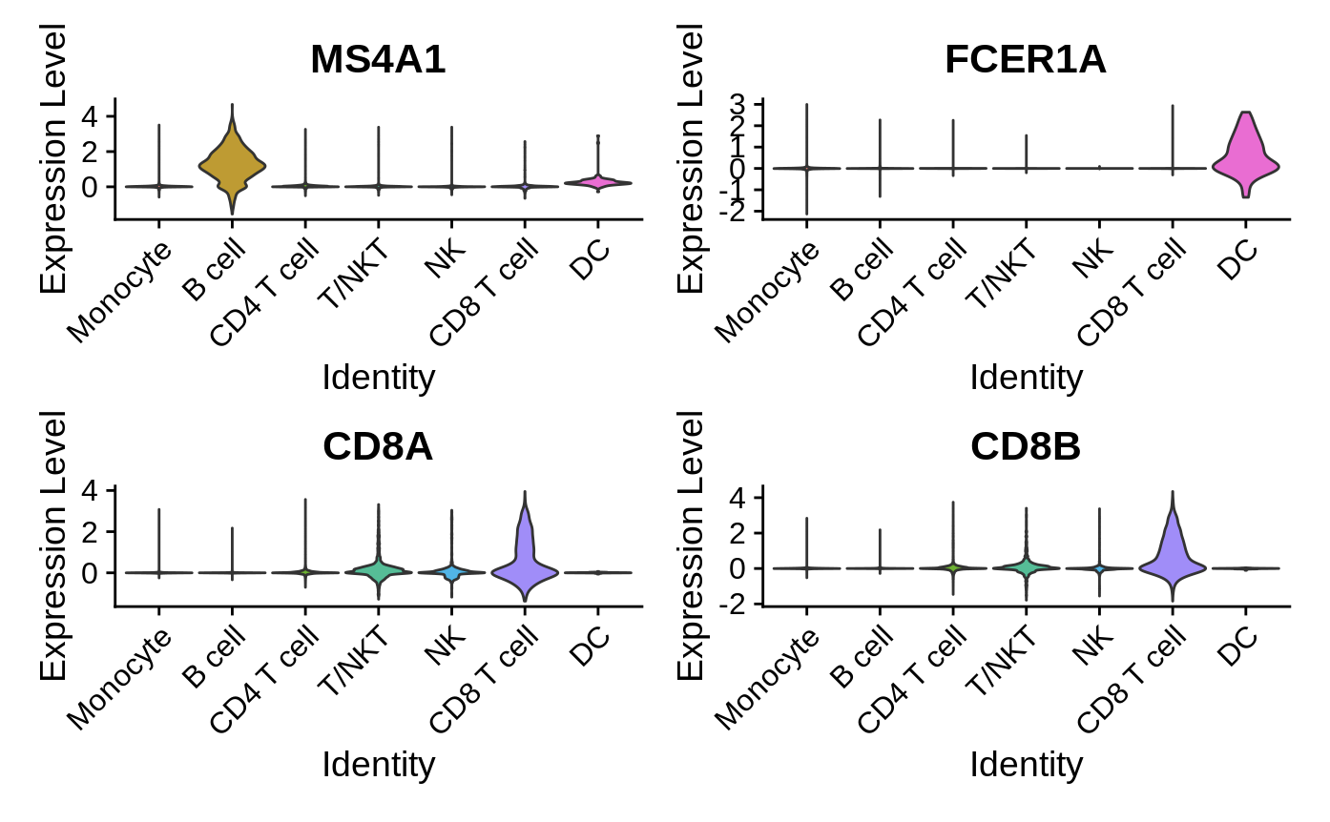
Manual assignment of clusters to cell types
Notes:
CD3D/CD3E^{hi} = T cells; CD8A/CD8B^{hi} and NKG7/GNLY^{lo} = CD8 T cells; non-CD8 T cells with high IL7R expression and low NKG7/GNLY = CD4 T cells; NKG7/GNLY^{hi} and CD3D/CD3E^{lo} = NK cells; CD14 or FCGR3A^{hi} = monocytes; FCER1A^{hi} = dendritic cells (DCs); MS4A1^{hi} = B cells; HBB^{hi} = red blood cells; PPBP^{hi} = platelets. Cells with high expression of CD3D/E and GNLY/NKG7 that were not annotated as CD8/CD4 T cells were included in a T or NKT cell group, denoted T/NKT

Slide 10
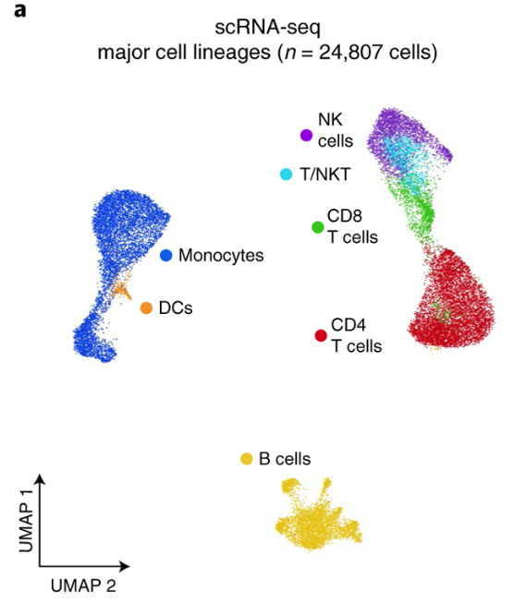
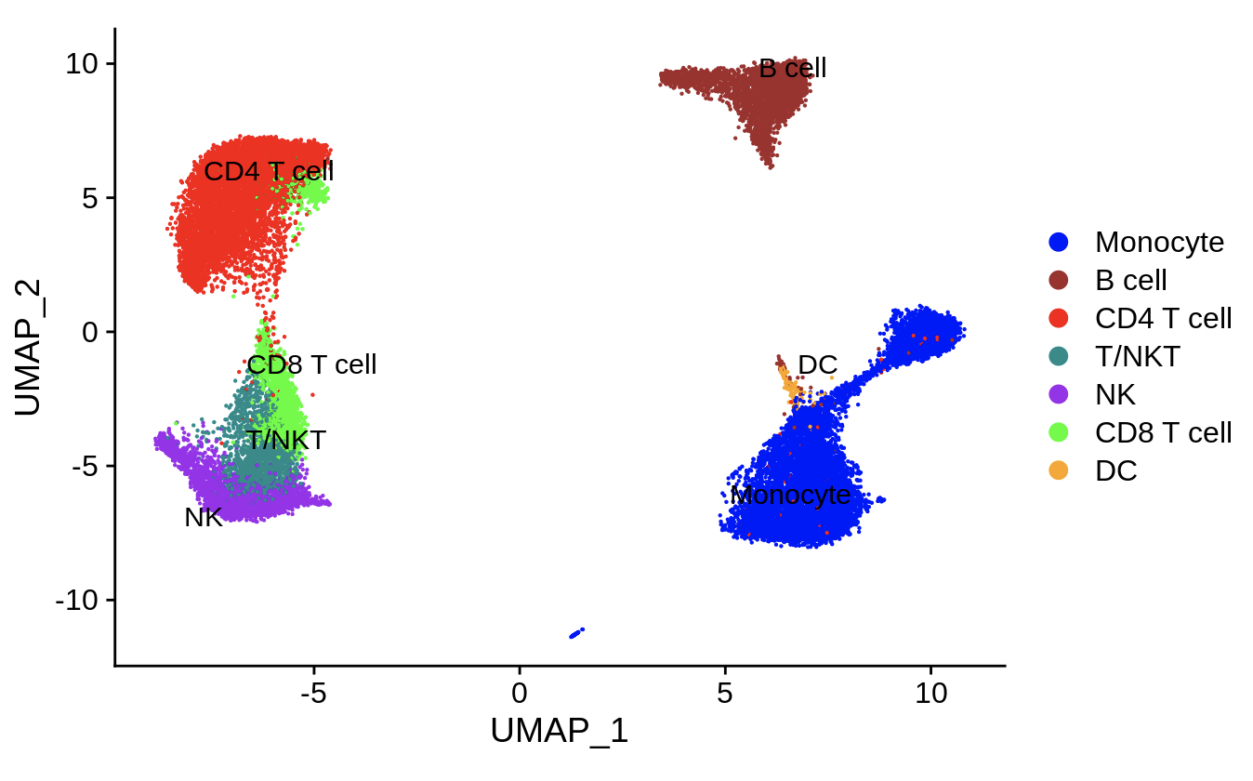
scRNAseq UMAP colored by cell lineage largely recapitulates Newman lab figure
Newman lab figure 3a
Ty’s data reproduction

Slide 11
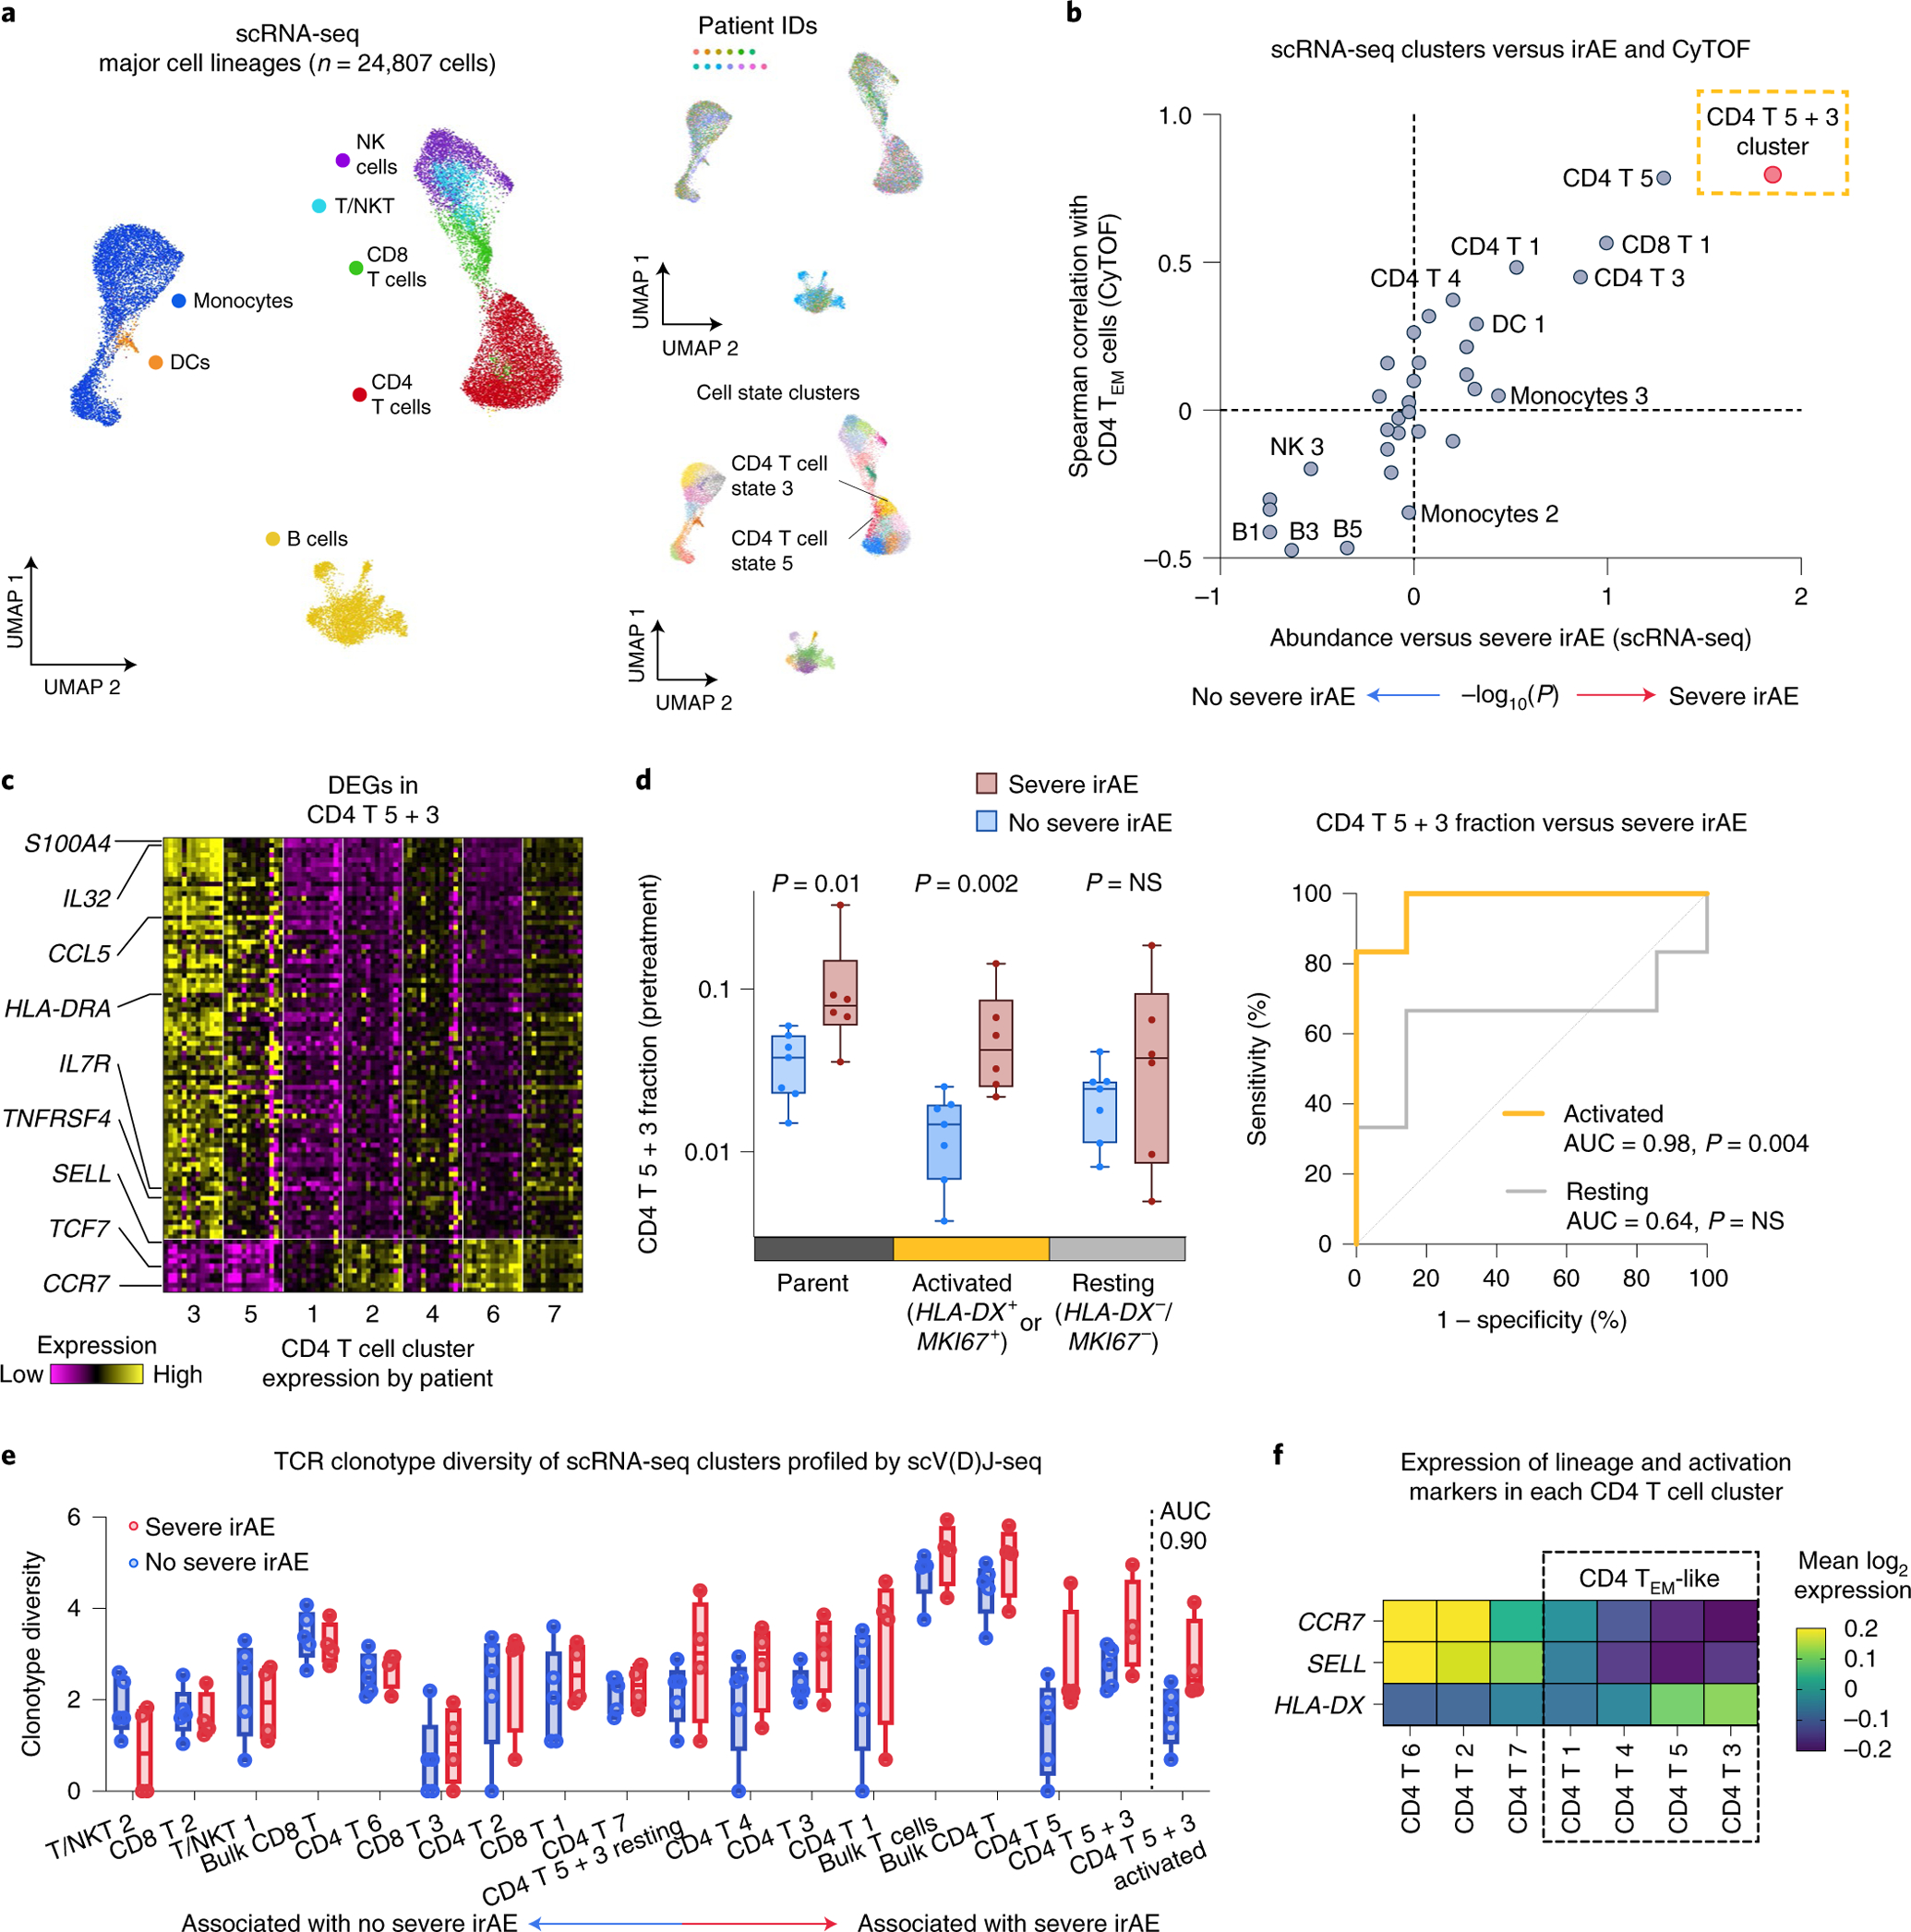
Next steps: continuing with Newman paper data recapitulation (rest of figure 3)
Subclustering of CD4 T cells
Incorporation of …
TCR/BCRseq data
CyTOF data

Slide 12
Next steps: higher priority additional potential papers to recapitulate findings of
Distinct mechanisms of mismatch repair deficiency delineate two modes of response to PD-1 immunotherapy in endometrial carcinoma
PD-1 inhibitor pembrolizumab, mismatch repair-deficient endometrial cancer
scRNA-seq/scTCR-seq
24 patients
Dynamic single-cell mapping unveils Epstein‒Barr virus-imprinted T-cell exhaustion and on-treatment response
human EBV-associated gastric cancer treated with immunochemotherapy (anti-PD-1 + XELOX/FOLFOX)
longitudinal scRNAseq and paired scTCR/BCR-seq
6 patients

Slide 13
Next steps: lower priority additional potential papers to recapitulate findings of
Lung tumor–infiltrating T_{reg} have divergent transcriptional profiles and function linked to checkpoint blockade response
single-cell RNA-seq/T cell receptor sequencing
tumor-infiltrating T_{reg} (TIL-T_{reg}) from anti–PD-1–treated and treatment-naive non–small cell lung cancers (NSCLC)
10 patients
in humans but with a focus for murine comparison
Lineage tracing reveals clonal progenitors and long-term persistence of tumor-specific T cells during immune checkpoint blockade
only 3 patients
paired single-cell RNA and T cell receptor sequencing
non-small cell lung cancer after immune checkpoint blockade (ICB)

