Slide 1
Weekly meeting
1 10 2024
Ty Bottorff

Slide 2
Outline
Cleaned up cell type abundance comparisons between irAE groups across both datasets, UMAP contour plot
Looking at feature differences between irAE groups across datasets across different bins of top clonotype %s using heatmaps

Slide 3
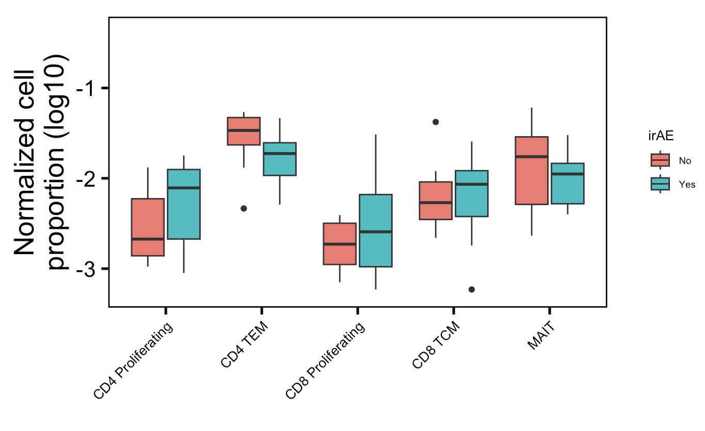
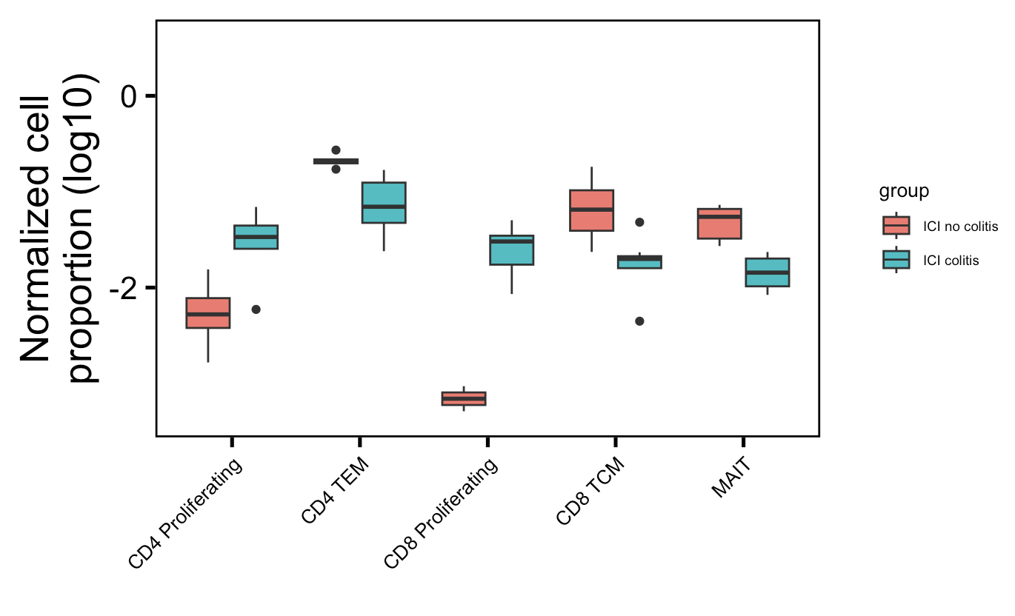
More proliferating T cells, fewer memory T cells (CD4 TEM, CD8 TCM), fewer MAITs in irAE colitis tissue: normalized by sequencing depth approach
Myocarditis dataset
Colitis dataset
**
**
*
**
**
None significant even with t test instead of Wilcox rank sum test
Wilcoxon rank sum test. **, p <1e-2; *; p <0.05
Notes:
Fewer Tregs associated with irAEs in literature, don’t see that here though, don’t even see ICI decreasing Tregs…
Wilcox rank sum test doesn’t assume equal variances (t test does)
~similar to what I see here: low baseline circulating MAITs associated with irAE colitis (PMID: 32734627)
~opposite to what I see here: activated CD4 TEM abundance (in PBMCs) associated with irAE development (PMID: 35027754)

Slide 4
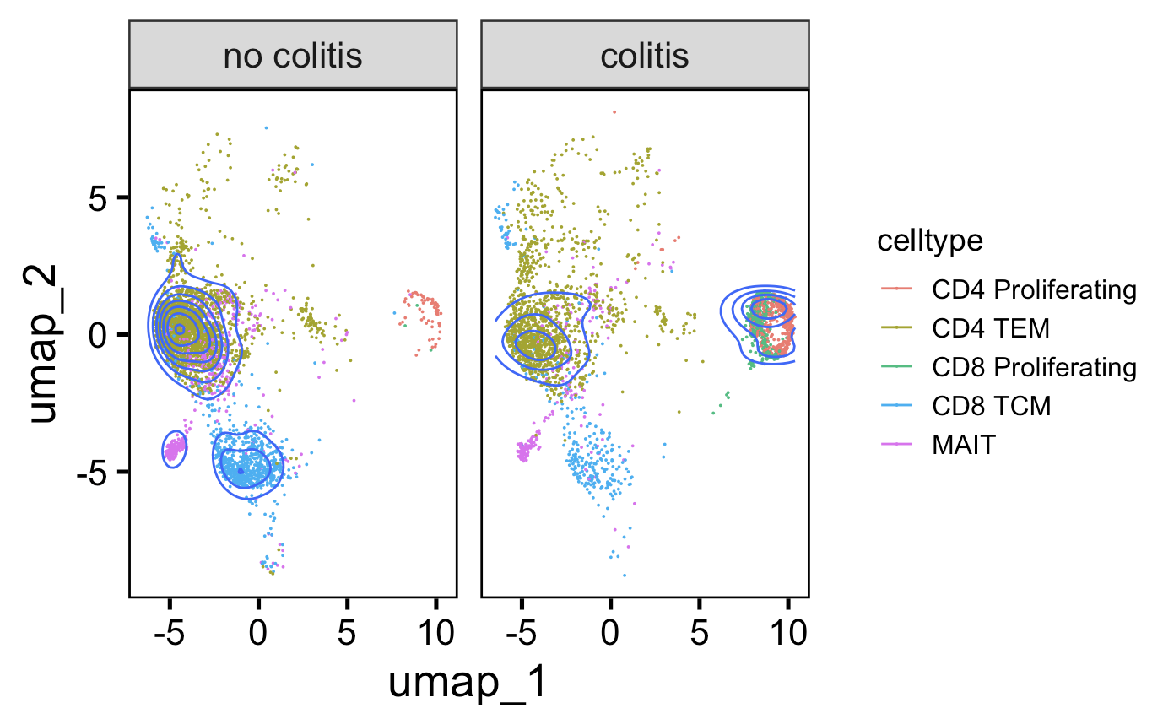
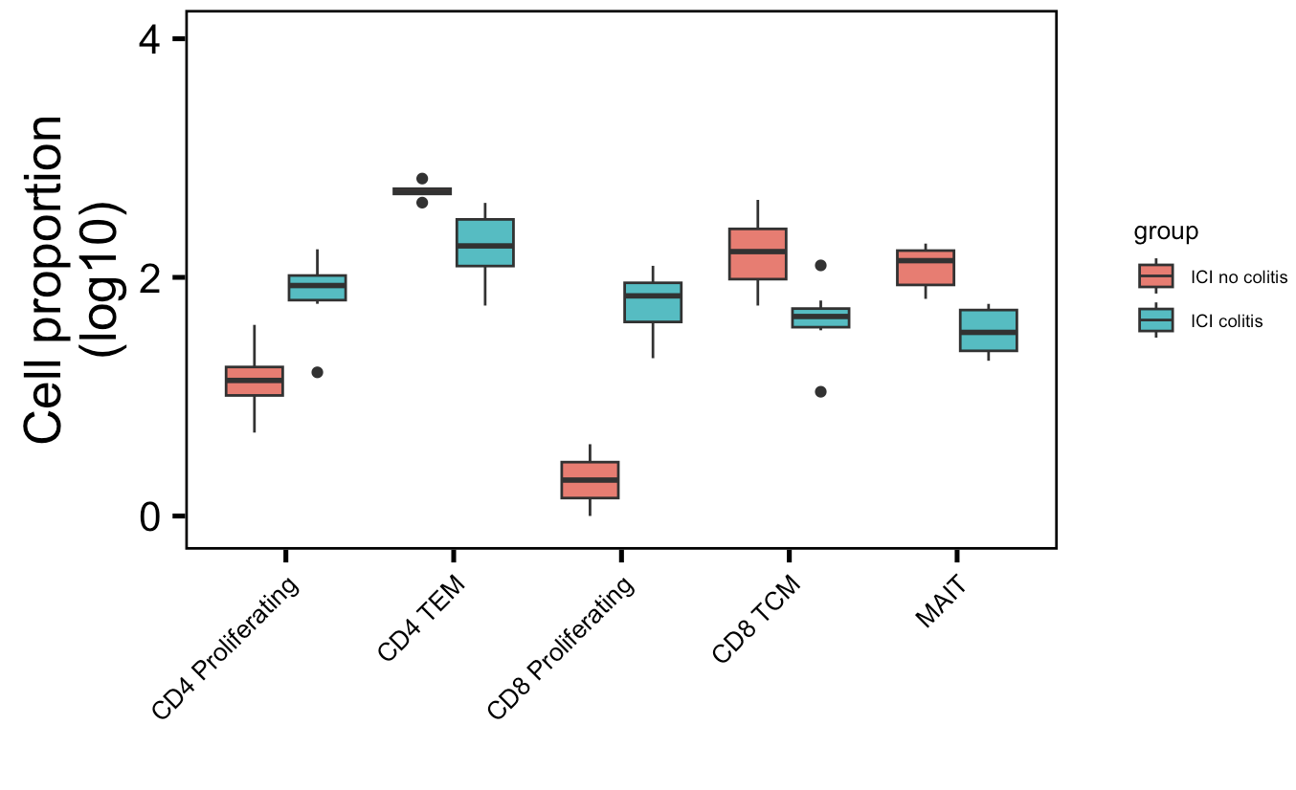
More proliferating T cells, fewer memory T cells (CD4 TEM, CD8 TCM), fewer MAITs in irAE colitis tissue: downsampling approach
Downsampled
**
**
*
**
**
Wilcoxon rank sum test. **, p <1e-2; *; p <0.05
Notes:
Fewer Tregs associated with irAEs in literature, don’t see that here though, don’t even see ICI decreasing Tregs…
~similar to what I see here: low baseline circulating MAITs associated with irAE colitis (PMID: 32734627)
~opposite to what I see here: activated CD4 TEM abundance (in PBMCs) associated with irAE development (PMID: 35027754)

Slide 5
Importance of the irAE organ
lower baseline levels of CD8 TCM cells in arthritis irAE patients, higher CD4 Th2 baseline levels in pneumonitis irAE patients, higher CD4 Th17 baseline levels in thyroiditis irAE patients (PMID: 36513074)
low baseline circulating MAITs associated with irAE colitis (PMID: 32734627, ~coincides with my analysis)
activated CD4 TEM abundance (in PBMCs) associated with irAE development (PMID: 35027754, ~disagrees with my analysis)
possible explanation for differences between myocarditis-focused PBMC and colitis irAE tissue datasets & my analysis and published literature results

Slide 6
Heatmap methods
Calculate clonotype (chain-CDR3-V-J) counts within each patient
If not downsampling, normalize clonotype counts within each patient by sum of clonotypes for that patient (sequencing depth)
Slice to only look at unique clonotypes from each patient
Arrange by (normalized if not downsampled) clonotype counts within cell type, chain groups
Create 10 bins per cell type, chain group, i.e. bin 1 is top 10% clonotypes for that chain-cell type across patients
Perform Wilcox rank sum test iteratively up to n^{th} bin within cell type, chain groups for features of interest
Create heatmaps of –log10(p value) by cell type, chain, feature groups across % repertoire bins

Slide 7
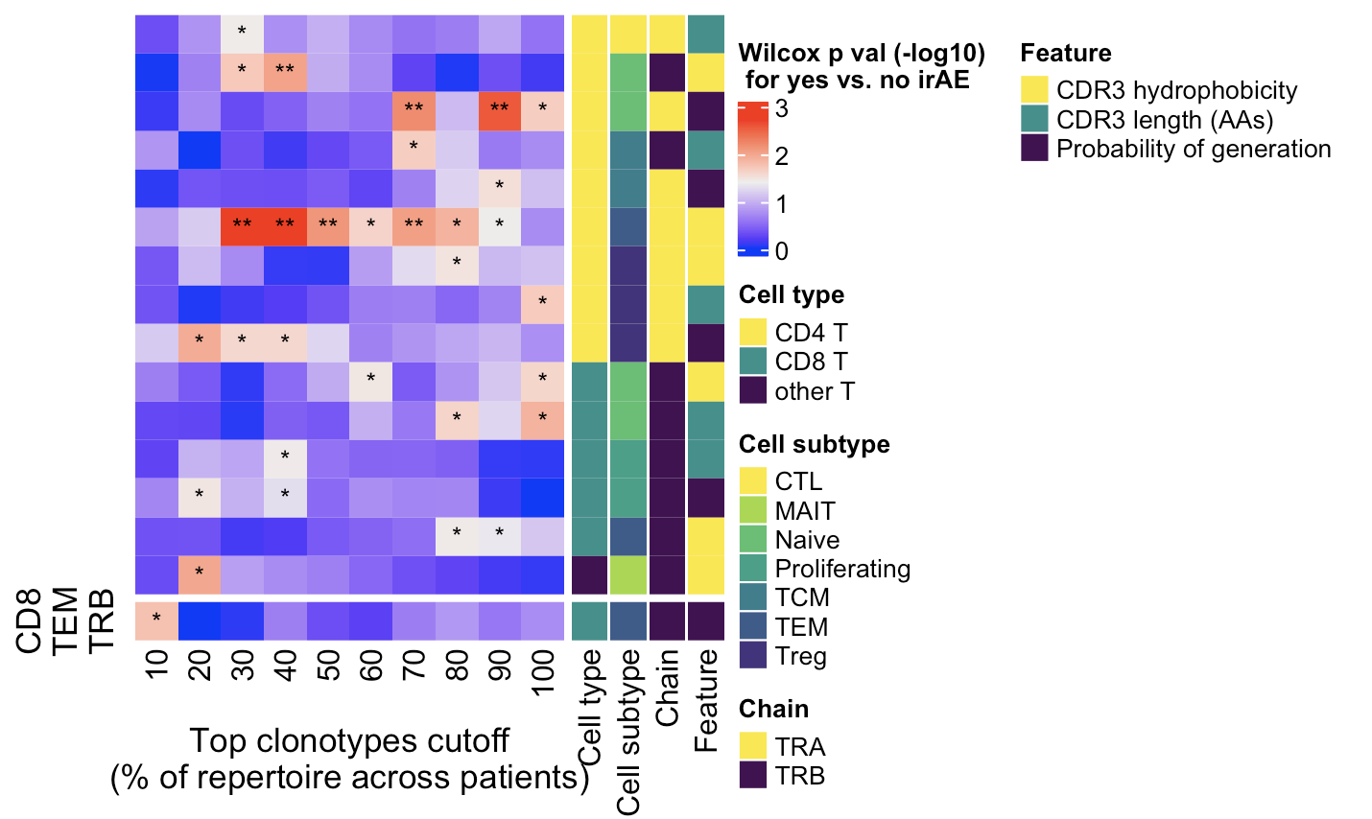
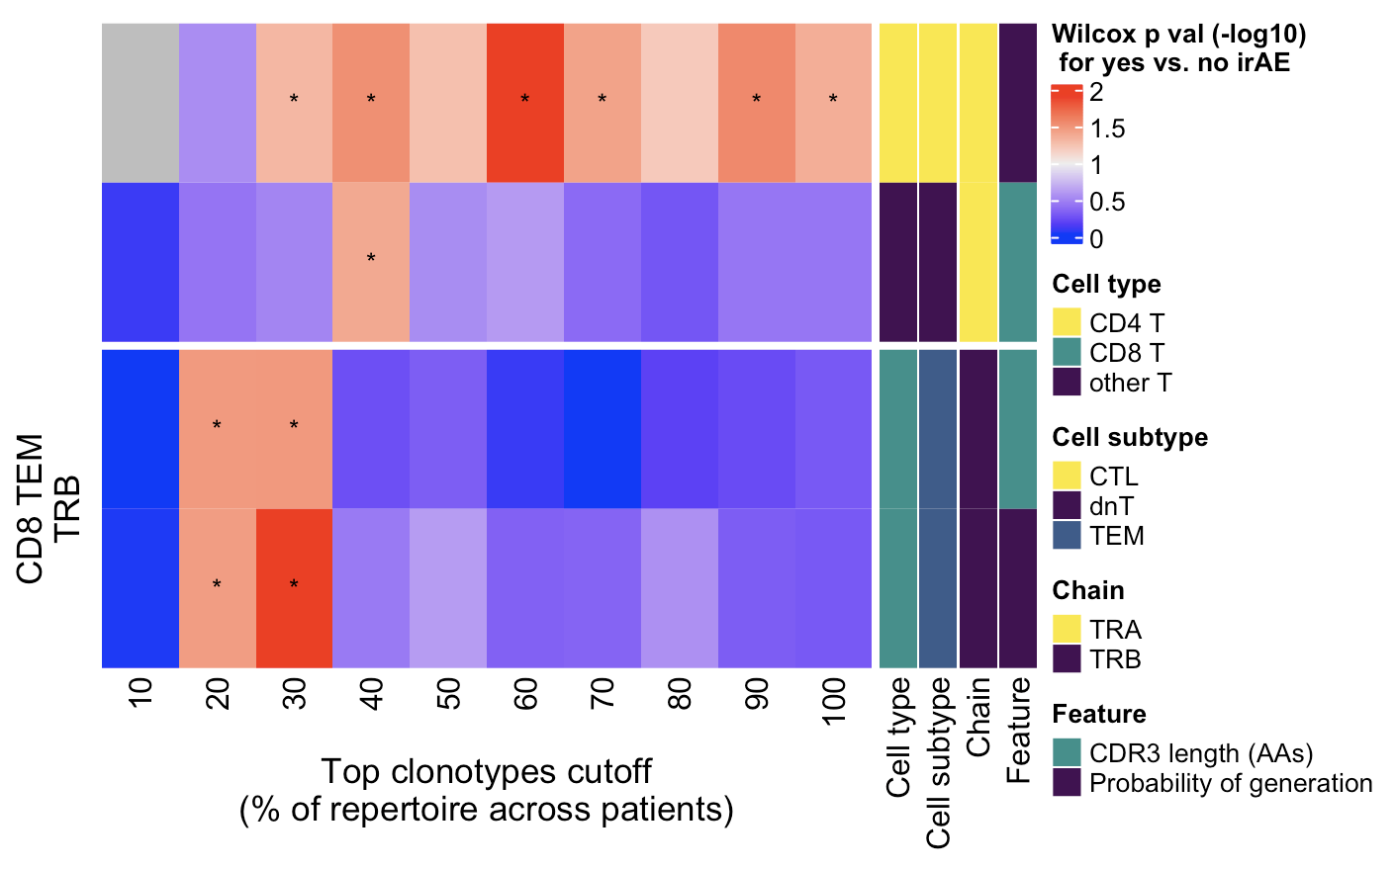
Myocarditis dataset: TRB pgen difference between irAE groups in highly expanded CD8 TEMs apparent in both heatmaps; TRB CDR3 length difference in highly expanded CD8 TEMs in right heatmap
Normalized by sequencing depth
Downsampled
Highly expanded ------- All
Highly expanded ----------------- All
Filtered for rows with > 1 p < 0.05 tile, **, p <1e-2; *; p <0.05

Slide 8
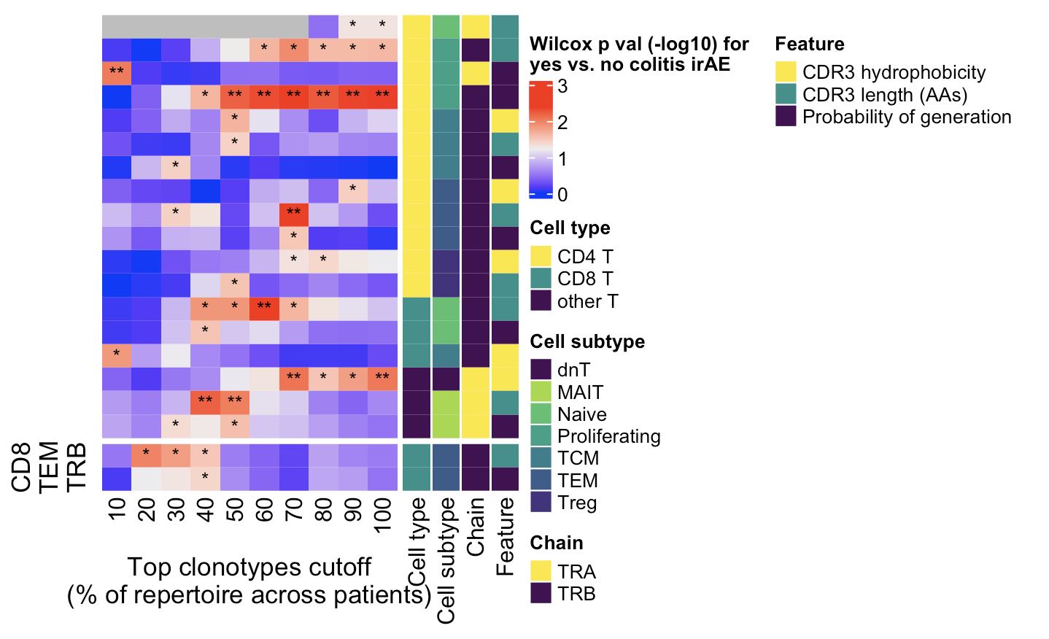
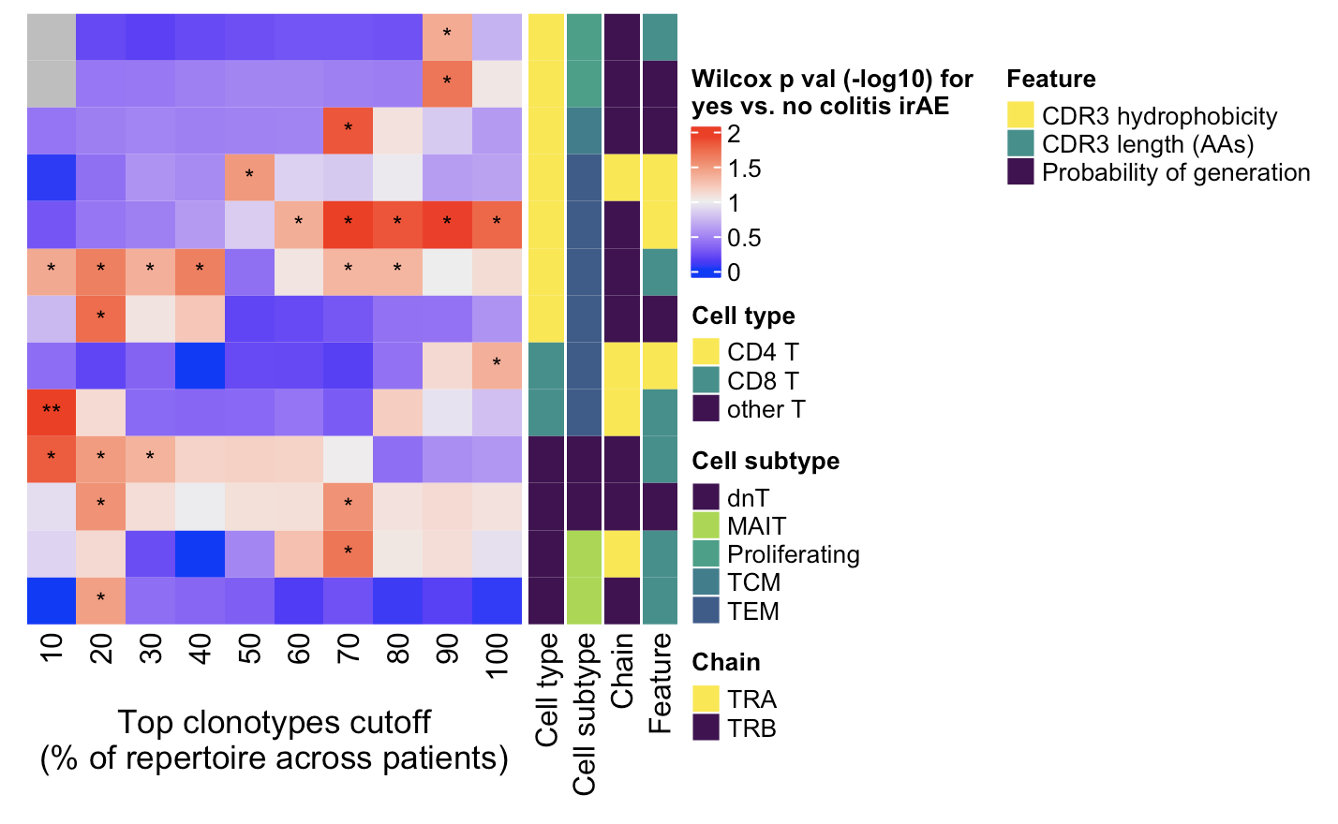
Colitis dataset: TRB pgen and CDR3 length differences between irAE groups in highly expanded CD8 TEMs apparent in left heatmap
Normalized by sequencing depth
Downsampled
CD4 TEM TRB CDR3 length
Colitis down: 10-40%, 70-80%
Colitis norm: 30, 70%
Highly expanded ----- All
Highly expanded ----- All
Filtered for rows with > 1 p < 0.05 tile, **, p <1e-2; *; p <0.05
Notes:
CD4 TEM TRB CDR3 length
Colitis down: 10-40%, 70-80%
Colitis norm: 30, 70%

Slide 9
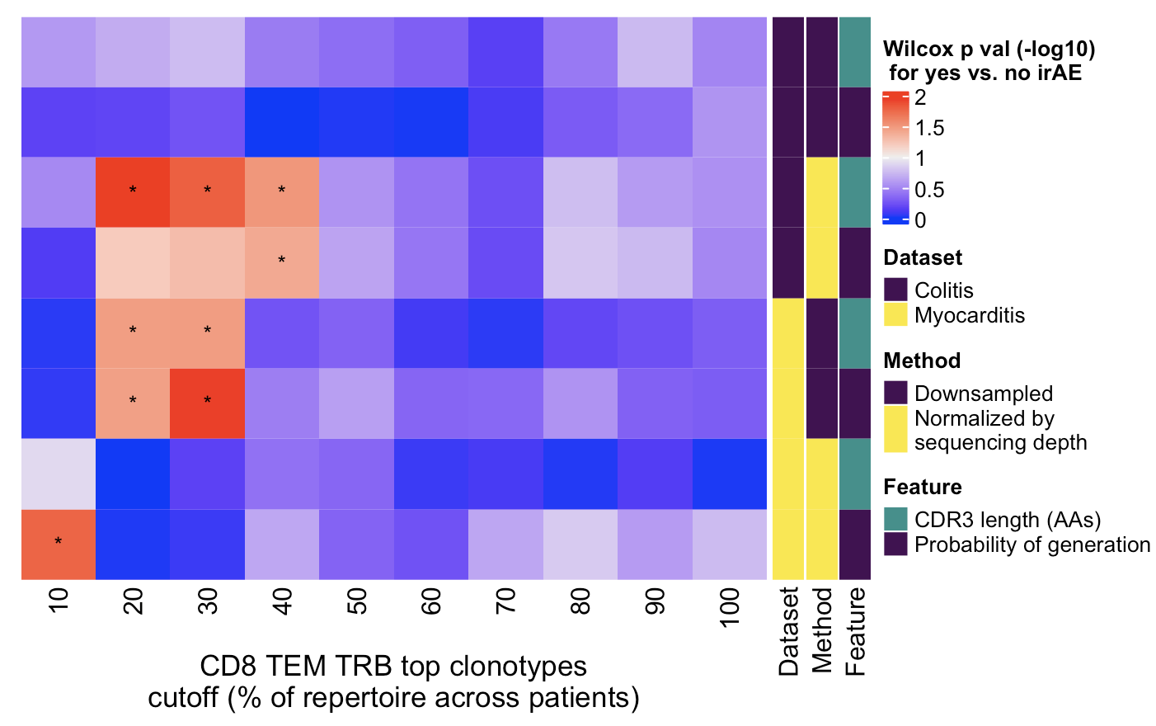
Conclusions
More proliferating T cells, fewer memory T cells (CD4 TEM, CD8 TCM), fewer MAITs in irAE colitis tissue
Consolidated strongest feature conclusions across both datasets: TRBs from highly expanded CD8 TEMs in irAE group…
are less germline-like (in 3/4 heatmaps)
have longer CDR3s (in 1 heatmap from each dataset)
donors/CDR3 (AA) vs. donors/CDR3 (nt) plot difference by irAE groupin colitis dataset was an artifact of erroneous grouping/slicing (data not shown)
Wilcoxon rank sum test. *; p <0.05

Slide 10
Next steps
Heatmaps
Finer binning?
Update Wilcox test to be one-sided for summary CD8 TEM TRB heatmap since I know effect direction (less germline-like, longer CDR3s in irAE group)
Prepare for…
1/16 JC
use RNAseq to call TCR clonotypes
only captures top clonotypes but maybe that’s all I’m interested in anyways for seeing if highly expanded CD8 TEM TRB pgen/CDR3 length effects are present in other RNAseq datasets
ATACseq data
2/1 SI talk (will have draft of slides for 1/25 weekly meeting)

Slide 11
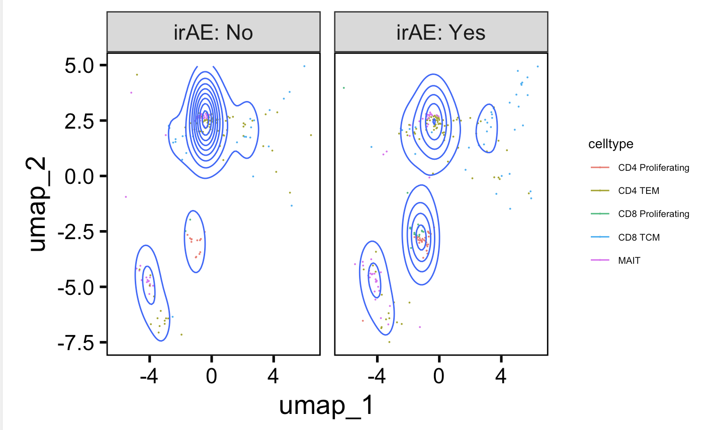
Don’t see cell type abundance differences in downsampled myocarditis UMAP - extreme sequencing depth differences between patients

Slide 12
Literature evidence of cell type abundances associated with irAE devlepment
I observe ~same effect in my data mining
Low baseline circulating MAITs associated with irAE colitis (PMID: 32734627)
I don’t observe in my data mining
More macrophages in organs developing irAEs (PMID: 37857527)
Dendritic cell , CD4 naïve T cell abundances correlate with irAE risk (PMID: 36505471)
Neutrophil/platelet to lymphocyte ratios mark irAE development in gastric cancer (PMID: 37936161)
CD3⁺ CD56⁺ CD16⁺ NKT-like cells correlate with irAE development in NSCLC patients (PMID: 36849947)
CD8⁺ CD28⁺ levels associated with irAE development (PMID: 36969245)
CD4⁺ higher in irAE, CD8⁺ CD38+ associated with irAEs (PMID: 35844502)
Lower baseline levels of CD8 TCM cells in arthritis irAE patients, higher CD4 Th2 baseline levels in pneumonitis irAE patients, higher CD4 Th17 baseline levels in thyroiditis irAE patients (PMID: 36513074)
Fewer Tregs in irAE patients (PMID: 37593676)
I observe ~opposite effect in my data mining
Activated CD4 TEM abundance (in PBMCs) associated with irAE development (PMID: 35027754)

Slide 13
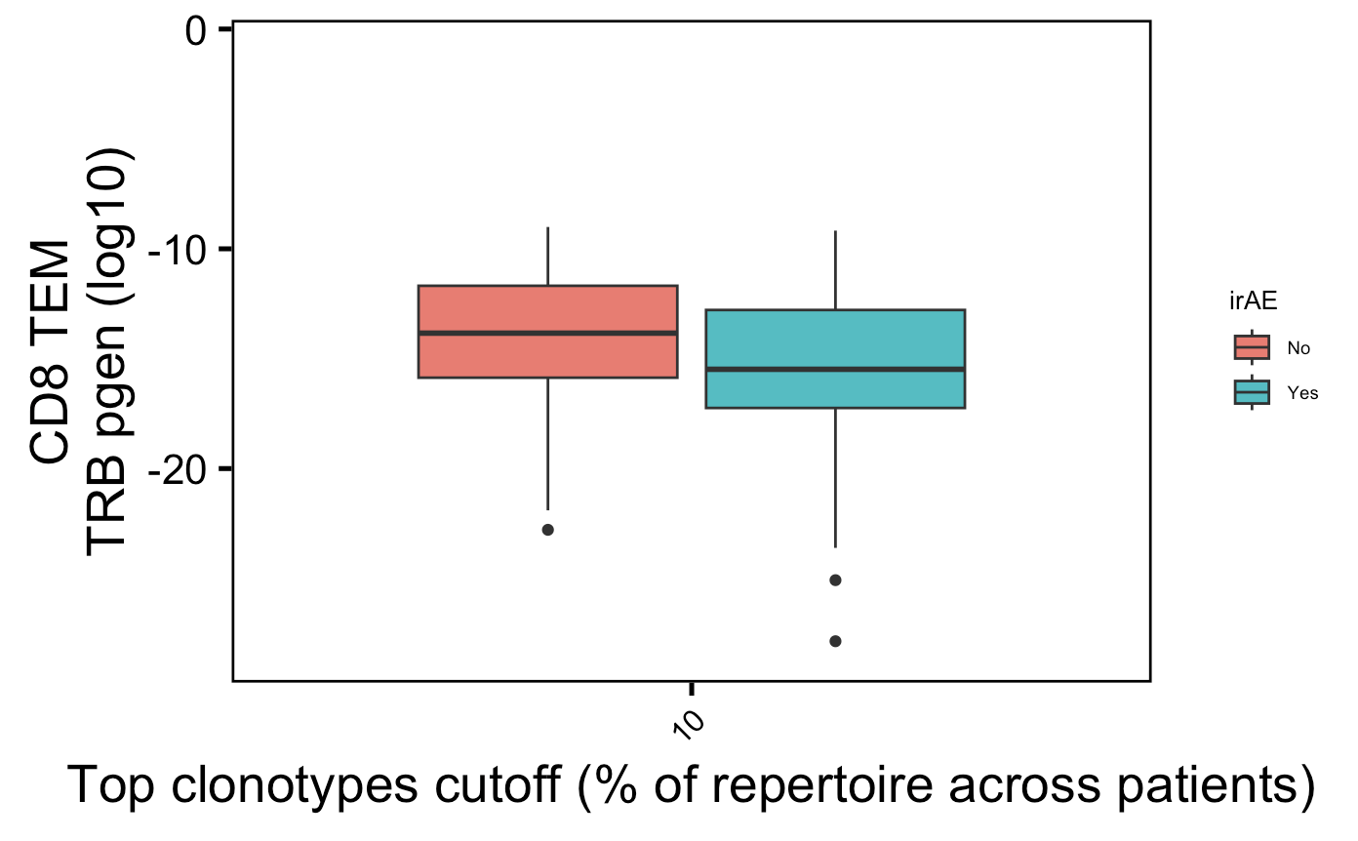
Boxplot of CD8 TEM TRB pgen difference at 10% cutoff (normalized method)
→
More germline-like
Less germline-like
→
Notes:
P = 0.02 for CD8 TEM pgen TRB 10% cutoff

