Slide 1
Weekly meeting
2 29 2024
Ty Bottorff

Slide 2
Outline
Colitis cohort differences & combining datasets

Slide 3
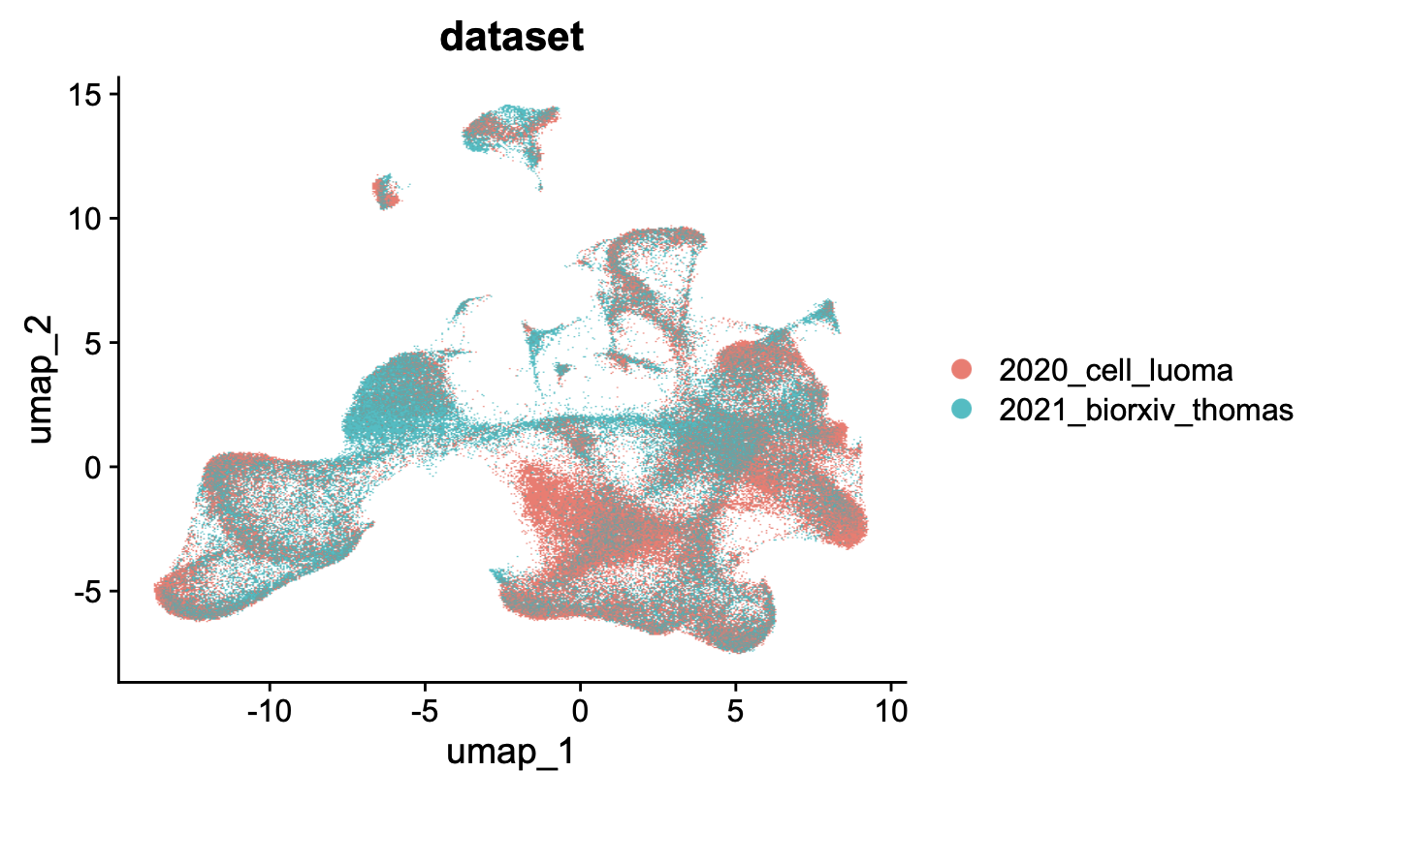
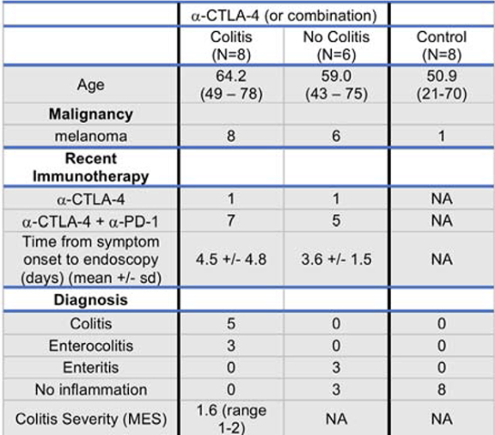
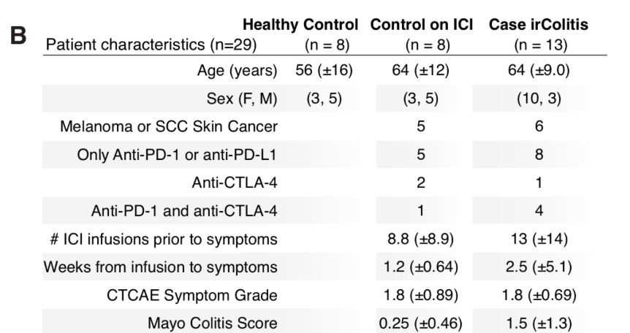
Observe batch effects in integration, cohorts differ most in ICB drug and cancer type
2020 cell Luoma
100% melanoma
Mostly combo ICB
2021 biorxiv Thomas
~50% melanoma/skin
Mostly PD-(L)1 blockade
Notes:
Among cohort differences, only ICB drug differences I’d think likely to contribute to batch effects

Slide 4
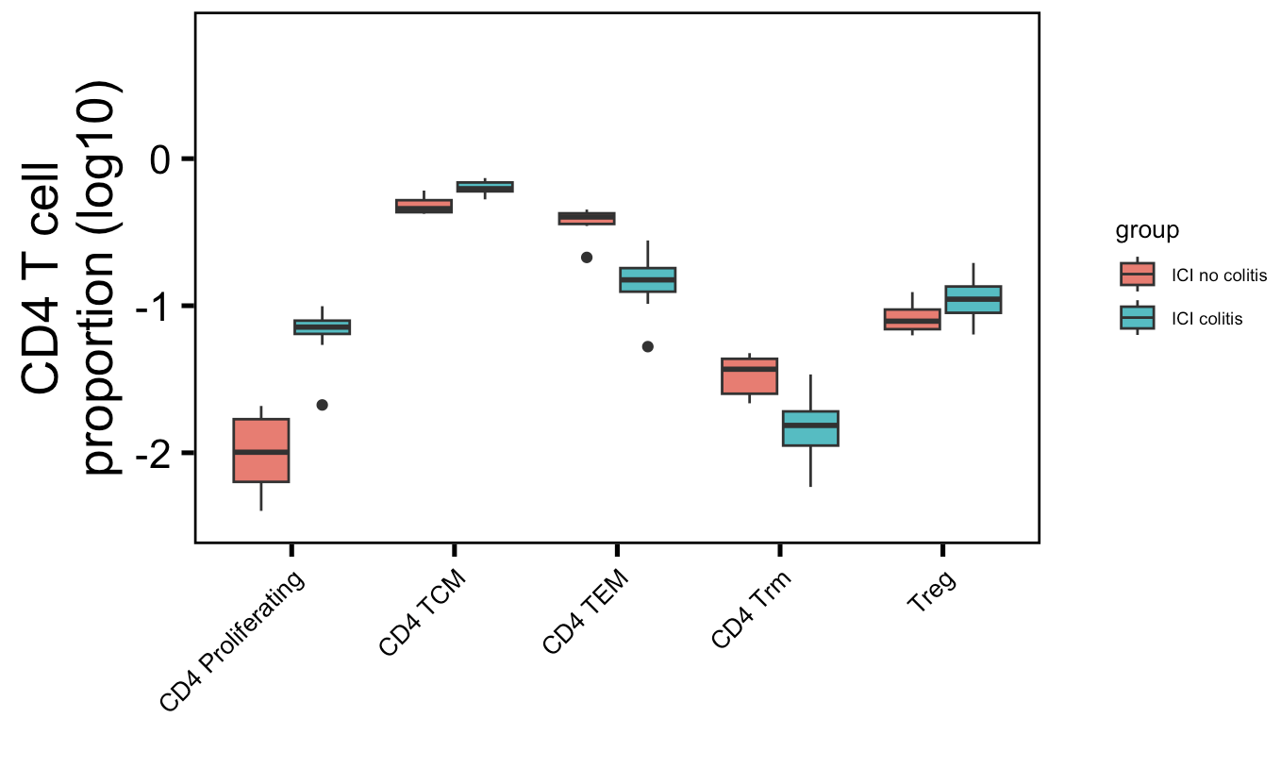
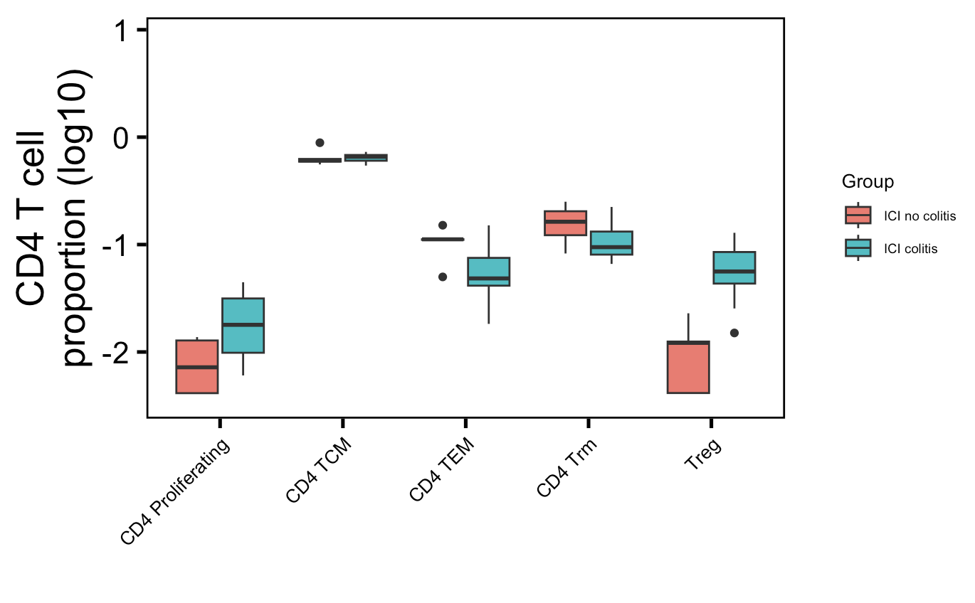
Splitting cell type analysis by CD4/CD8 doesn’t improve similarity between colitis datasets but does pull out more significant differences for Luoma (2020) dataset
Luoma (2020), Cell
Thomas (2021), bioRxiv
**
**
**
*
p =
0.07
**
→
→
→
→
→
→→
: clearly, kind of up in their analysis
→→
: clearly, kind of down in their analysis
Wilcoxon rank sum test. **, padj < 1e-2; *, padj < 0.05
Notes:
old
# CD4 prolif: 0.004
# CD4 TEM: 0.008
# CD4 TCM: 0.009
# CD4 Trm: 0.01
new
# Treg: 0.003
# CD4 TEM: 0.07

Slide 5
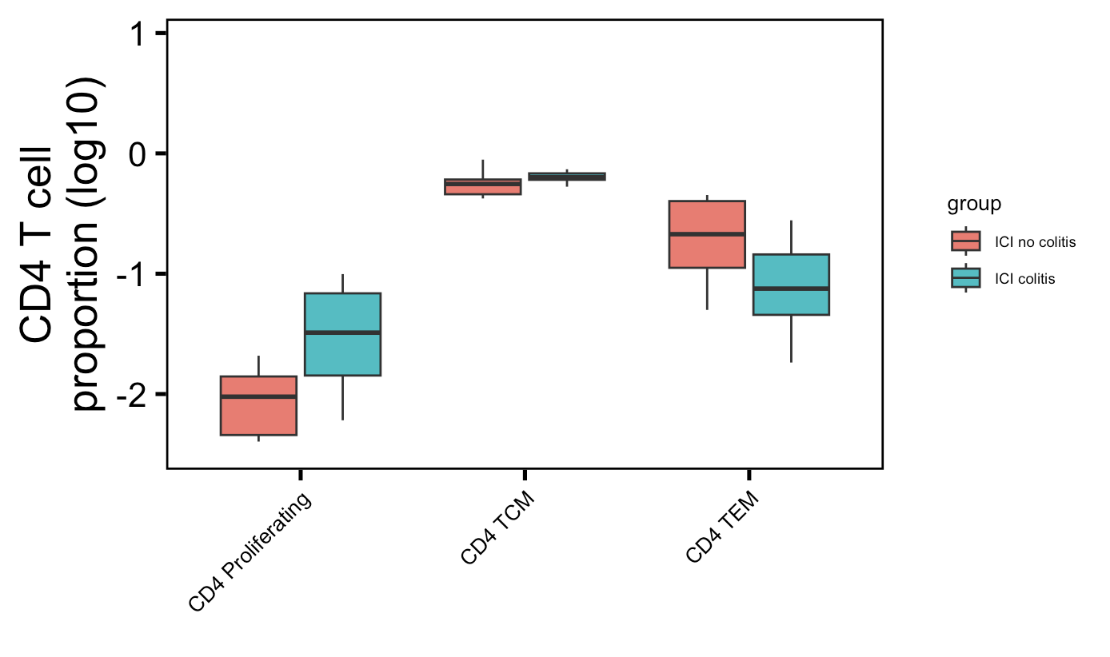
Combining colitis datasets for CD4 cell type abundance analysis
**
*
**
Wilcoxon rank sum test. **, padj < 1e-2; *, padj < 0.05
Notes:
# CD4 prolif: 0.006
# CD4 TEM: 0.008
# CD4 TCM: 0.02

Slide 6
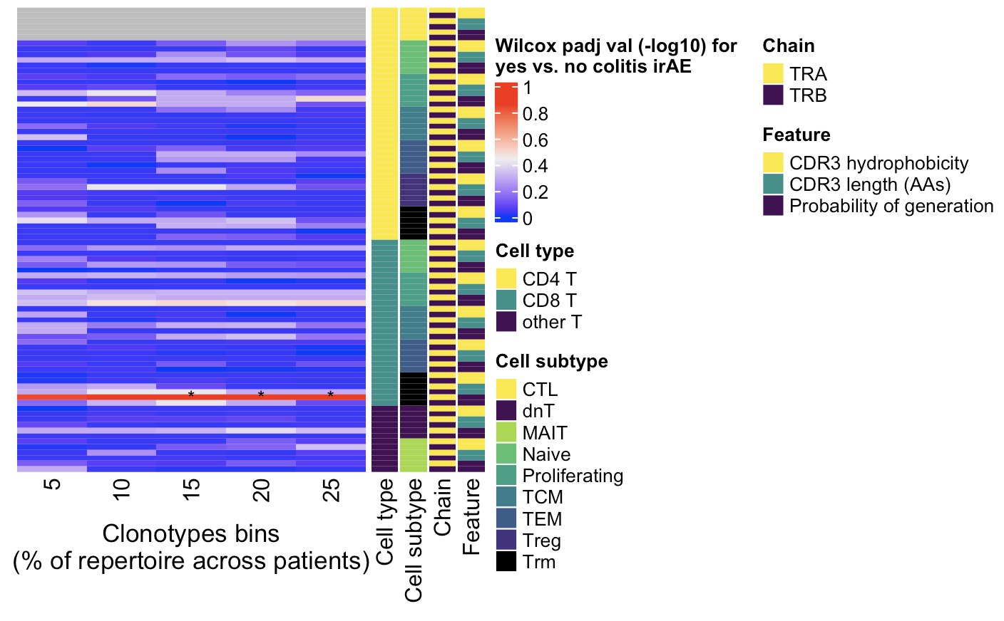
Combining colitis datasets for TCR feature analysis: highly expanded CD8 Trm TRA pgen scores different between irAE groups (what was seen in old colitis dataset)
Wilcoxon rank sum test. *, padj < 0.05
Notes:
Don’t see if downsampled

Slide 7
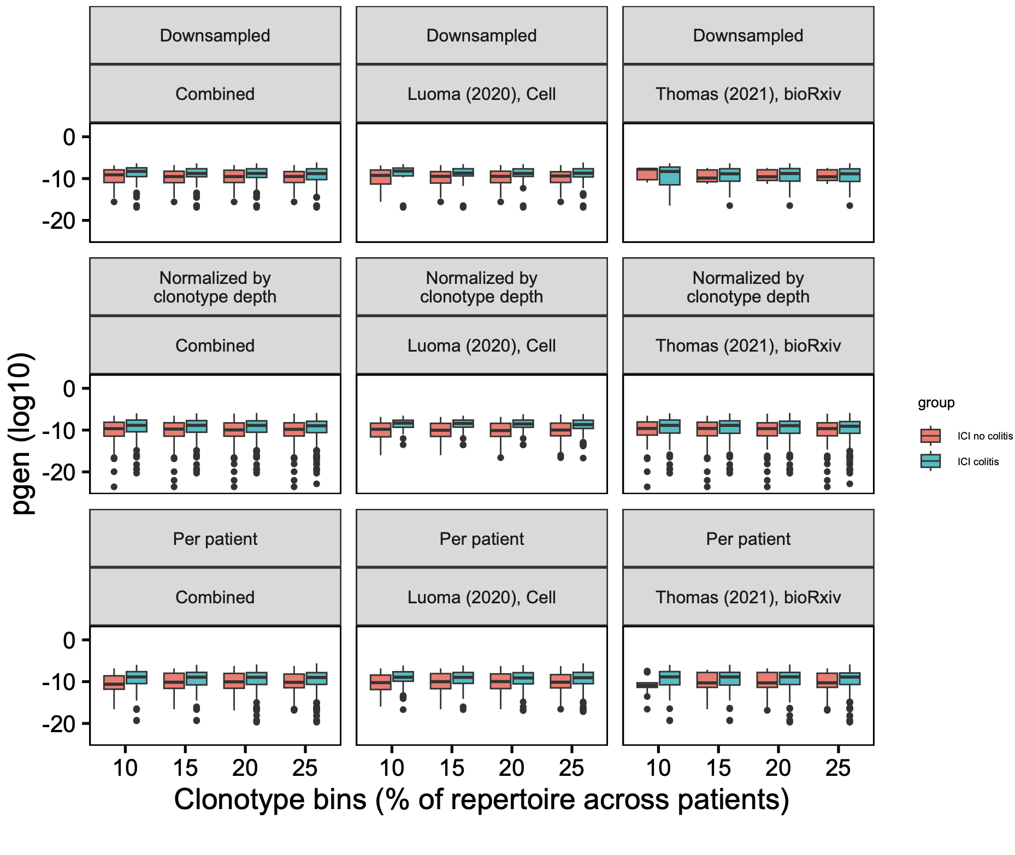
CD8 Trm TRA pgen analysis at combined colitis dataset level
→
*
*
*
**
*
*
More germline-like
Less germline-like
→
**
*
Wilcoxon rank sum test. **, padj < 1e-2; *, padj < 0.05
Notes:
Downsampled here: threw out some low count samples to avoid downsampling all small samples to that small count

Slide 8
Conclusions
No positive results when re-looking into cell type abundances or TCR feature differences among different cell types, chains in baseline pre-ICB PBMC dataset (data not shown)
In Luoma (2020), Cell dataset, no differences in TCR features between irAE groups in different clusters (data not shown)
Results across both colitis datasets
Solid results
CD4 TEMs less abundant in colitis tissue
CD4 proliferating T cells more abundant in colitis tissue
Less solid results
CD4 TCMs slightly more abundant in colitis tissue (this disagrees with Luoma (2020), Cell analysis)
Highly expanded CD8 Trm TRAs may be more germline-like in colitis tissue

Slide 9
Next steps
New datasets for cell type abundance comparisons? Would need non-PBMC data to hope to see Trm result again…
Best lead so far is a skin biopsy dataset (TCR and RNA, but issue is low n just 2-3 per irAE group…)

Slide 10
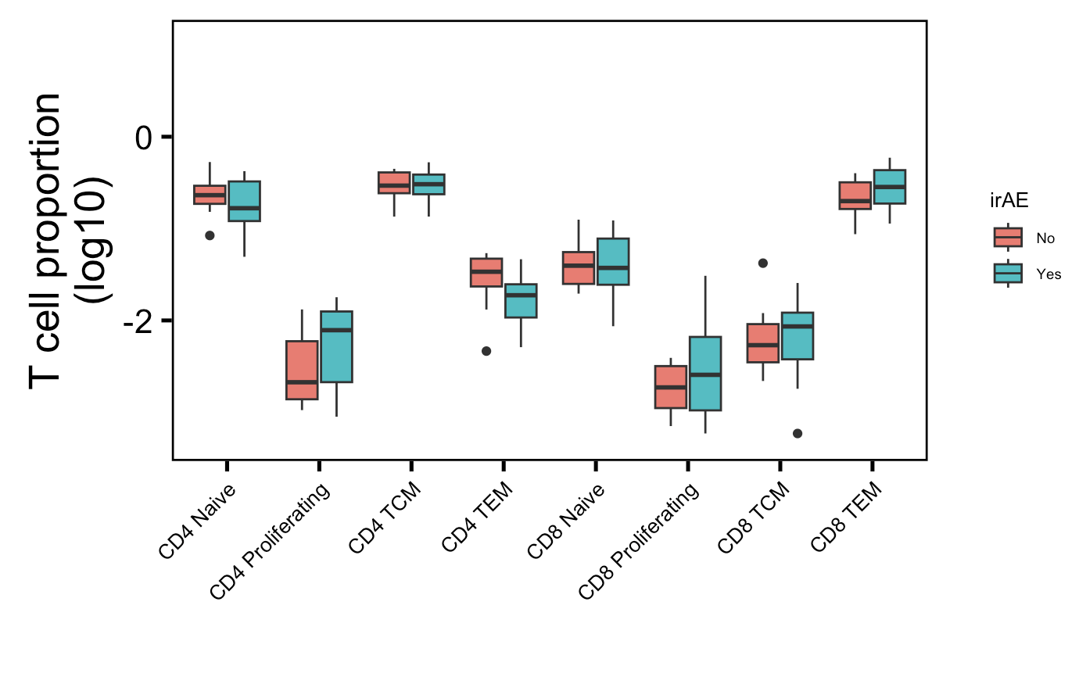
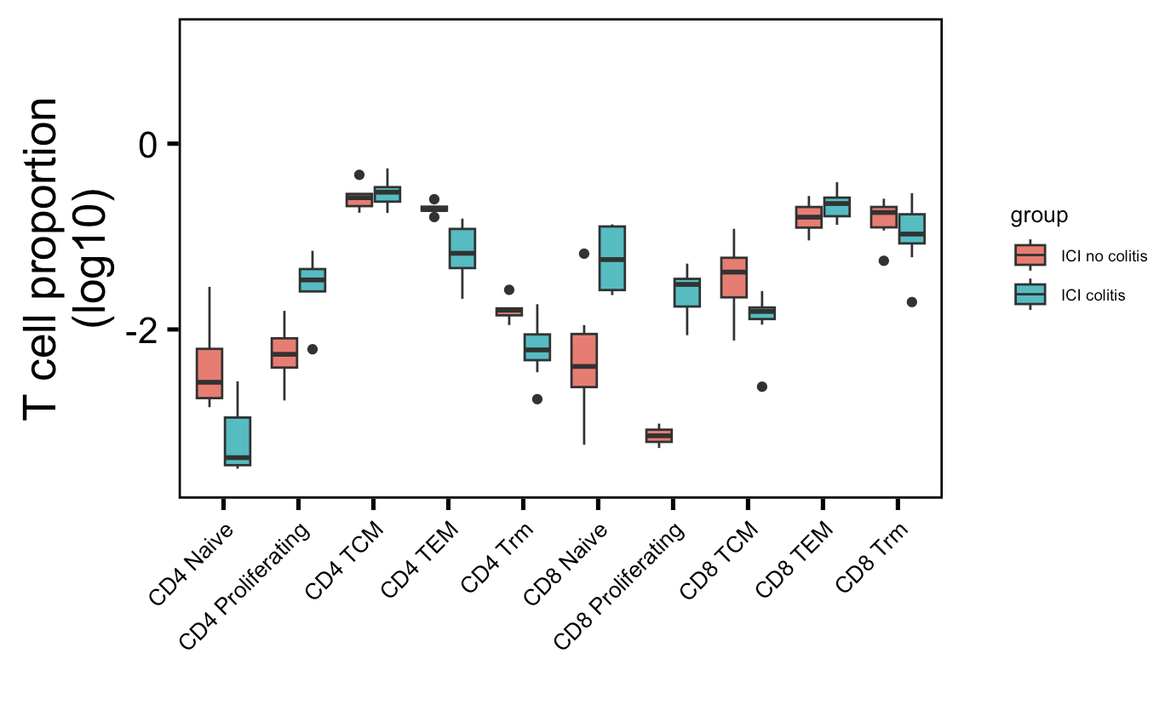
Old cell type abundance analysis
→
: up in their analysis
→
: down in their analysis
PBMC myocarditis-focused dataset (mostly PD-1 blockade)
Luoma (2020), Cell colitis dataset (CTLA-4/combo blockade)
→
→
→
→
**
Wilcoxon rank sum test. **, padj < 1e-2
Notes:
Basically not sure how useful this will be for cytometry people as it’s 1) in colon tissue, 2) doesn’t replicate super well with other papers (yes it does with same paper though but…)

Slide 11
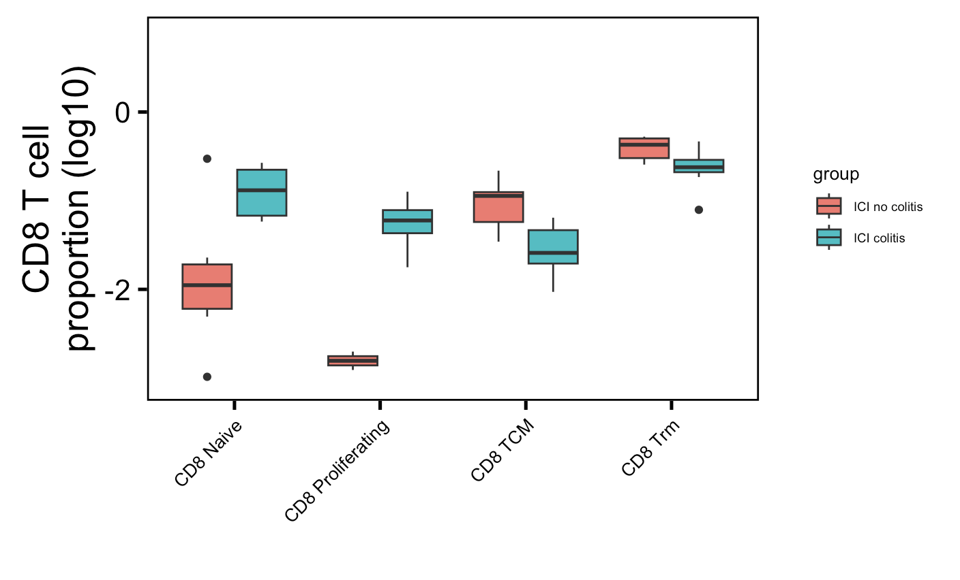
CD8s from Luoma (2020), Cell colitis dataset
padj ~= 0.05 for all of these

