Slide 1
Weekly meeting
2 8 2024
Ty Bottorff

Slide 2
Outline
Summary of SI meeting comments
ATACseq practice data QC

Slide 3
Summary of comments from SI meeting
Correct diversity comparisons for cell type abundance differences
Initial analysis: downsampling more common cell type abrogates differences I saw, so diversity differences due to cell type abundance differences
Compare TCR features between highly expanded and not expanded T cells
Initial analysis: don’t seem different by eye
Include UniCell Deconvolve among other cell typing methods
Investigate datasets even with just baseline data (i.e. are any T cell repertoires of patients who go on to develop irAEs more germline-like at baseline?)
Try to get HLA status from single cell data

Slide 4
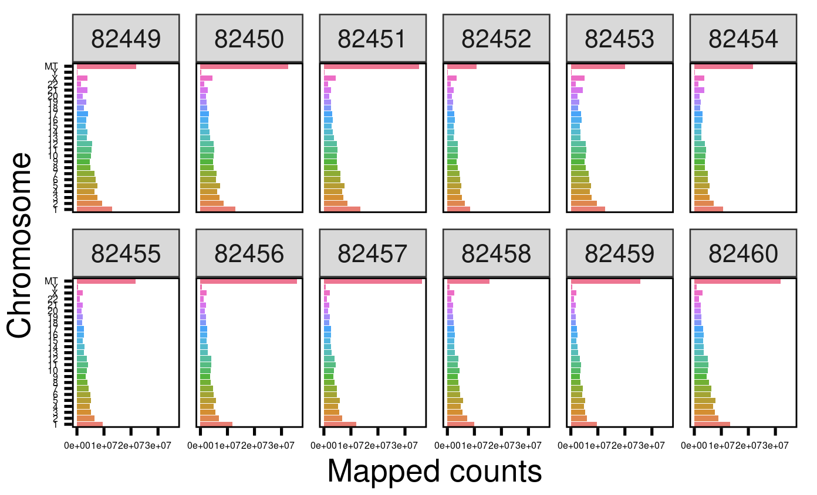
Initial ATAC-seq QC progress: comparing counts of reads mapped to different chr

Slide 5
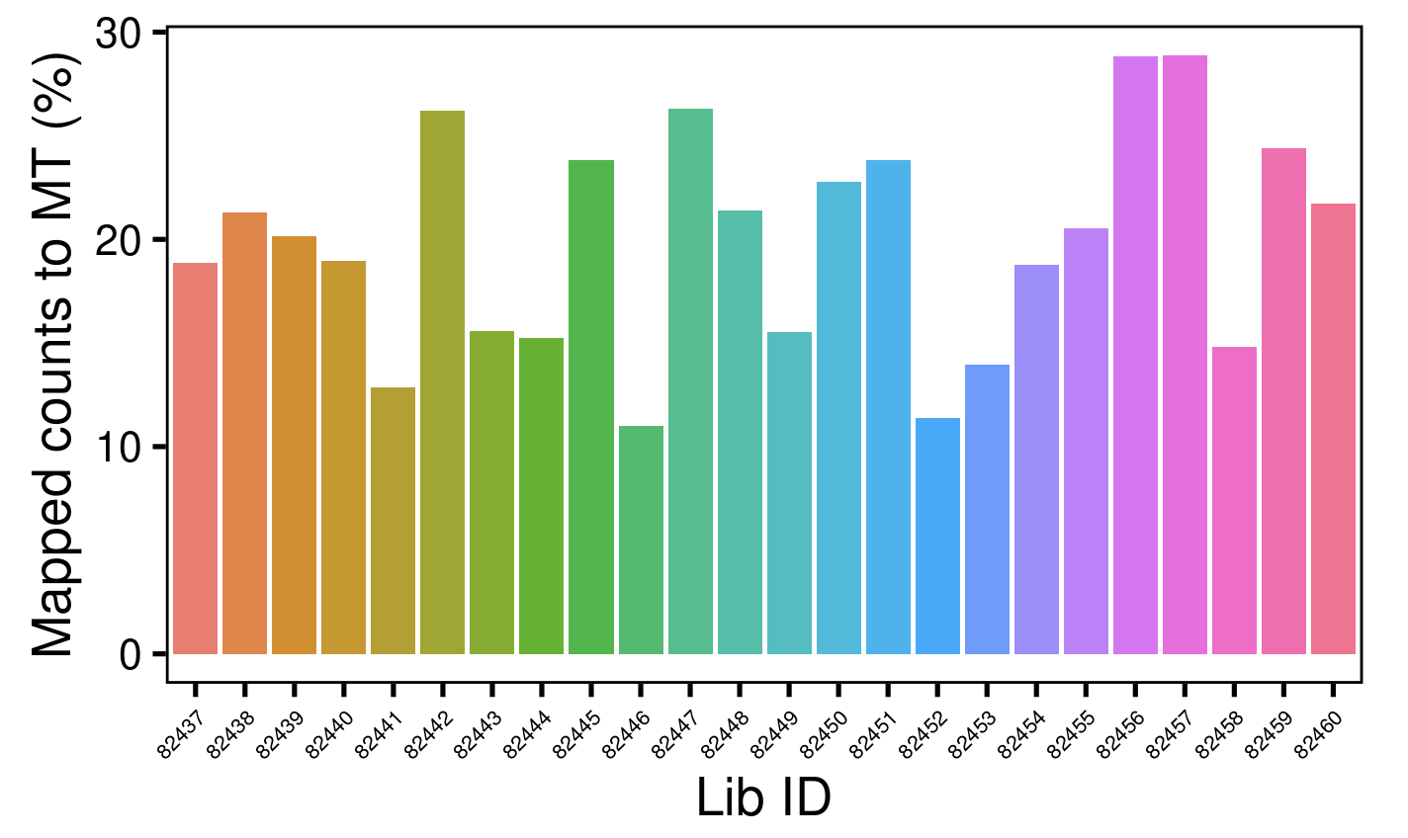
Comparing % of counts mapped to MT genome

Slide 6
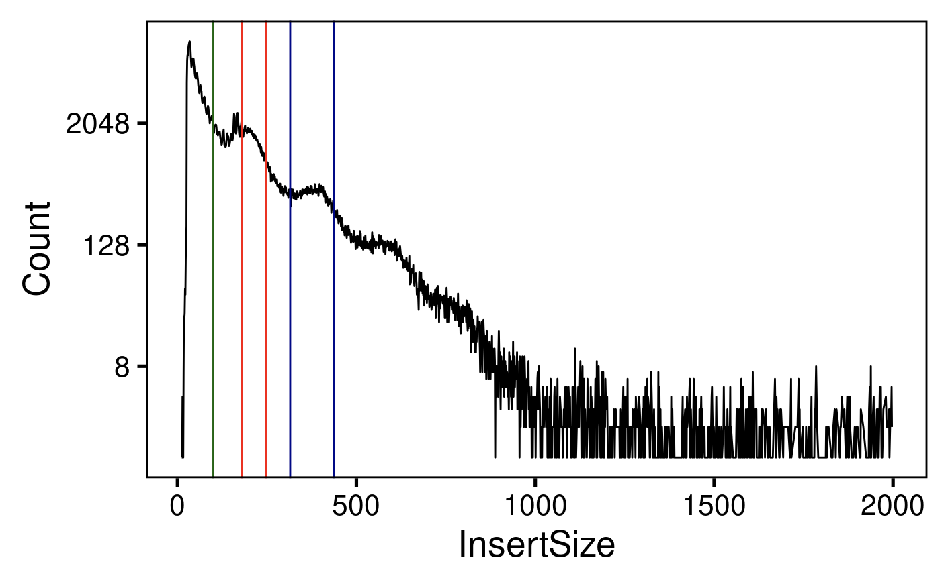
Looking at insert size distribution
Nucleosome free
Mononucleosome
Dinucleosome
Notes:
annotate our nucleosome free (< 100bp), mononucleosome (180bp-247bp) and dinucleosome (315-437) lengths

Slide 7
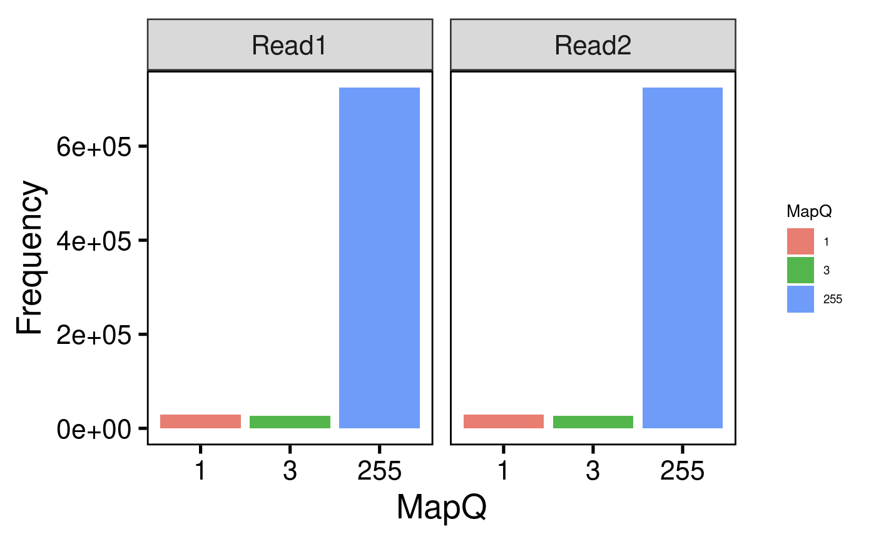
Looking at MapQ scores
Notes:
The quality of the alignment, or how well a read matches a specific region of the genome, is reported as a MAPQ score. The highest MAPQ value (255) goes to reads that are unique for a single region, while the lowest (0) goes to those that have a lot of matching regions
so most reads here are uniquely mapping!

Slide 8
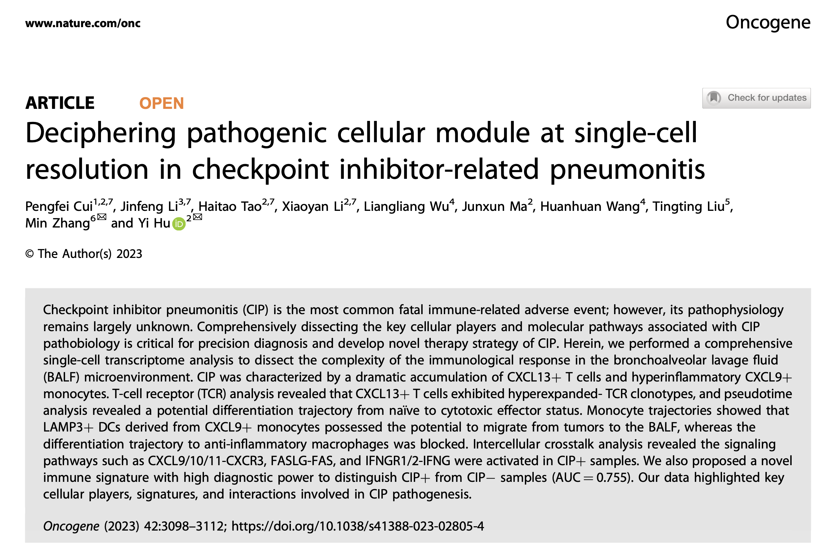
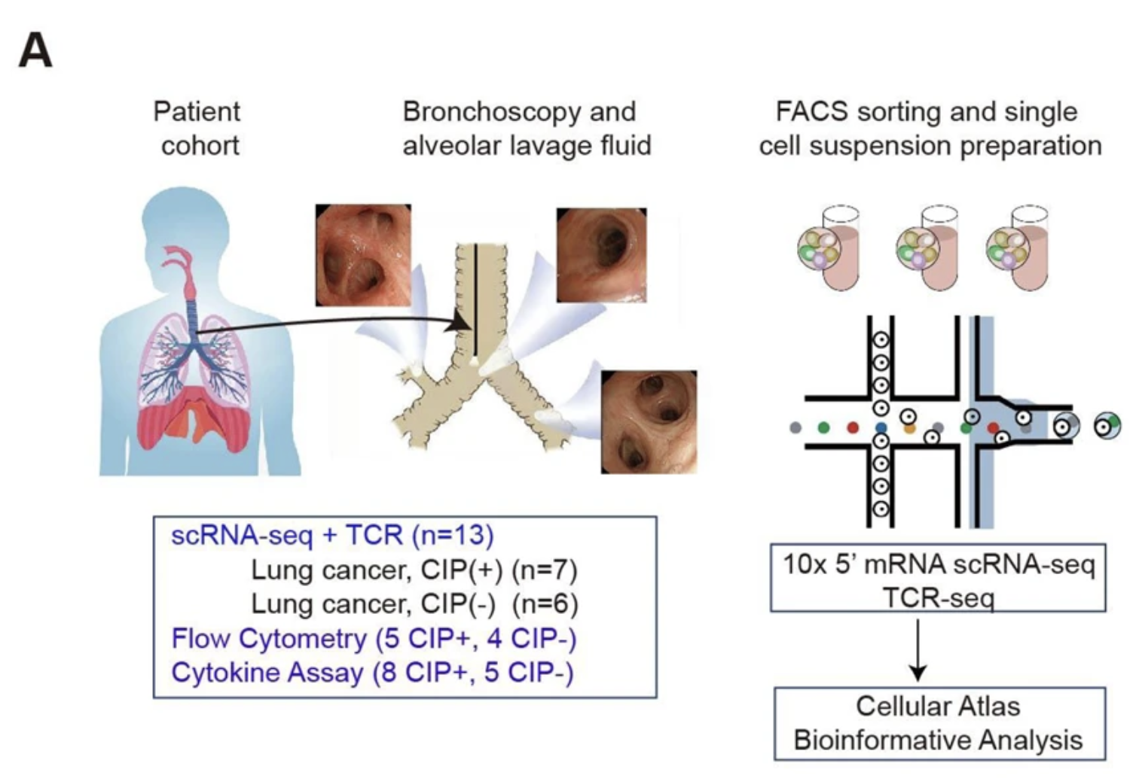
Next steps
irAE project
Diversity: try alternative metrics (not Shannon entropy) or alternative methods for abundance controlling
Linkage analysis: compare TCR features between sets, trajectory analysis, statistical tests, investigate many TCRs shared across datasets
Cell typing: UniCell Deconvolve, SingleR… other methods
Feature analysis: top vs. bot expansion, genes whose expression correlates with CD8 Trm TRA pgen
New dataset search: baseline datasets, non-RNA cell typing + TCR datasets
HLA status mining
ATACseq project preparation (practicing on Erin’s data)
More QC
Peak calling
Figure reproduction

