Slide 1
Weekly meeting
4 11 2024
Ty Bottorff

Slide 2
Outline
QC on merged data & preliminary conclusions from P576-1 ATACseq data
Another look at Erin’s ATACseq data

Slide 3
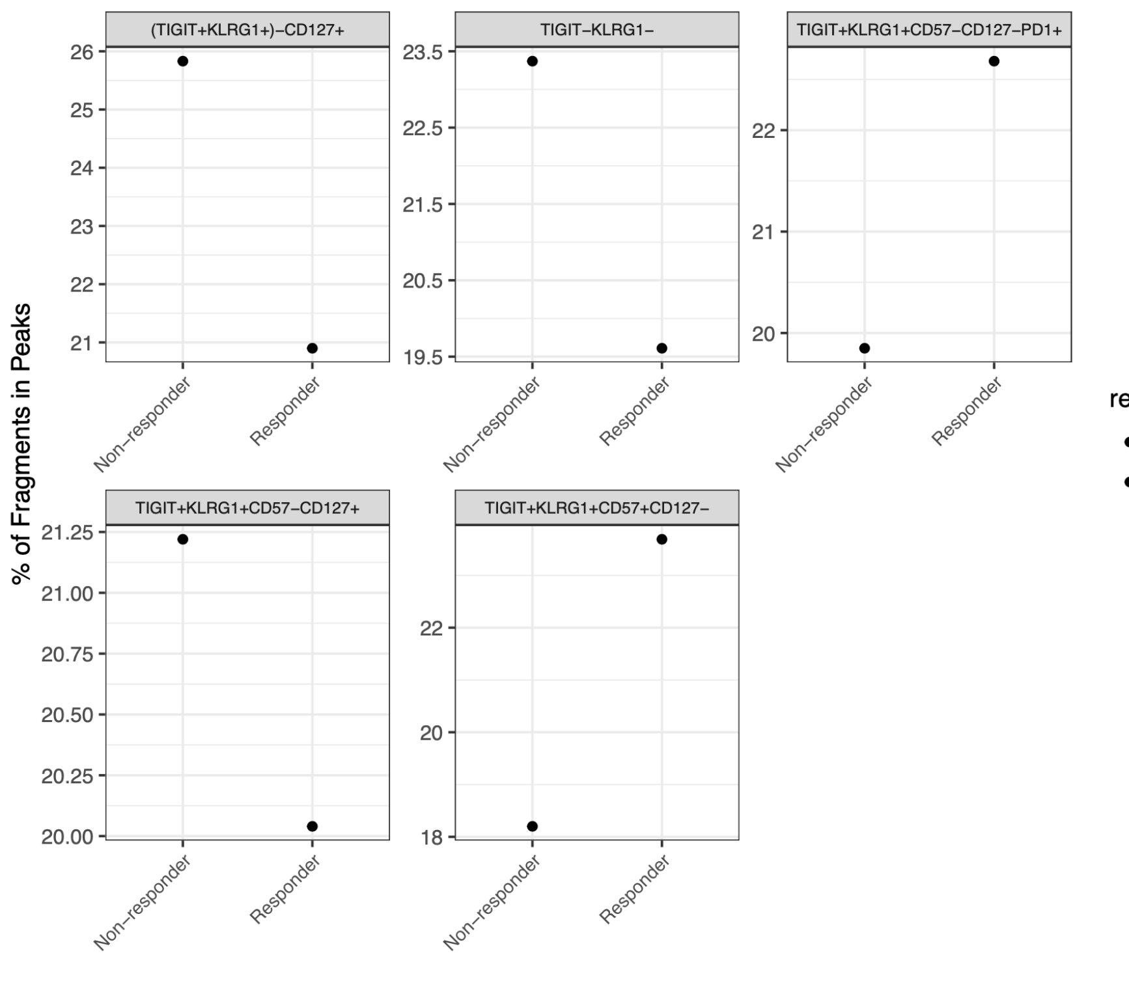
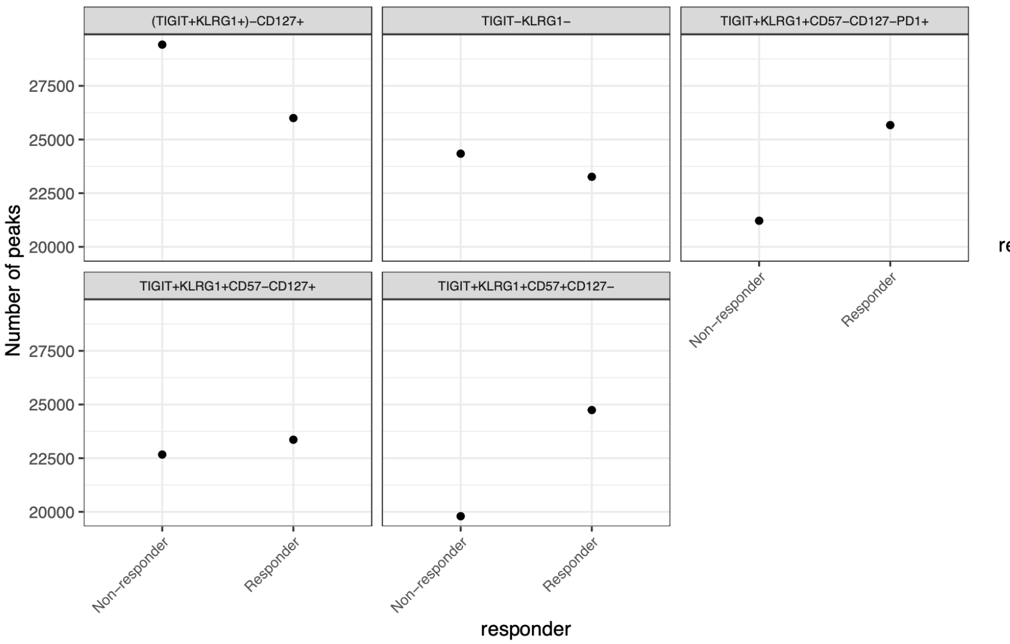
P576-1 ATACseq QC after merging files looks decent (FRiPs higher than before, peak counts still lower than expected but similar to Erin’s merged QC)

Slide 4
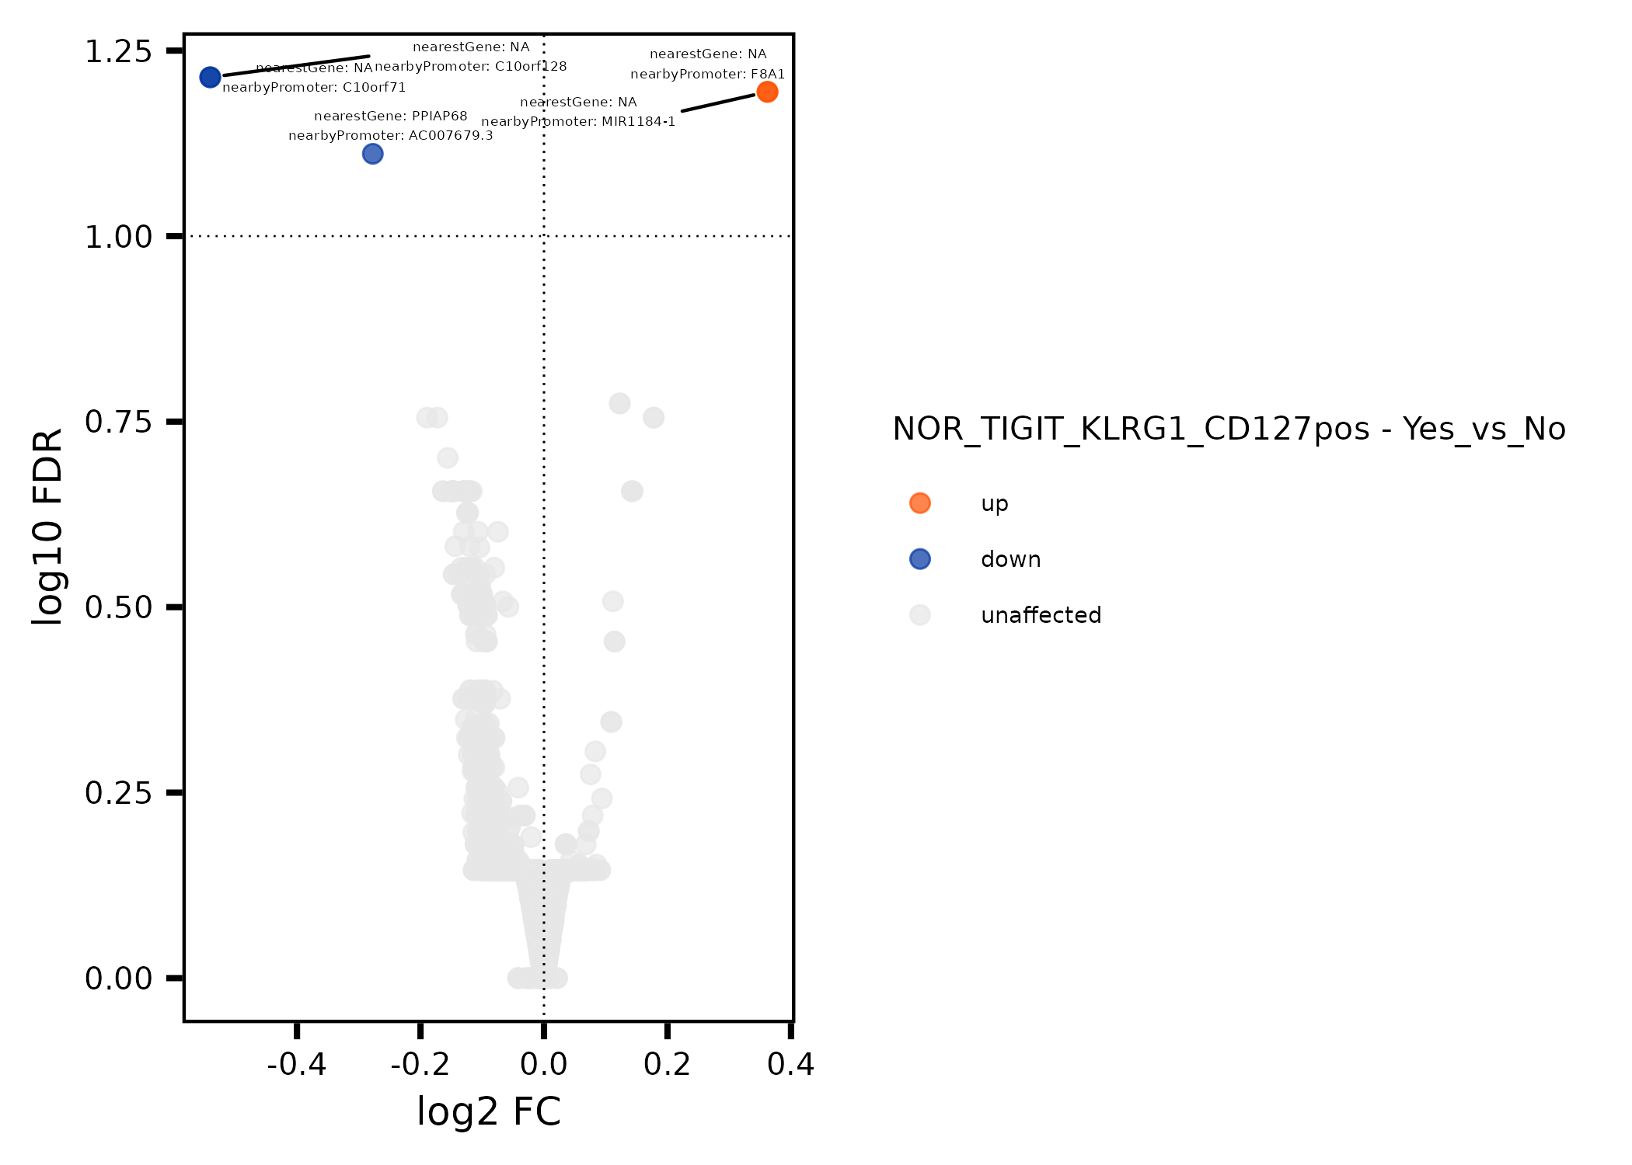
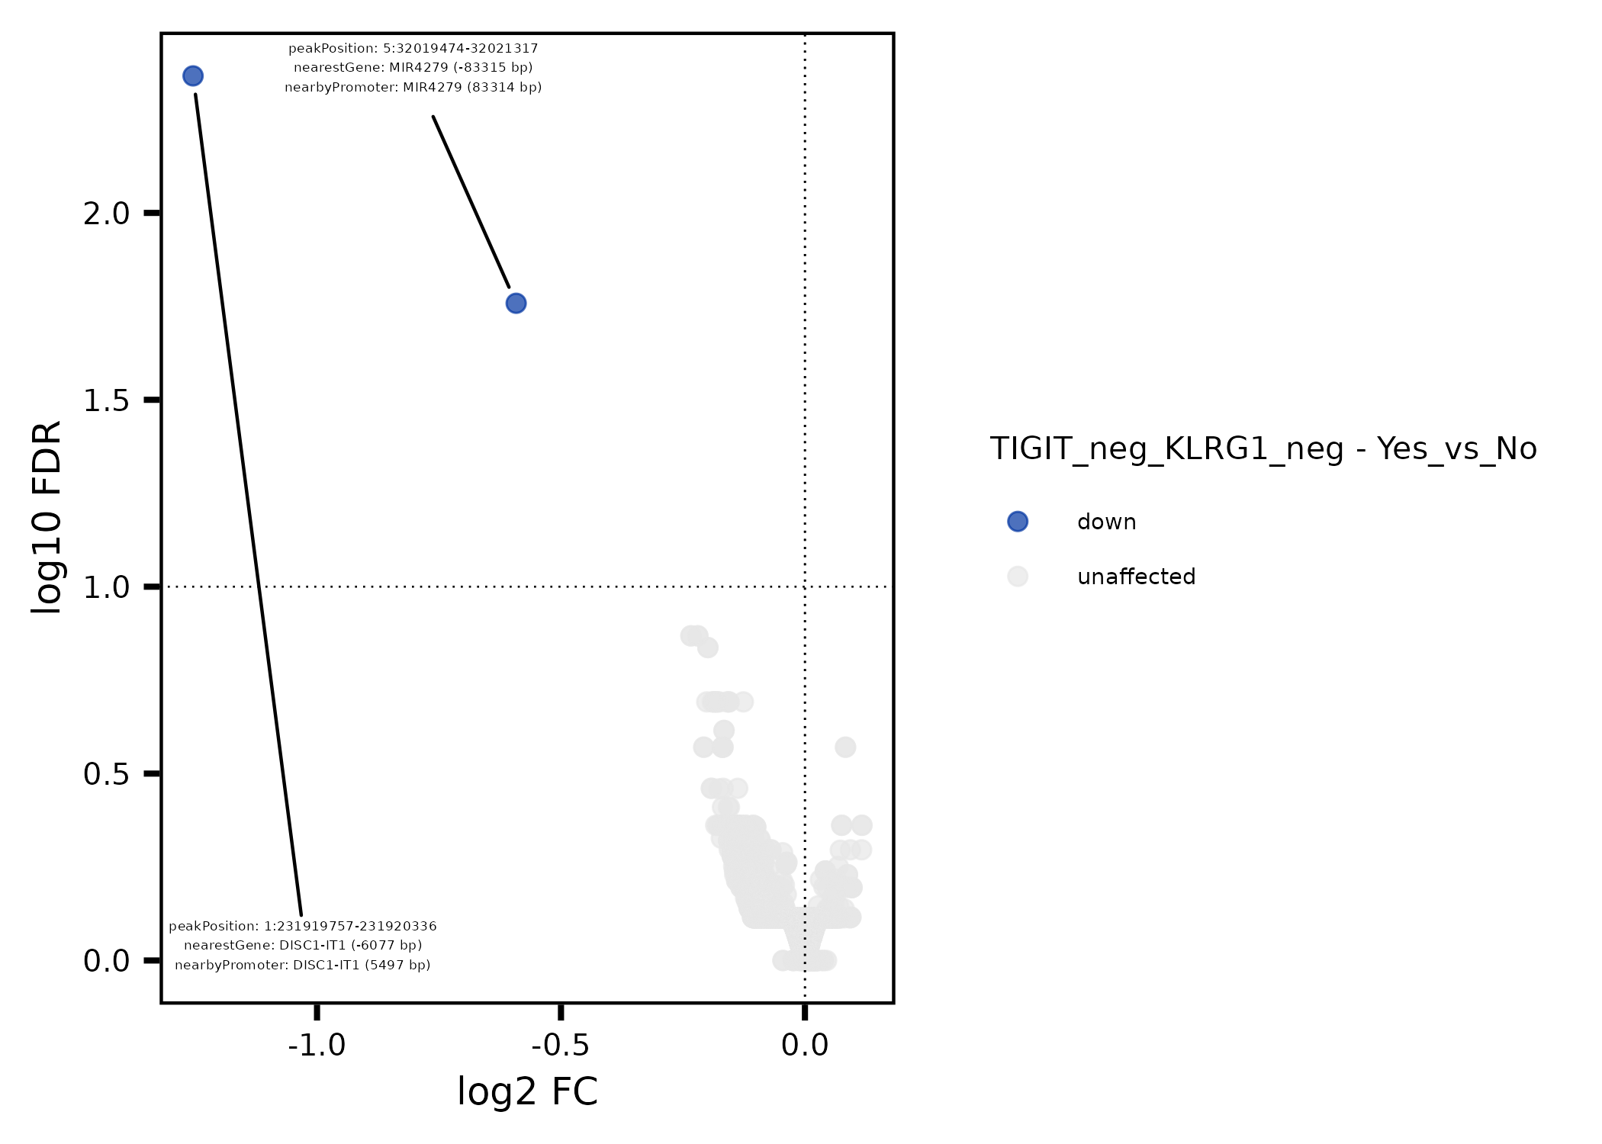
P576-1 ATACseq: not many differentially accessible regions between responders (yes) & non-responders (no) regardless of cell sort (tried 3/5 so far)
Also did TIGIT_pos_KLRG1_pos_CD57_neg_CD127_pos (similar results)
Notes:
C10orf128: human homolog of mouse cell surface protein unique to CD8 gamma 13 T cells

Slide 5
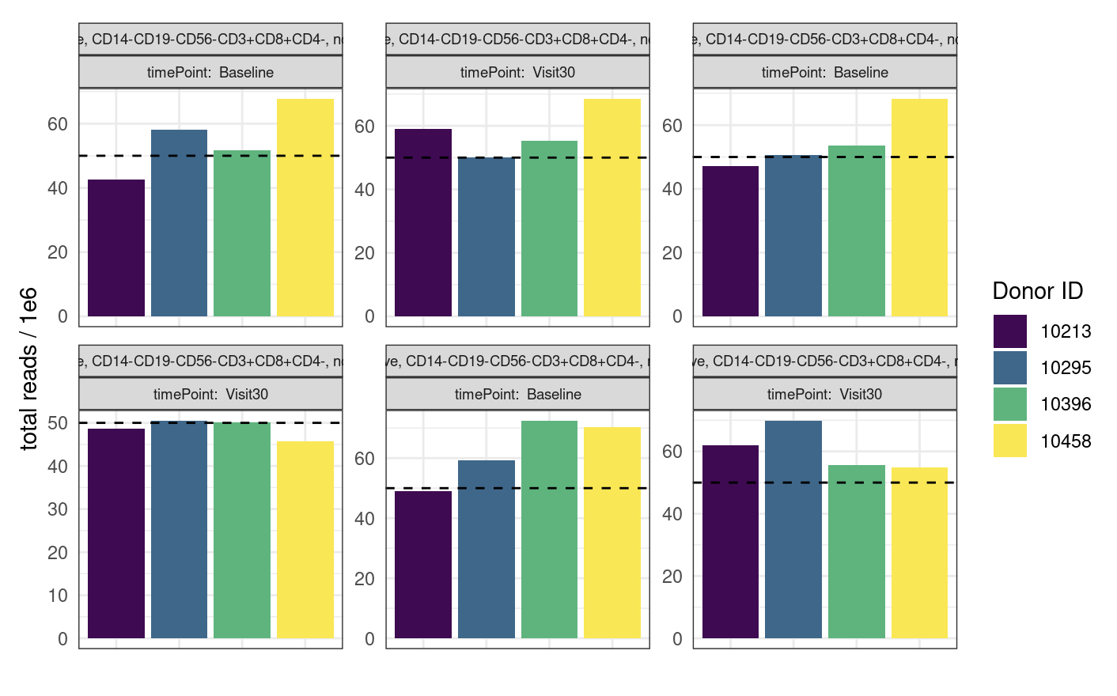
Erin’s ATACseq QC looks similar to P576-1 ATACseq QC, more reads though

Slide 6
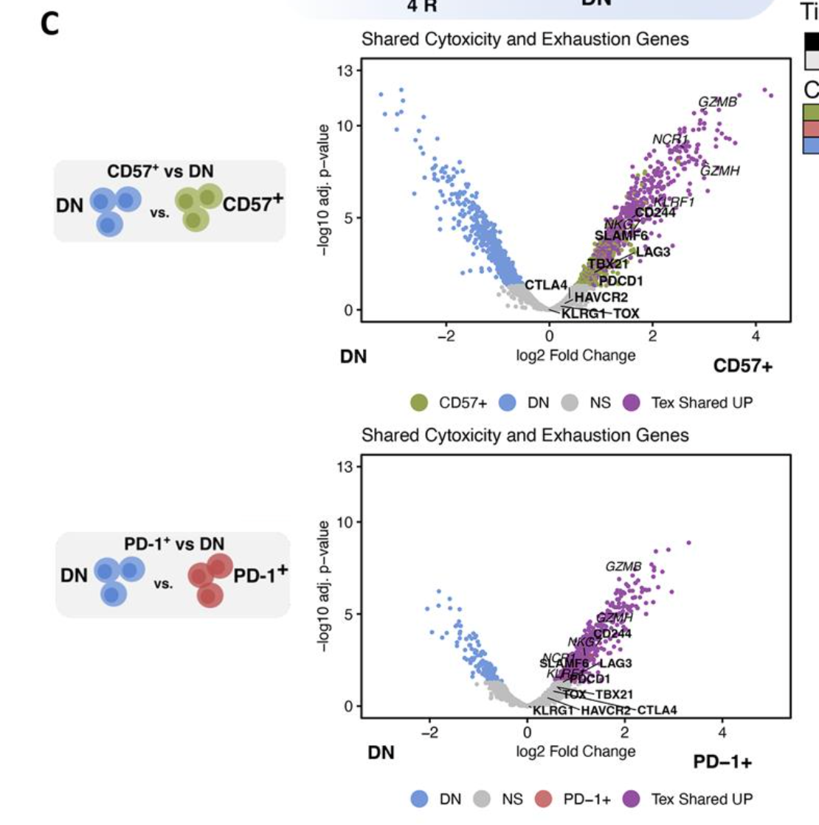
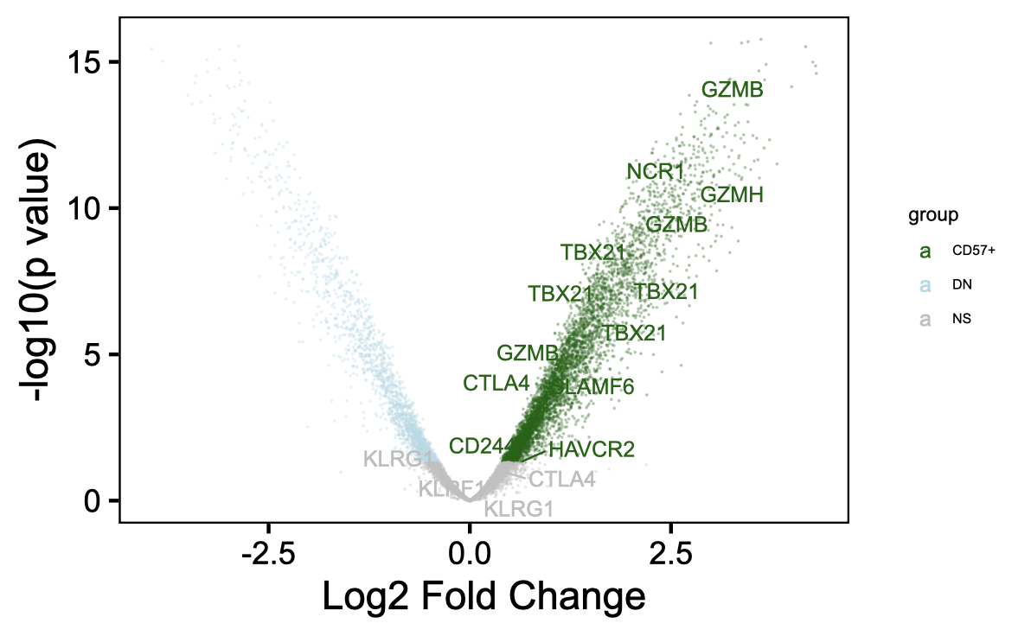
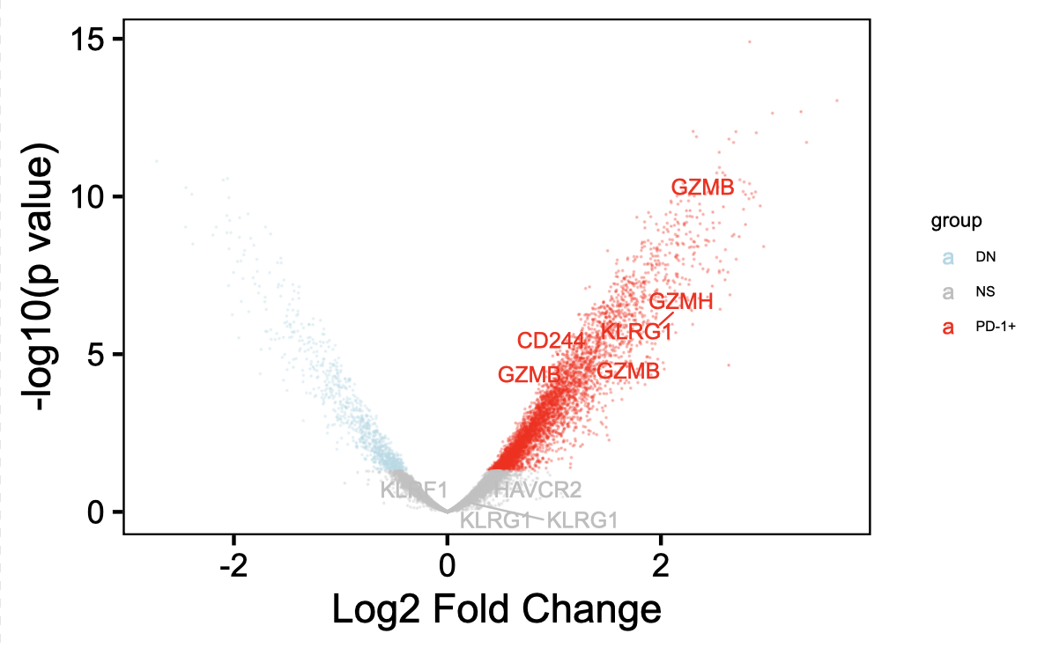
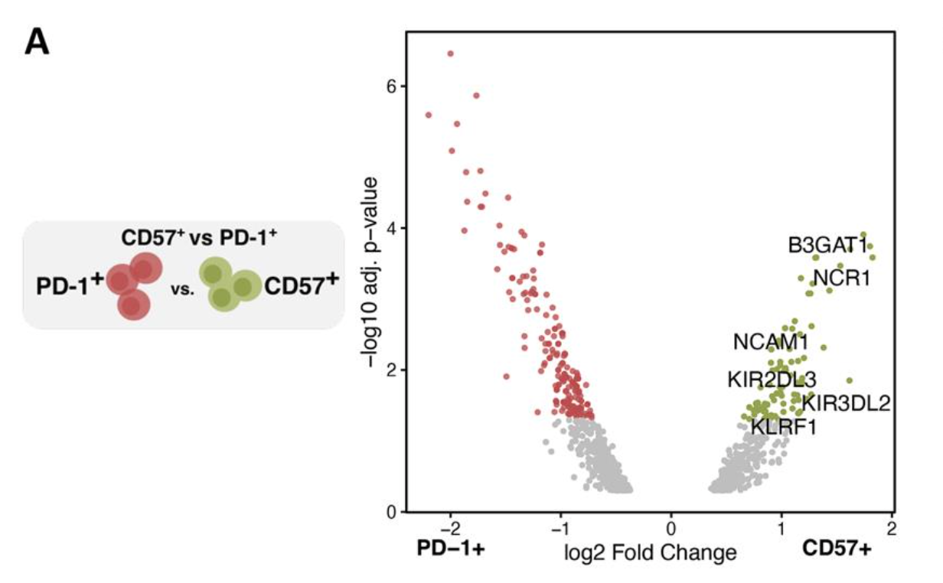
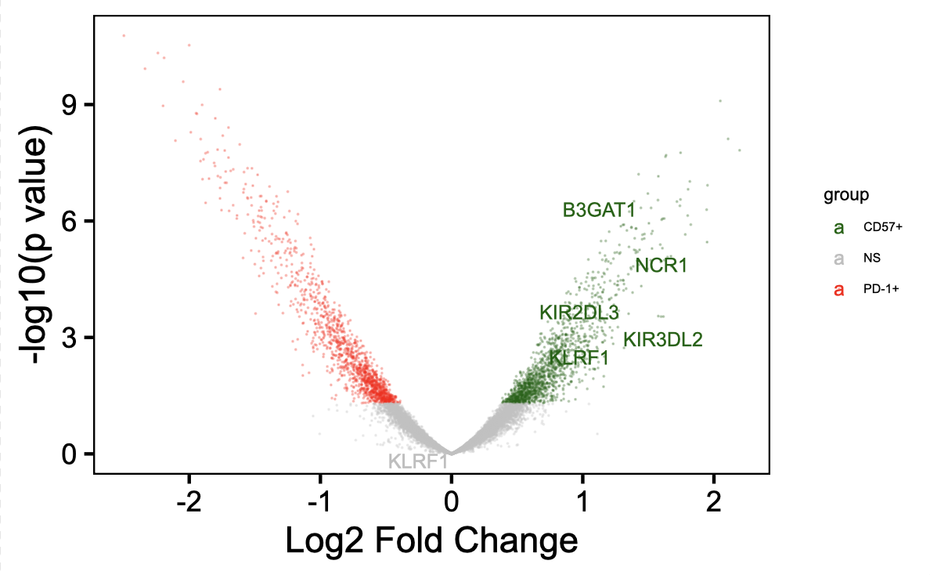
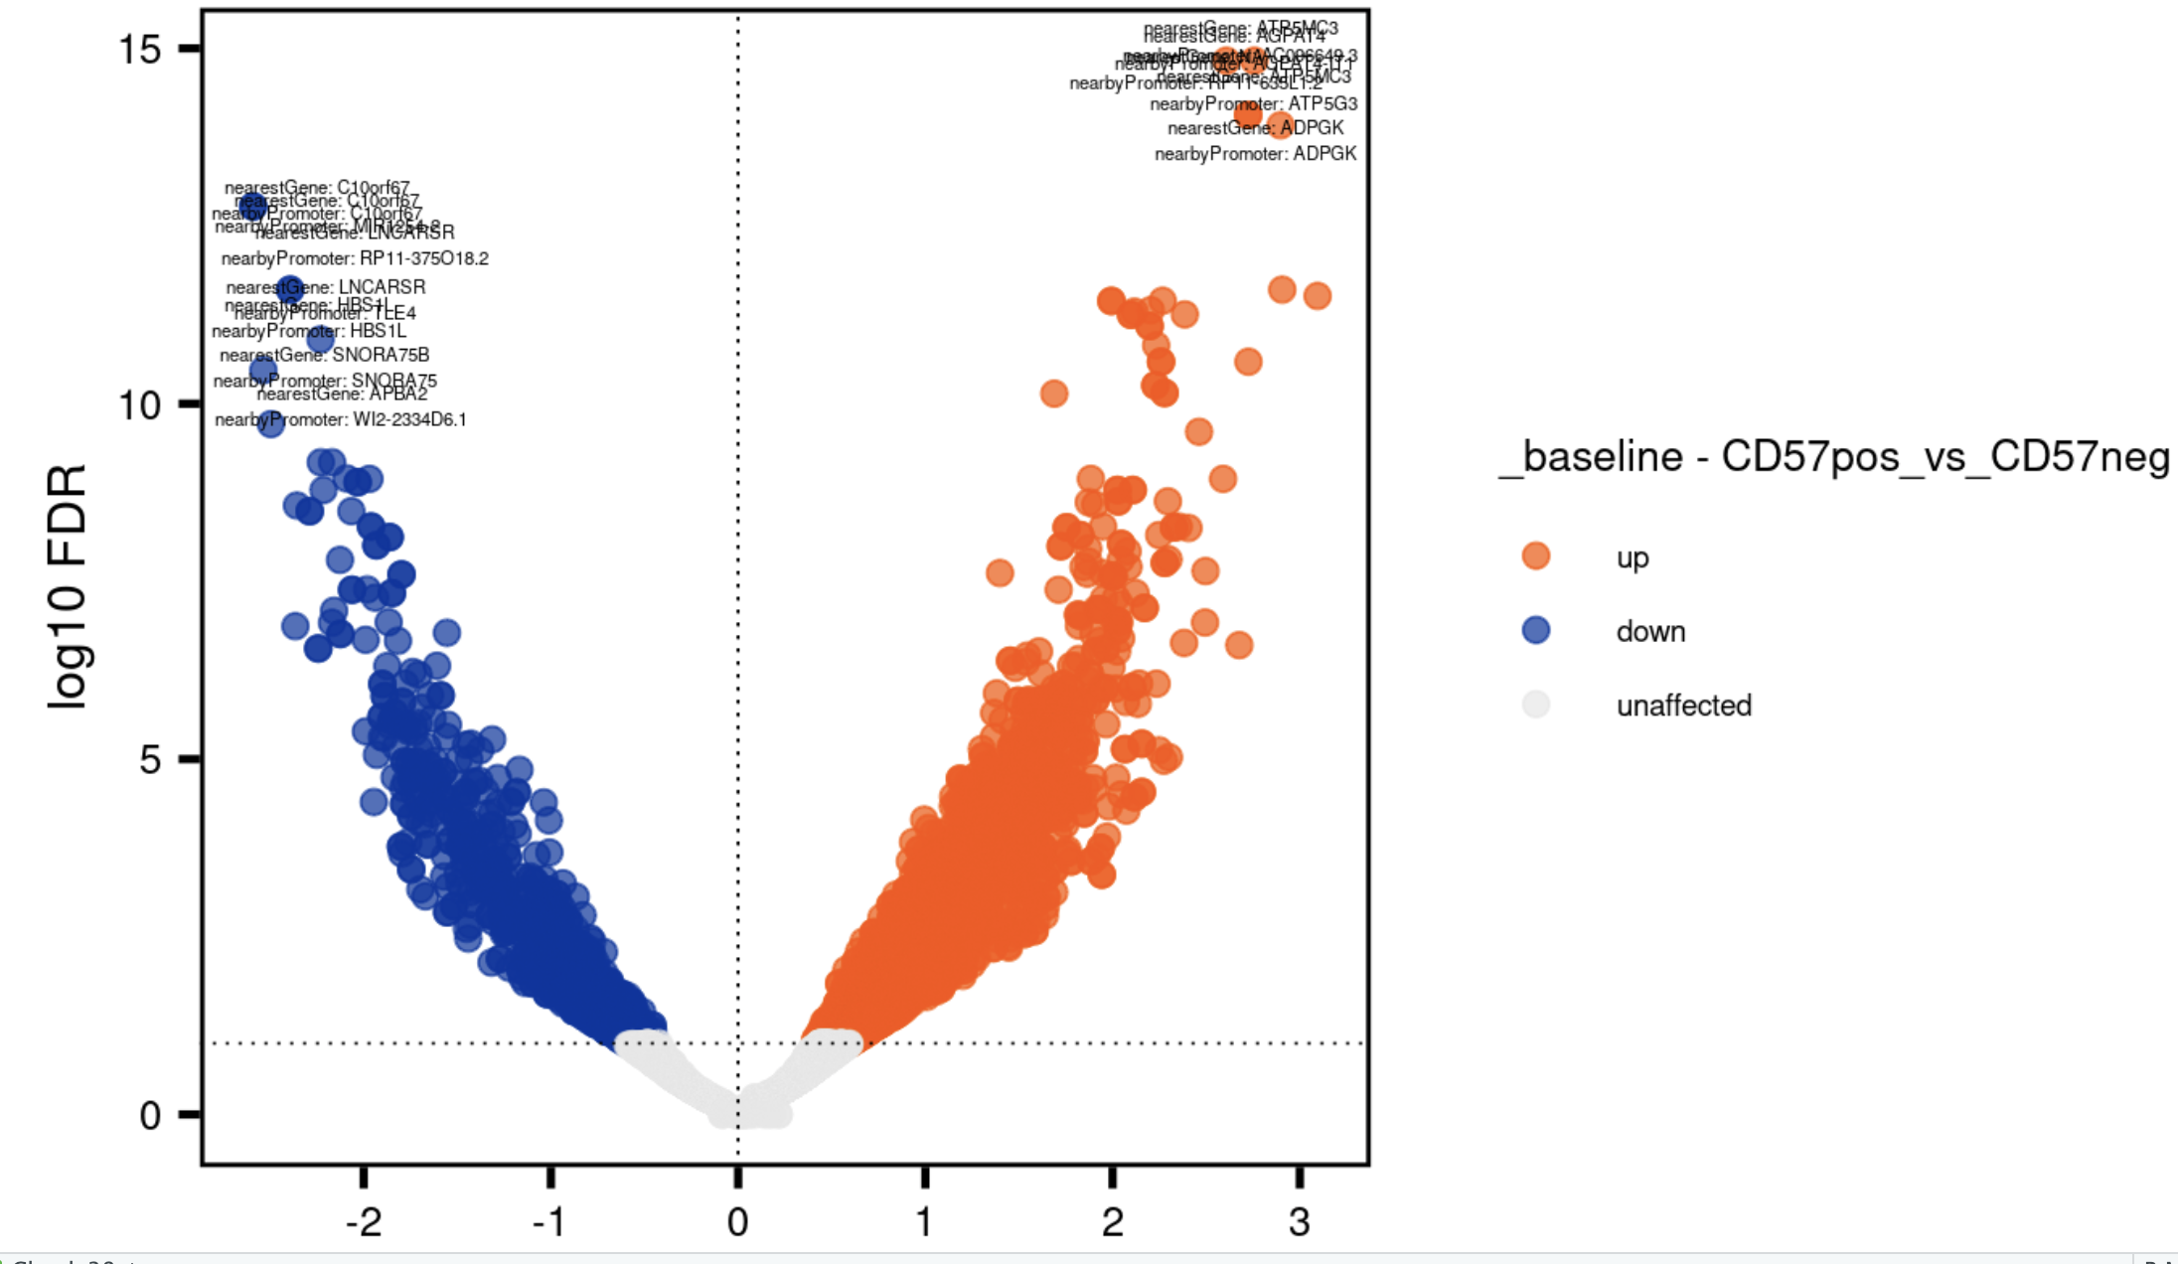
Similar results from newer/older ATACseq differential analysis methods
Erin’s (older method)
Ty’s (older method)
Ty’s (newer method)
9 instances of highlighted
genes in up here
Notes:
dplyr::filter(closestGene %in% c("B3GAT1", "NCR1", "NCAM1", "KIR2DL3", "KIR3DL2", "KLRF1"))
# 9 instancs of these genes in UP

Slide 7
Conclusions
ATACseq
Not many differentially accessible regions for P576-1 b/w R/NR, for now interpreting this as biologically not many epigenetic differences b/w R/NR
TCR graphs by irAE group (data not shown): looking at different top expanded cutoffs or random TCRs generally does still show slightly higher connectivity in irAE group (effect size varies), convergence frequency doesn’t seem to vary as a function of connectivity

Slide 8
Next steps
P576-1: differential analysis
Between cell sorts: can expect similar results from Erin’s baseline ATACseq comparisons between DN, DP-PD-1^{high}, and DP-CD57⁺ populations? Main difference would be teplizumab treatment in P576-1
Between R/NR for last 2/5 cell sorts
If TCR graph result is true (higher connectivity in irAE group), what does it mean?
Doesn’t seem to be due to diversity, as I’d expect lower diversity to lead to higher connectivity (diversity of CDR3s trends higher in irAE group)

