Slide 1
Weekly meeting
4 18 2024
Ty Bottorff

Slide 2
Outline

Slide 3
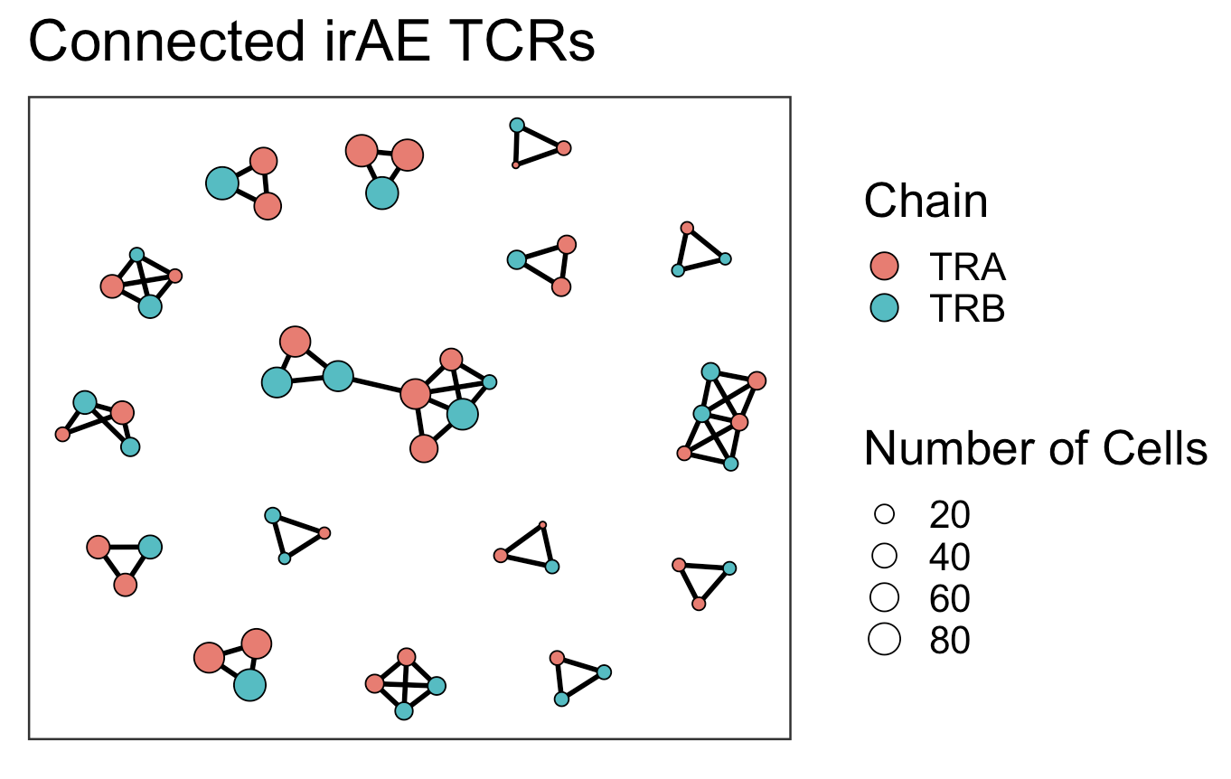
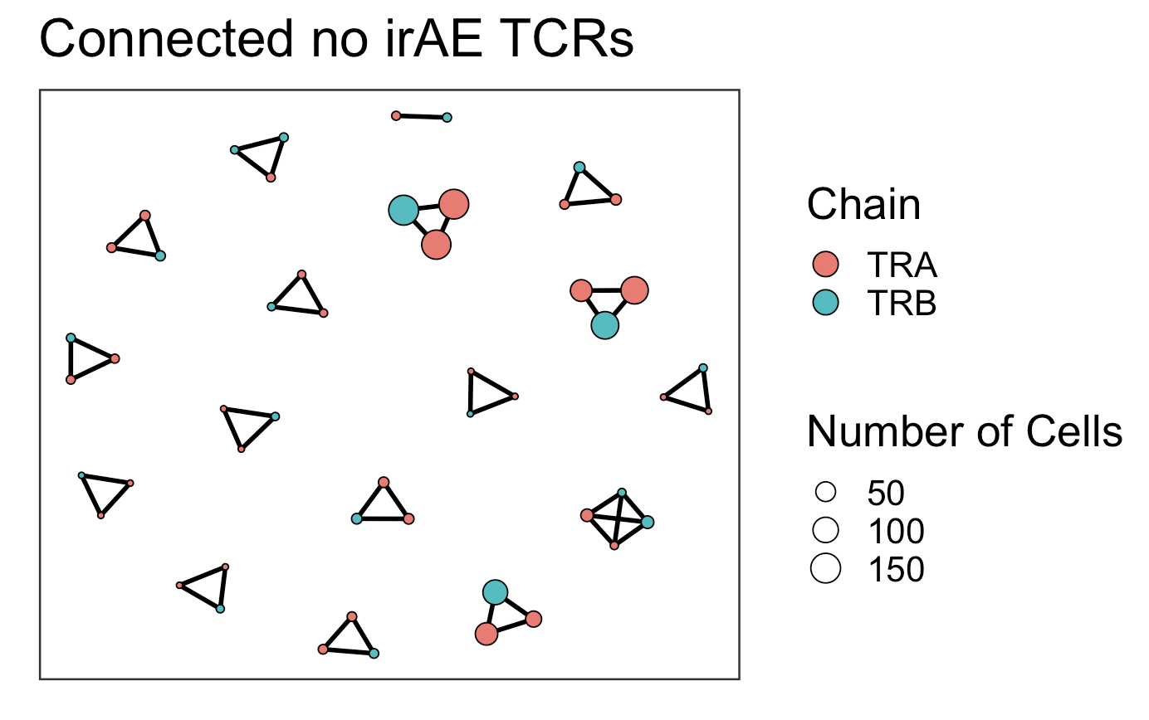
Convergence frequency much lower in connected TCRs regardless of irAE group (freq ~= 0.05 in all TCRs)
Convergence freq: 0
Convergence freq: ~0.003
evidence for selection against highly connected TCR structures?
Notes:
Convergence:
group_by(cdr3) %>%
filter(n_distinct(cdr3_nt) > 1)

Slide 4
Conclusions

Slide 5
Next steps

